Slide 1
SecretLab Data Engineering Case Study
Balasubramani Soundaraj

Slide 2
Agenda
1) Data Modelling
2) Data Pipelining
3) Analytical SQL

Slide 3
Model Diagram
order_items
order_item_id
order_item_order_id
order_item_product_id
order_item_quantity
order_item_subtotal
order_item_product_price
orders
order_id
order_date
order_customer_id
order_status
products
product_id
product_category_id
product_name
product_description
product_price FLOAT
product_image
categories
category_id
category_department_id
category_name
departments
department_id
department_name
customers
customer_id
customer_fname
customer_lname
customer_email
customer_password
customer_street
customer_city
customer_state
customer_zipcode
Data modeling is a way to organize and join data together for the purpose of data analysis. Data modelling is what we use to organize information for multiple tables and how they relate to each other.

Slide 4
IN order to Enable the Loading and Analysis for Database, we have to add the updated, inserted time columns in table, Which will leverage the Analysis at Macro to micro level with database in large data’s.
just Foreign keys for order tables , but I detail we need to apply across product and customer table levels with Indexing
DDL for Table Creation
Sample Insert Query

Slide 5
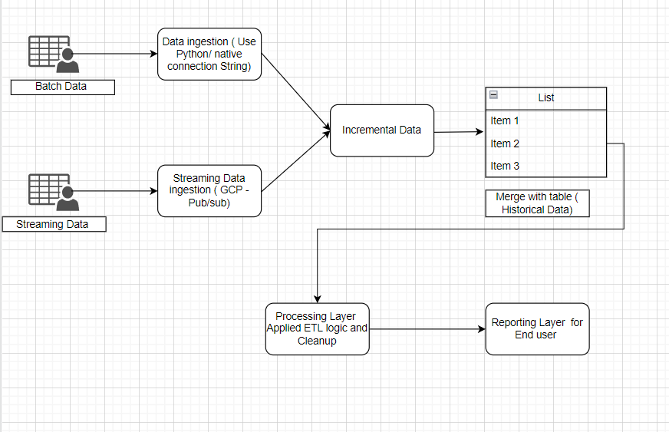
Data Pipelining

Slide 6
Above block diagram shows the workflow for most of the generic use cases how to ingest data from GCP and sending data to end user. Simply it’s a sequence of tasks scheduled and triggered in a well coordinated manner.
Below is the list of components used to build the pipelines ( Consider infra is Google cloud).
Google Storage – Where stored the source data’s
Data Transfer – Taken Data from respected source system to GCS.
Pub/Sub – Ingest Streaming Data
Dataflow – To receive stream data and load to Bigquery
Bigquery – Storing all the data’s in table format ( Specilay used for DWH purpose)
Data Studio - To generate report’s in virtualization format

Slide 7
5) Analytical SQL
Sometimes products for whatever reason stop selling and a symptom can be an item that was selling well faces a stock out or de-listing (or something else). Write a query that shows products that have sold for more than 30 days in the last 60 days, but hasn't had sales for the last week.
with product_morethan6 as (
select distinct ProductID ,COUNT(*) OVER (PARTITION BY productID) no_of_sold_items from (
select o.SalesorderID,ProductID ,OrderDate from [SalesLT].[SalesOrderHeader] O, [SalesLT].[SalesOrderDetail]
OD where o.salesorderid=OD.salesorderid
and orderdate between '2022-01-01 00:00:00.000' and '2022-06-01 00:00:00.000'
) as Sub
)
select distinct ProductID,No_of_sold_items_in6months , Not_sold_products as notsoldinthisweek from (
select od.ProductID ,OrderDate,no_of_sold_items as No_of_sold_items_in6months from [SalesLT].[SalesOrderHeader] O, [SalesLT].[SalesOrderDetail]
OD ,product_morethan6 lost_sale where lost_sale.productid=OD.ProductID
and o.salesorderid=OD.salesorderid
and no_of_sold_items > 6
)A

Slide 8
Full outer join (
select od.ProductID as Not_sold_products,no_of_sold_items as not_sold from [SalesLT].[SalesOrderHeader] O, [SalesLT].[SalesOrderDetail]
OD ,product_morethan6 lost_sale where lost_sale.productid=OD.ProductID
and o.salesorderid=OD.salesorderid
and no_of_sold_items > 6
except
select od.ProductID ,no_of_sold_items as not_sold from [SalesLT].[SalesOrderHeader] O, [SalesLT].[SalesOrderDetail]
OD ,product_morethan6 lost_sale where lost_sale.productid=OD.ProductID
and o.salesorderid=OD.salesorderid
and no_of_sold_items > 6
and orderdate not between '2022-01-01 00:00:00.000' and '2022-06-01 00:00:00.000'
)B
on a.ProductID=b.Not_sold_products

Slide 9
Implementing Business logics in Data Marts
Today’s market is dominated by big data and analytics, hence, Data Mart plays a significant role in turning data into insights.
A few advantages of Data Pipeline are listed below:
Data Marts are efficient, and cost-effective solutions as they take are cheaper to deploy than Data Warehouses and data access.
Hybrid Data Marts can improve the performance by taking a Data Warehouse processing. When dependent data marts are placed in a separate processing facility, they significantly reduce analytics processing costs as well.
Data Marts can be independent of each other, so any error in the central Data Warehouse doesn’t affect individual Data Marts.

Slide 10
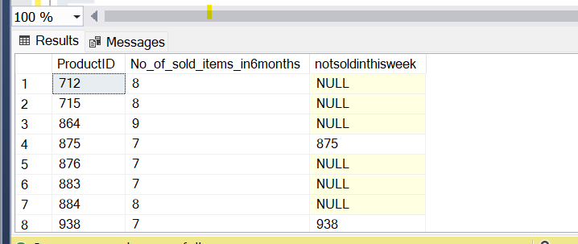
Sample Result
shows products that have sold for more than 30 days in the last 60 days

Slide 11
Q&A
Thanks

