Slide 1
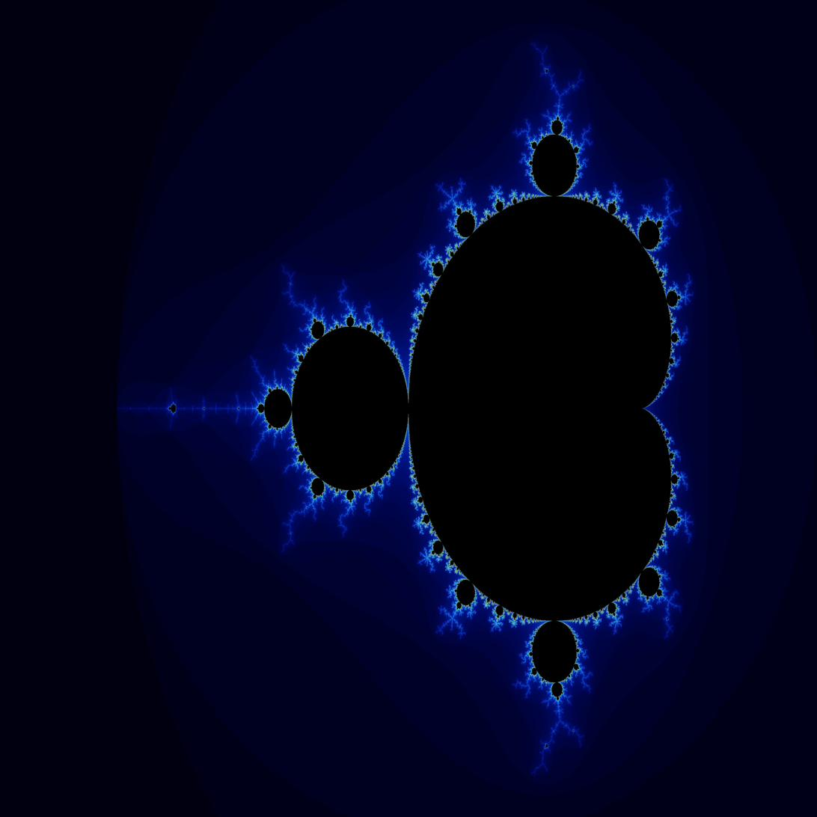
SB.
CPSC 375 — HIGH-PERFORMANCE COMPUTING
PARALLEL MANDELBROT
SET RENDERER.
Master-Worker Dynamic Scheduling with MPI
Sean Balbale | April 26, 2026
Three Idiots Cluster · 24 MPI Processes · 3 × 8-core Nodes
~6 min
276
3
Study Runtime
Data Points
Problem Sizes

Slide 2



01
Problem & Motivation.
Embarrassingly Parallel
Each pixel maps independently to a complex coordinate. No data hazards — zero inter-pixel dependencies.
Non-Uniform Workload
Boundary pixels iterate ~Nmax steps; interior/exterior escape instantly. Row-level load imbalance demands dynamic dispatch.
Why Dynamic Scheduling?
Static block decomposition leaves workers idle when assigned rows are cheap. A work-pool eliminates this with zero a-priori knowledge.
4096 × 4096 · Nmax = 1000
SEAN BALBALE · CPSC 375

Slide 3

02
Master-Worker Architecture.
KEY PROPERTIES
RANK 0
MASTER
RANK 1
TAG_WORK →
compute_row() → escape()
TAG_WORK:
1 × MPI_INT (row index)
← TAG_RESULT
TAG_RESULT:
(width+1) × MPI_INT
RANK 2
Distribute row indices
Blocking MPI_Recv
Re-dispatch idle workers
Collect & store results
Report wall time
TAG_WORK →
TAG_DONE:
0 bytes (shutdown)
compute_row() → escape()
← TAG_RESULT
Scheduling:
Dynamic work-pool
TAG_WORK →
… RANK P−1
Master role:
Dispatch only — no compute
← TAG_RESULT
Worker role:
Compute rows, return results
TAG_DONE: zero-length shutdown signal
when all rows exhausted
Baseline P:
P = 2 (1 master + 1 worker)
SEAN BALBALE · CPSC 375

Slide 4
03
Core Implementation.
escape() — inner loop kernel
Compiler Flags
static inline int escape(double cr, double ci, int max_iter) {
double zr = 0.0, zi = 0.0;
for (int n = 0; n < max_iter; n++) {
double
zr2 = zr * zr; // cached — avoids recompute
double
zi2 = zi * zi;
if (zr2 + zi2 > 4.0)
return n;
zi = 2.0 * zr * zi + ci;
zr = zr2 - zi2 + cr;
}
return max_iter;
// inside set
}
mpiicx -O3 -xHost -std=c99
AVX/AVX2 auto-vectorization
Inline escape() for hot loop
MPI Fabric
FI_PROVIDER=tcp
10.0.0.0/24 interface
PMI2 via SLURM srun
Cached zr² and zi² reduce multiply ops per iteration from 7 → 5
Timing
MPI_Wtime() brackets dispatch loop
PPM write excluded
Median of 3 trials
SEAN BALBALE · CPSC 375

Slide 5
04
Experimental Setup.
THREE IDIOTS CLUSTER
METRICS DEFINED
Nodes:
3
Speedup
Cores/node:
8 (24 total)
S(P) = T(2) / T(P)
Fabric:
TCP · 10.0.0.0/24
Relative to 2-process baseline (1 master + 1 worker).
Higher is better.
Scheduler:
SLURM (–nodes=3 –ntasks=24)
Worker Efficiency
P range:
P = 2 → P = 24
E(P) = S(P) / (P − 1)
Normalized by worker count. Rank 0 does no pixel work.
E > 1.0 = super-linear speedup.
STUDY DESIGN MATRIX
Amdahl's Law
Study | Sizes | Nmax | Trials
Strong | 1024², 2048², 4096² | 1000 | 3 × each
Weak | 512⌊√P⌋ × 512⌊√P⌋ | 1000 | 3 × each
S(P) = 1 / (f + (1−f)/P)
Serial fraction f estimated via least-squares fit.
1/f gives theoretical max speedup.
Weak Scaling
Norm T = T(P) / T(2)
Size scales as ⌊√P⌋ × base tile.
Ideal = constant 1.000.
SEAN BALBALE · CPSC 375

Slide 6
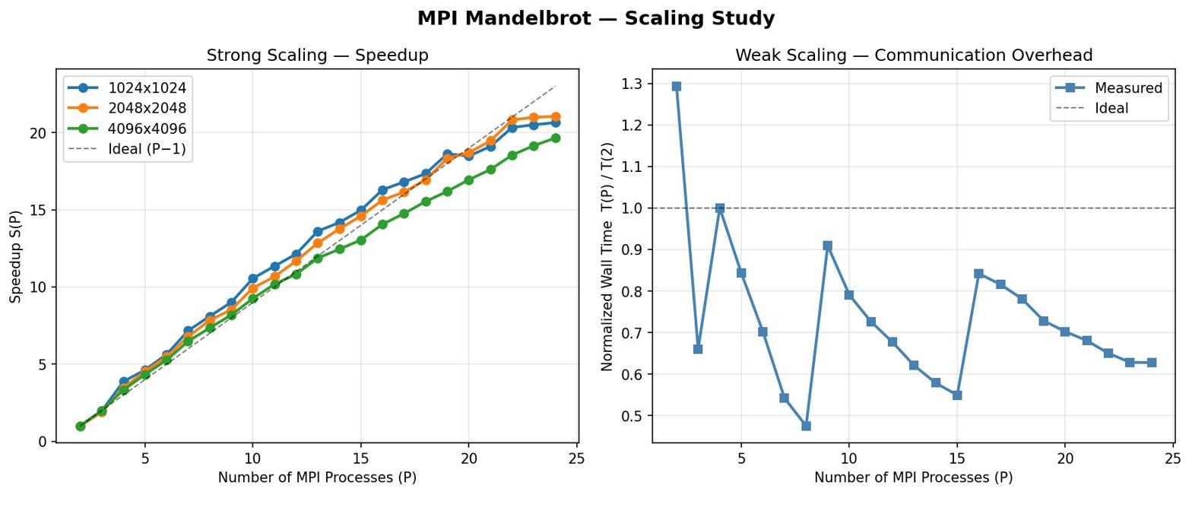
05
Scaling Study Results.
SEAN BALBALE · CPSC 375

Slide 7
06
Strong Scaling — Key Numbers.
1024 × 1024
2048 × 2048
4096 × 4096
P | T(P) s | S(P) | E(P)
2 | 0.8420 | 1.000 | 1.000
4 | 0.2175 | 3.871 | 1.290
8 | 0.1039 | 8.104 | 1.158
12 | 0.0694 | 12.13 | 1.103
16 | 0.0517 | 16.30 | 1.087
20 | 0.0456 | 18.48 | 0.973
24 | 0.0408 | 20.64 | 0.897
P | T(P) s | S(P) | E(P)
2 | 2.8870 | 1.000 | 1.000
4 | 0.8307 | 3.475 | 1.158
8 | 0.3679 | 7.847 | 1.121
12 | 0.2470 | 11.69 | 1.062
16 | 0.1847 | 15.63 | 1.042
20 | 0.1544 | 18.70 | 0.984
24 | 0.1372 | 21.05 | 0.915
P | T(P) s | S(P) | E(P)
2 | 10.267 | 1.000 | 1.000
4 | 3.0818 | 3.331 | 1.110
8 | 1.3956 | 7.356 | 1.051
12 | 0.9480 | 10.83 | 0.985
16 | 0.7302 | 14.06 | 0.937
20 | 0.6058 | 16.95 | 0.892
24 | 0.5226 | 19.65 | 0.854
Green E(P) > 1.0 = super-linear Orange E(P) < 0.9 = efficiency decay at high P
SEAN BALBALE · CPSC 375

Slide 8
07
Key Finding: Super-Linear Speedup.
1.29×
16%
8.10×
peak E at P=4
1024² problem
super-linear
efficiency at P=8
S(8) for 1024²
7 workers
WHY SUPER-LINEAR? Cache Amplification Effect.
P = 2 (baseline)
P grows
P = 4096² (weakest effect)
Single worker handles all rows. Master's image buffer ≈ 4 MB at 1024². This exceeds L2 cache — frequent cache misses on the write path slow down throughput.
Each worker's row share shrinks proportionally. The iteration result buffer fits entirely in L1/L2 cache. Memory latency drops dramatically, accelerating the escape() inner loop beyond the linear prediction.
Even the largest config shows S(8) = 7.36 with E = 1.05 — slightly super-linear. Wider rows mean more cache pressure but the effect persists at moderate P.
SEAN BALBALE · CPSC 375

Slide 9
08
Amdahl's Law Analysis.
S(P) = 1 / (f + (1 − f) / P) → max speedup = 1/f
1024 × 1024
2048 × 2048
4096 × 4096
Serial fraction f:
0.708 %
Serial fraction f:
0.610 %
Serial fraction f:
0.963 %
Max speedup 1/f:
≈ 141×
Max speedup 1/f:
≈ 164×
Max speedup 1/f:
≈ 104×
Measured S(24):
20.6×
Measured S(24):
21.0×
Measured S(24):
19.6×
Well below 1/f?:
Yes — headroom remains
Well below 1/f?:
Yes — headroom remains
Well below 1/f?:
Yes — headroom remains
Physical interpretation: rank 0's dispatch loop executes O(height) sequential operations while total work scales O(W × H × Nmax). The serial fraction shrinks as problem size grows — consistent with f being lowest for the 2048² case.
SEAN BALBALE · CPSC 375

Slide 10




09
Conclusions.
< 1%
20.6×
Near-ideal & super-linear speedup for P ≤ 16 via cache amplification
P=24 delivers 20.6× / 21.0× / 19.6× across all three problem sizes
Serial fraction
across all sizes
Peak speedup
@ P=24, 1024²
Worker efficiency stays above 0.85× across all tested configurations
164×
0.85+
Serial fraction f < 1% → theoretical max 100–164× still within reach
Theoretical max
(2048² Amdahl)
Min efficiency
across all runs
Weak scaling consistently better than ideal — cache tier within tiers
Future: Distributed work-stealing protocol → eliminates single-master bottleneck for P ≫ 24
SB.
SEAN BALBALE · CPSC 375

