Slide 1
An Introduction to Angular.JS
By
Pariwesh Gupta

Slide 2


Slide 3
About me
Pariwesh Gupta
Worked at Infosys, Yantra(Acquired by IBM), mChek.com, cleartrip.com as developer/team lead
Currently, working as an independent consultant for RIA frameworks.

Slide 4
The “Plan”
Presentation comprises of 3 parts:
  Part I. Introduction to Angular JS
  Part II. Angular JS building blocks
  Part III. A lot of coding

Slide 5

Client side UI development
Server-side UI layer is a drag on the server resources.
The network has to transfer large payload.
Client-side UI accepts json/xml data from server and generates DOM elements locally.
BUT, how do we generate DOM elements without getting a headache.

Slide 6
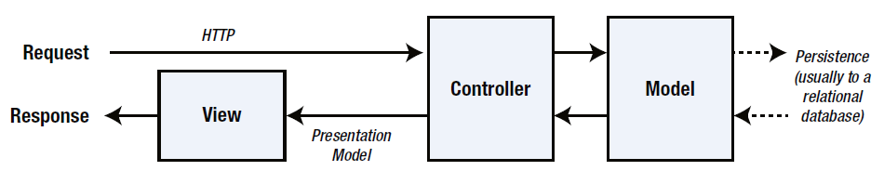
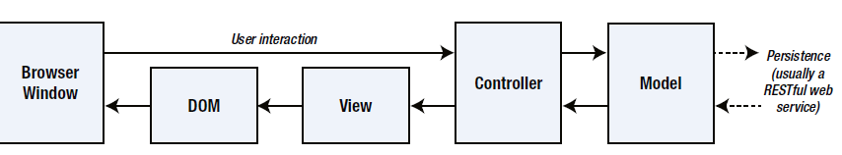
The need for Client side UI development

Slide 7

The Challenge with SPAs
DOM Manipulation
History
Module Loading
Routing
Caching
Object Modeling
Data Binding
Ajax/Promises
View Loading

Slide 8
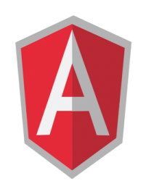
Data Binding
MVC
Routing
Testing
jqLite
Templates
History
Factories
ngularJS is a full-featured
SPA framework
ViewModel
Controllers
Views
Directives
Controllers
Dependency Injection
Validation

Slide 9
Angular JS facts
Open-source JavaScript framework
Developed in 2009 by Miško Hevery and Adam Abrons
Maintained by Google
client-side technology, written entirely in JavaScript.
works with the long-established technologies of the web (HTML, CSS, and JavaScript) to make the development of web apps easier

Slide 10
Angular JS facts
Uses JQLite (a subset of JQuery) for DOM manipulations
If you include jQuery before Angular, it will be used instead of JQLite

Slide 11
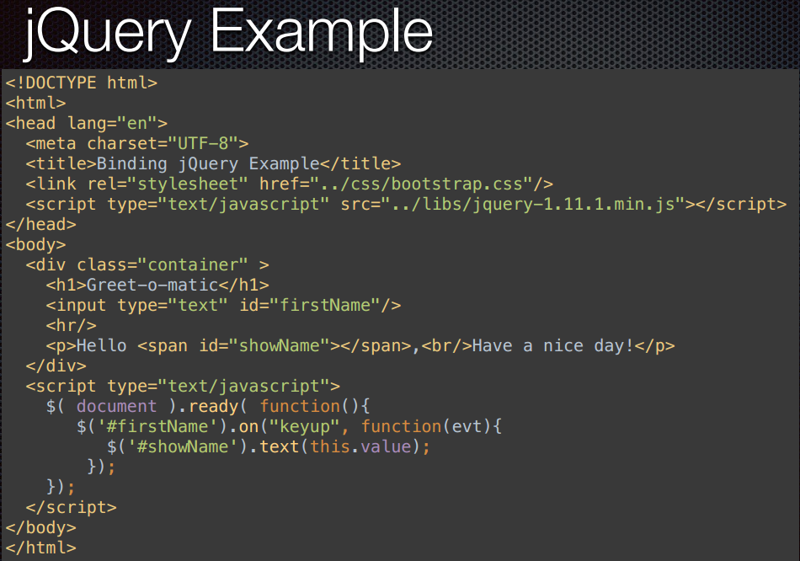
Why use it?

Slide 12
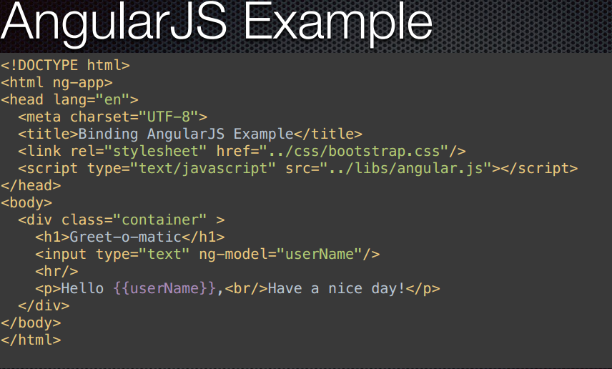
Why use it?

Slide 13
benefits
Less boilerplate code
Less effort in mundane tasks allowing for better focus on what is ACTUALLY VALUABLE – THE LOGIC
Separation of concerns - logic, data models, and views
Follows MVC architecture
Template support with Directives
1/2 way(s) data-binding
Routing
Services – helps in reusing code
Dependency injection
Testing

Slide 14
A word of warning
You better avoid using Angular JS for IE6 and IE7 projects
  Because of lack of support for custom tags and hashchange events

Slide 15
Some great resources (1)
http://www.egghead.io/ - Angular JS video course by John Lindquist (@johnlindquist)
http://www.yearofmoo.com/ - a blog that contains some great articles about Angular JS
http://angularjs.org/ - Angular JS official web-site
http://docs.angularjs.org/api/ - Angular JS API reference
https://groups.google.com/group/angular/ - Angular JS Google Group

Slide 16
Some great resources (2)
https://chrome.google.com/webstore/detail/angularjs-batarang/ighdmehidhipcmcojjgiloacoafjmpfk?hl=en - Angular JS Batarang, a great solution for debugging Angular JS applications
https://www.youtube.com/watch?feature=player_embedded&v=q-7mhcHXSfM#! - A video demo of using Batarang

Slide 17
Development Tools
Batarang
SublimeText https://sublime.wbond.net/packages/AngularJS
Optionally
Node.js with the following installed modules
  Karma
  Grunt/Gulp

Slide 18
How Angular.js is opinionated
  There is an “Angular way” of doing things.
  NO DOM MANIPULATION IN CONTROLLERS

Slide 19

Anatomy of an Angular application
Module
Config
Filter
Directive
Factory
Controller
Service
Routes
Provider
Value

Slide 20
Module
Config
Routes
View
$scope
Controller
Directives
*Factory

Slide 21
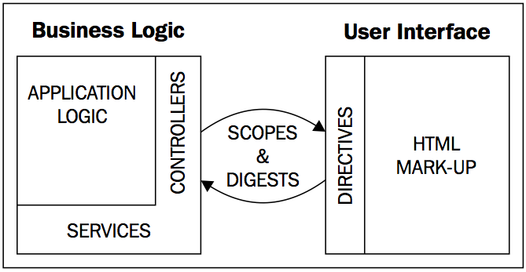

Slide 22

Part II. Angular JS building blocks

Slide 23
Angular.js Building Blocks
Concept | Description
Template | HTML with additional markup
Directives | extend HTML with custom attributes and elements
Model | the data that is shown to the user and with which the user interacts
Scope | context where the model is stored so that controllers, directives and expressions can access it
Expressions | access variables and functions from the scope
Compiler | parses the template and instantiates directives and expressions
Filter | formats the value of an expression for display to the user
View | what the user sees (the DOM)
Data Binding | sync data between the model and the view
Controller | the business logic behind views
Dependency Injection | Creates and wires objects / functions
Injector | dependency injection container
Module | configures the Injector
Service | reusable business logic independent of views

Slide 24
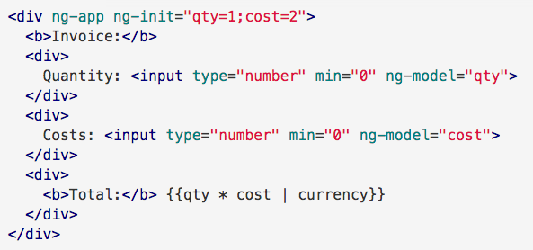
Hello World-1

Slide 25
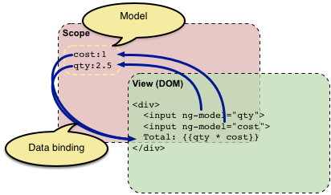
Hello World-1

Slide 26
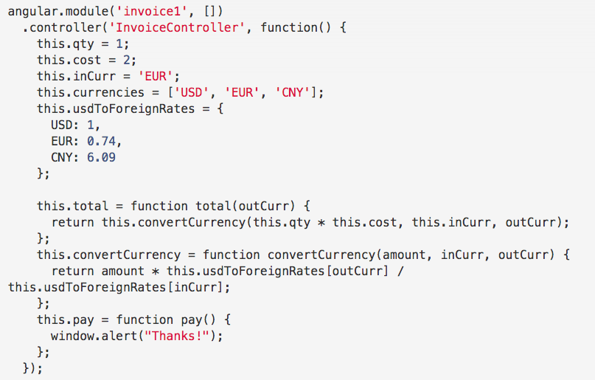
Hello World-2

Slide 27
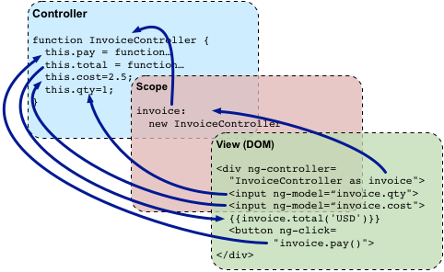
Hello World-2

Slide 28
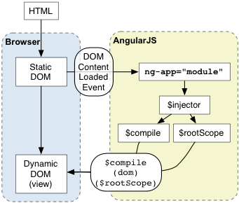

Slide 29
What Can Scopes Do?
They provide observers to watch for model changes
• They provide the ability to propagate model changes throughout the application as well as outside the system to other components
• They can be nested such that they can isolate functionality and model properties
• They provide an execution environment in which expressions are evaluated

Slide 30
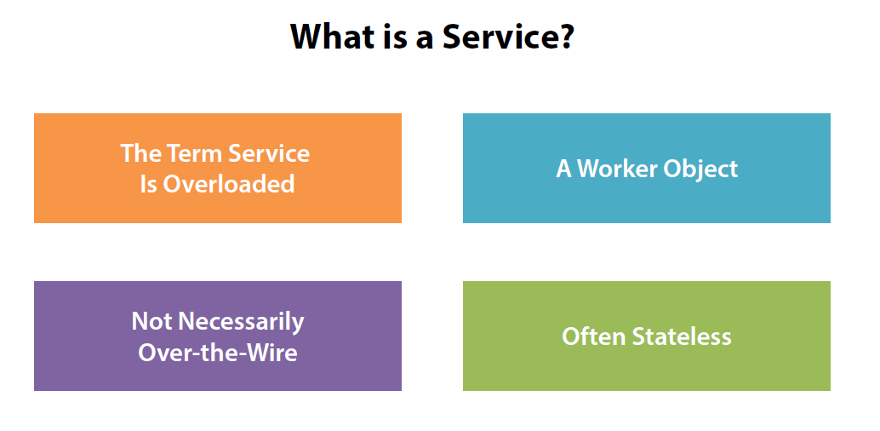

Slide 31
MVC
Model
  The data
Controller
  The behavior
  Modifying / updating the models
View
  The interface
  How the data is presented to the user
JavaScript
HTML

Slide 32
One-way data binding
View is updated automatically when the Model is changed
No DOM manipulation boilerplate needed!
ng-bind provides one-way data binding ($scope --> view). It has a shortcut
{{ val }} which displays the scope value $scope.val inserted into html.

Slide 33
Two-way data binding
View is updated automatically when the Model is changed
Model is updated automatically when a value in the View has changed
No DOM manipulation boilerplate needed!
ng-model is intended to be put inside of form elements and has two-way data binding ($scope --> view and view --> $scope) e.g. <input ng-model="val"/>.

Slide 34
Dependency Injection
No more “global” objects
Components will get the objects they need (their dependencies) in order to work
Each Angular application has an injector service which is a service locator responsible for construction and lookup of dependencies.

Slide 35
What is Angular module?
Each Angular JS app contains at least one module
Discrete logical part of the application
module1 = angular.module(‘name’, [dependencies….]);

Slide 36
Angular module
Can be used to separate the application into parts
Application module can include the other modules by listing them as dependencies
Container for
  Controllers
  Services
  Directives
  Factories
  Filters
  Configuration information

Slide 37
What is Angular module? –methods
config(configFn)
constant(name, object)
controller(name, constructor)
directive(name, directiveFactory)
filter(name, filterFactory)
run(initializationFn)
value(name, object)
service(name, serviceFactory)
factory(name, factoryFn)
provider(name, providerFn)

Slide 38
What is Angular module?
Module loading happens in two distinct phases:
  Config : AngularJS hooks up and registers all the providers in this phase. Because of this, only providers and constants can be injected into Config blocks.
Run : only instances and constants can be injected into Run blocks. Equivalent to main method.
We can set up event listeners that should happen at the
global scale of the app. For example, we’ll use the .run() block to set up listeners for routing events or unauthenticated requests.

Slide 39
What is Angular module?
Keeping our global namespace clean
Making tests easier to write and keeping them clean so as to more easily target isolated functionality
Making it easy to share code between applications
Allowing our app to load different parts of the code in any order

Slide 40
Controllers in Angular JS
is a JavaScript constructor function
A new child scope will be available as an injectable parameter to the Controller's constructor function as $scope.
Use Controllers to:
  Set up the initial state of the $scope object.
  Add behavior to the $scope object.

Slide 41
Controllers in Angular JS
Typically also contains module loading
angular.module(<name>, [<dependencies>]);
  Creates a module with the given name
  This module can then be configured
  Ex.
    var myApp = angular.module(‘myApp’, []);
    myApp.controller(‘MyCtrl’, function($scope) { … });
    myApp.controller(‘OtherCtrl’, [‘$scope’, ‘$http’, function($scope, $http) { … }]);

Slide 42
What to put in the Controller?
Define the application’s behavior
Focus on the application logic/validations
not the appropriate place to do any DOM manipulation or formatting, data manipulation, or state maintenance beyond holding the model data

Slide 43
What not to put in the Controller?
Any kind of DOM manipulation-improves testability
Input formatting — Use angular form controls instead.
Output filtering — Use angular filters instead.
Sharing reusable code across Controllers — Use angular services instead.
Managing the life-cycle of other components (for example, to create service instances).

Slide 44
The Scope object ($scope)
One scope for each controller instance
The GLUE between the View and the Controller
A hash of key/values
Holds the data to display in the View
Events are registered on it
$rootScope object – visible in all controllers, all other scopes either inherit, or are nested under it.

Slide 45
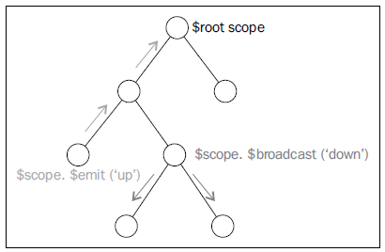
The Scope inheritance
The $scope of each Controller will have access to properties and methods defined by Controllers higher up the hierarchy

Slide 46

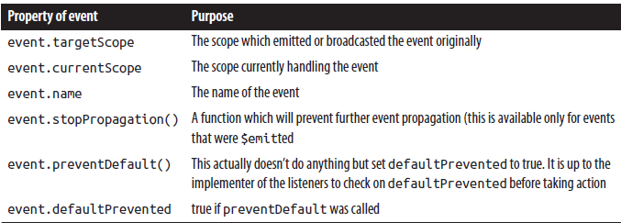
Communication among scopes

Slide 47
Communication among scopes

Slide 48
Dispatching event from parent scope to child scope
$scope.$broadcast(‘event_name’,
(optional) array of arguments to pass to eventlisteners);
// where $scope is the parent scope

Slide 49
Detecting events dispatched from parent scope in the child scope
$scope.$on(‘event_name’, function(event, args) {
// code to invoke if the event occurs
});
// where $scope is the child scope

Slide 50
Dispatching events from child scope to parent scope
$scope.$emit(‘event_name’);
// where $scope is the child scope
$emit communicates only upwards from its current scope

Slide 51
Detecting events dispatched from child scope in the parent scope
$scope.$on(‘event_name’, function(event, args) {
// code to invoke if the event occurs
});
// where $scope is the parent scope

Slide 52
Models
Holds data to display
Defined as properties of $scope object of the controller

Slide 53
What is Angular directive?
Are markers on a DOM element (such as an attribute, element name, or CSS class)
Use them when you have to make DOM manipulations
Ever wanted to create your own tag or attribute in HTML – this is how you do it!
Equivalent to Spring-MVC/struts ui-tags
Takes you one step closer to creating domain-specific markup

Slide 54
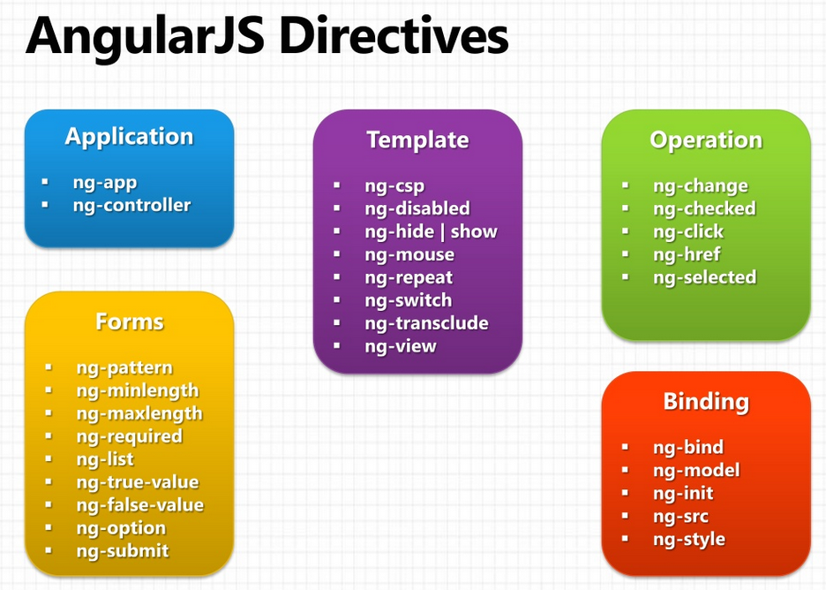
What does it mean to "compile" an HTML template?

Slide 55
What does it mean to "compile" an HTML template?
For AngularJS, "compilation" means attaching event listeners to the HTML to make it interactive.
The reason we use the term "compile" is that the recursive process of attaching directives mirrors the process of compiling source code in compiled programming languages.

Slide 56
What does it mean to "compile" an HTML template?
Angular normalizes an element's tag and attribute name to determine which elements match which directives. We typically refer to directives by their case-sensitive camelCase normalized name (e.g. ngModel). However, since HTML is case-insensitive, we refer to directives in the DOM by lower-case forms, typically using dash-delimited attributes on DOM elements (e.g. ng-model).
The normalization process is as follows:
Strip x- and data- from the front of the element/attributes.
Convert the :, -, or _-delimited name to camelCase.

Slide 57
Matching Directives
In the following example, we say that the <input> element matches the ngModel directive.
<input ng-model="foo">
The following also matches ngModel:
<input data-ng:model="foo">

Slide 58
What is Angular directive?
Directives should not change a model or controller’s logic directly
All they handle is creating the page’s content and structure of elements

Slide 59
In-built Directives
Make use of special ng attributes (directives) on the HTML elements
  ng-app
    Determines which part of the page will use AngularJS
    If given a value it will load that application module
  ng-controller
    Determines which Javascript Controller should be used for that part of the page
  ng-model
    Determines what model the value of an input field will be bound to
    Used for two-way binding

Slide 60
In-built Directives
More ng directives
  ng-if=“<model expression>”
    Inserts HTML element if expression is true
    Does not insert element in the DOM if it is false
  ng-repeat=“<variable> in <array>”
    Repeats the HTML element for each value in the array
    Also a key-value pair version for JSON objects
      “(<key>, <value>) in <JSON>”

Slide 61
Angular expressions
{{ }}
    Like JavaScript expressions except:
      Evaluated in the current scope , not the global window
      More forgiving to undefined and null errors
      No control statements: conditionals, loops, or throw
      They can accept a filter and/or filter chains.
  Insert model values directly into the view

Slide 62
What is Angular directive?
Do not prefix your own directives with ng-
Angular uses a normalized naming scheme for directives and will make camel-cased directive names available in templates in the five different validator friendly varieties. For example, if you’ve picked your prefix as super- and you’re writing a date-picker component, you might name it superDatePicker. In templates, you could then use it as super-date-picker, super:date-picker, data-super-date-picker.

Slide 63
Custom Angular directive
var myModule = angular.module(...);
myModule.directive('namespaceDirectiveName', function factory(injectables) {
var directiveDefinitionObject = {
restrict: string,
priority: number,
template: string,
templateUrl: string,
replace: bool,
transclude: bool,
scope: bool or object,
controller: function controllerConstructor($scope,
$element,
$attrs,
$transclude),
require: string,
link: function postLink(scope, iElement, iAttrs) { ... },
compile: function compile(tElement, tAttrs, transclude) {
return {
pre: function preLink(scope, iElement, iAttrs, controller) { ... },
post: function postLink(scope, iElement, iAttrs, controller) { ... }
}}};
return directiveDefinitionObject;
});

Slide 64
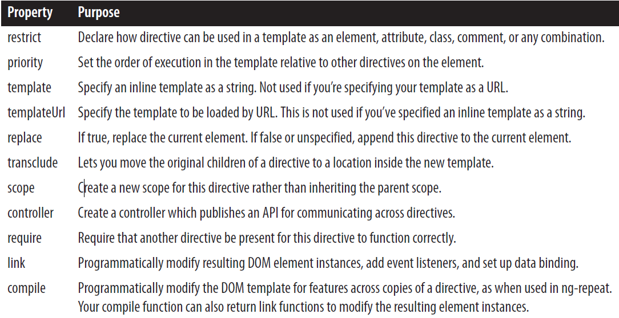
Custom Angular directives

Slide 65
What is Angular filter?
Reusable operation using which you can modify the content on the page
Filters remove the formatting responsibility from the application logic
Examples: uppercase a value, filter search results, etc.

Slide 66
Defining a new filter
appModule.filter('emailFilter', function(){
return function(data){
return data+"@gmail.com";
};
});

Slide 67
Communicating over $http
  facilitates communication with the remote HTTP servers via the browser's XMLHttpRequest object or via JSONP.
  based on the deferred/promise APIs exposed by the $q service.
  A response status code between 200 and 299 is considered a success status.
  if the response is a redirect (3xx), XHR will transparently follow it and the error callback will not be called for such responses.
  http://docs.angularjs.org/api/ng.$http

Slide 68
Communicating over $http
$http.get
$http.head
$http.post
$http.put
$http.delete
$http.jsonp

Slide 69
Communicating over $http - Sending Http Headers
$httpProvider.defaults.headers
$http.defaults.headers.common (headers that are common for all requests):
  Accept: application/json, text/plain, * / *
For Post/Put http methods:
  $httpProvider.defaults.headers.put (header defaults for PUT requests)
  $http.defaults.headers.post.header1=‘header-value';
For other http methods
  $http.defaults.headers.[http-method]={req-param:req-value}
  $httpProvider.defaults.headers.get = { 'My-Header' : 'value' }.

Slide 70
Communicating over $http - Sending Http Headers
defaults can also be set at runtime via the $http.defaults object in the same fashion. For example:
module.run(function($http) { $http.defaults.headers.common.Authentication = ‘user1' });

Slide 71
Transforming Requests and Responses
Both requests and responses can be transformed using transform functions. By default, Angular applies these transformations:
Request transformations:
  If the data property of the request configuration object contains an object, serialize it into JSON format.
Response transformations:
  If JSON response is detected, deserialize it using a JSON parser.

Slide 72
Transforming Requests and Responses
  To override the default transforms, modify the $httpProvider.defaults.transformRequest and $httpProvider.defaults.transformResponse properties.

Slide 73
Promises
In the asynchronous world, we can't simply chain function calls; we need to rely on callbacks.
Callbacks are fine when dealing with just one asynchronous event, but things start to get complicated as soon as we need to coordinate multiple asynchronous events. Exceptional situation handling is particularly tough in this case.
^{Promises} bring the ease of functions calls chaining and error handling in the asynchronous world.

Slide 74
Promises
AngularJS comes with the $q service, a very lightweight Promise API implementation. A number of AngularJS services (most notably $http, but also $timeout and others) heavily rely on the promise-style APIs.

Slide 75
Promises
Let's imagine that we want to order a pizza over the phone and have it delivered to our home. The outcome of our pizza order can be either delivered food or a phone call indicating problems with our order. While ordering a pizza is just a matter of a short phone call, the actual delivery (order fulfillment) takes some time, and is asynchronous.

Slide 76
Promises
var Person = function (name, $log) {
^{this.eat = function (food) {}
$log.info(name + " is eating delicious " + food);
};
this.beHungry = function (reason) {
$log.warn(name + " is hungry because: " + reason);
}
};

Slide 78
Angular Service

Slide 79
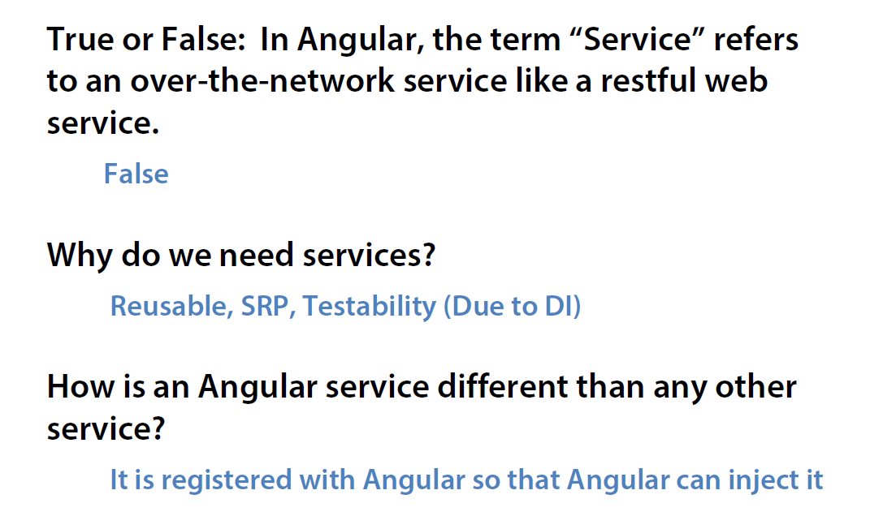
Angular Service Quiz

Slide 80
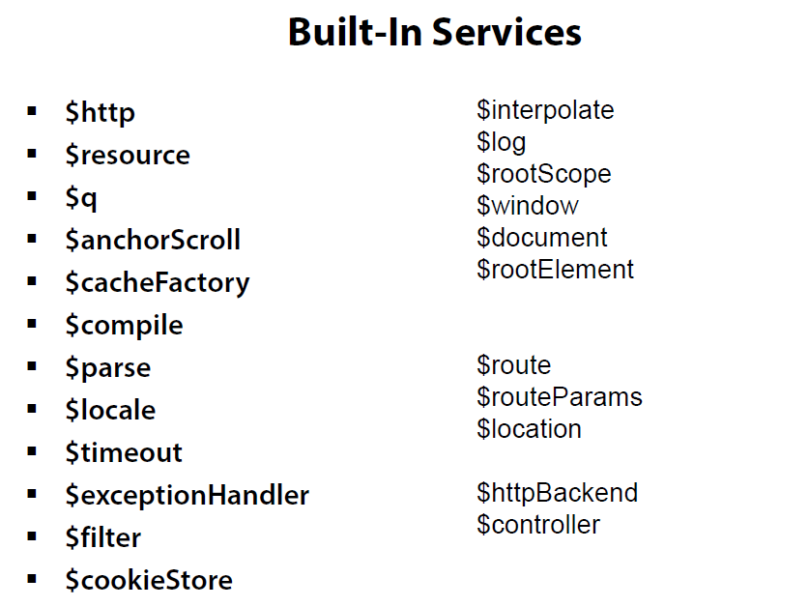

Slide 81
  binds an input,select, textarea (or custom form control) to a property on the scope using NgModelController, which is created and exposed by this directive.
ngModel is responsible for:
Binding the view into the model, which other directives such as input, textarea or select require.
Providing validation behavior (i.e. required, number, email, url).
Keeping the state of the control (valid/invalid, dirty/pristine, validation errors).
Setting related css classes on the element (ng-valid, ng-invalid, ng-dirty, ng-pristine).
Registering the control with its parent form.

Slide 82
For asynchronous calls, we can't simply chain function calls; we need to rely on callbacks.
Callbacks are fine when dealing with just one asynchronous event, but, things start to get complicated as soon as we need to coordinate multiple asynchronous events.
Exception handling is particularly tough in this case.

Slide 83
The $resource factory generates both class-level and instance level methods.
The instance level-methods are prefixed with the $ character.
Both the methods have the equivalent functionality

Slide 84
Routing
Enable by injecting the $routeProvider
  myApp = angular.module(‘myApp’, [‘ngRoute’]);
  myApp.config([‘$routeProvider’, function($routeProvider) { … }]);
$routeProvider.when(<path>, {<route>});
  Defines a new route that uses the given path
  The path may have parameters
    Parameters start with a colon (‘:’)
    Example ‘/user/:userId’
  Typical route fields:
    controller = The name of the controller that should be used
    templateUrl = A path to the template partial that should be used
$routeProvider.otherwise({<route>});
  Typical route fields:
    redirectTo: ‘<path>’
API: http://docs.angularjs.org/api/ngRoute.$routeProvider

Slide 85
Usefule resources
ngmodules.org : Get tons of new third-party modules

Slide 86
Using transclusion in directives
When you move elements from one part of the DOM to another, you have to decide what happens to their associated scope.
The simple approach is to associate the elements with the scope that is defined at the new position. This is likely to break the application, since the elements may no longer have access to items from their original scope.
We need is to "bring the original scope with us". Moving elements and their scope in this way is called transclusion.

Slide 87
Using transclusion in directives
Transclusion is necessary whenever a directive is replacing its original contents with new elements but wants to use the original contents somewhere in the new elements.
E.g. ng-repeat will transclude and clone its original element, stamping out multiple copies of the transcluded element as it iterates over a list of items. Each of these elements will be associated with a new scope, which is a child of the original element's scope.

Slide 88
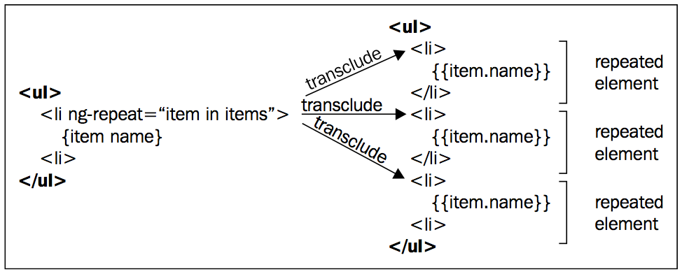
Using transclusion in directives
E.g. ng-repeat will transclude and clone its original element, stamping out multiple copies of the transcluded element as it iterates over a list of items. Each of these elements will be associated with a new scope, which is a child of the original element's scope.

Slide 89
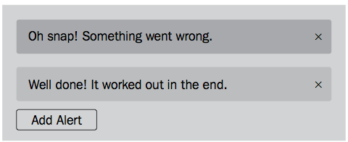
Creating an alert directive that uses transclusion
<alert type="alert.type" close="closeAlert($index)"
ng-repeat="alert in alerts">
{{alert.msg}}
</alert>

Slide 90
myModule.directive('alert', function () {
^{return {}
^{restrict:'E',}
replace: true, transclude: true, template:
'<div class="alert alert-{{type}}">' +
'<button type="button" class="close"' +
'ng-click="close()">&times;' + '</button>' +
'<div ng-transclude></div>' + '</div>',
^{scope: { type:'=', close:'&' }}
};
^{});}

Slide 91
replace property in the directive definition
tells the compiler to replace the original directive's element with the template given by the template field. If we had provided template but not replace, then the compiler would append the template to the directive's element.

Slide 92
transclude property in the directive definition
takes either true or 'element'. This tells the compiler to extract the contents of the original <alert> element and make them available to be transcluded into the template.
• Using transclude: true means that the children of the directive's element will be transcluded. This is what happens in the alert directive, although we then replaced the directive's element with our template.
• Using transclude: 'element' means the entire element will be transcluded including any attribute directives that have not already been compiled. This is what happens in the ng-repeat directive.

Slide 93
ng-transclude directive gets the transcluded elements and appends them to the element in the template on which it appears. This is the simplest and most common way to use transclusion.

Slide 94
Understanding the scope of transclusion
All DOM elements that have been compiled by AngularJS have a scope associated with them.
In most cases DOM elements do not have scopes defined directly on them but get their scope from some ancestor element.
New scopes are created by directives that specify a scope property on their directive definition object.
Only a few core directives define new scopes, these are ng-controller, ng-repeat, ng-include, ng-view, and ng-switch. They all create child scopes that prototypically inherit from their parent scopes.

Slide 96
Angular Service

Slide 97
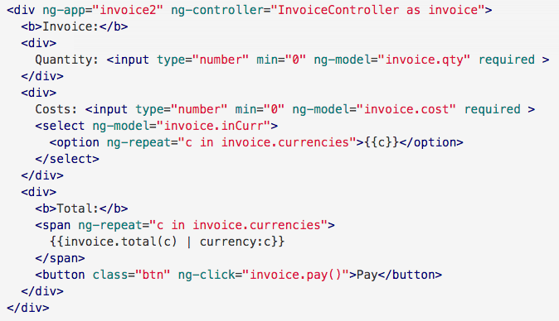
Hello World-3

Slide 98
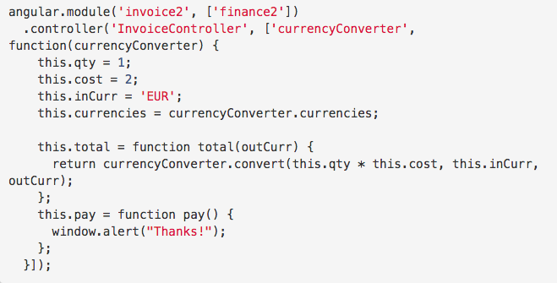
Hello World-3

Slide 99
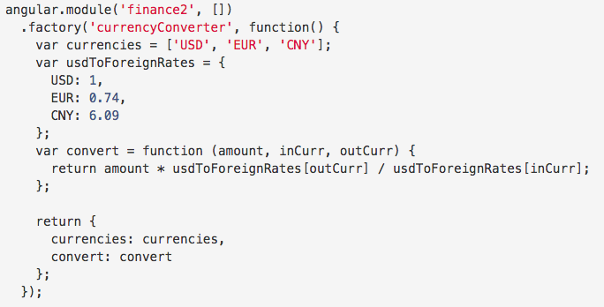
Hello World-3

Slide 100
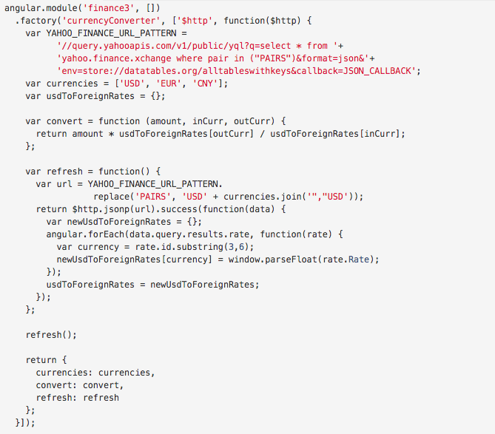
Hello World-3

Slide 101
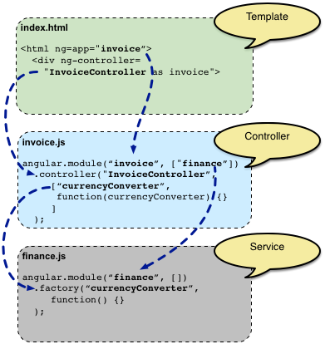
Hello World-3

