Slide 1

AngularJS Testing

Slide 2
Agenda
Jasmine.js
ngMock
Angular Unit Testing

Slide 3

Jasmine

Slide 4

What Is Jasmine?
Jasmine is a behavior-driven testing framework for JavaScript.
It does not rely on:
Browsers
DOM
Any JavaScript framework

Slide 5
Jasmine Structure
describe("A suite: describe your tests", function () {
var foo;
beforeEach(function () {
foo = 0;
foo += 1;
});
afterEach(function () { foo = 0; });
it("Contains spec with an expectation", function () {
expect(foo).toEqual(1);
});
it("Can have more than one expectation", function () {
expect(foo).toEqual(1);
expect(true).toEqual(true);
});
});

Slide 6
expect() Function
Takes a value, called the actual.
It is chained with a Matcher function, which takes the expected value.
it("Can contain any code", function () {
// actual == expected value
expect(value).toEqual(value);
});

Slide 7
Included Matchers
Jasmine has several built-in matchers. Here are a few:
toEqual(val)
toBe(val)
toMatch(pattern)
toBeDefined()
toBeUndefined()
toBeNull()
toBeTruthy()
toBeFalsy()
toBeContain(val)
toBeLessThen(val)
toBeGreaterThen(val)
toThrow(exp)
Every matcher's criteria can be inverted by prepending .not:
not.toEqual(val)
not.toBe(val)
not.toMatch(pattern)
…

Slide 8
Jasmine Test Runner Page
<link href="jasmine.css" rel="stylesheet" />
<script src="jasmine.js"></script>
<script src="jasmine-html.js"></script>
<!– Angular Framework Modules -->
<script src="angular.js"></script>
<script src="angular-mocks.js"></script>
<!-- The Application Modules-->
<script src="app.js"></script>
<!-- The Specs Unit Testing -->
<script src="appSpec.js"></script>
<!-- use Jasmine to run and display test results -->
<script type="text/javascript">
var jasmineEnv = jasmine.getEnv();
jasmineEnv.addReporter( new jasmine.HtmlReporter() );
jasmineEnv.execute();
</script>

Slide 9
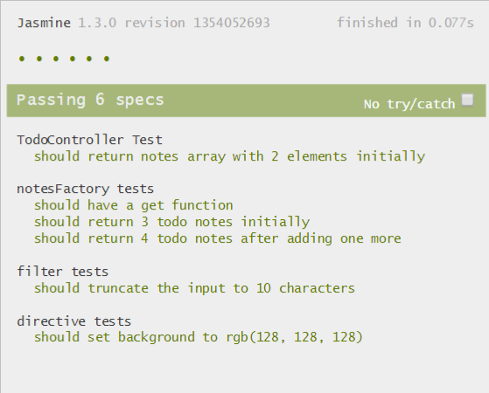
Jasmine Test Runner Page
<link href="jasmine.css" rel="stylesheet" />
<script src="jasmine.js"></script>
<script src="jasmine-html.js"></script>
<!– Angular Framework Modules -->
<script src="angular.js"></script>
<script src="angular-mocks.js"></script>
<!-- The Application Modules-->
<script src="app.js"></script>
<!-- The Specs Unit Testing -->
<script src="appSpec.js"></script>
<!-- use Jasmine to run and display test results -->
<script type="text/javascript">
var jasmineEnv = jasmine.getEnv();
jasmineEnv.addReporter( new jasmine.HtmlReporter() );
jasmineEnv.execute();
</script>

Slide 10
Angular Mock (ngMock)

Slide 11
ngMock Module
The ngMock module providers support to inject and mock Angular services into unit tests.
angular.mock.module()
angular.mock.inject()
ngMock also extends various core ng services such that they can be inspected and controlled in a synchronous manner within test code.
$httpBackend
$interval
$timeout

Slide 12
Jasmine & ngMock
describe('controllers', function () {
var $controller;
beforeEach( module('myApp.controllers') );
beforeEach( inject(function ( _$controller_ ) {
$controller = _$controller_;
}));
it('MyCtrl Spec', function () {
var myCtrl1 = $controller('MyCtrl1', { $scope: {} });
expect(myCtrl1).toBeDefined();
});
});

