Slide 1
GLOBAL TRENDS IN AI, ML, AND DATA SCIENCE SALARIES
GUIDE- Dr. Isuru Dassanayake
GROUP-11
SHASHIDHARREDDY MALIGIREDDDY
SRIRAJ BANDI
ABHINAY RAO V

Slide 2
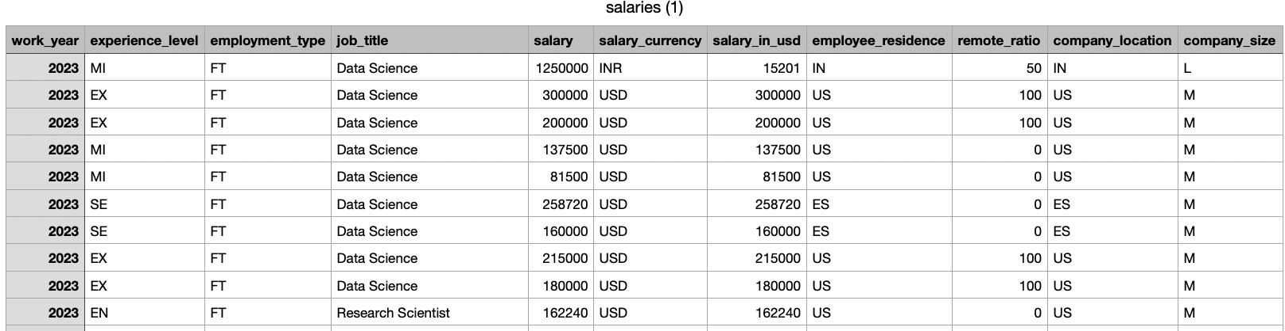
Dataset Overview
This dataset delves into salaries across AI, ML, and Data Science. It covers various job roles and experience levels, detailing employment types, job titles, and gross salary amounts. Notably, it highlights currency specifics and conversions to USD, along with employee residences, remote work levels, and company-related details like location and size. It's a compass for fair pay, aiding companies in talent management and professionals in making informed career moves. Beyond that, it offers a window into industry growth and the impact of remote work on compensation, painting a clear picture of the evolving job landscape in these specialized fields.

Slide 3
RESEARCH QUESTIONS
How the salary distribution varies across different experiences ?
Is there a significant difference in salaries based on the extent of remote work, and does this vary across countries or company sizes ?
Are certain job titles or experience levels consistently associated with higher salaries across different company sizes or regions?
Can we predict the salary of AI, ML, and Data Science professionals based on their job title and experience level?

Slide 4
METHODOLOGY
Logistic Regression
Random Forest
Lasso regression model

Slide 5
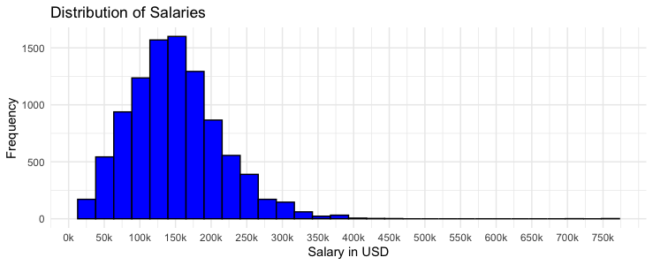
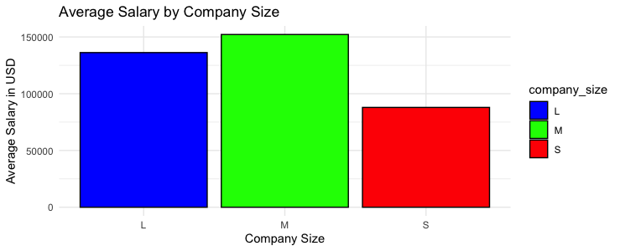
ANALYSIS DETAILS
Exploring the Salary Landscape
The Relationship Between Company Size and Average Salary

Slide 6
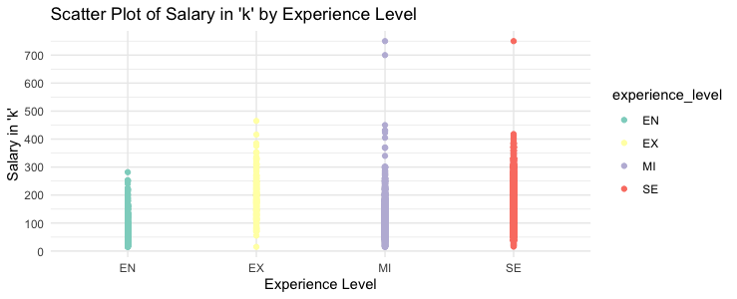
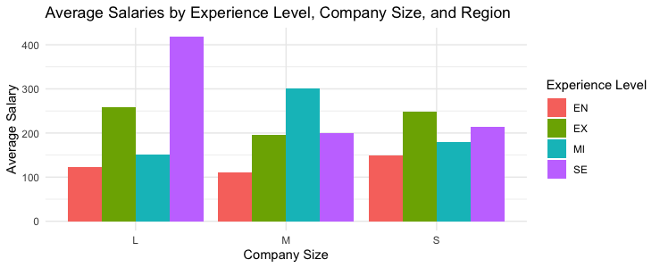
Salary Insights
Average Salaries by Experience Level, Company Size, and Region

Slide 7
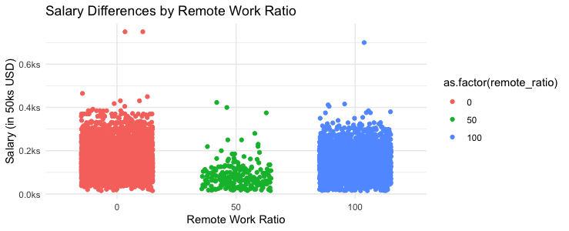
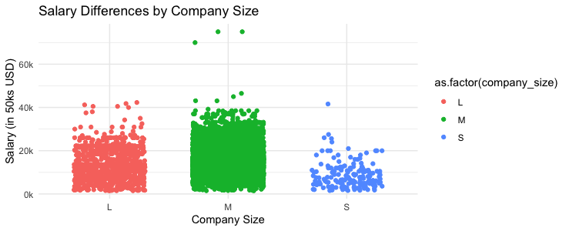
Exploring the Impact: Salary Variation Across Remote Work Ratios
Exploring Salary Variation Across Company Sizes

Slide 8
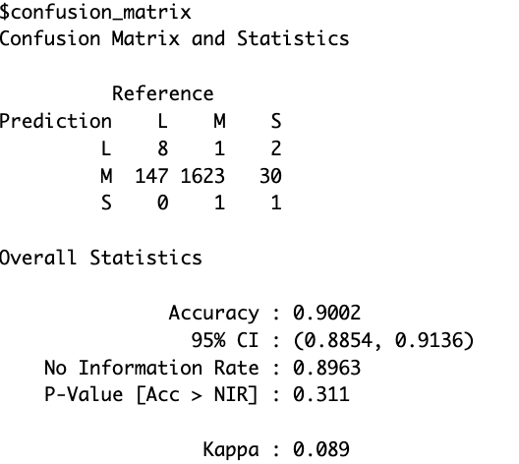
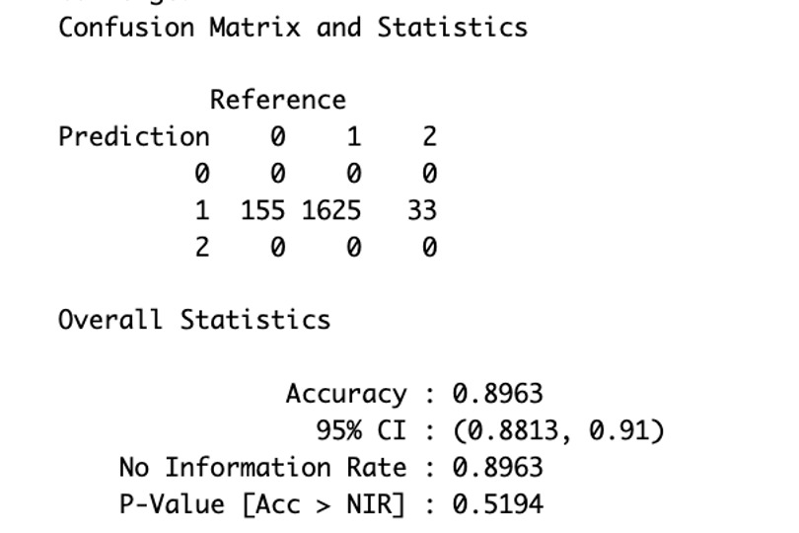
Q1) how can we predict the company level based on their experience level and the salary ?
1) Random Forest model
2) logistic regression model

Slide 9
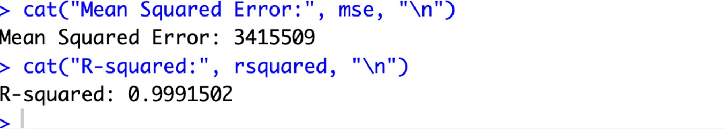
Q2) Can we predict the salary of AI, ML, and Data Science professionals based on their job title and experience level?
Lasso regression models

Slide 10
CONCLUSION
Both the Random Forest and Logistic Regression models performed well; the Random Forest model edged slightly ahead with an accuracy of 90.32% compared to Logistic Regression's 89.63%.Though we have used lasso regression model we have got decent r square. However, considering the confidence intervals, both ranges overlap, suggesting comparable performances. Both models outperformed the No Information Rate, signifying their effectiveness. The choice between them depends on factors like interpretability and handling complex relationships, where Random Forest excels. In conclusion, both models offer reliable predictions, and the decision should align with specific requirements and preferences.

Slide 11
REFERENCES
1) Download all data from our salary survey for free. (n.d.). ai-jobs.net. https://ai- jobs.net/salaries/download/
2) RPubs - SVM with CARET. (n.d.). https://rpubs.com/uky994/593668
3) Multinomial Logistic Regression | R Data Analysis Examples. (n.d.).
https://stats.oarc.ucla.edu/r/dae/multinomial-logistic-regression/
4) R, S. E. (2023, October 26). Understand random forest algorithms with examples (Updated 2023). Analytics Vidhya. https://www.analyticsvidhya.com/blog/2021/06/understanding-random- forest/
5) M, P. (2023, November 30). A comprehensive introduction to evaluating regression models. Analytics Vidhya. https://www.analyticsvidhya.com/blog/2021/10/evaluation-metric-for- regression-models/

