Slide 1
Lecture 12. Advanced
Balanced Trees
Instructor: 黄骏
jun.huang@pku.edu.cn
School of EECS
Peking University
Fall 2017

Slide 2
Outline
AVL tree
balanced binary search tree
2-3 trees
relax the “binary” condition
Red-black BSTs
relax the “balance” condition ⇒ black balance
variant: left-leaning red-black tree (LLRB)
Splay trees

Slide 3
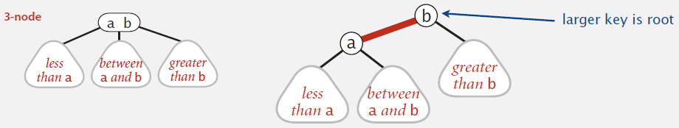
Left-Leaning Red-Black BSTs
Represent 2-3 tree as a BST
Use “internal” left-leaning links as “glue” for 3-nodes

Slide 4
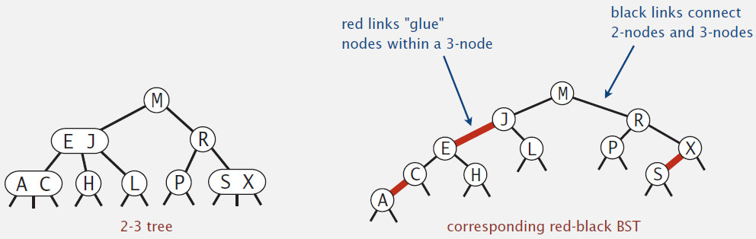
Left-Leaning Red-Black BSTs

Slide 5
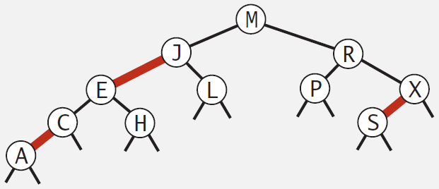
An Equivalent Definition
A BST such that
No node has two red links connected to it
Every path from root to null link has the same number of black links (“perfect black balance”)
Red links lean left

Slide 6
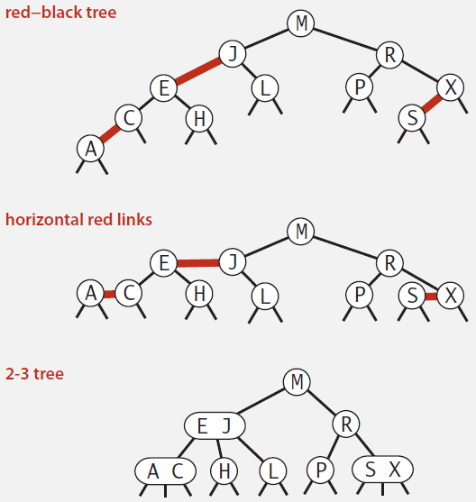
Left-Leaning Red-Black BSTs: 1-1 correspondence with 2-3 trees

Slide 7
Correspondence
2-3 tree ⬄ left-leaning red-black tree
[Sedgewick 2007]
LLRB considered harmful http://www.read.seas.harvard.edu/~kohler/notes/llrb.html
2-3-4 tree ⬄ red-black tree
[Rudolf Bayer 1972] (symmetric binary B-tree)
[Guibas-Sedgewick 1979]

Slide 8
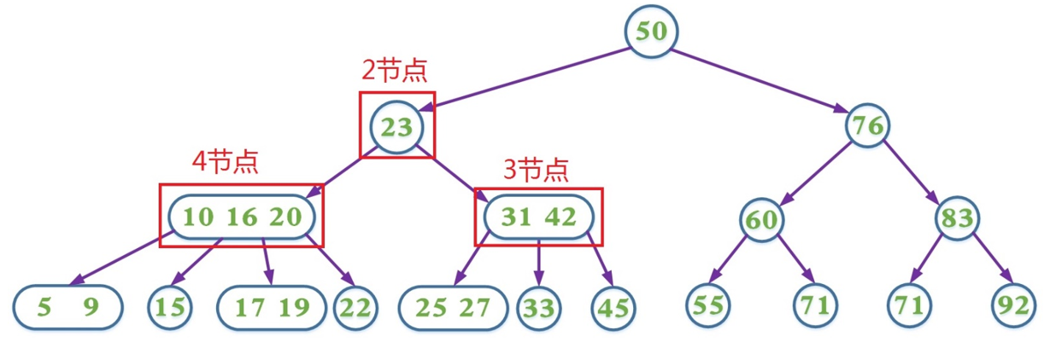
2-3-4 Tree

Slide 9
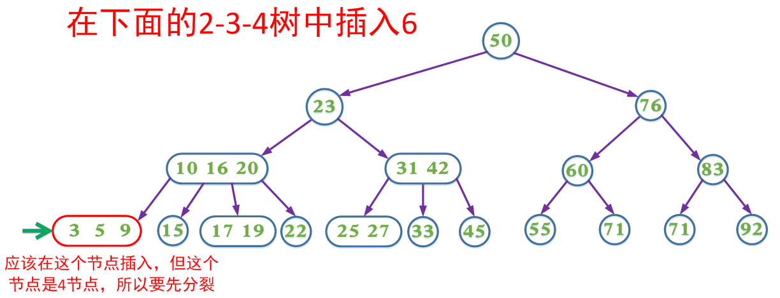
Insertion

Slide 10
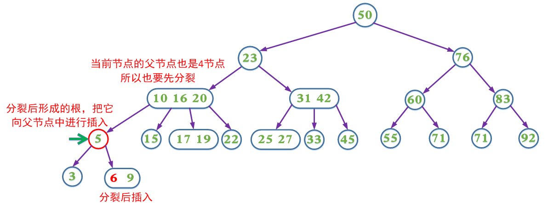
Insertion

Slide 11
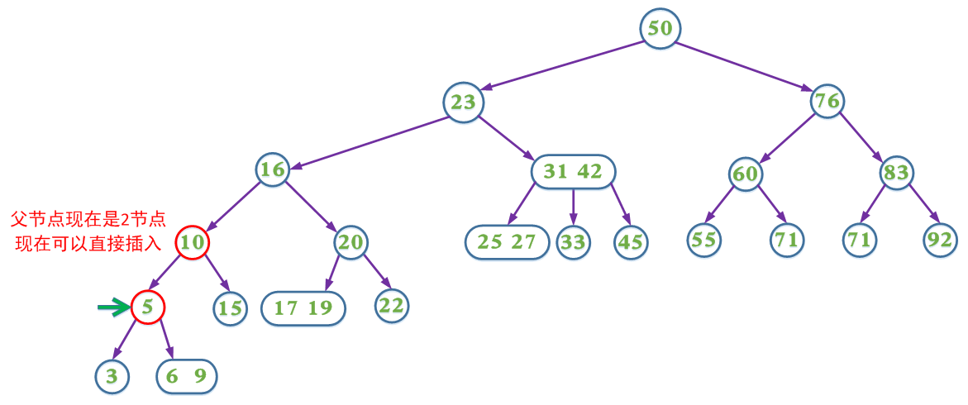
Insertion

Slide 12
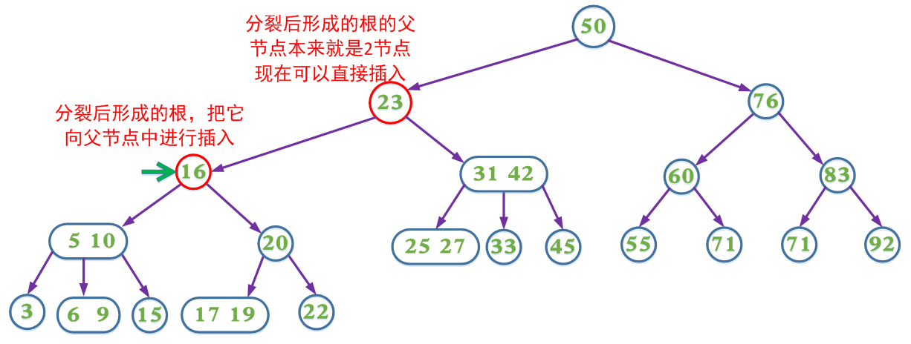
Insertion

Slide 13
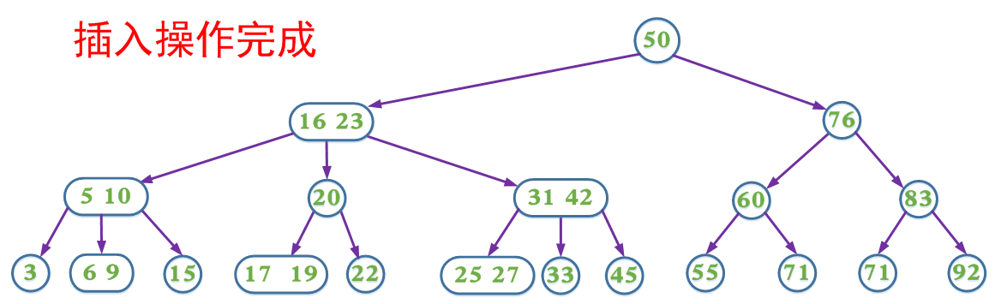
Insertion

Slide 14
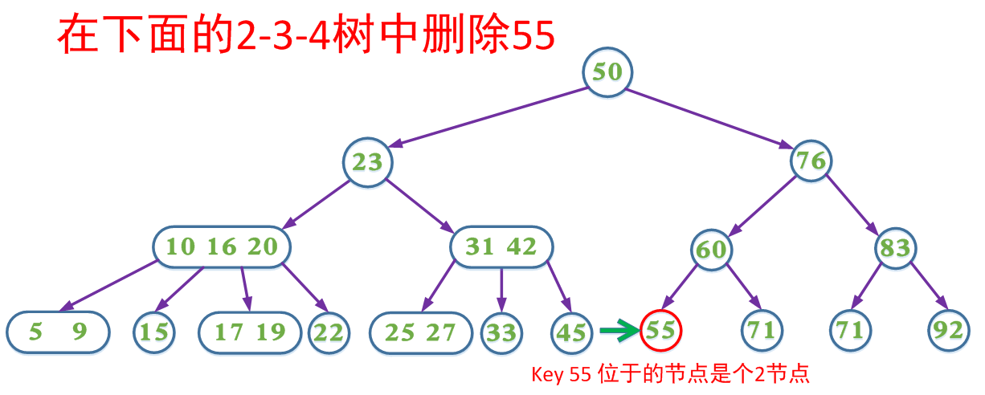
Deletion

Slide 15
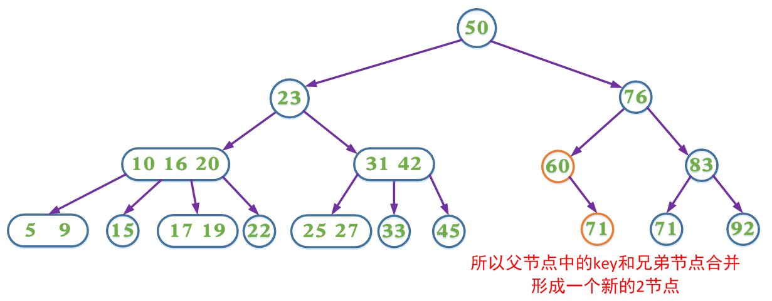
Deletion

Slide 16
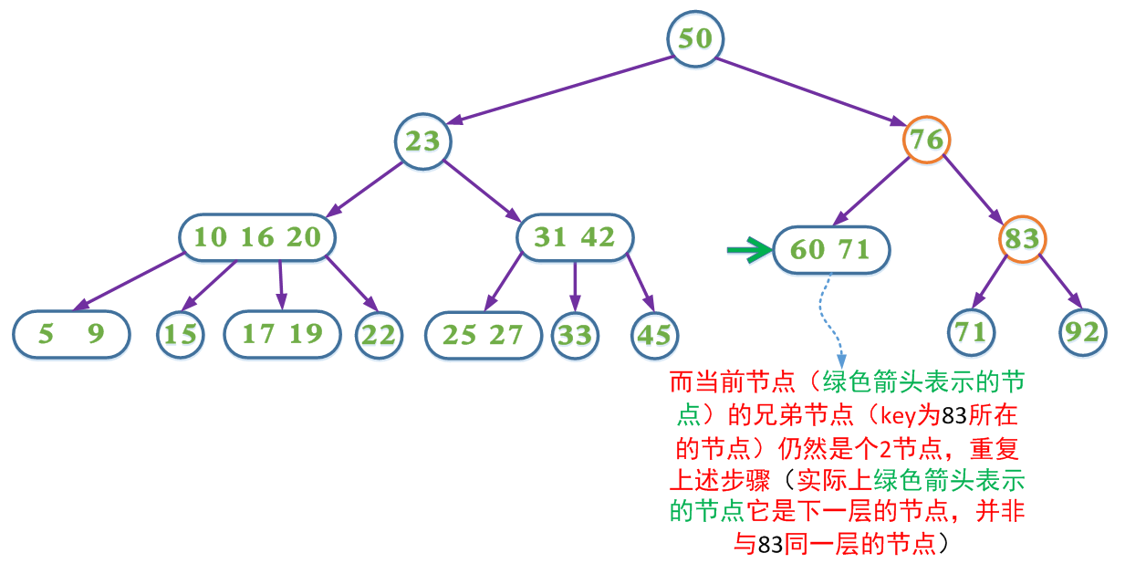
Deletion

Slide 17
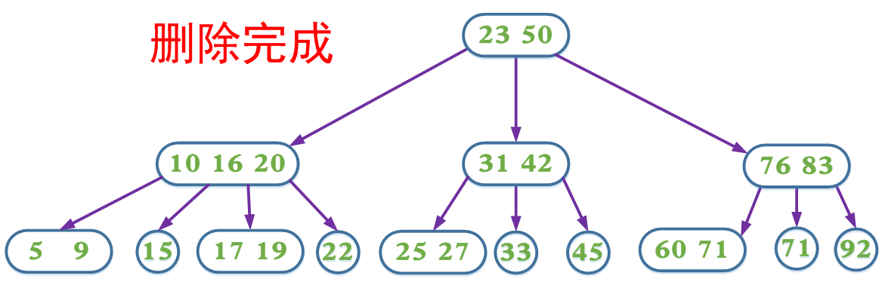
Deletion

Slide 18
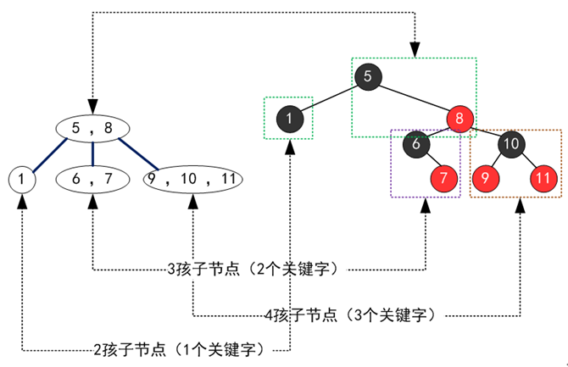
From 2-3-4 Tree to Red-Black Tree

Slide 19
Red-Black Tree
Each node is either red or black
The root is black
All leaves (NIL) are black
If a node is red, then both its children are black
Every path from a given node to any of its descendant NIL nodes contains the same number of black nodes

Slide 20
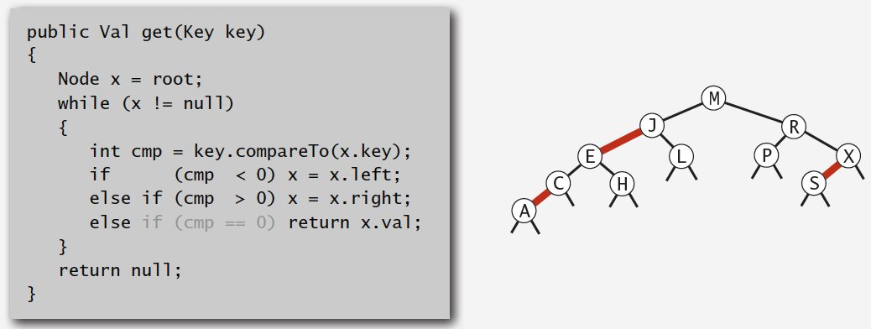
Search Implementation for Red-Black BSTs
Observation: search is the same as for elementary BST (ignore color)
but runs faster because of better balance

Slide 21
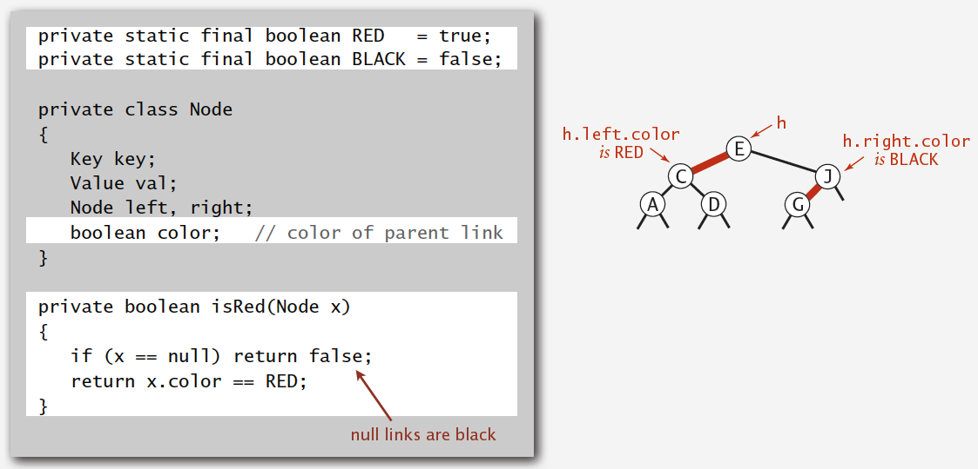
Red-Black BST Representation
Each node is pointed to by precisely one link (from its parent) ⇒ can encode color of links in nodes

Slide 22
RBT Insertion
Usual BST insertion
Color new node red
Check the color of its parent:
Black: fine
Red: transformations

Slide 23
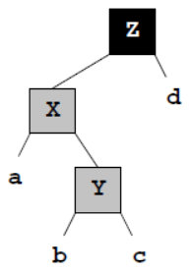
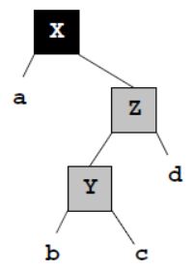
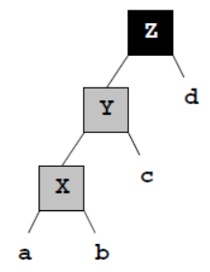
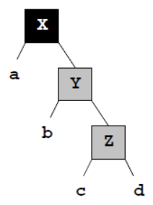
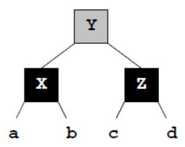
RBT Insertion
Simple but inefficient transformations
Check the parent of node Y and continue

Slide 24
RBT Insertion
Simple but inefficient transformations
Pro: easy to remember
Con: multiple rotations needed
Efficient transformation
Multiple re-coloring
One rotation at most

Slide 25
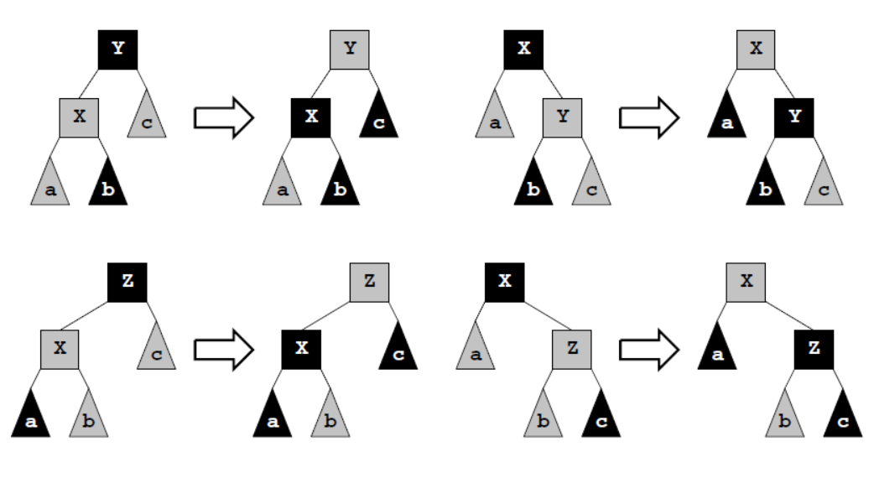
RBT Insertion
Efficient transformation
Case 1: both parent and uncle are red

Slide 26
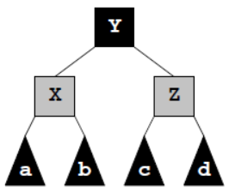
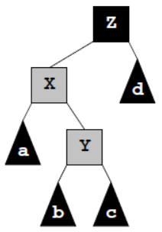
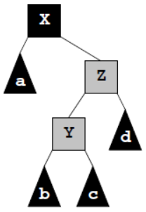
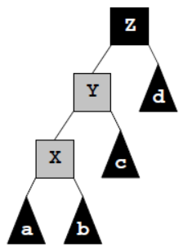
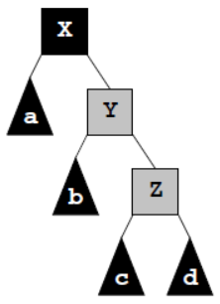
RBT Insertion
Efficient transformation
Case 2: red parent and black uncle

Slide 27
RBT Deletion
BST deletion
A
B
B
Now remove this node

Slide 28
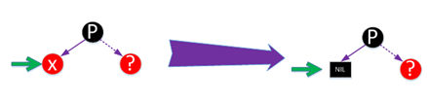
RBT Deletion
X is red

Slide 29
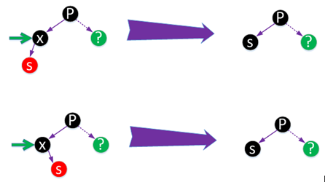
RBT Deletion
X is black, and has a single child
this child must be red

Slide 30
RBT Deletion
X is black, and has no child
Case 1: black sibling, red nephew
Case 2: black sibling, black nephew, red parent
Case 3: black sibling, black nephew, black parent
Case 4: red sibling, black nephew, black parent

Slide 31
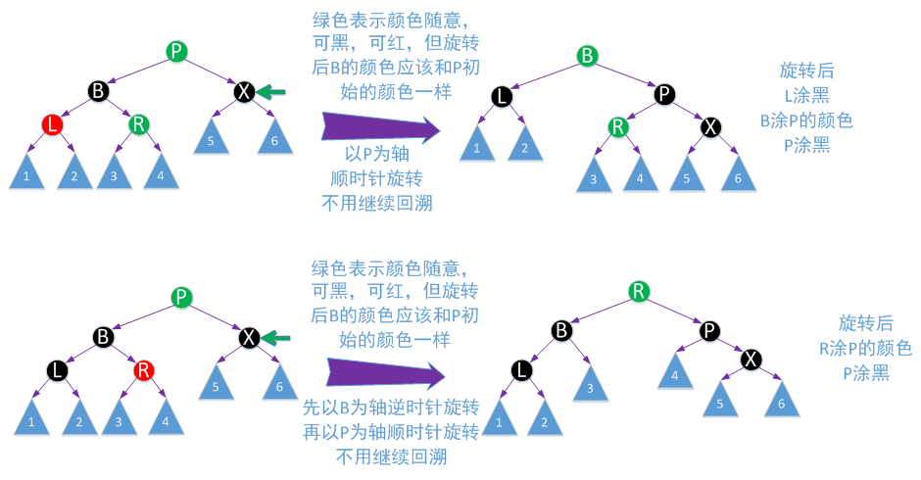
RBT Deletion
Case 1: Black Sibling and Red Nephew

Slide 32
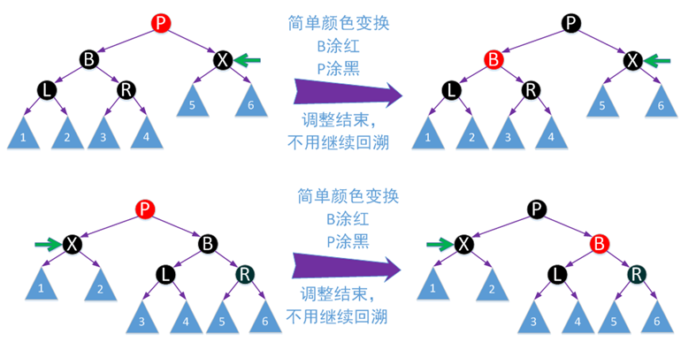
RBT Deletion
Case 2: Black Sibling, Black Nephew, and Red parent

Slide 33
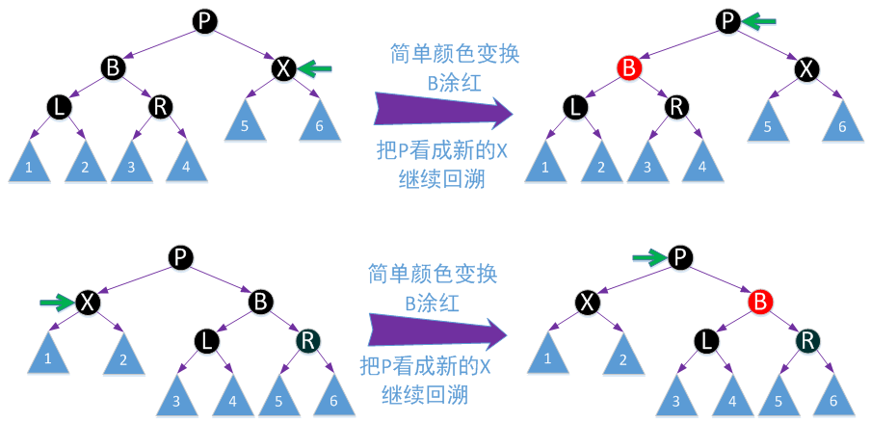
RBT Deletion
Case 3: Black Sibling, Black Nephew, and Black parent

Slide 34
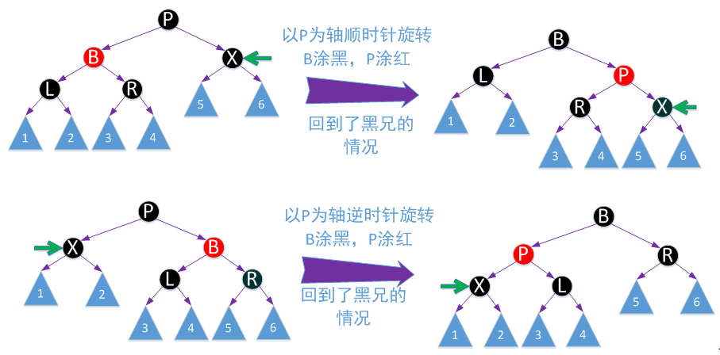
RBT Deletion
Case 4: Red Sibling, Black Nephew, and Black parent

Slide 35
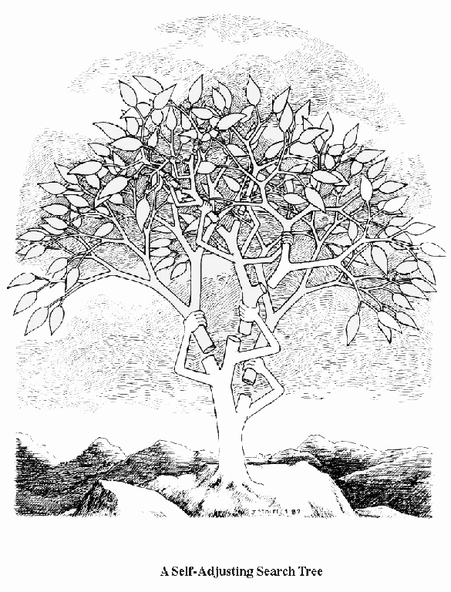
Splay Trees
A self-adjusting BST
the tree structure can be changed during the search operation
A set of rules to improve the performance of BST
reduce the cost of search and modification
no guarantee of the balance

Slide 36
Splay Trees
Fast both in worst-case amortized analysis and in practice
Used in the kernel of Windows NT for keep track of process information
Invented by Sleator and Tarjan (1985)
Notes:
We’ll start by introducing AVL trees.
Then, I’d like to spend some time talking about double-tailed distributions and means.
Next, we’ll gind out what AVL stands for.
Finally, you’ll receive a special bonus if we get to it!
(Unfortunately, the bonus is AVL tree deletion)

Slide 37
Splay Trees: Basic Idea
“Blind” rebalancing – no height info kept
Worst-case time per operation is O(n)
Worst-case amortized time is O(log n)
Insert/find always rotates node to the root
Good locality
Most commonly accessed keys move high in tree
Become easier and easier to find

Slide 38
Splay Trees: Idea
move n to root by series of zig-zag and zig-zig rotations, followed by a final single rotation (zig) if necessary
10
You’re forced to make
a really deep access:
17
Since you’re down there anyway,
fix up a lot of deep nodes!
5
2
9
3

Slide 39
Zig-Zag*
Helped
Unchanged
Hurt
g
n
up 2
X
p
g
p
down 1
down 1
up 1
n
W
X
Y
Z
W
Y
Z
*This is just a double rotation
Notes:
This is just a double rotation.

Slide 40
Zig-Zig
g
n
W
p
p
Z
X
n
g
Y
Y
Z
W
X
Notes:
Can anyone tell me how to implement this with two rotations?
There are two possibilities:
Start with rotate n
or rotate p?
Rotate p!
Rotate n makes p n’s left child and then we’re hosed.
Then, rotate n.
This helps all the nodes in blue and hurts the ones in red. So, in some sense, it helps and hurts the same number of nodes on one rotation.
Question: what if we keep rotating? What happens to this whole subtree?
It gets helped!

Slide 41
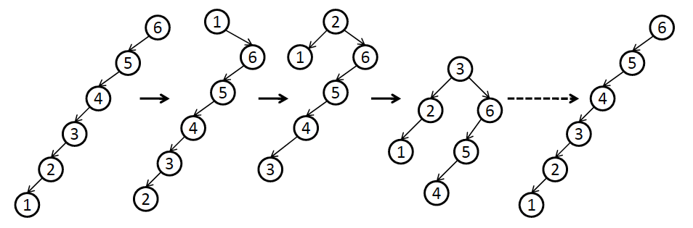
Why Not Single Rotations?
Bad example: sequential access
Notes:
http://www.cs.princeton.edu/courses/archive/spr11/cos423/Lectures/SelfAdjustingTrees.pdf

Slide 42
Why Splaying Helps
Node n and its children are always helped (raised)
Except for last step, nodes that are hurt by a zig-zag or zig-zig are later helped by a rotation higher up the tree
Result:
shallow nodes may increase depth by one or two
helped nodes decrease depth by a large amount
If a node n on the access path is at depth d before the splay, it’s at about depth d/2 after the splay
Exceptions are the root, the child of the root, and the node splayed
Notes:
Alright, remember what we did on Monday.
We learned how to splay a node to the root of a search tree.
We decided it would help because we’d go a lot of fixing up if we had an expensive access.
That means we have to fix up the tree on every expensive access.

Slide 43
Splaying Example
1
1
2
2
zig-zig
3
3
Find(6)
4
6
5
5
6
4

Slide 44
Still Splaying 6
1
1
2
6
zig-zig
3
3
6
2
5
5
4
4

Slide 45
Almost There, Stay on Target
1
6
6
1
zig
3
3
2
5
2
5
4
4

Slide 46
Splay Again
6
6
1
1
zig-zag
Find(4)
3
4
2
5
3
5
4
2

Slide 47
Example Splayed Out
6
4
1
1
6
zig-zag
4
3
5
3
5
2
2

Slide 48
Locality
“Locality” – if an item is accessed, it is likely to be accessed again soon
Assume m ≥ n access in a tree of size n
Total worst case time is O(m log n)
O(log n) per access amortized time
Suppose only k distinct items are accessed in the m accesses.
Time is O(k log n + m log k )
Compare with O( m log n ) for AVL tree
those k items are all at the top of the tree
getting those k items near root

Slide 49
Splay Operations: Insert
To insert, could do an ordinary BST insert
but would not fix up tree
A BST insert followed by a find (splay)?
Better idea: do the splay before the insert
How?
Notes:
What about insert?
Ideas?
Can we just do BST insert?
NO. Because then we could do an expensive operation without fixing up the tree.

Slide 50
Split
Split(T, x) creates two BST’s L and R:
All elements of T are in either L or R
All elements in L are ≤ x
All elements in R are > x
L and R share no elements
Then how do we do the insert?
Insert as root, with children L and R
Notes:
What about insert?
Ideas?
Can we just do BST insert?
NO. Because then we could do an expensive operation without fixing up the tree.

Slide 51
Splitting in Splay Trees
How can we split?
We have the splay operation
We can find x or the parent of where x would be if we were to insert it as an ordinary BST
We can splay x or the parent to the root
Then break one of the links from the root to a child
Notes:
How can we implement this?
We can splay.
We can find x or where x ought to be.
We can splay that spot to the root.
Now, what do we have?
The left subtree is all <= x
The right is all >= x

Slide 52
could be x, or what would have been the parent of x
split(x)
T
splay
L
R
if root is > x
if root is ≤ x
OR
L
R
L
R
≤ x
> x
< x
> x
Notes:
So, a split just splays x’s spot to the root then hacks off one subtree.
This code is _very_ pseudo. You should only use it as a general guideline.

Slide 53
Back to Insert
x
split(x)
L
R
L
R
≤ x
> x
Insert(x):
Split on x
Join subtrees using x as root
Notes:
Now, If we can split on x and produce one subtree smaller and one larger than x, insert is easy!
Just split on x.
Then, hang the left (smaller) subtree on the left of x.
Hang the right (larger) subtree on the right of x.
Pretty simple, huh?
Are we fixing up deep paths?

Slide 54
6
4
4
6
1
9
split(5)
1
6
1
9
4
7
2
9
2
7
2
7
Insert(5)
5
4
6
1
9
2
7
Notes:
Let’s do some examples.

Slide 55
Splay Operations: Delete
x
find(x)
delete x
L
R
L
R
< x
> x
Now what?
Notes:
OK, we’ll do something similar for delete.
We know x is in the tree.
Find it and bring it to the root.
Remove it.
Now, we have to split subtrees.
How do we put them back together?

Slide 56
Join
Join(L, R): given two trees such that L < R, merge them
Splay on the maximum element in L then attach R
splay
L
L
R
R
Notes:
The join operation puts two subtrees together as long as one has smaller keys to begin with.
First, splay the max element of L to the root.
Now, that’s gauranteed to have no right child, right?
Just snap R onto that NULL right side of the max.

Slide 57
Delete Completed
x
T
find(x)
delete x
L
R
L
R
< x
> x
Join(L,R)
T - x
Notes:
So, we just join the two subtrees for delete.

Slide 58
6
4
6
1
9
find(4)
1
6
1
9
4
7
2
9
2
7
Find max
2
7
Delete(4)
2
2
1
6
1
6
9
9
7
7

Slide 59
Splay Trees: Summary
Splay trees are arguably the most practical kind of self-balancing trees
If number of finds is much larger than n, then locality is crucial!
Example: word-counting
Also supports efficient Split and Join operations – useful for other tasks
e.g., range queries

Slide 60
Recommended Reading
Weiss, “DS & Algo. Analysis in C++” (3rd ed.)
Section 4.5 Splay Trees
Section 4.7 B-Trees

