Slide 1
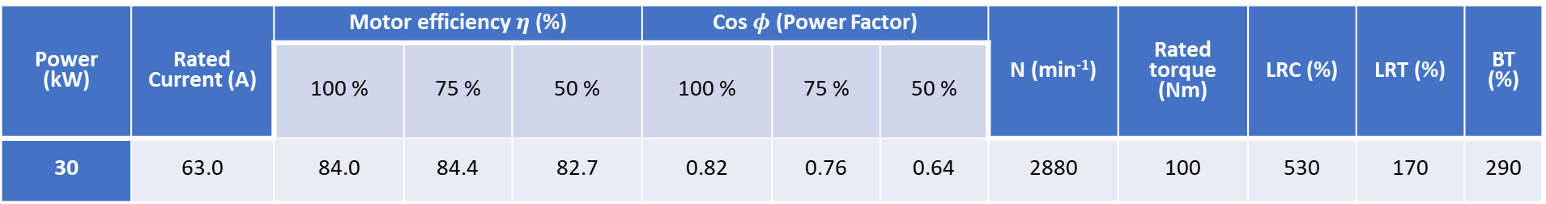
Cables and Circuit Breakers
DC Cables & circuit breakers
Solar panels and batteries
AC Cables & circuit breakers
Inverter and Generator
Table 1: Characteristics of Pump 3 x 415V, 50Hz, T40 (voltage code 18, 39) from Grundfos literature [1]
Power (kW) | Rated Current (A) | Motor efficiency $η$ (%) |  |  | Cos $φ$ (Power Factor) |  |  | N (min⁻¹) | Rated torque (Nm) | LRC (%) | LRT (%) | BT (%)
 |  | 100 % | 75 % | 50 % | 100 % | 75 % | 50 %
30 | 63.0 | 84.0 | 84.4 | 82.7 | 0.82 | 0.76 | 0.64 | 2880 | 100 | 530 | 170 | 290

Slide 2
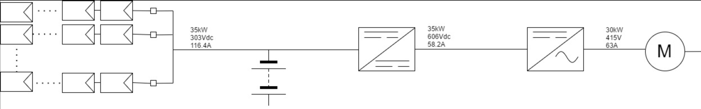
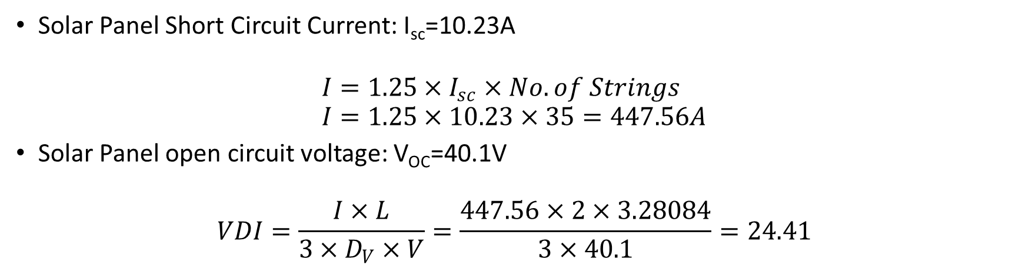
DC Cables
Solar Panel Short Circuit Current: I_{sc}=10.23A
$$I=1.25×I_{sc}×No. of Strings \\ I=1.25×10.23×35=447.56A$$
Solar Panel open circuit voltage: V_{OC}=40.1V
$$VDI=\frac{I×L}{3×D_{V}×V}=\frac{447.56×2×3.28084}{3×40.1}=24.41$$

Slide 3
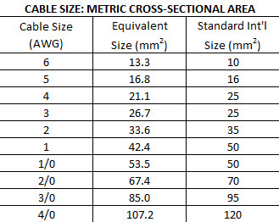
Table 2: Cable cross-sectional area DC cables [3]
Appropriate DC conductor size =35mm²
Maximum necessary conductor size = 70mm²
VDI = 31
AWG = 2
Only sufficient if the length of the circuit length is kept to a minimum (<2m) otherwise use AWG=2/0

Slide 4
AC Cables
Required to carry 63A, 415V to the load
Estimated I_{SC}=315A
Use a 25mm² PVC insulated 4- core (3-phase) copper conductor
Impedance = 0.8749 Ω/m, Voltage drop = 1.515 mV/A m.

Slide 5
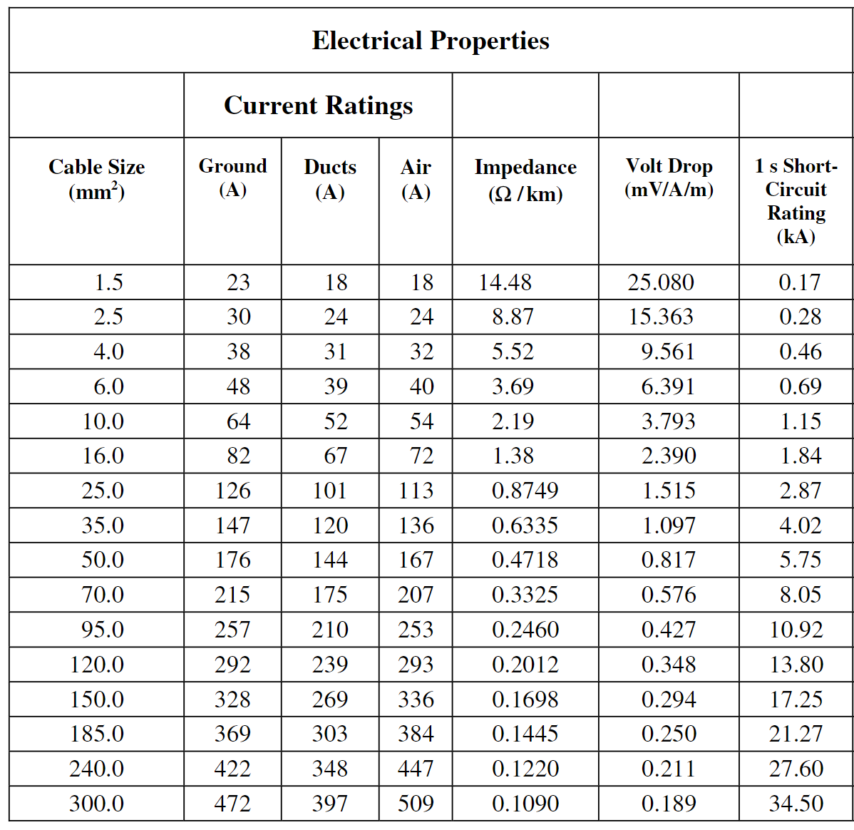
Table 3: Electrical properties of PVC insulated copper conductor cables [2]

Slide 6
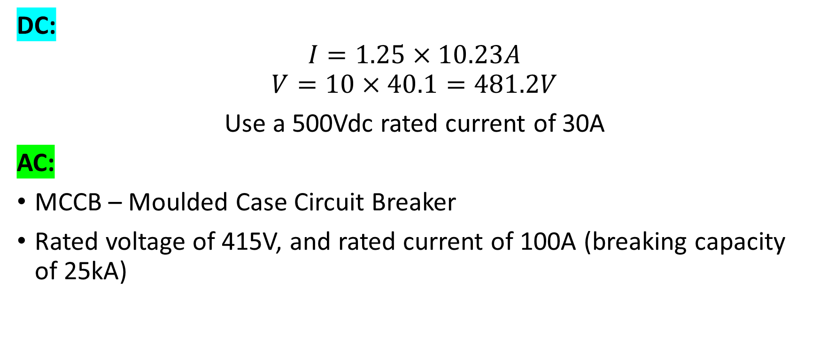
Circuit Breakers
DC:
$$I=1.25×10.23A$$
$$V=10×40.1=481.2V$$
Use a 500Vdc rated current of 30A
AC:
MCCB – Moulded Case Circuit Breaker
Rated voltage of 415V, and rated current of 100A (breaking capacity of 25kA)

Slide 7
References
[1] Grundfos, "Grundfos Data Booklet MS 6000 Submersible Motors 50/60Hz," 2015, Available: http://product-selection.grundfos.com/product-detail.product-detail.html?lang=ENU&productnumber=78635520&productrange=gma.
[2] L. G. Hewitson, M. Brown, and R. Balakrishnan, Practical Power System Protection (Practical Professional Books From Elsevier). Oxford: Newnes, 2005.
[3] Lincoln Electric. (2017). Selecting the proper size Cables. Available: http://www.lincolnelectric.com/en-us/support/welding-solutions/Pages/selecting-proper-size-welding-cables.aspx

