Slide 1

S4.2 – Fraud Patterns Detection Service Update
UPC, 5th May 2021
Marc Jené

Slide 2
Fraud in Distribution Grid
Distribution Grid Losses = Energy IN – Energy OUT
Energy IN: Energy entering the distribution network, from embedded generators or upstream, same level or downstream networks.
Energy OUT: Consumed and properly accounted energy.
Distribution Grid Losses = Technical Losses + Non-technical Losses
Technical Losses (TL): Variable losses (load related), fixed losses (not related to load) and network service (uncontracted consumptions of network equipment).
Non-technical Losses (NTL): Network equipment issues, network information issues and energy data processing issues.
Mainly theft and fraud

Slide 3
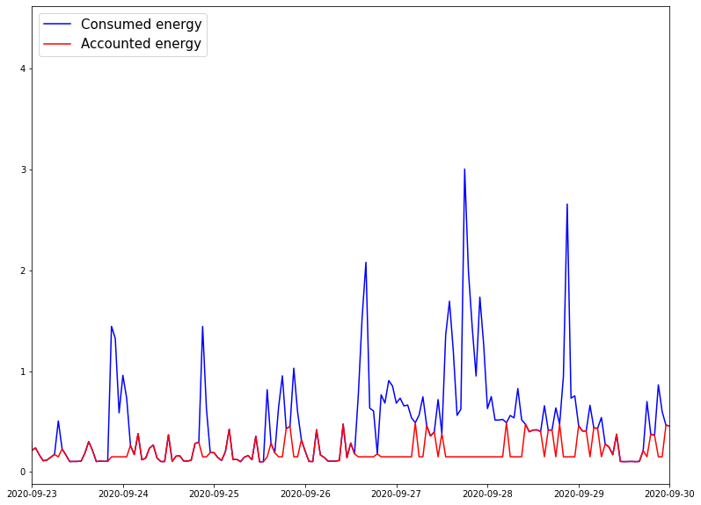
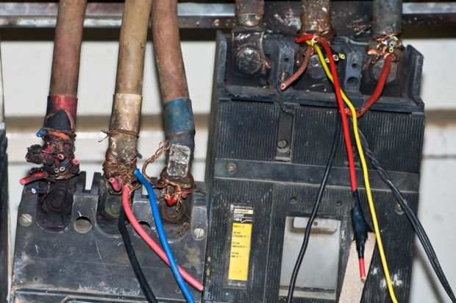
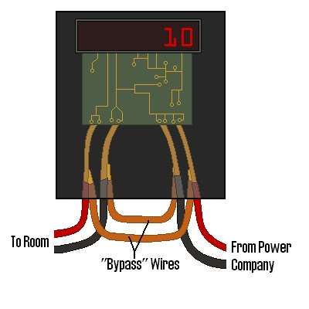
Fraud in Distribution Grid
Direct Connection
False Data Injection

Slide 4
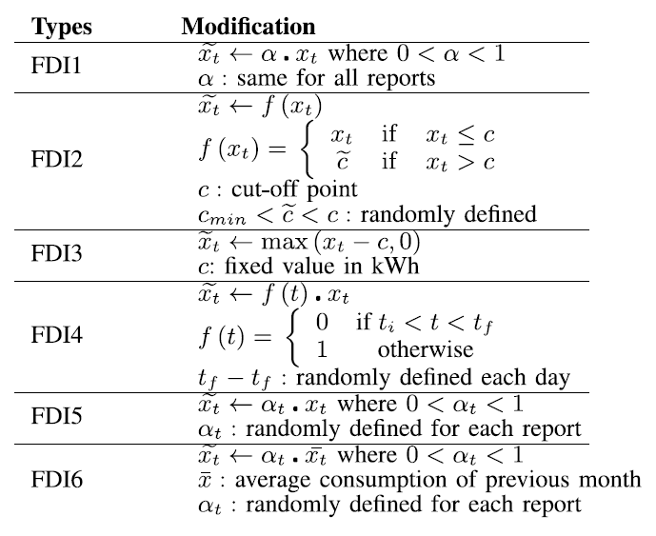
False Data Injection
How to detect this type of fraud?
Upward trend due to SM deployment.
Many different possibilities.
Changes in consumption are recorded in the SM, but are more difficult to detect by the operator.
Possible approaches:
Short-pattern clustering.
Clustering of all SMs.
Problem: subtle changes are difficult to detect.
FDI examples [2]
Correlation between SM consumption and NTL curve can help with this.

Slide 5
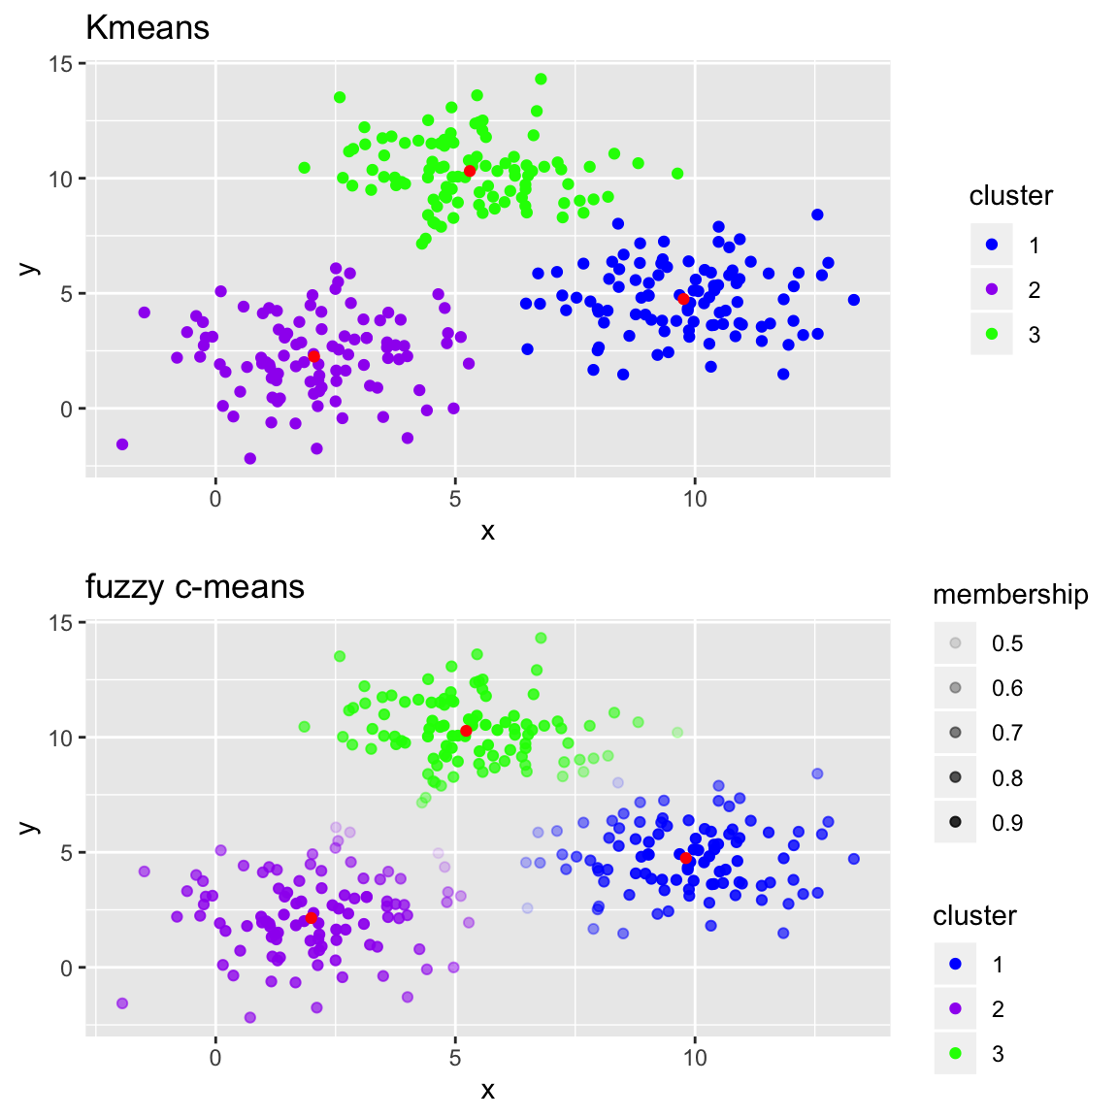
False Data Injection
Clustering
Division of the population or data points into a number of groups such that data points in the same groups are more similar to other data points in the same group and dissimilar to the data points in other groups. Unsupervised learning.
Features used: Mean, Median, Std, Max, Min, Mean P1 (0-8h), Mean P2 (8-16h), Mean P3 (16-24h), number of times the consumption crosses the average, steep rise, steep descent, peaks average.
Algorithms used: K-Means and Fuzzy C-Means with Euclidean Distance.
K-Means vs. Fuzzy C-Means. [3]
Why is Fuzzy C-Means interesting?

Slide 6
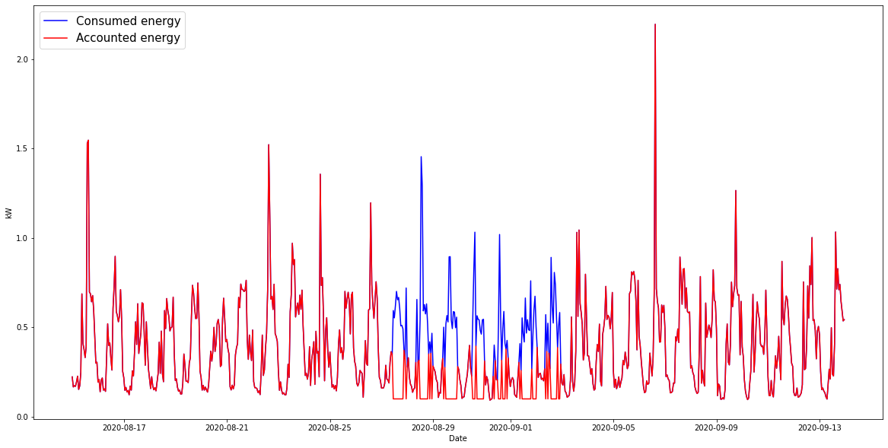
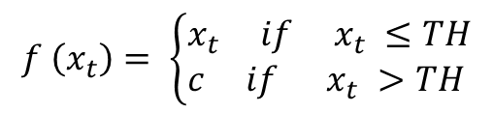
False Data Injection
FDI 2* – Examples
A. LGZ003XXX648
$$f \left(x_{t}\right)= \left\{\begin{aligned}&x_{t} if x_{t} ≤TH \\ &c if x_{t} >TH\end{aligned}\right.$$
TH = 0,4 kW
C = 0,1 kW
Period of fraud:
27/08/2020 – 02/09/2020

Slide 7
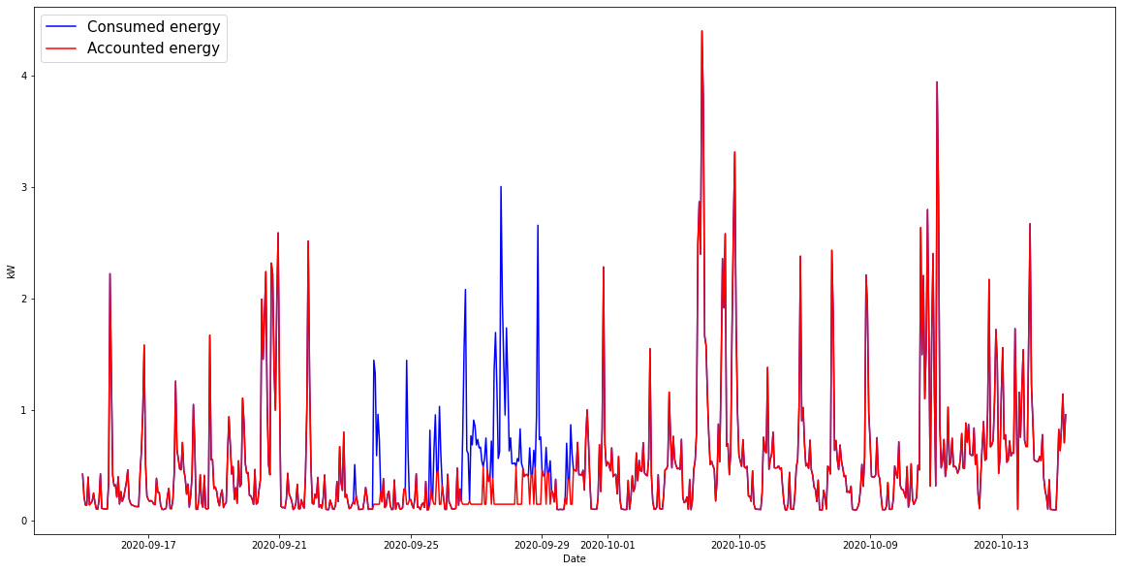
False Data Injection
FDI 2* – Examples
B. SAG01XXX64
$$f \left(x_{t}\right)= \left\{\begin{aligned}&x_{t} if x_{t} ≤TH \\ &c if x_{t} >TH\end{aligned}\right.$$
TH = 0,5 kW
C = 0,15 kW
Period of fraud:
23/09/2020 – 30/09/2020

Slide 8
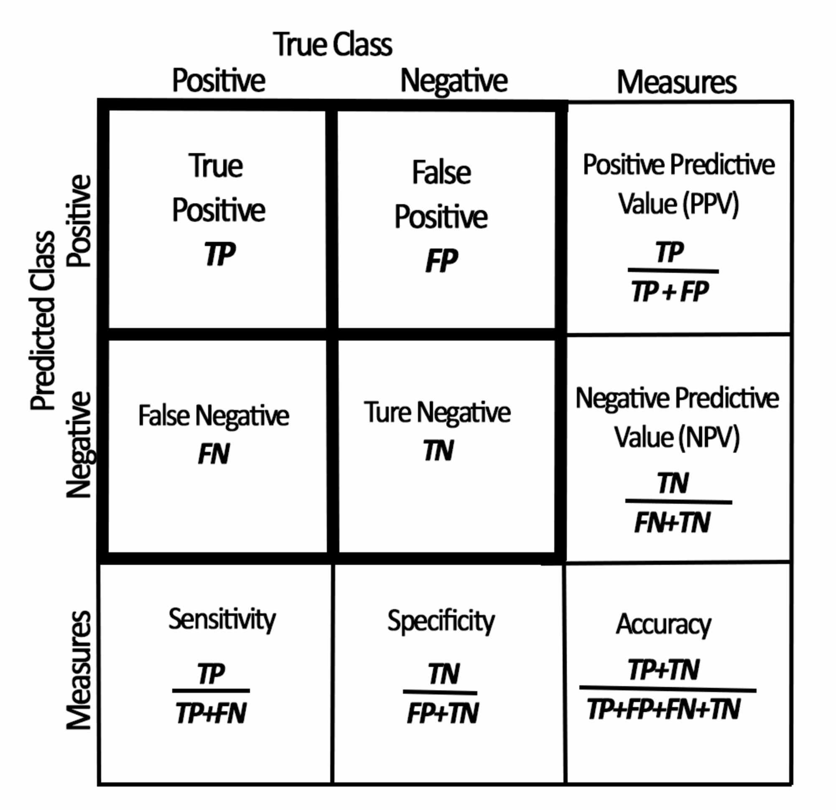
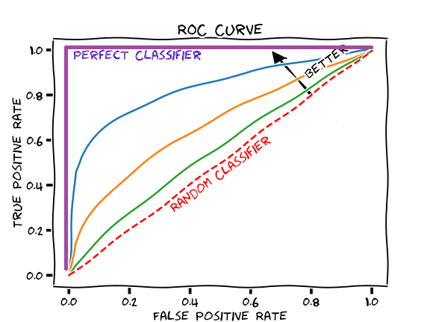
False Data Injection
KPIs Used
AUC-ROC curve. [5]
Binary classification KPIs. [4]

Slide 9
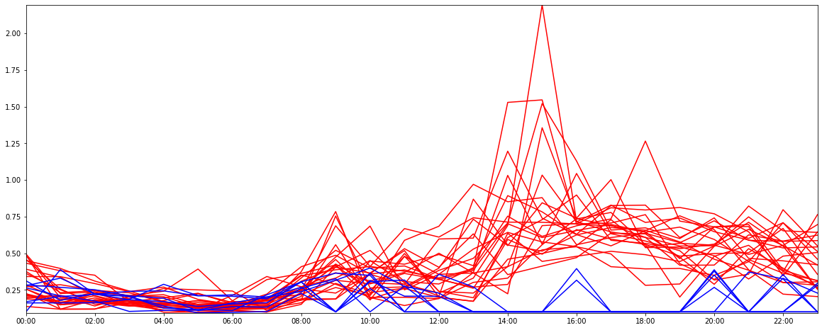
False Data Injection
Results - A. LGZ003XXX648
K-Means
Fuzzy C-Means
 |  | True Class
 |  | Positive | Negative
Predicted Class | Positive | 7 | 0
 | Negative | 0 | 23
Sensitivity = 1
Accuracy = 1
 |  | True Class
 |  | Positive | Negative
Predicted Class | Positive | 7 | 0
 | Negative | 0 | 23
Fraud Membership = 0,5
Sensitivity = 1
Accuracy = 1

Slide 10
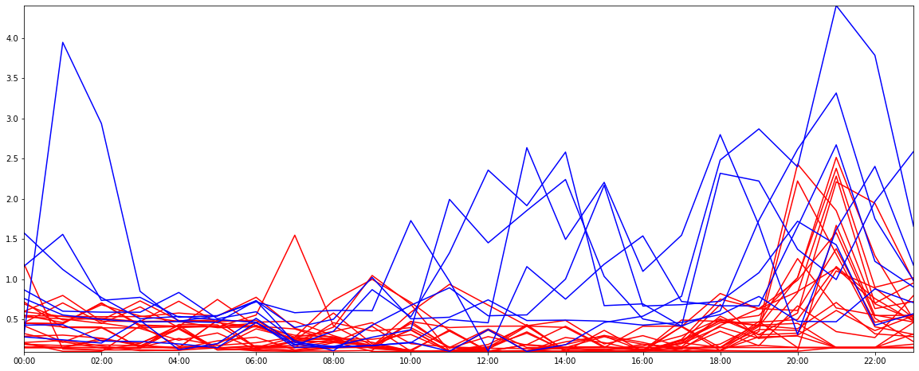
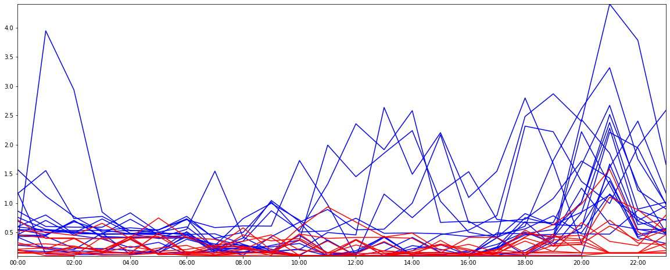
False Data Injection
OQ: How should we define the fraud membership degree in order to optimize the clustering?
Results - B. SAG01XXX64
K-Means
Fuzzy C-Means
 |  | True Class
 |  | Positive | Negative
Predicted Class | Positive | 7 | 16
 | Negative | 0 | 7
Sensitivity = 1
Accuracy = 0,47
 |  | True Class
 |  | Positive | Negative
Predicted Class | Positive | 7 | 5
 | Negative | 0 | 18
Fraud Membership = 0,85
Sensitivity = 1
Accuracy = 0,83

Slide 11
Ethical Questions of the Service
AI ethics is a field of increasing relevance.
Generally, in technical services, it might not be taken into account.
Fraud Detection involves people, so social aspects are also part of the service.
Should geospatial data be included to predict frauds? Location is closely related to wealth and race - danger of malicious feedback loop.
Why are these frauds happening? Not all of them should be considered the same – energy poverty shouldn’t be criminalized.

Slide 12
References
[1] Reduction of Technical and Non-Technical Losses in Distribution Networks. CIRED WG CC-2015-2. November 2017.
[2] M. Zanetti et al. "A Tunable Fraud Detection System for Advanced Metering Infrastructure Using Short-Lived Patterns," in IEEE Transactions on Smart Grid, Jan. 2019
[3] https://2-bitbio.com/post/clustering-rnaseq-data-using-fuzzy-c-means-clustering/
[4] https://www.cureus.com/articles/37517-the-results-of-abdominopelvic-computed-tomography-interpreted-via-remote-access-for-the-diagnosis-of-acute-appendicitis
[5] https://medium.datadriveninvestor.com/understanding-auc-roc-clearly-explained-74c53d292a02

Slide 13
Thank you for your attention

