Slide 1
M-209
-Ian Schwartz, Lucas Martin, Sam Barnes, Shannon Bull, Nicholas Perna.

Slide 2
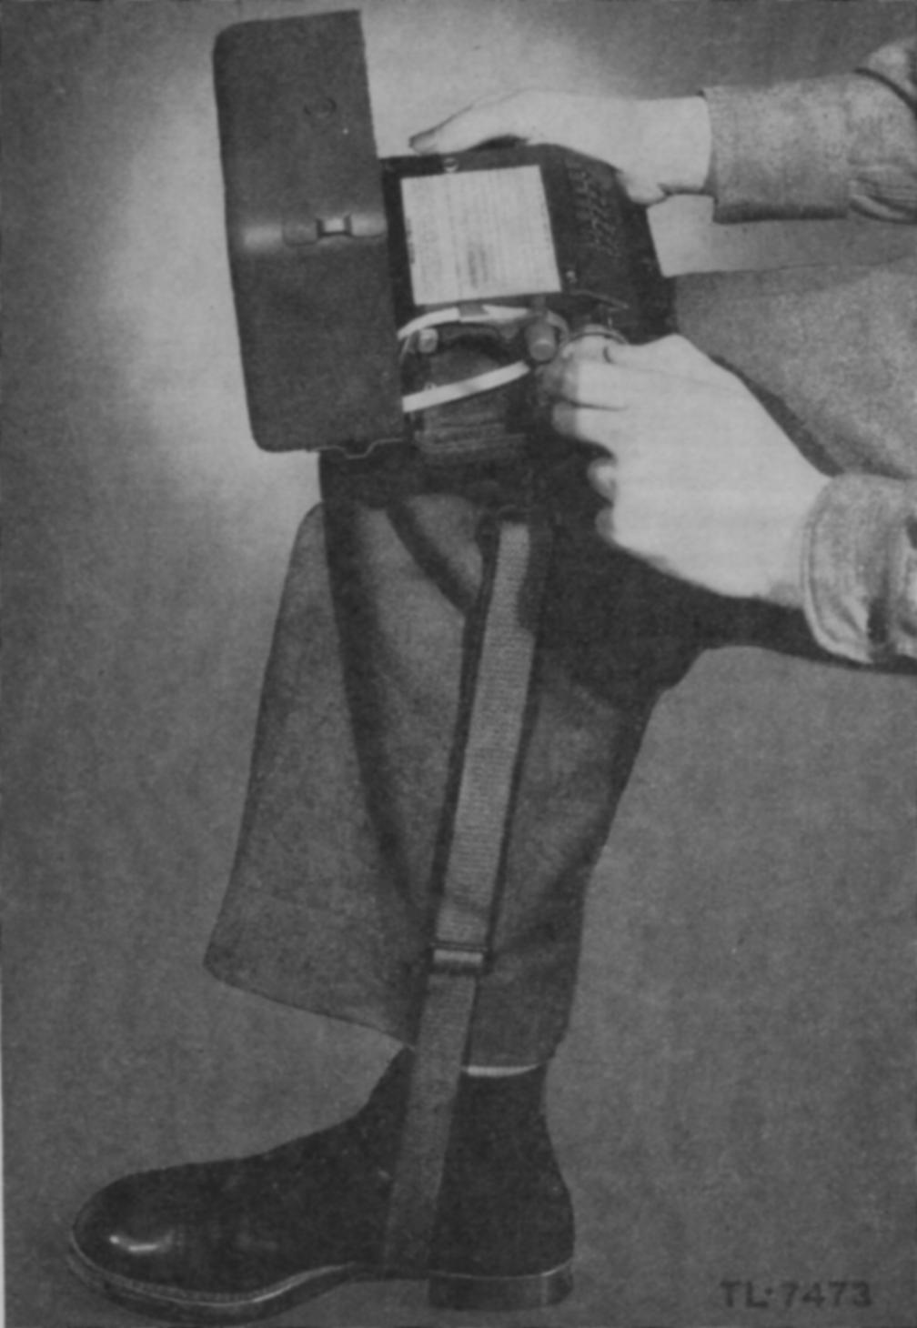
History(background)
The M-209 is a Cipher machine that was used mostly in WWII by the Americans to encrypt and decrypt secret messages throughout the war.
The M-209 was designed by Swedish Boris Hagelin
Weight: 6lb’s
Size: Lunchbox
Lifetime: Late 1930’s – Early 1960’s

Slide 3
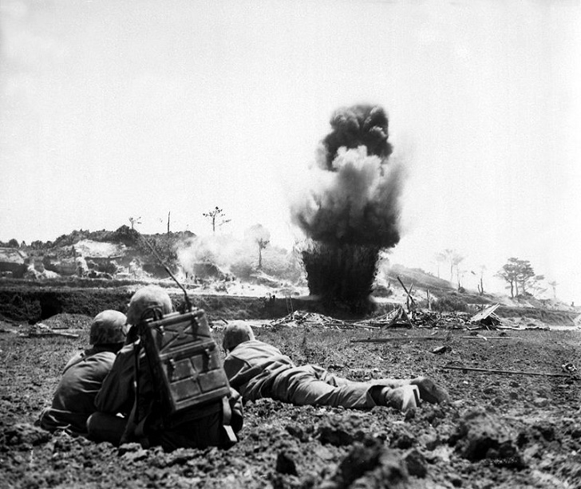
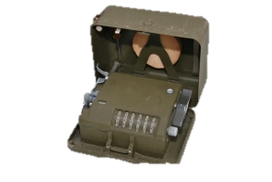
What Our Product is Used For
Our website mimics the M-209 for usage and a better understanding of how the cipher machine works.
It allows users to learn how the original machine was operated and used in wartime by replicating the characteristics and logic that the real machine used

Slide 4
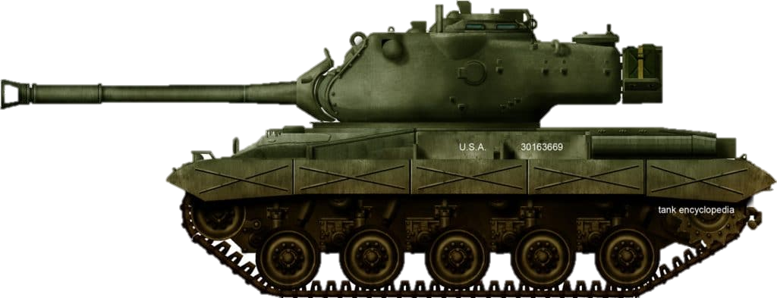
How it works
The user has the option to learn about the machine or explore how it is used
They will be asked to configure the pins, lugs, and wheels as was completed during the war
Upon completing their configuration, they have the option to experiment with the machine by encoding and decoding various messages with our emulator

Slide 5
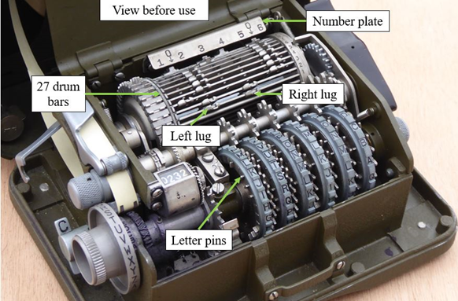
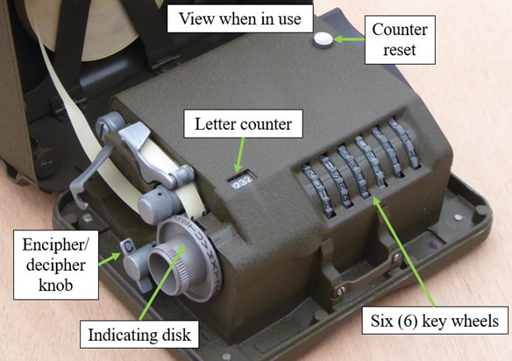
M-209 Hardware

Slide 6
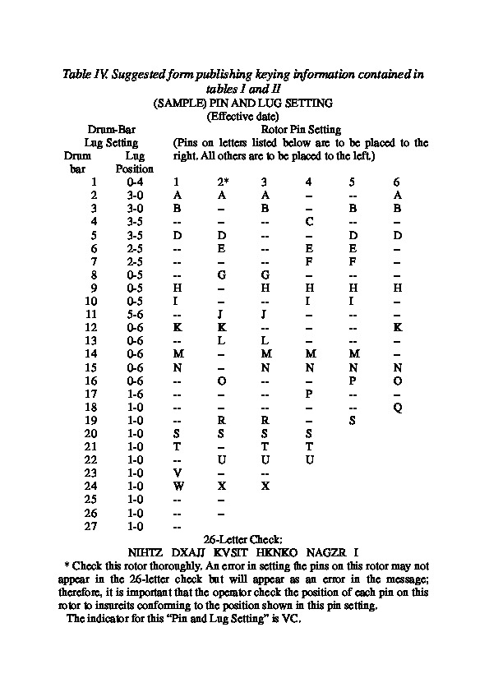
Operator’s Charts

Slide 7
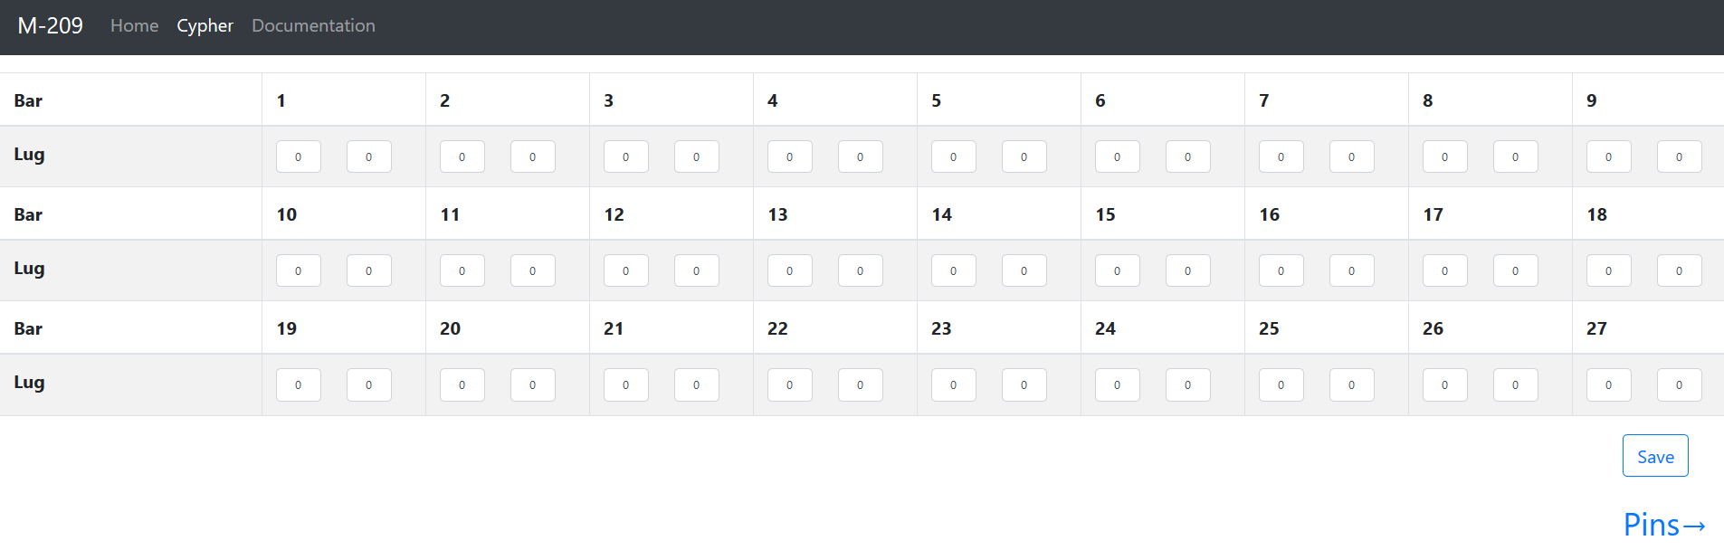
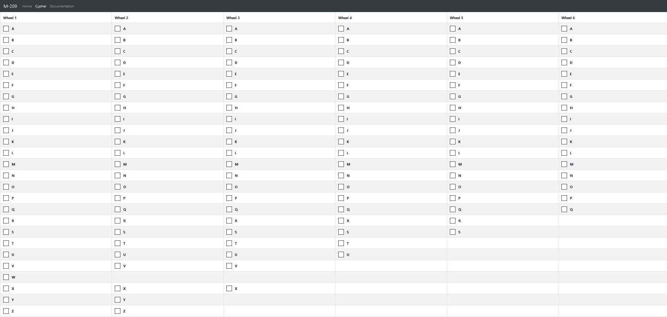
Machine Configuration

Slide 8
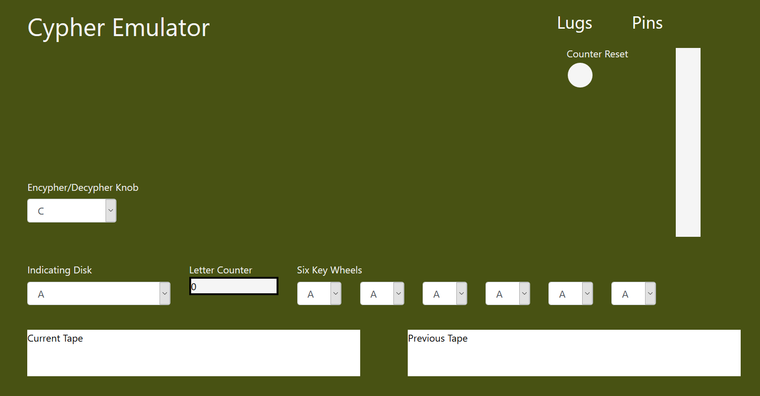
Machine Emulator

Slide 9
Technology Used
JavaScript
Python
HTML
CSS
BootStrap 4

Slide 10
Our Process
Research M-209 to understand how it works
Wrote algorithms what happens internally
Python implementation
Split up:
3 working on JavaScript implementation
2 working on the website skeleton
Merge two working pieces together to have a functioning website

Slide 11

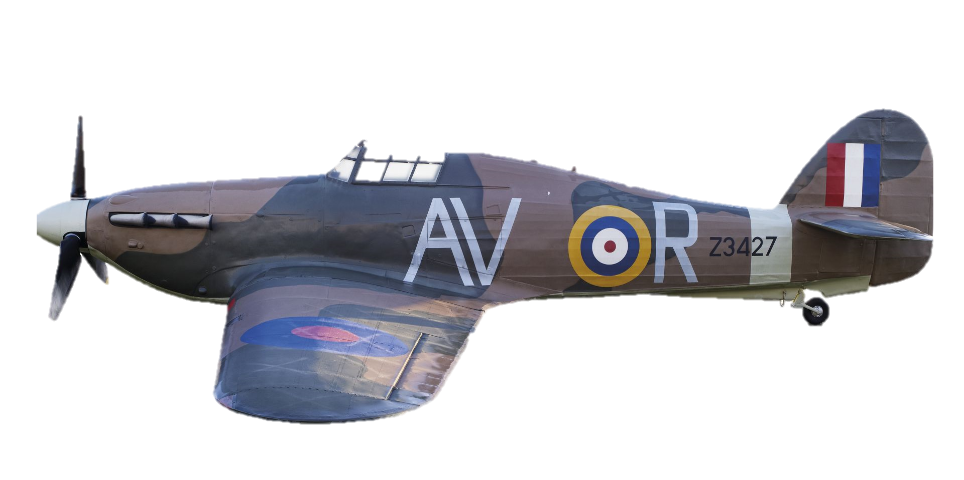
Demo

Slide 12
Future work
Update the user interface for a more true-to-life display when using the machine
Add graphics to simulate turning of wheels and spinning of knobs
Research SIGABA electric cipher machine (WWII)
Develop a similar web application to replicate how the SIGABA machine was used

