Slide 1
Coursera Data Science Capstone Class Final Project Summary
Massimiliano Pacilio
November 22, 2015

Slide 2
NWP: A Modern Next-Word-Prediction App
Next word prediction is a very popular (but challenging) topic.
A successful algorithm requires the following:
Data
A sufficiently large quantity of varied training (and test) data must be used
Tokenizing
Training data must be tokenized into sentences and cleaned
before being used to train the algorithm.
Unknown Words
There will always be unknown words encountered by
the next word prediction algorithm.
Unknown words must be anticipated and handled or the algorithm will crash.
NWP: A Modern Next-Word-Prediction App
Next word prediction is a very popular (but challenging) topic. A successful algorithm requires the following:
Data
A sufficiently large quantity of varied training (and test) data must be used
Tokenizing
Training data must be tokenized into sentences and cleaned before being used to train the algorithm.
Unknown Words
There will always be unknown words encountered by the next word prediction algorithm. Unknown words must be anticipated and handled or the algorithm will crash.
State-of-the-art methods to do next word prediction are based on n-grams (an ordered sequence of n words or terms)[1]. These methods base the next word prediction on the previous n words typed. NWP employs a modified version of the Kneser-Ney smoothing, as discussed by Körner[2]
References
Feinerer, I., Hornik, K. and Meyer, D., “Text Mining Infrastructure in R”, Journal of Statistical Software, March 2008, 25, 5,http://www.jstatsoft.org/v25/i05/paper, Retrieved July 8, 2015.
Körner, M. C., Implementation of Modified Kneser-Ney Smoothing on Top of Generalized Language Models for Next Word Prediction, Univ. of Koblenz-Landau, Sept. 2013, Thesis,https://west.uni-koblenz.de/sites/default/files/BachelorArbeit_MartinKoerner.pdfRetrieved July 21, 2015.
NWP Interface and Use
Simple interface. Enter your text in the “User Text:” area and hit the “Predict!” button. That's all there is to it!
Algorithm Details
Training, Held-out and Test data subsets were taken from a corpus of 200 MB of blog data, 196 MB of news data and 159 MB of twitter data. Training was done with several sizes of training set and a 24 MB training set was selected, to maximize precision and performance, drawing randomly from the blog, news and twitter data.
Model Performance Results:

Slide 3
State-of-the-art methods to do next word prediction are based on n-grams
(an ordered sequence of n words or terms)[1].
These methods base the next word prediction on the previous n words typed.
NWP employs a modified version of the Kneser-Ney smoothing,
as discussed by Körner[2]
References
Feinerer, I., Hornik, K. and Meyer, D., “Text Mining Infrastructure in R”,
Journal of Statistical Software,
March 2008, 25, 5,http://www.jstatsoft.org/v25/i05/paper,
Retrieved Novembrer 12, 2015.
2.Körner, M. C., Implementation of Modified Kneser-Ney Smoothing
on Top of Generalized Language Models for Next Word Prediction,
Univ. of Koblenz-Landau, Sept. 2013,
Thesis,
https://west.uni-koblenz.de/sites/default/files/BachelorArbeit_MartinKoerner.pdf
Retrieved Novembrer 21, 2015.
NWP: A Modern Next-Word-Prediction App
Next word prediction is a very popular (but challenging) topic. A successful algorithm requires the following:
Data
A sufficiently large quantity of varied training (and test) data must be used
Tokenizing
Training data must be tokenized into sentences and cleaned before being used to train the algorithm.
Unknown Words
There will always be unknown words encountered by the next word prediction algorithm. Unknown words must be anticipated and handled or the algorithm will crash.
State-of-the-art methods to do next word prediction are based on n-grams (an ordered sequence of n words or terms)[1]. These methods base the next word prediction on the previous n words typed. NWP employs a modified version of the Kneser-Ney smoothing, as discussed by Körner[2]
References
Feinerer, I., Hornik, K. and Meyer, D., “Text Mining Infrastructure in R”, Journal of Statistical Software, March 2008, 25, 5,http://www.jstatsoft.org/v25/i05/paper, Retrieved July 8, 2015.
Körner, M. C., Implementation of Modified Kneser-Ney Smoothing on Top of Generalized Language Models for Next Word Prediction, Univ. of Koblenz-Landau, Sept. 2013, Thesis,https://west.uni-koblenz.de/sites/default/files/BachelorArbeit_MartinKoerner.pdfRetrieved July 21, 2015.
NWP Interface and Use
Simple interface. Enter your text in the “User Text:” area and hit the “Predict!” button. That's all there is to it!
Algorithm Details
Training, Held-out and Test data subsets were taken from a corpus of 200 MB of blog data, 196 MB of news data and 159 MB of twitter data. Training was done with several sizes of training set and a 24 MB training set was selected, to maximize precision and performance, drawing randomly from the blog, news and twitter data.
Model Performance Results:
State-of-the-art methods to do next word prediction are based on n-grams (an ordered sequence of n words or terms)[1]. These methods base the next word prediction on the previous n words typed. NWP employs a modified version of the Kneser-Ney smoothing, as discussed by Körner[2]
References
Feinerer, I., Hornik, K. and Meyer, D., “Text Mining Infrastructure in R”, Journal of Statistical Software, March 2008, 25, 5,http://www.jstatsoft.org/v25/i05/paper, Retrieved July 8, 2015.
Körner, M. C., Implementation of Modified Kneser-Ney Smoothing on Top of Generalized Language Models for Next Word Prediction, Univ. of Koblenz-Landau, Sept. 2013, Thesis,https://west.uni-koblenz.de/sites/default/files/BachelorArbeit_MartinKoerner.pdfRetrieved July 21, 2015.
NWP Interface and Use
Simple interface. Enter your text in the “User Text:” area and hit the “Predict!” button. That's all there is to it!
Algorithm Details
Training, Held-out and Test data subsets were taken from a corpus of 200 MB of blog data, 196 MB of news data and 159 MB of twitter data. Training was done with several sizes of training set and a 24 MB training set was selected, to maximize precision and performance, drawing randomly from the blog, news and twitter data.
Model Performance Results:

Slide 4
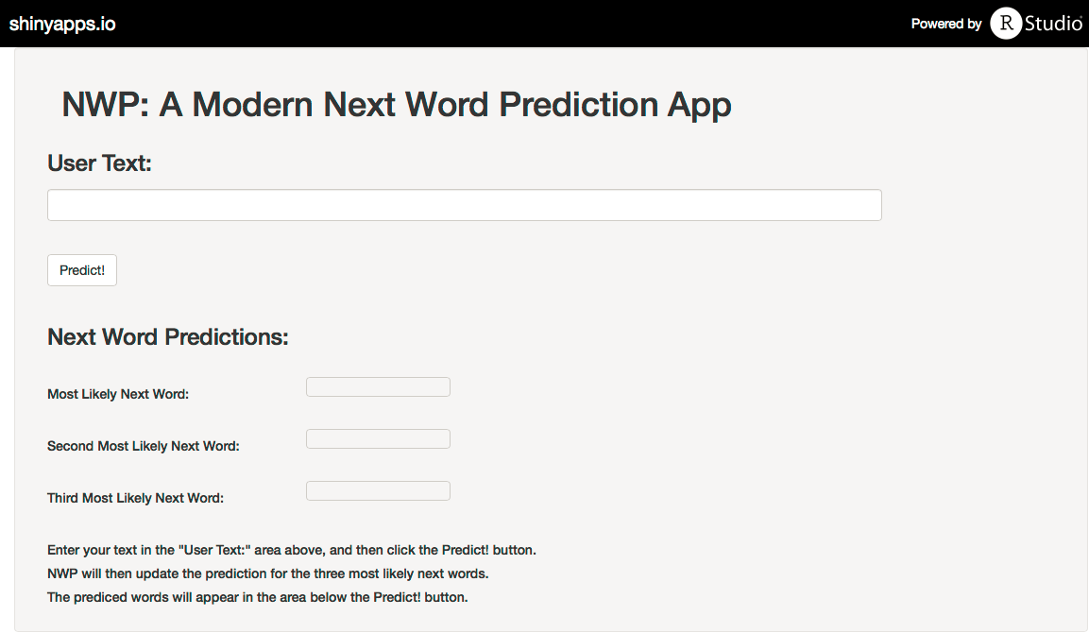
NWP Interface and Use
Simple interface. Enter your text in the “User Text:” area and hit the “Predict!” button. That's all there is to it!

Slide 5
Algorithm Details
Training, Held-out and Test data subsets were taken from a corpus of 200 MB of blog data, 196 MB of news data and 159 MB of twitter data. Training was done with several sizes of training set and a 24 MB training set was selected, to maximize precision and performance, drawing randomly from the blog, news and twitter data.
Model Performance Results:
Training File Size (MB) | Model Processing Time (hours) | Vocabulary Size | Single-Occurance Word Count (words used for Unknown Modeling) | Perplexity
24 | 5.98 | 139,707 | 84,314 | 23,473

