Slide 1
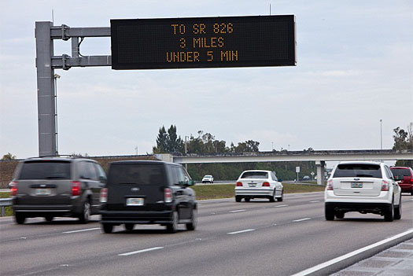
Travel Time-Based Performance Measures

Slide 2
Learning Outcomes
Define travel time and travel time reliability
Discuss the importance of travel time and travel time reliability
List performance measures related to travel time
Define the terms Cumulative Distribution Function and Probability Density Function and explain their use in measuring performance
Explain the use of the Travel Time Index and the Planning Time Index in measuring performance
Calculate performance measures from raw data
Discuss how decision makers use performance measures

Slide 3
Performance Measures
Defined as statistically based evidence used to track the progress towards preset objects
Used in a variety of disciplines (health, business, etc.)
Name some non-transportation performance measures
In transportation, performance monitoring using performance measures has become essential under the Moving Ahead for Progress in the 21st Century Act (MAP-21)
Notes:
Performance measures are defined as statistically based evidence used to track the progress towards preset objects. Performance measurement is not just used in transportation, many other fields such as health, business, and economics have performance measures.
Some examples include: blood pressure (the doctor may tell you your blood pressure is to high and tell you a certain blood pressure you should get to. In business it could be the amount of sales for a certain product.
Many DOTS have been performance monitoring, but with MAP-21, states and Metropolitan Planning Organizations (MPO) will need to start measuring the performance of their transportation facilities if they want to receive federal funding.

Slide 4
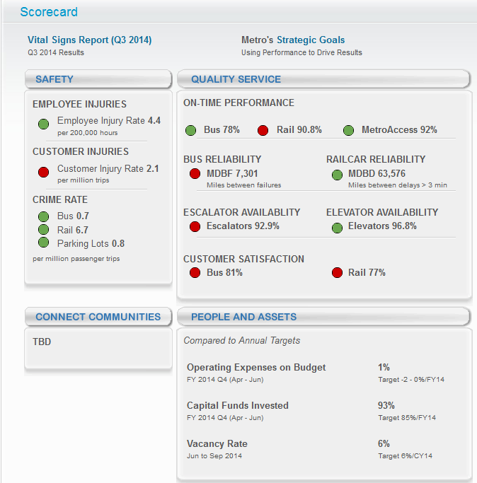
Transportation Performance Measures
Every aspect of transportation engineering has a set of performance measures to keep track of how well facilities operate.
WMATA.com (12/16/2014)
Notes:
Pretty much every aspect of transportation engineering has a set up performance measures to get an idea how well a facility is operating. The Washington Metropolitan Area Transit Authority produces a score card with several metrics such as elevator availability and customer satisfaction. The state of Maryland produced an annual Attainment Report of Transportation System Performance. The specific figure shown is a graph of percent of roadway miles with acceptable ride quality over time. WMATA and Maryland are measuring different facilities with different metrics, but they are both keeping track of measurements and have targets for those measurements.

Slide 5
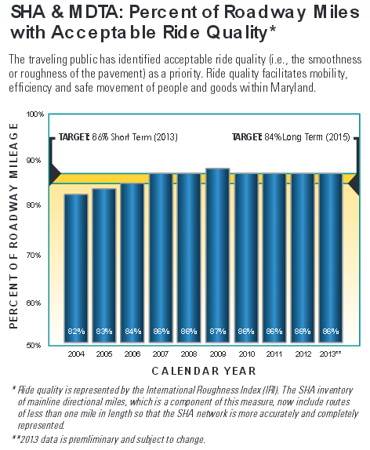
Transportation Performance Measures
Maryland’s 2014 Annual Attainment Report of Transportation System Performance
Notes:
Pretty much every aspect of transportation engineering has a set up performance measures to get an idea how well a facility is operating. The Washington Metropolitan Area Transit Authority produces a score card with several metrics such as elevator availability and customer satisfaction. The state of Maryland produced an annual Attainment Report of Transportation System Performance. The specific figure shown is a graph of percent of roadway miles with acceptable ride quality over time. WMATA and Maryland are measuring different facilities with different metrics, but they are both keeping track of measurements and have targets for those measurements.

Slide 6
What is Travel Time and Travel Time Reliability?
Travel time (how long it takes to get from A to B) is a measure of the impact of recurrent (repeatable) congestion
Travel time reliability (how the time it take to A to B can vary) is a measure of the impact of non-recurrent (non-repeating) congestion
Recurrent congestion is caused by commuter traffic, shopping traffic, etc.
Non-recurrent congestion is caused by unanticipated events such as crashes, special events, weather and construction
Notes:
There are many different definitions of travel time, but essential it is the time it takes to get from A to B. When you keep track of travel time for a certain facility throughout the day and year you can see the impact of recurrent congestion on that facility. With the same travel time data, you can see how reliable travel times are. That is, when traffic is worse than usual, how bad it can get. Recurrent congestion is often due to rush hour conditions, while non-recurrent congestion is due to unanticipated events such as car crashes.

Slide 7
Why are Travel Time and Travel Time Reliability Important?
Travel time and travel time reliability are transportation system measures of mobility
These two measures are extremely important to travelers and shippers
Transportation costs are influenced by the values of travel time and travel time reliability
They are among the most significant transportation performance measures
They are usually based on travel time percentiles which often follow statistical distributions
Notes:
Travel time and travel time reliability are important in transportation because they inform you when you need to leave if you need to get somewhere at a certain time. If you need to get to work by 9 am, you don’t just pick a random time to leave your home, you figure out how long it takes to get there and give yourself a little bit of extra time in case something happens. This information is used by individuals and businesses who rely on transportation. They also inform on how well a facility is operating. Poor travel time and travel time reliability can negatively influence travel costs. These type of performance measures are usually based on travel time percentiles which follow statistical distrubtions.

Slide 8
Performance Measures Based on Travel Time
Copious amounts of travel time data made available through third-party vendors have allowed DOTs to utilize travel time/speed for their performance measures
These performance measures quantify travel time and travel time reliability in a way that the performance of facilities with different lengths and or capacity can be compared using the same metric
Notes:
Using travel times for performance measurement used to be a challenge for DOT since the data wasn’t easily available. It often required expensive infrastructure along the roadway. We will go over third-party travel time data vendors in a few slides. These performance measures quantify travel time and travel time reliability that are intrinsic, thus values are scalable for a short roadway, long roadway, and even a large network.

Slide 9
Terminology – Statistics
Probability Density Function (PDF) – describes the likelihood that a variable will assume a (range of) given value(s).
Cumulative Distribution function (CDF) – the probability that a variable with a given distribution will assume a value less than or equal to a given value.
Notes:
Before we get into some sample travel time performance measures, we have to quickly go over some statistical functions.
Probability density functions (PDF) show values of a certain variable on the x axis and likelihood of occurrence of those values on the y axis. Cumulative distribution functions (CDF) are similar to PDFs, except the y axis show the probability of values being less than or equal to the x value. CDFs are significant to applications concerned with travel time reliability. Its use as an indicator of the quality of flow for signalized arterials, is also being explored. Since the PDF and CDF are closely related, it is important to understand both.

Slide 10
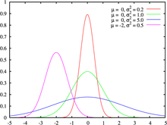
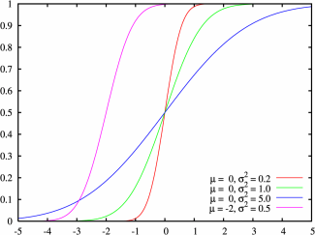
PDF CDF Examples
Probability Density Function (PDF): Plots of several hypothetical normal distributions with various means (µ) and variance (σ²). For transportation applications, horizontal axis could represent various travel times while vertical axis could represent the probability of their occurrence.
Cumulative Distribution Function (CDF): The CDF is a plot of the same data as the PDF. Curves with the same colors represent the corresponding PDF plot. These curves indicate the probability that the travel time will be less than or equal to the value on the X axis.
Notes:
The PDF and CDF curves are particularly significant to engineers and planners concerned with a transportation system’s reliability. The lower the variance (σ²), the more reliable the system. In other words, the probability of travel times at their mean value is the highest. In the curves above, the most reliable system would be the one represented by the red curve; a narrower PDF and a more vertical CDF.
The symbol (µ) represents the mean (or average) value of the distribution. The symbol σ² represents the variance or the spread of the curve.
The PDF curve shows the probability of various travel times (or whatever variable is on the horizontal axis) occurring. The CDF shows the probability that the travel time will be equal to or less than the value on the horizontal axis. Curves with the corresponding colors represent the same data.
It must be emphasized that the shapes of the PDF’s and CDF”s shown here are for normal probability distributions. Other probability distributions for travel time are possible (and even likely). These examples are presented only to explain the concept of PDF and CDF. For an actual travel time distribution, the values on the horizontal axis would be quite different. These curves show a mean (average) value of zero at the center of the horizontal axis with negative values to the left and positive values to the right. In an actual travel time curve, the zero value would be replaced with the average travel time of the roadway in question.
Source of graphics: “Information About Normal Distribution” http://english.turkcebilgi.com/normal+distribution

Slide 11
The Probability Density Function
Notes:
Two different PDFs are shown here with differing widths – also known as standard distributions. The narrower PDF (red) is an indication of reliable operation since there is a lower variation in travel times. This narrower PDF has a lower standard deviation. The wider PDF represents an unreliable operation with a higher PDF. If these two curves both represent the same facility, they could be representative of a before and after study for which measures were taken to improve the reliability of the facility – such as implementation of a freeway service patrol.

Slide 12
Cumulative Distribution Function
Notes:
The cumulative distribution functions (CDFs) shown here, are plotted for exactly the same data as the curves on the previous slide. The difference is that CDF shows the probability that the travel time will be less than or equal to the value on the x axis, whereas the PDF shows the probability that the travel time will be equal to the value on the x axis. Comparing the CDF curves with the PDF curves which are plotted in corresponding colors shows that the narrower the PDF distribution, the more vertical the CDF distribution. In other words, both curves show the same information. The more vertical CDF distribution implies a more reliable system. As a result, the buffer time and planning time indices will both be closer to 100% and 1.0 respectively.

Slide 13
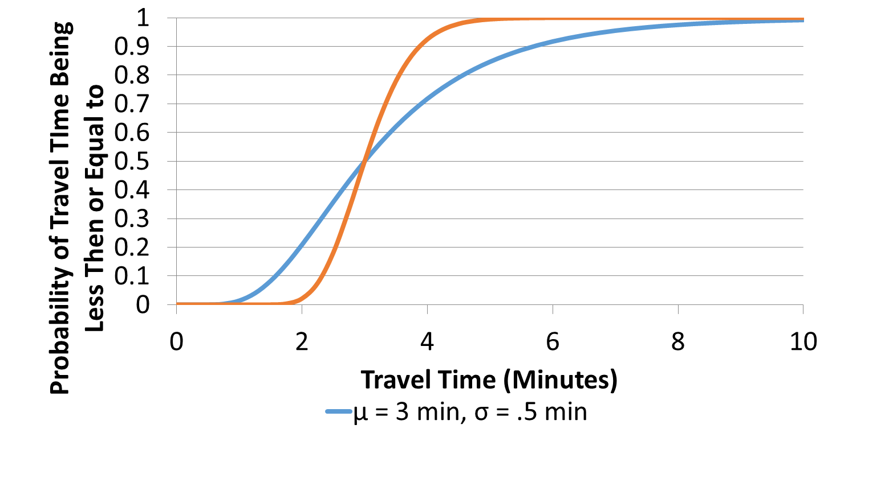
Using Values from CDFs for Performance Measures
Percentiles from the CDF along with free flow travel time are used to calculate several different type of performance measures
95th Percentile
DOTs either create their own or use commonly adopted performance measures, which ever meet their needs
See the next few slides for the performance measures many jurisdictions use
Notes:
Most travel time performance measures are based off the percentiles take from the CDF along with the free flow travel time. Free flow travel time is often considered the travel time during the middle of night or the 15th percentile travel time. DOTS have the choice to create their own performance measures or use common performance measures that the FHWA and many other jurisdictions adopted.

Slide 14
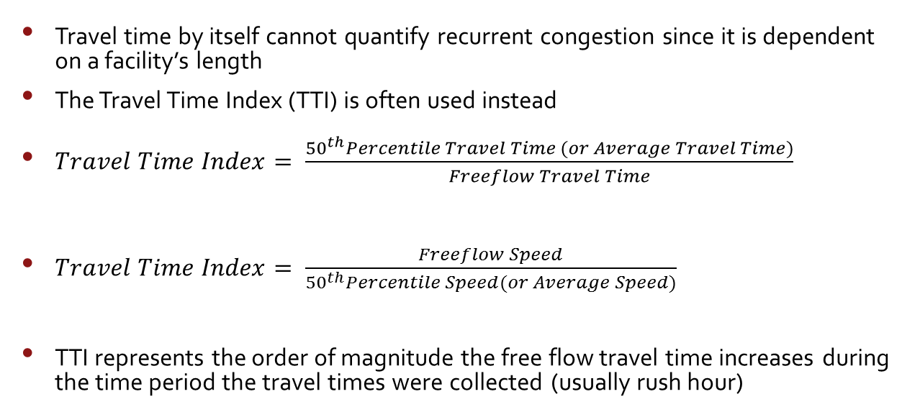
Travel Time (Index)
Travel time by itself cannot quantify recurrent congestion since it is dependent on a facility’s length
The Travel Time Index (TTI) is often used instead
TTI represents the order of magnitude the free flow travel time increases during the time period the travel times were collected (usually rush hour)
Notes:
Since travel time is not intrinsic, it cannot be used alone as a measure of recurrent congestion. TTI is used instead. It is a multiplier than can be applied to freeflow travel time to show how much longer it takes to get through a facility during a certain time of the day. TTI essentially measures recurrent congestion. Congestion you expect to see everyday. The 50th Percentile Speed/Travel Time or Average Speed/Travel Time can be used as long as it is specified.

Slide 15
TTI Questions
The less a roadway’s TTI is, the _____ the road suffers from recurrent congestion
If the free flow travel time on your commute to work is 15 minutes and the rush hour TTI is 1.33, how long does it take you on average to get to work during rush hour?
Notes:
Less
20 minutes

Slide 16
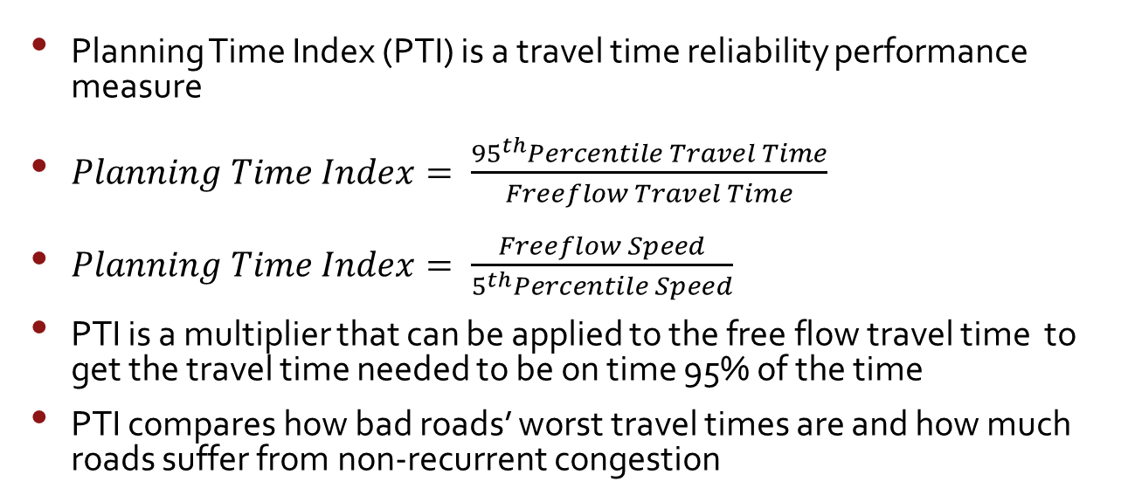
Planning Time Index
Planning Time Index (PTI) is a travel time reliability performance measure
PTI is a multiplier that can be applied to the free flow travel time to get the travel time needed to be on time 95% of the time
PTI compares how bad roads’ worst travel times are and how much roads suffer from non-recurrent congestion
Notes:
Planning time index or PTI measures how reliable a roadway is. If a roadway is unreliable, it suffers from a lot of non-recurrent/unexpected congestion such as bad weather or traffic incidents. It is a multiplier applied on the free flow travel time to estimate how much time you need to allow to arrive to your destination on-time 95% of the time.

Slide 17
PTI Questions
The greater a roadway’s PTI is, the _______ reliable a roadway is
Can a roadway have a relatively high PTI and low TTI?
Notes:
Less
Yes, if the travel times PDF has a long right tail (low re-current congestion with high non-recurrent congestion)

Slide 18
Calculate the PTI and TTI* if the free flow travel time is the 15th percentile
* Use 50th percentile travel time for calculating TTI
Notes:
15% Percentile = 16 minutes
50% Percentile = 37 minutes
95% Percentile = 56 minutes
PTI= 56/16 = 3.5
TTI = 37/16 = 2.3

Slide 19
Where does data come from?
Travel time data can come from a variety of sources from devices along roadways to cell phone/ GPS data collected by third party vendors (vehicle probe data)
The I-95 Corridor Coalition allows states to purchase third party travel time with a set a tools used to use the travel time data
This initiative is called the Vehicle Probe Project
Notes:
Travel time data must be obtained from somewhere. It can be collected from devices planted inside, on top, or on the side of roadways. This is expensive and requires constant maintenance. These days, many departments of transportation buy travel time data from third party vendors who aggregate data from cell phones, GPS devices, and other electronic devices in cars or trucks. The I-95 Corridor Coalition, a group of transportation organizations on the east coast, purchase data from third party vendors with the Vehicle Probe Project. This data comes with a set of tools embedded in the VPP Suite to use the data.

Slide 20
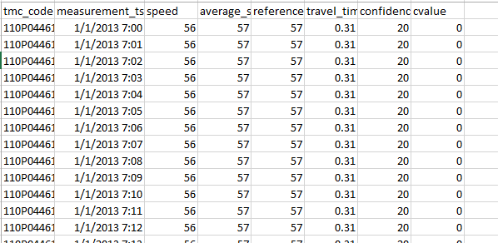
Calculating PM from Raw Data
This data come from the I-95 Corridor’s Vehicle Probe Project Suite Massive Raw Data Downloader
Data comes in tables
TMC_Code identifies a certain stretch of road
Measurement-tstamp refers to when the speed reading was taken
Speed is the speed of traffic at the time stamp on the stretch of road (MPH)
Average_speed is the average speed of the stretch of road during that time period throughout the year (MPH)
Reference_speed is the free flow speed the stretch of roadway (MPH)
Travel_time is the travel time derived from the speed reading (minutes)
Confidence_score and cvalue refer to the accuracy of the speed data.
Notes:
The VPP Suite can calculate TTI and PTI, but it is important to know the process behind the calculation. Using the VPP-Suite Massive Raw Data Downloader, you can download speed/travel time data for a given region for a given period of time. TMC_Code refers to traffic message channel, which identifies a certain stretch of road. Measurement-tstamp (time stamp) is the moment in time the speed/ travel time readings were recorded. Speed is the prevailing speed of the TMC segment at the time stamp. Average_speed is the expected speed is the average speed for the TMC segment for the time period throughout the year. Reference_speed is the freeflow speed of that TMC segment. Travel_time is speed reading converted to travel time. Confidence_score and cvalue estimate how well the speed/ travel time reading reflected the actual conditions during the time period. A confidence score of 30 means that the speed measurement was based on real time data. A confidence score of 20 means that the speed measurement was based on a combination of real time and historical/trend data. A confidence score of 10 means that the speed measurement was based on mostly historical data. When traffic is light and there is not many vehicle probes on the road, third party vendors used historical data (data from previous readings during the same time of data) to fill in the gaps. The cvalue refers to the probability that the speed/travel time reading reflected actual conditions during the time period. If the confidence score is not 30, the cvalue with automatically be 0. Each third party vendor has a different way of measuring accuracy.

Slide 21
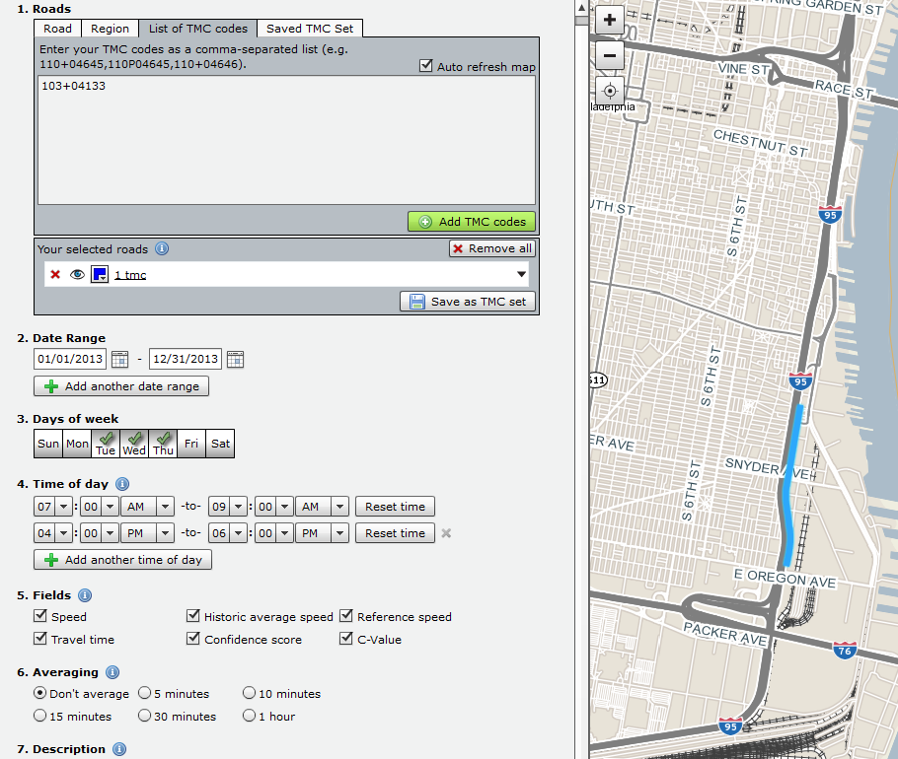
1. Download Data
What geography?
What date range?
What days of the week?
What time of day?
Which fields?
What granularity?
Notes:
Before calculating the performance measures, you first download the raw data, which can be done in the Vehicle Probe Project Suite Massive Raw Data Downloader.
The tool will prompt you to specify geography. You have the option for selecting geography by road (NB I-85 from exit 34 to 38), region (all of Hudson County, New Jersey), or by specific one-way segments (TMC codes).
You then must select the time period. Different studies warrant different time periods. If you are studying congestion going to the beach, then you might only select Thursday and Friday afternoons from Memorial Day to Labor Day. If you are studying rush hour congestion through the year, you would select Tuesday-Thursday every week of the year from 7am to 9 am and 4 pm to 6 pm.
You might not need all the fields discussed from the previous slide. In that case you can deselect them, reducing file size. Averaging the data set gives you less data points, but also shrinks down the data set.
For the following example and the project, non-averaged rush hour data for all of 2013 on single segments were used. This was done to give enough data for a meaningful analysis while minimizing file size. Large file sizes are useable, but not in excel. It is not common to analyze one (TMC) segment at a time.

Slide 22
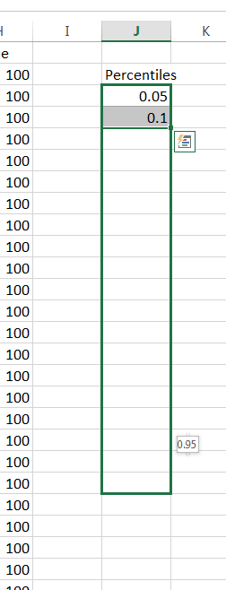
2. Create Percentiles
Open the data up in MS Excel
Save as an Excel File
Create a column of the percentiles you want Excel to calculate
5% granularity is advisable because most percentile based performance measures are divisible by 5
Notes:
Open your dataset in excel. The VPP data is in a CSV file, so make sure when you are opening the file up in excel, select “All Files” instead of the default “All Excel Files”. After you open the file up, save it as an excel file. In a column to the right of the data, create a column of the percentiles you want excel to calculate. Since most performance measures are divisible by 5%, so it is advisable to use 5%/.05 granularity. For larger files, excel cannot be used. Other tools such as Matlab or custom programs must be used.

Slide 23
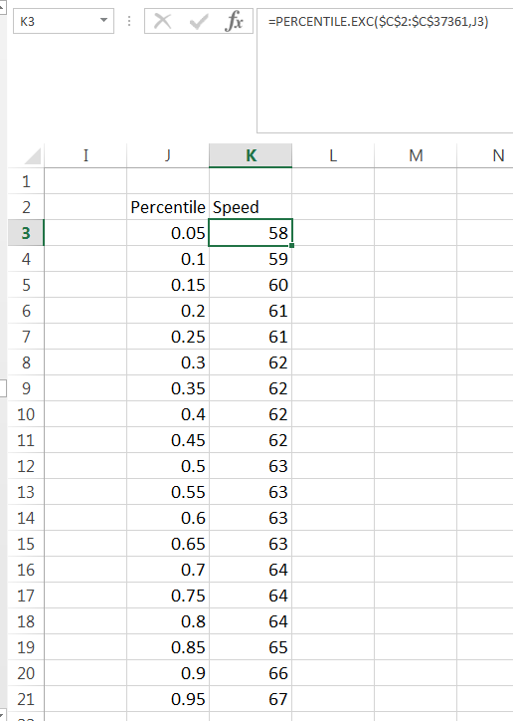
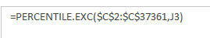
3. Calculate Percentiles
Use Excel’s PERCENTILE.EXC command which calculates percentiles based on a selected array
Don’t forget to use ‘$’ when referring to the array
If you had travel time data for a given period of time, how could you calculate performance measures?
(Speed/Travel Time Array, Percentile)
Notes:
If you select the travel times with the percentile.exc command and specify which percentile you want, excel with give you percentile values. The first value of the command is the array that excel will calculate percentiles from. For calculating performance measures, it is the speed column. Travel time can also be used as well. Don’t forget to use ‘$’ when referring to the array to disable relative referencing. The second value excel wants you to specify is which percentile you want to calculate. In this case, it is the cell to the left with the percentile.
Answer: (This is discussed in the next slide, but this is a good opportunity to see if students are listening) Calculate 5th percentile and 50th percentile using the percentile.exc command along with the reference. Calculate TTI and PTI with the 50th percentile, 5th percentile, and the free flow travel time. TTI= FF travel time/ 50th %ile travel time PTI = FF travel time/ 5th %ile travel time

Slide 24
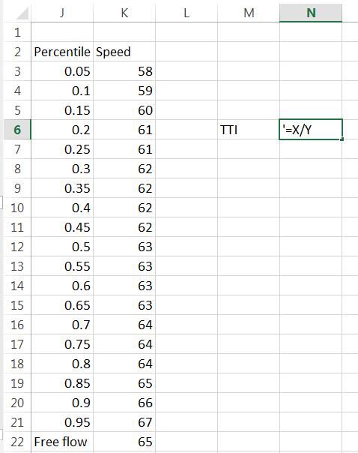
Calculate Performance Measures
To calculate percentile-based performance measures simply plug in the percentiles calculated into the performance measure equation
Free-flow travel time can be given or assumed (85th percentile, reference speed, speed limit, etc.)
What would the TTI be? (X & Y)
Notes:
Calculating percentile-based performance measures is easy once you calculated the percentiles. Simply recreate the performance equation into an empty cell using the calculated percentiles. Free-flow speed is often needed. It is either given or assumed to be the 85th percentile, the reference speed on VPP, or the speed limit.
How would you calculate TTI using these calculated percentiles?
Answer: It would be the Freeflow Speed (or 85th percentile speed) over the 50th Percentile Speed. That is K22/K12 (or K19/K12). Both of those equal 1.03. That is an uncongested TTI value.

Slide 25
Using Performance Measures
If performance measures are available for a whole roadway network, it gives decisions makers information of which parts of the transportation network are operating well and which need investment to improve operations
If a particular stretch of roadway is monitored before and after an improvement, the resulting performance measures can show if the improvement was justified
Notes:
Performance measures can be used in a variety of different ways. If a whole region has performance measures available for one point in time, it helps decision makers charged with allocating money make tough choices on which improvement projects to approve. With leaner infrastructural funding, performance measures help use money for efficiently. If performance measures are available on a select corridor of roadway before and after an improvement project, the change of performance measures can show if the improvement was justified.

Slide 26
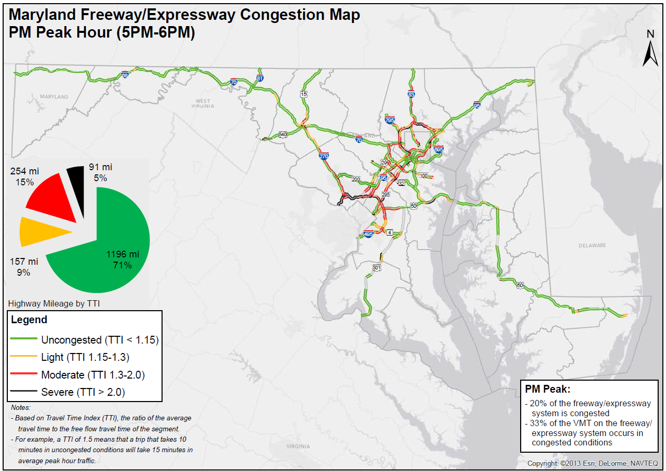
Performance Measure Application Example (General Awareness)
What are some areas with bad congestion?
Source: 2013 Maryland Mobility Report
Notes:
The state of Maryland through their Annual Mobility report uses performance measures on Maryland’s freeway network and some arterial roadways. This provides engineering staff, the public, and politics information on how Maryland roadways are operating. Based on this map, which areas have bad recurrent congestion during the PM rush hour?
Capital Beltway, Baltimore Beltway, roads leading out of the Washington DC area.

Slide 27
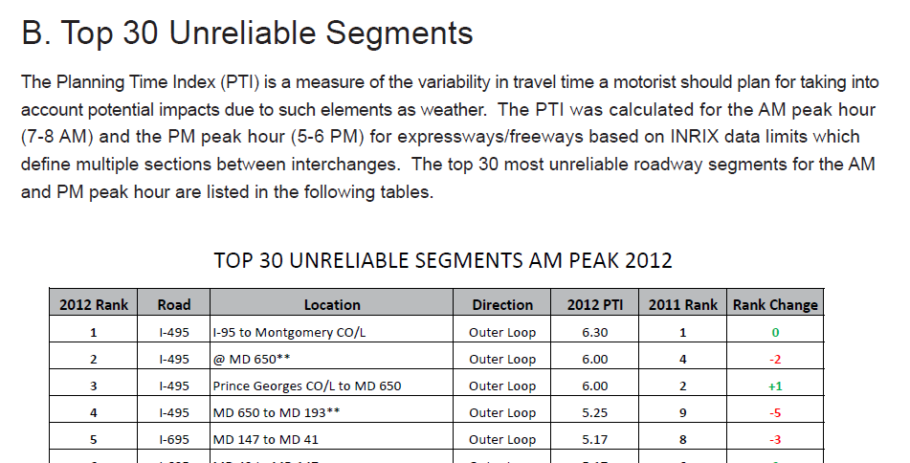
Performance Measure Application Example (Investment Prioritization)
Rankings of the worst segments in an area help decision makers focus on key areas
Engineering judgment, politics, and policy also play a role
Source: 2013 Maryland Mobility Report
Notes:
Having the entire major highway/freeway system in a jurisdiction ranked by performance measures helps decision makers choose specific areas that need investment. While performance measures are key in making decisions, engineering judgment, politics, and policy plays a role. For example, if a particularly bad bottleneck occurs in an area on the edge of a suburban area, decision makers might not want to invest in fixing in the bottleneck for fear of encouraging more development and creating induced demand (increase in vehicles because of an improved facility). On the other hand, decision makers might want to focus on fixing a minor bottleneck somewhere else to encourage growth.

Slide 28
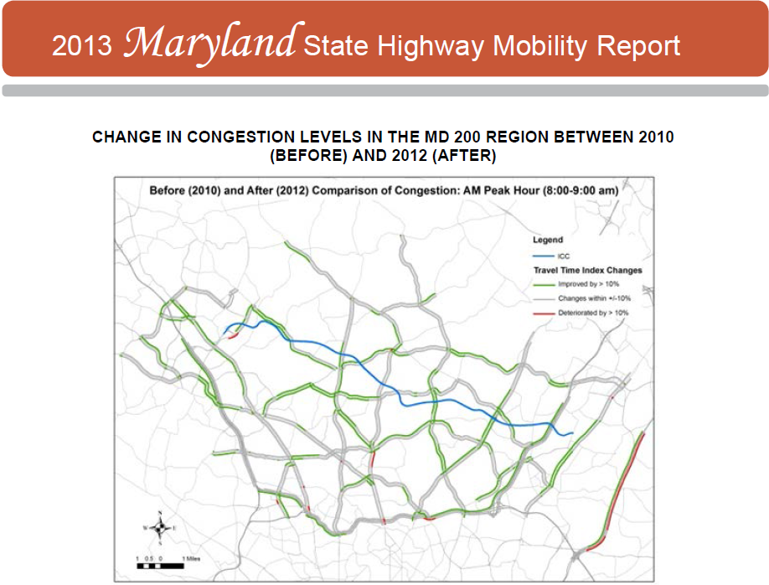
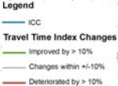
Performance Measure Application Example (Investment Justification)
Source: 2013 Maryland Mobility Report
Notes:
The Intercounty Connector (ICC, MD-200), a tolled freeway that runs between Montgomery County and Prince George’s County Maryland, was mostly completed before Thanksgiving in 2011. This map shows how the travel time index (TTI) changed in the vicinity after most of the ICC was open. This helped decision makers justify the initial investment into the ICC.
Did some areas get a worse TTI?
Yes, there are a few red areas, which indicate an increase in TTI.

