Slide 1
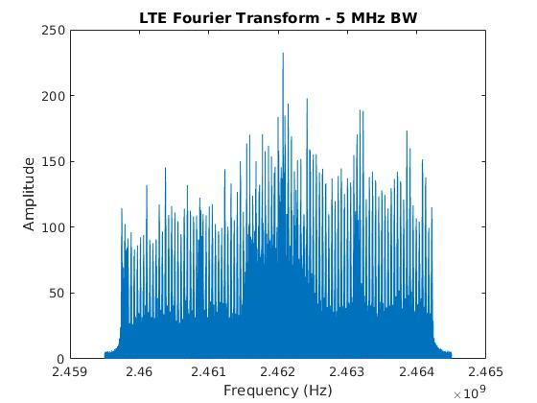

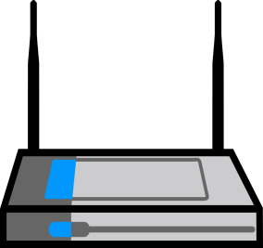



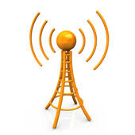

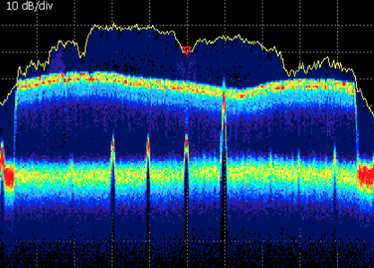
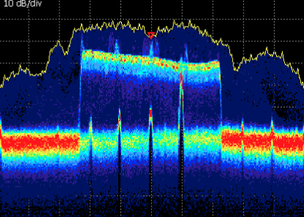
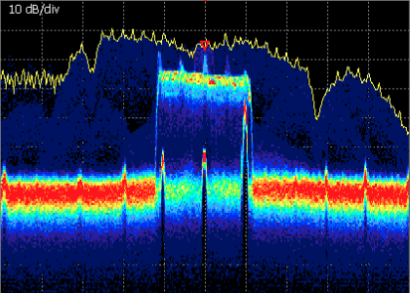
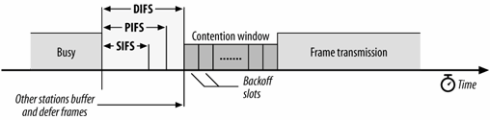
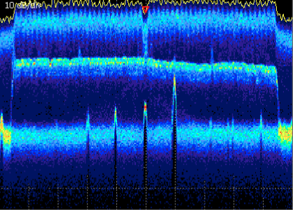
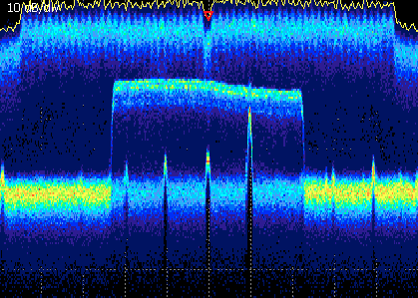
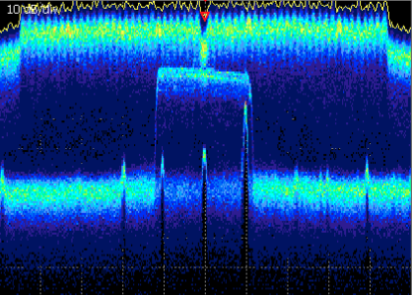
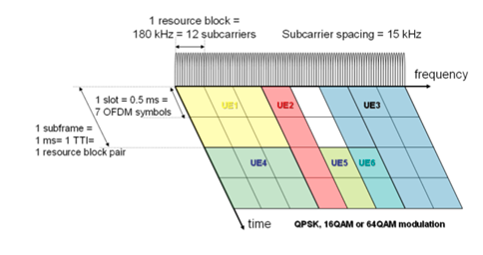

Experimental Evaluation of Co-existent LTE-U and Wi-Fi on ORBIT
Samuel Baysting - sbaysting@winlab.rutgers.edu
Acknowledgments: Shweta Sagari, Wade Trappe, Ivan Seskar
Problem Definition
Experimental Procedure
Observation
Proposed operation of LTE in unlicensed band (LTE-U) : possible coexistence with Wi-Fi networks
Coexistence leads to interference
Objectives:
Experimental evaluation of Wi-Fi in the presence of LTE-U
To characterize the Wi-Fi throughput
To help to construct a solution for coordination between Wi-Fi and LTE-U
Hardware and Software
Parameters
LTE signal: lightly loaded (control signals only, no data, power assigned only at few frequency subcarriers) as shown in FFT of LTE signal
20-60% throughput decrease in Wi-Fi throughput when LTE is present
ORBIT Testbed
USRP Software Defined Radios (SDR)
Open Air Interface FPGA software to broadcast LTE-U[3]
Iperf Linux software to measure throughput
WLAN Channel 11 (2462 MHz Center Freq)
Saturated Traffic Conditions
SISO 802.11n Wi-Fi 20 MHz Bandwidth
LTE-U 5, 10 and 20 MHz Bandwidths
Wi-Fi
LTE-U
eNB-AP distance (variable) range = [1,20]m
AP-Client distance (fixed) = 0.25m
FFT of LTE collected on USRP node
As the distance between Wi-Fi and LTE increases, lesser effect of LTE interference on Wi-Fi and increase in Wi-Fi SINR and throughput
Similar throughput performance at Wi-Fi when LTE = {5 MHz, 10 MHz, 20 MHz}
Packet aggregation at 802.11n: higher occupancy of channel compared to 802.11g; due to LTE control signals, which are periodic in time, only few data units gets corrupted in a single Wi-Fi transmission; thus higher throughput is achieved for 802.11n compared 802.11g
LTE eNB
Wi-Fi AP
Wi-Fi Client
LTE-U
Wi-Fi
Results
Theory and Modeling
Spectrum Analyzer screenshots with only LTE-U transmitting
Conclusion
Bianchi’s Wi-Fi Model [2]
If the channel is busy, Wi-Fi waits to transmit
Once the channel is clear, it waits for the DIFS time
In the contention window, it waits for a random amount of time
After the random time has passed, it transmits the data
After data transmission, it waits for the SIFS time and sends the acknowledgment
20 MHz LTE
10 MHz LTE
5 MHz LTE
802.11n Wi-Fi reacts less to control signal LTE-U interference than 802.11g Wi-Fi [1]
Introduction of LTE-U in unlicensed bands degrades throughput in both 802.11n and 802.11g without a coordination solution
Future Work
Throughput evaluation of LTE-U in the presence of Wi-Fi interference
Develop a protocol to coordinate LTE-U with other unlicensed technologies based on known interference data
[2]
Spectrum Analyzer screenshots with LTE-U and Wi-Fi transmitting
20 MHz LTE 20 MHz Wi-Fi
10 MHz LTE 20 MHz Wi-Fi
5 MHz LTE 20 MHz Wi-Fi
LTE Scheduling
Divided into resource blocks
A resource block is allocated in the frequency and the time domain
Allocations are based on the type of data transmitted
Literature Cited
Analytical vs. Experimental Wi-Fi Throughput with LTE-U
Wi-Fi Throughput with LTE-U at 5, 10 and 20 MHz bandwidths
1. Sagari, S., Baysting, S., Saha, D., Seskar, I., Trappe, W., Raychaudhuri, D. (2015). Coordinated Dynamic Spectrum Management of LTE-U and Wi-Fi Networks. IEEE Dynamic Spectrum Access Networks Conference.
2. Bianchi, G. (2000). Performance analysis of the IEEE 802.11 distributed coordination function. IEEE Journal on Selected Areas in Communications, 18(3), 535-547.
3. OpenAir5G LAB. (n.d.). Retrieved from http://openairinterface.eurecom.fr/
4. Celtic San. (n.d.). Retrieved from http://celtic-san.com/2014/07/29/mac-and-scheduling/
[4]
Analytical Model
SINR – Signal to Interference Noise Ratio
Rx – Received power
I_{L} – Received power from LTE to Wi-Fi client
N₀ - Noise
WINLAB
Notes:
1

