Slide 1
Stencil Guidelines
2020 v2

Slide 2
Box with text
Use case
Text
Text
Text
Box with text
Text
Text color
Text color
Box color
Box color
Out line Box with text
Color Box
Box with text and icon
Physical Storage
1
2
3
4
5
6
7
8
9
10
11
12
13
Text
Group boxes
Box with outline
1
2
3
4
5
6
7
Shapes
8
9
10
11
12
13
1
2
3
4
5
Use the above provided shapes only. Use only flat colors for the shapes and use the color from the color palette only.
Do not use Gradients, Drop shadows, Reflections and 3D effects.

Slide 3
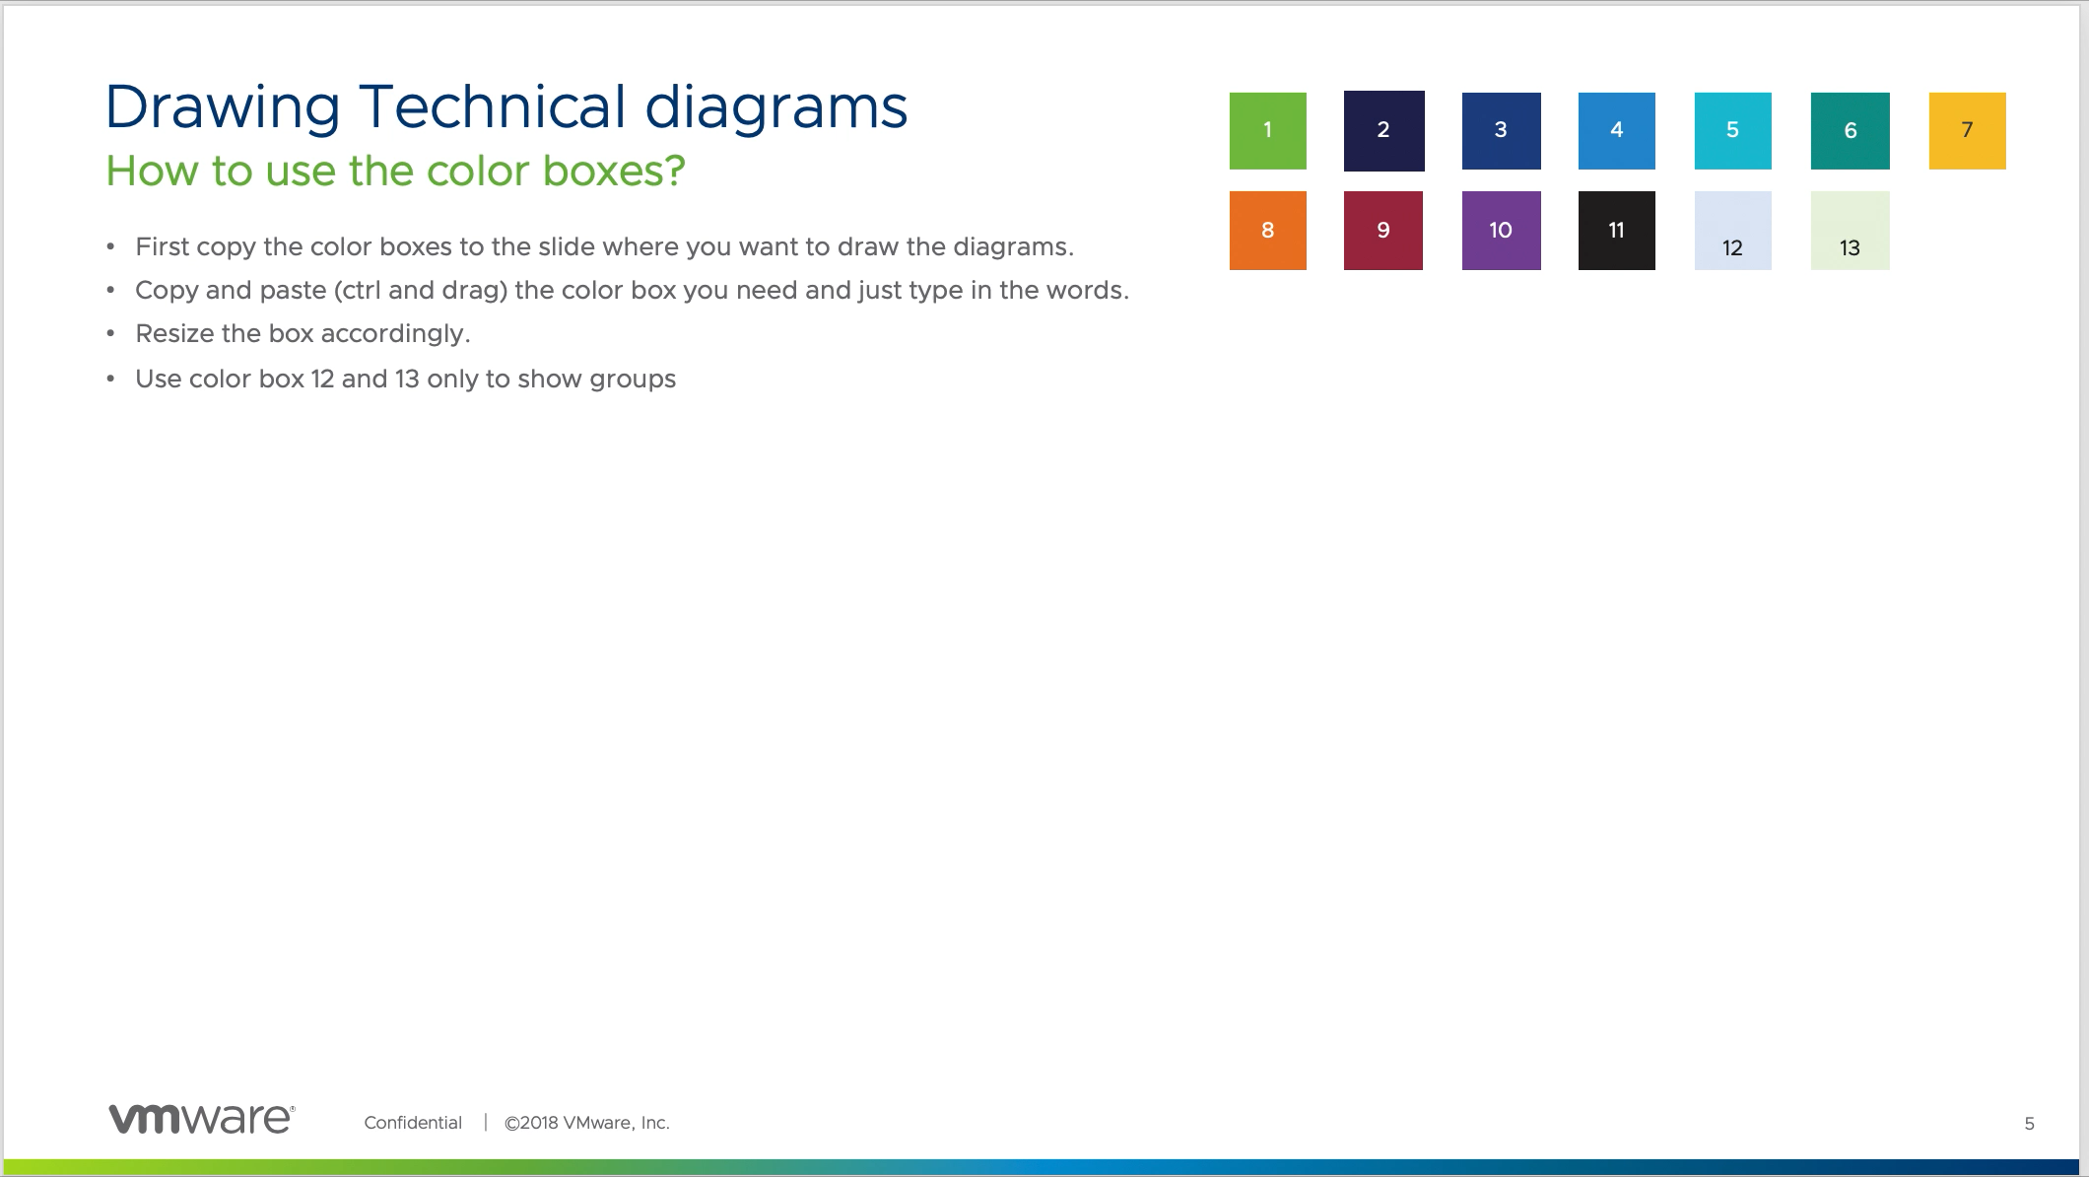
Drawing Technical diagrams
1
2
3
4
5
6
7
How to use the color boxes?
8
9
10
11
12
13
First copy the color boxes to the slide where you want to draw the diagrams.
Copy and paste (ctrl and drag) the color box you need and just type in the words.
Resize the box accordingly.
Use color box 12 and 13 only to show groups
Source site
Use case for box 12 and 13
Group 1
Group 2
Source site
Source site
Source site
Source site
Run the ppt to see this animation

Slide 4
Arrows
Use case
Use this connector to show the connections
Text
Use arrow connector to show the data flow
Text
Arrow types
Single sided arrows
Text
Text
Double sided arrows
Text

Slide 5
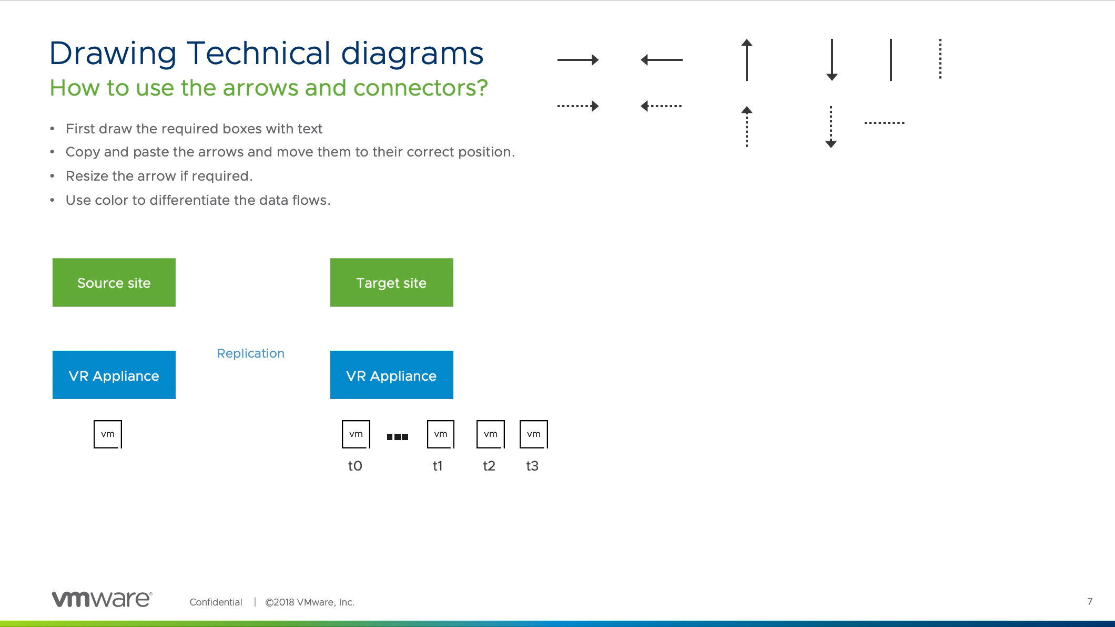
Drawing Technical diagrams
How to use the arrows and connectors?
First draw the required boxes with text
Copy and paste the arrows and move them to their correct position.
Resize the arrow if required.
Use color to differentiate the data flows.
Source site
Target site
VR Appliance
Replication
VR Appliance
t0
t1
t2
t3
Run the ppt to see this animation

Slide 6
Icons and Legend box
Use case
Use icon along with labels for easy identification.
Client Device
Physical Storage
Physical Storage
Legend 1
Legend 2
With in color box
Stand alone icons
External Network
DMZ
Load Balancer
Please refer sides from slide no 14 for approved set of icons.
If you require any new icons please contact the graphic team.
Unified Access Gateway appliance
Horizon Server
Icons and Legend box
Microsoft Active Directory
ESXi hosts running Virtual Desktop Virtual machines
vCenter Management Server
Legend 1
Legend 2
Use the legend box when you what to show case multiple connection types.

Slide 7
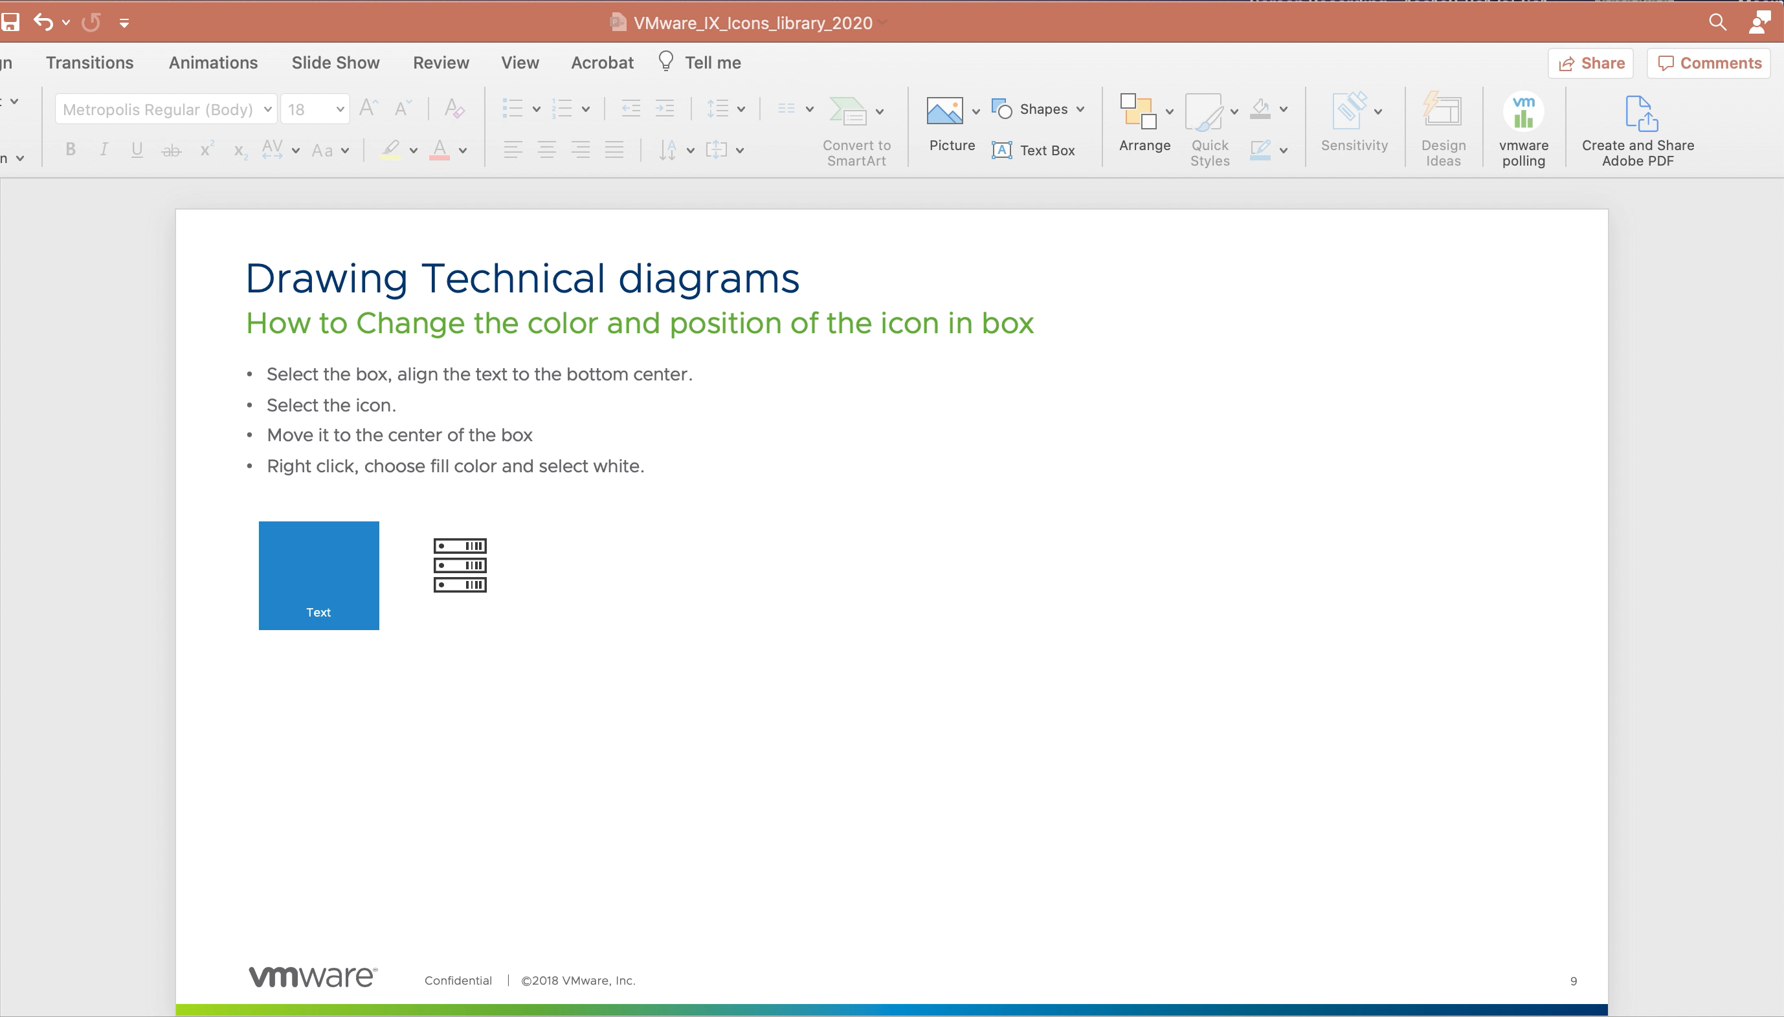
Drawing Technical diagrams
How to Change the color and position of the icon in box
Select the box, align the text to the bottom center.
Select the icon.
Move it to the center of the box
Right click, choose fill color and select white.
Text
Run the ppt to see this animation

Slide 8
Drawing Technical diagrams
How to apply arrow and box style to custom shapes
Select the box or the arrow style you want to apply and double click the Format painter icon and the click the custom shape
2
12
Source Site
Source Site
Source Site
Source Site
Run the ppt to see this animation

Slide 9
Sample Diagram
Technical diagrams
Source site
Target site
Replication
VR Appliance
VR Appliance
t0
t1
t2
t3

Slide 10
Diagram sample
Flow chart
Start
Create an upgrade spec for
vCenter Server Appliance
Create a history migration spec
Run the vCenter server upgrade
By using the API and check
Whether the upgrade is
successful
Paus the historical data import
Or get the data import status
End

Slide 11
Diagram sample
Diagram using icons
Client Device
Legend 1
Legend 2
External Network
DMZ
Load Balancer
Unified Access Gateway appliance
Horizon Server
Microsoft Active Directory
vSphere ESXi Hosts
Enterprise Certificate Authority

Slide 12

Iconography
Use these icon for creating technical diagrams
Desktop
Laptop
Mobile
Rack Server
Rack Storage
Servers
Server
Hard Disk
Data Center
Data Base
virtual Switch
Memory
Physical NIC
CPU
Ethernet Plug
SSD
Scsi Controller
Horizon Icon
p to v Gateway
Load Balancer
NSX Manager
Consumption Plane
NSX controller
PSC
Reservation icon
Car
Mobile Tower
Book
NSX CSM
VMC
Key
VPN
Template
VCOPS
Blue Print
AW DB Server
AD/LDAP
SMTP Server
Enterprise CA
Web Browser
Vmware Cloud Solutions
Log Files
SaaS
On-Prem
vRealize Operations
vCloud Availability
Action-Based Extensibility service
VMC Sizer and TCO tool
Resource Pool
AW API
HCX Network Extension
HCX WAN Interconnect
HCX WAN Optimization
VNFC
AirWatch Cloud Messaging
ENS
Airwatch
AW Console API
Thin-App /RSA/DNS/DC

Slide 13
Iconography
Use these icon for creating technical diagrams
Public Cloud
Site container
VM Server
Router
VXLAN
Service Provider Cloud Environment
Datastore
NSX DLR Control
Infrastructure
Virtual Machine
Firewall
Switch
Virtual App
Virtual Appliance
Networking
Cog
NSX
Alert
Folder
User
Group
Local Building
vCenter Server
USB
Security
Disc
Data Protection
Code Stream
Cloud Assembly
vShield
Identity
Keyboard
Mouse
Wi-Fi
On-demand
self-service
File
Wavefront
Cloud Director
vRealize Orchestrator
vROps
vcloud extender
vRealize Log Insight
vREalize Cost Insight
Discovery
HCX
PKS
Pulse IOT
Pivotal
Secure State
vRealize Service Broker
vSphere Replication
NSX-T
NSX
NSX-V

Slide 14

Iconography
Use these icon for creating technical diagrams
Site Recovery
VMware Cloud
vRealize Automation
vRealize Business
vRealize Suite
CloudFoundation
Cloud on Dell EMC / Dimension
Calendar
License
Alignment
vRealize Log Insight
Workspace ONE
Kubernetes
App Defense
vSAN
Cloud Native Apps
Cloud PKS
App
vRealize Orchestrator
vRealize Network Insight
vAPP
Application Container
vSphere Replication
Clock
vSphere Update Manager
VMware Tanzu
SnapShot
ser
v
er

