Slide 1
Energy

Slide 2
Overview
Conservation of energy
Types of energy
Examples

Slide 3
Conservation of Energy
Energy is neither created or destroyed, it can only be transformed into other forms of energy.

Slide 4
Energy
Four main types
Mechanical
Thermal
Electrical
Chemical

Slide 5
Mechanical Energy
Either kinetic (KE) or potential energy (PE)
Describes pure movements of objects
(not related to density changes as with thermal)
Examples:
Ball bouncing
Roller coaster
Coin falling
Movement of gears
Bicycle (Chemical -> Mechanical)

Slide 6
Thermal Energy
Movement of thermal energy (heat) throughout objects/films
Also causes movement of liquids with density changes
Densities of some liquids change with temperature
Usually called heat transfer in engineering
Examples:
Air conditioner
Boiling water
Hot air
Solar rays (radiation)

Slide 7
Electrical Energy
Energy which powers electrical equipment
Usually causes an actuator to cause an energy change
Examples:
Motor uses battery to move car (electrical -> mechanical)
Dry cell battery

Slide 8
Chemical Energy
Energy in foods and sugars
All living things eat to transform their food into chemical energy
ATP transports chemical energy to each cell
Examples:
Pizza
Milk
Food
Electrolytes

Slide 9
Cons. of Energy (CoE) - Example #1: KE
Box
v = 10 m/s

Slide 10
Cons. of Energy (CoE) - Example #2: PE
Coin
Building
h = 50m

Slide 11
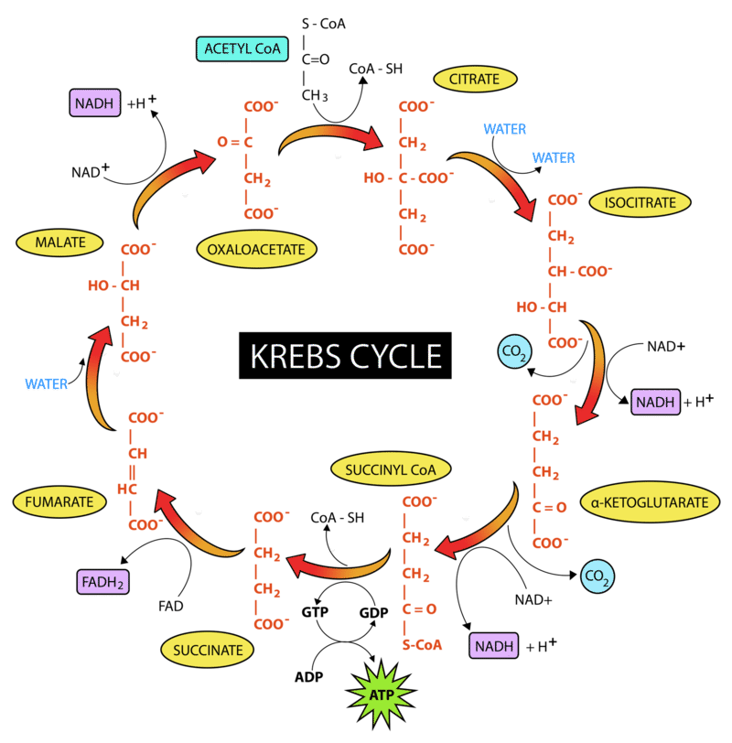
Cons. of Energy (CoE) - Example #3: ATP Production

Slide 12
Cons. of Energy (CoE) - Example #4: Roller Coaster
1
3
h [m]
2
H [m]
0 [m]

