Slide 1

Welcome to
ENGR 3080:
Technical Communication for Engineers
ENGR 3080, Technical Communication for Engineers

Slide 2
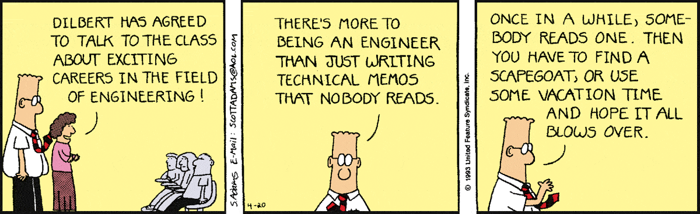
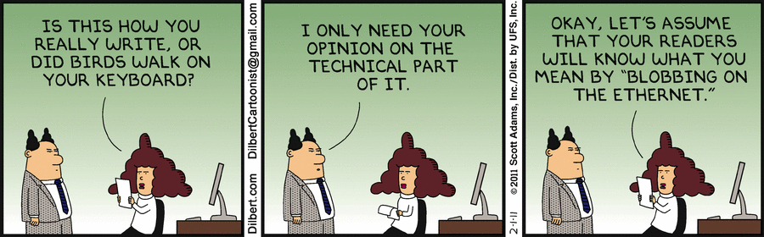


Slide 3
A Dose of the Real World
Chad Hymel
ASME website
“When I first started interviewing, I found that the interviewers were not especially interested in my technical knowledge. A few of the interviewers even told me that. They assumed that since I was graduating with a decent GPA, that I had the technical background necessary to be a successful mechanical engineer. What they wanted to know was what type of person I was. Could I communicate plainly? Could I write my thoughts in a clear and concise manner? Was I a team player? Was I a hard worker? These are the skills that make an organization's team successful.”

Slide 4

Written and Verbal Communication
Memos
Emails
Proposals
Reports
Site visits
Bug reports
Progress reports
Letters
Journal articles
Conference posters
Resumes
Presentations
Job interviews
Phone calls
Committee meetings
Team projects
Guest lecturer
Teach

Slide 5

The Myth:
There is Good With Math and
There is Good With Words –
There is no Both

Slide 6
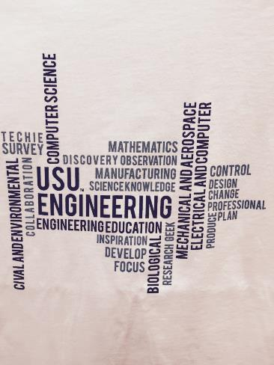
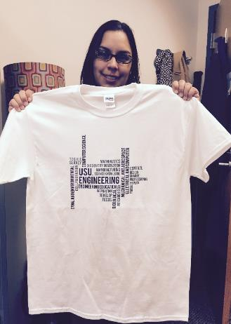
Engineering Week T-Shirt
ENGR 3080, Technical Communication for Engineers

Slide 7

Proofreading is not a myth
ENGR 3080, Technical Communication for Engineers

Slide 8
Communication Skills
in the Workplace
Up to 25% of a new engineer’s time is spent in the communication process. As the engineer moves up the managerial ladder, this time can increase to up to 80%.
ENGR 3080, Technical Communication for Engineers

Slide 9
The Top 15 Attributes Employers Seek in College Graduates
1. Problem-solving skills
2. Ability to work in a team
3. Communication skills (written)
4. Leadership
5. Strong work ethic
6. Analytical/quantitative skills
7. Communication skills (verbal)
8. Initiative
9. Detail-oriented
10. Flexibility/adaptability
11. Technical skills
12. Interpersonal skills (relates well to others)
13. Computer skills
14. Organizational ability
15. Strategic planning skills
National Association of Colleges and Employers, 2018

Slide 10
Some Basic Principles to Remember…..
1. Writing demonstrates your competence as an engineer.
“Flawed writing implies flawed engineering.” Why?
ENGR 3080, Technical Communication for Engineers

Slide 11
Your credibility is impacted by what you say
and what you write.
“Hydroelectric energy is one of the greatest sources for renewable energy and has been used for hundreds of years to help power our cities. Until now the use of damns has been the greatest source of this energy but this comes at a cost to the environment. The idea of putting turbines into water mains is a similar concept to a damn but instead of using the water from rivers and streams; it utilizes the energy in our pipes, and has no impact on the environment.” ENGR 3080 Student
ENGR 3080, Technical Communication for Engineers

Slide 12
Your credibility is impacted by what you say
and what you write.
“Hydroelectric energy is one of the greatest sources for renewable energy and has been used for hundreds of years to help power our cities. Until now the use of damns has been the greatest source of this energy but this comes at a cost to the environment. The idea of putting turbines into water mains is a similar concept to a damn but instead of using the water from rivers and streams; it utilizes the energy in our pipes, and has no impact on the environment.” ENGR 3080 Student
ENGR 3080, Technical Communication for Engineers

Slide 13
3. Engineers bear the responsibility of communicating.
After the Hyatt Regency walkway disaster in 1981, the commission investigating the failure reported:
The ambiguous communication between the structural engineer and the steel fabricator was identified in Missouri’s Administrative Hearing as a major factor in the disaster. The Commission report states that the structural engineer “bears the burden of communicating [their] intent to the contractor and assumes the risk of confusion or non-communication.” The report also states, “…the burden and responsibility for clear communication lies with the engineer who assumes the risk of ambiguity in [their] design drawings.”
https://safety.productions/2019/02/17/tea-dance-party-leads-to-disaster-the-hyatt-regency-walkway-collapse/
ENGR 3080, Technical Communication for Engineers

Slide 14
The Reality…..
More than 50% of the engineering projects that fail are due to communication issues—either verbally, in writing, or both.
ENGR 3080, Technical Communication for Engineers

Slide 15
Some Myths and Some Truths
The Myth: “I did not go into engineering to write.”
The Truth: Every engineering function has an associated communication component. To be an engineer or computer scientist is to be a technical writer and communicator.
ENGR 3080, Technical Communication for Engineers

Slide 16

Some Myths and Some Truths
The Myth: “Why do I have to take another English class?”
The Truth: Technical writing uses English language principles but is very different from a “typical” English class. Engineers have complicated stories to tell. This class will help you tell those stories.
ENGR 3080, Technical Communication for Engineers
Notes:
Forget most of what you learned about the writing process. Technical writing follows a very specific set of rules and guidelines.

Slide 17
Some Myths and Some Truths
The Myth: “My company will have technical writers who will do all of the writing for me.”
The Truth: Maybe, but they will not write for you. The goal is to make you “writers of technical information” not technical writers.
ENGR 3080, Technical Communication for Engineers

Slide 18




Some Myths and Some Truths
The Myth: “I’m not good at writing.”
The Truth: Writing is a process not an event and like any skill takes practice to improve.
ENGR 3080, Technical Communication for Engineers
Notes:
You will leave this class a better writer than when you began, but it takes a lifetime of writing to perfect the skill. The good news it is a skill and the more you do it, the better you will get.

Slide 19

Some Myths and Some Truths
The Myth: “Grammar does not apply in technical writing.”
The Truth: Misused grammar can lead to misunderstanding, loss of money, and critical failures.
A missing punctuation mark in a guidance equation led to the explosion of the
rocket carrying the Mariner 1 space probe shortly after liftoff on July 22, 1962, in
what is widely believed to the most expensive grammar mistake of all time.
NASA investigators traced the cause of the accident to the omission of a single
hyphen in the guidance control software, which transmitted a series of incorrect
course correction signals that threw the vehicle off its flight trajectory.
ENGR 3080, Technical Communication for Engineers
Notes:
You will leave this class a better writer than when you began, but it takes a lifetime of writing to perfect the skill. The good news it is a skill and the more you do it, the better you will get.

Slide 20
Some Myths and Some Truths
The Myth: “Technical writing is boring.”
The Truth: Technical writing is boring. Unlike creative writing, there is no plot, no emotion, no evocative language, no surprise ending, and no entertainment value.
ENGR 3080, Technical Communication for Engineers

Slide 21
What is a Professional?
ENGR 3080 students are in the Professional Program in the College of Engineering.
Now is time to start practicing being professional in your emails, networking, and interactions.

Slide 22

Email
Should only be used for company business when on company time
Requires thought and careful editing
Is not private
Often replaces verbal conversations—even when it should not
Should not be sent in the “heat of the moment”
An email is not the same as text; do not use text-style language.
Technical Communication for Engineers
Notes:
Be careful not to use company email for personal business. Who owns the information in an email sent on your organization’s server? The organization.
Some cautions about using email:
Email is not an informal means of communication (although many of us treat it as such). The same thought and editing should go into an email as anything else you write.
Email is not private.
Don’t rely on email for the sole means of communication. It shouldn’t replace face-to-face communication.
Many times emails are sent based on an initial reaction. Be sure to think carefully about what you are writing. Keep emotion out of your writing.
Emails and texts are used for different purposes. Be careful to keep text language out of emails.

Slide 23
Email Format
Open with a greeting (Dear); if the person is familiar, the greeting can be omitted
Never start a professional email with “hey.”
Write the message body in complete sentences
Include a closing (Thank you, Sincerely, Best)
Add a signature block (your name, title, and complete contact info)
Technical Communication for Engineers
Notes:
Walk through email format

Slide 24

Not Appropriate
hey
i woke up with the scratchy flu-y stuff that is going around. probs shouldn’t share this. did i miss anything important. can i do any extra credit to make up for my absence.. Sorry if there are any typos in this message (LOL).
Technical Communication for Engineers
Notes:
Sample email received from a student.

