Slide 1
Target
Use the same push button to shutdown the system and to restart it without unpligging power supply
Principals
If system is up, send 3.3V on a GPIO PIN to detect when button is pushed to shutdown the system (init 0)
If system is dow, send 3.3V on RESET PIN to restart the board
To switch between RST PIN and GPIO PIN, we gonna use a 2 position relay
0 : circuit to RST
1 : circuit to GPIO PIN (lets say GPIO4 on header PIN16)
We’re going to control the relay with an other GPIO (lets GPIO5 on header PIN18)

Slide 2
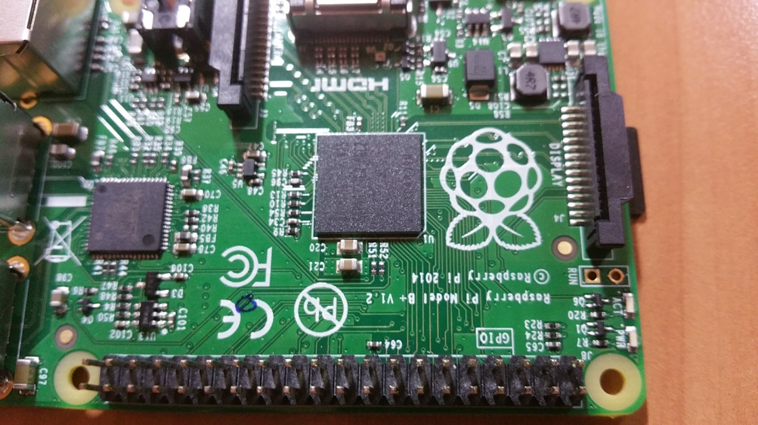
Setup the board
By default the Rasp board have a RST pin but it's not sold out. Up to you to solder a pin on the board. It's between the GPIO connectors and the display connector
It’s the 2 small holes with pills to solder :
One is +3.3V the one is RESET
+3.3V
RESET

Slide 3
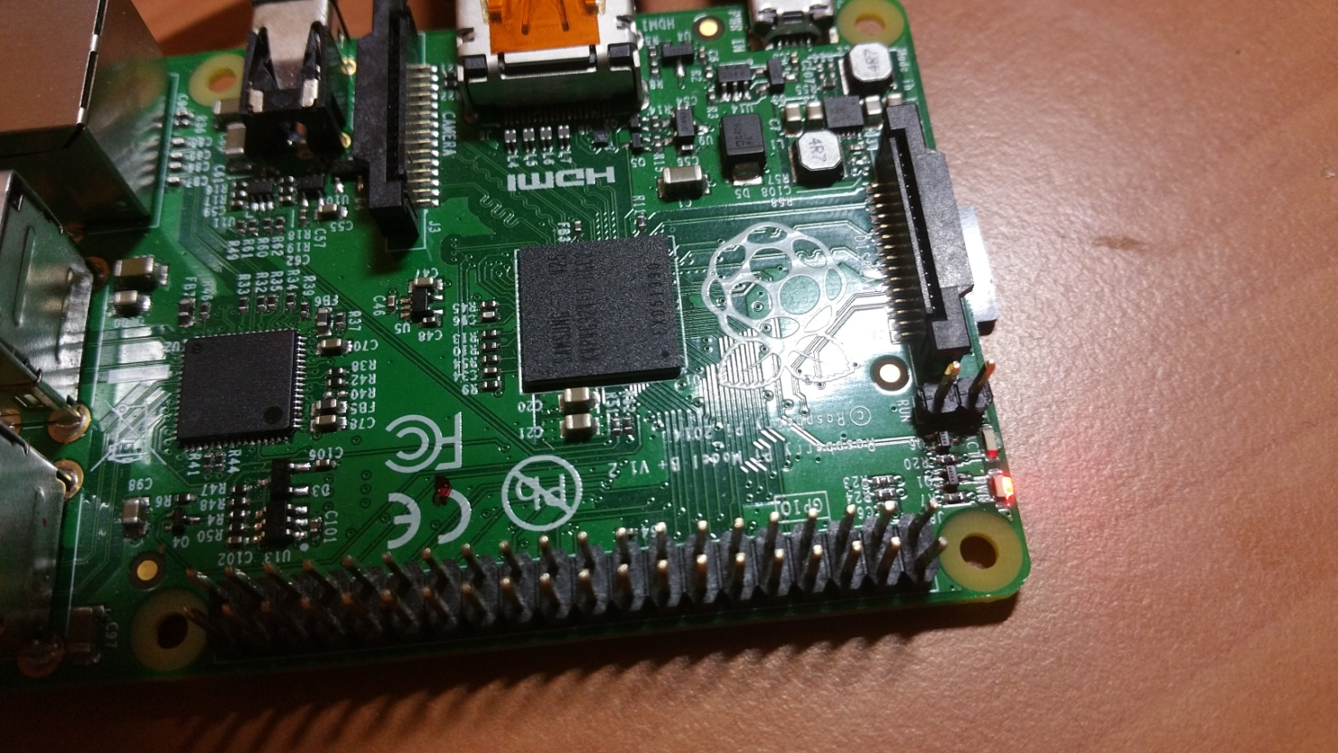
Setup the board
After jour job, it should look like this

Slide 4

Schematic
GPIO5
(PIN 18)
GPIO4
(PIN 16)
1
VCC 3.3V
0
GND
Reset PIN

Slide 5
Main code
First of all, install wiringPI http://wiringpi.com/download-and-install/
Script to run at startup (daemon)
#!/bin/bash
RELAY_GPIO=5
BUTTON_GPIO=4
trap stopRelay 1 2 3 6 9 14 15
function stopRelay(){
gpio write $RELAY_GPIO 0
exit 0
}
gpio mode $RELAY_GPIO out
gpio mode $BUTTON_GPIO in
gpio write $RELAY_GPIO 1
while [ 1 ] ; do
BUTT=`/usr/local/bin/gpio read $BUTTON_GPIO`
if [ $BUTT -eq 1 ] ; then
while [ $BUTT -eq 1 ] ; do
sleep 0.2
BUTT=`/usr/local/bin/gpio read $BUTTON_GPIO `
done
echo init 0
fi
done
Create a service (init.d script) from /etc/init.d/skeleton

