Slide 1
CRM v2 — A Beginner's Walkthrough
A guided tour of the platform, built directly from the live product pages, the route map, and the implementation docs — so what you see here is exactly what you get in the app.
Generated: 5/17/2026, 11:27:26 PM
CRM v2 Executive Walkthrough

Slide 2
The Big Picture
• It replaces scattered sales activity with one connected journey: find a prospect, qualify them, raise an RFQ, win the quote, and keep the customer.
• Growth engines (ABM, email campaigns, web discovery) feed straight into execution engines (tasks, meetings, pipeline control) — no copy-paste between tools.
• Every action leaves a trace, so day-to-day work turns into measurable signals you can actually report on and improve.
CRM v2 Executive Walkthrough

Slide 3
How To Read Each Slide
• Start with Where it fits — what problem this page solves in the customer journey.
• Look at What this page does for a plain description of the screen's job.
• Use Try this in the demo as the two clicks worth showing live.
• Wrap with Why it matters — the change in speed, quality, or conversion.
• The small Built into the product footer proves the route and docs really exist.
CRM v2 Executive Walkthrough

Slide 4
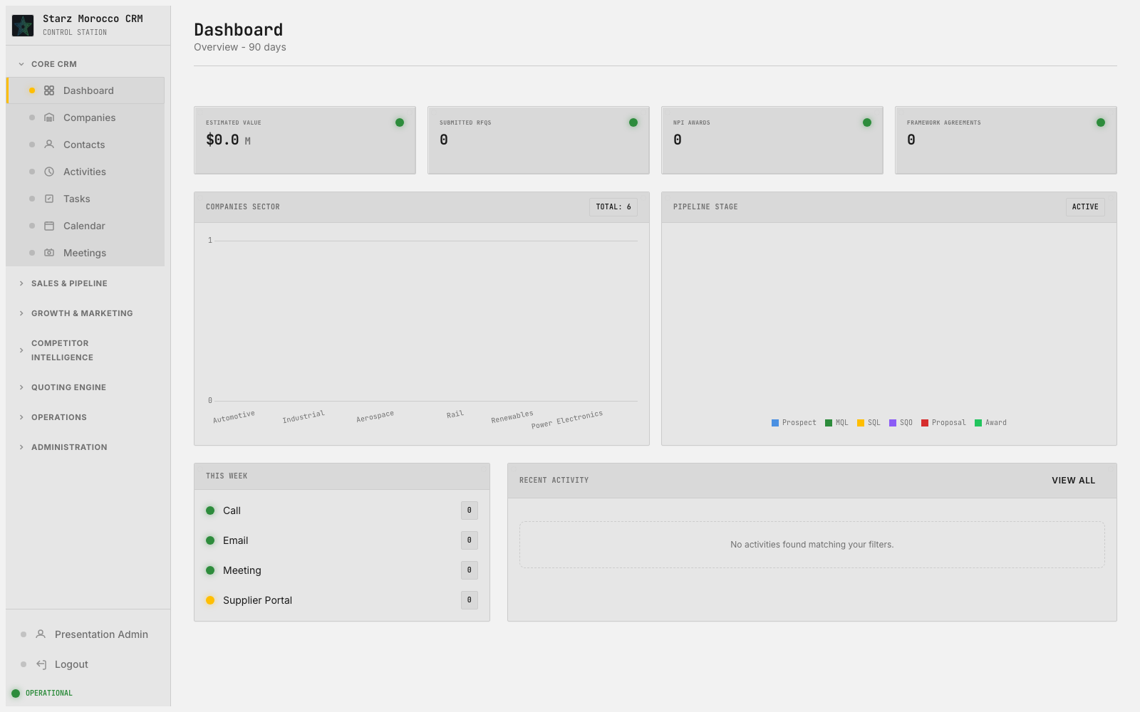
01. / — Dashboard
Module: Executive Dashboard (Cross-module KPIs)
Module Purpose: The morning cockpit — one screen that shows whether sales, marketing, and operations are healthy today.
On-screen header: Overview - 90 days
Where it fits: Start here in the morning — it’s the one screen that tells you whether the business is healthy today. The morning starting point — it pulls pipeline health, reminders, and conversion trends together so leaders know where to focus first.
What this page does: The morning starting point — it pulls pipeline health, reminders, and conversion trends together so leaders know where to focus first.
Try this in the demo:
Why it matters:
• Scan pending lead approvals, at-risk RFQs, and the task backlog before deciding what the team should tackle today.
• Compare today’s KPIs to last week or last month — the gap tells you whether to push discovery, outreach, or quote closure.
• No new records are created here — the value is in seeing every module on one screen so priorities are obvious.
• Leadership reacts faster when conversion or activity drifts off target.
CRM v2 Executive Walkthrough

Slide 5
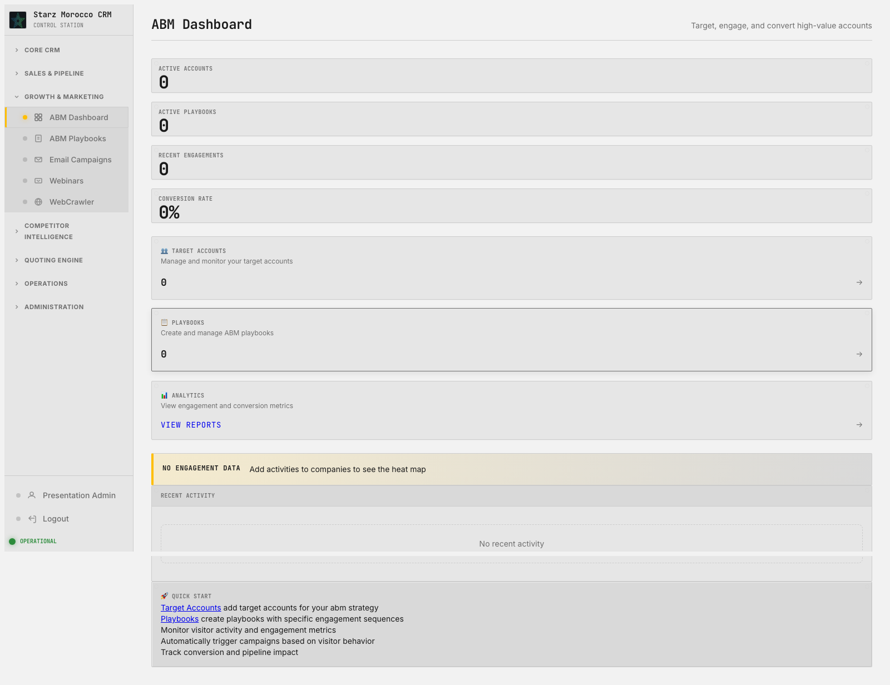
02. /abm-dashboard — ABM Dashboard
Module: ABM Workspace (ABM Account/Playbook)
Module Purpose: Pick the handful of accounts that really matter and coordinate the plays that win them.
On-screen header: Target, engage, and convert high-value accounts
Where it fits: The strategic targeting happens here, before a single outreach dollar gets spent. The ABM control room — pick the accounts that really matter, orchestrate the plays that win them, and watch progress against the strategic target list.
What this page does: The ABM control room — pick the accounts that really matter, orchestrate the plays that win them, and watch progress against the strategic target list.
Try this in the demo:
Why it matters:
• Rank accounts by fit, engagement, and buying signals before launching account-specific plays.
• Link account view with playbook view so the strategy on paper turns into the actual next outreach.
• Saves the ABM account and playbook state that campaign targeting and account-level reports rely on.
• Focus shifts to high-value opportunities instead of high-volume but low-fit activity.
CRM v2 Executive Walkthrough

Slide 6
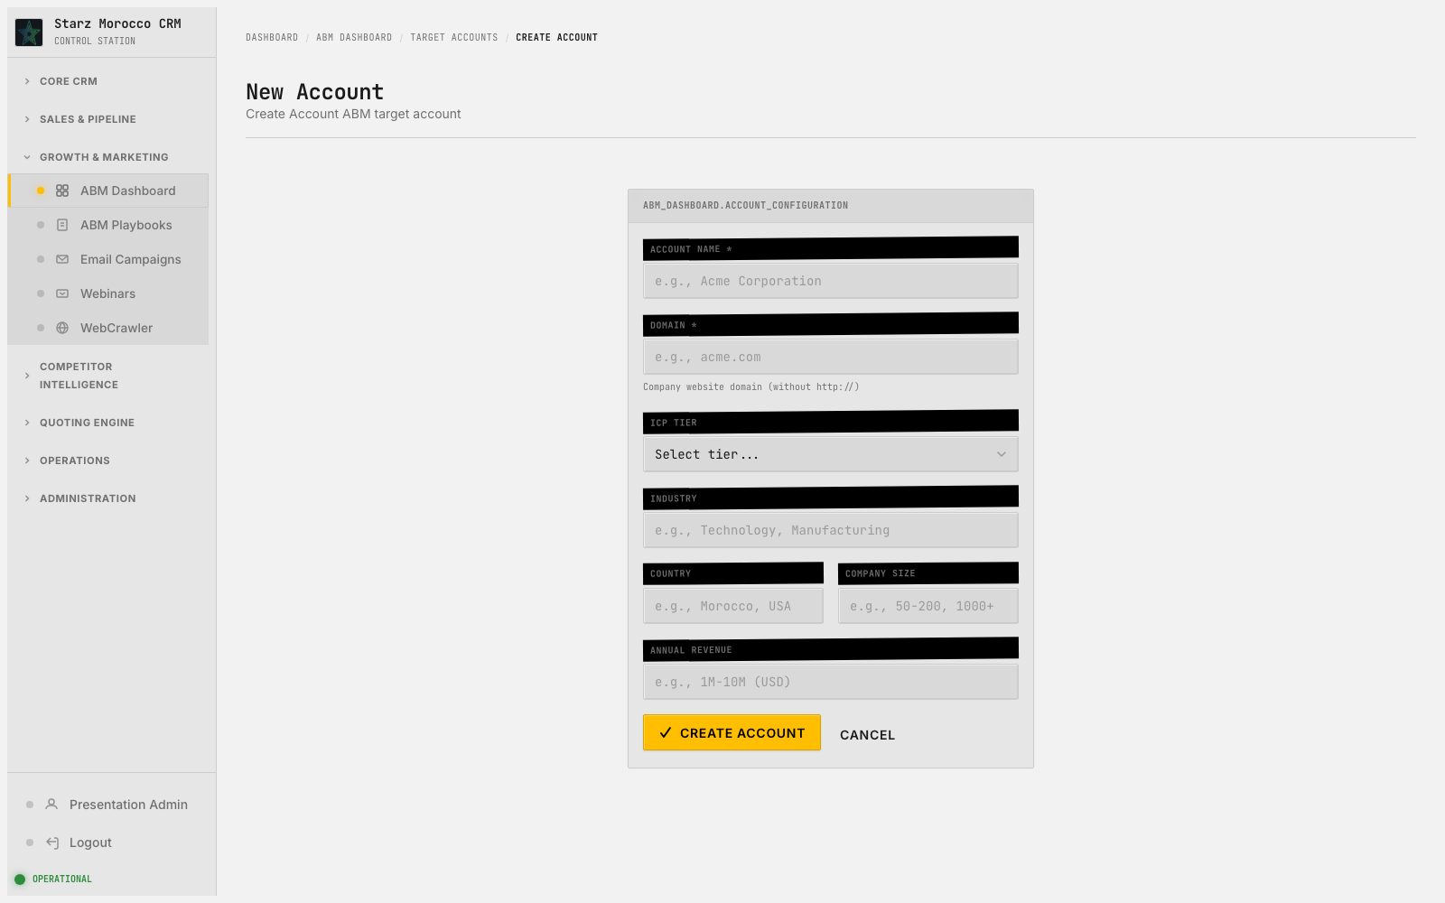
03. /abm-dashboard/account/new — New Account
Module: ABM Workspace (ABM Account/Playbook)
Module Purpose: Pick the handful of accounts that really matter and coordinate the plays that win them.
On-screen header: Create Account ABM target account
Where it fits: This is where the team decides which accounts deserve special focus and coordinated plays. The ABM control room — pick the accounts that really matter, orchestrate the plays that win them, and watch progress against the strategic target list.
What this page does: The ABM control room — pick the accounts that really matter, orchestrate the plays that win them, and watch progress against the strategic target list.
Try this in the demo:
Why it matters:
• Rank accounts by fit, engagement, and buying signals before launching account-specific plays.
• Link account view with playbook view so the strategy on paper turns into the actual next outreach.
• Saves the ABM account and playbook state that campaign targeting and account-level reports rely on.
• Focus shifts to high-value opportunities instead of high-volume but low-fit activity.
CRM v2 Executive Walkthrough

Slide 7
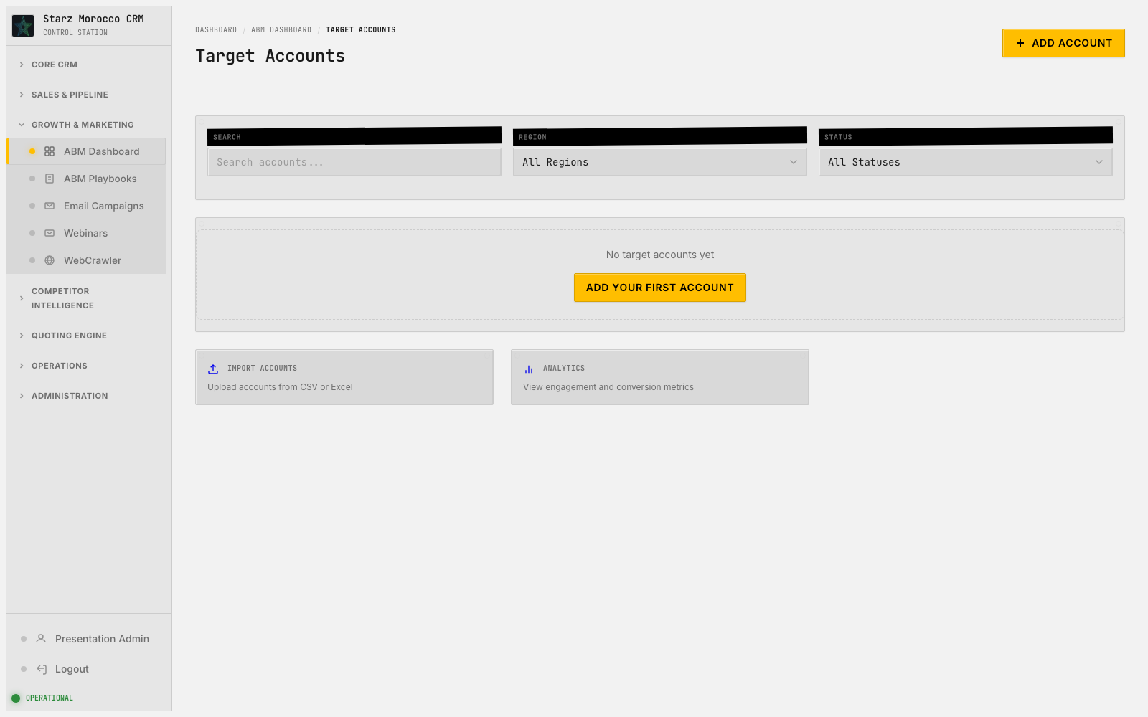
04. /abm-dashboard/accounts — Target Accounts
Module: ABM Workspace (ABM Account/Playbook)
Module Purpose: Pick the handful of accounts that really matter and coordinate the plays that win them.
Where it fits: This is where the team decides which accounts deserve special focus and coordinated plays. The ABM control room — pick the accounts that really matter, orchestrate the plays that win them, and watch progress against the strategic target list.
What this page does: The ABM control room — pick the accounts that really matter, orchestrate the plays that win them, and watch progress against the strategic target list.
Try this in the demo:
Why it matters:
• Rank accounts by fit, engagement, and buying signals before launching account-specific plays.
• Link account view with playbook view so the strategy on paper turns into the actual next outreach.
• Saves the ABM account and playbook state that campaign targeting and account-level reports rely on.
• Focus shifts to high-value opportunities instead of high-volume but low-fit activity.
CRM v2 Executive Walkthrough

Slide 8
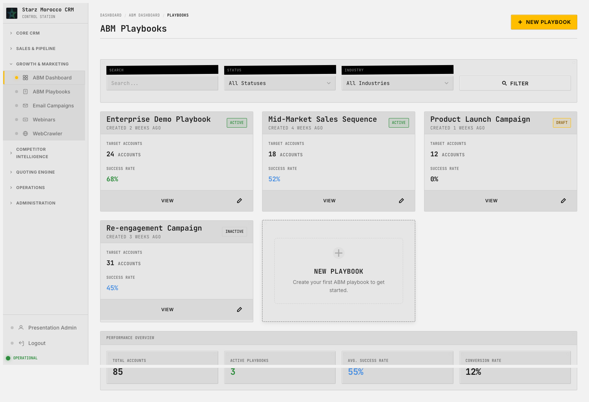
05. /abm-dashboard/playbooks — ABM Playbooks
Module: ABM Workspace (ABM Account/Playbook)
Module Purpose: Pick the handful of accounts that really matter and coordinate the plays that win them.
Where it fits: This is where the team decides which accounts deserve special focus and coordinated plays. The ABM control room — pick the accounts that really matter, orchestrate the plays that win them, and watch progress against the strategic target list.
What this page does: The ABM control room — pick the accounts that really matter, orchestrate the plays that win them, and watch progress against the strategic target list.
Try this in the demo:
Why it matters:
• Rank accounts by fit, engagement, and buying signals before launching account-specific plays.
• Link account view with playbook view so the strategy on paper turns into the actual next outreach.
• Saves the ABM account and playbook state that campaign targeting and account-level reports rely on.
• Focus shifts to high-value opportunities instead of high-volume but low-fit activity.
CRM v2 Executive Walkthrough

Slide 9
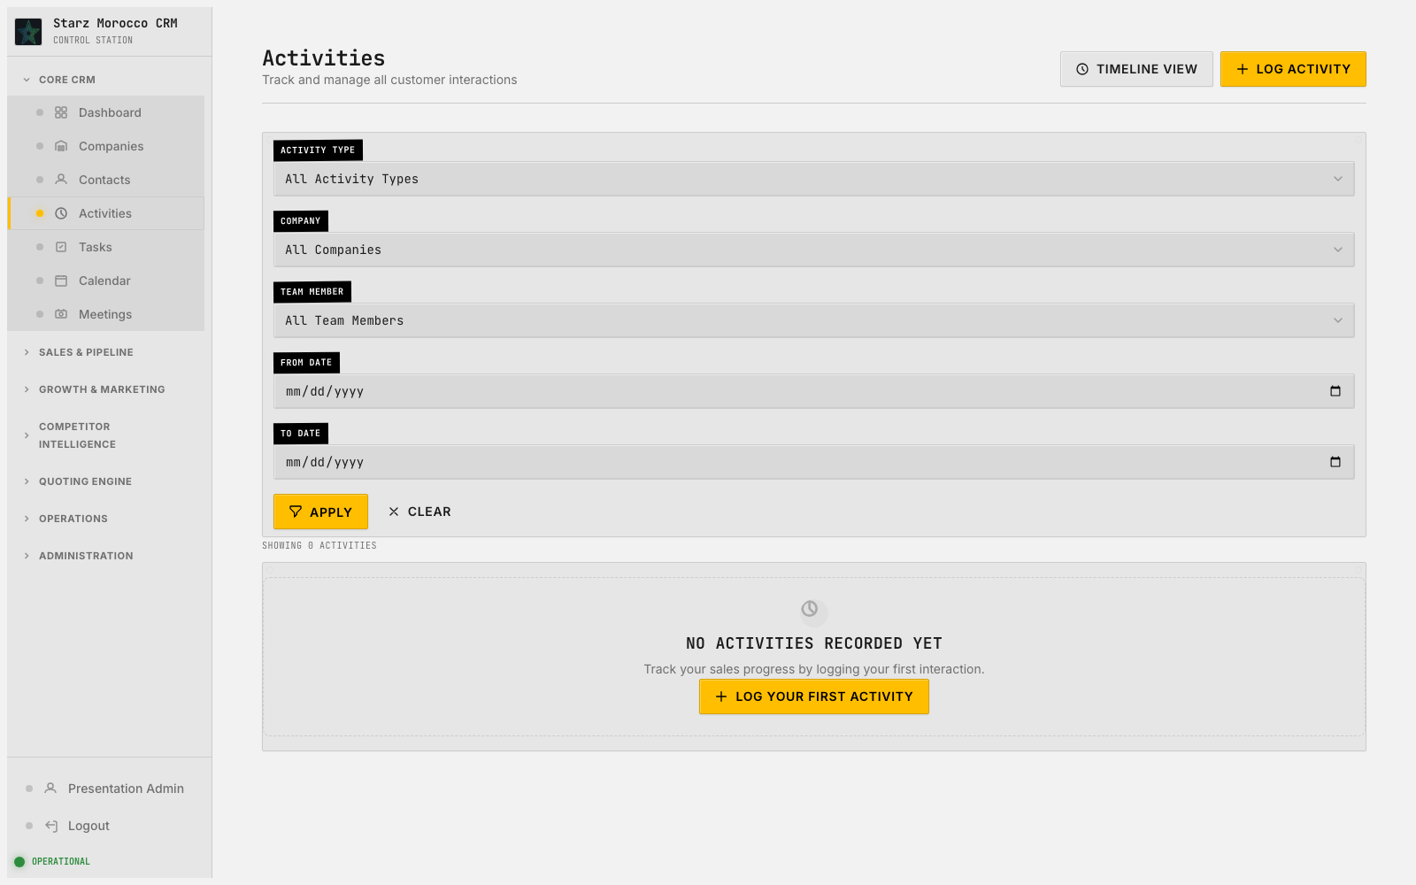
06. /activities — Activities
Module: Activity Tracking (Activity)
Module Purpose: A running log of every call, email, and meeting so account history is never lost in someone’s inbox.
On-screen header: Track and manage all customer interactions
Where it fits: Here, work is prioritized and routed to the right person. The history book of customer interactions — calls, meetings, and touches, all logged so account momentum is something you can actually see, not just guess at.
What this page does: The history book of customer interactions — calls, meetings, and touches, all logged so account momentum is something you can actually see, not just guess at.
Try this in the demo:
Why it matters:
• Log every customer touch with a quick outcome note so future decisions are based on facts, not memory.
• Use the timeline to spot stalled accounts and reach out before the opportunity goes cold.
• Writes activity records linked to the right company and contact so the full relationship is traceable.
• Forecasts get more credible because engagement recency is visible to everyone on the team.
CRM v2 Executive Walkthrough

Slide 10
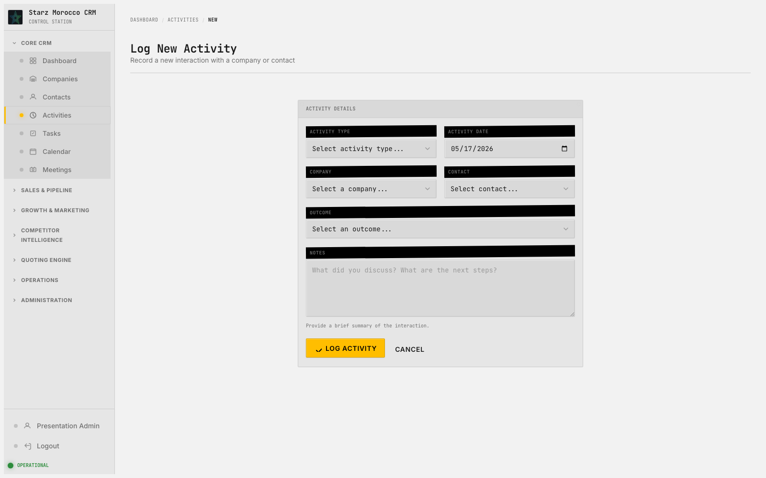
07. /activities/new — Log New Activity
Module: Activity Tracking (Activity)
Module Purpose: A running log of every call, email, and meeting so account history is never lost in someone’s inbox.
On-screen header: Record a new interaction with a company or contact
Where it fits: At this moment, the team is creating something new — a record that everything downstream will depend on. The history book of customer interactions — calls, meetings, and touches, all logged so account momentum is something you can actually see, not just guess at.
What this page does: The history book of customer interactions — calls, meetings, and touches, all logged so account momentum is something you can actually see, not just guess at.
Try this in the demo:
Why it matters:
• Log every customer touch with a quick outcome note so future decisions are based on facts, not memory.
• Use the timeline to spot stalled accounts and reach out before the opportunity goes cold.
• Writes activity records linked to the right company and contact so the full relationship is traceable.
• Forecasts get more credible because engagement recency is visible to everyone on the team.
CRM v2 Executive Walkthrough

Slide 11
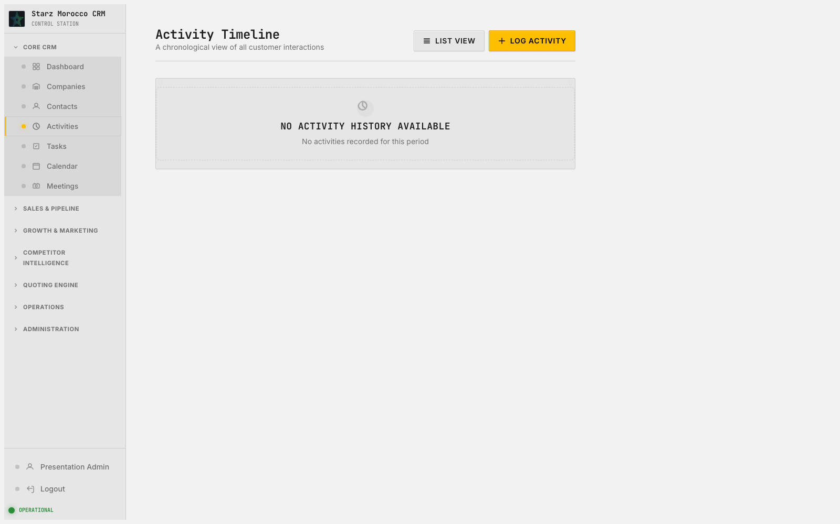
08. /activities/timeline — Activity Timeline
Module: Activity Tracking (Activity)
Module Purpose: A running log of every call, email, and meeting so account history is never lost in someone’s inbox.
On-screen header: A chronological view of all customer interactions
Where it fits: At this point in the journey, this page keeps the customer lifecycle moving forward. The history book of customer interactions — calls, meetings, and touches, all logged so account momentum is something you can actually see, not just guess at.
What this page does: The history book of customer interactions — calls, meetings, and touches, all logged so account momentum is something you can actually see, not just guess at.
Try this in the demo:
Why it matters:
• Log every customer touch with a quick outcome note so future decisions are based on facts, not memory.
• Use the timeline to spot stalled accounts and reach out before the opportunity goes cold.
• Writes activity records linked to the right company and contact so the full relationship is traceable.
• Forecasts get more credible because engagement recency is visible to everyone on the team.
CRM v2 Executive Walkthrough

Slide 12
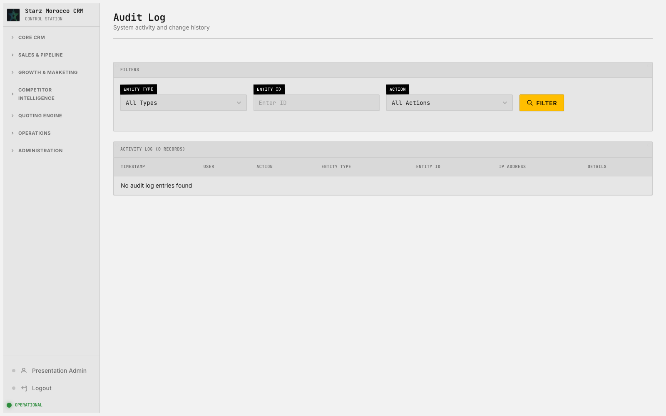
09. /admin/audit — Audit Log
Module: Administration (Users/Datasets/Fields/Audit records)
Module Purpose: Behind-the-scenes control: users, custom fields, datasets, and the audit trail of every change.
On-screen header: System activity and change history
Where it fits: This step is where the team gets a clear handle on what is in flight and who owns it. The platform governance area — it keeps the data model clean, controls who can do what, and preserves an honest record of every change.
What this page does: The platform governance area — it keeps the data model clean, controls who can do what, and preserves an honest record of every change.
Try this in the demo:
Why it matters:
• Use this page to keep schema discipline, control imports, and adjust permissions carefully.
• Read the audit and history outputs before making big process changes — they catch silent regressions early.
• Saves configuration and governance state that quietly shapes how every business module behaves.
• Compliance and reliability risks go down because changes are visible and controlled.
CRM v2 Executive Walkthrough

Slide 13
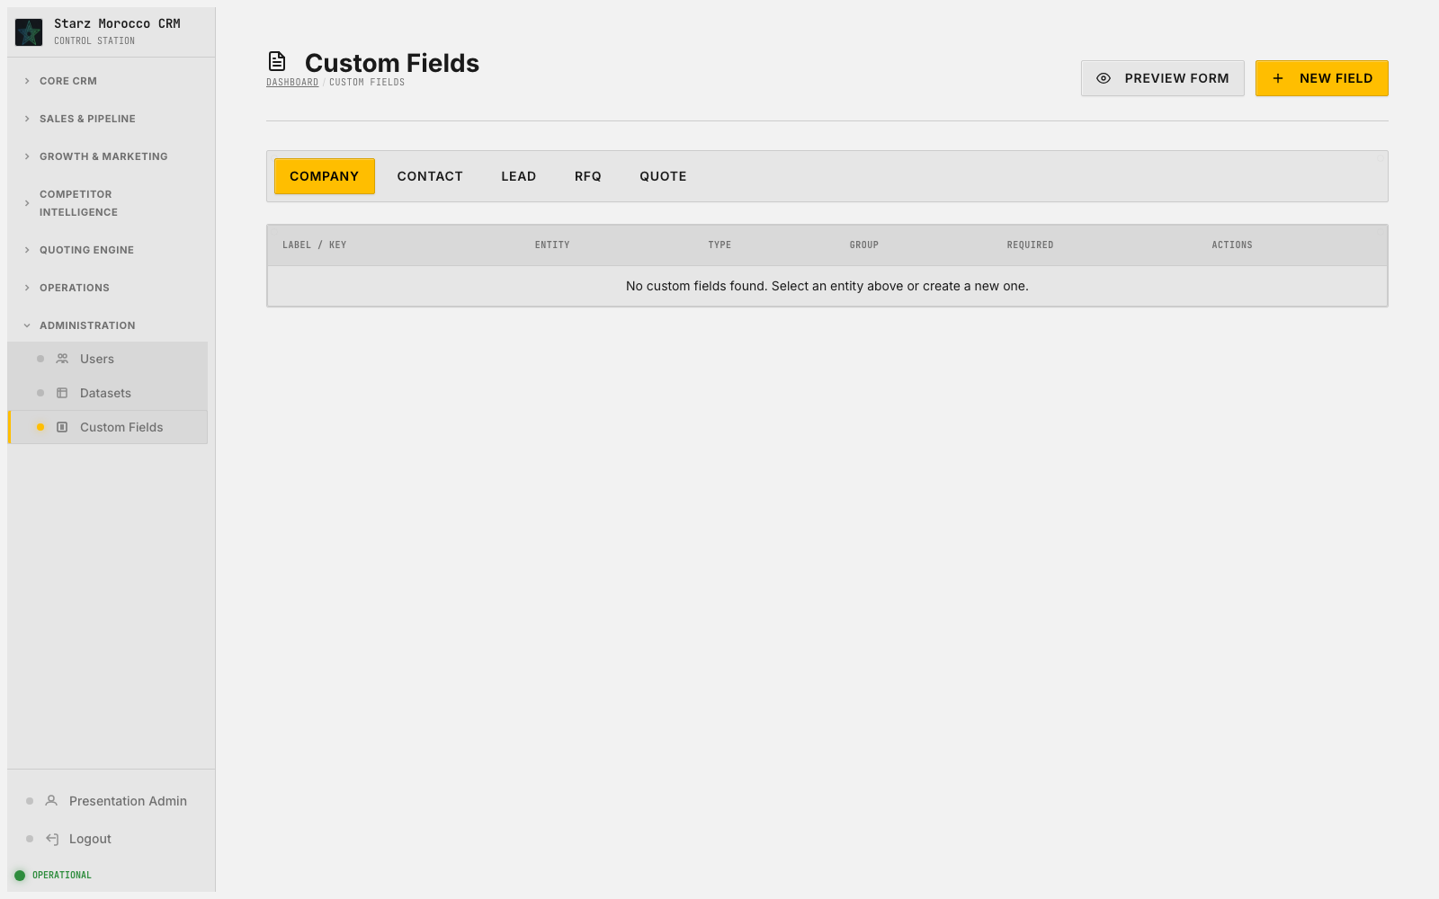
10. /admin/custom-fields — Custom Fields
Module: Administration (Users/Datasets/Fields/Audit records)
Module Purpose: Behind-the-scenes control: users, custom fields, datasets, and the audit trail of every change.
Where it fits: This step is where the team gets a clear handle on what is in flight and who owns it. The platform governance area — it keeps the data model clean, controls who can do what, and preserves an honest record of every change.
What this page does: The platform governance area — it keeps the data model clean, controls who can do what, and preserves an honest record of every change.
Try this in the demo:
Why it matters:
• Use this page to keep schema discipline, control imports, and adjust permissions carefully.
• Read the audit and history outputs before making big process changes — they catch silent regressions early.
• Saves configuration and governance state that quietly shapes how every business module behaves.
• Compliance and reliability risks go down because changes are visible and controlled.
CRM v2 Executive Walkthrough

Slide 14
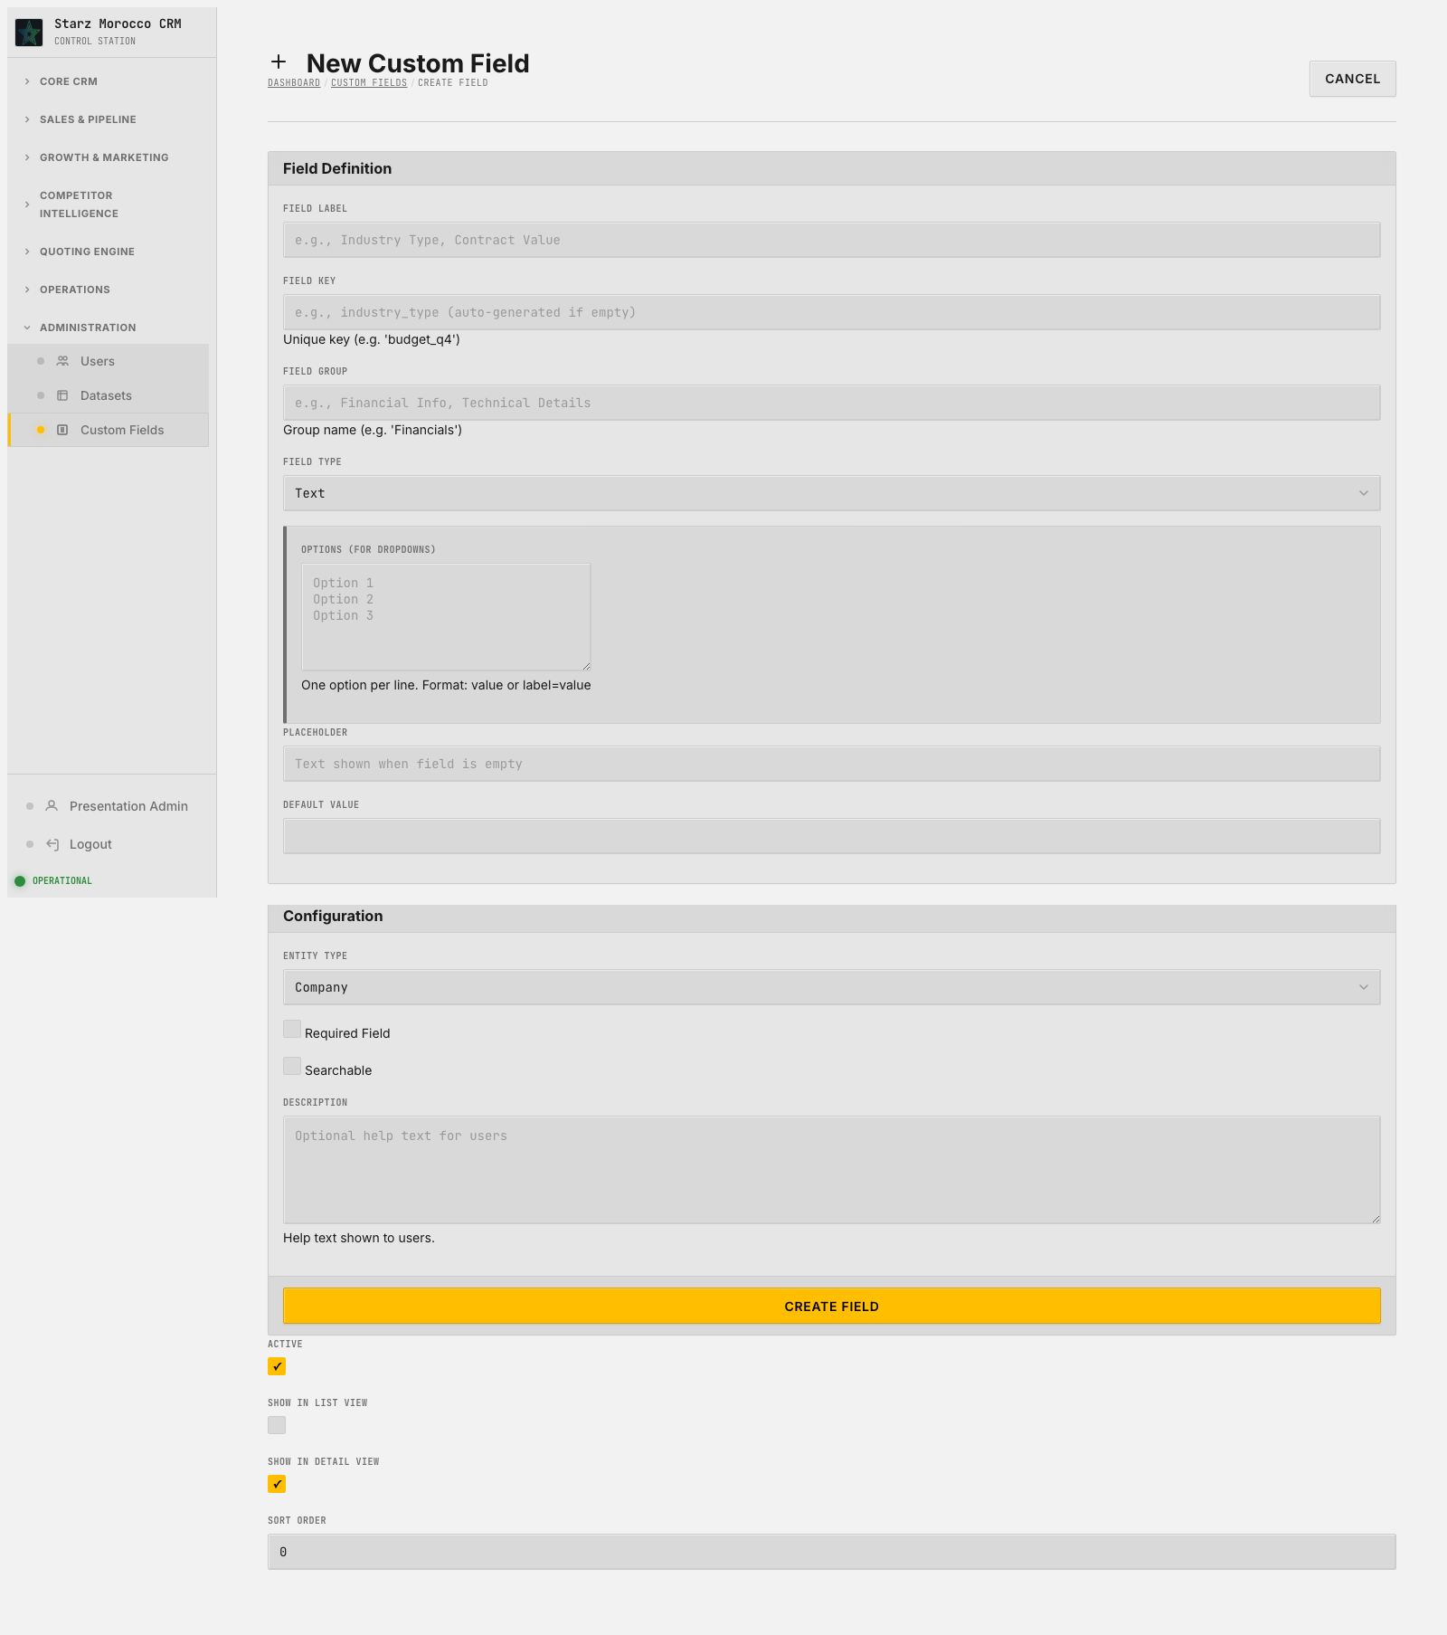
11. /admin/custom-fields/new — New Custom Field
Module: Administration (Users/Datasets/Fields/Audit records)
Module Purpose: Behind-the-scenes control: users, custom fields, datasets, and the audit trail of every change.
Where it fits: This is a record-creation moment, and the quality at entry shapes how fast things move later. The platform governance area — it keeps the data model clean, controls who can do what, and preserves an honest record of every change.
What this page does: The platform governance area — it keeps the data model clean, controls who can do what, and preserves an honest record of every change.
Try this in the demo:
Why it matters:
• Use this page to keep schema discipline, control imports, and adjust permissions carefully.
• Read the audit and history outputs before making big process changes — they catch silent regressions early.
• Saves configuration and governance state that quietly shapes how every business module behaves.
• Compliance and reliability risks go down because changes are visible and controlled.
CRM v2 Executive Walkthrough

Slide 15
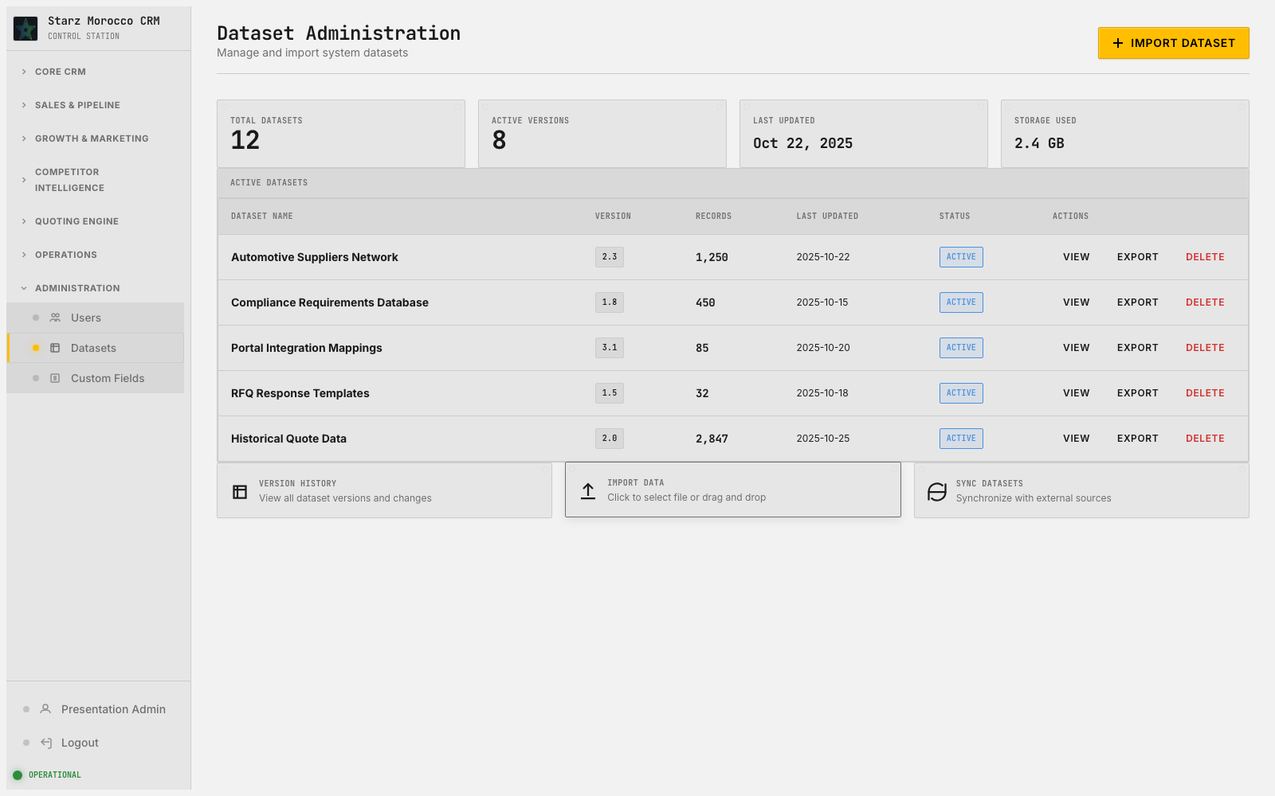
12. /admin/datasets — Dataset Administration
Module: Administration (Users/Datasets/Fields/Audit records)
Module Purpose: Behind-the-scenes control: users, custom fields, datasets, and the audit trail of every change.
On-screen header: Manage and import system datasets
Where it fits: This step is where the team gets a clear handle on what is in flight and who owns it. The platform governance area — it keeps the data model clean, controls who can do what, and preserves an honest record of every change.
What this page does: The platform governance area — it keeps the data model clean, controls who can do what, and preserves an honest record of every change.
Try this in the demo:
Why it matters:
• Use this page to keep schema discipline, control imports, and adjust permissions carefully.
• Read the audit and history outputs before making big process changes — they catch silent regressions early.
• Saves configuration and governance state that quietly shapes how every business module behaves.
• Compliance and reliability risks go down because changes are visible and controlled.
CRM v2 Executive Walkthrough

Slide 16
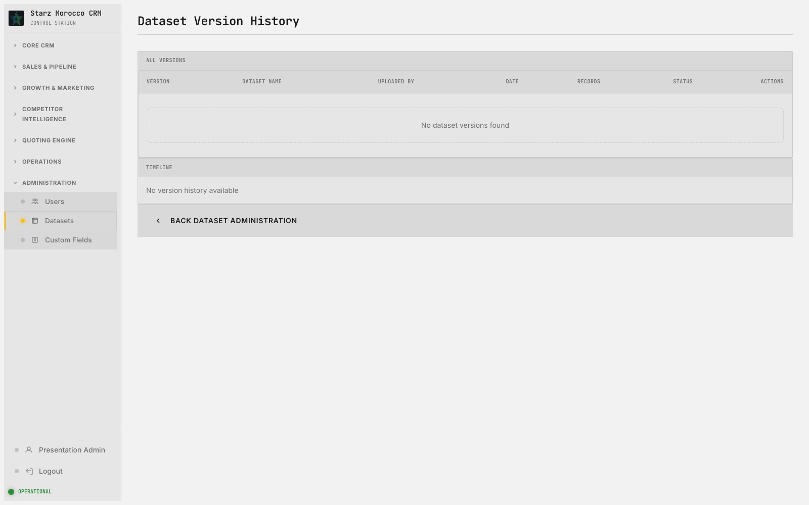
13. /admin/datasets/history — Dataset Version History
Module: Administration (Users/Datasets/Fields/Audit records)
Module Purpose: Behind-the-scenes control: users, custom fields, datasets, and the audit trail of every change.
Where it fits: Here, work is prioritized and routed to the right person. The platform governance area — it keeps the data model clean, controls who can do what, and preserves an honest record of every change.
What this page does: The platform governance area — it keeps the data model clean, controls who can do what, and preserves an honest record of every change.
Try this in the demo:
Why it matters:
• Use this page to keep schema discipline, control imports, and adjust permissions carefully.
• Read the audit and history outputs before making big process changes — they catch silent regressions early.
• Saves configuration and governance state that quietly shapes how every business module behaves.
• Compliance and reliability risks go down because changes are visible and controlled.
CRM v2 Executive Walkthrough

Slide 17
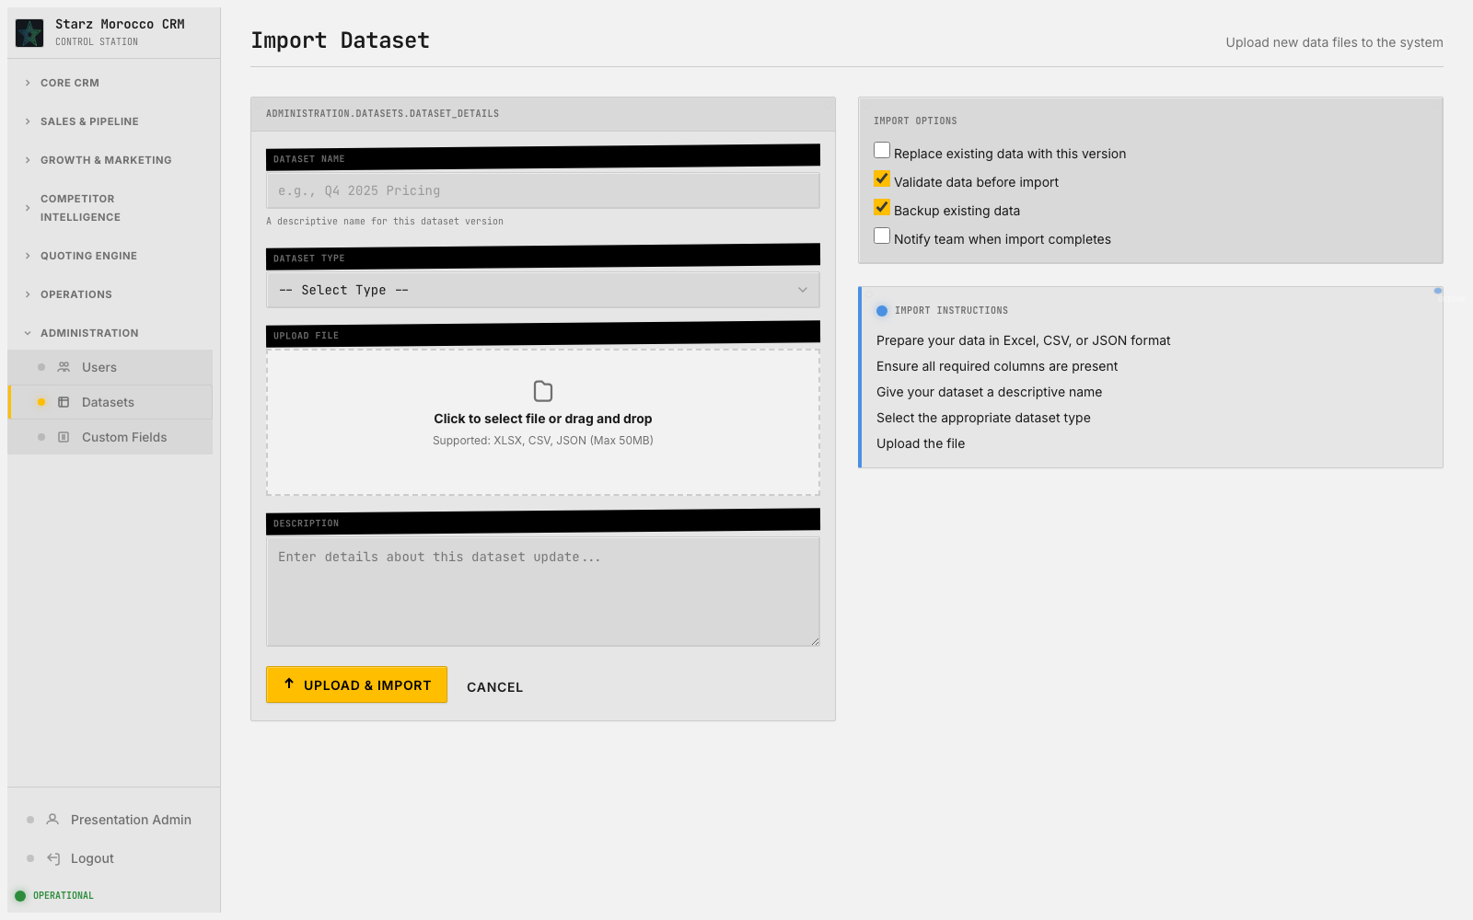
14. /admin/datasets/import — Import Dataset
Module: Administration (Users/Datasets/Fields/Audit records)
Module Purpose: Behind-the-scenes control: users, custom fields, datasets, and the audit trail of every change.
On-screen header: Upload new data files to the system
Where it fits: This step is where the team gets a clear handle on what is in flight and who owns it. The platform governance area — it keeps the data model clean, controls who can do what, and preserves an honest record of every change.
What this page does: The platform governance area — it keeps the data model clean, controls who can do what, and preserves an honest record of every change.
Try this in the demo:
Why it matters:
• Use this page to keep schema discipline, control imports, and adjust permissions carefully.
• Read the audit and history outputs before making big process changes — they catch silent regressions early.
• Saves configuration and governance state that quietly shapes how every business module behaves.
• Compliance and reliability risks go down because changes are visible and controlled.
CRM v2 Executive Walkthrough

Slide 18
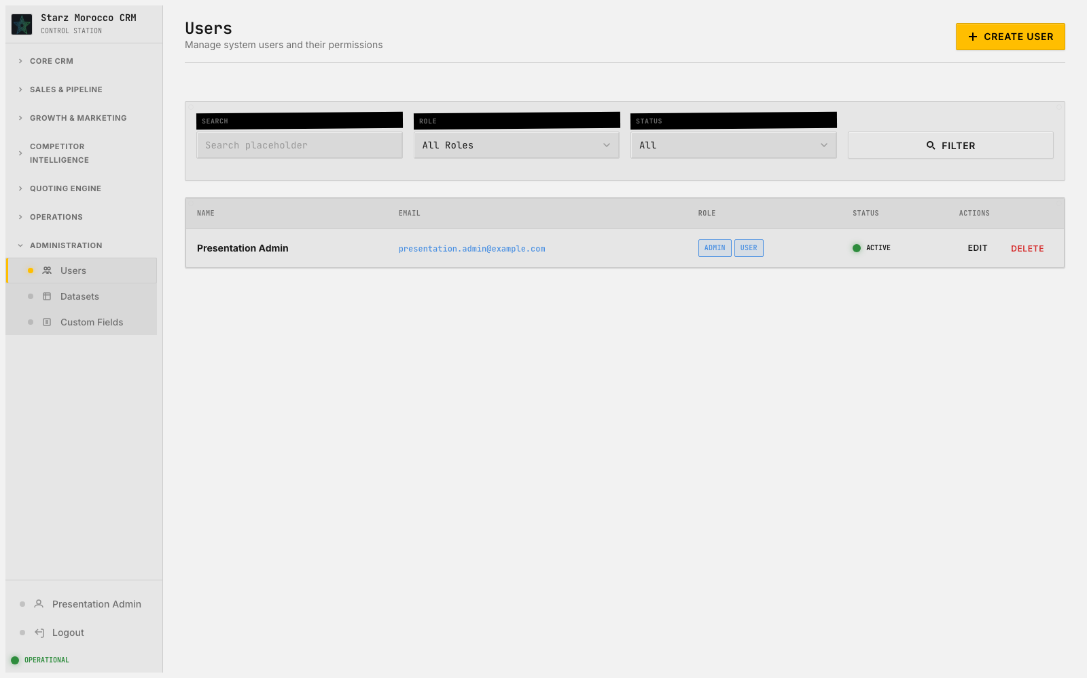
15. /admin/users — Users
Module: Administration (Users/Datasets/Fields/Audit records)
Module Purpose: Behind-the-scenes control: users, custom fields, datasets, and the audit trail of every change.
On-screen header: Manage system users and their permissions
Where it fits: This step is where the team gets a clear handle on what is in flight and who owns it. The platform governance area — it keeps the data model clean, controls who can do what, and preserves an honest record of every change.
What this page does: The platform governance area — it keeps the data model clean, controls who can do what, and preserves an honest record of every change.
Try this in the demo:
Why it matters:
• Use this page to keep schema discipline, control imports, and adjust permissions carefully.
• Read the audit and history outputs before making big process changes — they catch silent regressions early.
• Saves configuration and governance state that quietly shapes how every business module behaves.
• Compliance and reliability risks go down because changes are visible and controlled.
CRM v2 Executive Walkthrough

Slide 19
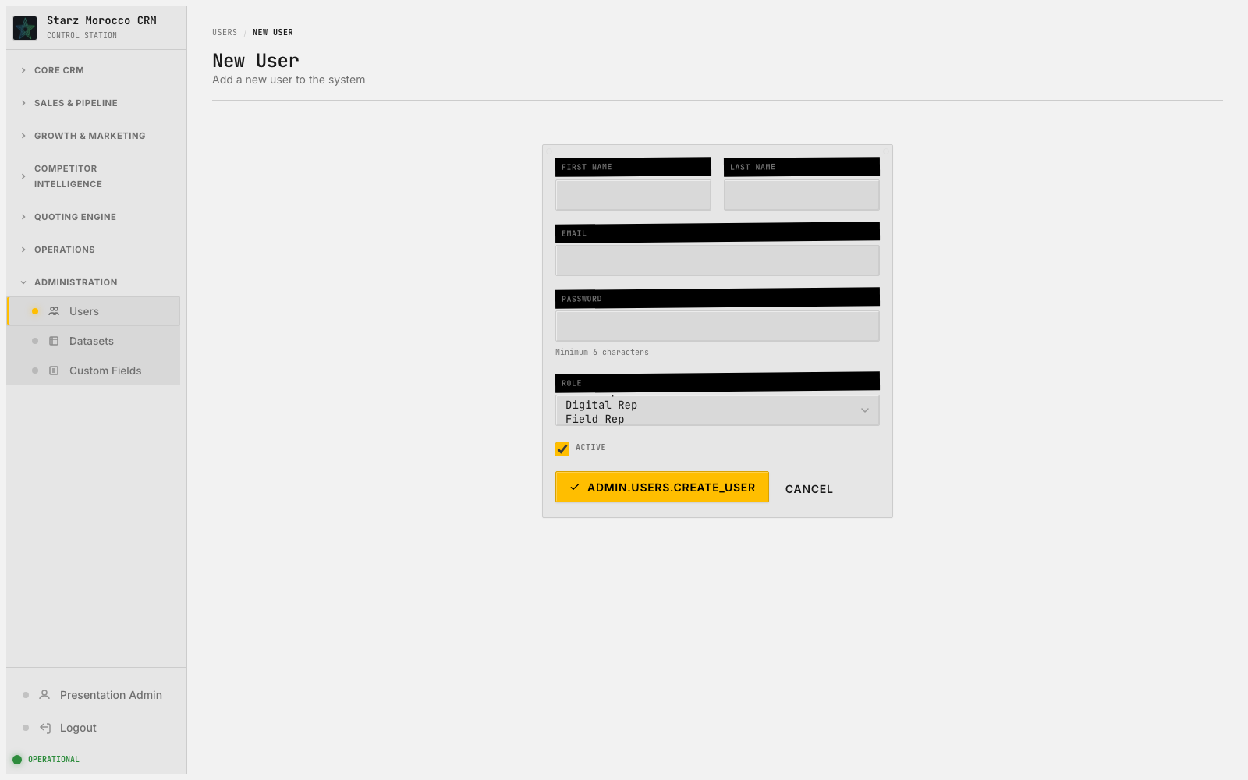
16. /admin/users/new — New User
Module: Administration (Users/Datasets/Fields/Audit records)
Module Purpose: Behind-the-scenes control: users, custom fields, datasets, and the audit trail of every change.
On-screen header: Add a new user to the system
Where it fits: This is a record-creation moment, and the quality at entry shapes how fast things move later. The platform governance area — it keeps the data model clean, controls who can do what, and preserves an honest record of every change.
What this page does: The platform governance area — it keeps the data model clean, controls who can do what, and preserves an honest record of every change.
Try this in the demo:
Why it matters:
• Use this page to keep schema discipline, control imports, and adjust permissions carefully.
• Read the audit and history outputs before making big process changes — they catch silent regressions early.
• Saves configuration and governance state that quietly shapes how every business module behaves.
• Compliance and reliability risks go down because changes are visible and controlled.
CRM v2 Executive Walkthrough

Slide 20
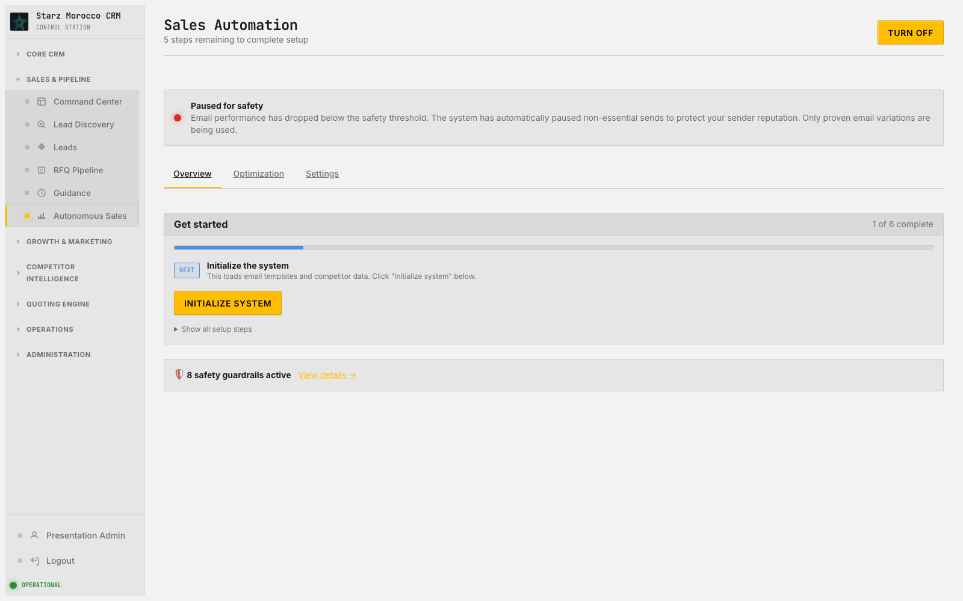
17. /autonomous-sales — Sales Automation
Module: Autonomous Sales (Autonomous orchestration state)
Module Purpose: The control room for automated outreach — see what is running, what is working, and what to pause.
On-screen header: 5 steps remaining to complete setup
Where it fits: Here, work is prioritized and routed to the right person. The mission control for automated outbound — see what is running, how it is performing, and where the guardrails need adjusting.
What this page does: The mission control for automated outbound — see what is running, how it is performing, and where the guardrails need adjusting.
Try this in the demo:
Why it matters:
• Tune the automation’s boundaries and check output quality before turning up the volume.
• Confirm the learning loops, targeting, and fail-safes are still healthy before each scale-up.
• Updates the automation’s configuration and changes how downstream outbound pipelines behave.
• You get more reach without sacrificing relevance, as long as the guardrails stay maintained.
CRM v2 Executive Walkthrough

Slide 21
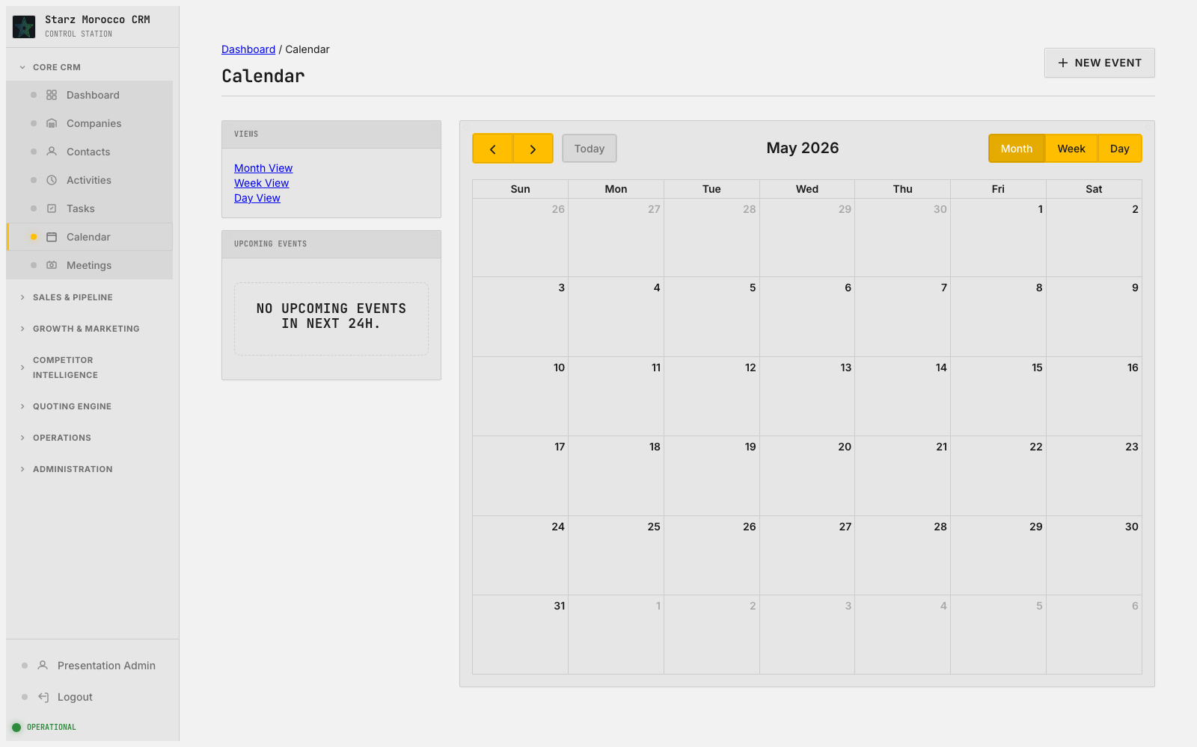
18. /calendar — Calendar
Module: Calendar Planning (Calendar events)
Module Purpose: Schedule the events that drive the sales motion and see them next to the pipeline they support.
Where it fits: Here, work is prioritized and routed to the right person. The scheduling layer — it turns “someone is interested” into “meeting on the calendar at 2pm Tuesday” and keeps follow-up cadence predictable.
What this page does: The scheduling layer — it turns “someone is interested” into “meeting on the calendar at 2pm Tuesday” and keeps follow-up cadence predictable.
Try this in the demo:
Why it matters:
• Manage slots, availability, and booking links so it is easy to go from interest to confirmed meeting.
• Protect selling time by watching the calendar for bottlenecks and over-booking.
• Saves the schedule and booking state that the pipeline timeline depends on.
• More meetings get booked because the time between first interest and confirmed slot is shorter.
CRM v2 Executive Walkthrough

Slide 22
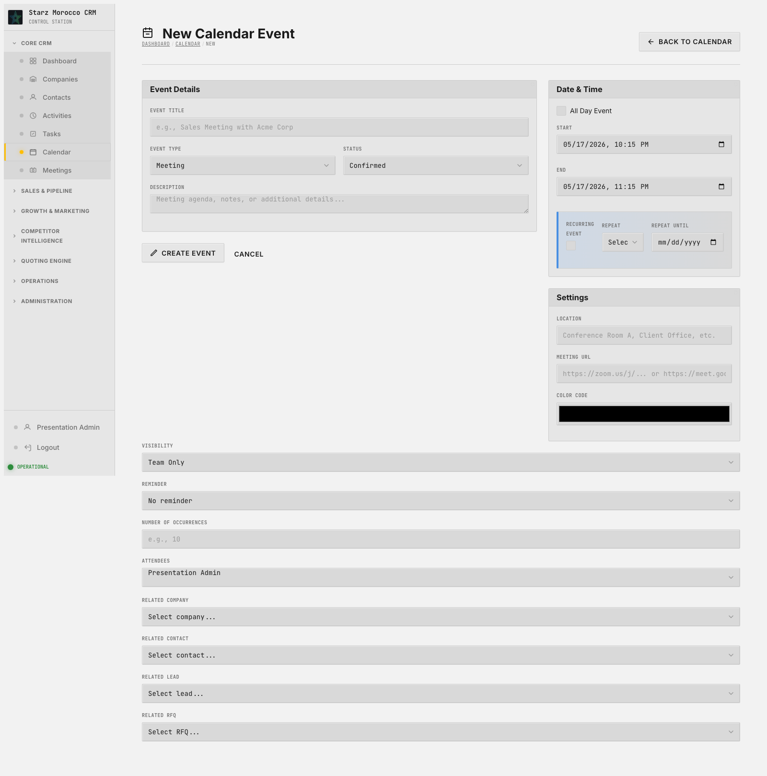
19. /calendar/new — New Calendar Event
Module: Calendar Planning (Calendar events)
Module Purpose: Schedule the events that drive the sales motion and see them next to the pipeline they support.
Where it fits: At this moment, the team is creating something new — a record that everything downstream will depend on. The scheduling layer — it turns “someone is interested” into “meeting on the calendar at 2pm Tuesday” and keeps follow-up cadence predictable.
What this page does: The scheduling layer — it turns “someone is interested” into “meeting on the calendar at 2pm Tuesday” and keeps follow-up cadence predictable.
Try this in the demo:
Why it matters:
• Manage slots, availability, and booking links so it is easy to go from interest to confirmed meeting.
• Protect selling time by watching the calendar for bottlenecks and over-booking.
• Saves the schedule and booking state that the pipeline timeline depends on.
• More meetings get booked because the time between first interest and confirmed slot is shorter.
CRM v2 Executive Walkthrough

Slide 23
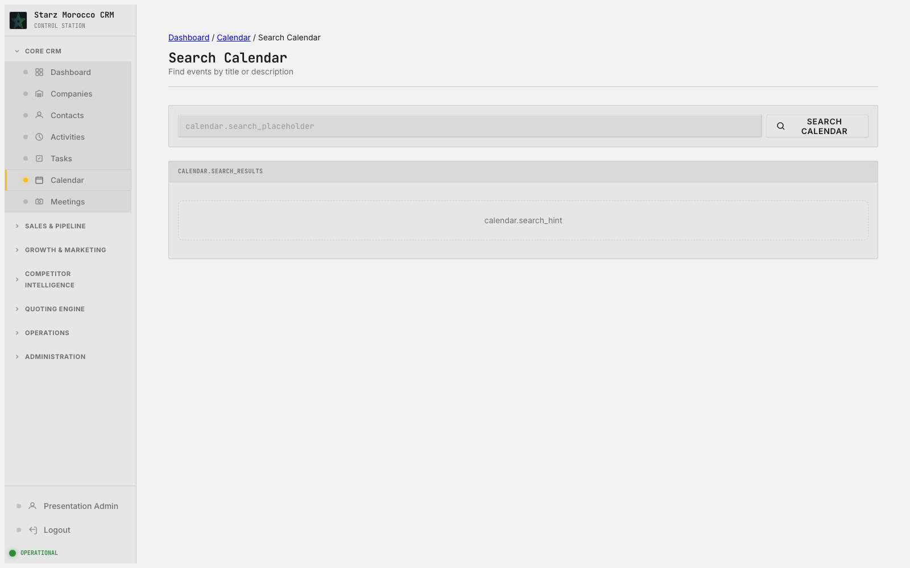
20. /calendar/search — Search Calendar
Module: Calendar Planning (Calendar events)
Module Purpose: Schedule the events that drive the sales motion and see them next to the pipeline they support.
On-screen header: Find events by title or description
Where it fits: At this point in the journey, this page keeps the customer lifecycle moving forward. The scheduling layer — it turns “someone is interested” into “meeting on the calendar at 2pm Tuesday” and keeps follow-up cadence predictable.
What this page does: The scheduling layer — it turns “someone is interested” into “meeting on the calendar at 2pm Tuesday” and keeps follow-up cadence predictable.
Try this in the demo:
Why it matters:
• Manage slots, availability, and booking links so it is easy to go from interest to confirmed meeting.
• Protect selling time by watching the calendar for bottlenecks and over-booking.
• Saves the schedule and booking state that the pipeline timeline depends on.
• More meetings get booked because the time between first interest and confirmed slot is shorter.
CRM v2 Executive Walkthrough

Slide 24
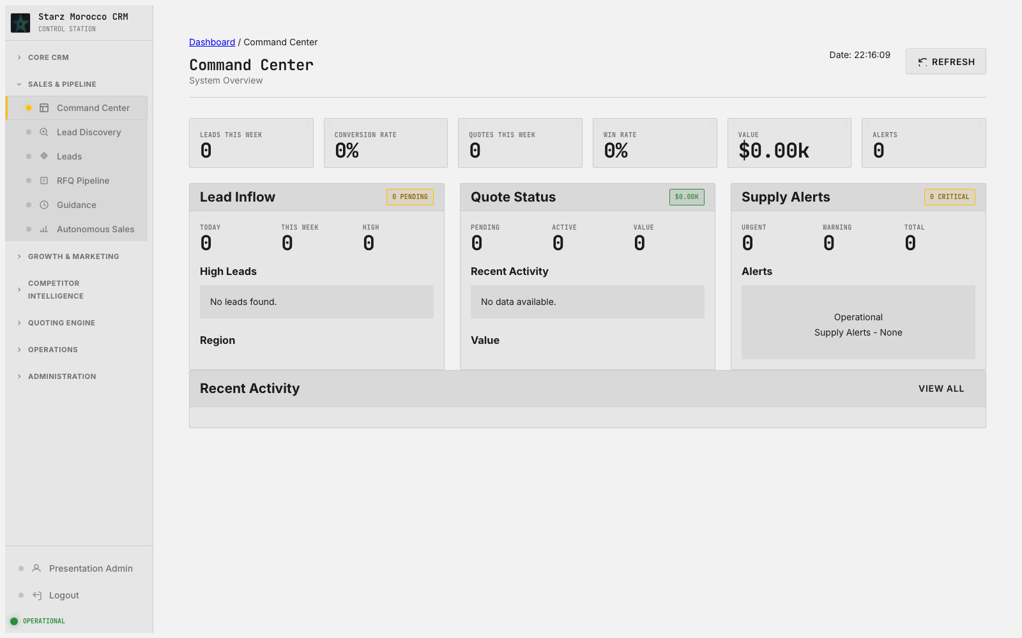
21. /command-center — Command Center
Module: Command Center (Cross-module operational signals)
Module Purpose: The live nerve center — alerts, suggested actions, and metrics from across the platform in one view.
On-screen header: System Overview
Where it fits: When something starts to drift, the team coordinates here before the problem compounds. The live operations panel — alerts, metric shifts, and recommended actions across every active revenue workflow, all on one screen.
What this page does: The live operations panel — alerts, metric shifts, and recommended actions across every active revenue workflow, all on one screen.
Try this in the demo:
Why it matters:
• Triage alerts by business impact first, then click through to the page that can actually fix the issue.
• Use the data, actions, and metrics views together so detection turns into immediate execution.
• Pulls operational events from many modules into one place where the team can respond fast.
• Reaction time drops when opportunities or risks shift unexpectedly.
CRM v2 Executive Walkthrough

Slide 25
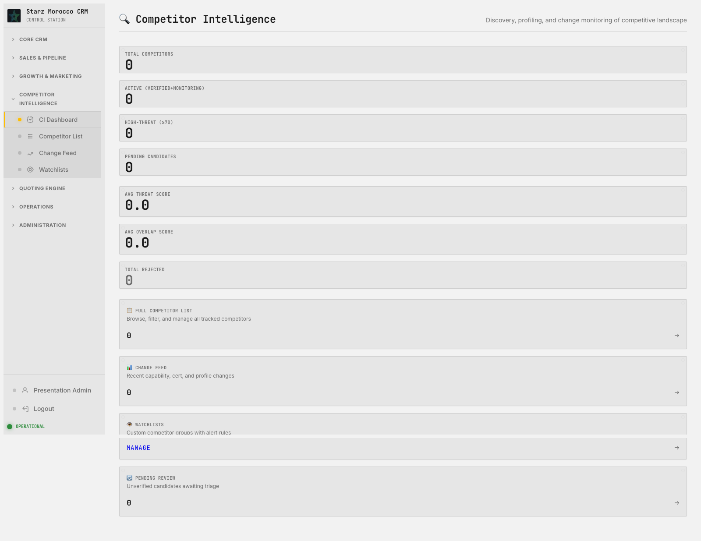
22. /comp-crawler — 🔍 Competitor Intelligence
Module: Competitive Crawler (Competitor pages and signals)
Module Purpose: Watches competitor websites for changes and feeds the team useful market intelligence.
On-screen header: Discovery, profiling, and change monitoring of competitive landscape
Where it fits: At this point in the journey, this page keeps the customer lifecycle moving forward. The discovery and qualification layer — it finds high-fit targets out on the web and decides which ones earn a spot in the real CRM funnel.
What this page does: The discovery and qualification layer — it finds high-fit targets out on the web and decides which ones earn a spot in the real CRM funnel.
Try this in the demo:
Why it matters:
• Read the fit evidence, run dedupe checks, and apply qualification thresholds before promoting a lead.
• Use the review and discovered views to keep low-fit noise away from real companies and contacts.
• Saves new or updated lead records with explicit status transitions and a clear reason for each decision.
• Top-of-funnel quality rises and the team stops burning hours on companies that were never going to buy.
CRM v2 Executive Walkthrough

Slide 26
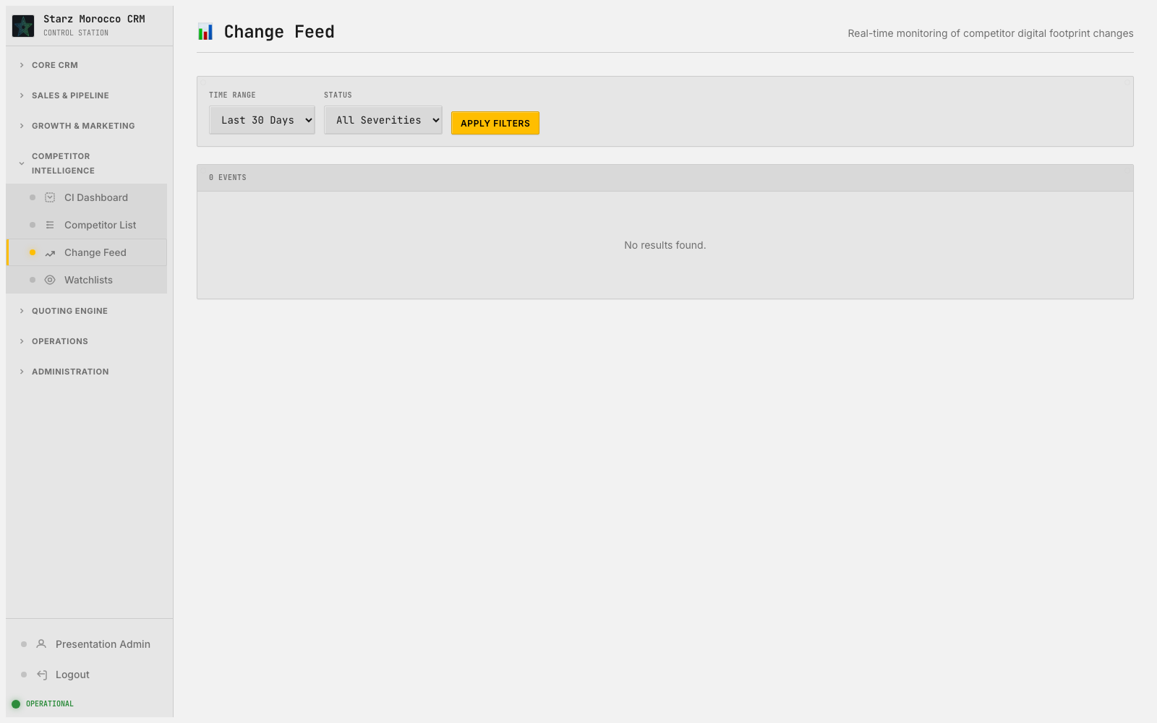
23. /comp-crawler/changes — 📊 Change Feed
Module: Competitive Crawler (Competitor pages and signals)
Module Purpose: Watches competitor websites for changes and feeds the team useful market intelligence.
On-screen header: Real-time monitoring of competitor digital footprint changes
Where it fits: This step is where the team gets a clear handle on what is in flight and who owns it. The discovery and qualification layer — it finds high-fit targets out on the web and decides which ones earn a spot in the real CRM funnel.
What this page does: The discovery and qualification layer — it finds high-fit targets out on the web and decides which ones earn a spot in the real CRM funnel.
Try this in the demo:
Why it matters:
• Read the fit evidence, run dedupe checks, and apply qualification thresholds before promoting a lead.
• Use the review and discovered views to keep low-fit noise away from real companies and contacts.
• Saves new or updated lead records with explicit status transitions and a clear reason for each decision.
• Top-of-funnel quality rises and the team stops burning hours on companies that were never going to buy.
CRM v2 Executive Walkthrough

Slide 27
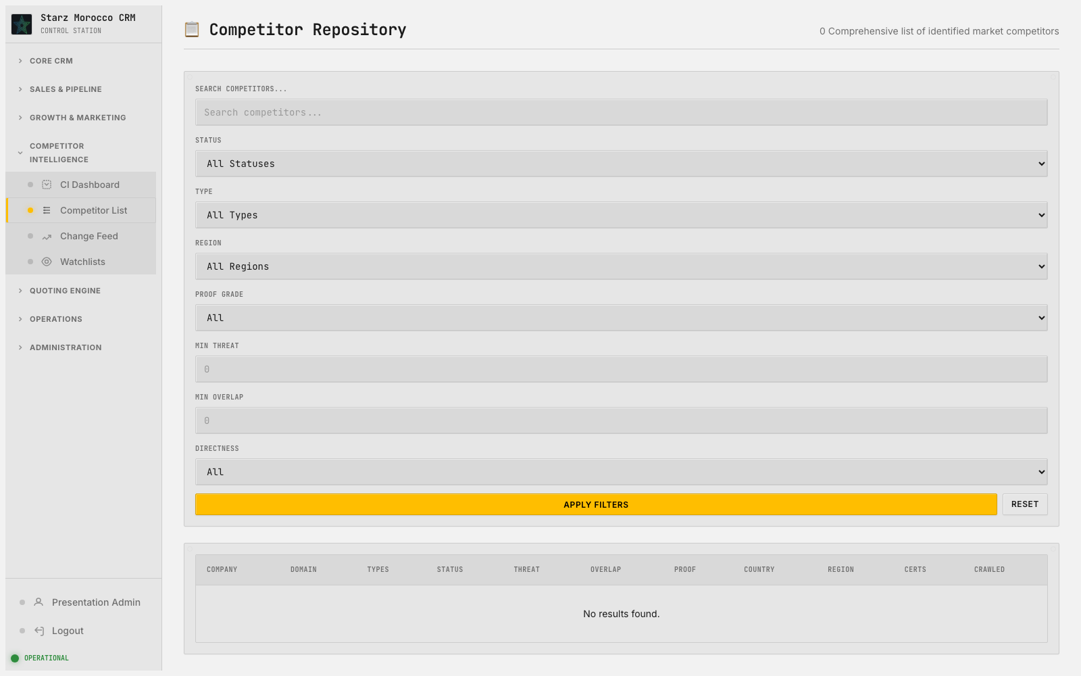
24. /comp-crawler/list — 📋 Competitor Repository
Module: Competitive Crawler (Competitor pages and signals)
Module Purpose: Watches competitor websites for changes and feeds the team useful market intelligence.
On-screen header: 0 Comprehensive list of identified market competitors
Where it fits: This step is where the team gets a clear handle on what is in flight and who owns it. The discovery and qualification layer — it finds high-fit targets out on the web and decides which ones earn a spot in the real CRM funnel.
What this page does: The discovery and qualification layer — it finds high-fit targets out on the web and decides which ones earn a spot in the real CRM funnel.
Try this in the demo:
Why it matters:
• Read the fit evidence, run dedupe checks, and apply qualification thresholds before promoting a lead.
• Use the review and discovered views to keep low-fit noise away from real companies and contacts.
• Saves new or updated lead records with explicit status transitions and a clear reason for each decision.
• Top-of-funnel quality rises and the team stops burning hours on companies that were never going to buy.
CRM v2 Executive Walkthrough

Slide 28
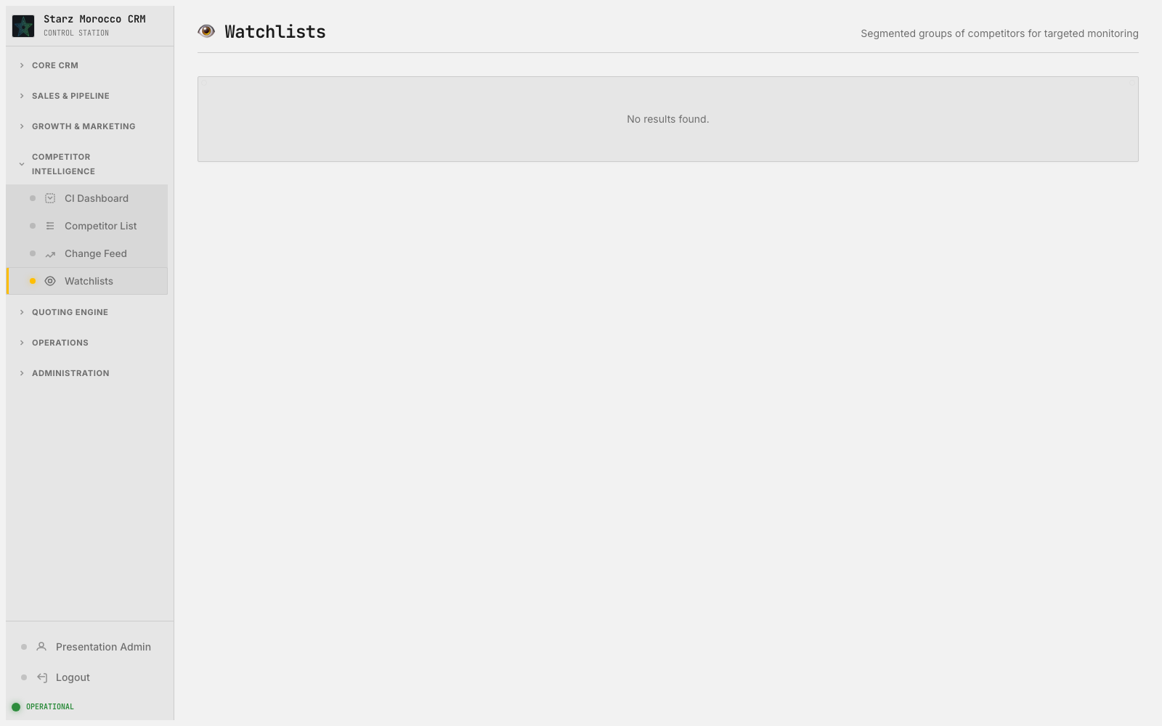
25. /comp-crawler/watchlists — 👁️ Watchlists
Module: Competitive Crawler (Competitor pages and signals)
Module Purpose: Watches competitor websites for changes and feeds the team useful market intelligence.
On-screen header: Segmented groups of competitors for targeted monitoring
Where it fits: This step is where the team gets a clear handle on what is in flight and who owns it. The discovery and qualification layer — it finds high-fit targets out on the web and decides which ones earn a spot in the real CRM funnel.
What this page does: The discovery and qualification layer — it finds high-fit targets out on the web and decides which ones earn a spot in the real CRM funnel.
Try this in the demo:
Why it matters:
• Read the fit evidence, run dedupe checks, and apply qualification thresholds before promoting a lead.
• Use the review and discovered views to keep low-fit noise away from real companies and contacts.
• Saves new or updated lead records with explicit status transitions and a clear reason for each decision.
• Top-of-funnel quality rises and the team stops burning hours on companies that were never going to buy.
CRM v2 Executive Walkthrough

Slide 29
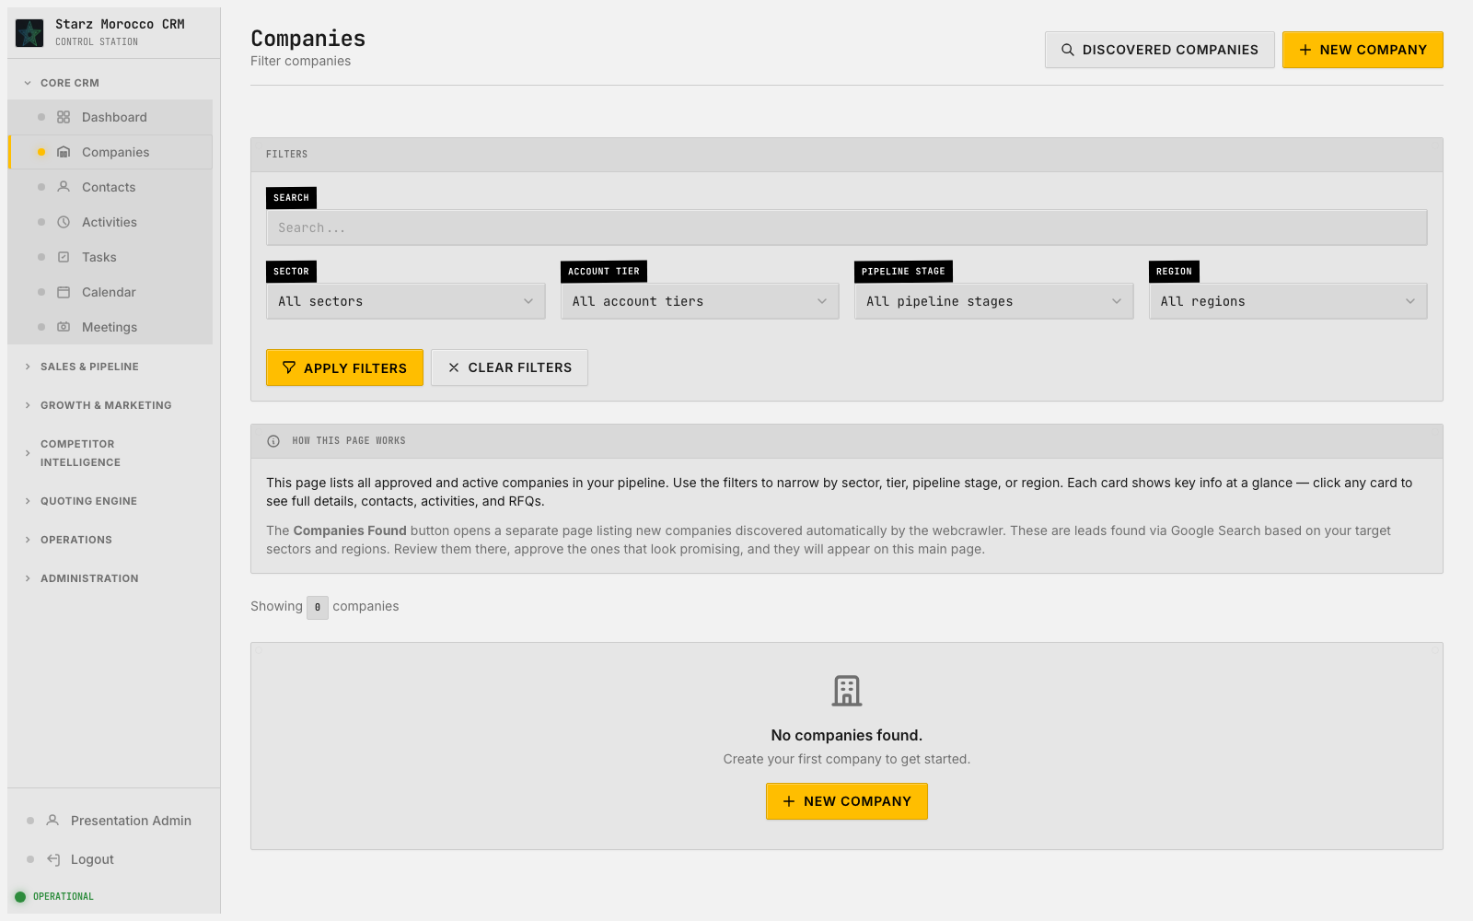
26. /companies — Companies
Module: Company Management (Company)
Module Purpose: The home for every buyer account — who they are, where they are in the journey, and what we know about them.
On-screen header: Filter companies
Where it fits: A clean account record here prevents friction in campaigns, RFQs, and handoffs down the line. The master-data workspace — it keeps the people-and-companies records that every other workflow leans on accurate, current, and ready for action.
What this page does: The master-data workspace — it keeps the people-and-companies records that every other workflow leans on accurate, current, and ready for action.
Try this in the demo:
Why it matters:
• Keep account and contact attributes clean before you trigger any RFQ, campaign, or meeting from them.
• Use the discovered, new, and edit flows to keep duplicates and half-finished records out of core operations.
• Saves the core CRM records that every other workflow depends on.
• Personalization, routing, and handoffs between teams all get more accurate.
CRM v2 Executive Walkthrough

Slide 30
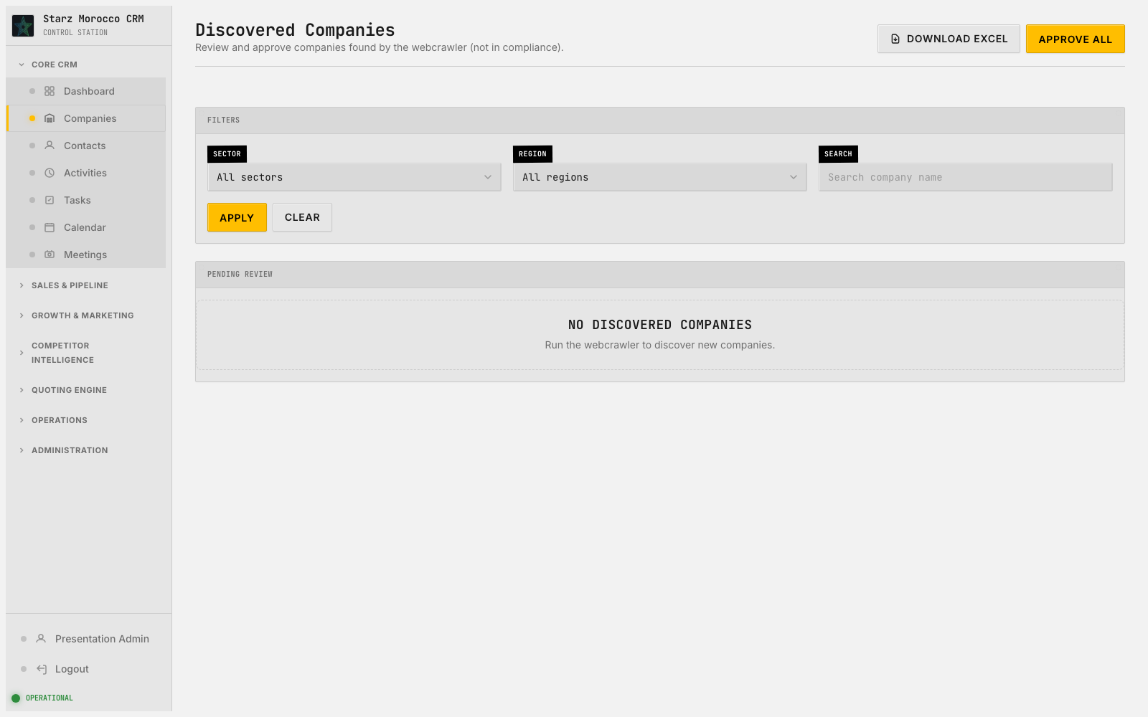
27. /companies/discovered — Discovered Companies
Module: Company Management (Company)
Module Purpose: The home for every buyer account — who they are, where they are in the journey, and what we know about them.
On-screen header: Review and approve companies found by the webcrawler (not in compliance).
Where it fits: This is the master record for every buyer account — get it right here and every later stage gets easier. The master-data workspace — it keeps the people-and-companies records that every other workflow leans on accurate, current, and ready for action.
What this page does: The master-data workspace — it keeps the people-and-companies records that every other workflow leans on accurate, current, and ready for action.
Try this in the demo:
Why it matters:
• Keep account and contact attributes clean before you trigger any RFQ, campaign, or meeting from them.
• Use the discovered, new, and edit flows to keep duplicates and half-finished records out of core operations.
• Saves the core CRM records that every other workflow depends on.
• Personalization, routing, and handoffs between teams all get more accurate.
CRM v2 Executive Walkthrough

Slide 31
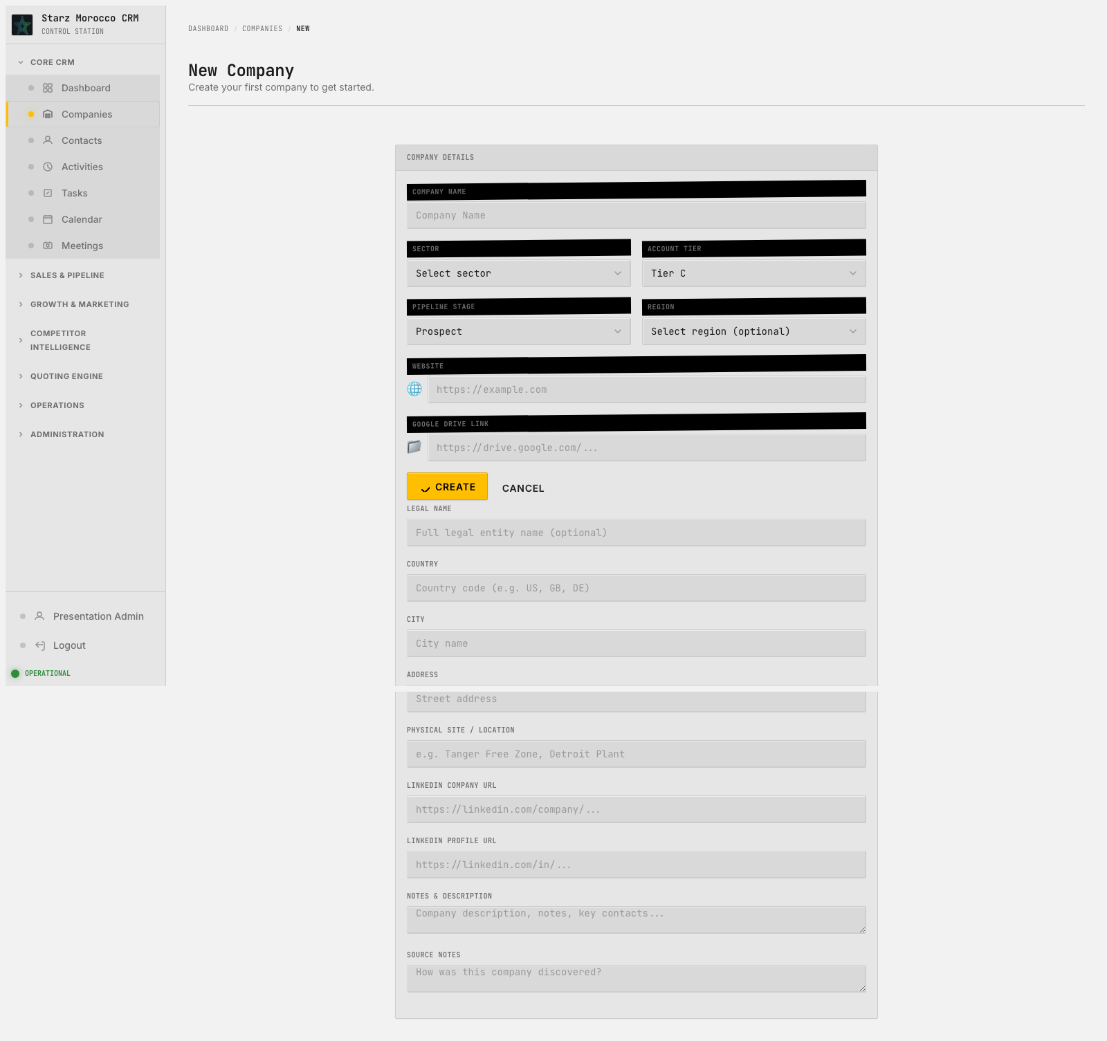
28. /companies/new — New Company
Module: Company Management (Company)
Module Purpose: The home for every buyer account — who they are, where they are in the journey, and what we know about them.
On-screen header: Create your first company to get started.
Where it fits: This is the master record for every buyer account — get it right here and every later stage gets easier. The master-data workspace — it keeps the people-and-companies records that every other workflow leans on accurate, current, and ready for action.
What this page does: The master-data workspace — it keeps the people-and-companies records that every other workflow leans on accurate, current, and ready for action.
Try this in the demo:
Why it matters:
• Keep account and contact attributes clean before you trigger any RFQ, campaign, or meeting from them.
• Use the discovered, new, and edit flows to keep duplicates and half-finished records out of core operations.
• Saves the core CRM records that every other workflow depends on.
• Personalization, routing, and handoffs between teams all get more accurate.
CRM v2 Executive Walkthrough

Slide 32
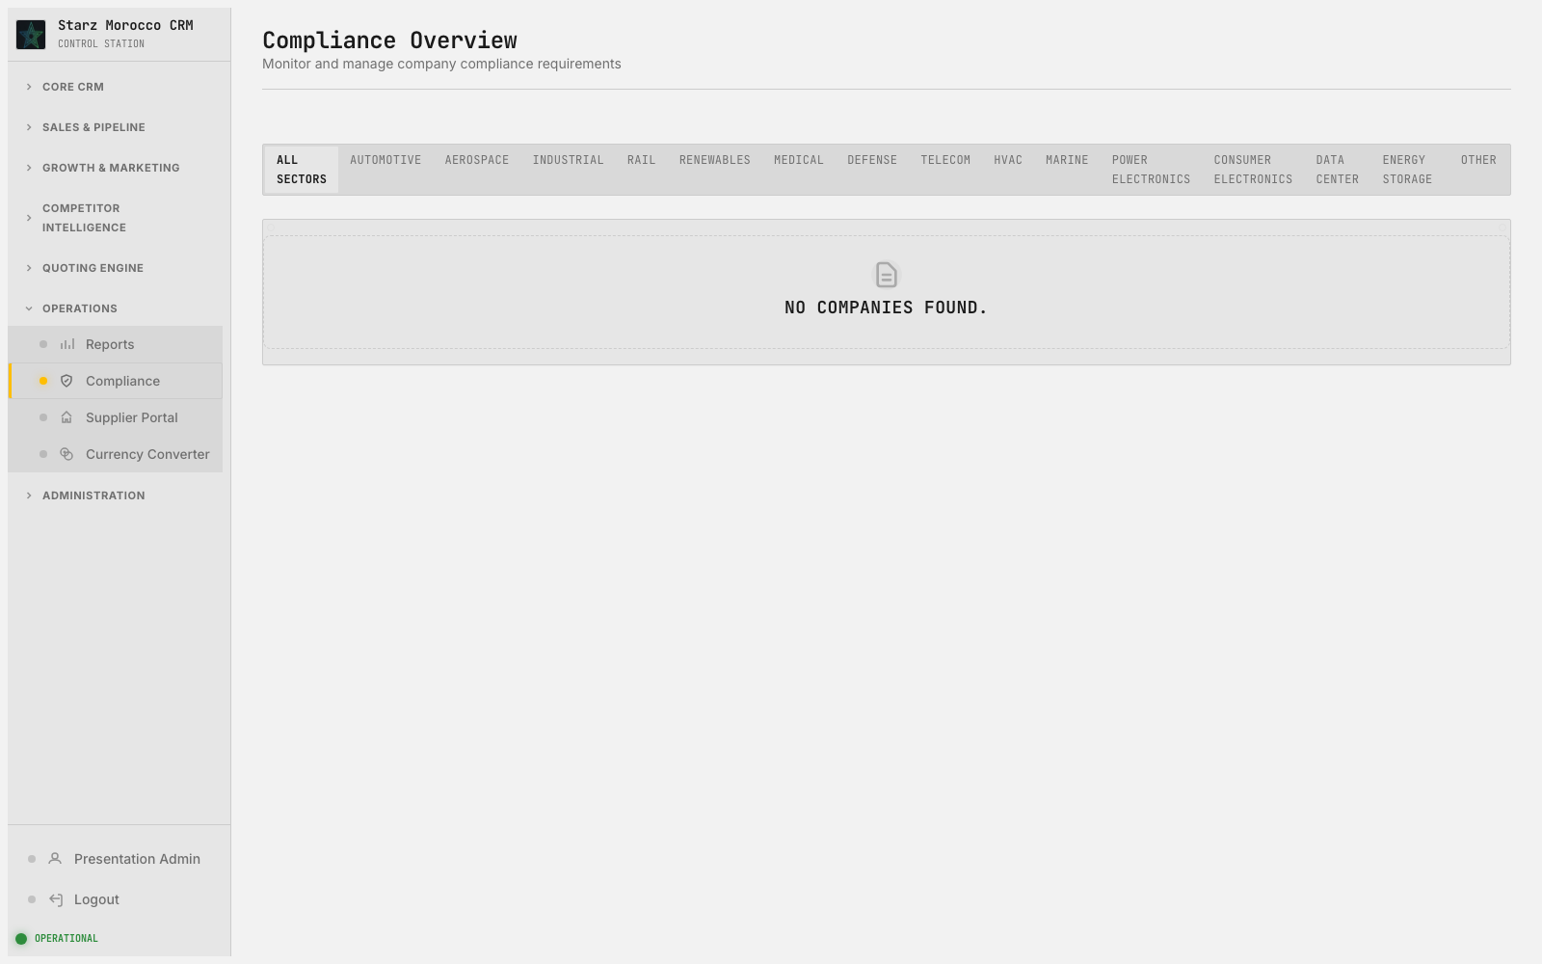
29. /compliance/overview — Compliance Overview
Module: Compliance Tracking (Compliance document requirements)
Module Purpose: Keeps track of required documents — what is on file, what is missing, and what is about to expire.
On-screen header: Monitor and manage company compliance requirements
Where it fits: This step is where the team gets a clear handle on what is in flight and who owns it. This page is the main list and triage view for Compliance Tracking.
What this page does: This page is the main list and triage view for Compliance Tracking.
Try this in the demo:
Why it matters:
• Use the main controls on this screen to finish the current step without bouncing around the app.
• Double-check the data before saving — reports, automations, and handoffs all rely on what gets recorded here.
• Saves the change (or filtered view) tied to this route and leaves a clear trail of what happened.
• Keeps execution sharp because everyone knows who owns the next step and where it sits in the lifecycle.
CRM v2 Executive Walkthrough

Slide 33
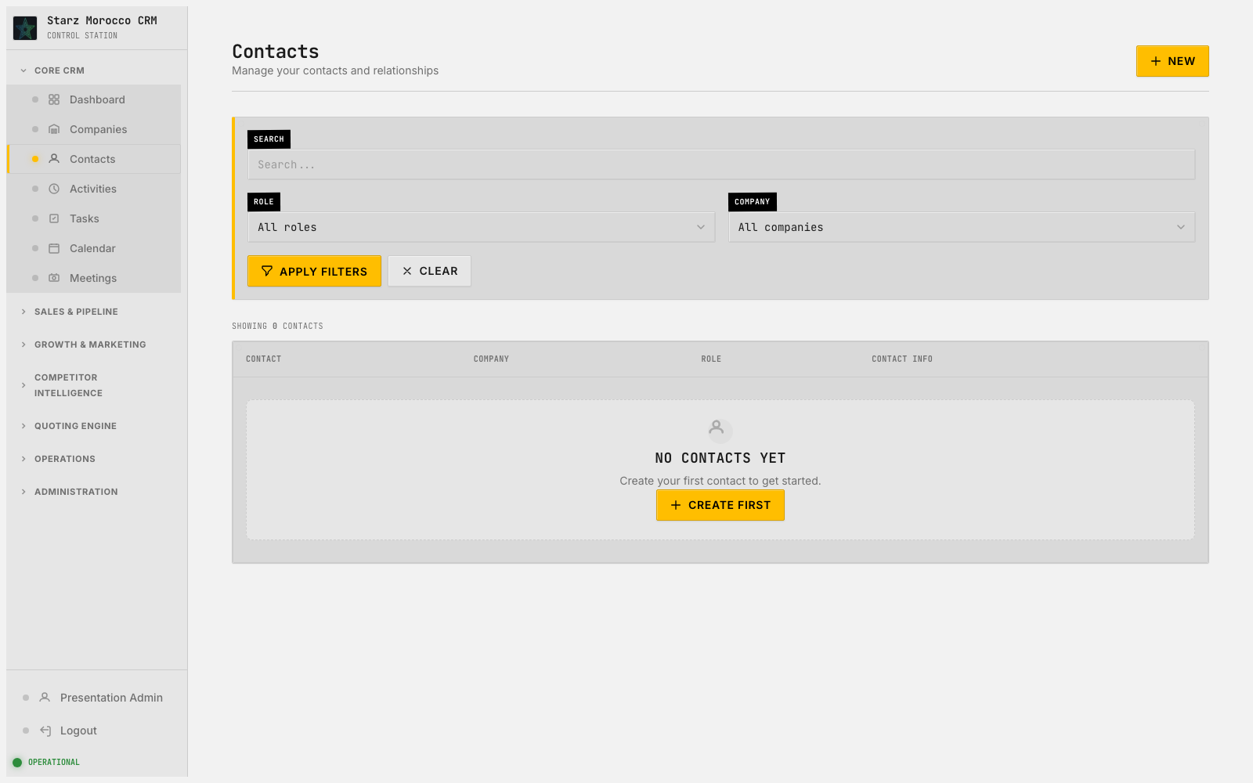
30. /contacts — Contacts
Module: Contact Management (Contact)
Module Purpose: The people side of each account: procurement, engineering, and decision-makers, with how strong the relationship is.
On-screen header: Manage your contacts and relationships
Where it fits: This is the people side of the business — the procurement leads, engineers, and decision-makers we actually talk to. The master-data workspace — it keeps the people-and-companies records that every other workflow leans on accurate, current, and ready for action.
What this page does: The master-data workspace — it keeps the people-and-companies records that every other workflow leans on accurate, current, and ready for action.
Try this in the demo:
Why it matters:
• Keep account and contact attributes clean before you trigger any RFQ, campaign, or meeting from them.
• Use the discovered, new, and edit flows to keep duplicates and half-finished records out of core operations.
• Saves the core CRM records that every other workflow depends on.
• Personalization, routing, and handoffs between teams all get more accurate.
CRM v2 Executive Walkthrough

Slide 34
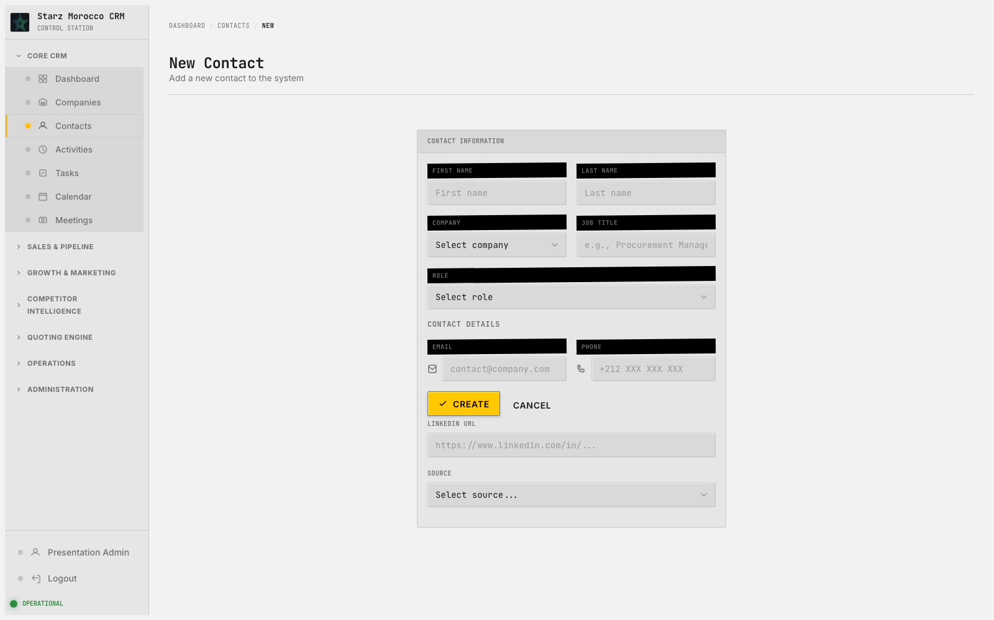
31. /contacts/new — New Contact
Module: Contact Management (Contact)
Module Purpose: The people side of each account: procurement, engineering, and decision-makers, with how strong the relationship is.
On-screen header: Add a new contact to the system
Where it fits: Accurate contact context here means outreach lands at the right time with the right person. The master-data workspace — it keeps the people-and-companies records that every other workflow leans on accurate, current, and ready for action.
What this page does: The master-data workspace — it keeps the people-and-companies records that every other workflow leans on accurate, current, and ready for action.
Try this in the demo:
Why it matters:
• Keep account and contact attributes clean before you trigger any RFQ, campaign, or meeting from them.
• Use the discovered, new, and edit flows to keep duplicates and half-finished records out of core operations.
• Saves the core CRM records that every other workflow depends on.
• Personalization, routing, and handoffs between teams all get more accurate.
CRM v2 Executive Walkthrough

Slide 35
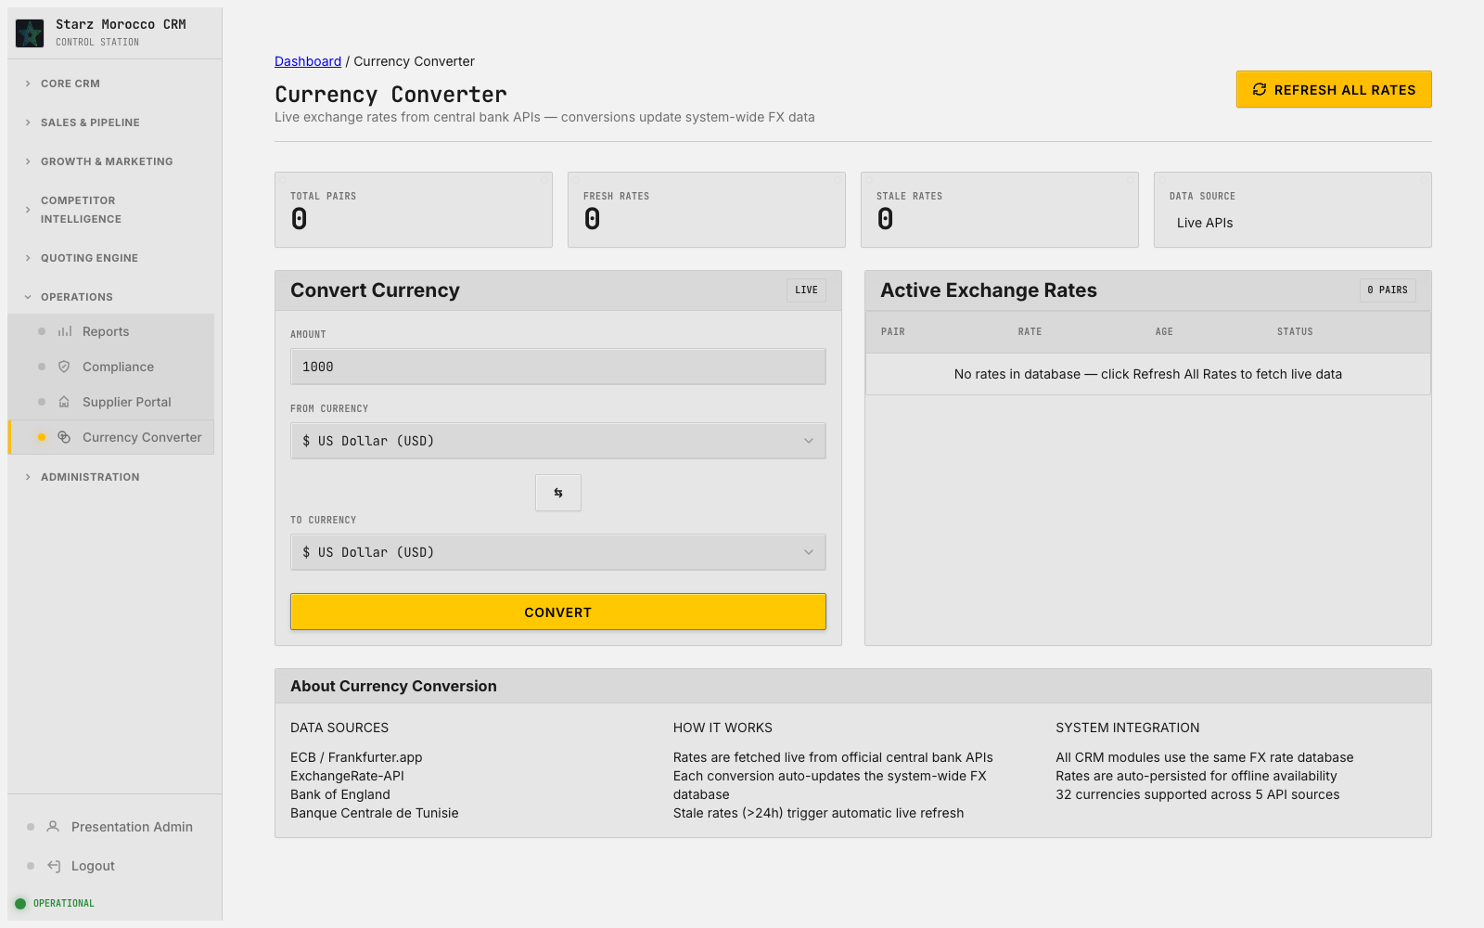
32. /currency-converter — Currency Converter
Module: Currency Converter (FX conversion records)
Module Purpose: Keeps every quote and report in comparable currency so cross-region comparisons stay honest.
On-screen header: Live exchange rates from central bank APIs — conversions update system-wide FX data
Where it fits: Here, work is prioritized and routed to the right person. The analytical and normalization layer — it makes numbers comparable so decisions can be made on a fair, consistent basis.
What this page does: The analytical and normalization layer — it makes numbers comparable so decisions can be made on a fair, consistent basis.
Try this in the demo:
Why it matters:
• Use this page to standardize comparisons and take guesswork out of performance discussions.
• Treat reports and conversions as inputs to a next decision, not as one-off documents.
• Produces decision-grade reports and normalized values that sales operations actually use.
• Executive and team-level planning becomes more consistent across regions and time periods.
CRM v2 Executive Walkthrough

Slide 36
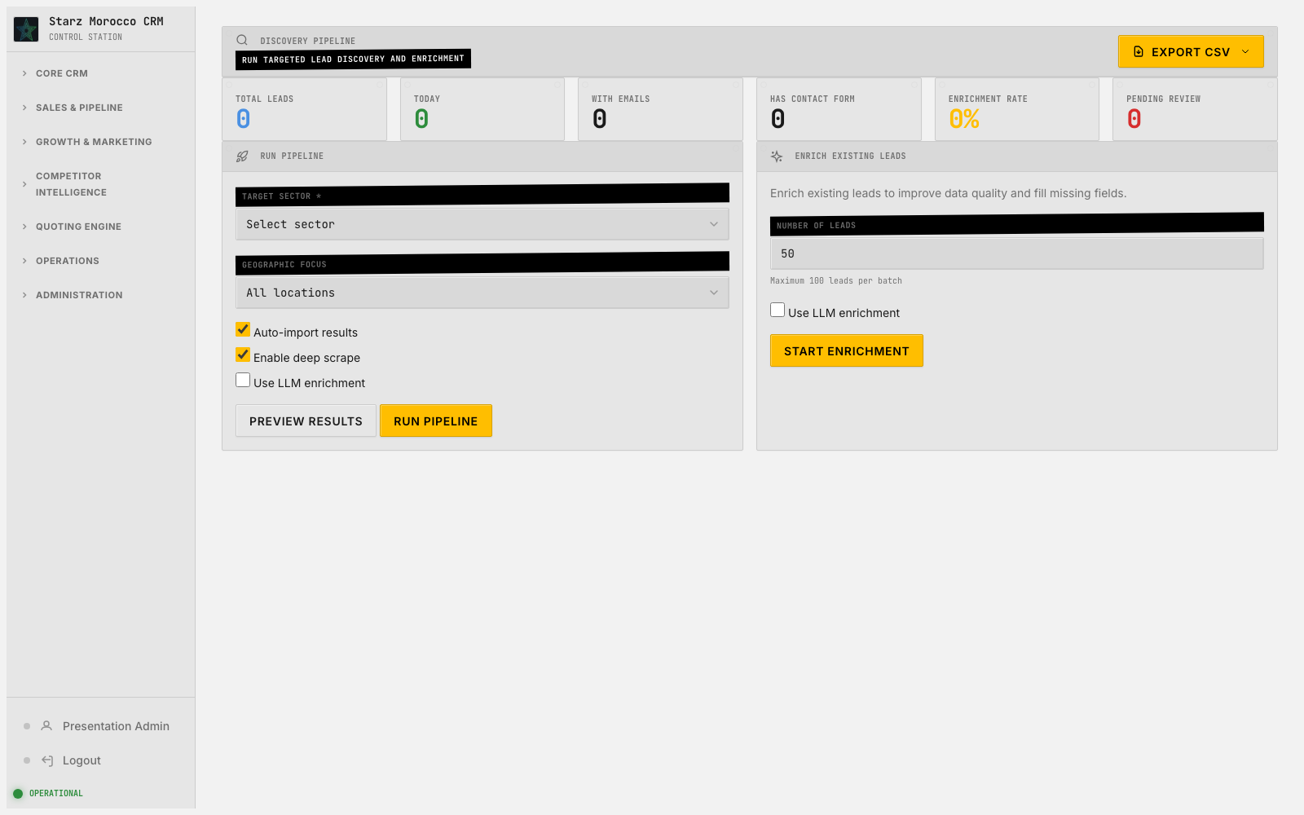
33. /discovery-pipeline — Discovery Pipeline
Module: Discovery Pipeline (Discovery pipeline stages)
Module Purpose: Shows how new prospects flow from first discovery all the way to qualified opportunity.
Where it fits: Here, work is prioritized and routed to the right person. The discovery and qualification layer — it finds high-fit targets out on the web and decides which ones earn a spot in the real CRM funnel.
What this page does: The discovery and qualification layer — it finds high-fit targets out on the web and decides which ones earn a spot in the real CRM funnel.
Try this in the demo:
Why it matters:
• Read the fit evidence, run dedupe checks, and apply qualification thresholds before promoting a lead.
• Use the review and discovered views to keep low-fit noise away from real companies and contacts.
• Saves new or updated lead records with explicit status transitions and a clear reason for each decision.
• Top-of-funnel quality rises and the team stops burning hours on companies that were never going to buy.
CRM v2 Executive Walkthrough

Slide 37
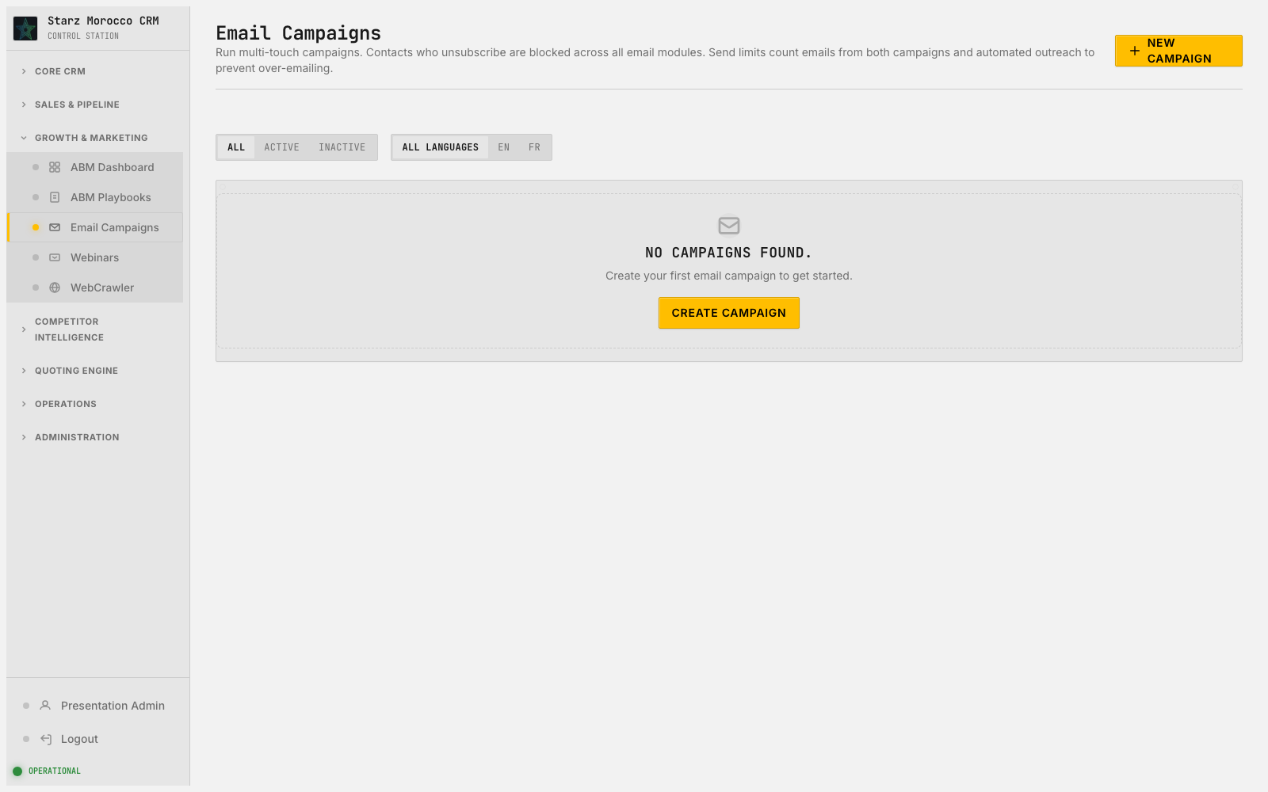
34. /email-campaigns/ — Email Campaigns
Module: Email Campaigns (EmailCampaign + EmailSend)
Module Purpose: Plan outreach sequences, send them, and watch how recipients respond — all in one place.
On-screen header: Run multi-touch campaigns. Contacts who unsubscribe are blocked across all email modules. Send limits count emails from both campaigns and automated outreach to prevent over-emailing.
Where it fits: This stage turns messaging work into something measurable instead of guesswork. The outreach engine — build campaigns or webinars, send them, and watch how the audience reacts so the next one is sharper.
What this page does: The outreach engine — build campaigns or webinars, send them, and watch how the audience reacts so the next one is sharper.
Try this in the demo:
Why it matters:
• Adjust sequences based on real open, click, and reply patterns plus how well the audience fits.
• Treat sending and analytics as one loop: launch, measure, refine, relaunch.
• Saves campaign and send records and captures every engagement event so iteration is measurable.
• Outreach gets more efficient because untargeted volume drops and response quality climbs.
CRM v2 Executive Walkthrough

Slide 38
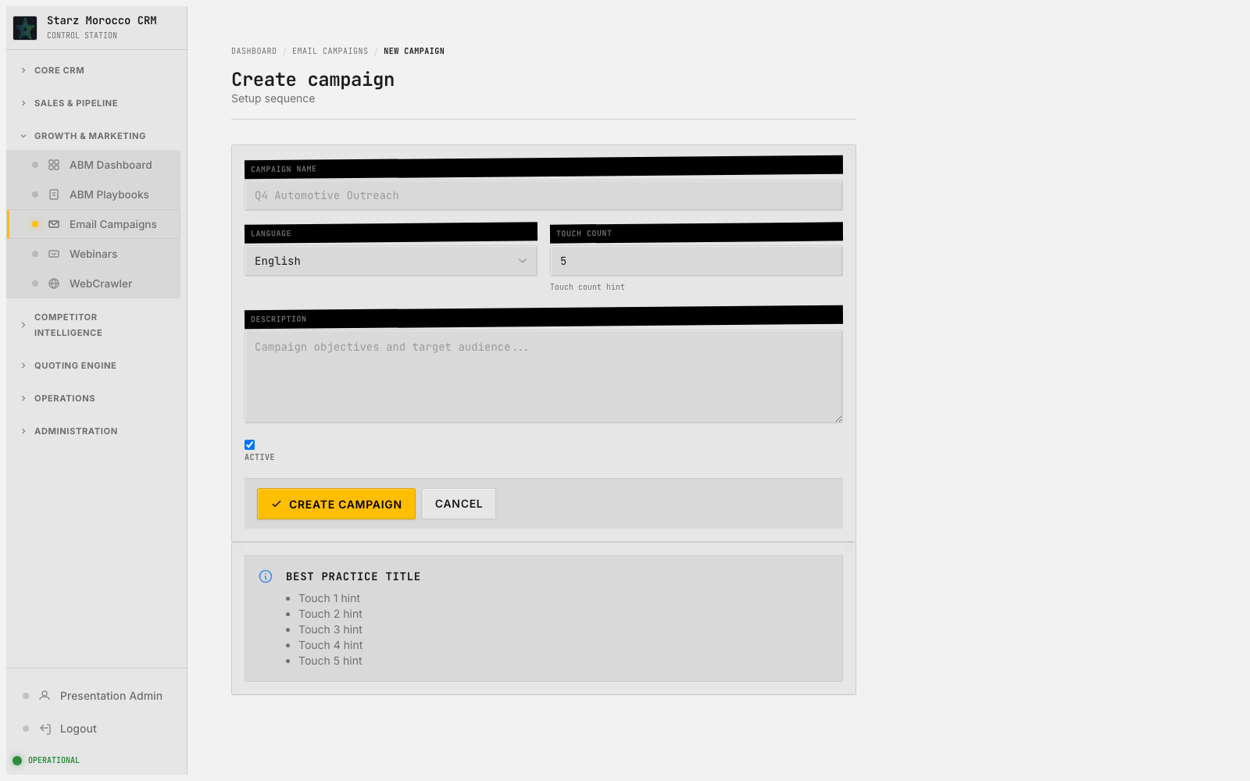
35. /email-campaigns/new — Create campaign
Module: Email Campaigns (EmailCampaign + EmailSend)
Module Purpose: Plan outreach sequences, send them, and watch how recipients respond — all in one place.
On-screen header: Setup sequence
Where it fits: This stage turns messaging work into something measurable instead of guesswork. The outreach engine — build campaigns or webinars, send them, and watch how the audience reacts so the next one is sharper.
What this page does: The outreach engine — build campaigns or webinars, send them, and watch how the audience reacts so the next one is sharper.
Try this in the demo:
Why it matters:
• Adjust sequences based on real open, click, and reply patterns plus how well the audience fits.
• Treat sending and analytics as one loop: launch, measure, refine, relaunch.
• Saves campaign and send records and captures every engagement event so iteration is measurable.
• Outreach gets more efficient because untargeted volume drops and response quality climbs.
CRM v2 Executive Walkthrough

Slide 39
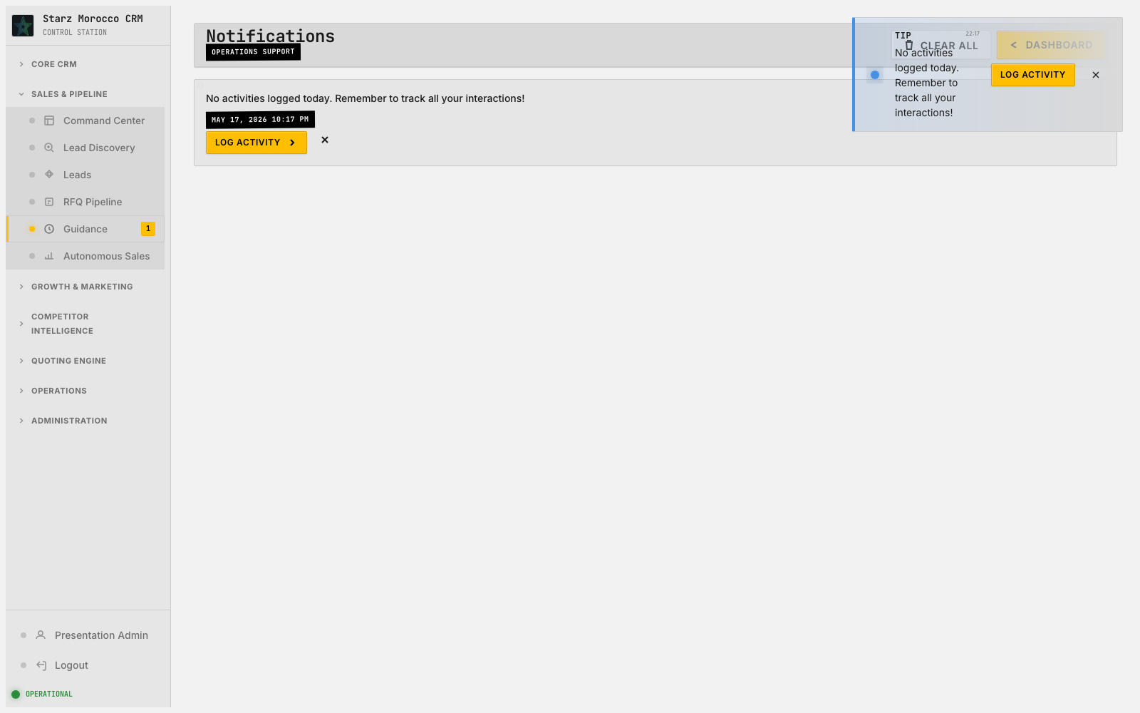
36. /guidance/all — Notifications
Module: Guidance Notifications (Session guidance events)
Module Purpose: Smart nudges that appear after big actions to remind you of the next best step.
Where it fits: This step is where the team gets a clear handle on what is in flight and who owns it. The execution layer — it turns intent into assigned, time-bound work that the team actually closes out.
What this page does: The execution layer — it turns intent into assigned, time-bound work that the team actually closes out.
Try this in the demo:
Why it matters:
• Rank due actions by urgency and impact, then close them out or re-scope honestly — no zombie tasks.
• Pay attention to guidance prompts after big actions (new company, activity, conversion) — they catch easy misses.
• Saves task and guidance state so next steps after big workflow events are operational, not theoretical.
• Follow-ups actually happen and commitments stop slipping between teams.
CRM v2 Executive Walkthrough

Slide 40
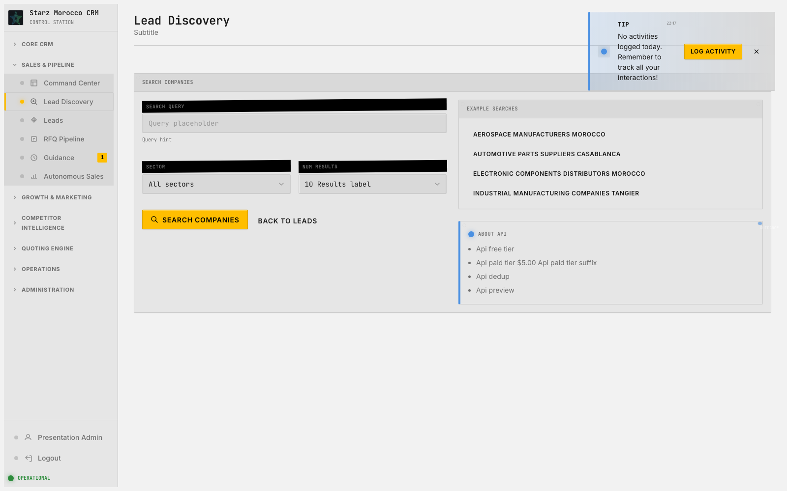
37. /lead-discovery/ — Lead Discovery
Module: Lead Discovery Queue (Lead queue)
Module Purpose: A staging area to sort through new leads before they ever touch your real account or contact list.
Where it fits: This is where raw discovery volume gets sorted into actual qualified opportunity flow. The discovery and qualification layer — it finds high-fit targets out on the web and decides which ones earn a spot in the real CRM funnel.
What this page does: The discovery and qualification layer — it finds high-fit targets out on the web and decides which ones earn a spot in the real CRM funnel.
Try this in the demo:
Why it matters:
• Read the fit evidence, run dedupe checks, and apply qualification thresholds before promoting a lead.
• Use the review and discovered views to keep low-fit noise away from real companies and contacts.
• Saves new or updated lead records with explicit status transitions and a clear reason for each decision.
• Top-of-funnel quality rises and the team stops burning hours on companies that were never going to buy.
CRM v2 Executive Walkthrough

Slide 41
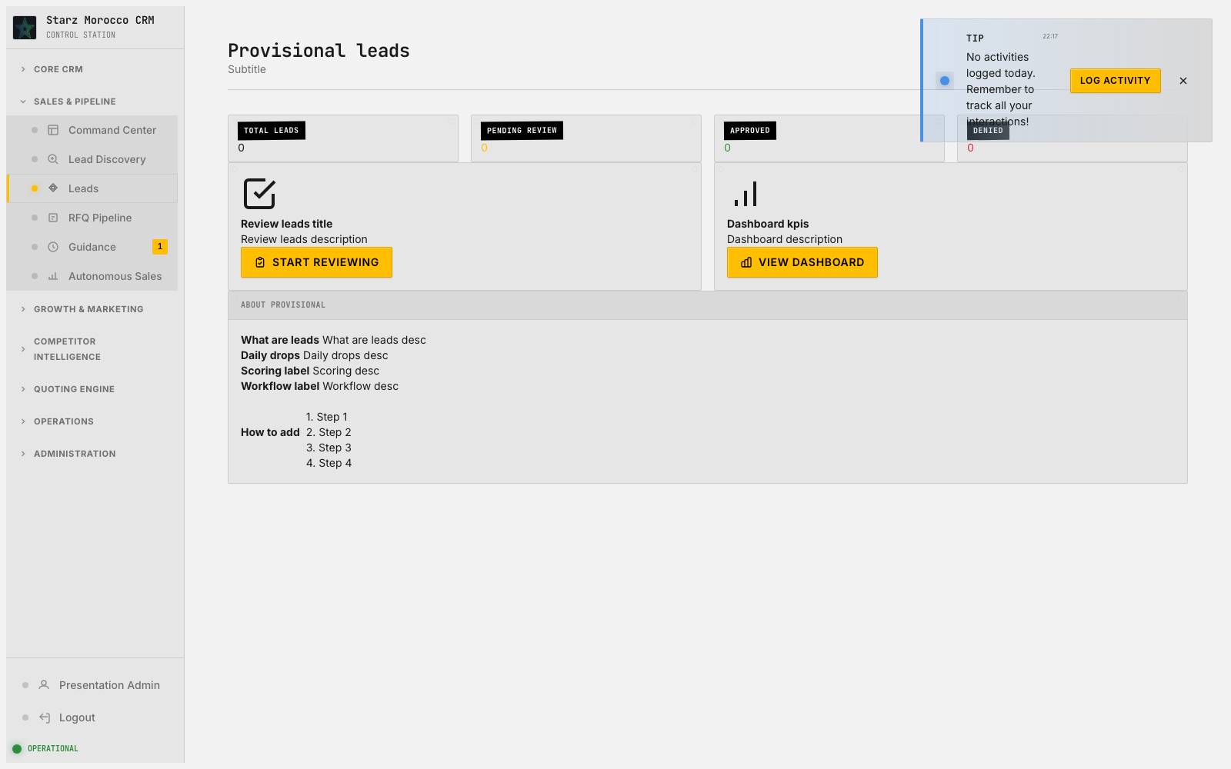
38. /leads/ — Provisional leads
Module: Lead Operations (Lead)
Module Purpose: Where freshly discovered companies are reviewed, approved or denied, and promoted into the real CRM.
Where it fits: Filtering for fit happens here so sales effort stays focused and the funnel stays clean. The discovery and qualification layer — it finds high-fit targets out on the web and decides which ones earn a spot in the real CRM funnel.
What this page does: The discovery and qualification layer — it finds high-fit targets out on the web and decides which ones earn a spot in the real CRM funnel.
Try this in the demo:
Why it matters:
• Read the fit evidence, run dedupe checks, and apply qualification thresholds before promoting a lead.
• Use the review and discovered views to keep low-fit noise away from real companies and contacts.
• Saves new or updated lead records with explicit status transitions and a clear reason for each decision.
• Top-of-funnel quality rises and the team stops burning hours on companies that were never going to buy.
CRM v2 Executive Walkthrough

Slide 42
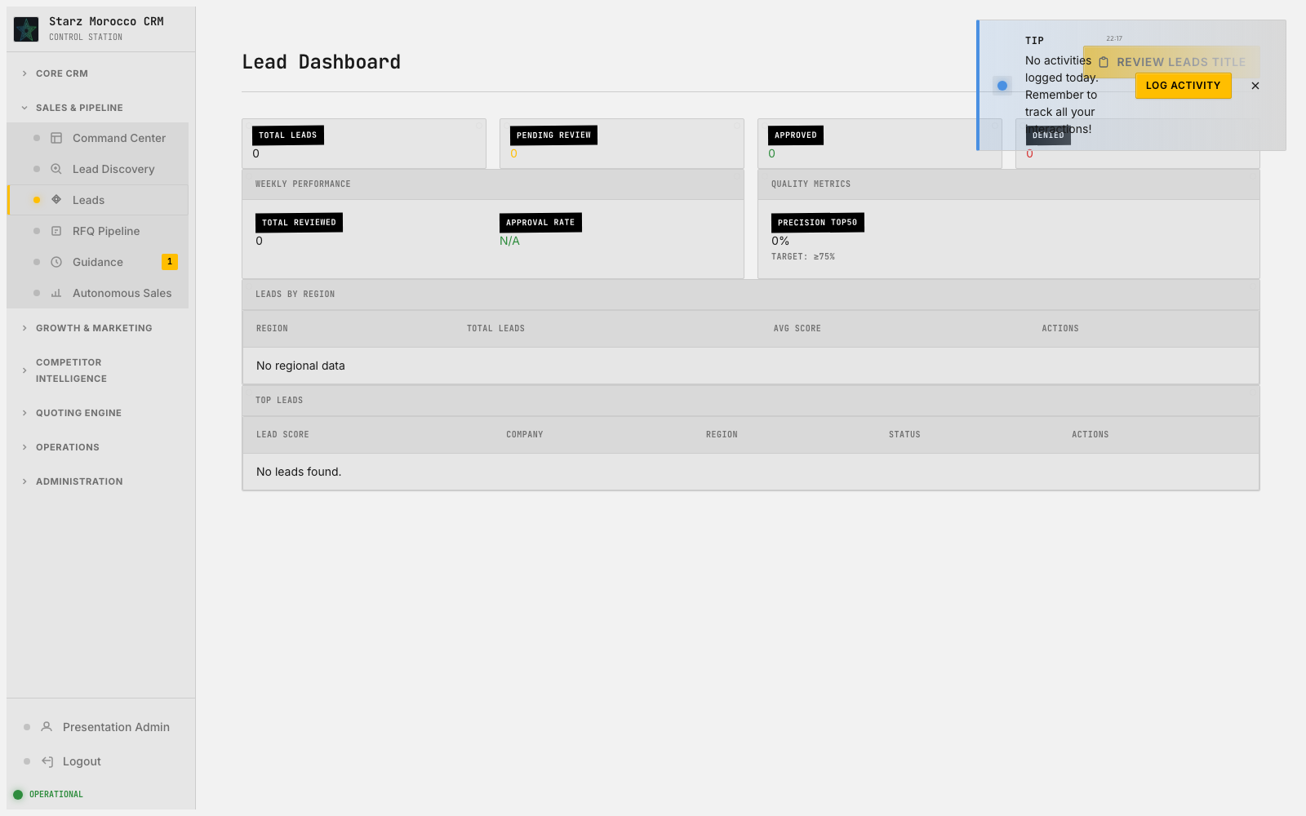
39. /leads/dashboard — Lead Dashboard
Module: Lead Operations (Lead)
Module Purpose: Where freshly discovered companies are reviewed, approved or denied, and promoted into the real CRM.
Where it fits: Filtering for fit happens here so sales effort stays focused and the funnel stays clean. The discovery and qualification layer — it finds high-fit targets out on the web and decides which ones earn a spot in the real CRM funnel.
What this page does: The discovery and qualification layer — it finds high-fit targets out on the web and decides which ones earn a spot in the real CRM funnel.
Try this in the demo:
Why it matters:
• Read the fit evidence, run dedupe checks, and apply qualification thresholds before promoting a lead.
• Use the review and discovered views to keep low-fit noise away from real companies and contacts.
• Saves new or updated lead records with explicit status transitions and a clear reason for each decision.
• Top-of-funnel quality rises and the team stops burning hours on companies that were never going to buy.
CRM v2 Executive Walkthrough

Slide 43
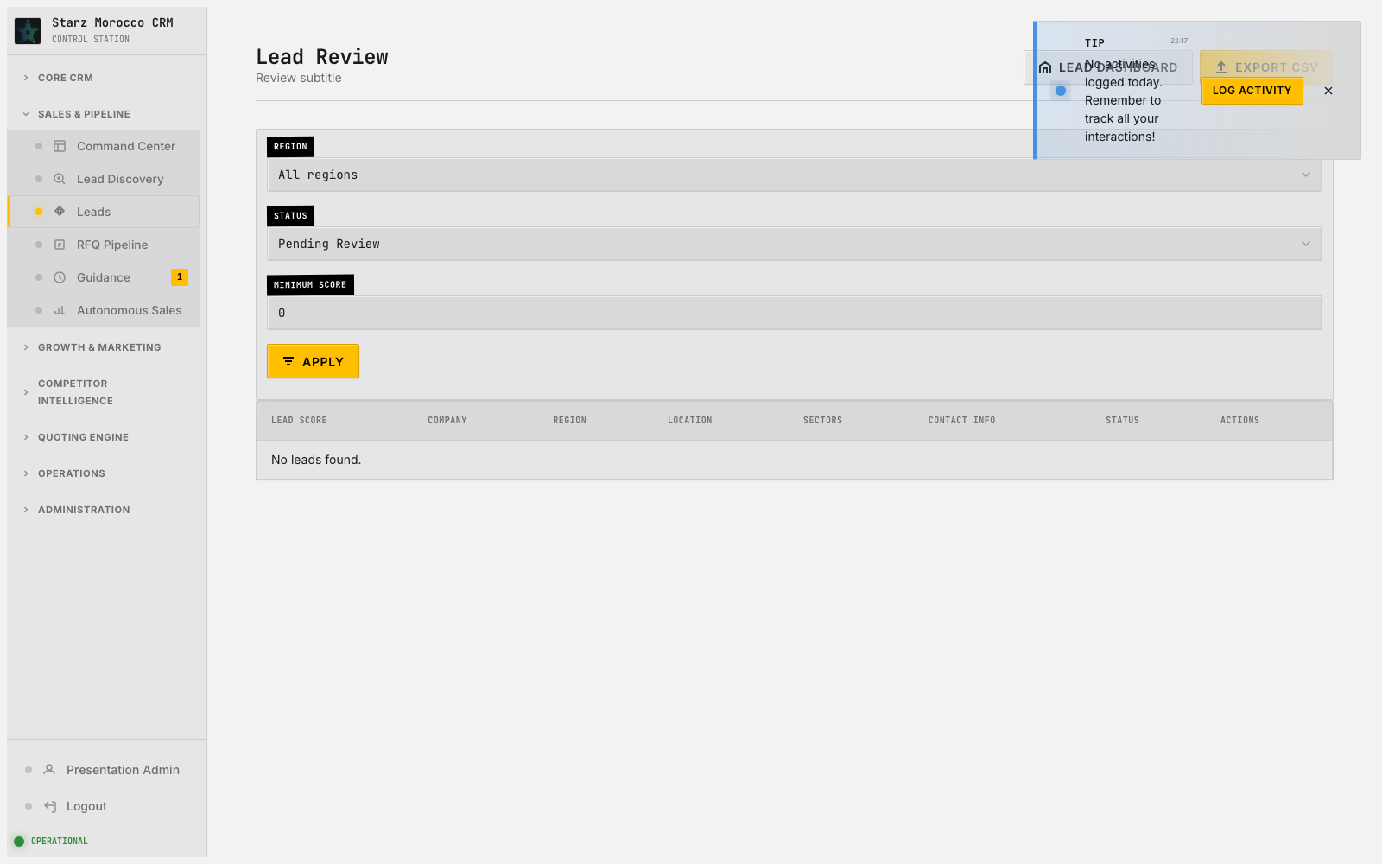
40. /leads/review — Lead Review
Module: Lead Operations (Lead)
Module Purpose: Where freshly discovered companies are reviewed, approved or denied, and promoted into the real CRM.
Where it fits: Filtering for fit happens here so sales effort stays focused and the funnel stays clean. The discovery and qualification layer — it finds high-fit targets out on the web and decides which ones earn a spot in the real CRM funnel.
What this page does: The discovery and qualification layer — it finds high-fit targets out on the web and decides which ones earn a spot in the real CRM funnel.
Try this in the demo:
Why it matters:
• Read the fit evidence, run dedupe checks, and apply qualification thresholds before promoting a lead.
• Use the review and discovered views to keep low-fit noise away from real companies and contacts.
• Saves new or updated lead records with explicit status transitions and a clear reason for each decision.
• Top-of-funnel quality rises and the team stops burning hours on companies that were never going to buy.
CRM v2 Executive Walkthrough

Slide 44
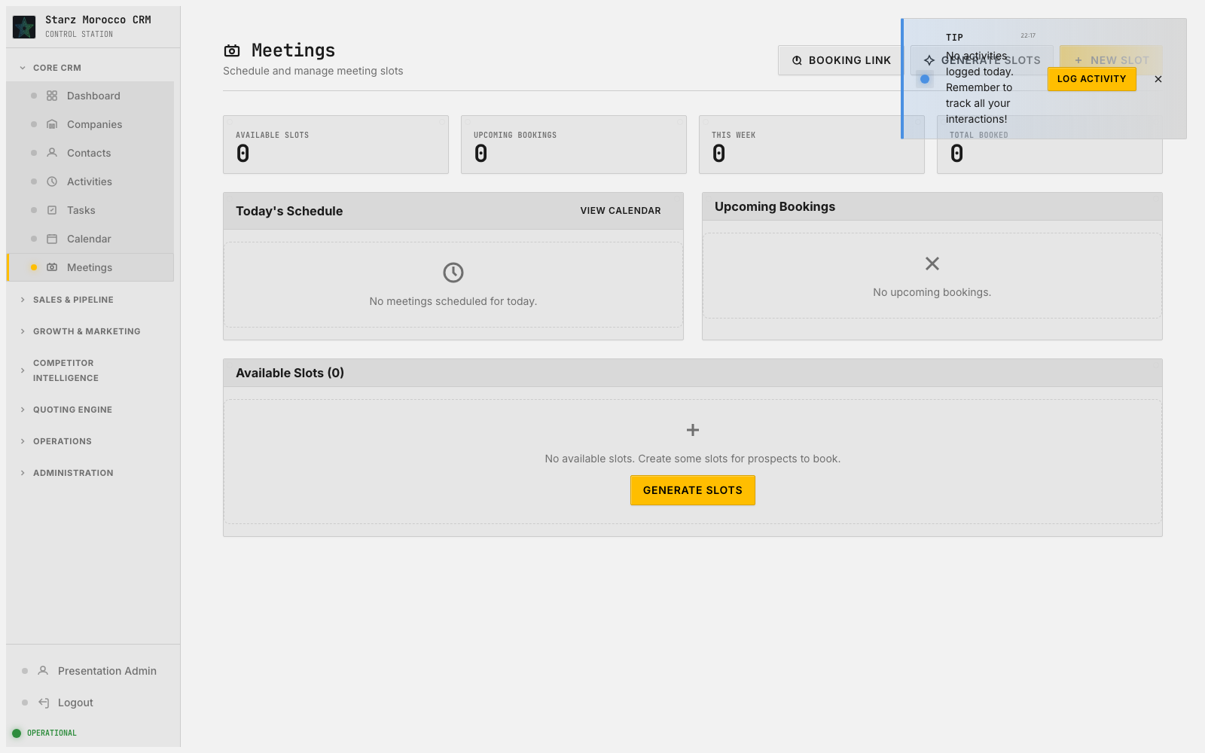
41. /meetings — Meetings
Module: Meeting Scheduler (Meeting)
Module Purpose: Share booking links, surface real availability, and convert interest into confirmed meetings.
On-screen header: Schedule and manage meeting slots
Where it fits: This step is where the team gets a clear handle on what is in flight and who owns it. The scheduling layer — it turns “someone is interested” into “meeting on the calendar at 2pm Tuesday” and keeps follow-up cadence predictable.
What this page does: The scheduling layer — it turns “someone is interested” into “meeting on the calendar at 2pm Tuesday” and keeps follow-up cadence predictable.
Try this in the demo:
Why it matters:
• Manage slots, availability, and booking links so it is easy to go from interest to confirmed meeting.
• Protect selling time by watching the calendar for bottlenecks and over-booking.
• Saves the schedule and booking state that the pipeline timeline depends on.
• More meetings get booked because the time between first interest and confirmed slot is shorter.
CRM v2 Executive Walkthrough

Slide 45
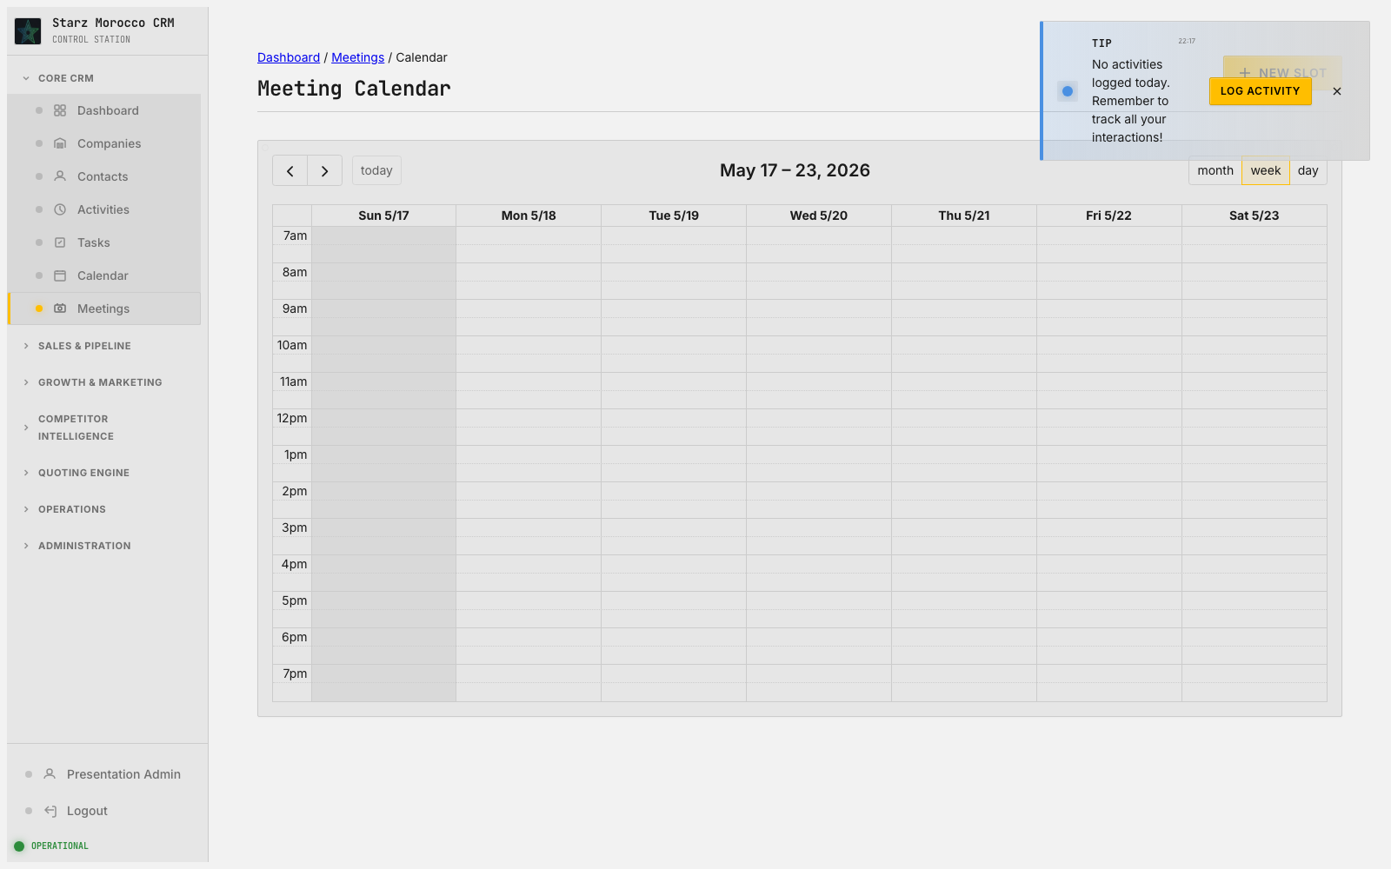
42. /meetings/calendar — Meeting Calendar
Module: Meeting Scheduler (Meeting)
Module Purpose: Share booking links, surface real availability, and convert interest into confirmed meetings.
Where it fits: Here, work is prioritized and routed to the right person. The scheduling layer — it turns “someone is interested” into “meeting on the calendar at 2pm Tuesday” and keeps follow-up cadence predictable.
What this page does: The scheduling layer — it turns “someone is interested” into “meeting on the calendar at 2pm Tuesday” and keeps follow-up cadence predictable.
Try this in the demo:
Why it matters:
• Manage slots, availability, and booking links so it is easy to go from interest to confirmed meeting.
• Protect selling time by watching the calendar for bottlenecks and over-booking.
• Saves the schedule and booking state that the pipeline timeline depends on.
• More meetings get booked because the time between first interest and confirmed slot is shorter.
CRM v2 Executive Walkthrough

Slide 46
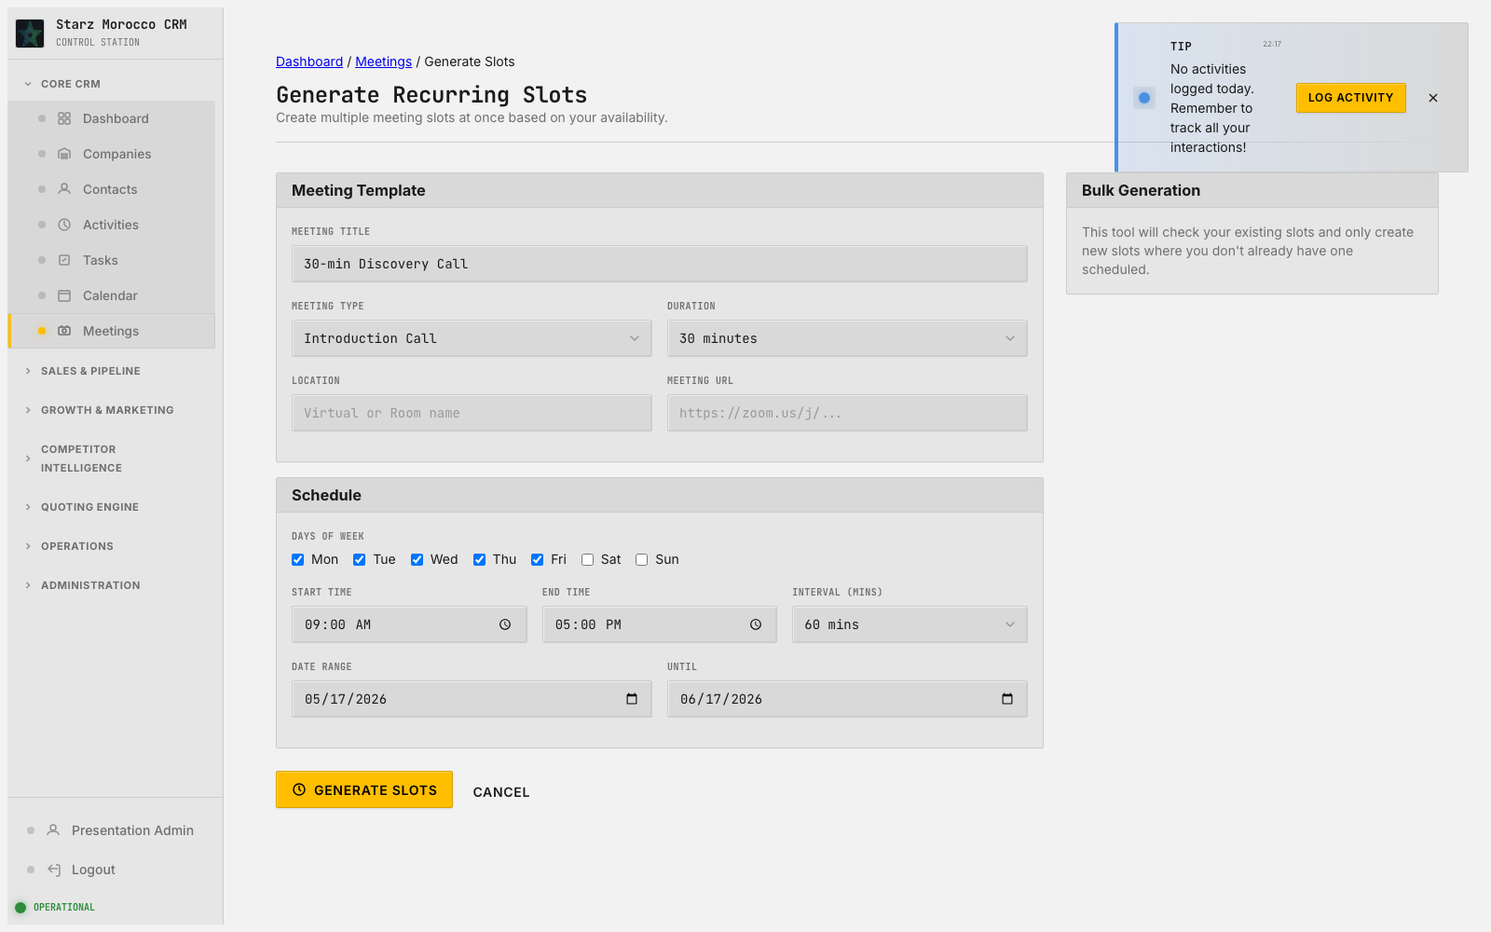
43. /meetings/generate — Generate Recurring Slots
Module: Meeting Scheduler (Meeting)
Module Purpose: Share booking links, surface real availability, and convert interest into confirmed meetings.
On-screen header: Create multiple meeting slots at once based on your availability.
Where it fits: At this point in the journey, this page keeps the customer lifecycle moving forward. The scheduling layer — it turns “someone is interested” into “meeting on the calendar at 2pm Tuesday” and keeps follow-up cadence predictable.
What this page does: The scheduling layer — it turns “someone is interested” into “meeting on the calendar at 2pm Tuesday” and keeps follow-up cadence predictable.
Try this in the demo:
Why it matters:
• Manage slots, availability, and booking links so it is easy to go from interest to confirmed meeting.
• Protect selling time by watching the calendar for bottlenecks and over-booking.
• Saves the schedule and booking state that the pipeline timeline depends on.
• More meetings get booked because the time between first interest and confirmed slot is shorter.
CRM v2 Executive Walkthrough

Slide 47
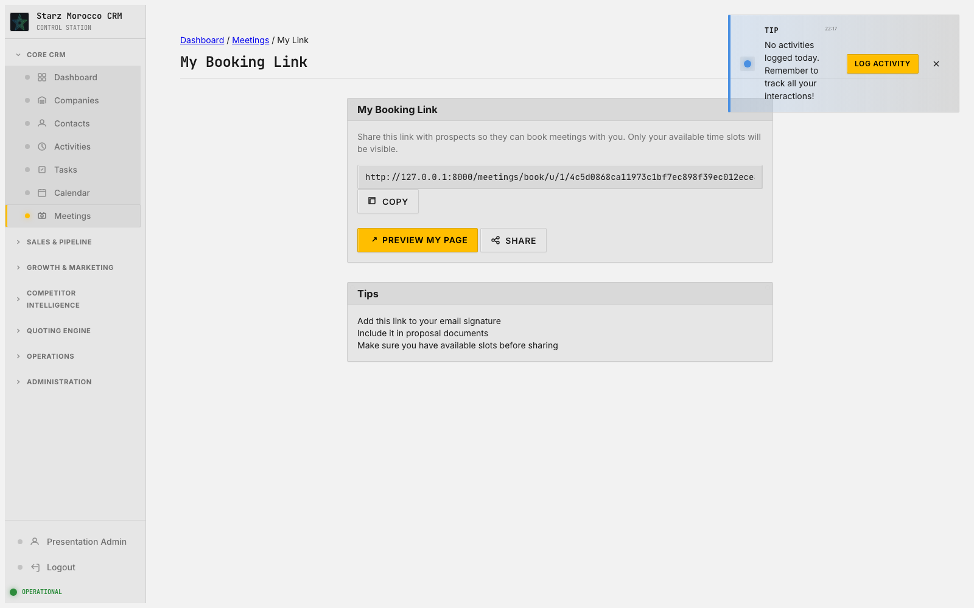
44. /meetings/my-link — My Booking Link
Module: Meeting Scheduler (Meeting)
Module Purpose: Share booking links, surface real availability, and convert interest into confirmed meetings.
Where it fits: Here, work is prioritized and routed to the right person. The scheduling layer — it turns “someone is interested” into “meeting on the calendar at 2pm Tuesday” and keeps follow-up cadence predictable.
What this page does: The scheduling layer — it turns “someone is interested” into “meeting on the calendar at 2pm Tuesday” and keeps follow-up cadence predictable.
Try this in the demo:
Why it matters:
• Manage slots, availability, and booking links so it is easy to go from interest to confirmed meeting.
• Protect selling time by watching the calendar for bottlenecks and over-booking.
• Saves the schedule and booking state that the pipeline timeline depends on.
• More meetings get booked because the time between first interest and confirmed slot is shorter.
CRM v2 Executive Walkthrough

Slide 48
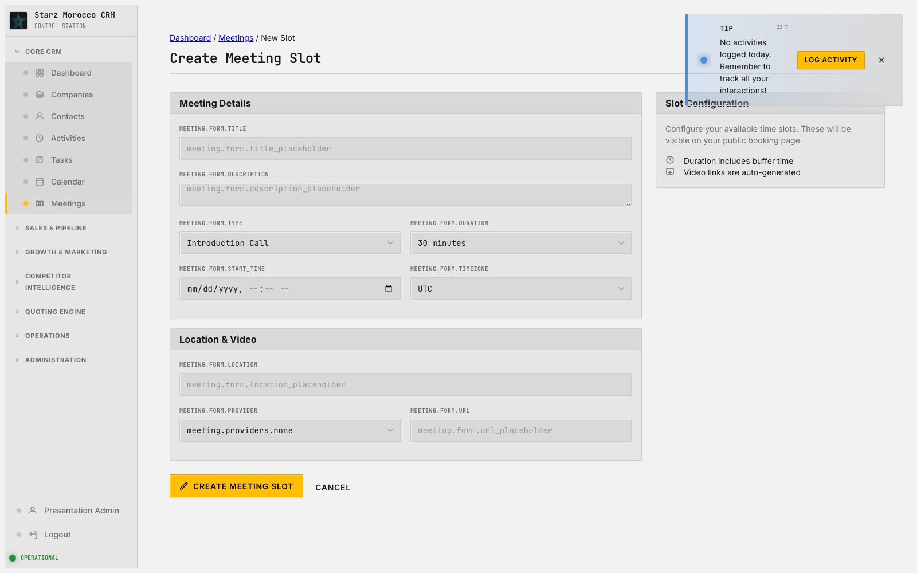
45. /meetings/new — Create Meeting Slot
Module: Meeting Scheduler (Meeting)
Module Purpose: Share booking links, surface real availability, and convert interest into confirmed meetings.
Where it fits: This is a record-creation moment, and the quality at entry shapes how fast things move later. The scheduling layer — it turns “someone is interested” into “meeting on the calendar at 2pm Tuesday” and keeps follow-up cadence predictable.
What this page does: The scheduling layer — it turns “someone is interested” into “meeting on the calendar at 2pm Tuesday” and keeps follow-up cadence predictable.
Try this in the demo:
Why it matters:
• Manage slots, availability, and booking links so it is easy to go from interest to confirmed meeting.
• Protect selling time by watching the calendar for bottlenecks and over-booking.
• Saves the schedule and booking state that the pipeline timeline depends on.
• More meetings get booked because the time between first interest and confirmed slot is shorter.
CRM v2 Executive Walkthrough

Slide 49
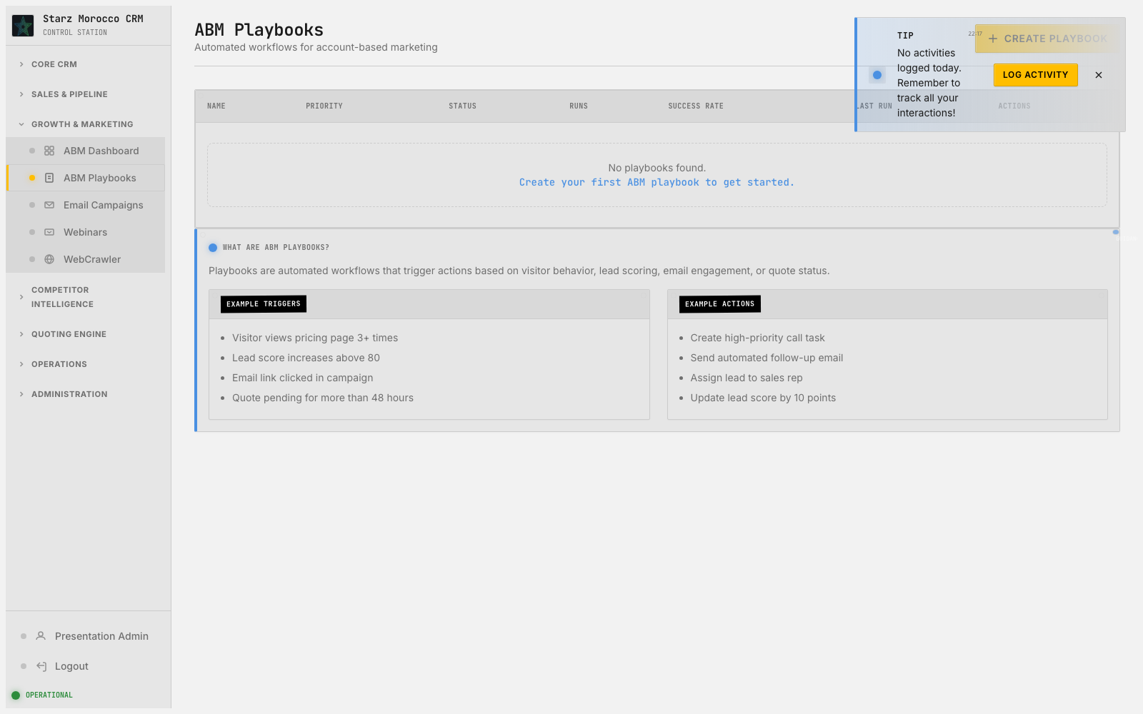
46. /playbooks/ — ABM Playbooks
Module: ABM Playbooks (Playbook)
Module Purpose: Reusable engagement recipes for the accounts and segments you target most often.
On-screen header: Automated workflows for account-based marketing
Where it fits: Here, work is prioritized and routed to the right person. This page is the main list and triage view for ABM Playbooks.
What this page does: This page is the main list and triage view for ABM Playbooks.
Try this in the demo:
Why it matters:
• Use the main controls on this screen to finish the current step without bouncing around the app.
• Double-check the data before saving — reports, automations, and handoffs all rely on what gets recorded here.
• Saves the change (or filtered view) tied to this route and leaves a clear trail of what happened.
• Keeps execution sharp because everyone knows who owns the next step and where it sits in the lifecycle.
CRM v2 Executive Walkthrough

Slide 50
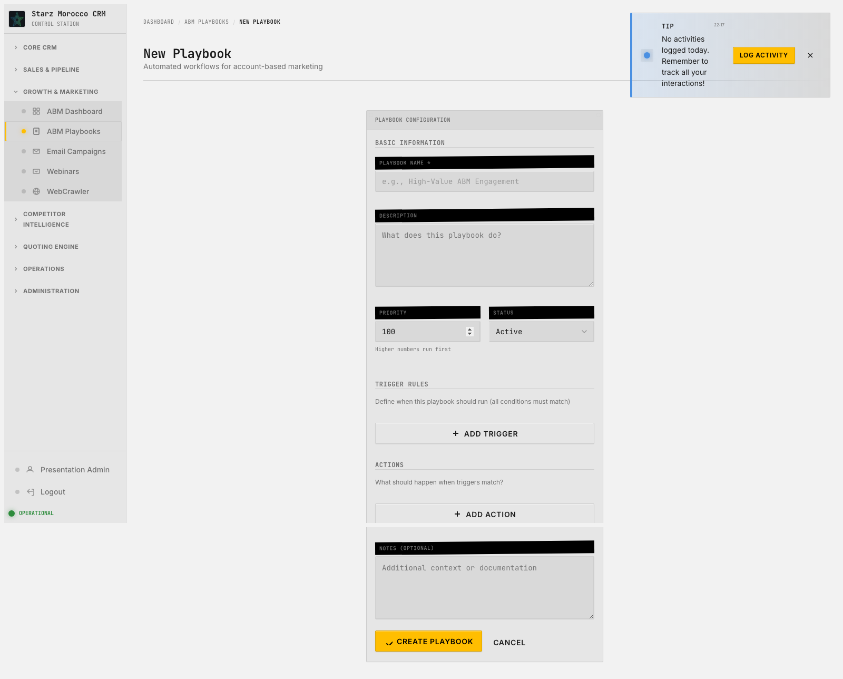
47. /playbooks/new — New Playbook
Module: ABM Playbooks (Playbook)
Module Purpose: Reusable engagement recipes for the accounts and segments you target most often.
On-screen header: Automated workflows for account-based marketing
Where it fits: This is a record-creation moment, and the quality at entry shapes how fast things move later. This page is the screen for adding new records for ABM Playbooks.
What this page does: This page is the screen for adding new records for ABM Playbooks.
Try this in the demo:
Why it matters:
• Use the main controls on this screen to finish the current step without bouncing around the app.
• Double-check the data before saving — reports, automations, and handoffs all rely on what gets recorded here.
• Saves the change (or filtered view) tied to this route and leaves a clear trail of what happened.
• Keeps execution sharp because everyone knows who owns the next step and where it sits in the lifecycle.
CRM v2 Executive Walkthrough

Slide 51
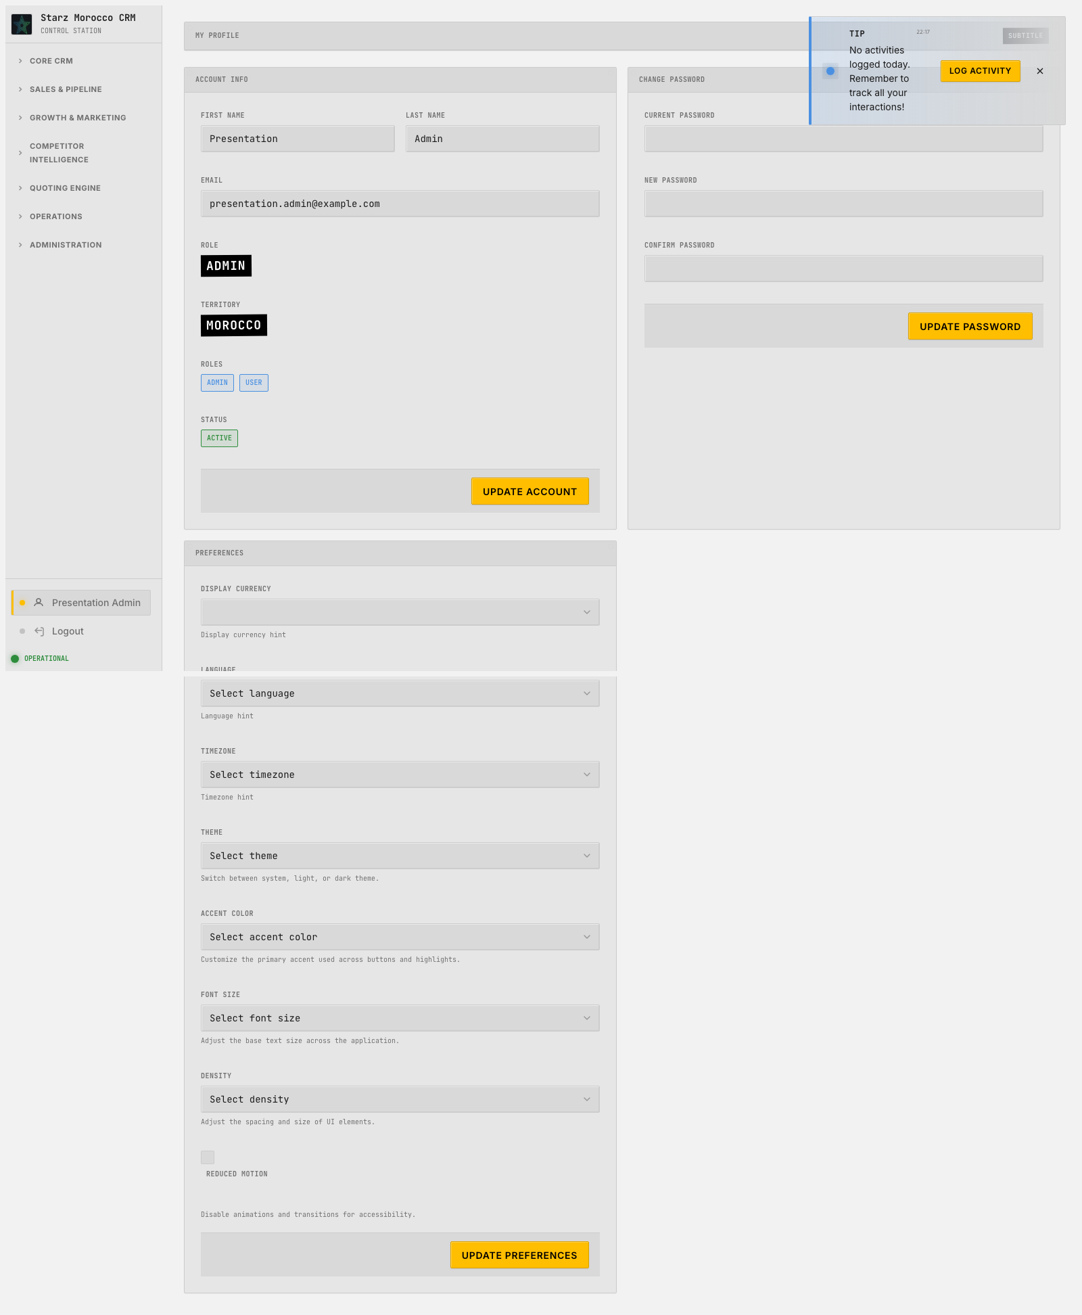
48. /profile — My Profile
Module: User Profile (User profile)
Module Purpose: Personal settings — how you appear in the system and how the system behaves for you.
Where it fits: Here, work is prioritized and routed to the right person. The master-data workspace — it keeps the people-and-companies records that every other workflow leans on accurate, current, and ready for action.
What this page does: The master-data workspace — it keeps the people-and-companies records that every other workflow leans on accurate, current, and ready for action.
Try this in the demo:
Why it matters:
• Keep account and contact attributes clean before you trigger any RFQ, campaign, or meeting from them.
• Use the discovered, new, and edit flows to keep duplicates and half-finished records out of core operations.
• Saves the core CRM records that every other workflow depends on.
• Personalization, routing, and handoffs between teams all get more accurate.
CRM v2 Executive Walkthrough

Slide 52
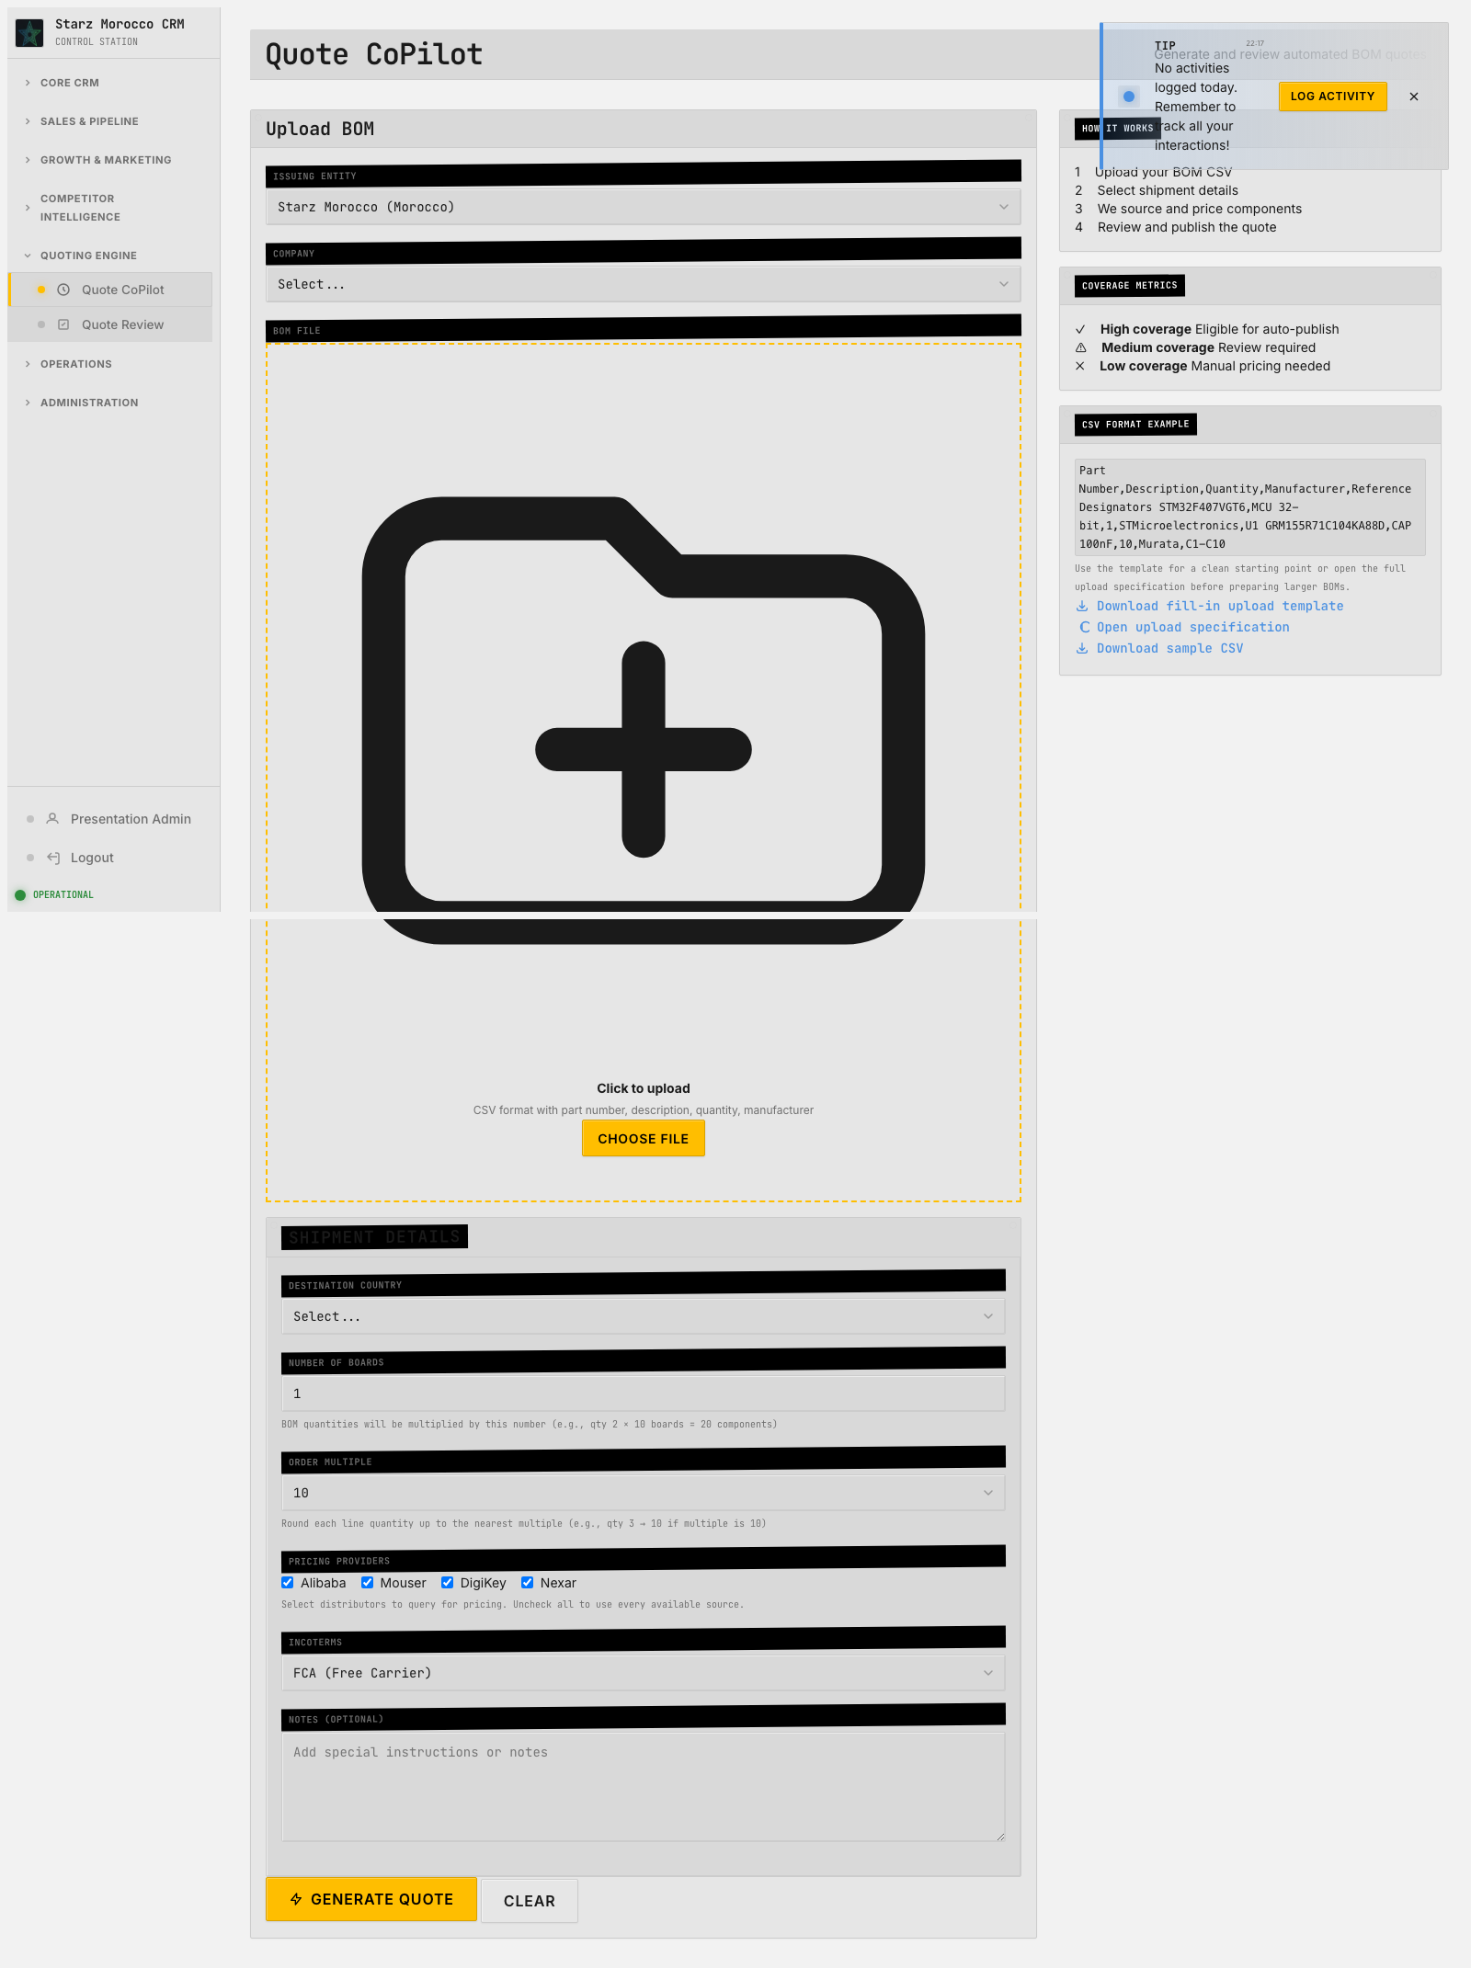
49. /quote-copilot — Quote CoPilot
Module: Quote CoPilot (Quote + BOM insights)
Module Purpose: A guided helper that walks you through pricing and sourcing decisions on each quote.
Where it fits: Here, work is prioritized and routed to the right person. The commercial workspace — deal economics, quote readiness, and stage movement all get actively managed here, where revenue is actually won or lost.
What this page does: The commercial workspace — deal economics, quote readiness, and stage movement all get actively managed here, where revenue is actually won or lost.
Try this in the demo:
Why it matters:
• Check pricing, risk, and readiness signals before you push a quote or RFQ to the next stage.
• Use pipeline and analytics views together — they tell you whether the problem is speed or win rate.
• Saves quote and RFQ status changes plus the reasoning behind them, which feeds revenue forecasts.
• Conversion quality goes up because every commercial checkpoint is deliberate, not skipped.
CRM v2 Executive Walkthrough

Slide 53
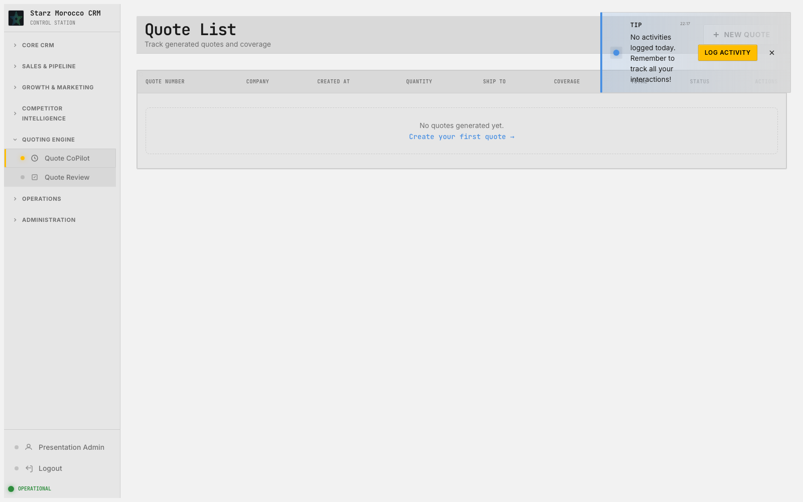
50. /quote-copilot/quotes — Quote List
Module: Quote CoPilot (Quote + BOM insights)
Module Purpose: A guided helper that walks you through pricing and sourcing decisions on each quote.
Where it fits: Here, work is prioritized and routed to the right person. The commercial workspace — deal economics, quote readiness, and stage movement all get actively managed here, where revenue is actually won or lost.
What this page does: The commercial workspace — deal economics, quote readiness, and stage movement all get actively managed here, where revenue is actually won or lost.
Try this in the demo:
Why it matters:
• Check pricing, risk, and readiness signals before you push a quote or RFQ to the next stage.
• Use pipeline and analytics views together — they tell you whether the problem is speed or win rate.
• Saves quote and RFQ status changes plus the reasoning behind them, which feeds revenue forecasts.
• Conversion quality goes up because every commercial checkpoint is deliberate, not skipped.
CRM v2 Executive Walkthrough

Slide 54

51. /quote-review — Quote Review
Module: Quote Review (Quote review records)
Module Purpose: Final commercial check on each quote before it goes to the customer — numbers, terms, readiness.
On-screen header: Review generated quotes and price coverage
Where it fits: Here, work is prioritized and routed to the right person. The commercial workspace — deal economics, quote readiness, and stage movement all get actively managed here, where revenue is actually won or lost.
What this page does: The commercial workspace — deal economics, quote readiness, and stage movement all get actively managed here, where revenue is actually won or lost.
Try this in the demo:
Why it matters:
• Check pricing, risk, and readiness signals before you push a quote or RFQ to the next stage.
• Use pipeline and analytics views together — they tell you whether the problem is speed or win rate.
• Saves quote and RFQ status changes plus the reasoning behind them, which feeds revenue forecasts.
• Conversion quality goes up because every commercial checkpoint is deliberate, not skipped.
CRM v2 Executive Walkthrough

Slide 55

52. /reports — Reports
Module: Report Builder (Report definitions + exports)
Module Purpose: Build the reports you keep coming back to — pipeline, performance, and pacing — once, and reuse them.
Where it fits: This is where everyday activity becomes the kind of insight you can build a plan on. The analytical and normalization layer — it makes numbers comparable so decisions can be made on a fair, consistent basis.
What this page does: The analytical and normalization layer — it makes numbers comparable so decisions can be made on a fair, consistent basis.
Try this in the demo:
Why it matters:
• Use this page to standardize comparisons and take guesswork out of performance discussions.
• Treat reports and conversions as inputs to a next decision, not as one-off documents.
• Produces decision-grade reports and normalized values that sales operations actually use.
• Executive and team-level planning becomes more consistent across regions and time periods.
CRM v2 Executive Walkthrough

Slide 56

53. /reports/new — Create New Report
Module: Report Builder (Report definitions + exports)
Module Purpose: Build the reports you keep coming back to — pipeline, performance, and pacing — once, and reuse them.
Where it fits: This layer turns work into clear planning and accountability numbers. The analytical and normalization layer — it makes numbers comparable so decisions can be made on a fair, consistent basis.
What this page does: The analytical and normalization layer — it makes numbers comparable so decisions can be made on a fair, consistent basis.
Try this in the demo:
Why it matters:
• Use this page to standardize comparisons and take guesswork out of performance discussions.
• Treat reports and conversions as inputs to a next decision, not as one-off documents.
• Produces decision-grade reports and normalized values that sales operations actually use.
• Executive and team-level planning becomes more consistent across regions and time periods.
CRM v2 Executive Walkthrough

Slide 57

54. /rfqs/ — RFQ Pipeline
Module: RFQ Pipeline (RFQ)
Module Purpose: The heart of commercial work — opportunities move through clear stages from first request to final outcome.
On-screen header: Track and manage RFQs
Where it fits: Quote readiness and stage confidence are managed here — it is where revenue is really won or lost. The commercial workspace — deal economics, quote readiness, and stage movement all get actively managed here, where revenue is actually won or lost.
What this page does: The commercial workspace — deal economics, quote readiness, and stage movement all get actively managed here, where revenue is actually won or lost.
Try this in the demo:
Why it matters:
• Check pricing, risk, and readiness signals before you push a quote or RFQ to the next stage.
• Use pipeline and analytics views together — they tell you whether the problem is speed or win rate.
• Saves quote and RFQ status changes plus the reasoning behind them, which feeds revenue forecasts.
• Conversion quality goes up because every commercial checkpoint is deliberate, not skipped.
CRM v2 Executive Walkthrough

Slide 58

55. /rfqs/analytics/win-loss — Win/Loss Analytics
Module: RFQ Pipeline (RFQ)
Module Purpose: The heart of commercial work — opportunities move through clear stages from first request to final outcome.
On-screen header: rfq.competitive_intelligence
Where it fits: Quote readiness and stage confidence are managed here — it is where revenue is really won or lost. The commercial workspace — deal economics, quote readiness, and stage movement all get actively managed here, where revenue is actually won or lost.
What this page does: The commercial workspace — deal economics, quote readiness, and stage movement all get actively managed here, where revenue is actually won or lost.
Try this in the demo:
Why it matters:
• Check pricing, risk, and readiness signals before you push a quote or RFQ to the next stage.
• Use pipeline and analytics views together — they tell you whether the problem is speed or win rate.
• Saves quote and RFQ status changes plus the reasoning behind them, which feeds revenue forecasts.
• Conversion quality goes up because every commercial checkpoint is deliberate, not skipped.
CRM v2 Executive Walkthrough

Slide 59

56. /rfqs/new — New RFQ
Module: RFQ Pipeline (RFQ)
Module Purpose: The heart of commercial work — opportunities move through clear stages from first request to final outcome.
Where it fits: Quote readiness and stage confidence are managed here — it is where revenue is really won or lost. The commercial workspace — deal economics, quote readiness, and stage movement all get actively managed here, where revenue is actually won or lost.
What this page does: The commercial workspace — deal economics, quote readiness, and stage movement all get actively managed here, where revenue is actually won or lost.
Try this in the demo:
Why it matters:
• Check pricing, risk, and readiness signals before you push a quote or RFQ to the next stage.
• Use pipeline and analytics views together — they tell you whether the problem is speed or win rate.
• Saves quote and RFQ status changes plus the reasoning behind them, which feeds revenue forecasts.
• Conversion quality goes up because every commercial checkpoint is deliberate, not skipped.
CRM v2 Executive Walkthrough

Slide 60

57. /rfqs/pipeline — RFQ Pipeline
Module: RFQ Pipeline (RFQ)
Module Purpose: The heart of commercial work — opportunities move through clear stages from first request to final outcome.
On-screen header: Track RFQs across stages
Where it fits: Quote readiness and stage confidence are managed here — it is where revenue is really won or lost. The commercial workspace — deal economics, quote readiness, and stage movement all get actively managed here, where revenue is actually won or lost.
What this page does: The commercial workspace — deal economics, quote readiness, and stage movement all get actively managed here, where revenue is actually won or lost.
Try this in the demo:
Why it matters:
• Check pricing, risk, and readiness signals before you push a quote or RFQ to the next stage.
• Use pipeline and analytics views together — they tell you whether the problem is speed or win rate.
• Saves quote and RFQ status changes plus the reasoning behind them, which feeds revenue forecasts.
• Conversion quality goes up because every commercial checkpoint is deliberate, not skipped.
CRM v2 Executive Walkthrough

Slide 61

58. /supplier-portal — Supplier Portal
Module: Supplier Portal (Supplier portal records)
Module Purpose: Handles supplier sign-up and tracks how actively they engage with us as a buyer.
On-screen header: Manage supplier onboarding and portal access
Where it fits: Here, work is prioritized and routed to the right person. The master-data workspace — it keeps the people-and-companies records that every other workflow leans on accurate, current, and ready for action.
What this page does: The master-data workspace — it keeps the people-and-companies records that every other workflow leans on accurate, current, and ready for action.
Try this in the demo:
Why it matters:
• Keep account and contact attributes clean before you trigger any RFQ, campaign, or meeting from them.
• Use the discovered, new, and edit flows to keep duplicates and half-finished records out of core operations.
• Saves the core CRM records that every other workflow depends on.
• Personalization, routing, and handoffs between teams all get more accurate.
CRM v2 Executive Walkthrough

Slide 62

59. /tasks — Tasks
Module: Task Execution (Task)
Module Purpose: Where intent becomes work — plan, assign, and close the things people actually need to do today.
Where it fits: This is the discipline layer — commitments turn into actual closed-out work here. The execution layer — it turns intent into assigned, time-bound work that the team actually closes out.
What this page does: The execution layer — it turns intent into assigned, time-bound work that the team actually closes out.
Try this in the demo:
Why it matters:
• Rank due actions by urgency and impact, then close them out or re-scope honestly — no zombie tasks.
• Pay attention to guidance prompts after big actions (new company, activity, conversion) — they catch easy misses.
• Saves task and guidance state so next steps after big workflow events are operational, not theoretical.
• Follow-ups actually happen and commitments stop slipping between teams.
CRM v2 Executive Walkthrough

Slide 63

60. /tasks/kanban — Kanban Board
Module: Task Execution (Task)
Module Purpose: Where intent becomes work — plan, assign, and close the things people actually need to do today.
Where it fits: Execution reliability is built here, one assigned task with a due date at a time. The execution layer — it turns intent into assigned, time-bound work that the team actually closes out.
What this page does: The execution layer — it turns intent into assigned, time-bound work that the team actually closes out.
Try this in the demo:
Why it matters:
• Rank due actions by urgency and impact, then close them out or re-scope honestly — no zombie tasks.
• Pay attention to guidance prompts after big actions (new company, activity, conversion) — they catch easy misses.
• Saves task and guidance state so next steps after big workflow events are operational, not theoretical.
• Follow-ups actually happen and commitments stop slipping between teams.
CRM v2 Executive Walkthrough

Slide 64

61. /tasks/my-day — My Day
Module: Task Execution (Task)
Module Purpose: Where intent becomes work — plan, assign, and close the things people actually need to do today.
On-screen header: Sunday, May 17, 2026
Where it fits: Execution reliability is built here, one assigned task with a due date at a time. The execution layer — it turns intent into assigned, time-bound work that the team actually closes out.
What this page does: The execution layer — it turns intent into assigned, time-bound work that the team actually closes out.
Try this in the demo:
Why it matters:
• Rank due actions by urgency and impact, then close them out or re-scope honestly — no zombie tasks.
• Pay attention to guidance prompts after big actions (new company, activity, conversion) — they catch easy misses.
• Saves task and guidance state so next steps after big workflow events are operational, not theoretical.
• Follow-ups actually happen and commitments stop slipping between teams.
CRM v2 Executive Walkthrough

Slide 65

62. /tasks/new — Create Task
Module: Task Execution (Task)
Module Purpose: Where intent becomes work — plan, assign, and close the things people actually need to do today.
Where it fits: Execution reliability is built here, one assigned task with a due date at a time. The execution layer — it turns intent into assigned, time-bound work that the team actually closes out.
What this page does: The execution layer — it turns intent into assigned, time-bound work that the team actually closes out.
Try this in the demo:
Why it matters:
• Rank due actions by urgency and impact, then close them out or re-scope honestly — no zombie tasks.
• Pay attention to guidance prompts after big actions (new company, activity, conversion) — they catch easy misses.
• Saves task and guidance state so next steps after big workflow events are operational, not theoretical.
• Follow-ups actually happen and commitments stop slipping between teams.
CRM v2 Executive Walkthrough

Slide 66

63. /webcrawler — LeadBot WebCrawler
Module: Webcrawler Discovery (Discovered company/contact candidates)
Module Purpose: Find new high-fit companies on the open web and score them by how well they match our ideal customer.
On-screen header: Discover companies using Google Dorks and LinkedIn search
Where it fits: Here, work is prioritized and routed to the right person. The discovery and qualification layer — it finds high-fit targets out on the web and decides which ones earn a spot in the real CRM funnel.
What this page does: The discovery and qualification layer — it finds high-fit targets out on the web and decides which ones earn a spot in the real CRM funnel.
Try this in the demo:
Why it matters:
• Read the fit evidence, run dedupe checks, and apply qualification thresholds before promoting a lead.
• Use the review and discovered views to keep low-fit noise away from real companies and contacts.
• Saves new or updated lead records with explicit status transitions and a clear reason for each decision.
• Top-of-funnel quality rises and the team stops burning hours on companies that were never going to buy.
CRM v2 Executive Walkthrough

Slide 67

64. /webcrawler/dork-generator — Dork Generator
Module: Webcrawler Discovery (Discovered company/contact candidates)
Module Purpose: Find new high-fit companies on the open web and score them by how well they match our ideal customer.
On-screen header: Generate custom Google search queries for company discovery
Where it fits: At this point in the journey, this page keeps the customer lifecycle moving forward. The discovery and qualification layer — it finds high-fit targets out on the web and decides which ones earn a spot in the real CRM funnel.
What this page does: The discovery and qualification layer — it finds high-fit targets out on the web and decides which ones earn a spot in the real CRM funnel.
Try this in the demo:
Why it matters:
• Read the fit evidence, run dedupe checks, and apply qualification thresholds before promoting a lead.
• Use the review and discovered views to keep low-fit noise away from real companies and contacts.
• Saves new or updated lead records with explicit status transitions and a clear reason for each decision.
• Top-of-funnel quality rises and the team stops burning hours on companies that were never going to buy.
CRM v2 Executive Walkthrough

Slide 68

65. /webcrawler/keyword-expansion — Keyword Expansion
Module: Webcrawler Discovery (Discovered company/contact candidates)
Module Purpose: Find new high-fit companies on the open web and score them by how well they match our ideal customer.
Where it fits: At this point in the journey, this page keeps the customer lifecycle moving forward. The discovery and qualification layer — it finds high-fit targets out on the web and decides which ones earn a spot in the real CRM funnel.
What this page does: The discovery and qualification layer — it finds high-fit targets out on the web and decides which ones earn a spot in the real CRM funnel.
Try this in the demo:
Why it matters:
• Read the fit evidence, run dedupe checks, and apply qualification thresholds before promoting a lead.
• Use the review and discovered views to keep low-fit noise away from real companies and contacts.
• Saves new or updated lead records with explicit status transitions and a clear reason for each decision.
• Top-of-funnel quality rises and the team stops burning hours on companies that were never going to buy.
CRM v2 Executive Walkthrough

Slide 69

66. /webinars — Webinars
Module: Webinar Operations (Webinar + registrations)
Module Purpose: Plan webinars, capture who registered, and route their interest into proper follow-up.
Where it fits: This step is where the team gets a clear handle on what is in flight and who owns it. The outreach engine — build campaigns or webinars, send them, and watch how the audience reacts so the next one is sharper.
What this page does: The outreach engine — build campaigns or webinars, send them, and watch how the audience reacts so the next one is sharper.
Try this in the demo:
Why it matters:
• Adjust sequences based on real open, click, and reply patterns plus how well the audience fits.
• Treat sending and analytics as one loop: launch, measure, refine, relaunch.
• Saves campaign and send records and captures every engagement event so iteration is measurable.
• Outreach gets more efficient because untargeted volume drops and response quality climbs.
CRM v2 Executive Walkthrough

Slide 70

67. /webinars/new — New Webinar
Module: Webinar Operations (Webinar + registrations)
Module Purpose: Plan webinars, capture who registered, and route their interest into proper follow-up.
Where it fits: This is a record-creation moment, and the quality at entry shapes how fast things move later. The outreach engine — build campaigns or webinars, send them, and watch how the audience reacts so the next one is sharper.
What this page does: The outreach engine — build campaigns or webinars, send them, and watch how the audience reacts so the next one is sharper.
Try this in the demo:
Why it matters:
• Adjust sequences based on real open, click, and reply patterns plus how well the audience fits.
• Treat sending and analytics as one loop: launch, measure, refine, relaunch.
• Saves campaign and send records and captures every engagement event so iteration is measurable.
• Outreach gets more efficient because untargeted volume drops and response quality climbs.
CRM v2 Executive Walkthrough

Slide 71
Bringing It All Together
The real power of CRM v2 is that every page pushes the same revenue journey forward — each click leaves an audit trail and feeds the next decision, so the team works as one connected system instead of a stack of disconnected tools.
Suggested demo path: Dashboard → Discovery → Master Data → Commercial Pipeline → Execution Discipline → Growth Loops → Reporting.
CRM v2 Executive Walkthrough

