Slide 1

Project evaluation
ML/DM
Students: Soumaya belfeki
Jury: Dr. Mohamed Lassaad Ammari
Dr. Tarek Aroui

Slide 2
Plan
Dataset description
Data preprocessing
Model training:
Logistic regression
Decision Tree
Testing performance

Slide 3
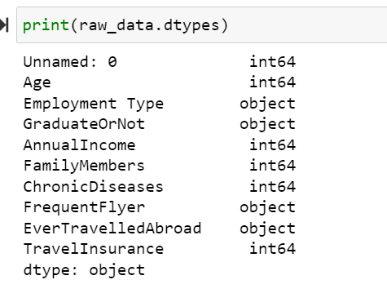
1- Dataset description
Name: Travel insurance prediction : Kaggel reference [1]
Attributs : 10
Nb of examples: 1800
Problem :
we want to investigate "what factors/variables affect the purchase of an insurance
2. Make predictions whether a customer will purchase the insurance policy from the company or not based on their characteristics

Slide 4
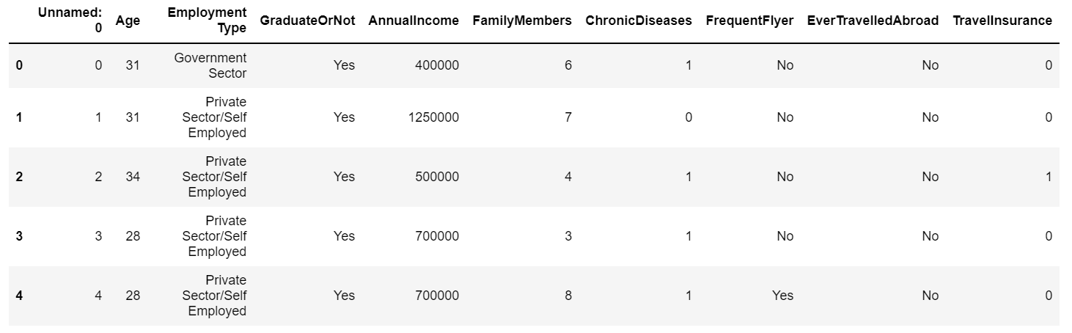
2- Data preprocessing
#we use panda is null () function to check null and missing value
#we use panda drop() function to drop unnamed column
raw_data.isnull().sum()

Slide 5
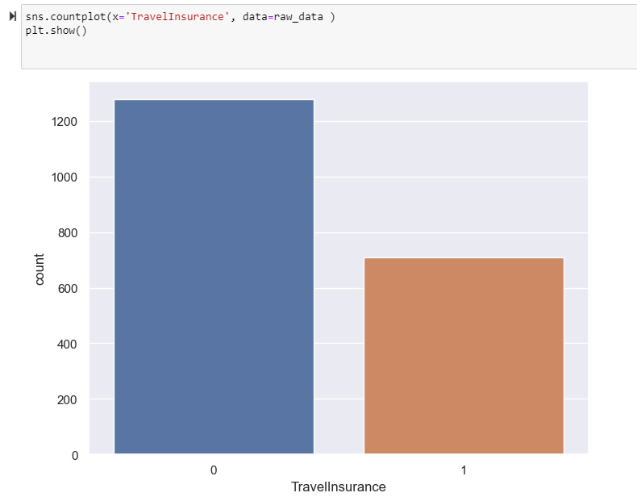
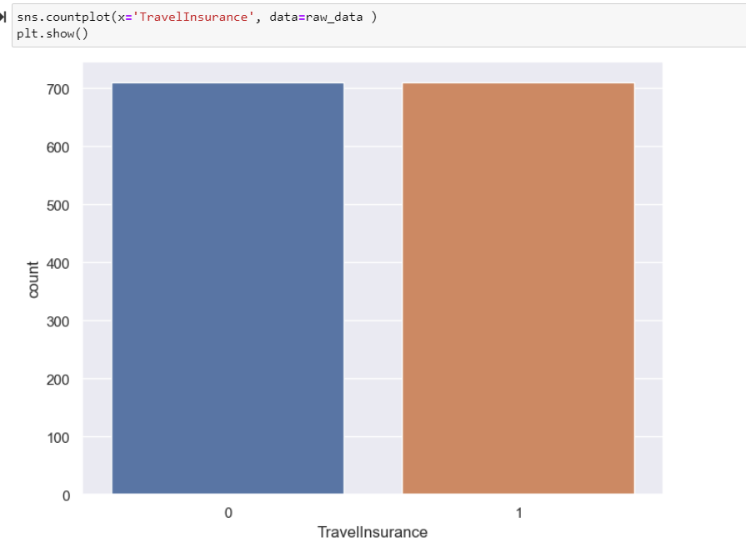
2- Data preprocessing : balincing dataset
Undersampling is a technique to balance datasets by keeping all of the data in the minority class and decreasing the size of the majority class
#under sampling

Slide 6
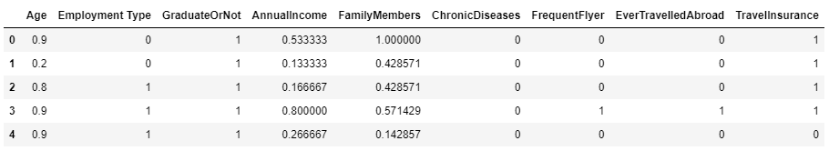
2- Data preprocessing : convert categorical variable to numeric value
# make categorical variable into numeric value

Slide 7
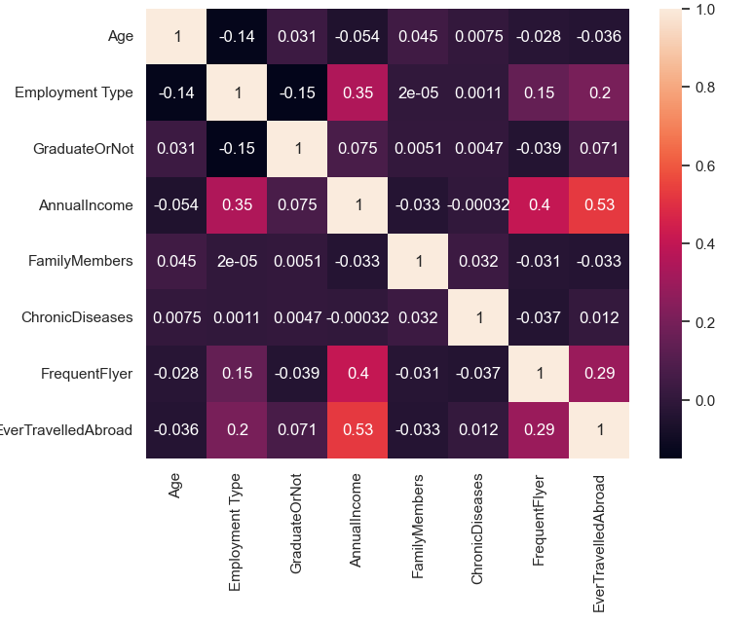
2- Data preprocessing : selecting feature
#all the variable are not dependent on each other

Slide 8
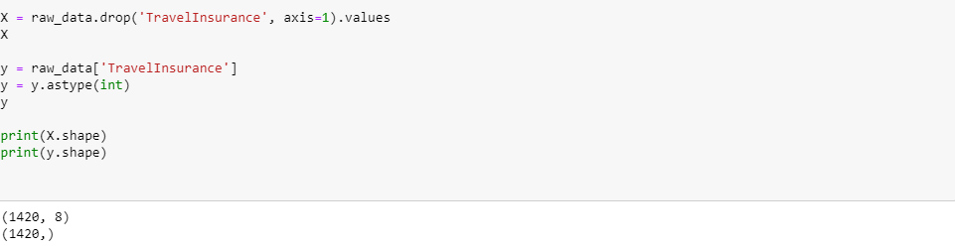
3- Model training (1)
X
y

Slide 9
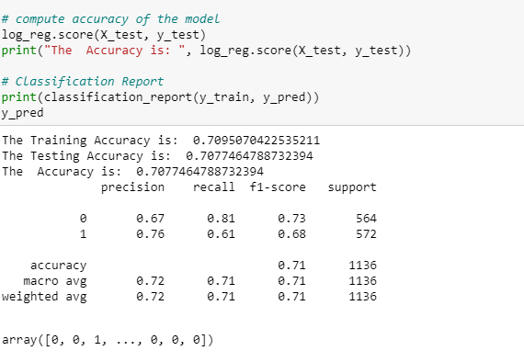
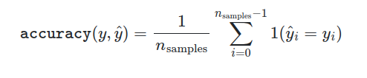
3- a. Logistic regression [2]
score

Slide 10
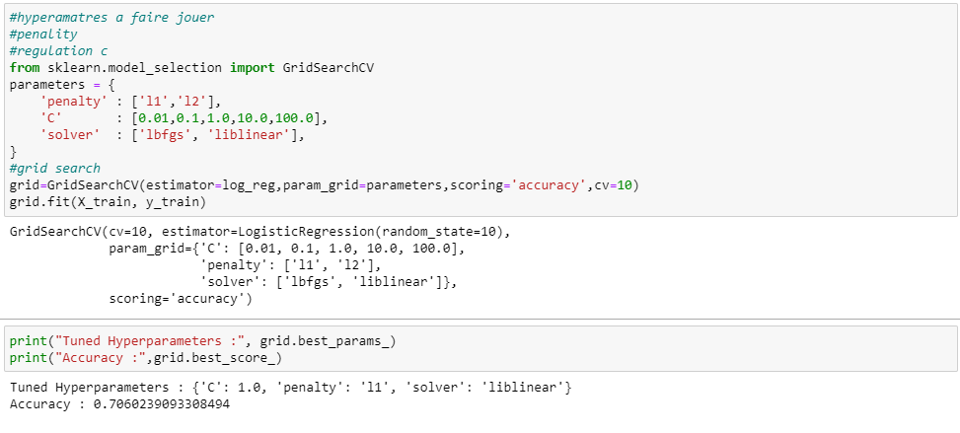
3- a. Logistic regression : hyperparameter
Number of Split

Slide 11
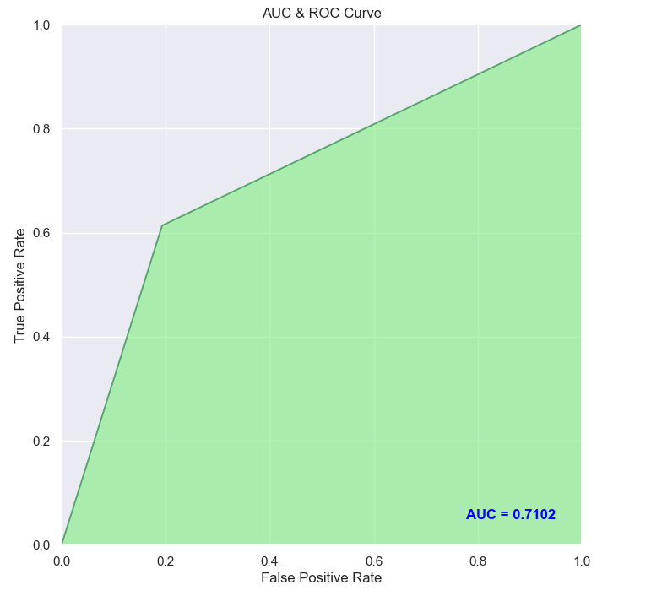
3- a. Logistic regression :
ROC and AUC for decision tree
For the first model (logistic regression ) AUC =0.710 means classifier will distinguish the positive class value from negative class value because it is finding more number of TP and TN compare to FP and FN.

Slide 12
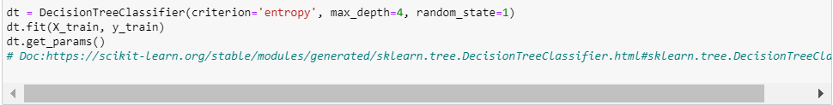
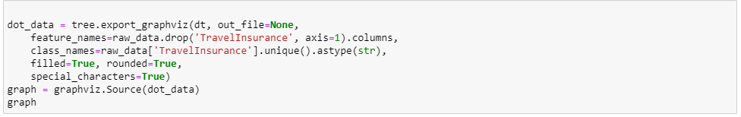
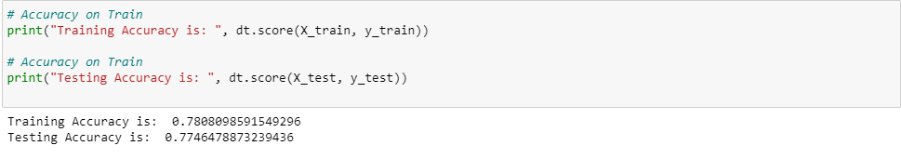

4- b. decision Tree

Slide 13
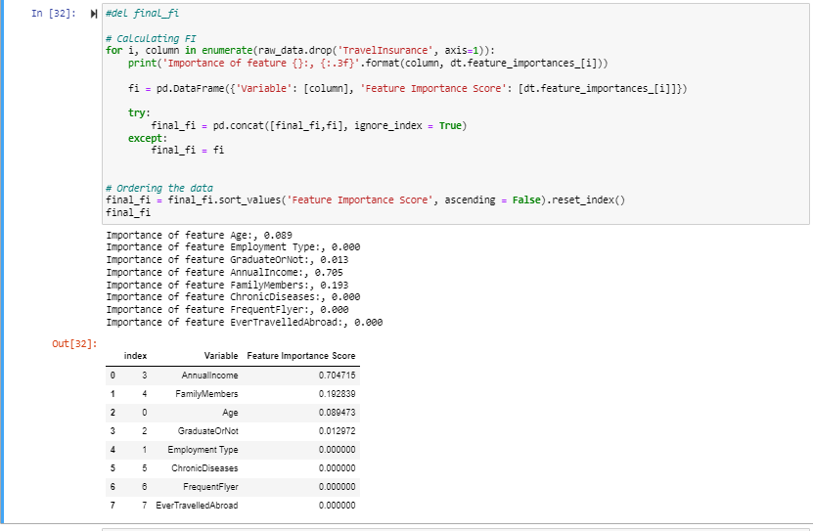
3- b. decision Tree : feature important

Slide 14
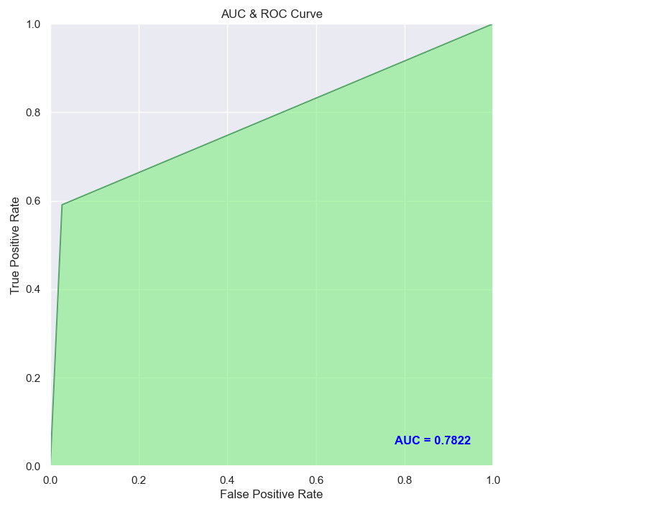
3- b. decision Tree :
ROC and AUC for decision tree(metric for comparing classifiers)
For the model (decision Tree) AUC =0.778 means classifier will distinguish the positive class value from negative class value because it is finding more number of TP and TN compare to FP and FN.
Here we infer s that value of AUC in first model is 0.778 while in second it is 0.710 which means our second model is better compare to our first model

Slide 15
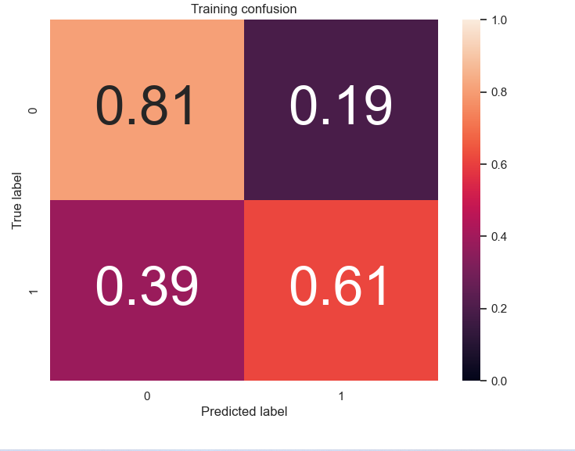
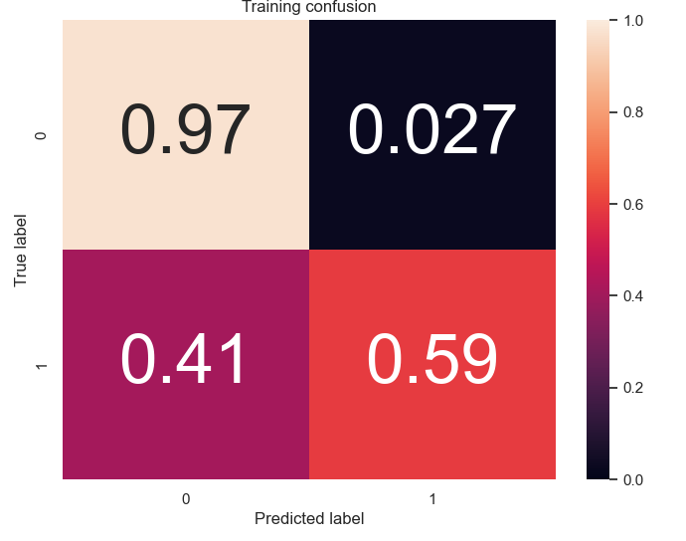
4- comparing confusing matrix results
Confusing matrix logistic regression
Confusing matrix decision tree
In the decision tree model model we predict more TN then the logistic regression while
In logistic model we predict more TP then the decision tree model

Slide 16
 | Regression Logistic | Decision tree
Accuracy | 0.709 | 07.7
precision | 0.67 | 0.69
recall | 0.81 | 0.84
F1 score | 0.73 | 0.76
False positive | 0.39 | 0.4
True positive(TP) | 0.61 | 0.6
True negative(TN) | 0.81 | 0.97
false negative | 0.19 | 0.03

