Slide 1
Abundance index for butterflies

Slide 2
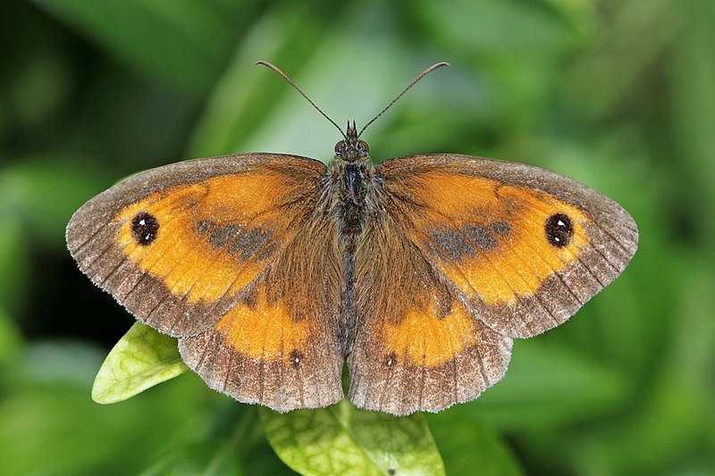
Gatekeeper Pyronia tithonus

Slide 3
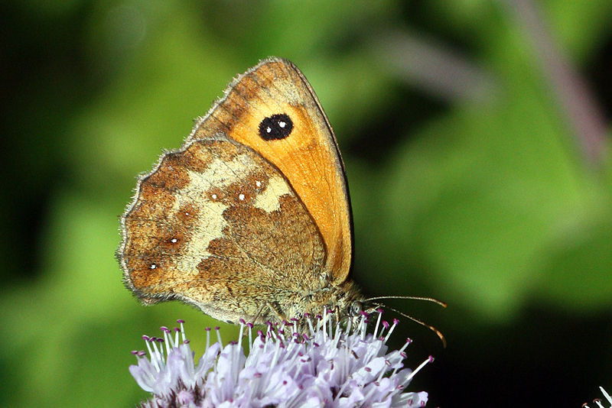
Gatekeeper Pyronia tithonus

Slide 4
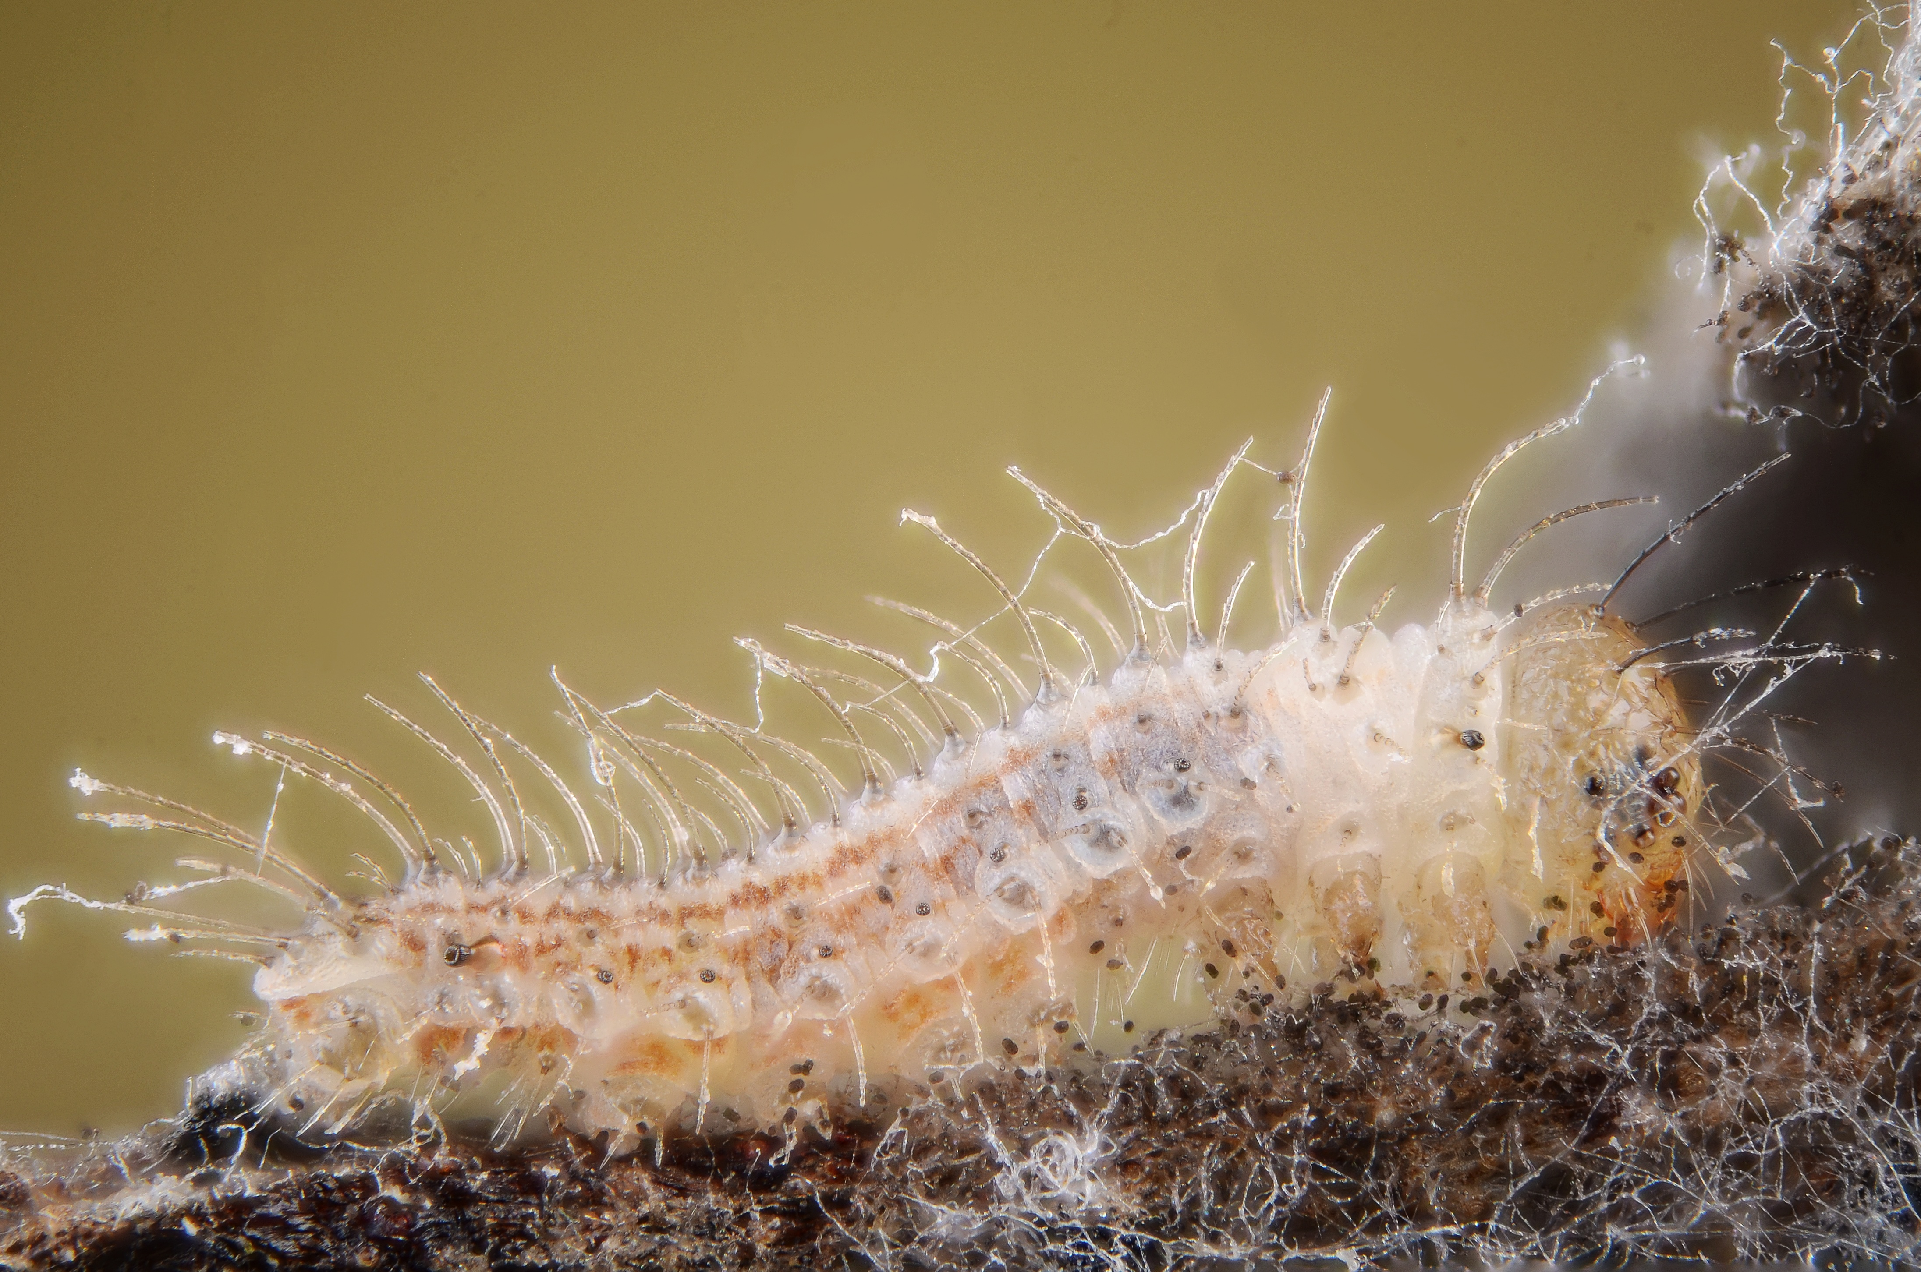
Gatekeeper Pyronia tithonus

Slide 5
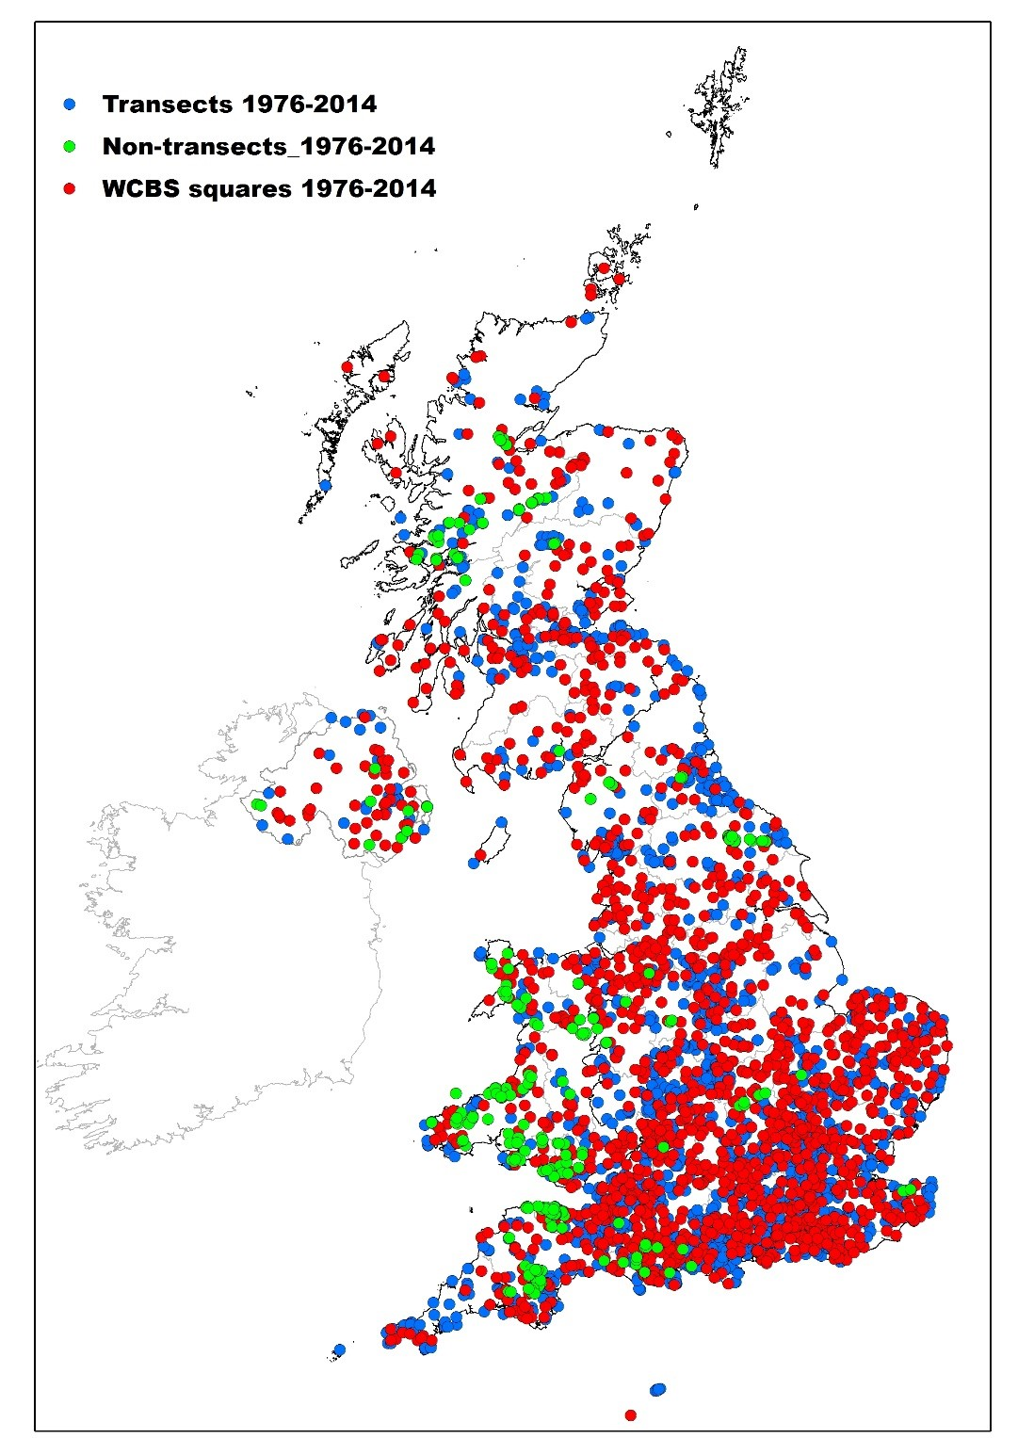
Butterfly monitoring

Slide 6
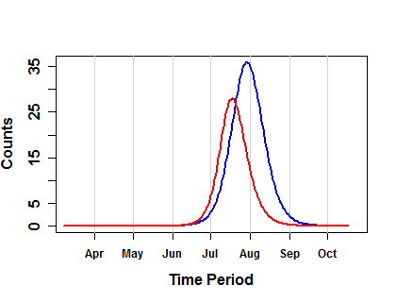
Phenology example

Slide 7
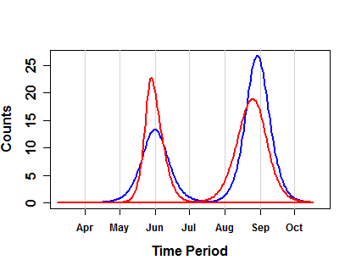
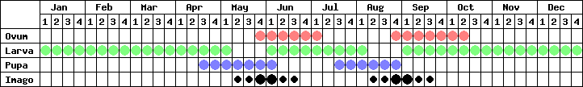
Phenology example

