Slide 1
e19.2
The PowerPoint Extension

Slide 2
When you are in your
zone going through the
presentation for your team,
your managers, your students,
or as a keynote and then
you got to switch to the next slide....

Slide 3
You cringe down into
your laptop searching for
the key that gets what you want....
And right there tempo is lost.

Slide 4
This product which is currently
in its development phase
gets the above situation solved
once and for all.

Slide 5
A gesture from you for the
next slide.

Slide 6
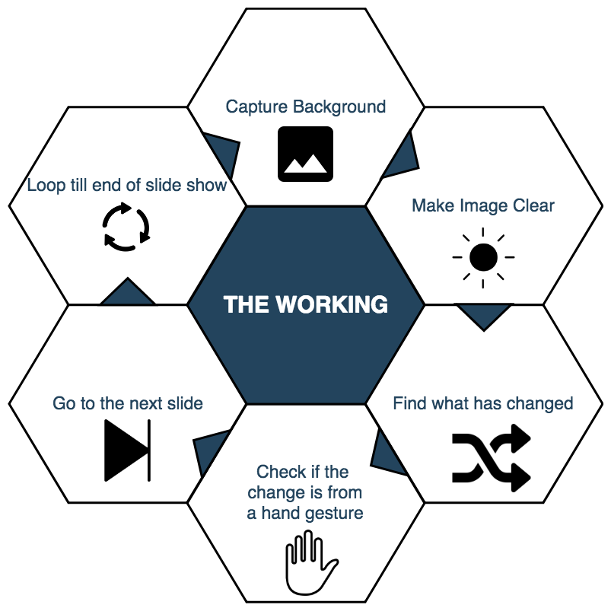

Slide 7
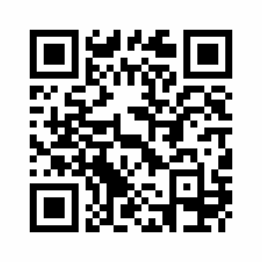
developed by
S. Ben Stewart
I. Sam Sunder
Y. Janananathan

