Slide 1
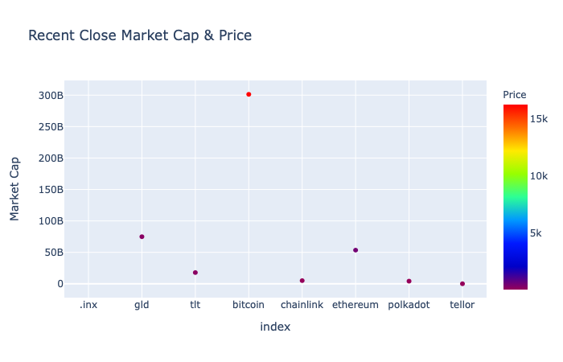
Data Visualization for the Crypto Analyzer

Slide 2
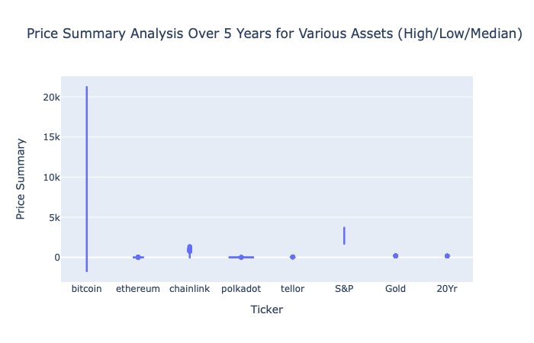
Data Visualization for the Crypto Analyzer

Slide 3
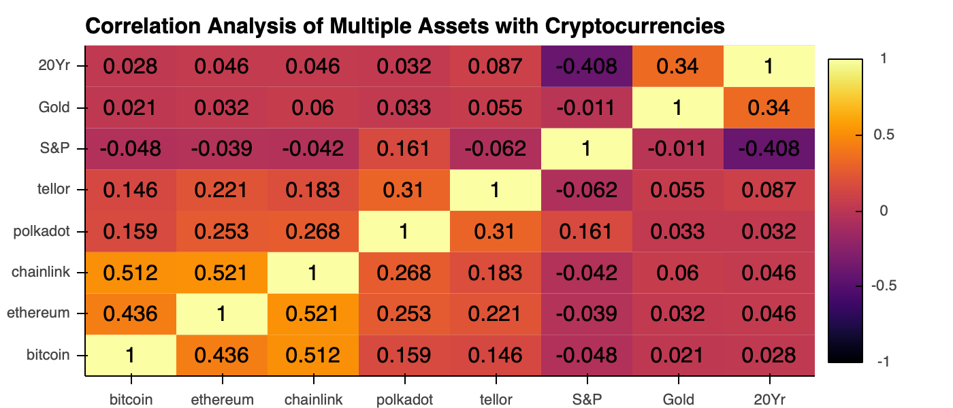
Data Visualization for the Crypto Analyzer

Slide 4
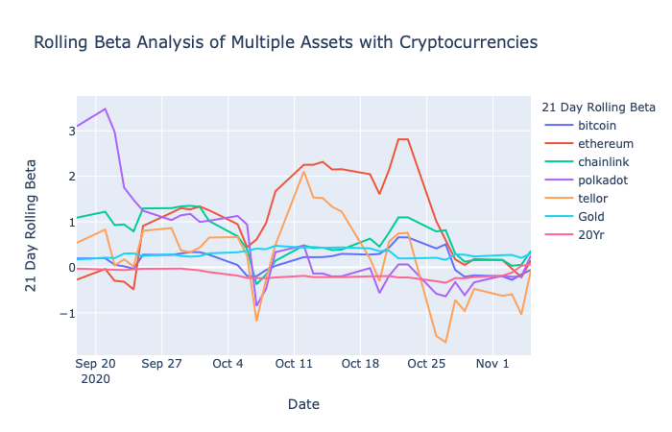
Data Visualization for the Crypto Analyzer

Slide 5
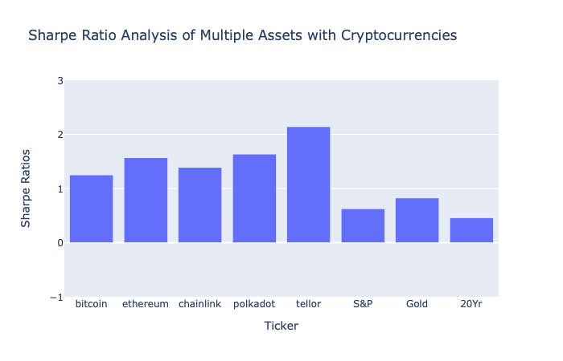
Data Visualization for the Crypto Analyzer

Slide 6
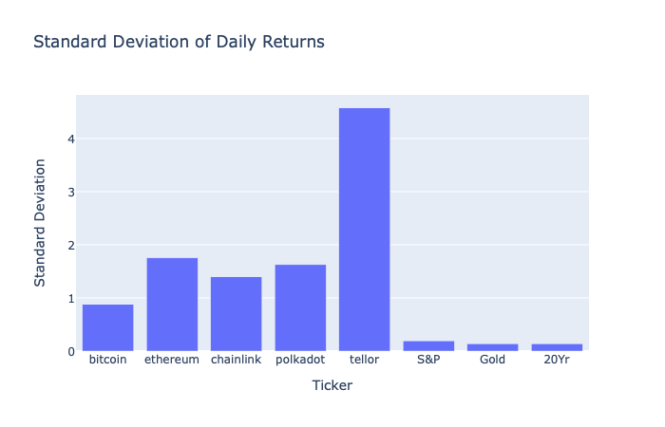
Data Visualization for the Crypto Analyzer

Slide 7
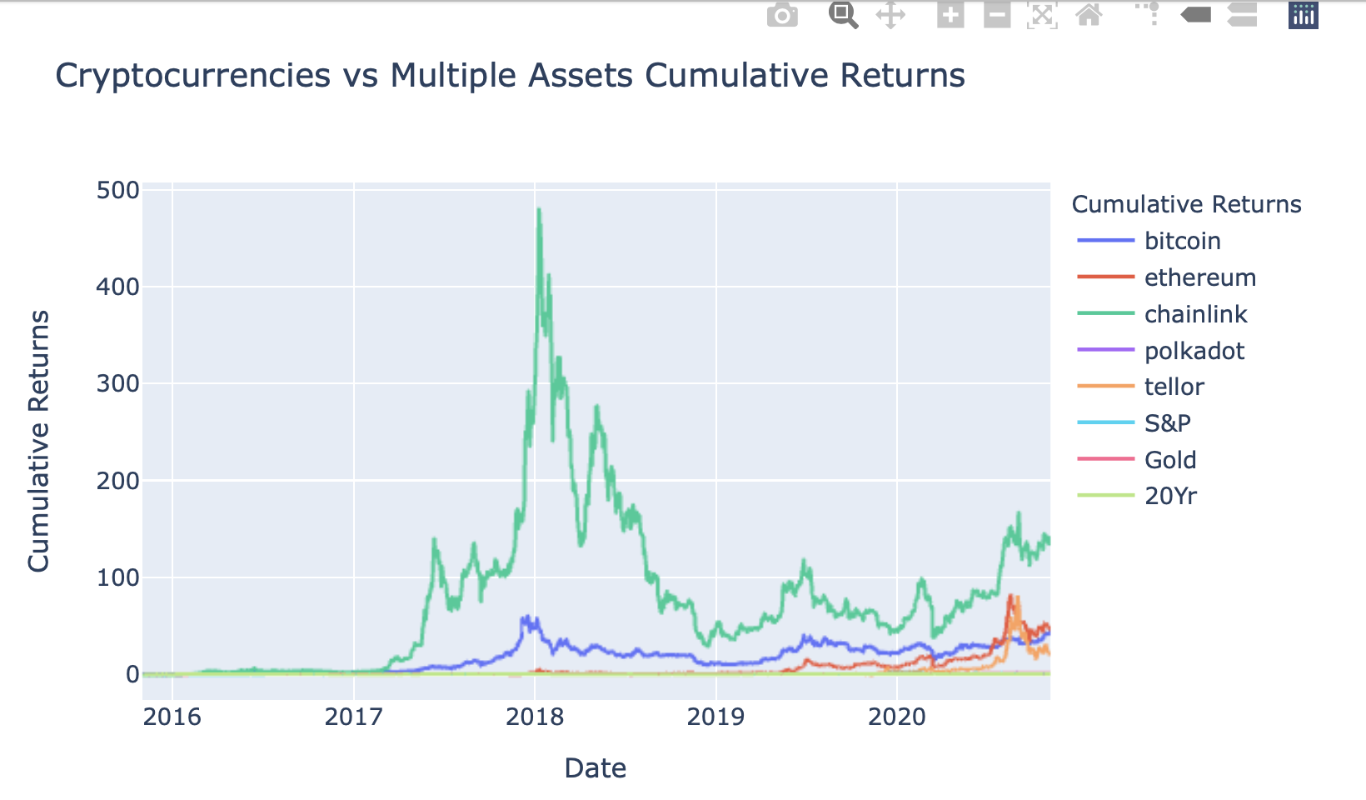
Data Visualization for the Crypto Analyzer

Slide 8
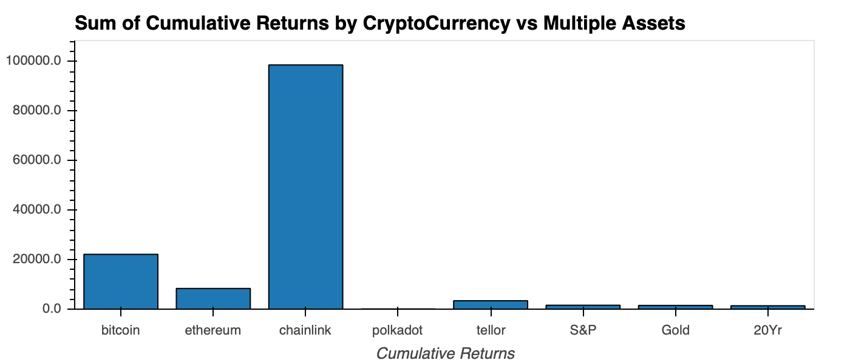
Data Visualization for the Crypto Analyzer

Slide 9
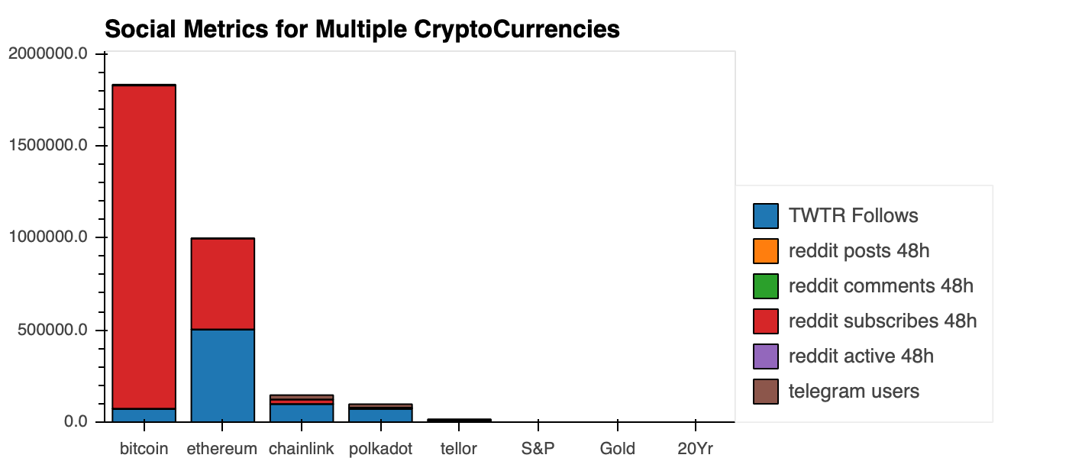
Data Visualization for the Crypto Analyzer

