Slide 1
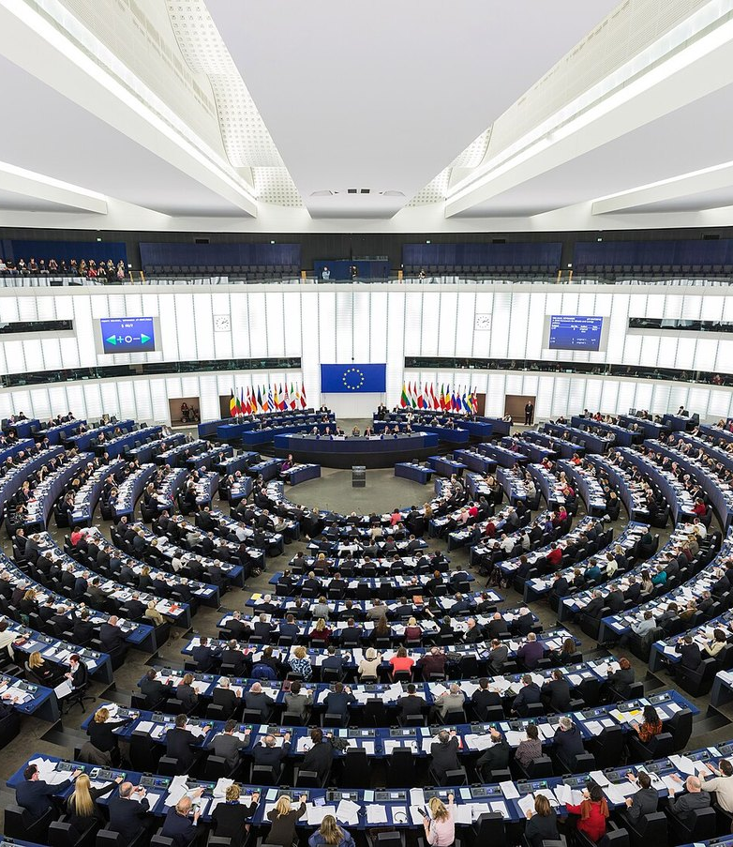
ETHICS & AI / TOPIC 3
AI, misinformation
and democracy
Deepfakes, false identities
and platform responsibility
Scott Brodie Forsyth
Information and Organisation / 20 October 2026
Notes:
Suggested speaking time: approximately 15 seconds.
AI makes it easier to impersonate politicians and manufacture convincing identities at scale. We examine three documented incidents and ask how democratic participation can be protected while political debate remains open. Our ethical analysis uses Laudon and Laudon’s Figure 4.1.
SOURCES
Laudon & Laudon, Management Information Systems, Chapter 4, Figure 4.1, reproduced in L3 slides, Ch 4, Ethical and social issues_st.pdf, p. 8. Edition and year are not specified.
Cover photograph: David Iliff, 2014. CC BY-SA 3.0. Cropped. https://commons.wikimedia.org/wiki/File:European_Parliament_Strasbourg_Hemicycle_-_Diliff.jpg
Licence: https://creativecommons.org/licenses/by-sa/3.0/

Slide 2
TERMINOLOGY
Key concepts
MISINFORMATION
DEEPFAKES AND IMPERSONATION
False information shared without a deliberate intention to mislead.
Synthetic audio, images or video that imitate a real person or event.
DISINFORMATION
FABRICATED NEWS AND ALGORITHMS
False or misleading information deliberately spread to deceive.
AI can produce false news stories. Recommender systems select and rank what users see.
The same false post can begin as disinformation and spread further as misinformation.
[2] Council of Europe / Wardle & Derakhshan. [10] European Commission. Algorithm descriptions are our own.
02
Notes:
Suggested speaking time: approximately 40 seconds.
The distinction between misinformation and disinformation concerns the intention behind sharing. A citizen may share a post in good faith even though its creator deliberately fabricated it. Deepfakes can imitate voices as well as images. A fabricated profile can also conceal the real actor. AI-generated content can be accurate, and disinformation can be entirely human-made. We therefore examine the source, the content and its distribution separately. A recommender system need not create a post to influence who encounters it. That creates a separate question of platform responsibility.
SOURCES
https://merlin.obs.coe.int/article/8092
https://digital-strategy.ec.europa.eu/en/faqs/transparency-obligations-under-article-50-ai-act

Slide 3
LAUDON & LAUDON
Figure 4.1: the ripple effects of technology
INDIVIDUAL
Five moral dimensions
What rights and duties do citizens, impersonated people and those sharing content have?
01
Information rights and obligations
02
Property rights and obligations
SOCIETAL
How does technology affect shared trust, public debate and political participation?
Accountability and control
03
04
System quality
POLITICAL AND POLICY
Who should set the rules, supervise compliance and provide a right to appeal?
05
Quality of life
[1] Figure 4.1, reproduced in the course slides, Chapter 4, p. 8. Wording and application are our own.
03
Notes:
Suggested speaking time: approximately 35 seconds.
The model explains how new information technology creates ripple effects at individual, societal and political levels. The five moral dimensions cut across those levels. Information rights concern personal data and reliable information about the source. Property rights raise questions about protected material and permission to use it. Accountability requires someone to answer for decisions and a way to investigate them. System quality concerns errors and safeguards. Quality of life includes meaningful participation in democracy. We apply the model to three cases and then compare the results.
SOURCES
Laudon & Laudon, Management Information Systems, Chapter 4, Figure 4.1, reproduced in L3 slides, Ch 4, Ethical and social issues_st.pdf, p. 8. Edition and year are not specified.

Slide 4
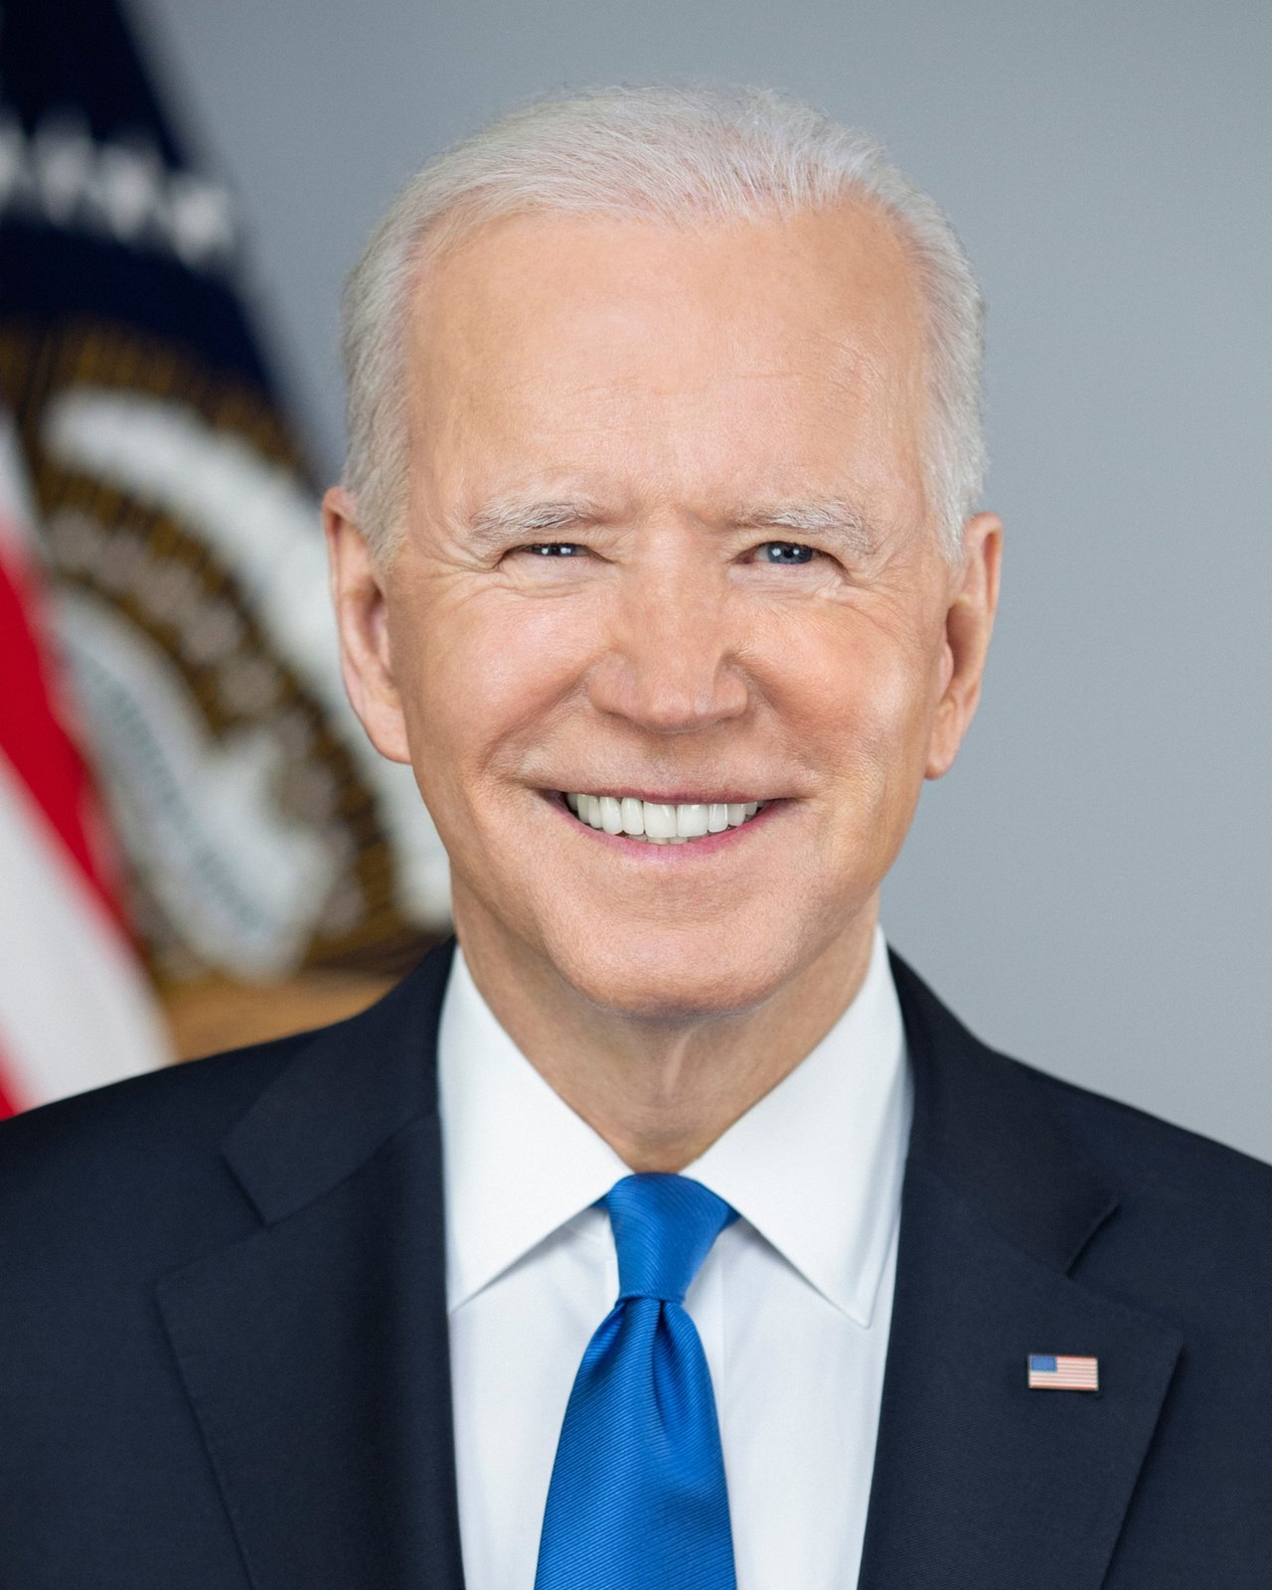
CASE 1 / NEW HAMPSHIRE, USA / JANUARY 2024
A cloned Biden voice called voters
WHAT HAPPENED
Robocalls using an AI-cloned voice urged voters to skip the presidential primary.
ETHICAL ISSUE
A deceptive identity undermines voters’ ability to make an informed decision.
CONSEQUENCES AND RESPONSIBILITY
Steve Kramer commissioned the campaign. The FCC imposed a $6 million administrative fine in 2024.
A jury acquitted Kramer in the separate state criminal case in June 2025. A turnout effect is not established here.
[3] FCC, 26 September 2024. [4] NHPR, 13 June 2025. Photo: Adam Schultz / White House, 2021, public domain.
04
Notes:
Suggested speaking time: approximately 60 seconds.
The calls arrived two days before the primary. Voters received the deceptive message, while Biden’s identity was misused. Caller ID spoofing also made the calls appear to come from a local political figure. The ethical problem is that the recipient lacks important information about who is trying to influence them. The FCC made an administrative decision concerning misleading caller identification. That differs from the state criminal prosecution, which ended in a jury acquittal. Administrative penalties, criminal guilt and our ethical assessment therefore require separate judgments. The sources establish the calls and the authorities’ response, but do not establish how many voters stayed home because of the message.
SOURCES
https://docs.fcc.gov/public/attachments/DOC-405811A1.pdf
https://docs.fcc.gov/public/attachments/FCC-24-104A1_Rcd.pdf
https://www.nhpr.org/nh-news/2025-06-13/political-operative-fake-biden-robocalls-nh-primary-found-not-guilty
Image source: https://commons.wikimedia.org/wiki/File:Joe_Biden_2021_(4x5).png

Slide 5
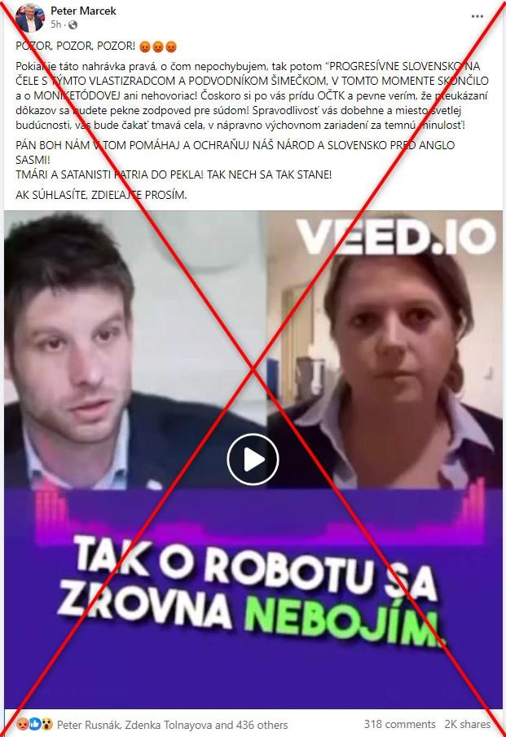
CASE 2 / SLOVAKIA / SEPTEMBER 2023
Fabricated audio alleged election rigging
WHAT HAPPENED
Two days before the election, audio circulated imitating politician Michal Šimečka and journalist Monika Tódová.
ETHICAL ISSUE
The fabricated conversation portrayed them as participants in planned election fraud.
CONSEQUENCES AND RESPONSIBILITY
Repeated sharing exposed the candidate, journalist and voters to deception. The original producer remains unidentified in the source.
AFP found signs of synthetic audio. An effect on the election result has not been established.
[5] AFP Fact Check, 28 September 2023. The image shows the false post documented and marked by AFP.
05
Notes:
Suggested speaking time: approximately 60 seconds.
Timing is central to this case. A correction may be accurate and still arrive too late to reach the same audience before an election. The recording targeted both a politician and a journalist, creating a risk to trust in political representation and independent media. That is our risk assessment, rather than a measured change in votes. Although some people who shared the recording can be identified, AFP does not establish who originally produced it. Primary responsibility lies with a deliberate fabricator. Sharers and platforms should be assessed according to their knowledge and their opportunities to respond.
SOURCES
https://fakty.afp.com/doc.afp.com.33WY9LF

Slide 6
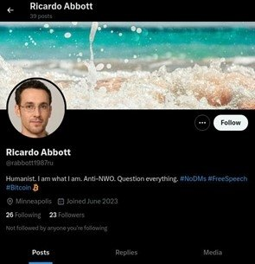
CASE 3 / MELIORATOR BOT FARM / DISRUPTED JULY 2024
AI profiles gave propaganda a false identity
WHAT HAPPENED
U.S. authorities identified 968 accounts. AI helped create fictitious people on X.
ETHICAL ISSUE
Covert state influence appeared to be ordinary citizens’ views and activity.
CONSEQUENCES AND RESPONSIBILITY
The DOJ linked the network to RT and the FSB. Authorities seized domains, and X suspended accounts.
False identities are documented. The sources do not measure the campaign’s effect on voters’ attitudes.
[6] U.S. Department of Justice, 9 July 2024. [7] FBI et al., AA24-191A. Profile image from DOJ evidence.
06
Notes:
Suggested speaking time: approximately 55 seconds.
AI helped manufacture credible identities, while automation supported the accounts’ activity. The FBI describes accounts able to post, like and repost material. Citizens could therefore encounter state-organised messaging presented as spontaneous contributions from fellow citizens. That makes it harder to judge the source’s interests. The link to RT and the FSB is the authorities’ attribution, which we report as such. The account count measures the identified network, rather than the number of persuaded voters. The platform has its own responsibility to detect coordinated manipulation and support investigation.
SOURCES
https://www.justice.gov/archives/opa/pr/justice-department-leads-efforts-among-federal-international-and-private-sector-partners
https://www.ic3.gov/Media/News/2024/240709.pdf

Slide 7
PRODUCTION AND DISTRIBUTION
Algorithms shape political exposure
Recommender systems rank content against selected objectives. They can change which political messages receive attention.
Study | Finding | What we can conclude
Facebook / Instagram 2020 election, published 2023 | A chronological feed changed exposure, without a detectable change in polarisation. | Exposure and attitude change are different outcomes.
X 2023 experiment, published 2026 | Switching the algorithm on shifted some political attitudes in a conservative direction. | Effects depend on the platform, period and outcome measured.
Political bias and factual falsity are different questions. Distribution alone does not establish an election effect.
[8] Guess et al., Science, 2023. [9] Gauthier et al., Nature, 2026. Both studies use experiments.
07
Notes:
Suggested speaking time: approximately 35 seconds.
The cases concern manipulation, but we should also examine how platforms decide what people see. Research does not establish one universal effect. In the Meta experiment, a chronological feed changed content exposure without a detectable change in polarisation during the study period. A subsequently published X experiment found changes in certain political attitudes when the algorithm was switched on. Neither finding establishes that our three incidents determined an election. Ethical problems can still be serious when a precise effect on voting is difficult to measure.
SOURCES
https://doi.org/10.1126/science.abp9364
https://doi.org/10.1038/s41586-026-10098-2

Slide 8
APPLYING FIGURE 4.1
Analysis across the model’s three levels
Case | Individual | Societal | Political and policy
Biden calls | Voter autonomy and Biden’s identity. | Risk to participation and trust in elections. | Caller identification and enforcement of election rules.
Slovak audio | The candidate’s and journalist’s reputations. | Distrust of elections and independent media. | Rapid response before elections and access to corrections.
Meliorator | Citizens’ ability to recognise the real source. | Covert foreign influence and fabricated public support. | Platform oversight and international investigation.
Shared tension: free expression and citizens’ ability to recognise manipulation.
[1] Laudon & Laudon, Figure 4.1. Our analysis draws on the case sources [3-7].
08
Notes:
Suggested speaking time: approximately 40 seconds.
This comparison applies all three levels to each case. At the individual level, we examine autonomy and the rights of people being impersonated. At the societal level, we consider participation and trust in the shared information environment. At the political level, we consider rules and legitimate intervention. Property rights include permission to use protected material. System quality concerns authentication, error and platform response. Quality of life includes participation in public life without systematic deception. Broader democratic risks are our analytical assessment and should remain distinct from measured consequences.
SOURCES
Laudon & Laudon, Management Information Systems, Chapter 4, Figure 4.1, reproduced in L3 slides, Ch 4, Ethical and social issues_st.pdf, p. 8. Edition and year are not specified.
https://docs.fcc.gov/public/attachments/DOC-405811A1.pdf
https://fakty.afp.com/doc.afp.com.33WY9LF
https://www.justice.gov/archives/opa/pr/justice-department-leads-efforts-among-federal-international-and-private-sector-partners

Slide 9
FIGURE 4.1 / ACCOUNTABILITY AND CONTROL
Accountability needs controls and appeals
Actor | Responsibility | Controls and follow-up
Creator / commissioner | Bears primary responsibility for deliberate deception. | Identify the source and preserve evidence.
Platform / telecom | Limits coordinated abuse and responds promptly. | Keep logs, explain interventions and provide appeals.
AI provider | Addresses foreseeable misuse of its tools. | Test risks and support traceability.
Public authority | Enforces rules and protects rights. | Independent oversight and access to review.
Ethical responsibility, administrative penalties and criminal guilt are distinct.
[1] Laudon & Laudon. This allocation of duties is our recommendation, informed by the cases and DSA guidance [11].
09
Notes:
Suggested speaking time: approximately 35 seconds.
Accountability means that an actor can answer for its decisions. Control concerns safeguards that prevent harm and mechanisms that correct it. We propose allocating duties according to knowledge, capability and actual control. Citizens can question a source, but rarely have access to account data and distribution logs. Platforms can investigate networks, while authorities can use lawful investigative powers. A sound system must also correct mistaken interventions. Affected people should receive reasons and have access to an appeal, and researchers should be able to scrutinise the platform’s assessments.
SOURCES
Laudon & Laudon, Management Information Systems, Chapter 4, Figure 4.1, reproduced in L3 slides, Ch 4, Ethical and social issues_st.pdf, p. 8. Edition and year are not specified.
https://digital-strategy.ec.europa.eu/en/library/guidelines-providers-vlops-and-vloses-mitigation-systemic-risks-electoral-processes
https://www.nhpr.org/nh-news/2025-06-13/political-operative-fake-biden-robocalls-nh-primary-found-not-guilty

Slide 10
TECHNICAL, ORGANISATIONAL AND REGULATORY RESPONSES
Solutions must address several stages
Response | Application to the cases | Limitation
Technical controls Origin checks | Authenticate callers. Label AI content and preserve origin information. | Sources can lie. Labels can be removed.
Organisation Election response | Shared contact point, rapid fact-checking and visible corrections. | Corrections may miss the original audience.
Platform design Bot detection | Detect bot farms. Test recommenders for abuse. | Errors can restrict legitimate debate.
Regulation Oversight / appeals | Require risk assessment, researcher access and reasoned decisions. | Oversight needs resources and due process.
Our proposals draw on [3], [7] and the European Commission’s guidance [10-11].
10
Notes:
Suggested speaking time: approximately 50 seconds.
Caller authentication and telecom customer checks are relevant to the Biden case, but cannot alone prove that a message is true. In Slovakia, the timing points to the need for a response team that can verify a report quickly and circulate a correction. In Meliorator, coordination between accounts matters more than the wording of a single post. Labels and detectors can help, but the absence of a label does not establish authenticity, and detectors can be wrong. We therefore combine technical safeguards with organisational responsibility and independent scrutiny. Solutions should also be evaluated through their error rates and the ability to challenge decisions.
SOURCES
https://docs.fcc.gov/public/attachments/DOC-405811A1.pdf
https://www.ic3.gov/Media/News/2024/240709.pdf
https://digital-strategy.ec.europa.eu/en/library/guidelines-providers-vlops-and-vloses-mitigation-systemic-risks-electoral-processes
https://digital-strategy.ec.europa.eu/en/faqs/transparency-obligations-under-article-50-ai-act

Slide 11
REGULATION / POSITION ON 20 OCTOBER 2026
EU rules and freedom of expression
AI ACT, ARTICLE 50
Actors within scope must disclose deepfakes. Providers also face machine-readable marking requirements for generated content.
DIGITAL SERVICES ACT
Very large platforms must assess and mitigate systemic election risks. Oversight and researcher access support scrutiny.
Interventions should be proportionate, reasoned and open to appeal. Satire and legitimate political debate need protection.
Article 50 applies from 2 August 2026. Certain existing systems have a transition period until 2 December 2026 for technical marking.
[10] European Commission, Article 50 FAQ and Quick Facts. [11] DSA election guidelines. Summary.
11
Notes:
Suggested speaking time: approximately 40 seconds.
The AI Act distinguishes the provider’s technical marking from the deployer’s disclosure of deepfake content. The rules have a defined scope and qualifications, including specific treatment of art and satire. AI-generated public-interest text also has particular rules, including an exemption involving substantive human review or editorial control with responsibility. A blanket requirement to label everything involving AI would therefore oversimplify the law. The DSA requires risk mitigation by the designated very large services. Our normative point is that measures against deception need transparency and due process, so moderation does not arbitrarily close political debate.
SOURCES
https://digital-strategy.ec.europa.eu/en/faqs/transparency-obligations-under-article-50-ai-act
https://digital-strategy.ec.europa.eu/en/factpages/quick-facts-transparency-rules-ai-systems
https://digital-strategy.ec.europa.eu/en/library/guidelines-providers-vlops-and-vloses-mitigation-systemic-risks-electoral-processes

Slide 12
OUR CONCLUSION
Overall assessment
AI makes false voices and identities easier to produce. Democratic vulnerability also depends on distribution and accountability.
REALISTIC DANISH EXAMPLE / HYPOTHETICAL
An audio clip impersonates a candidate shortly before an election. A platform temporarily limits distribution while a response team verifies its origin and gives the source an opportunity to respond.
A justified response protects informed participation and provides a way to correct mistakes.
12
Notes:
Suggested speaking time: approximately 20 seconds.
Our answer is that harm emerges through the interaction of production, distribution and failures of accountability. An AI detector alone is therefore insufficient. The Danish example is hypothetical and illustrates our recommendation: a brief, reasoned response, rapid verification, and opportunities for correction and appeal. Whether a particular intervention is justified depends on evidence, severity and timing. The goal is to protect participation without turning uncertainty into a reason for arbitrary restrictions.
SOURCES
Laudon & Laudon, Management Information Systems, Chapter 4, Figure 4.1, reproduced in L3 slides, Ch 4, Ethical and social issues_st.pdf, p. 8. Edition and year are not specified.
https://digital-strategy.ec.europa.eu/en/library/guidelines-providers-vlops-and-vloses-mitigation-systemic-risks-electoral-processes

Slide 13
CHOOSE A, B, C OR D / DISCUSS FOR 30 SECONDS
Multiple-choice question
A viral audio clip impersonates a candidate one day before an election. Its origin is unknown and an AI detector is uncertain. What is the best response?
A
Remove every political post until the election is over.
B
Verify the source, act proportionately, and provide an appeal.
C
Add an AI label and leave distribution unchanged.
D
Use the AI detector as the sole basis for removal.
13
Notes:
Suggested speaking time: approximately 35 seconds.
Read the scenario aloud. Ask the other groups to select A, B, C or D and explain their reasoning. Allow roughly 30 seconds of discussion. Keep the next slide hidden until they have answered. The correct answer is B. If needed, ask who can access evidence, what an AI label achieves, and what happens if the platform makes a mistake.
SOURCES
Laudon & Laudon, Management Information Systems, Chapter 4, Figure 4.1, reproduced in L3 slides, Ch 4, Ethical and social issues_st.pdf, p. 8. Edition and year are not specified.
https://digital-strategy.ec.europa.eu/en/library/guidelines-providers-vlops-and-vloses-mitigation-systemic-risks-electoral-processes

Slide 14
REVEAL AFTER DISCUSSION
Correct answer: B
Verify the source, act proportionately,
and provide an appeal.
WHY B?
It combines verification, proportionate action and a way to correct a mistaken decision.
A suppresses debate too broadly. C relies on a label alone. D ignores the detector’s uncertainty.
14
Notes:
Suggested speaking time: approximately 15 seconds.
B best follows our ethical analysis. It takes the risk seriously and assigns responsibility to actors able to investigate and act, while requiring reasons and an appeal. A is an excessively broad restriction. C does not address the potential harm of continuing to distribute deceptive impersonation. D treats an uncertain technical assessment as a final judgment. The question tests the combination of accountability, system quality and political rights.
SOURCES
Laudon & Laudon, Management Information Systems, Chapter 4, Figure 4.1, reproduced in L3 slides, Ch 4, Ethical and social issues_st.pdf, p. 8. Edition and year are not specified.
https://digital-strategy.ec.europa.eu/en/library/guidelines-providers-vlops-and-vloses-mitigation-systemic-risks-electoral-processes

Slide 15
EVIDENCE / CLICKABLE LINKS IN THE PDF AND POWERPOINT
References and image credits
[1] Laudon & Laudon. Figure 4.1
[7] FBI et al. (9 July 2024). Meliorator
Course slides: Chapter 4, p. 8. Edition not specified.
Joint Cybersecurity Advisory AA24-191A.
[2] Council of Europe (2018). Information disorder
[8] Guess et al. (2023). Feed algorithms
IRIS 2018-1:1/6, on Wardle & Derakhshan (2017).
Science 381, 398-404. doi:10.1126/science.abp9364
[3] FCC (26 September 2024). Biden robocalls
[9] Gauthier et al. (2026). X’s feed algorithm
DOC-405811A1. Administrative penalty and incident.
Nature 652, 416-423. doi:10.1038/s41586-026-10098-2
[4] Bookman / NHPR (13 June 2025)
[10] European Commission. AI Act, Article 50
Kramer’s acquittal in the separate state criminal case.
Transparency FAQ and Quick Facts on deadlines.
[5] Barca / AFP (28 September 2023)
[11] European Commission (2024). DSA
Fact-check of the fabricated Slovak audio recording.
Guidelines on systemic risks to electoral processes.
[6] U.S. DOJ (9 July 2024). AI bot farm
Authorities’ evidence and attribution.
Images: David Iliff (2014), European Parliament, cropped. Adam Schultz / White House (2021), Biden, public domain.
Case images: AFP [5] and U.S. DOJ [6], source excerpts for analysis. Full sources and image links appear in the speaker notes.
Parliament photograph: CC BY-SA 3.0. creativecommons.org/licenses/by-sa/3.0/
Sources accessed 20 October 2026. Documented events, authorities’ attribution and our ethical assessments are distinguished.
15
Notes:
Suggested speaking time: approximately 0 seconds.
References on the slides use the numbering shown here. The photographs document the relevant people and posts. The Parliament photograph illustrates a democratic institution in 2014, and the Biden image is his official 2021 portrait. Neither photograph depicts the incident itself. The red cross on the Slovak source image comes from AFP’s fact-check. Full source and image links follow.
SOURCES
Laudon & Laudon, Management Information Systems, Chapter 4, Figure 4.1, reproduced in L3 slides, Ch 4, Ethical and social issues_st.pdf, p. 8. Edition and year are not specified.
https://merlin.obs.coe.int/article/8092
https://docs.fcc.gov/public/attachments/DOC-405811A1.pdf
https://docs.fcc.gov/public/attachments/FCC-24-104A1_Rcd.pdf
https://www.nhpr.org/nh-news/2025-06-13/political-operative-fake-biden-robocalls-nh-primary-found-not-guilty
https://fakty.afp.com/doc.afp.com.33WY9LF
https://www.justice.gov/archives/opa/pr/justice-department-leads-efforts-among-federal-international-and-private-sector-partners
https://www.ic3.gov/Media/News/2024/240709.pdf
https://doi.org/10.1126/science.abp9364
https://doi.org/10.1038/s41586-026-10098-2
https://digital-strategy.ec.europa.eu/en/faqs/transparency-obligations-under-article-50-ai-act
https://digital-strategy.ec.europa.eu/en/factpages/quick-facts-transparency-rules-ai-systems
https://digital-strategy.ec.europa.eu/en/library/guidelines-providers-vlops-and-vloses-mitigation-systemic-risks-electoral-processes
https://commons.wikimedia.org/wiki/File:European_Parliament_Strasbourg_Hemicycle_-_Diliff.jpg
https://commons.wikimedia.org/wiki/File:Joe_Biden_2021_(4x5).png

