Slide 1
Ward 1
β₂₁
β₁₁
Ward 2
β₂₂
β₁₂
β_{ward-out}
β_{ward-out}
β_{out-out}
Discrete time model

Slide 2
Joint distribution of observed data, augmented data and parameters
Y = observed data
Z = augmented data
θ = model parameters
P(Y, Z, θ) = P(Y|Z, θ) P(Z|θ) P(θ)
Observation
Prior
Transmission

Slide 3
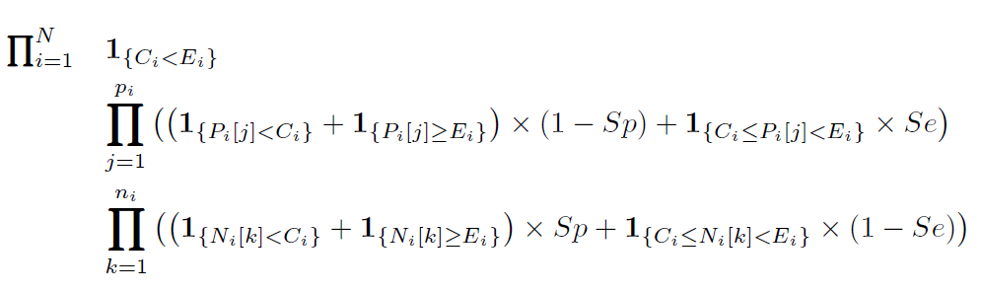
P(Y, Z, θ) = P(Y|Z, θ) P(Z|θ) P(θ)
Observation
Prior
Transmission
False +
True +
True -
False -
Specificity = 100%

Slide 4
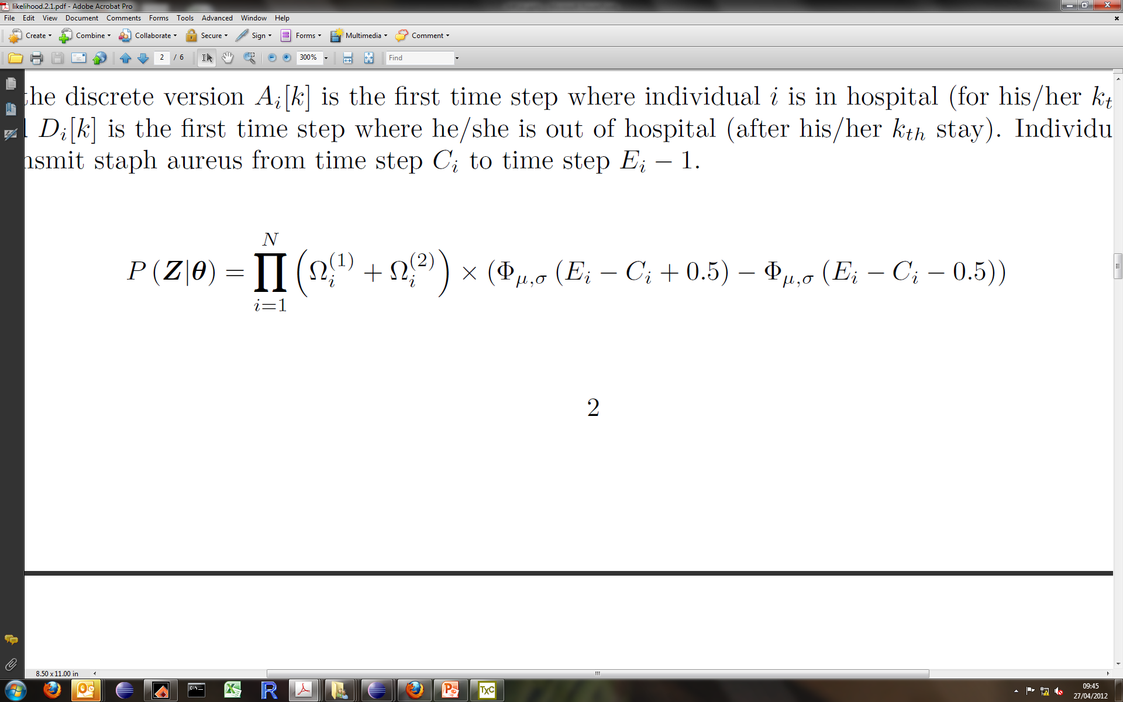
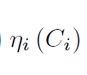
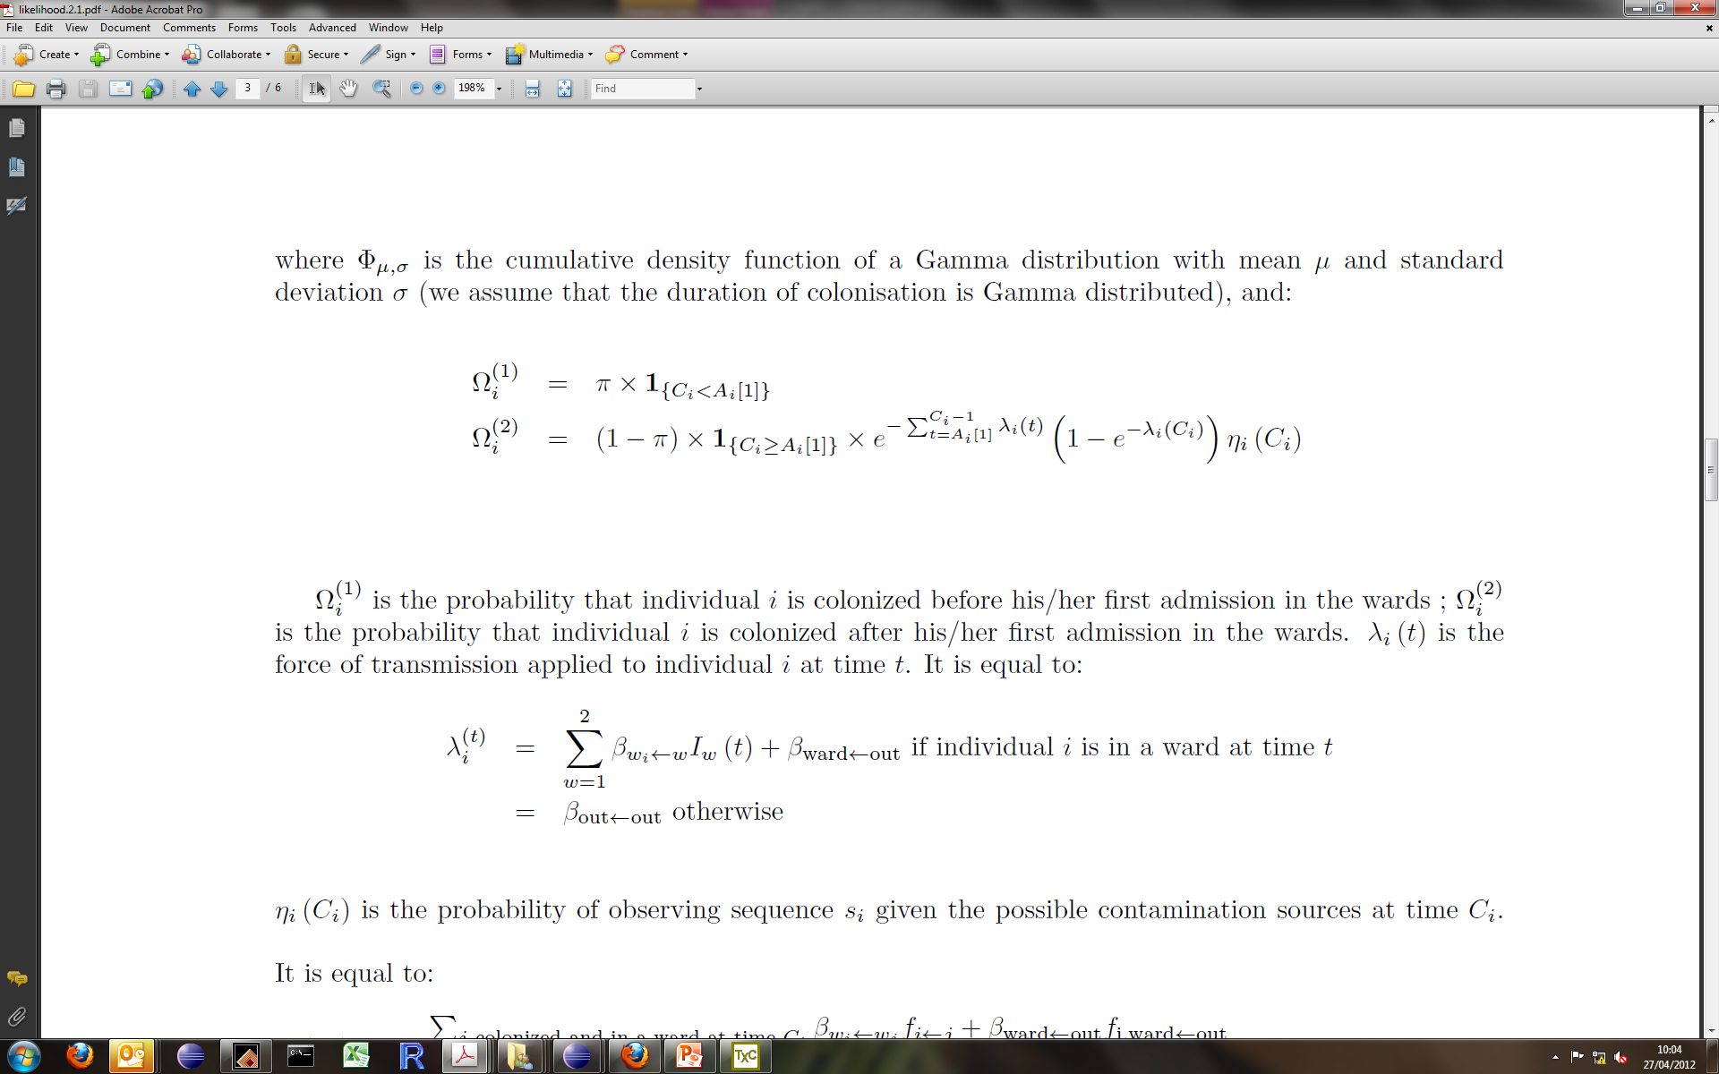
P(Y, Z, θ) = P(Y|Z, θ) P(Z|θ) P(θ)
Observation
Transmission
Prior
P(being infected at C_{i})
P(being colonised for E_{i}-C_{i} time steps)
P(observing sequences S_{i} given i is colonised at C_{i} and given mutation rates)

Slide 5
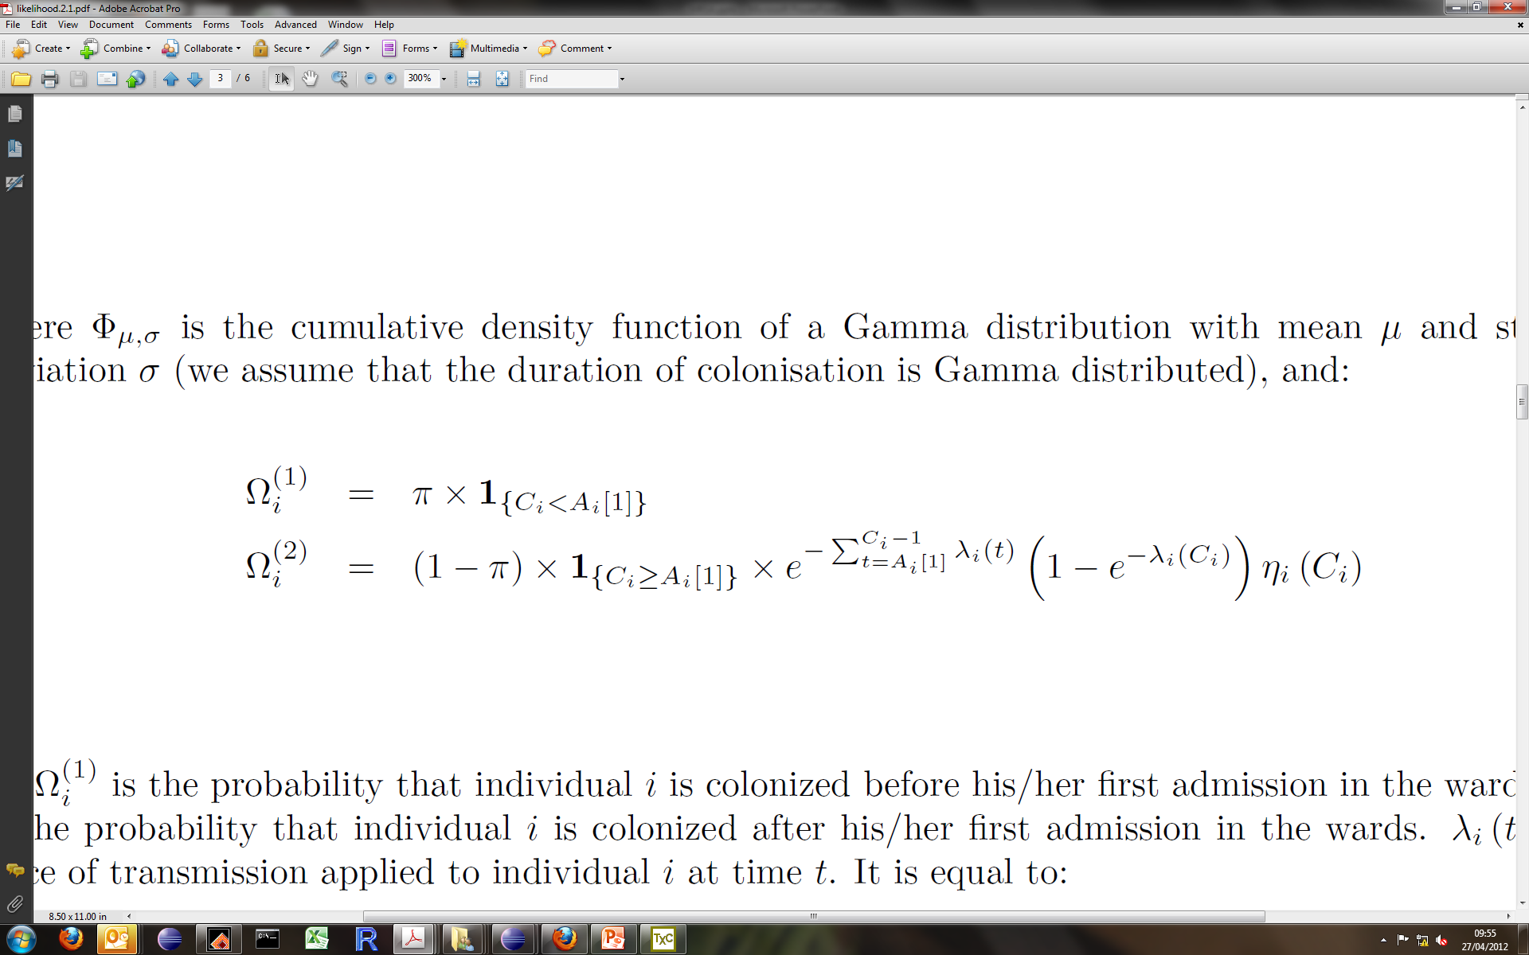
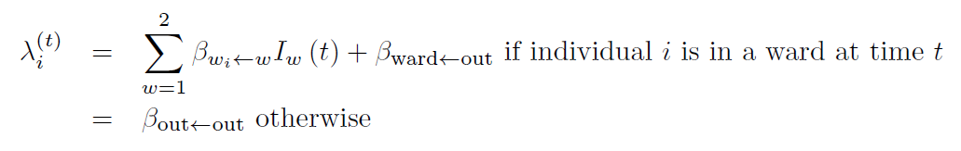
P(Y, Z, θ) = P(Y|Z, θ) P(Z|θ) P(θ)
Observation
Transmission
Prior
P(being infected at C_{i})
Case 2:
C_{i} > A_{i}
Uncolonised at first admission
Case 1:
C_{i} <= A_{i} (colonised at first admission)
Notes:
What’s the likelihood for individuals who are never colonised?

Slide 6
P(Y, Z, θ) = P(Y|Z, θ) P(Z|θ) P(θ)
Observation
Transmission
Prior
P(being infected at C_{i})
P(being colonised for E_{i}-C_{i} time steps)
P(observing sequences S_{i} given i is colonised at C_{i} and given mutation rates)
Discretised gamma distribution

Slide 7
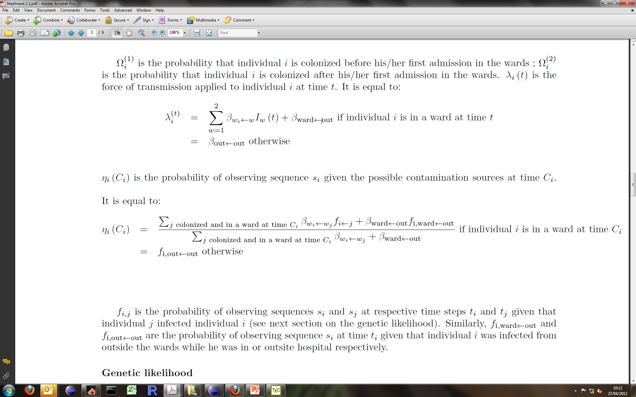
P(Y, Z, θ) = P(Y|Z, θ) P(Z|θ) P(θ)
Observation
Transmission
Prior
P(being infected at C_{i})
P(being colonised for E_{i}-C_{i} time steps)
P(observing sequences S_{i} given i is colonised at C_{i} and given mutation rates)
f_{i<-j} is the probability of observing sequences from individual i given that j infected i.
Notes:
How to parametrise fij?

Slide 8
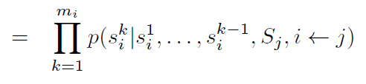
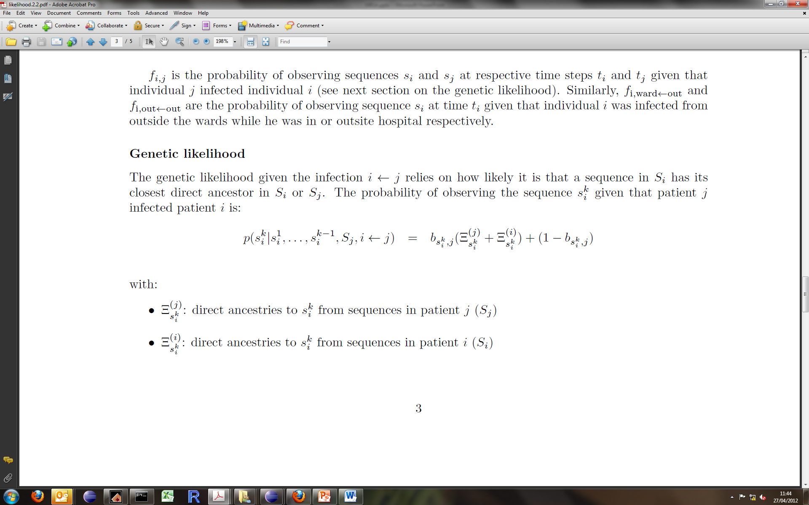
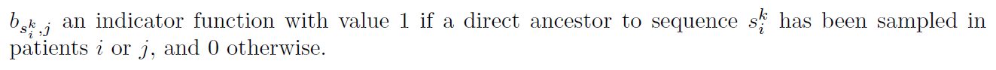
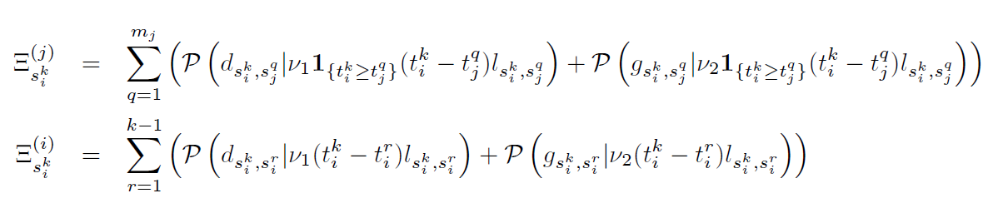
f_{i<-j} is the probability of observing sequences from individual i given that j infected i.
Notes:
How to parametrise fij?

