Slide 1


Systems Biology Graphical Notation
Richard Adams
Centre for Systems Biology, Edinburgh

Slide 2
The challenge of reconstructing complex systems
"The greatest challenge today, not just in cell biology and ecology but in all of science, is the accurate and complete description of complex systems.
Scientists have broken down many kinds of systems. They think they know most of the elements and forces.
The next task is to reassemble them, at least in mathematical models that capture the key properties of the entire ensembles.”
E.O. Wilson –’Consilience’ 1998
Notes:
Still as true today as in 1998 ->
How to reassemble the components?

Slide 3
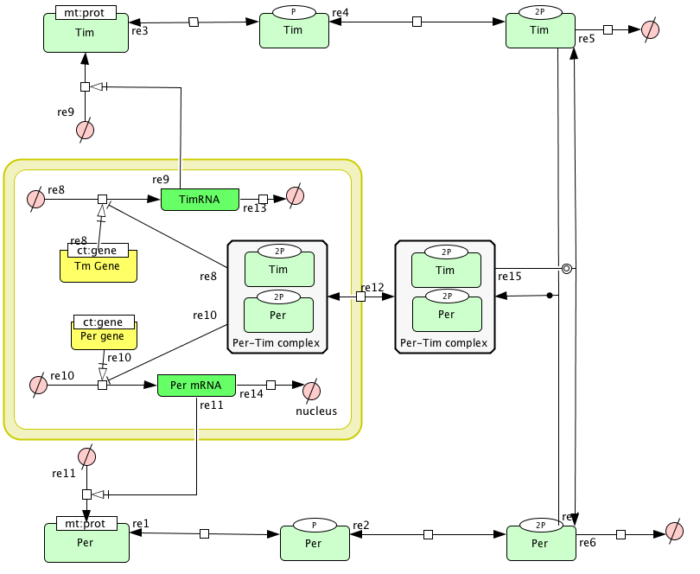
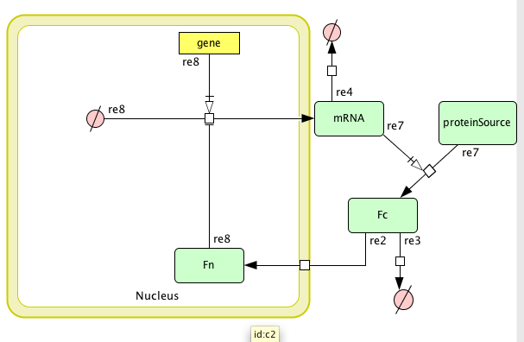

Slide 4
There’s a lot of information…
PubMed has 19,953,959 publications dating 1860-2010.
Growing at 2 per minute
How to assemble information suitable for modelling?
Notes:
This is just literature data, let alone all the data in databases, exptal data etc.,

Slide 5
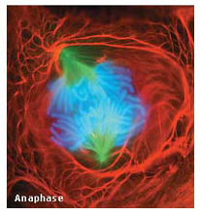
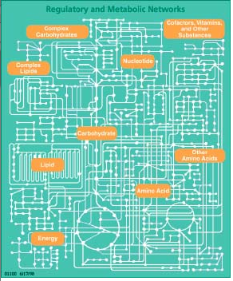
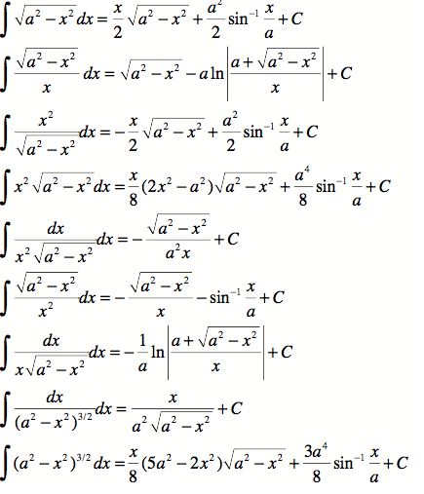
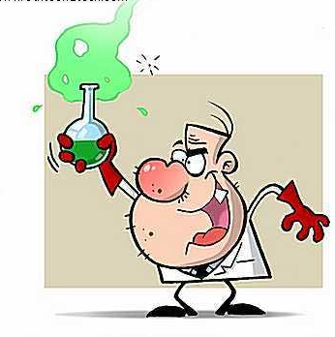


Diagrams can help….
Notes:
But, depends on the diagram
modellers need abstract, rigorous, unambigious definition of the system
biologists may think more holistically or not have enough information to make a model
Store of distilled information
communication point
start of modelling.

Slide 6
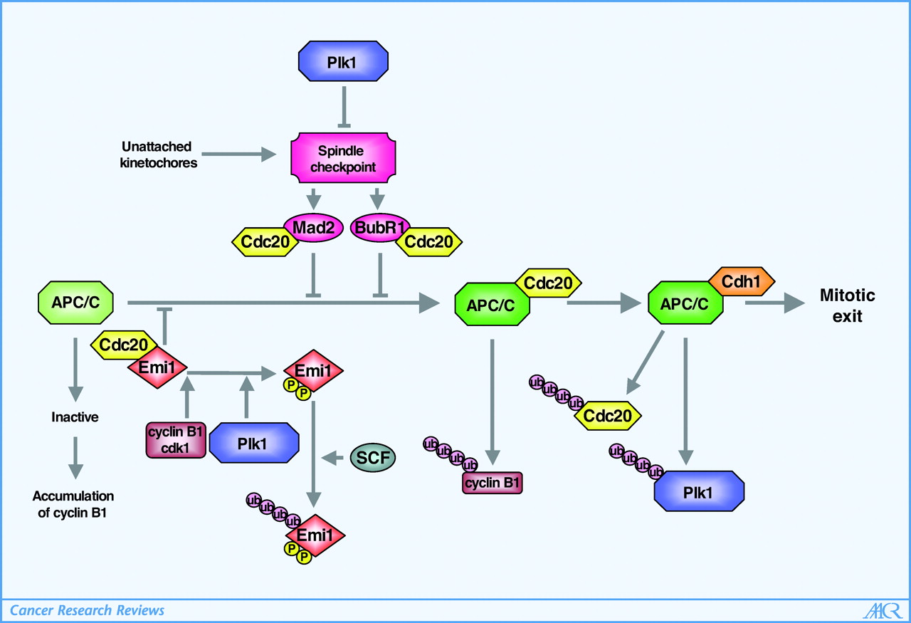
..but diagrams are of uncertain quality.
Notes:
Example diagram of the control of exit of mitosis:
1) Different proteins have different shapes & colours – why? Is this meaningful or just artistic licence?
2) All transitions are just arrows – presumably ‘activation’ but could be translocation?
3) What is the nature of inhibition? Enzymatic inhibition? Degradation?
4) Missing information – Mad2 OR Bub1 are sufficient to inhibit APC
5) What are sources and sinks?
6) Number of ubiquitations?

Slide 7
Plk1 activity regulates APC/C in multiple ways to promote mitotic progression. In early mitosis, Plk1 activity triggers the degradation of Emi1 via SCFß-TRCP, a prerequisite for the generation of an active APC/CCdc20 complex. However, in case of an activated spindle assembly checkpoint, Mad2 and/or BubR1 bind to Cdc20, thereby inhibiting the APC/C. Plk1 acts antagonistically to the spindle checkpoint and regulates the kinetochore localization of Mad2. Silencing of the spindle checkpoint enables the formation of active APC/CCdc20 and the degradation of cyclin B1. When Cdc20 is replaced by Cdh1, additional substrates, like Cdc20 itself and Plk1, are degraded. Finally, active APC/CCdh1 allows mitotic exit and entry into the subsequent G1 phase
Notes:
Needs long and complex figure legend to understand the diagram.

Slide 8
Why the need for a standard notation?
Most pathway diagrams are :
  Ambiguous
  Not amenable to computational analysis
  Not interpretable without figure legend.
  Use ‘one-off’ graphical symbols that must be learned
  Hard to disseminate (colour, line-width, dashes).
Notes:
Line width/dashed – hard to reproduce, may be lost by photocopying, hand-drawing.
Colour – photpcopying.
Specific symbols.
Identical line terminators used to mean different actions.

Slide 9
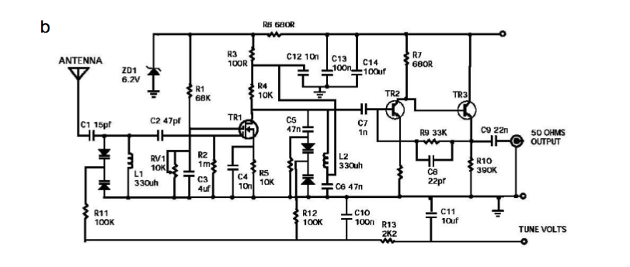
What we really need is …
Notes:
Circuit diagram of a radio ( from Lazebnik, 2001).

Slide 10
SBGN goals
  Standardize the graphical notation used to represent biological processes.
  A single diagram has a single meaning.
  Self-explanatory.
  Amenable to computation.
  Able to cope with missing/incomplete information.
  Processes to be drawn at different levels of granularity.
  Unrestricted in use.
  Not dependent on single software product.
  Can be drawn by hand or printed without loss of information.

Slide 11
SBGN development
Developed in community workshops since 2005
Takes best ideas from several graphical notations.
Version 1 spec released 2009
Supported by BBSRC, NEDO (Japan), EML Research
Coordinated by 5 editors.

Slide 12
Some tools for SBGN
CellDesigner (www.celldesigner.org)PD
Edinburgh Pathway Editor (www.pathwayeditor.org) PD, ER, AF
Arcadia PD http://sourceforge.net/projects/arcadiapathways/
Vanted PD (http://vanted.ipk-gatersleben.de/)

Slide 13
Three types of diagram
Process Description
Entity Relationship
Activity Flow
Notes:
One single language is too complicated.
Process description – not a modelling language but has its concepts in modelling. Diagrams indicate the processes by which
molecules change each other in temporal sequence -> can form the basis of kinetic modelling.
Entity relationships – these diagrams show independent facts, for example derived from the literature.
Activity flow – these diagrams indicate how biological activities impact on each other when perhaps not all molecular details are known.

Slide 14
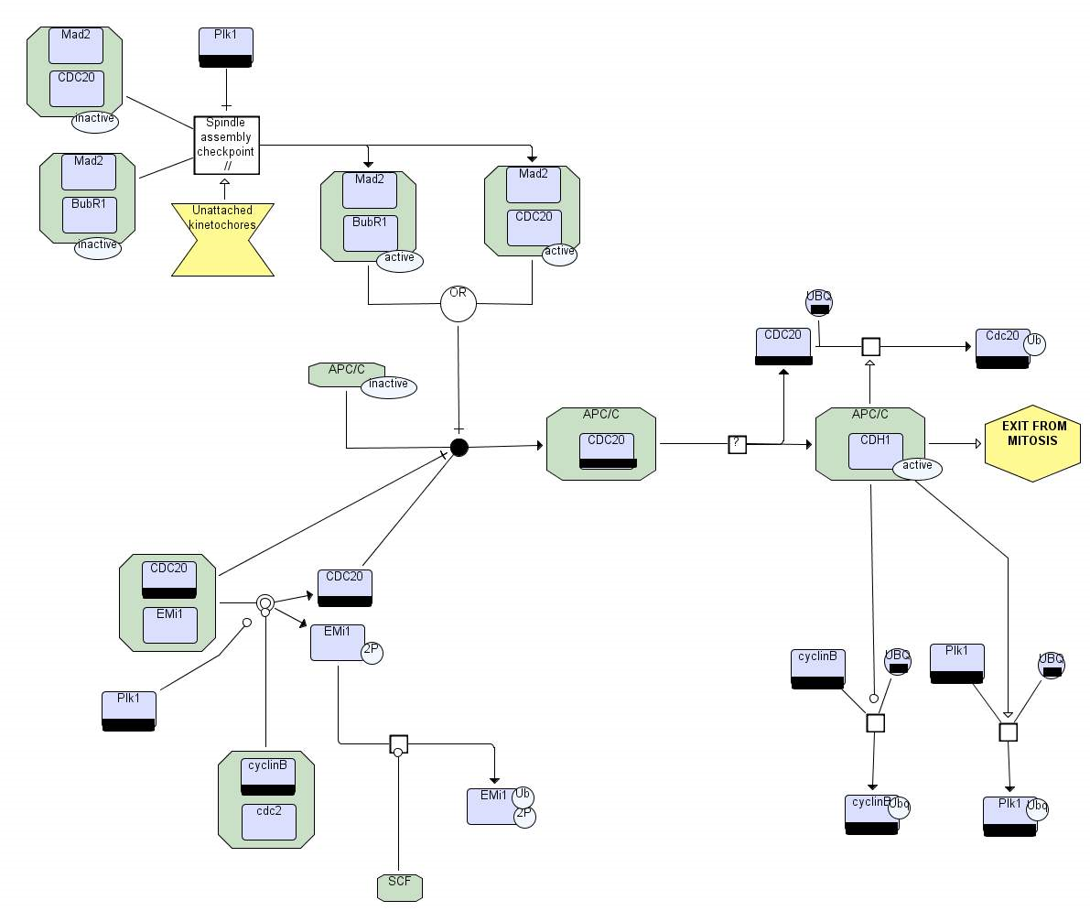
Mitotic exit in SBGN-PD
Notes:
More types of glyph
Semantically richer
More complex ( more nodes ) but unambiguous.
Colour has no meaning.Entity Pool Nodes

Slide 15
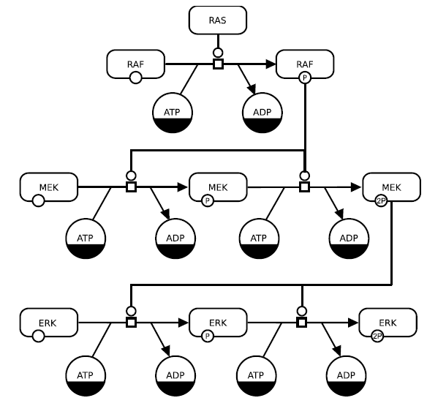
Example SBGN Process Diagram
Notes:
Clone markers
Catalysis glyphs
State markers
Reactions go L->R

Slide 16
Categories of glyphs in SBGN-PD
The main types of visual features, or glyphs are:
1) Entity pool nodes, representing things.
2) Process nodes, representing transformation
3) Connecting arcs, linking transformations to things.
4) Logical operators, representing Boolean logic
5) Containment nodes, representing physical restriction

Slide 17
Restricted vocabularies
The Systems Biology Ontology (SBO) is used to provide a restricted vocabulary of terms for use in SBGN diagrams. For example, several common material types of entity are:
Non-macromolecular ion mt:ion SBO:0000327
Non-macromolecular radical mt:rad SBO:0000328
Ribonucleic acid mt:rna SBO:0000250
Deoxribonucleic acid mt:dna SBO:0000251
Protein mt:prot SBO:0000297
Polysaccharide mt:psac SBO:0000249
Notes:
These terms can be added to units of information

Slide 18
Restricted vocabularies (2)
Within a diagram, an entity can be labeled with a conceptual type which indicates its role in the pathway.
For example:
Gene ct:gene SBO:0000243
Transcription start site ct:tss SBO:0000329
Gene coding region ct:coding SBO:0000335
Gene regulatory region ct:grr SBO:0000369
Messenger RNA ct:mRNA SBO:0000278
These can be used to annotate various entities, by inserting this information in a Unit of Information.

Slide 19
Entity nodes
  Unspecified entity
  Macromolecule
  Simple compound
  Nucleic acid feature
  Multimer
  Complex
All of these entities can hold (or ‘contain’) clone markers, and units of information. In addition, macromolecules, nucleic acid features and multimers can hold state glyphs.

Slide 20
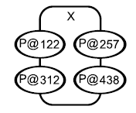
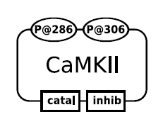
Entity node example
Clone markers are only needed for complexes in identical states.

Slide 21
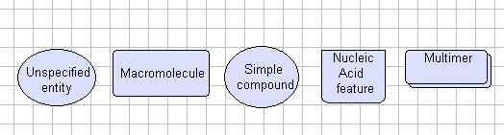
Entity nodes

Slide 22
Container nodes
Container nodes are used to hold multiple entity nodes, to arbitrary levels of complexity.
Complex - to represent macromolecular complexes
Compartment – to represent a physically restricted location in the cell.
Submap – indicating a complex process that should be mentioned, but whose details we are not concerned with in this particular diagram.

Slide 23
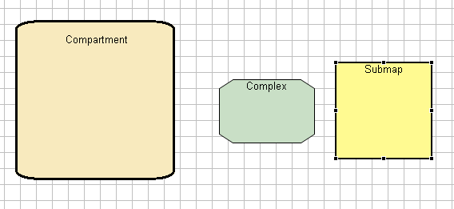
Container nodes

Slide 24
Process nodes
These nodes represent transformation. They are:
Process: a generic, widely used glyph representing any transformation
Uncertain process – can represent unknown or hypothetical processes.
Omitted process – a process whose details we are not concerned with in this pathway
Association - the non-covalent binding of 2 or more entity nodes into a larger complex
Dissociation - the breaking up of such a complex

Slide 25

Process nodes
Association Dissociation Transition Uncertain process Omitted process

Slide 26
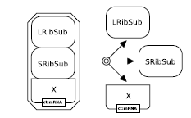
Example - dissociation

Slide 27
Connecting arcs
Arcs connect entities with processes. In SBGN, the following types of arc exist:
Consumption - links substrates to a reaction transition
Production - links a reaction transition to a product
Modulation - indicates that an entity has either an unknown, or variable effect on a reaction process.
Catalysis special case of stimulation
Stimulation increases reaction flux
Inhibition decreases reaction flux
Trigger - this is an ‘absolute’ stimulation that is essential for the transition to occur.
Logic arc - connects logic gates to their input and output nodes
Equivalence arc - indicates that an entity is equivalent to a tag.

Slide 28
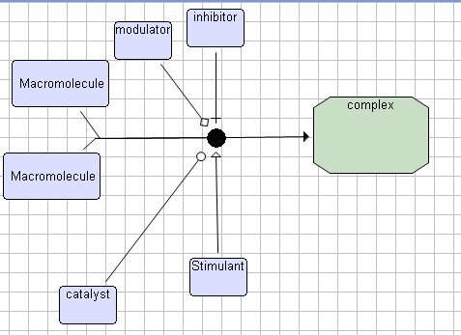
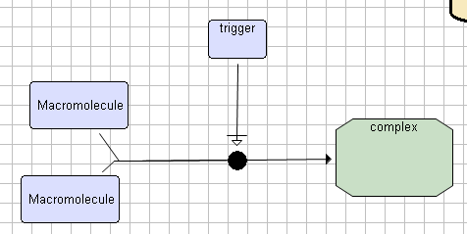
Connecting arcs
Notes:
Trigger now = necessary stimulation

Slide 29
Other nodes
Source and sink nodes are used to denote an unspecified starting and ending points of a pathway.
Perturbation indicate some external stimulus on the system – e.g., light
Phenotype an externally visible alteration or biochemical process.
Clone markers

Slide 30

Other nodes

Slide 31
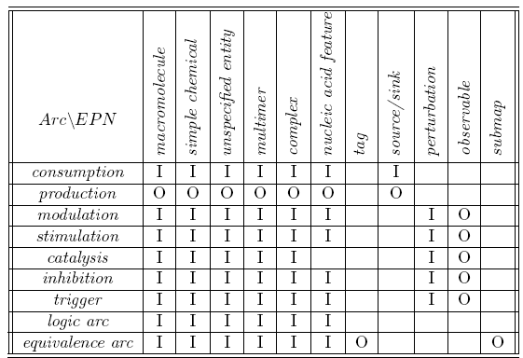
Connectivity of entity nodes
Read this as :
‘A [row] can have a [column] as [input or output]’

Slide 32
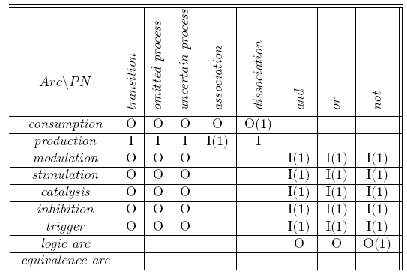
Connectivity of processes
Read this as :
‘A [row] arc can have a [column] as [input or output]’

Slide 33
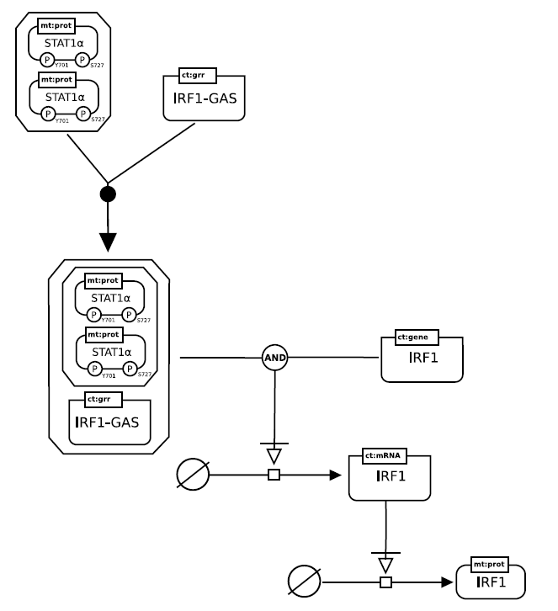
Association of transcription factors to produce
IRF1
Note the stimulus arrows for transcription and
Translation.

Slide 35
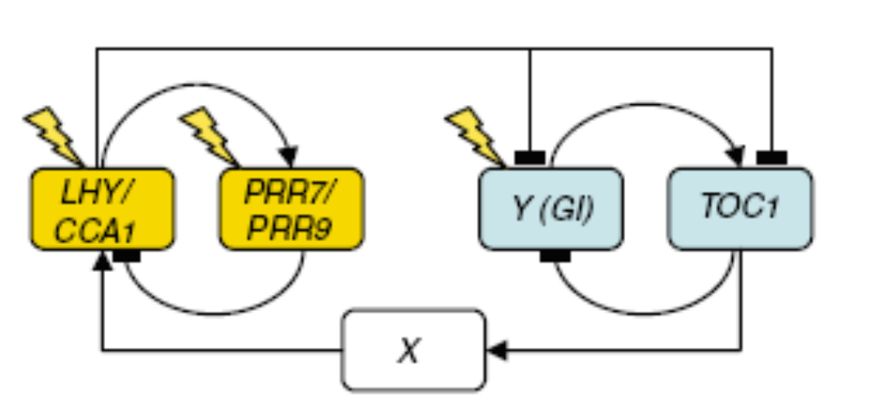
Arabidopsis Circadian clock 3 loop model.

Slide 36
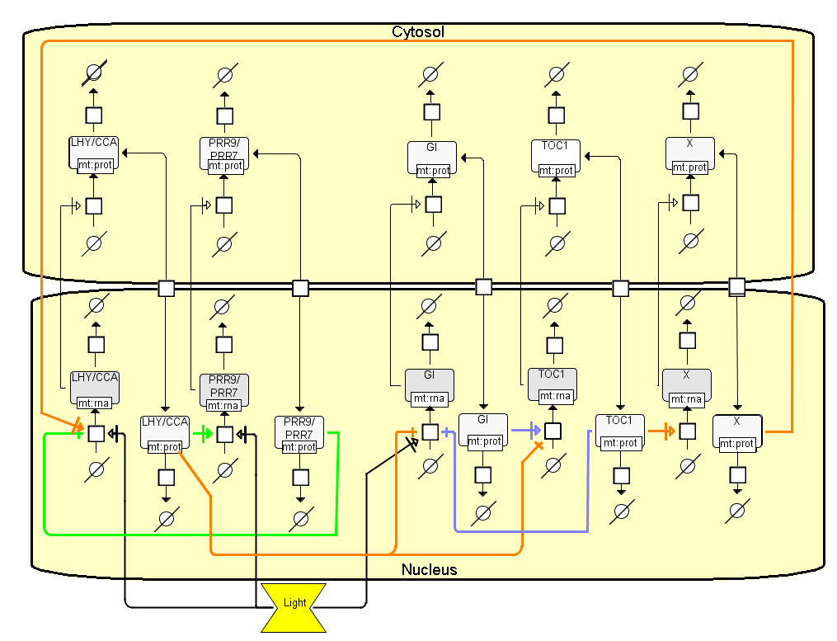
Notes:
Light stimulates LHY transcription. LHY protein returns to nucleus and stimulates PRR transcription.
PRR –vely regulates LHY.
2n loop: light stimulates GI production , which in turn activates TOC1. TOC1 –vely regulates GI and stimulates protein X
3rd loop Protein X stimulates LHY production. LHY inhibits transcription of GI and TOC1

Slide 37
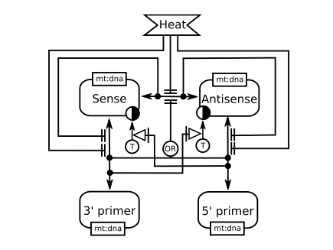
Entity relationship diagrams
Notes:
Not temporal

Slide 38
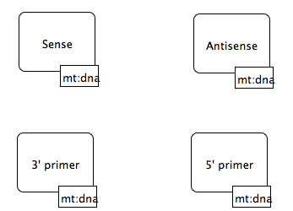
The entity interactors..

Slide 39
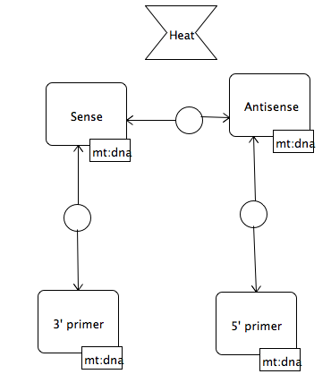
Adding relationships…
Notes:
Interaction relationships

Slide 40
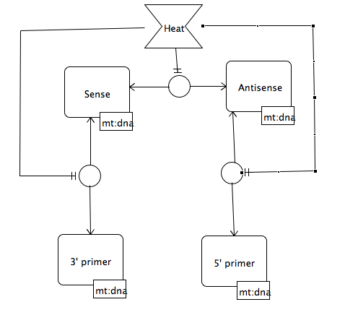
Adding influences…
Notes:
Absolute inhibition

Slide 41
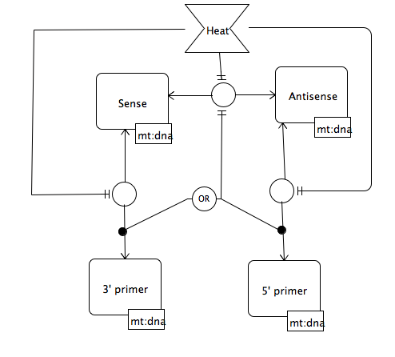
More influences…
Notes:
Think about a single entity rather than pool of entities, here. Hence the ‘Or’ loop

Slide 42
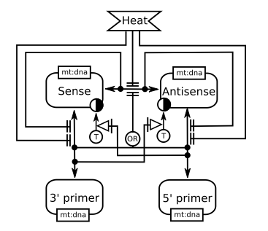
Outcomes and their influences..

Slide 43
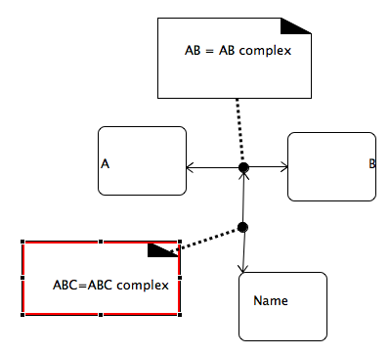
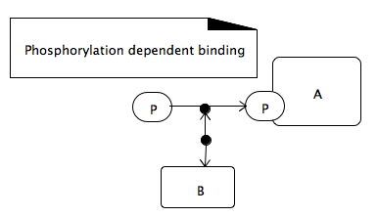
Motifs in SBGN-ER -1
Notes:
1) Sequential complex (Name should be C)

Slide 44
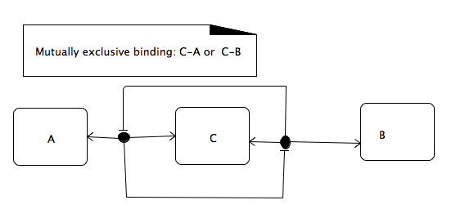
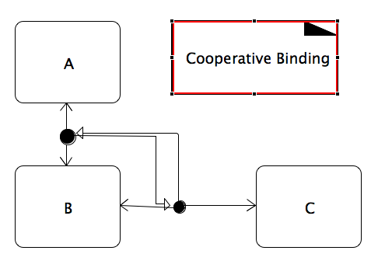
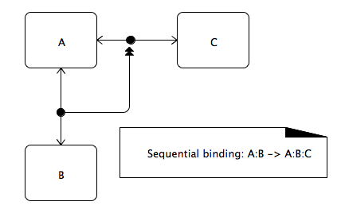
Motifs in SBGN-ER -2

Slide 45
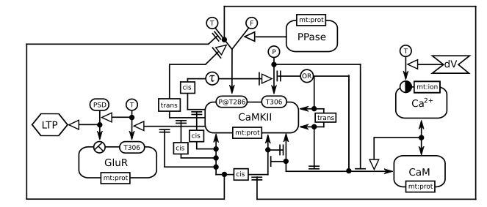
A more complex example…

Slide 46
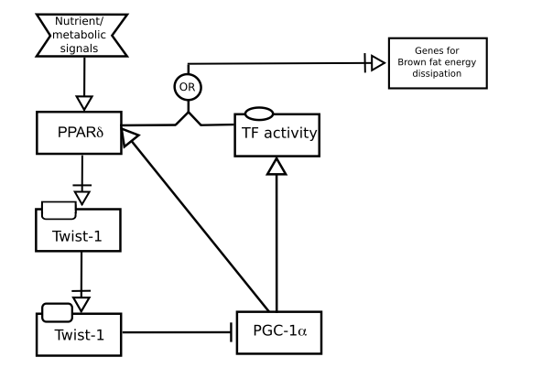
Activity flow notation
Notes:
Much simpler notation – details of reaction mechanisms not considered

Slide 47
light
Y
LHY
PRR
TOC1
v
v
TOC1
v
PRR
LHY
v
Y
v
X
X
Arabadopsis 3 loop model in SBGN-Activity Flow notation
Notes:
Simpler; omits compartments
Could coalesce genes and proteins into a single activity if appropriate.
No dynamics

Slide 48
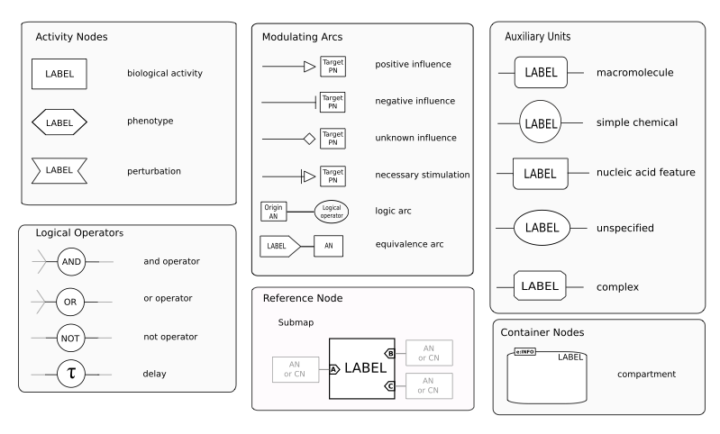

Slide 49
SBGN resources
www.sbgn.org
The Systems Biology Graphical Notation. Nature Biotechnology 27, 735 - 741 (2009).
http://dx.doi.org/10.1038/nbt.1558

Slide 50
SBGN drawbacks
Limited tool support as yet – requires dedicated software.
Many standard tools not implementing yet (e.g., Cytoscape).
Arrowheads confusing/ not always implemented (e.g., Powerpoint).
Exchange between tools
Lack of 3D visualization support
Nature of state transition hard to interpret

Slide 51
SBGN future development
Exchange format
  Current spec is just graphical.
  Ideally could save in one application, open in another.
    Content ( entities, connections)
    Annotation (semantics)
    Visual appearance (shape / colour)

Slide 52
Tools for SBGN
CellDesigner (www.celldesigner.org)PD
Edinburgh Pathway Editor (www.pathwayeditor.org) PD, ER, AF
Arcadia PD
Vanted PD (http://vanted.ipk-gatersleben.de/)

Slide 53
Tutorial – using CellDesigner to explore SBGN-PD
Goals:
Develop a working knowledge of SBGN-PD
Learn to use CellDesigner pathway editing/simulation software
CellDesigner overview and tour
Circadian clock model drawing and modelling
‘Exit from mitosis’ diagram.
‘Bring your own’.
Explore

Slide 54
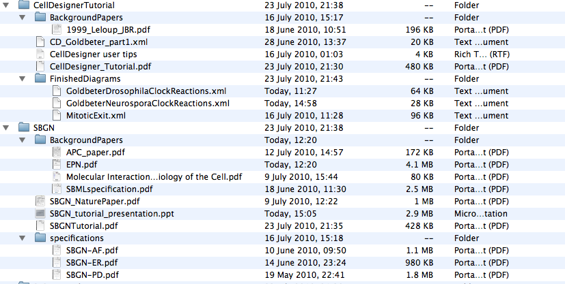
Tutorial contents….

Slide 55






Model
Simulation
Result
Minimal
Requirements
?
implements
implements
Data model
SED-ML
SBRML
Makes
sense of
Makes
sense of
Ontology

Slide 56
MIASE
  What base model to use & which modifications to apply
  What simulation task to run on those models (algorithms, see KiSAO; simulation parameters)
  How to post-process the numerical results and to present them
http://www.ebi.ac.uk/compneur-srv/miase/
Subset of MISE could be encoded in
SED-ML

Slide 57
SED-ML
Encode MIASE requirements

Slide 58
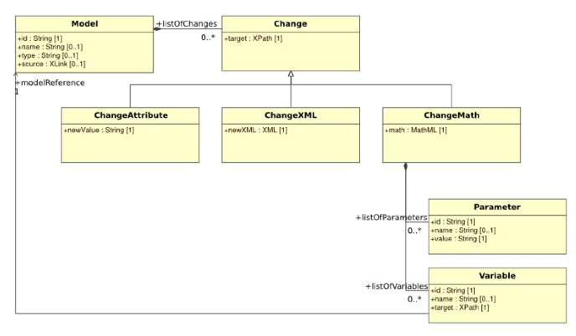
Description of models
Anatoly Sorokin

Slide 59
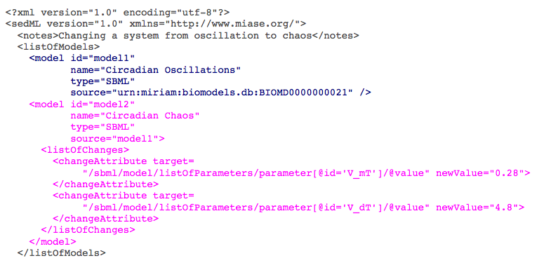
Description of models

Slide 60
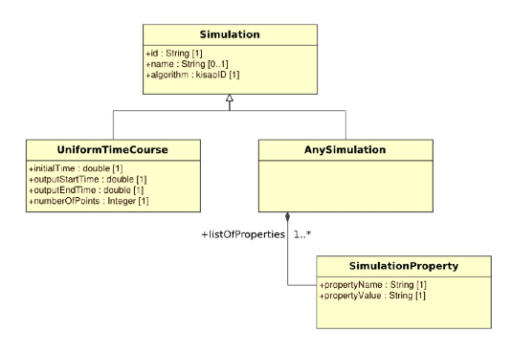
Simulations

Slide 61
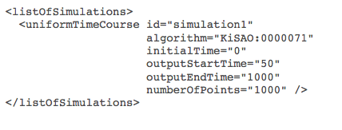
Simulations

Slide 62
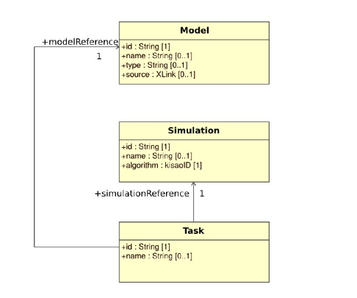
Simulation task

Slide 63
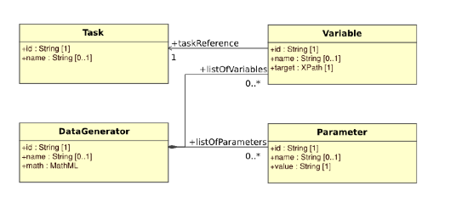
Data generation

Slide 64
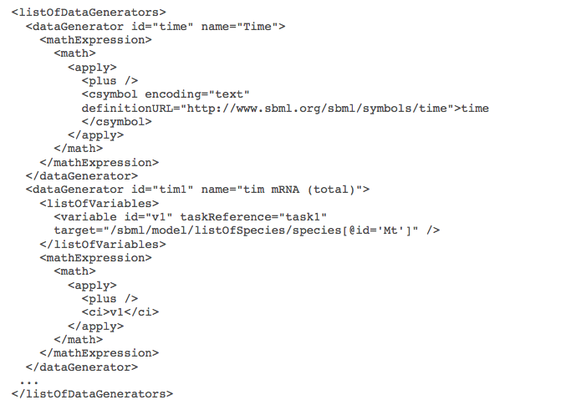
Data generation
Anatoly Sorokin

Slide 65
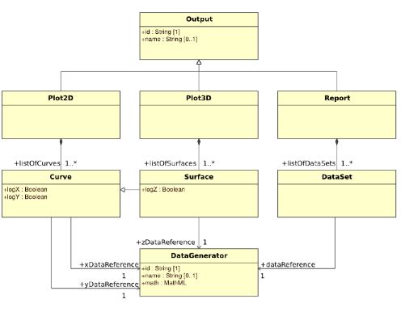
Production of results
Anatoly Sorokin

Slide 66
Model
Simulation
Result
Minimal
Requirements
?
implements
implements
Data model
SED-ML
SBRML
Makes
sense of
Makes
sense of
Ontology

Slide 67
KiSAO
Kinetic Simulation Algorithm Ontology
  Classification of simulation algorithms & methods
  Definition, literature references
  Relations between different simulation algorithms & methods
http://www.ebi.ac.uk/compneur-srv/kisao/index.html

Slide 68
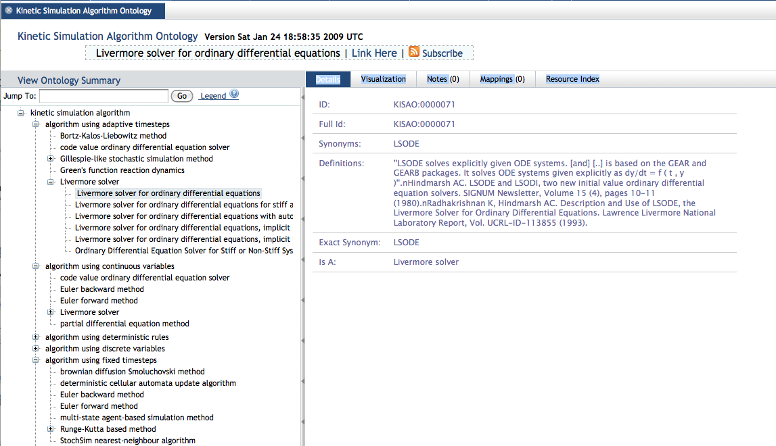
KiSAO
http://bioportal.bioontology.org/visualize/40844
Anatoly Sorokin

