Slide 1
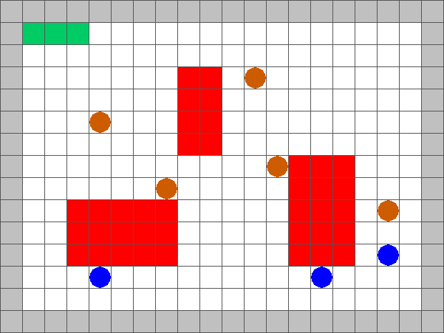
Surveillance Strategy Synthesis via Belief Abstraction
Goal: To establish surveillance on a target(s) whilst satisfying mission specifications
Agents can have varying velocities and visibility ranges

Slide 2
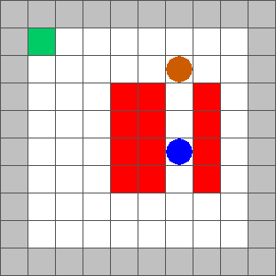
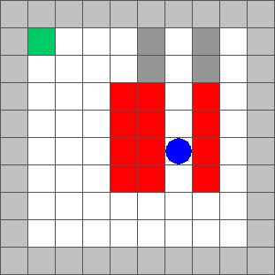
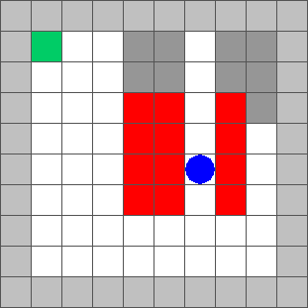
Surveillance Strategy Synthesis via Belief Abstraction
Can be treated as a partial-information 2-player game.
These can be solved by reducing to a perfect information game
Agent maintains a belief. Following shows progression of belief in target location

Slide 3
Surveillance Strategy Synthesis via Belief Abstraction
Every possible belief an agent can have on the location of the target is a state in the 2-player game.
The shaded grey in each gridworld is one belief state
Have to account for every combination of states. In a 10x10 grid this is 2¹⁰⁰ combinations!

Slide 4
Surveillance Strategy Synthesis via Belief Abstraction
To avoid constructing these belief sets we force the agent to maintain perfect information – maintain vision at all times.
This requirement is conservative and may not always be feasible.

Slide 5
Surveillance Strategy Synthesis via Belief Abstraction
Video of following closely goes here (insert Video 1)

Slide 6
Surveillance Strategy Synthesis via Belief Abstraction
To loosen the restriction on the agent, we allow it to lose vision and maintain a rough belief on the target location
We restrict size of the belief. Agent should have a reasonable idea of the target location
If we restrict belief size to 8, then this is a losing position for the agent as there 9 possible locations for the target

Slide 7
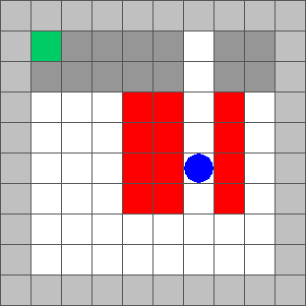
Surveillance Strategy Synthesis via Belief Abstraction
We construct rough belief sets → once we lose sight, the target can be in many possible locations.
Even though it may be physically impossible, it allows fewer states to be constructed.
If there are 4 partitions, then only 2⁴ = 16 more states!

Slide 8
Surveillance Strategy Synthesis via Belief Abstraction
Tradeoffs:
Rough belief sets → More efficient computation, but closer tracking of the target required.
If belief sets are too rough, agent will default to keeping target in vision at all times.
Video example (15x20 with rough sets)

Slide 9
Surveillance Strategy Synthesis via Belief Abstraction
Tradeoffs:
Fine belief sets → Slow computation, but agent can allow target out of sight for longer
Video example (15 x 20 with fine sets)

Slide 10
Surveillance Strategy Synthesis via Belief Abstraction
Choices for user:
Roughness of belief set
Restriction in belief size for agent
Changing the above parameters will result in different behaviours for the agent!
Next steps:
Automate construction of belief sets
Use counterexamples to guide where belief needs to be refined – no need to refine in wide open spaces!

