Slide 1
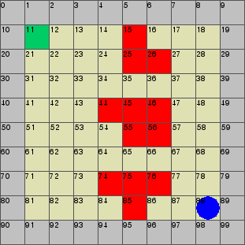
Reduction Techniques for Learning in MDPs
Model-based learning - attractive theoretical guarantees, but requires excessive exploration.
We ask which states and actions are relevant to our objective
Intuitively, the dashed circles is where we need knowledge of our transitions in order to decide which path is safer
We can guarantee safety elsewhere

Slide 2
Reduction Techniques for Learning in MDPs : Contribution
We provide sufficient conditions for irrelevancy that can be checked in polynomial time.
Informally, we check if some transitions are better than others regardless of their value
Output is a reduced MDP with equivalent reachability probability.

Slide 3
Reduction Techniques for Learning in MDPs : Results
We test our reductions on benchmarks and compare with existing techniques.
We also test on randomly generated gridworlds and compare sampling requirements before guarantees are reached

Slide 4
Reduction Techniques for Learning in MDPs : Benchmarks
Benchmark | Case | Existing techniques | Proposed reductions
Randomized consensus shared coin protocol | Case 1 | 98% | 19%
Case 2 | 98% | 23%
Zeroconf protocol | Case 1 | 96% | 10.7%
Case 2 | 97.2% | 12.6%
Size of MDP compared to original after applying existing techniques and proposed novel techniques

Slide 5
Reduction Techniques for Learning in MDPs : Gridworlds
Size | Existing techniques | Proposed reductions
12x12 | 48.4% | 29.4%
15x15 | 47.0% | 32%
20x20 | 46.1% | 35.6%
Reduction comparison on randomly generated gridworlds
 | Size | Existing techniques | Proposed reductions
Size | 10x10 | 25% | 2%
Episodes | 15x15 | 948,000 | 83,000
Reduction in learning episodes after reductions. There is a 98% reduction in learning episodes after applying our techniques compared to existing techniques

Slide 6
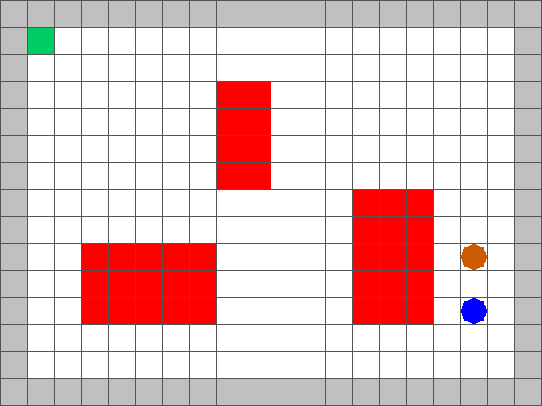
Surveillance Strategy Synthesis via Belief Abstraction
Goal: To establish surveillance on a target(s) whilst satisfying mission specifications

Slide 7
Surveillance Strategy Synthesis via Belief Abstraction
Can be treated as a partial-information 2-player game.
These are notoriously difficult to solve.
In order to maintain perfect information, we force the agent to maintain vision at all times.
This requirement is conservative which may not always be feasible.

Slide 8
Surveillance Strategy Synthesis via Belief Abstraction
Video of following closely goes here

Slide 9
Surveillance Strategy Synthesis via Belief Abstraction
To loosen the restriction on the agent, we allow it to lose vision and maintain a belief on the target location
We restrict size of the belief. Agent should have a reasonable idea of the target location
However, constructing a full set of beliefs on target location means we need to maintain every combination of states the target can be in → exponential number of combinations!
We construct rough belief sets → once we lose sight, the target can be in many possible locations.

Slide 10
Surveillance Strategy Synthesis via Belief Abstraction
Tradeoffs:
Rough belief sets → More efficient computation, but closer tracking of the target required.
If belief sets are too rough, agent will default to keeping target in vision at all times.
Video example (10x10 with rough sets)

Slide 11
Surveillance Strategy Synthesis via Belief Abstraction
Tradeoffs:
Fine belief sets → Slow computation, but agent can allow target out of sight for longer
Video example (10 x 10 with fine sets)

Slide 12
Surveillance Strategy Synthesis via Belief Abstraction
Choices for user:
Roughness of belief set
Restriction in belief size for agent
Changing the above parameters will result in different behaviours for the agent!

