Slide 1
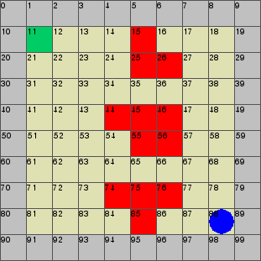
Reduction Techniques for Learning in MDPs
Model-based learning - attractive theoretical guarantees, but requires excessive exploration.
We ask which states and actions are relevant to our objective
Intuitively, the dashed circles is where we need knowledge of our transitions in order to decide which path is safer
We can guarantee safety elsewhere

Slide 2
Reduction Techniques for Learning in MDPs : Contribution
We provide sufficient conditions for irrelevancy that can be checked in polynomial time.
Informally, we check if some transitions are better than others regardless of their value
Offline computation based only on structure – no knowledge of probabilities needed
Output is a reduced MDP with equivalent reachability probability.

Slide 3
Reduction Techniques for Learning in MDPs : Results
We test our reductions on benchmarks and compare with existing techniques.
We also test on randomly generated gridworlds and compare sampling requirements before guarantees are reached

Slide 4
Reduction Techniques for Learning in MDPs : Benchmarks
Benchmark | Case | Existing techniques | Proposed reductions
Randomized consensus shared coin protocol | Case 1 | 98% | 19%
Case 2 | 98% | 23%
Zeroconf protocol | Case 1 | 96% | 10.7%
Case 2 | 97.2% | 12.6%
Size of MDP compared to original after applying existing techniques and proposed novel techniques

Slide 5
Reduction Techniques for Learning in MDPs : Gridworlds
Size | Existing techniques | Proposed reductions
12x12 | 48.4% | 29.4%
15x15 | 47.0% | 32%
20x20 | 46.1% | 35.6%
Reduction comparison on randomly generated gridworlds
 | No reductions | Existing techniques | Proposed reductions
Size | 100% | 25% | 2%
Total steps | 11,700,000 | 7,900,000 | 730,000
Reduction in learning episodes after reductions on a random 10x10 gridworld. There is a 94% reduction in learning steps after applying our techniques compared to 67% under existing techniques

