Slide 1
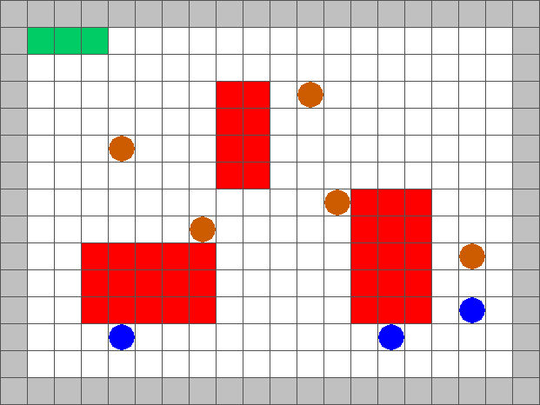
Surveillance Strategy Synthesis via Belief Abstraction
Goal: To establish surveillance on a target(s) whilst satisfying mission specifications
Agents can have varying velocities and visibility ranges

Slide 2
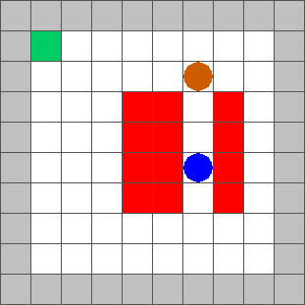
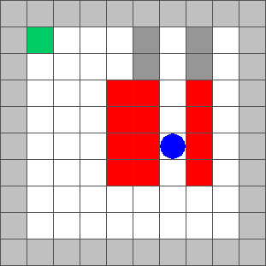
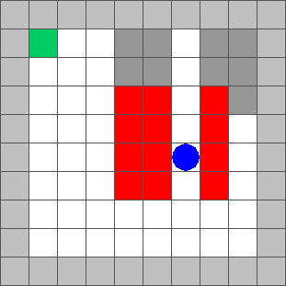
Surveillance Strategy Synthesis via Belief Abstraction
Can be treated as a partial-information 2-player game.
These can be solved by reducing to a perfect information game
Agent maintains a belief. Following shows progression of belief in target location

Slide 3
Surveillance Strategy Synthesis via Belief Abstraction
Every possible belief an agent can have on the location of the target is a state in the 2-player game.
The shaded grey in each gridworld is one belief state
Have to account for every combination of states. In a 10x10 grid this is 2¹⁰⁰ combinations!

Slide 4
Surveillance Strategy Synthesis via Belief Abstraction
To avoid constructing these belief sets we force the agent to maintain perfect information – maintain vision at all times.
This requirement is conservative and may not always be feasible.

Slide 5
Surveillance Strategy Synthesis via Belief Abstraction
Insert closefollowing.mp4

Slide 6
Surveillance Strategy Synthesis via Belief Abstraction
To loosen the restriction on the agent, we allow it to lose vision and maintain a rough belief on the target location
We restrict size of the belief. Agent should have a reasonable idea of the target location
If we restrict belief size to 8, then this is a losing position for the agent as there 9 possible locations for the target

Slide 7
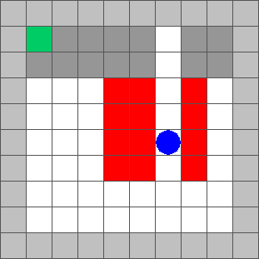
Surveillance Strategy Synthesis via Belief Abstraction
We construct rough belief sets → once we lose sight, the target can be in many possible locations.
Even though it may be physically impossible, it allows fewer states to be constructed.
If there are 4 partitions, then only 2⁴ = 16 more states!

Slide 8
Surveillance Strategy Synthesis via Belief Abstraction
Tradeoffs:
  Rough belief sets → More efficient computation, but closer tracking of the target required.
  If belief sets are too rough, agent will default to keeping target in vision at all times.
  Insert roughsets.mp4

Slide 9
Surveillance Strategy Synthesis via Belief Abstraction
Tradeoffs:
  Fine belief sets → Slow computation, but agent can allow target out of sight for longer
Insert Finesets.mp4

Slide 10
Surveillance Strategy Synthesis via Belief Abstraction
Choices for user:
  Roughness of belief set
  Restriction in belief size for agent
Changing the above parameters will result in different behaviours for the agent!
Next steps:
  Automate construction of belief sets
  Use counterexamples to guide where belief needs to be refined – no need to refine in wide open spaces!

