Slide 1
Simulated Hospital Report

Slide 2
2020 Encounter Report for Rhode Island Hospital
Encounter reasons and visits by date from a simulated population of 10k Rhode Islanders.
Data simulated using synthea: https://github.com/synthetichealth/synthea
Overview
509 individuals visiting
Encounter for symptom (procedure) was the top encounter type
COVID-19 was the top condition targeted during encounters
Top 10 reasons for visit
visits_by_reason %>% top_n(10, n) %>% drop_na() %>% ggplot()+ geom_col(aes(y=reorder(reasondescription, n), x=n), fill='mediumblue')+ theme_classic()+ xlab('Number of Encounters')+ ylab('')

Slide 3
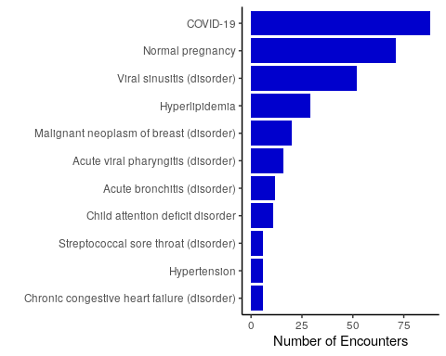

Slide 4
Encounters by date
ggplot(visits_by_date)+ geom_line(aes(x=start_date, y=n))+ xlab('Date')+ ylab('Number of Encounters')+ theme_classic()

Slide 5
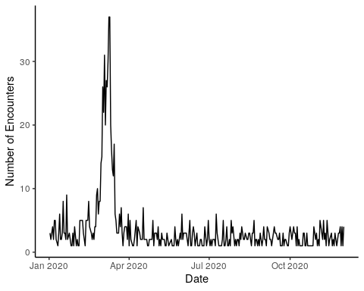

Slide 6
Top Encounter Types
data %>% count(description) %>% drop_na() %>% top_n(10,n) %>% ggplot()+ geom_col(aes(y=reorder(description, n), x=n), fill='darkgreen')+ theme_classic()+ xlab('Number of Encounters')+ ylab('')

Slide 7
