Slide 1
Title: Titanic Dataset Analysis: A Comprehensive Study of Survival Patterns
Subtitle: Advanced Big Data and Data Mining Project
Titanic Dataset Analysis: PowerPoint Presentation Content
Authors:
David Andrejsin,
Sakchham Sangroula,
Milan Bista,
Unique Karanjit,
Shimon Bhandari
Course: MSCS-634-M40 Advanced Big Data and Data Mining Date: July 13, 2025

Slide 2
Slide 2: Project Overview
Title: Project Overview & Objectives
Key Points:
Analyzed passenger data from the RMS Titanic disaster (April 15, 1912)
Applied multiple data mining techniques to understand survival patterns
Developed predictive models using modern machine learning algorithms
Main Objectives:
Conduct comprehensive exploratory data analysis
Build regression models to predict fare prices
Develop classification models for survival prediction
Identify passenger clusters using unsupervised learning
Discover association rules related to survival patterns

Slide 3
Slide 3: Dataset Description
Title: Dataset Overview
Dataset Characteristics:
Training Set: 891 passengers with 12 features
Test Set: 418 passengers with 11 features
Target Variable: Survival status (0 = Did not survive, 1 = Survived)
Key Features:
Demographic: Age, Sex, Passenger Class
Family: Siblings/Spouses (SibSp), Parents/Children (Parch)
Travel: Fare, Cabin, Port of Embarkation
Overall Survival Rate: 38.4% (342 out of 891 passengers)

Slide 4
Slide 4: Data Preprocessing & Cleaning
Title: Data Preprocessing Strategy
Missing Values Identified:
Age: 177 missing values (19.9%)
Cabin: 687 missing values (77.1%)
Embarked: 2 missing values (0.2%)
Data Cleaning Approach:
Age: Imputed with median value (28.0 years)
Cabin: Dropped due to excessive missing values
Embarked: Filled with mode value ('S' - Southampton)
Feature Engineering:
Created AgeGroup categories (Child, Teen, Young Adult, Adult, Senior)
Generated FamilySize feature (SibSp + Parch + 1)
Standardized categorical variables

Slide 5
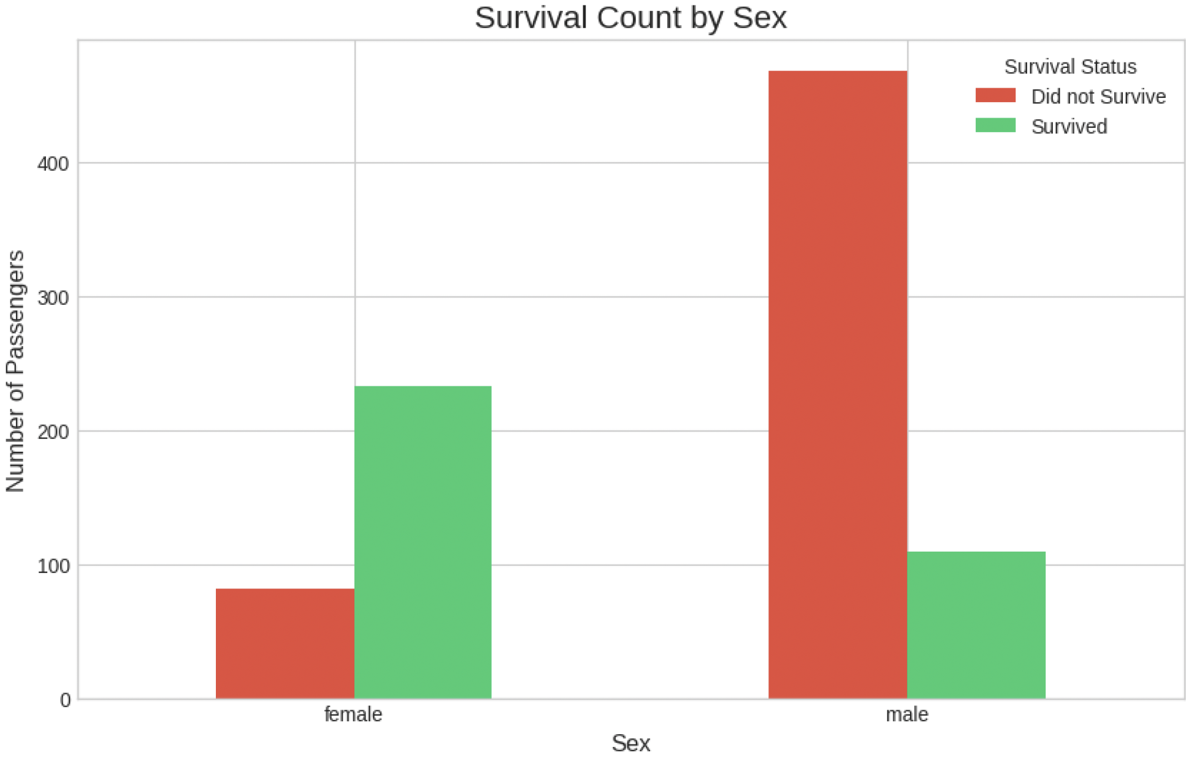
Slide 5: Key Findings from EDA
Title: Exploratory Data Analysis - Key Insights
Survival Rate by Gender:
Female: 74.2% survival rate (233 out of 314)
Male: 18.9% survival rate (109 out of 577)
Insight: Gender was the strongest predictor of survival
Survival Rate by Passenger Class:
First Class: Highest survival rate
Second Class: Moderate survival rate
Third Class: Lowest survival rate
Insight: Clear correlation between socioeconomic status and survival
Age Distribution:
Adults (30-50) comprised the largest passenger group
Children showed relatively better survival rates

Slide 6
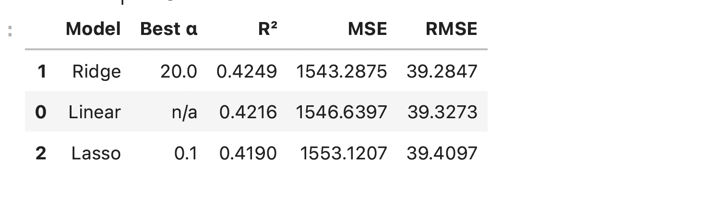
Slide 6: Regression Analysis Results
Title: Fare Prediction Models
Models Evaluated:
Linear Regression: Baseline model
Ridge Regression: L2 regularization
Lasso Regression: L1 regularization
Performance Results:
Ridge Regression: Best performer
R² = 0.4249
RMSE = 39.28
Optimal alpha = 20.0
Linear Regression: R² = 0.4216, RMSE = 39.33
Lasso Regression: R² = 0.4190, RMSE = 39.41
Key Insight: Passenger class, age, and family size were primary fare determinants

Slide 7
Slide 7: Classification Results
Title: Survival Prediction Models
Algorithms Implemented:
Decision Tree Classifier: Rule-based interpretable model
k-Nearest Neighbors: Instance-based learning
Model Performance:
Decision Tree:
Accuracy = 77.09%
F1 Score = 64.35%
Optimal parameters: max_depth=5, min_samples_split=10
k-Nearest Neighbors:
Accuracy = 73.74%
F1 Score = 66.67%
Key Insight: Decision Tree showed superior accuracy while k-NN had slightly better F1 performance

Slide 8
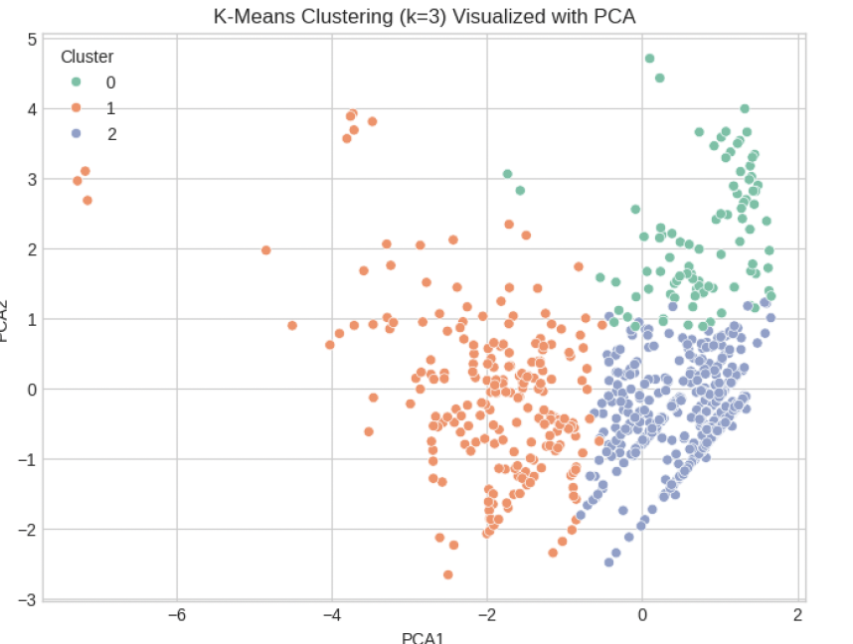
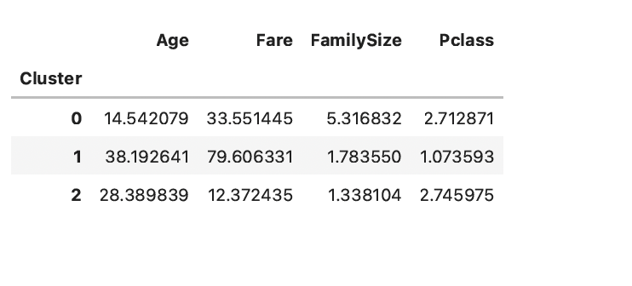
Slide 8: Clustering Analysis
Title: Passenger Segmentation
Methodology:
Applied K-means clustering with k=3
Used PCA for 2D visualization
Analyzed cluster characteristics
Cluster Profiles:
Cluster 0: Young passengers (avg age 14.5) with large families (avg size 5.3)
Cluster 1: Older, affluent passengers (avg age 38.2) with high fares ($79.61)
Cluster 2: Working-age passengers (avg age 28.4) with low fares ($12.37)
Business Insight: Clear segmentation by age, family structure, and socioeconomic status

Slide 9
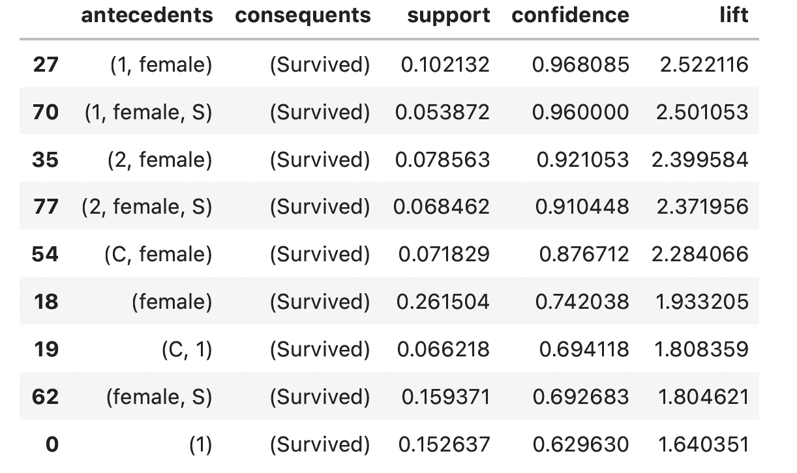
Slide 9: Association Rule Mining
Title: Pattern Discovery
Top Association Rules:
First-class females: 96.8% survival rate (confidence), 2.52x lift
First-class females from Southampton: 96.0% survival rate, 2.50x lift
Second-class females: 92.1% survival rate, 2.40x lift
General female passengers: 74.2% survival rate, 1.93x lift
Key Insights:
Gender-class combinations showed strongest survival associations
Port of embarkation provided additional predictive value
Rules confirmed "women and children first" maritime protocol effectiveness

Slide 10
Slide 10: Ethical Considerations
Title: Ethical Analysis & Considerations
Data Privacy & Consent:
Historical dataset contains personal information of deceased individuals
Data handled with appropriate sensitivity for educational purposes
Identified Biases:
Socioeconomic bias: Survival rates heavily influenced by passenger class
Gender bias: Systematic differences in survival rates by gender
Age bias: Certain age groups had preferential treatment
Mitigation Strategies:
Acknowledged historical context and social norms of 1912
Avoided perpetuating discriminatory practices in recommendations
Emphasized educational value over predictive applications

Slide 11
Slide 11: Challenges & Future Work
Title: Challenges Faced & Future Directions
Current Limitations:
Missing Data: Substantial cabin information unavailable (77% missing)
Sample Size: Limited to passengers with complete records
Historical Context: 1912 social norms may not apply to modern scenarios
Future Research Directions:
Advanced Modeling: Explore ensemble methods and deep learning approaches

Slide 12
Slide 12: Conclusion
Title: Project Conclusion & Key Takeaways
Historical Insights:
"Women and Children First" protocol was largely followed
Significant survival advantages for higher-class passengers
Complex relationships between family size and survival outcomes
Main Findings:
Gender was the strongest predictor of survival (74.2% vs 18.9%)
Passenger class significantly impacted survival chances
Age groups showed varying survival patterns
Family size provided additional predictive power

