Slide 1
Finance Report Dashboard
Prepared by: Sirumalla Bhanu Vardhan
Power BI | Task 4: Dashboard Design

Slide 2
Objective
Goal:
Create a dynamic, interactive dashboard to visualize financial performance
To assist stakeholders in making data-driven decisions.

Slide 3
Dataset Used
Source:
- Microsoft’s sample finance dataset
- File: financial_data_task_4.csv
Tool:
- Power BI

Slide 4
Key Features
- Filter data by Segment, Country, and Year
- Summary cards for:
• Total Units Sold
• Total Gross Sales
• Total Profit
- Interactive visuals:
• Quarterly Profit (Bar Chart)
• Monthly Profit (Area Chart)
- Reset Button for slicers

Slide 5
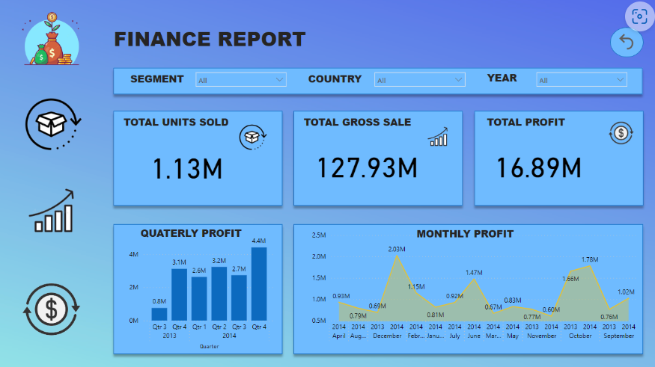
Dashboard Visuals

Slide 6
Interactivity & Design
- Slicers enable focused insights
- Time-based visuals for trend analysis
- Clean and consistent color theme
- Navigation made simple with Reset feature

Slide 7
Business Impact
- Easy monitoring of financial KPIs
- Quick insights into sales and profit trends
- Better decision-making through visuals

Slide 8
Thank You
THANK YOU

