Slide 1

Predictive Modeling Project
Kiran Varre
Priya Bandi
Rajan Mehta
Krishna Shah
Charanjith Thottathil
MS-BAPM PREDICTIVE MODELING 1

Slide 2
Agenda
Problem Statement
Data Cleaning
Model Generation
Model Valuation and Parameter Tuning
Insights and Enhancements
Conclusion
MS-BAPM PREDICTIVE MODELING 2

Slide 3




Problem Statement
Lending Club is the world’s largest peer-to-peer marketplace connecting borrowers and investors.
Since its inception in 2007, the number of loans in the marketplace has increased exponentially and the borrowers default on their loans.
A loan status is either good/bad so that the company can approve/decline the new loan applications based on historical loan information.
MS-BAPM PREDICTIVE MODELING 3

Slide 4
Project Timeline
Classification Tree
Linear Regression
Boosted Trees
Bootstrap Forest
Random Forest
SVM
Key take-aways to improve the business model
SAS
Data Cleaning
Model Generation
Model Valuation & Parameter Tuning
Insights &
Enhancements
Choosing best model using model parameters and parameter tuning
MS-BAPM PREDICTIVE MODELING 4

Slide 5
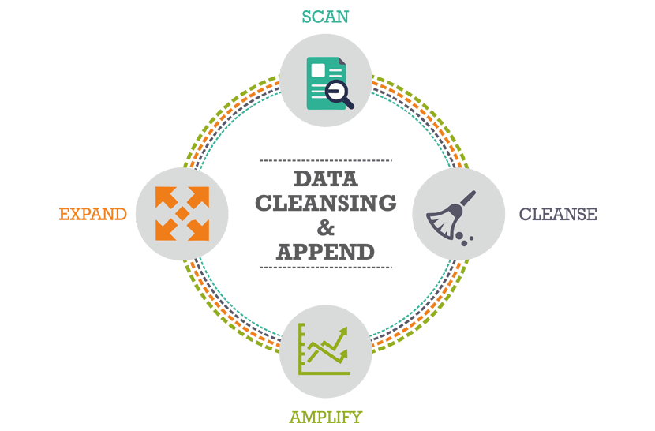

Data Cleaning
Time Consuming: 60% of the time went in data cleansing
Importance: 125 out of 145 columns are removed from the initial data
MS-BAPM PREDICTIVE MODELING 5

Slide 6

Data Cleaning
Performed using SAS 9.4
Steps followed:
Removed Unnecessary Data Fields(125)
Removed Outliers(3 Std. Deviation)
Removed incorrect format(4)
Values Group(2)
Converted Ordinal Variables to Ordered Numeric Variables(3)
Converted Nominal Variables to Numeric Variables(3)
Replaced Nulls with 0(6)
Derived Variables(1)
Classifier(1)
MS-BAPM PREDICTIVE MODELING 6

Slide 7


Model Validation
Classification Tree
Logistic Regression
4Lift – 1.7
AUC – 0.69 Lift – 1.8
Boosted Tree
Bootstrap Forest
AUC – 0.66 Lift – 1.7
.
AUC – 0.68 Lift – 1.8
Random Forest
Linear - SVM
AUC – 0.89 Lift – 2
.
AUC – 0.64 Lift – 1.8
Random forest is best fit suitable for the data based on the AUC and Lift
MS-BAPM PREDICTIVE MODELING 7

Slide 9
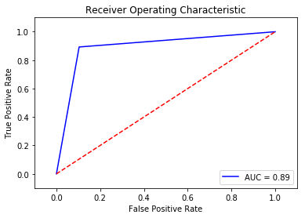
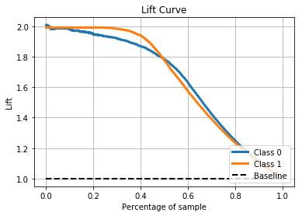

Model Generation
Random Forest
SMOTE
Choosing the best parameters - find the parameters that can give the best cross-validation score
Building the model - implement the model with best combination of parameters found above. {'max_features': 'sqrt', 'max_depth': 27}
Confusion Matrix: [[ 7679 889]
[ 926 7711]]
MS-BAPM PREDICTIVE MODELING 8

Slide 10

Parameter Tuning
Hyperparameter_tuning^{[1]} (training_data, hp_list):
hp_perf = []
foreach hp_setting in hp_list:
validation_results = cross_val_score (training_data)
hp_perf.append (validation_results)
best_hp_setting = hp_list [max_index (hp_perf)]
best_model = train_model (training_data, best_hp_setting)
return (best_hp_setting, best_model)
[1] https://www.oreilly.com/ideas/evaluating-machine-learning-models/page/5/hyperparameter-tuning
Automate choosing of the best tuning parameters (Hyper-parameters) for training of that model
Examples: For knn - n_neighbors , weights , etc
For decision trees - criterion , splitter , max_features , max_depth , etc.
For Random forest classifiers - n_estimators , max_depth, max_features , etc
MS-BAPM PREDICTIVE MODELING 9

Slide 11
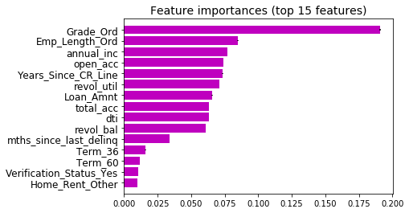
Feature Engineering
These are the top 10 features according to impact on the output variable
MS-BAPM PREDICTIVE MODELING 10

Slide 12
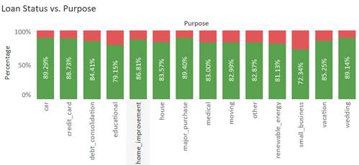
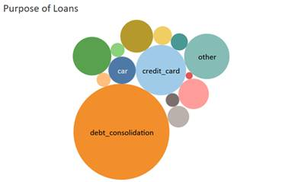

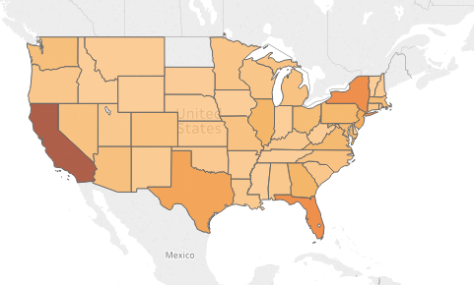
Insights &
Enhancements
Insights
The proportion of bad loans are decreasing over the time
Majority of the loan applications were received for debt consolidations and credit card purposes
However, the risky loans were not from these major categories. They are from ‘Small business’ and ‘educational’ categories.
California, Texas, Florida and New York are having higher bad loan amount
Enhancements
In case of chronological data, should we validate model on previous years data!?
Data(Column values) for purpose variable can be grouped into smaller sets
MS-BAPM PREDICTIVE MODELING 11

Slide 13
Conclusion
Data cleansing is critical and time consuming
The performance of predictive model is better in case of balanced data
AUC is independent of the fraction of the test population. It is useful for evaluating the performance of classifiers on unbalanced data set
Random Forest works best on the given data based on the performance metrics
The focus is should be more on False Positive(Bad loan predicted as Good) as the cost involved is more
MS-BAPM PREDICTIVE MODELING 12

Slide 14

Q & A
MS-BAPM PREDICTIVE MODELING 13

Slide 15

MS-BAPM PREDICTIVE MODELING 14

