Slide 1
phylo2vec workshop
19.09.2025
Neil Scheidwasser, Prince Ravi Leow, Samir Bhatt (KU)
Don Setiawan, Anshul Tambay (SSEC)
Oliver Ratmann (IC)
Notes:
##-AccessibilityAssistant: Skip layout check-##

Slide 2
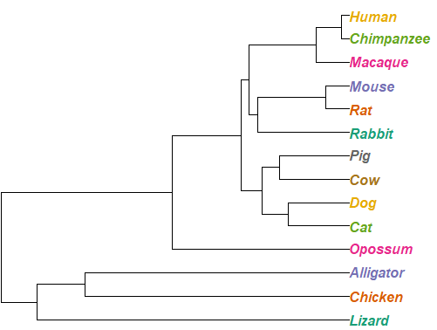
Overview
phylo2vec = ”phylogeny to vector”
Ancestors
Branch lengths
Topology
Taxa
(Leaves)
[0, 0, 2, 4, 5]
Topology
Branch lengths
[[0.2, 0.3, 0.1, 0.43, 0.5],
[0.7, 0.8, 1.2, 0.3, 0.4]]
Notes:
##-AccessibilityAssistant: Skip layout check-##

Slide 3
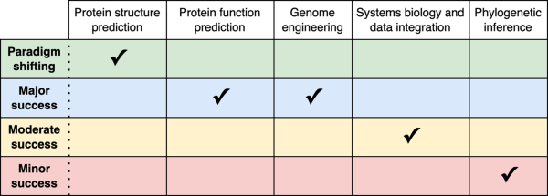

Motivation
Machine/deep learning
Sapoval et al., 2022

Slide 4
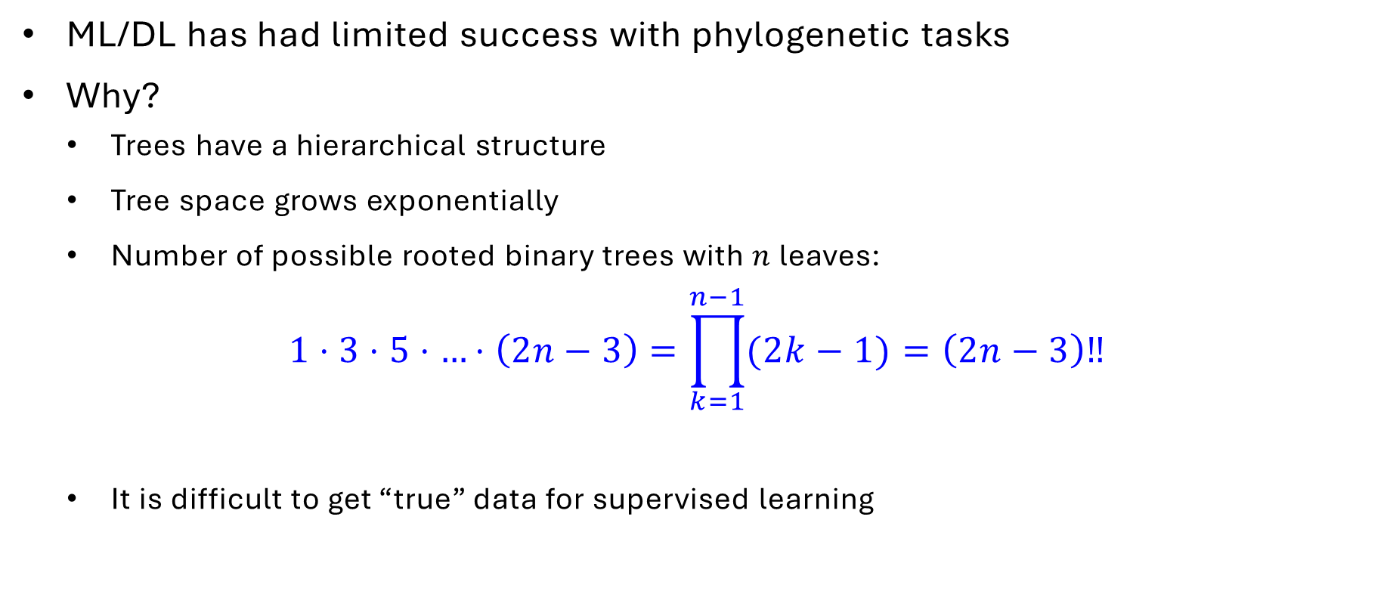
Motivation
Machine/deep learning
ML/DL has had limited success with phylogenetic tasks
Why?
  Trees have a hierarchical structure
  Tree space grows exponentially
  Number of possible rooted binary trees with $n$ leaves:
$$1⋅3⋅5⋅…⋅\left(2n−3\right)=\prod_{k=1}^{n−1}{(2k−1)}=\left(2n−3\right)‼$$
  It is difficult to get “true” data for supervised learning

Slide 5
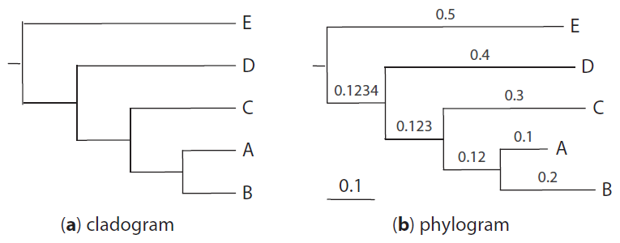
Motivation
Representing trees
Traditional format for representing trees = Newick format
Example:
Without branch lengths:
((((A, B), C), D), E);
With branch lengths:
((((A:0.1,B:0.2):0.12,C:0.3):0.123,D:0.4):0.1234, E: 0.5);
Source: Yang, Z., Molecular Evolution: A Statistical Approach, 2014

Slide 6
Motivation
Representing trees
Comparing trees is nontrivial
  Tree 1 = (((aaaaad,(aaaaae,aaaaaf)),(aaaaag,(aaaaah,(aaaaai,aaaaaj)))),(aaaaa,(aaaaab,aaaaac)));
  Tree 2 = ((aaaaa,(aaaaab,aaaaac)),((aaaaad,(aaaaae,aaaaaf)),(aaaaag,(aaaaah,(aaaaai,aaaaaj)))));
  Are both trees the same?
Sampling random trees is not immediately easy
Computer-readable, but not very computer-manipulable
  Need to balance parentheses + many string manipulation operations

Slide 7
phylo2vec
A vector representation for binary (rooted) trees
  Fast to sample random trees
  Compressed representation
  Easy to check that two trees are identical
  Offers a new heuristic to find the best phylogenetic tree
  Easy to manipulate (as a NumPy array in Python, a vector in R…)

Slide 8
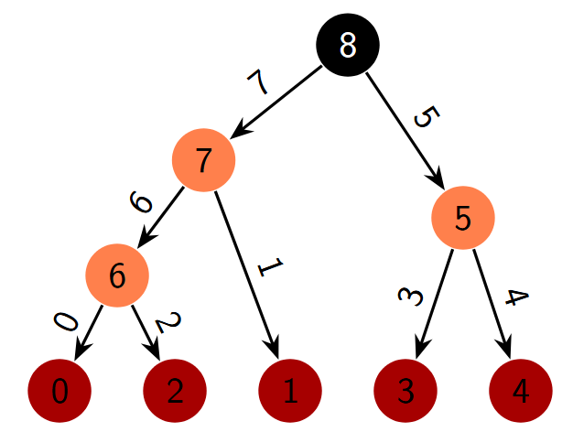
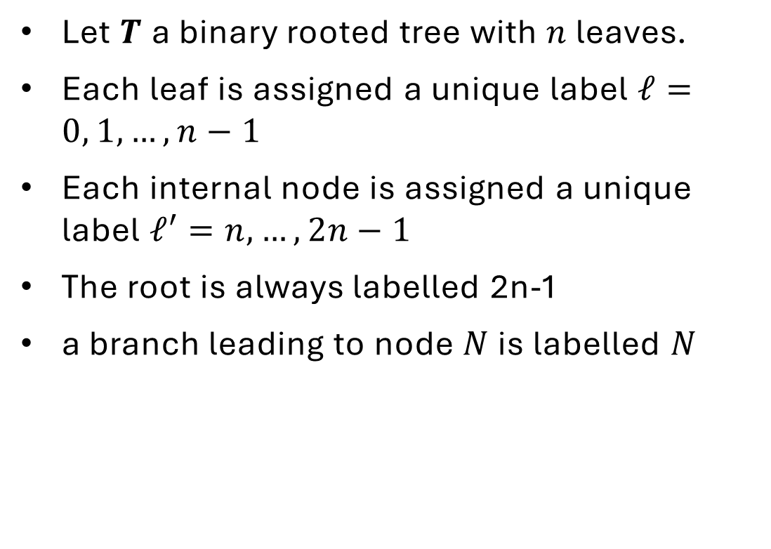
Assumptions
Let $T$a binary rooted tree with $n$ leaves.
Each leaf is assigned a unique label $ℓ=0, 1, …, n−1$
Each internal node is assigned a unique label $ℓ′=n, …, 2n−1$
The root is always labelled 2n-1
a branch leading to node $N$ is labelled $N$

Slide 9
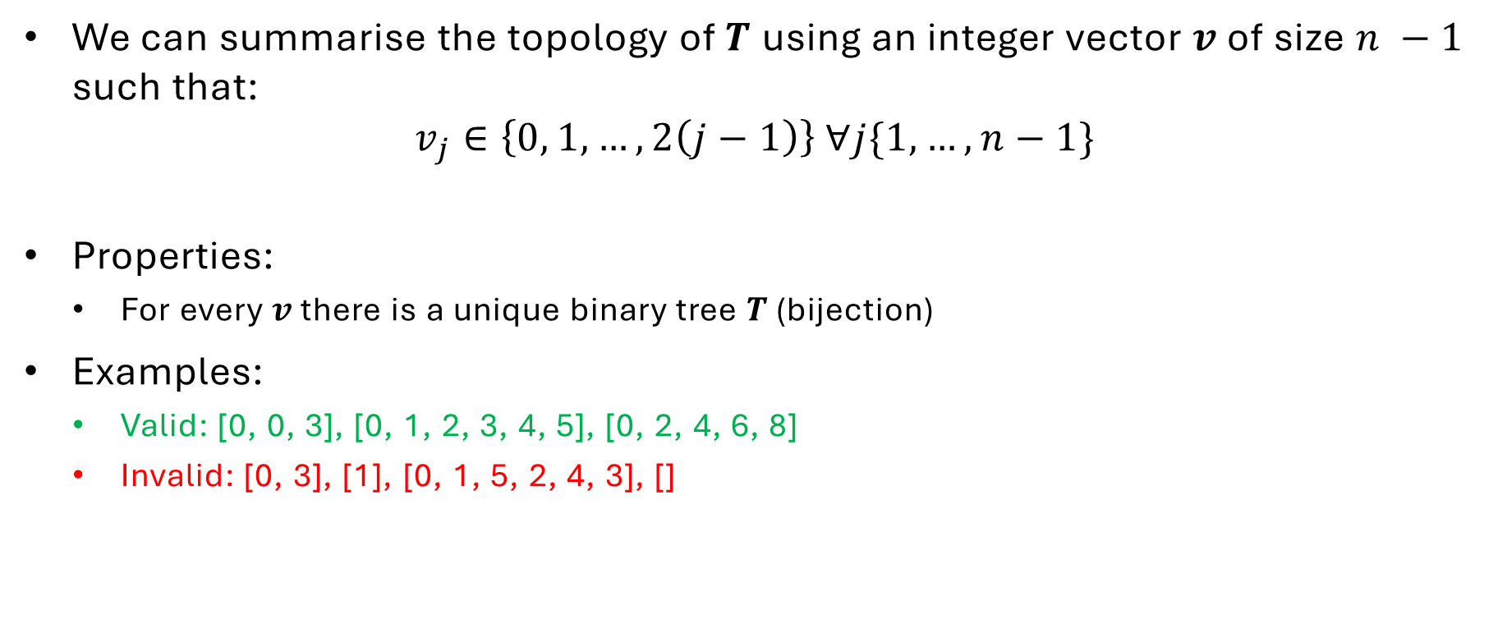
Definition
We can summarise the topology of $T$ using an integer vector $v$ of size $n −1$ such that:
$$v_{j}∈\left\{0, 1, …, 2\left(j−1\right)\right\} ∀j\{1, …, n−1\}$$
Properties:
  For every $v$ there is a unique binary tree $T$ (bijection)
Examples:
  Valid: [0, 0, 3], [0, 1, 2, 3, 4, 5], [0, 2, 4, 6, 8]
  Invalid: [0, 3], [1], [0, 1, 5, 2, 4, 3], []

Slide 10
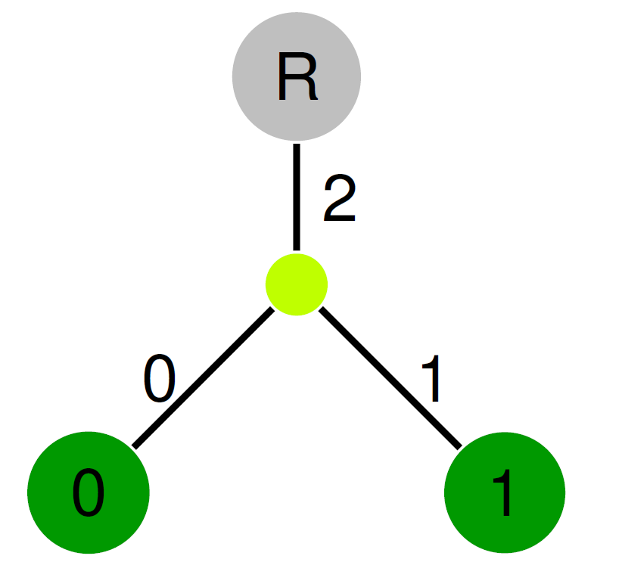
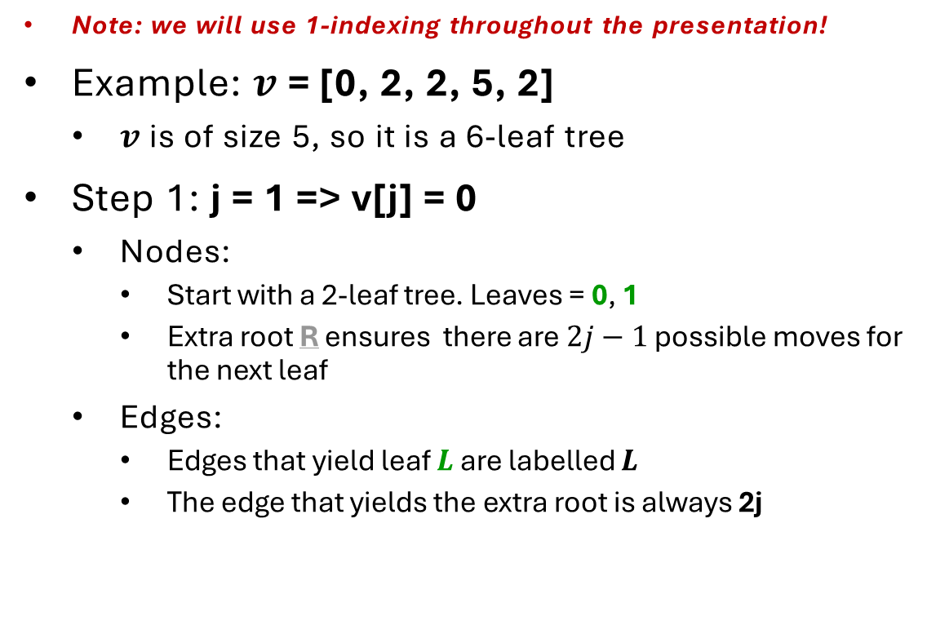
Converting a vector to a tree
Initial conditions
Note: we will use 1-indexing throughout the presentation!
Example: $v$ = [0, 2, 2, 5, 2]
  $v$ is of size 5, so it is a 6-leaf tree
Step 1: j = 1 => v[j] = 0
  Nodes:
    Start with a 2-leaf tree. Leaves = 0, 1
    Extra root R ensures there are $2j−1$ possible moves for the next leaf
  Edges:
    Edges that yield leaf $L$ are labelled $L$
    The edge that yields the extra root is always 2j

Slide 11
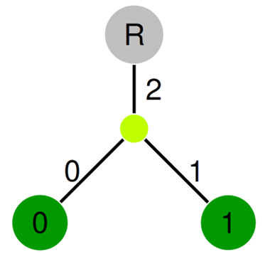
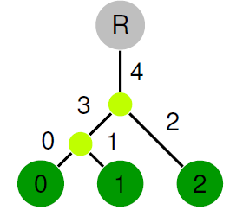

phylo2vec: converting a vector to a tree
Example: $v$ = [0, 2, 2, 5, 2]
Step 2: j = 2 => v[2] = 2
  Split edge 2, yield leaf 2
  Re-label the edges (explained later)
split here

Slide 12
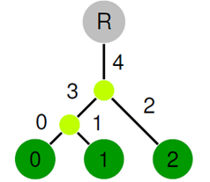
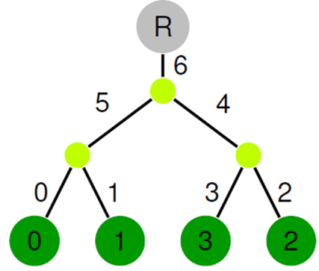

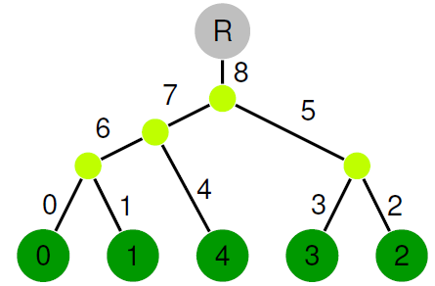
phylo2vec: converting a vector to a tree
Example: $v$ = [0, 2, 2, 5, 2]
Step 3: j = 3 => v[3] = 2
  Split edge 2, yield leaf 3
Step 4: j = 4 => v[4] = 5
  Split edge 2, yield leaf 3
split here
split here

Slide 13

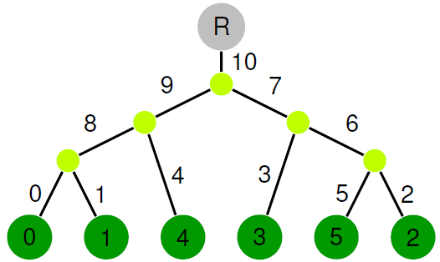
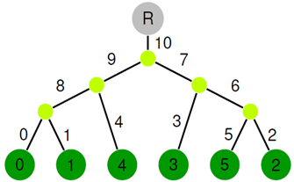
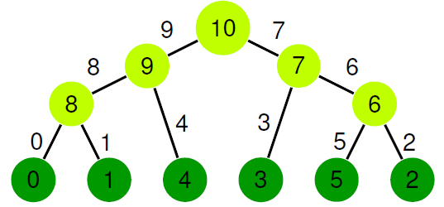
phylo2vec: converting a vector to a tree
Example: $v$ = [0, 2, 2, 5, 2]
Step 5: j = 5 => v[5] = 2
  Split edge 2, yield leaf 5
Final step:
  Remove the extra root
  Name the internal nodes
split here

Slide 14
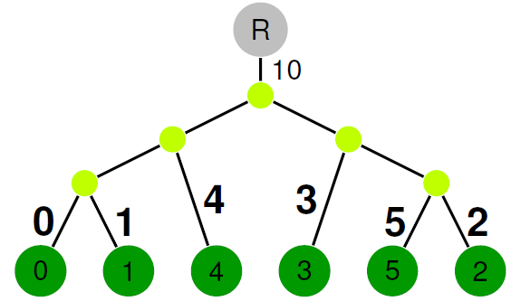

phylo2vec: converting a vector to a tree
Renaming the branches
Step 1: leaf edges & extra root
  Edges that yield leaf $L$ are labelled $L$
  The edge that yields the extra root is always 2j

Slide 15
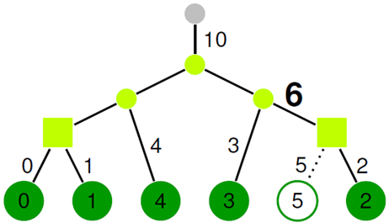
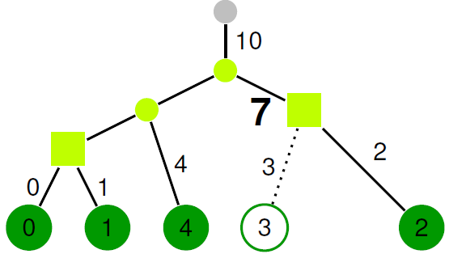
phylo2vec: converting a vector to a tree
Renaming the branches
Step 2
  Two cherries: (0,1) and (3,2)
  Find the cherry with the highest label (3)
  Label its parent branch as 7
  Prune leaf 3

Slide 16

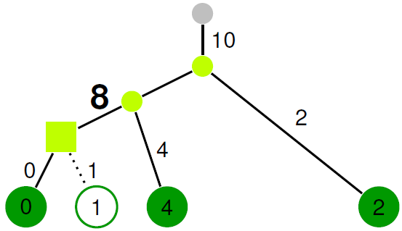
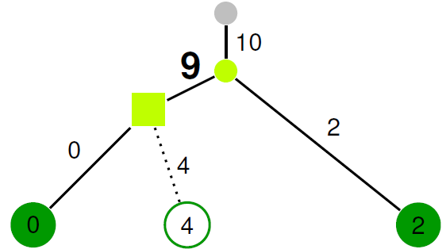
phylo2vec: converting a vector to a tree
Renaming the branches
Step 2 (continued)
  One cherry: (0,1)
  Label its parent branch as 8
  Prune leaf 1
Final step:
  One cherry: (0, 4)
  Label its parent branch as 9
  Prune leaf 4

Slide 17
phylo2vec: convert a vector to a tree
In practice
Algorithm (general idea)
  Build an (post)ordered traversal of a tree through a list of pairs of nodes
  Form a Newick string from the pair list
Complexity: O(n log n)
  Using AVL trees for fast(er) insertions
Notes:
In computer science, an AVL tree (named after inventors Adelson-Velsky and Landis) is a self-balancing binary search tree. In an AVL tree, the heights of the two child subtrees of any node differ by at most one; if at any time they differ by more than one, rebalancing is done to restore this property. Lookup, insertion, and deletion all take O(log n) time in both the average and worst cases, where $n$ is the number of nodes in the tree prior to the operation. Insertions and deletions may require the tree to be rebalanced by one or more tree rotations.
Sure! Here’s a quick breakdown of how an AVL tree works:
It’s a binary search tree (BST) → every node’s left child is smaller, right child is bigger.
After every insertion (or deletion), it checks the balance factor of each node (height of left subtree − height of right subtree).
If any node becomes too unbalanced (difference > 1), the tree fixes itself using rotations (small tree rearrangements).
These rotations keep the tree’s height about log(n), so searches, insertions, and deletions stay fast (O(log n)).

Slide 18
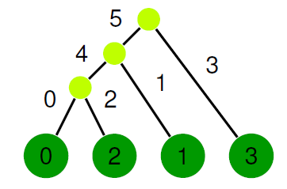
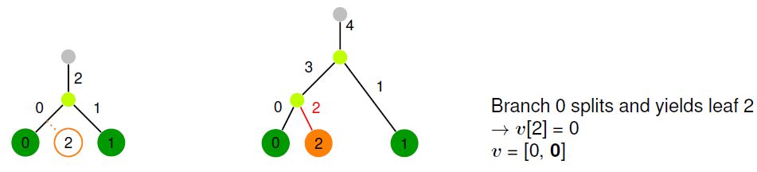
phylo2vec: convert a tree to a vector
Example: (((0,2)4,1)5,3)6;
Input:
Next leaf: 2

Slide 19
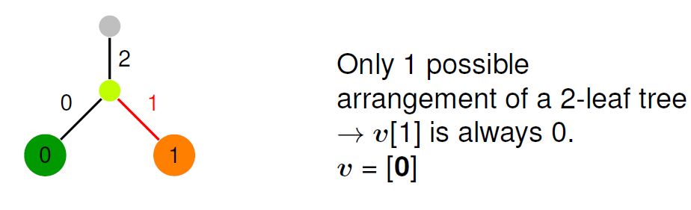
phylo2vec: convert a tree to a vector
Example: (((0,2)4,1)5,3)6;
Input:
Next leaf: 1

Slide 20
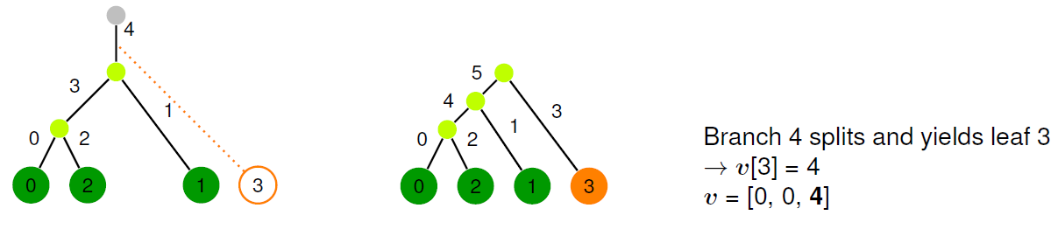
phylo2vec: convert a tree to a vector
Example: (((0,2)4,1)5,3)6;
Input:
Next leaf: 3

Slide 21
phylo2vec: convert a tree to a vector
In practice
Algorithm (general idea)
  Find cherries from the Newick string
  Reorder them to form an ordered tree traversal to find the vector
Complexity: O(n log n)
  Using Fenwick trees for fast computing of cumulative sums
Notes:
It’s a data structure for working with prefix sums (like sum of the first k numbers).
It lets you do two things very efficiently:
Update a value in the array (O(log n))
Query the sum from the start up to index k (O(log n))
How it works (idea):
The tree is stored in an array, not an actual tree.
Each position in the array keeps track of the sum of a certain range of elements (decided by the lowest set bit of the index in binary).
By moving through indices using those bits, you can quickly jump across ranges to compute sums or apply updates.
👉 In short:
It’s a clever way of using binary representation to make prefix sums and updates really fast.
Want me to show you a tiny numeric example (like updating and querying a Fenwick tree with 5 elements)?

Slide 22






Software
https://github.com/sbhattlab/phylo2vec
Core in Rust
  Fast, type-safe + memory-safe, portable
Bindings in Python and R
CI/CD with GitHub Actions
Package management using pixi
Benchmarking and testing using pytest

Slide 23
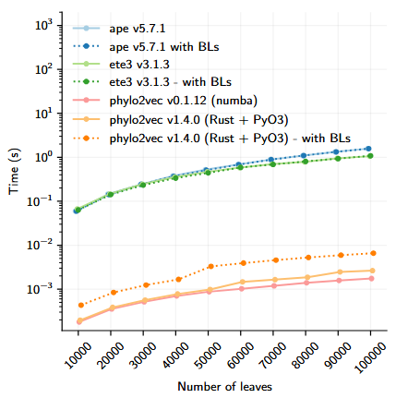
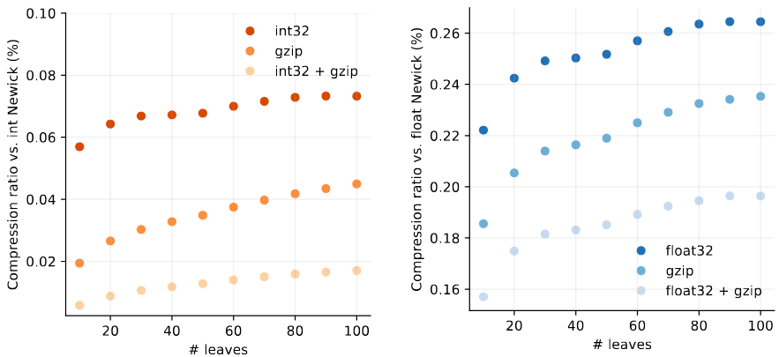
What you can (currently) do with phylo2vec
Currently available:
  Fast tree sampling (~0.3 ms for 100k leaves)
  Compress Newick data
  Standard tree operations + metrics
  I/O operations
  Examples of phylo2vec-derived optimisation schemes

Slide 24
Link to the workshop repo
https://www.github.com/sbhattlab/phylo2vec-workshop

