Slide 1

DEPARTMENT OF ARTIFICIAL INTELLIGENCE AND DATA SCIENCE ACADEMIC YEAR 2025 - 2026 SEMESTER III ARTIFICIAL INTELLIGENCE LABORATORY MINI PROJECT REVIEW Implementation and analysis of A search algorithm for route optimization
REGISTER NUMBER | 2117240070039
NAME | BHAVATHARINI.S
YEAR | II
SECTION | A
FACULTY IN-CHARGE | Mrs. M. Divya

Slide 2
PROBLEM STATEMENT
Artificial Intelligence (AI) enables machines to think, learn, and make decisions like humans.
It applies data-driven algorithms to solve real-world problems efficiently.
AI is widely used in automation, robotics, and intelligent navigation systems.
Project Focus: Implement and analyze the A* Search Algorithm for route optimization.
Problem Statement: Finding the shortest and most efficient route between two nodes while minimizing computation time.
Goal: To develop a system that uses heuristic-based search to achieve faster and optimal pathfinding compared to traditional methods like dijkstra algorithm
Expected Output: Display the optimal path, total cost, and execution time, proving that A* achieves better performance and efficiency.

Slide 3
THEORETICAL BACKGROUND
The A* Search Algorithm is a heuristic-based search technique that finds the least-cost path from a start node to a goal node. It uses the evaluation function: where,
g(n) is the actual cost from the start node to the current node
h(n) is the estimated cost from the current node to the goal (heuristic).
Other algorithms like Dijkstra’s algorithm and Greedy Best-First Search are also used for route optimization, but A* outperforms them by combining both path cost and heuristic intelligence.
Justification: A* is chosen because it provides optimal and efficient solutions when using a good heuristic, making it ideal for route optimization and navigation problems.
f(n) = g(n) + h(n)

Slide 4
IMPLEMENTATION AND CODE
Link to code in Git-hub Repository
List | Git-hub Repository Links
Implementation of Code Link | https://github.com/sbhavatharini0110-web/Artificial-Intelligence-Mini-Project/blob/0da6b031034dbad2d388a002db8d7942689794e8/A*_alg_code
Word Document Report Link | https://1drv.ms/w/c/006e10d139b1534c/ETEeQFDsRs1OlSZ__inBpnkByRgGbf6LQkjRLhRNjN2rRg
PPT Link | https://1drv.ms/p/c/006e10d139b1534c/EZ6UuflkL91FuaLS0Pcpk98BztYCpeBsjJYvNf7RFbvn4Q

Slide 5
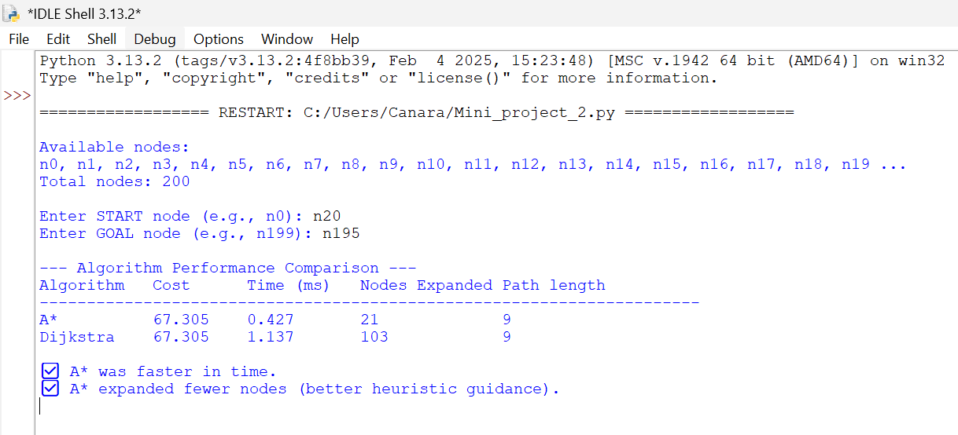
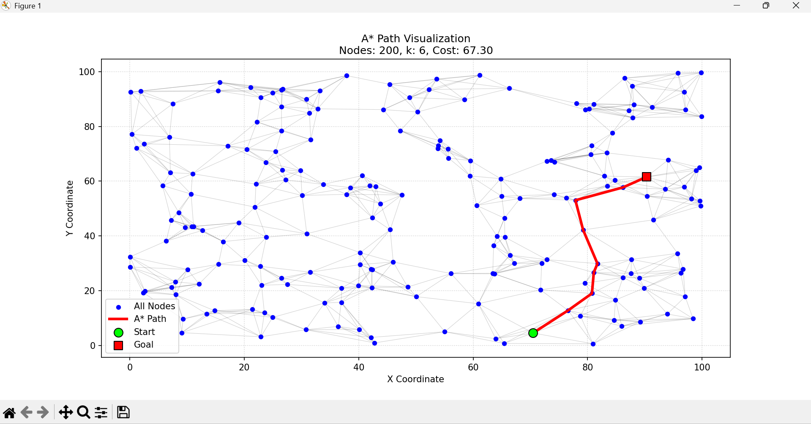
OUTPUT AND RESULTS

Slide 6
OUTPUT AND RESULTS
EXPLANATION:-
Implemented the A* Search algorithm to find the most efficient route between selected nodes and compared its performance with Dijkstra’s algorithm
The output displays the optimal path, total cost, execution time , and visualization proving that A* performs faster and expands fewer nodes due to its heuristic based search
FUTURE ENHANCEMENT:-
Integrate real world map data (GPS/Google Maps API) for practical route optimization
Extend the model to handle dynamic traffic conditions and real time path updates.

Slide 7
REFERENCES
Russell, S., & Norvig, P. (2021). Artificial Intelligence: A Modern Approach (4th Ed.).
GeeksforGeeks – A* Search Algorithm Explanation.
TutorialsPoint – Artificial Intelligence Search Techniques.
Gate smashers – A* search algorithm in AI (Youtube video)
Towards Data Science - Understanding A Pathfinding and its Implementation in Python.

