Slide 1

DEPARTMENT OF ARTIFICIAL INTELLIGENCE AND DATA SCIENCE ACADEMIC YEAR 2025 - 2026 SEMESTER IV ARTIFICIAL INTELLIGENCE LABORATORY MINI PROJECT REVIEW SMART PARKING SPACE AVAILABILITY PREDICTION USING RANDOM FOREST CLASSIFIER
REGISTER NUMBER | 2117240070039
NAME | BHAVATHARINI.S
YEAR | II
SECTION | A
FACULTY IN-CHARGE | Mrs. M. Divya

Slide 2
PROBLEM STATEMENT
In urban areas, finding an available parking space has become a challenging and time-consuming task due to the rapid increase in the number of vehicles. Drivers often struggle with uncertainty regarding parking availability, leading to traffic congestion, fuel wastage, and delays. To address this issue, this project titled “Smart Parking Space Availability Prediction using Random Forest Classifier” aims to develop an intelligent system that can predict whether a parking space is available or not.
The proposed system uses Machine Learning techniques to analyze factors such as time of day, day type, and vehicle count to make accurate predictions. By implementing the Random Forest Classifier, the model learns patterns from historical data and provides reliable outputs, helping users make better parking decisions and improving overall efficiency in parking management.
Another key challenge in parking management is the lack of real-time and predictive insights that can assist users in making efficient decisions. Traditional parking systems rely heavily on manual observation or static information, which does not adapt to changing conditions such as peak hours or varying traffic density.
This creates inefficiencies in urban mobility and increases the overall burden on transportation systems. Therefore, there is a strong need for an intelligent, data-driven solution that can analyze patterns and provide accurate predictions of parking availability, enabling better utilization of parking resources and improving the overall user experience.

Slide 3
THEORETICAL BACKGROUND
Predicting parking space availability is an important application of Machine Learning in smart city systems. It uses historical data such as time, day type, and vehicle density to determine whether a parking space is available (1) or not (0), making it a binary classification problem. This helps reduce traffic congestion and improve user convenience.
This project uses the Random Forest Classifier, an ensemble learning method that combines multiple decision trees to improve accuracy. Each tree is trained on different subsets of data, and the final prediction is based on majority voting: ŷ = mode(T₁(x), T₂(x), …, Tₙ(x))
Decision trees split data based on features, often using the Gini Index to select the best split by minimizing impurity.
Other algorithms like Logistic Regression, Decision Trees, SVM, and Neural Networks have also been used for this problem. However, Logistic Regression struggles with non-linear data, Decision Trees may overfit, SVMs are computationally expensive, and Neural Networks require large datasets.
Random Forest is chosen because it handles non-linear relationships well, reduces overfitting, works efficiently with smaller datasets, and provides a good balance of accuracy and simplicity.

Slide 4
IMPLEMENTATION AND CODE
Link to code in Git-hub Repository
List | Git-hub Repository Links
Implementation of Code Link | https://github.com/sbhavatharini0110web/ML_MINIPROJECT/tree/main
Word Document Report Link | BHAVATHARINI_ML_REPORT.pdf
PPT Link | https://1drv.ms/p/c/006e10d139b1534c/IQDTMFhjNFgORZGlZvZCvH4iAb9qG6IZn-bsLjsEsqFslxw?e=AH6Tck

Slide 5
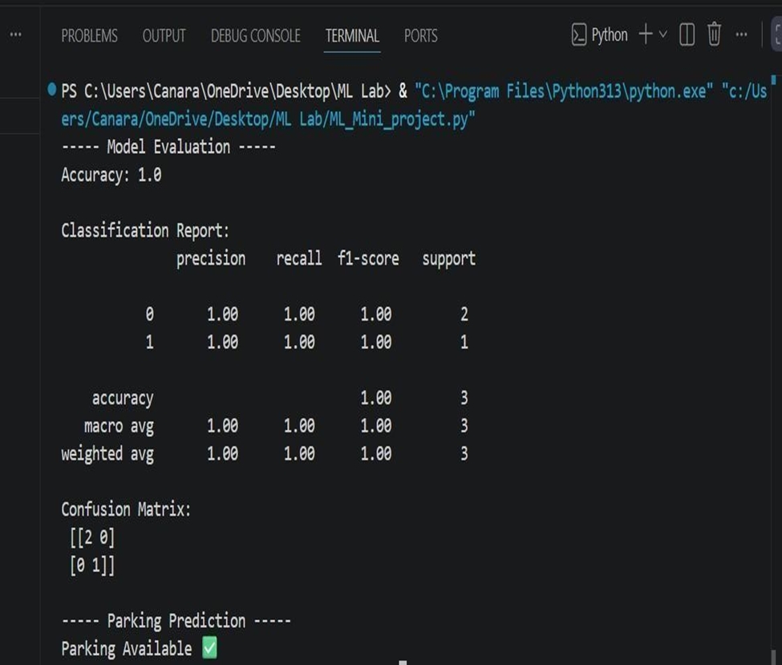
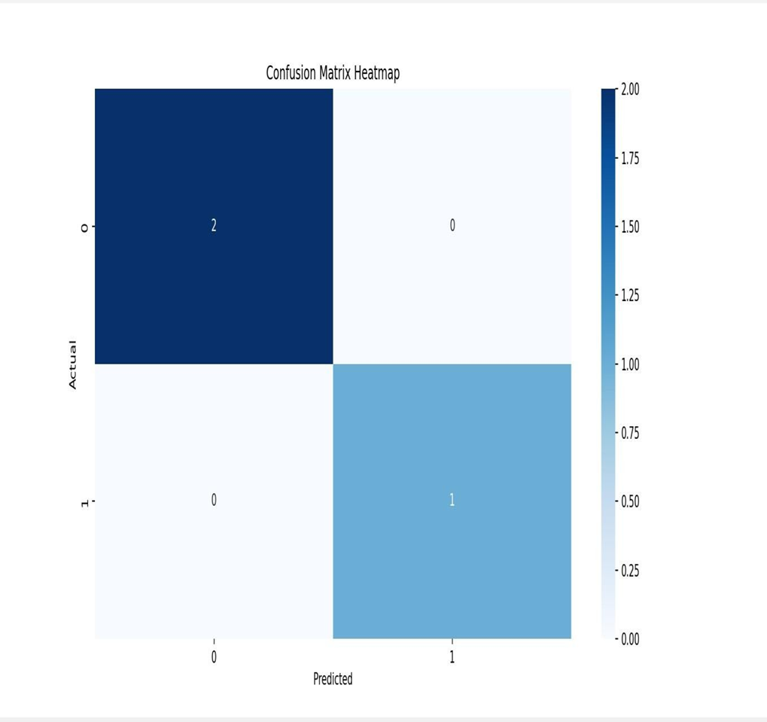
OUTPUT AND RESULTS
.

Slide 6
OUTPUT AND RESULTS
The proposed system for Smart Parking Space Availability Prediction using Random Forest Classifier successfully demonstrates the ability to predict parking availability based on input features such as time, day type, and vehicle count. The model achieved high accuracy and produced reliable predictions for the given dataset, indicating that Random Forest is effective for this classification problem.
Compared to simpler algorithms like Logistic Regression, which assumes a linear relationship between features, the Random Forest model performs better in capturing complex and non-linear patterns in the data.
Additionally, unlike a single Decision Tree, Random Forest reduces overfitting by combining multiple trees, resulting in improved stability and accuracy.

Slide 7
REFERENCES
Pattern Recognition and Machine Learning
Christopher M. Bishop, Pattern Recognition and Machine Learning, Springer, 2006.
Hands-On Machine Learning with Scikit-Learn, Keras, and TensorFlow
Scikit-learn Official Documentation https://scikitlearn.org/stable/
GeeksforGeeks https://www.geeksforgeeks.org/machinelearning/ (Concept explanations and examples)
Towards Data Science https://towardsdatascience.com/

