Slide 1

EURURALIS
Discussing the future of European rural areas
Kopenhagen April 6 2006
Willem Rienks
Alterra Wageningen UR

Slide 2
Goals of Eururalis
possible developments of EU rural areas
Impact of policy options on PPP
European focus - global context
Spatially explicit – 2030
strategic discussion

Slide 3
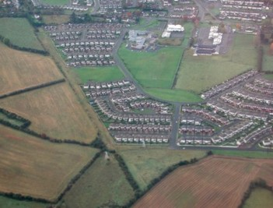
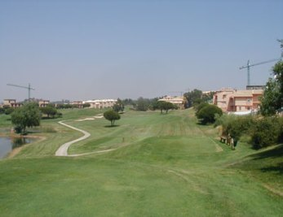
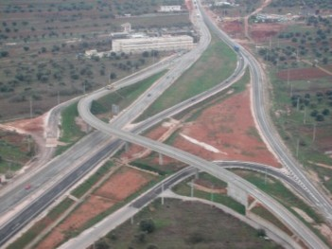
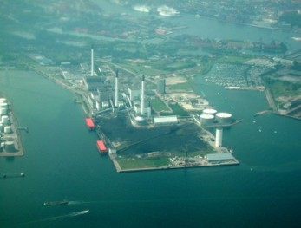
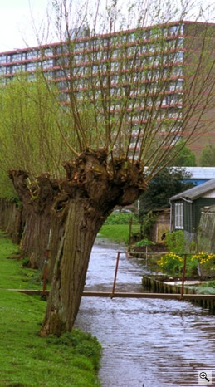
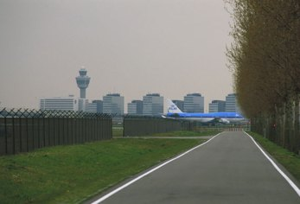
Urbanization
Residential
Industrial
Infrastructure
Recreation

Slide 4
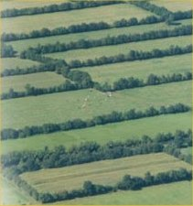
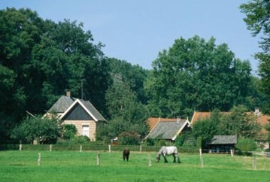
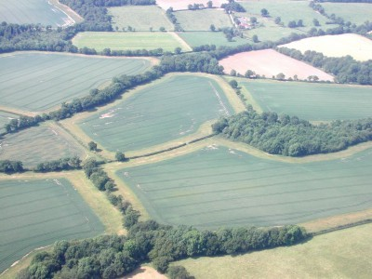
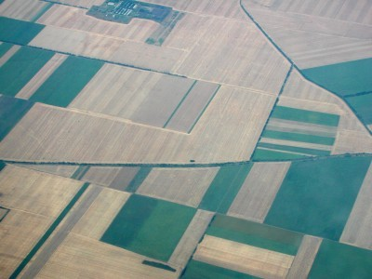
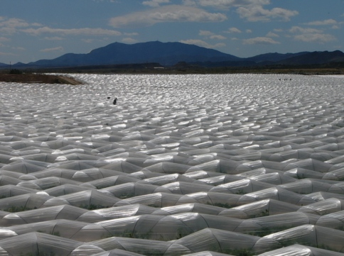
Intensification of agriculture
Management and scale

Slide 5
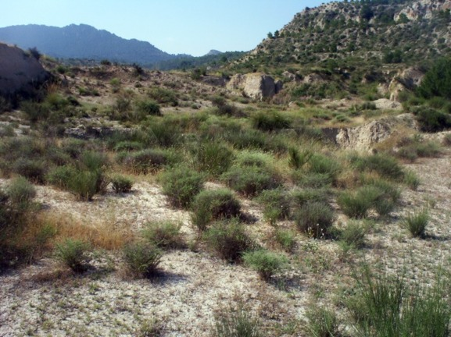
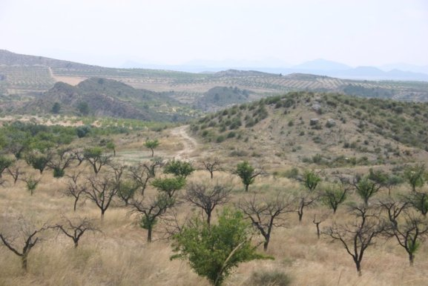
Land abandonment
Regrowth of natural vegetation
Degradation
Extensive land uses (hobby farming)

Slide 6
Driving forces of rural areas
Demography
Economic growth
Technology
Climate
Policy – eg CAP, biofuels

Slide 7
Eururalis 2.0 proces
Choose one of the four scenarios
Adjust policy options (new)
  2006: CAP, biofuels, LFA
  Later: WFD, nature, RDP
Calculations are being made
Explore impact indicators PPP
  Graphs, text, maps
  Overview of trade offs
  Compare scenario’s and policy options (new)
  Why does what happen? (new)

Slide 8
Why a scenario approach ?
Address the complexity and uncertainty of future developments from now to 2030, like:
  demography, economic growth, oil prices
  the future of the CAP & WTO;
Look 30 years back: EU-10, divided Europe, no quota, no nature conservation policy, no Euro etc
No agreement on policies after 2013
  CAP after 2013?
  Rural & regional policies after 2013 ?
  Size of EU 27? 28? 35?
Scenarios do not lead necessarily lead to a “desired” situation

Slide 9
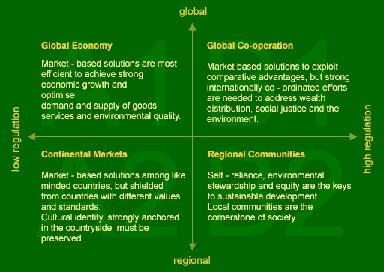
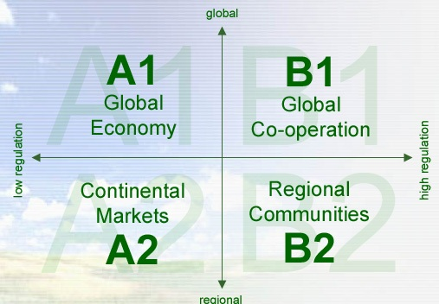

Slide 10
Adjust strategic policy
Policy packages – based on Amsterdam discussion
CAP 1 – amount of support in CAP
  150% - 100% - 50% - 0% of current budget
CAP 2 – type of support – distortion of the market
  Mix market and income support - current situation
  Decoupled fully compensated
  Decoupled partially compensated
  Fully liberalized

Slide 11
Adjust policy
Policy packages
Biofuels – ambition on biofuels
  High – medium – low
LFA – area designated for extra payment
  No LFA – current LFA – new LFA

Slide 12
EURURALIS 2.0 prototype
1 Intro 2 past 3 scenario 4 drivers 5 general policy 6 rural policy 7 landuse change 8 indicators 9 integration 10 conclusions
Scenario A1 scenario A2 scenario B1 scenario B2 ……….
Choose scenario
Adjust policy
Effect indicators
Agro employment
Rural employment
Self-sufficiency
CO2 storage
N-use per ha
Air pollution
Water quality
Biodiversity
Landscape
Farm Income
Farm size
Expenses
Means indicators
Available land
Inputs
Water
Landuse change
50 bill. Euro 1st pillar
Continuation quota
Continuation tariff
25 bill. Euro 1st pillar
No quota
Lower tariff walls
0 bill. Euro
No quota
No tariff wall
CAP1
info
Current party decoupled
Fully decoupled
No farm payments
CAP2
info
30% biofuels
Medium ambition
20% biofuels
No ambition
0% biofuels
Energy
info
current LFA
Services payments
New LFA
No LFA
LFA
info

Slide 13
EURURALIS 2.0 prototype
1 Intro 2 past 3 scenario 4 drivers 5 general policy 6 rural policy 7 landuse change 8 indicators 9 integration 10 conclusions
Scenario A1 scenario A2 scenario B1 scenario B2 ……….
Choose scenario
Adjust policy
Effect indicators
Agro employment
Rural employment
Self-sufficiency
CO2 storage
N-use per ha
Air pollution
Water quality
Biodiversity
Landscape
Farm Income
Farm size
Expenses
Means indicators
Available land
Inputs
Water
Landuse change
50 bill. Euro 1st pillar
Continuation quota
Continuation tariff
25 bill. Euro 1st pillar
No quota
Lower tariff walls
0 bill. Euro
No quota
No tariff wall
CAP1
info
Current party decoupled
Fully decoupled
No farm payments
CAP2
info
30% biofuels
Medium ambition
20% biofuels
No ambition
0% biofuels
Energy
info
current LFA
Services payments
New LFA
No LFA
LFA
info

Slide 14
Impact indicators
People
  Share of agricultural employment
  Share of unemployment
  Share of industries and services employment
  Self sufficiency
Planet
  Biodiversity
  Nitrogen emissions
  Erosion
  Carbon sequestration
  Landscape pressure
  Landuse dynamics
Profit
  Agricultural income
  Gross added value in food production
  Farm structure

Slide 15
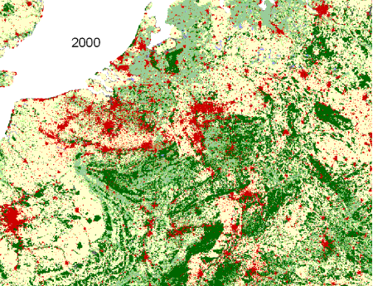

A1: Global Economy
B2: Regional Communities
Land use dynamics differ by scenario:
Quantity of change
Spatial pattern of change

Slide 16
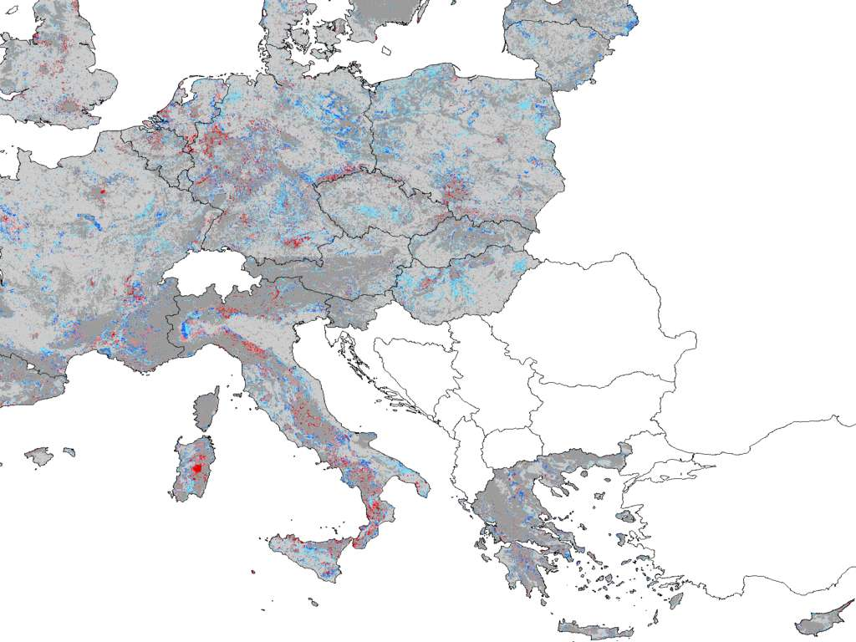
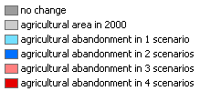

Slide 17
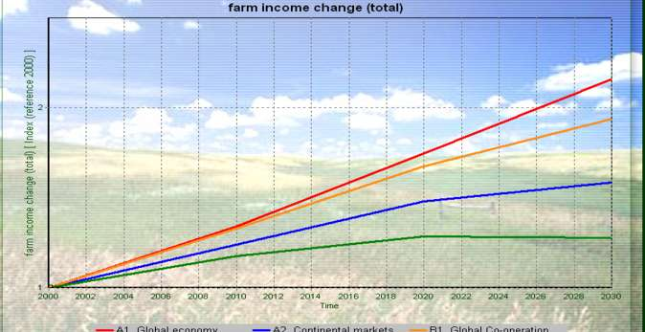
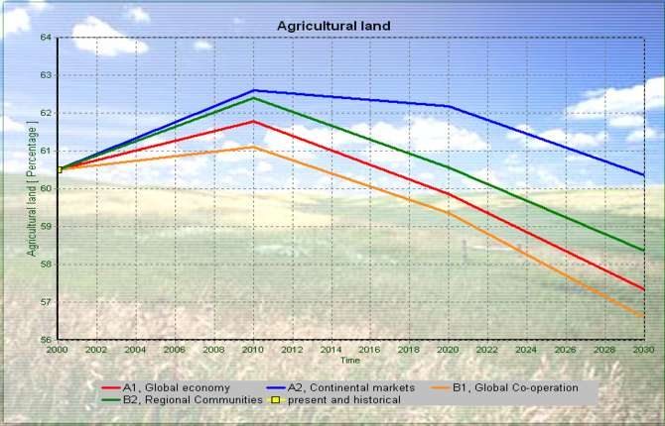
Example Poland
A1 – highest farm income
A1 - decline agri area
But A1 means also:
High food self sufficiency
Lowest biodiversity
Average carbon storage
Highest GDP growth
What about water quality?

Slide 18
Trade off’s between indicators
Scenario
GDP
…
Bio fuel revenues
…
Bio diversity index (area)
Policy
Unemployment reduction
Bio diversity index (gdp)

Slide 19
Each indicator
Graph over time
Hotspotmap of Europe
Explanatory text
Compare scenario’s & policy options
Causal tracing:
  overview of main forces responsible for the outcome
Overview of indicators
  Overview of trade off’s

Slide 20
Conclusions Eururalis 1
Agriculture remains strong in all scenarios
land to spare in most scenarios (max 10%):
biofuels; biodiversity?
Insight in the trade off’s – eg higher farm income versus lower biodiversity or lower self sufficiency
There are not only threats but also chances…
There is something to choose for….
Outcomes sometimes differ from what you expected….

Slide 21
Whats next: Eururalis 2.0
Preserve strong points
  Strategic discussion tool for future rural Europe
  Improve consciousness of Europe’s diversity and the effects of large scale, long term, global driving forces
  Common Language
Extensions
  Policy options – interactive altering of policy
  Transparancy – why is what happening
  Information on regional level
  Trade off information – balance winners and losers

Slide 23
EURURALIS 2.0 prototype
1 Intro 2 past 3 scenario 4 drivers 5 general policy 6 rural policy 7 landuse change 8 indicators 9 integration 10 conclusions
Scenario A1 scenario A2 scenario B1 scenario B2 ……….
Choose scenario
Adjust policy
Effect indicators
Agro employment
Rural employment
Self-sufficiency
CO2 storage
N-use per ha
Air pollution
Water quality
Biodiversity
Landscape
Farm Income
Farm size
Expenses
Means indicators
Available land
Inputs
Water
Landuse change
governance philosophy
A1: Global Economy
value: competetiveness
market regulation
B1: Global Co-operation
value: global solidarity
government rules/regulations
narrative
narrative
A2: Continental Market
value: security
legal liability
B2: Regional communities
value: local responsibility
behavioural change
narrative
narrative

Slide 24
KRW – beleidsknop (verkennend)
Beleidsknop niet voorzien in 2006
Definitiestudietje naar mogelijkheden
----------- ZGET - Zeer goede ecologische toestand (ref natuur)
GET – goede ecologische toestand (ambitie)
----------- HS - Huidige situatie (varieert per land)

Slide 25
KRW – beleidsknop (verkennend)
Zeer compex / uitdagende knop – complicaties:
Normen per deelstroomgebied/regionaal ingevuld
Grote diversiteit watertypes; diversiteit normen
Data beschikbaarheid?
Andere bronnen dan landbouw: verkeer, industrie, rwzi – data maar ook toekomstontwikkeling bronnen?
Schaal: kennis nu mn farm level – stroomgebied
Opschalen lastig naar NL: aquarein
Opschalen naar EU niveau nog lastiger…

Slide 26
KRW
Wat wel in 2006?
Beknopte definitiestudie (enkele dagen)
Indicator stikstofbelasting is opgenomen
Hotspotmap van Europa
Inzicht in waar liggen problemen (landbouw)
Effect andere beleidsknoppen (CAP, biofuels) daarop

Slide 27
EURURALIS 2.0 prototype
1 Intro 2 past 3 scenario 4 drivers 5 general policy 6 rural policy 7 landuse change 8 indicators 9 integration 10 conclusions
Scenario A1 scenario A2 scenario B1 scenario B2 ……….
Choose scenario
Adjust policy
Impact indicators
PEOPLE
Agro employment
Rural employment
Self-sufficiency
PLANET
CO2 storage
N-use per ha
Water quality
Biodiversity
Landscape
PROFIT
Farm Income
Farm size
Expenses
Means indicators
Available land
Inputs
Water
Landuse change
Agro employment
Biodiversity
0 Target: 5% 30
0 Target: 100 120
Rural employment
Landscape div.
0 Target: 7% 40
0 Target: 100 120
Self sufficiency
Farm income
0 Target: 100% 200
0 Target: 30.000 euro 100.000 euro
CO2 storage
Farm size
0 Target: 30
0 Target: 40 ha 1000 ha
Nitrogen use
EU expenses
0 Target: 170 kg / ha 300
0 50 bill euro 100 bill. euro
Current level
A1 level
A1* + policy
level
Adjust
target
Water quality
0 Target: 50 mg N/l 100

Slide 28
EURURALIS 2.0 prototype
1 Intro 2 past 3 scenario 4 drivers 5 general policy 6 rural policy 7 landuse change 8 indicators 9 integration 10 conclusions
Scenario A1 scenario A2 scenario B1 scenario B2 ……….
Choose scenario
Adjust policy
Effect indicators
Agro employment
Rural employment
Self-sufficiency
CO2 storage
N-use per ha
Water quality
Biodiversity
Landscape
Farm Income
Farm size
Expenses
Means indicators
Available land
Inputs
Water
Landuse change
Nitrogen use
0 Target: 170 kg / ha 300
210
170
A1
Target
A1 + policy
Maps
Compare other scenarios
2000 2010 2020 2030

Slide 29
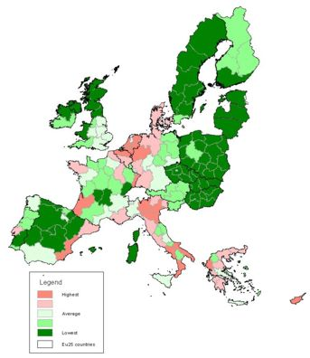
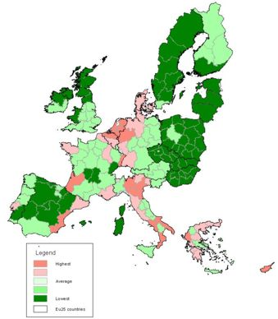
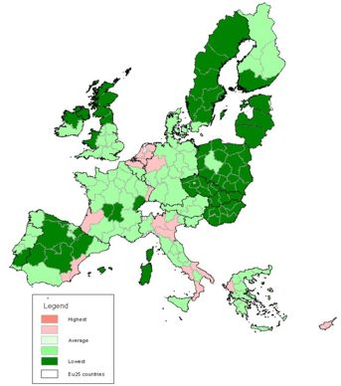
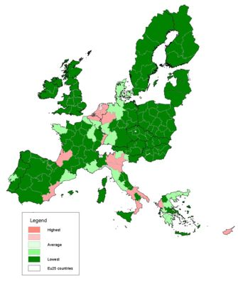
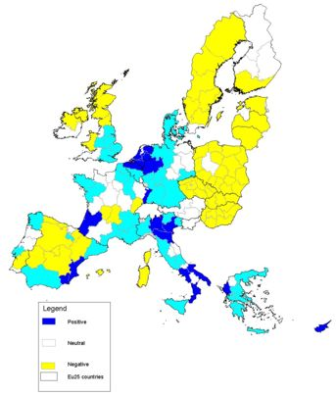
EURURALIS 2.0 prototype
1 Intro 2 past 3 scenario 4 drivers 5 general policy 6 rural policy 7 landuse change 8 indicators 9 integration 10 conclusions
Scenario A1 scenario A2 scenario B1 scenario B2 ……….
Choose scenario
Adjust policy
Effect indicators
Agro employment
Rural employment
Self-sufficiency
CO2 storage
N-use per ha
Water quality
Biodiversity
Landscape
Farm Income
Farm size
Expenses
Means indicators
Available land
Inputs
Water
Landuse change
N use per ha
Policy effect
2030
2020
2000
2010
Λ 2000-2030
STATE
Effect of policy options on Nitrogen use per ha. In the green areas the target is reached; in the red areas the target is not reached.
COMPARISON
The blue areas there is a positive policy effect. In the yellow and white areas there is no policy effect.
back

Slide 30
join the discussion: learning by doing!

Slide 31
Effect indicators maps – graphs - text
Employment
Farm income
Carbon sequestration
Erosion
Nitrogen emissions
Landscape pressure
Biodiversity
Livestock density
Self sufficiency
EU rural spending

Slide 32
What is in it for you:
Common language for strategic discussion
Adjust policy options interactively
Insight in autonomous developments
Insight in effectiveness of policy options
Insight in interactions / trade-offs
Find regions with the same problems
Overview of threats and opportunities

Slide 33
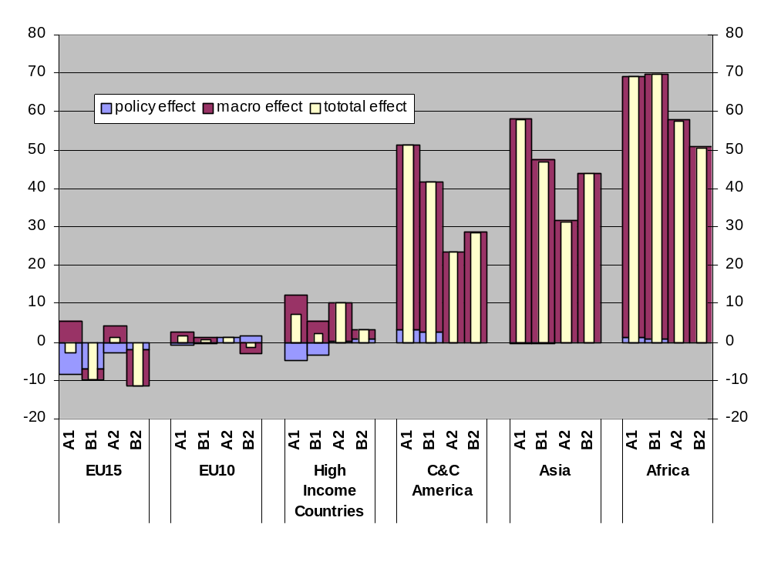
Results: land use

