Slide 1
Impact assessment of a stylized CAP reform scenario: the effectiveness of targeted measures
John Helming, Sander Janssen, Hans van Meijl, Koen Overmars, Andrzej Tabeau, Peter Verburg

Slide 2
A stylized CAP reform scenario with targeted measures
Stylized CAP reform scenario (budget neutral, no co-financing): from generic to more targeted payments
  25% linked to competitiveness and sustainability
    additional physical and human capital investments (effects productivity and efficiency)
  25% linked to valuable areas
    LFA, Natura 2000
  25% linked to ecosystem services
    agri-environmental payments (stimulation of more extensive production technologies)
  25% linked to base premium (not part of Dutch outlook)
    paid as a flat rate at national level
  Phasing out of decoupled income support (-100%)
Approach: combined use of different types of economic an ecological models (as in Scenar 2020 I & II, Impact of Modulation, EUruralis)

Slide 3
Effectiveness of individual measures and total impact of stylized CAP reform scenario on agricultural production in the EU-27 (% change compared to reference)
2.5
2
1.5
1
0.5
0
-0.5
+ 25%
+ 25%
+ 25%
+ 25%
- abolition
= total
competitiveness
valuable
ecosystem
base
income
impact
areas
services
premium
support
Notes:
Mogelijk ook exporten\importen laten zien
Hogere productie is in kader food security weer goed. Dit werkt beter dan de overige maatregelen. Sommige beweren dat je DP hiervoor nodig hebt maar dat blijkt niet uit onze analyses.
Geringe productie daling komt doordat resources in use blijven (vaak specifiek voor landbouw). Winstgevendheid neemt af, leidt tot lagere prijzen voor fixed factors, met name land. Hierdoor blijft productie concurrerend.

Slide 4
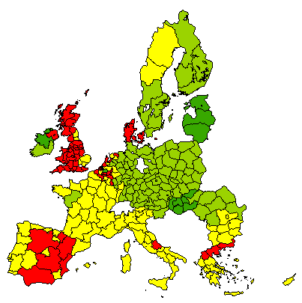
Effectiveness of competitiveness measures on regional supply of cereals in the EU-27 (% change compared to reference)
less than 0%
between 0% and 1.5%
between 1.5% and 5%
between 5% and 10%
Note: total impact of CAP reform scenario on regional supply of agricultural commodities is more complex
Notes:
Supply of agricultural products increases especially in the EU10. This is due to productivity and efficiency shocks from LEITAP. The effect of investments in capital and labour are relatively much bigger in the EU10 as compared to the EU15. Also within the EU10 there are differences between individual countries. For example the positive effect of capital and labour investments on productivity and efficiency in Hungary exceeds the effects in Poland. As a result it can be expected that effects on value added is more positive in countries with relative large effects on productivity and efficiency. Effects on value added ánd production can be negative as negative prices effects of agricultural commodities offsets the positive productivity and efficiency effects. This is the case in Danmark and in regions in the UK, the Netherlands, Belgium, Spain, Greece and Italy.

Slide 5
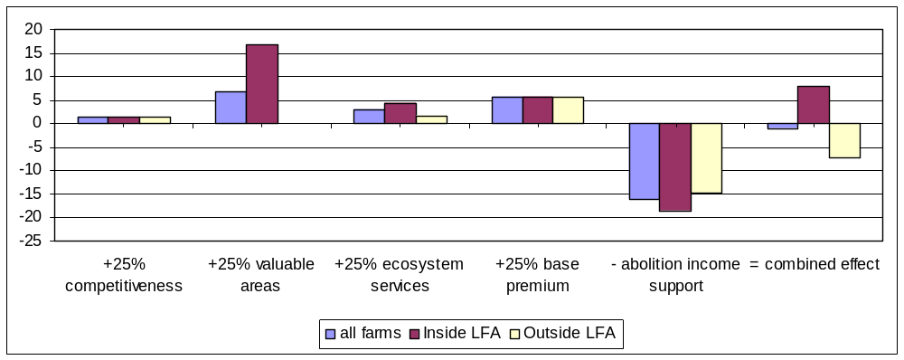
Effectiveness of individual measures and total impact of stylized CAP reform scenario on average value added per continuing farm for all farms and for farms inside LFA and outside LFA in the EU-25 (% change compared to reference)

Slide 6
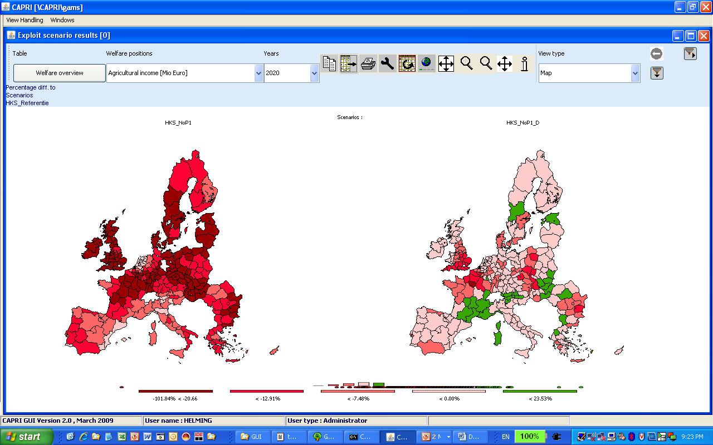

Impact on value added per region for agriculture in EU-27
(% change compared to reference)
Abolition of direct income support
Stylized CAP reform

Slide 7
Effectiveness of individual measures and total impact of stylized CAP reform scenario on total agricultural area in the EU-27 (% change compared to reference)
4
2
0
-2
-4
-6
-8
+ 25%
+ 25%
+ 25%
+ 25%
- abolition
= total
competitiveness
valuable
ecosystem
base
income
impact
areas
services
premium
support
Notes:
Fixed factor: payments linked to land keep land into good agricultural practice. If you take money away linked to land, land gets more expensive for farmer (actor price, including this subsidy)

Slide 8
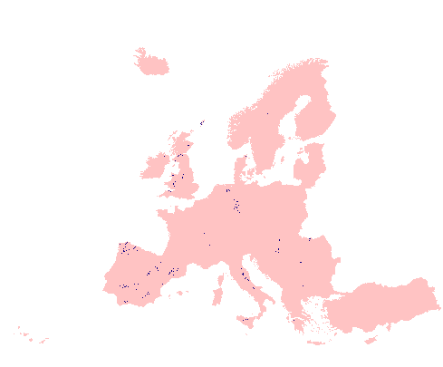
Total impact of stylized CAP reform scenario on land abandonment in the EU27
Blue spots locate areas were land abandonment is more concentrated in the stylized CAP reform scenario
These are areas with:
  relatively high initial direct farm payments in reference scenario
  relatively little subsidies from targeted payments in stylized CAP reform scenario
  “marginal” land

Slide 9
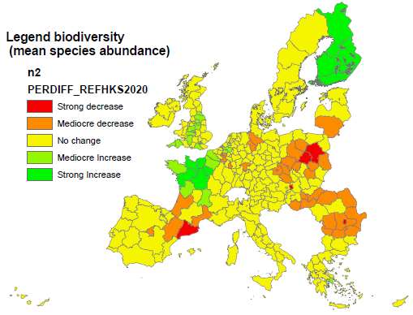
Total impact of stylized CAP reform scenario on biodiversity in a region as a result of structural changes in agriculture
No or very little change in biodiversity in most regions
Positive exceptions (dark green color):
  regions in north-west of France
  Finland
  regions in the UK
Negative exceptions (red color):
  regions in Eastern Europe

Slide 10
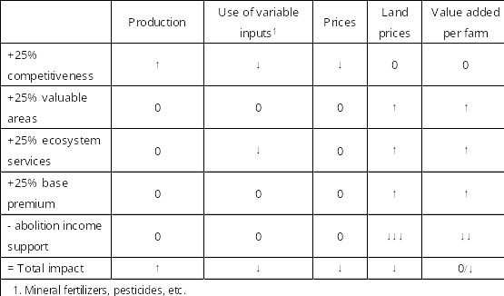
Conclusions

Slide 11
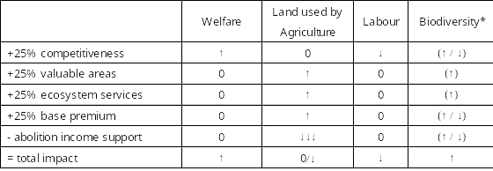
Conclusions (continued)
* () = Qualitative analysis

Slide 12
Discussion
Dutch Outlook translated to a stylized CAP reform scenario gives plausible results at EU-27 level
Impact assessment builds upon approach and results of earlier studies
  EUruralis, Scenar 2020 I & II, Impact of Modulation,
Alternative budget allocations are possible for:
  Targeted measures
  Level of direct income support

Slide 13




More info and possibilities for international cooperation:
WWW.EURURALIS.EU
Hans.vanmeijl@wur.nl
EUruralis: The future of rural Europe

Slide 14
Discussion/limitations of the methodology
Ex post information hardly exists
Economic value of public goods are not included in the modelling
Environmental impacts vary locally
Targeted payments are a complex of measures with different impacts, depending on how they are implemented
Lack of empirical information about deadweight
Transaction costs have not been addressed

