Slide 1

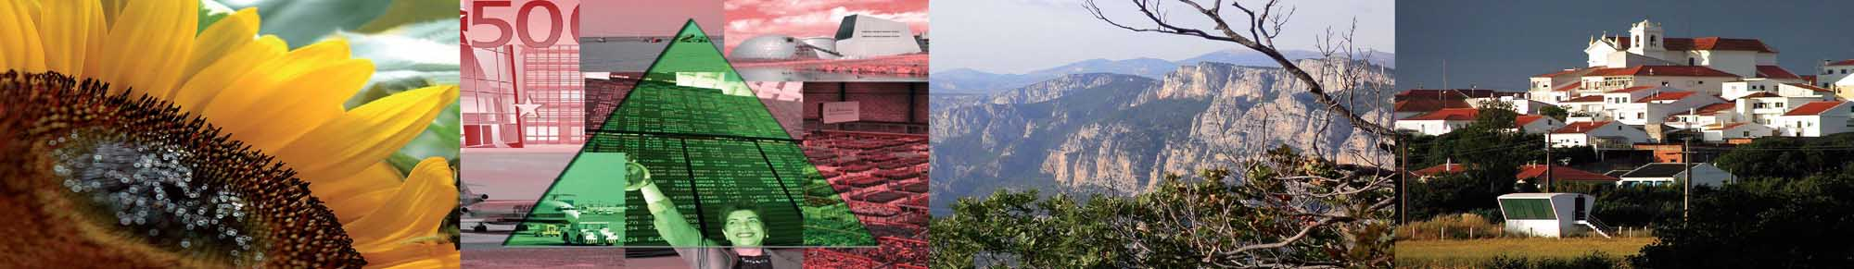


The future of rural Europe
The Hague, 1 November 2010
Hans van Meijl (LEI WUR)

Slide 2
Goals of today
Overview EUruralis
Discussion:
  Use of integrated assessment modeling in policy processes;
  Is it useful to extend the EUruralis appraoch to other regions in the world and especially developing countries

Slide 3
Programme
Eururalis
Overview
CAP policies
Agro-biodiversity
Spatial policies
RED and REDD policies
Plenary: integrated impact assessment & policy discussion
Notes:
Willem, I would add the first names, especially for the ladies
Mogelijk aangeven wat eenieder of ons drieen precies doet.

Slide 4
The future of rural Europe

Slide 5
What is Eururalis?
Integrated impact assessment study
Global trends & strategic policy
Multi scale linked models
EU embedded in the world
People, planet and profit + land use
Spatially explicit results
EU, MS, region and km² level
Time horizon 2030; 10 year time steps
Notes:
Ik heb toegeveogd EU embedded in the world. Hier wijkt eurualis af. We hebben ook resultaten voor de wereld.

Slide 6
Why Eururalis?
Support discussion at EU level
Grip on future uncertainties
Interaction economic, environmental and social aspects
Insight in trade offs: later and elsewhere
Mission
Understand the world better
Contribute to decision making

Slide 7
History
Dutch presidency of EU in 2004
Discuss the future of EU rural areas
Tool to support discussion
Scientifically sound
Linked existing economic, environmental and land-use models
Four narratives / scenarios

Slide 8
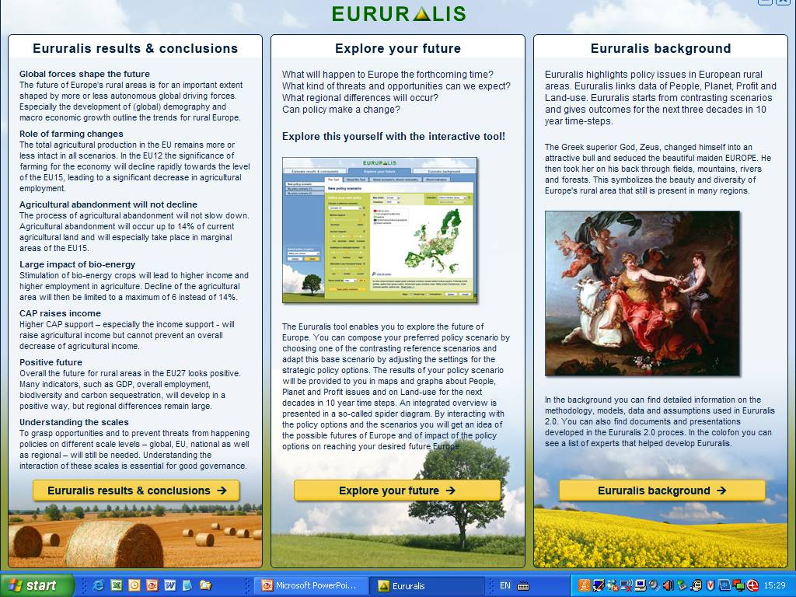

Slide 9
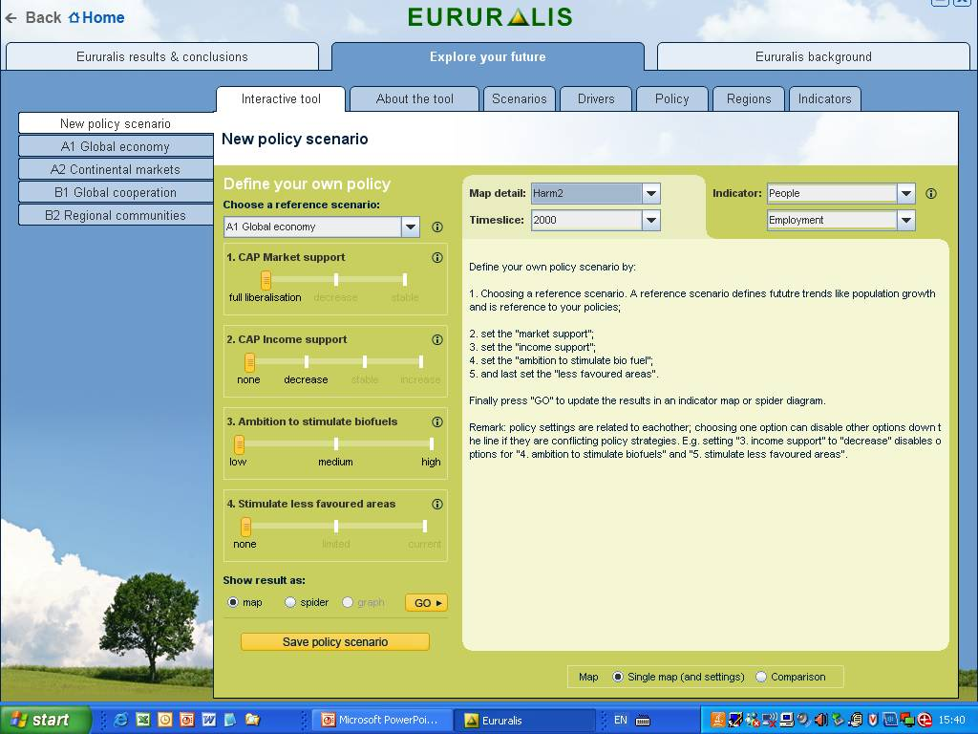

Slide 10
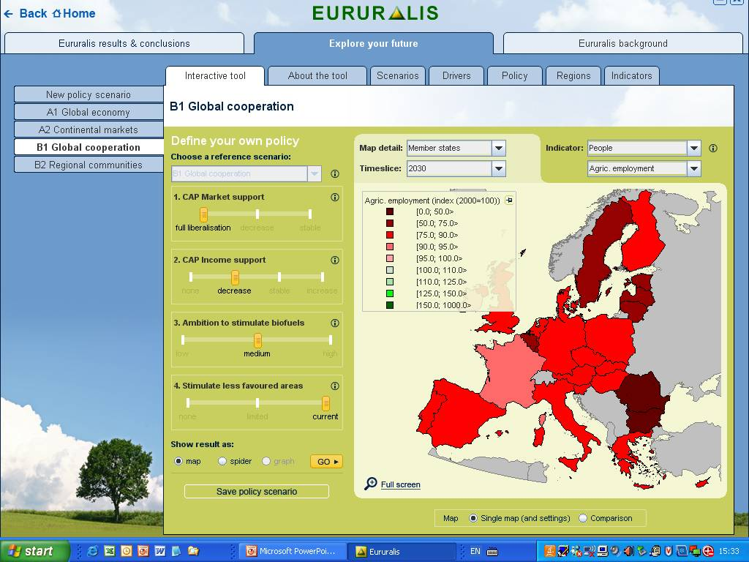

Slide 11
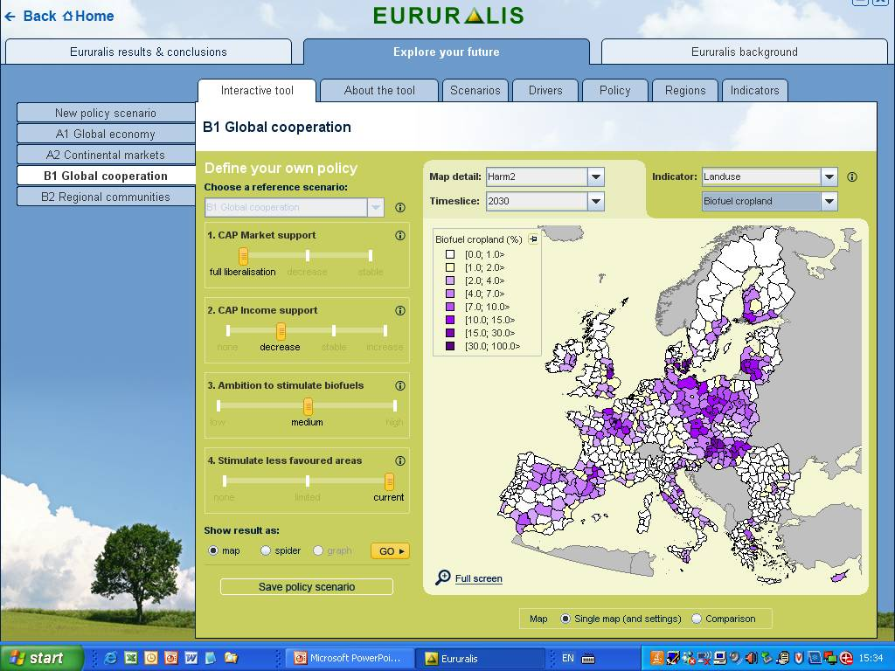

Slide 12
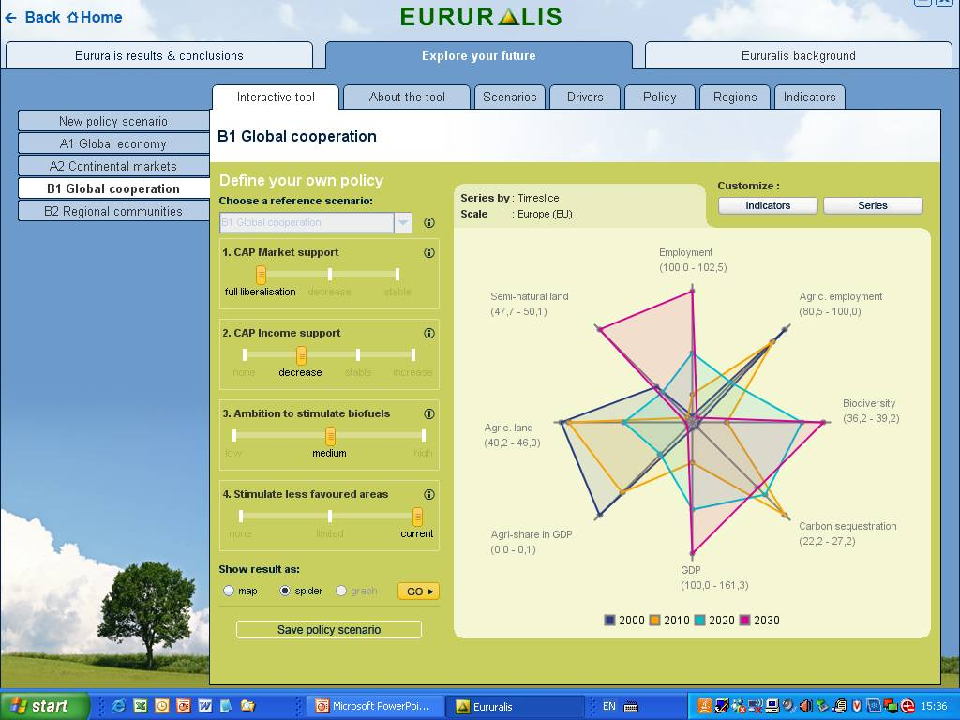

Slide 13
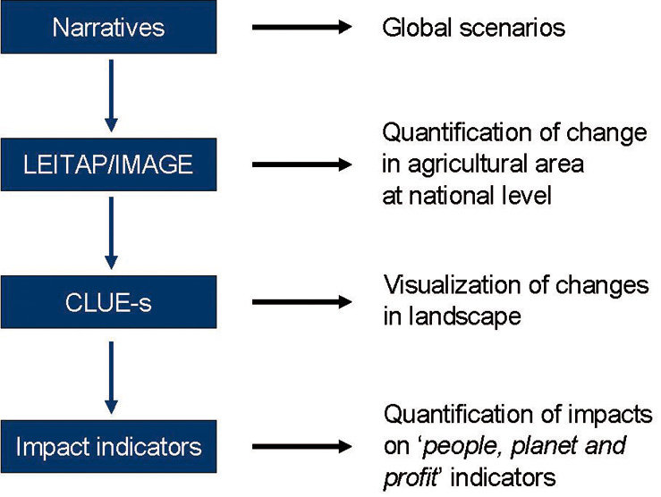
Model framework
CAPRI
Quantification at regional level for agriculture

Slide 14
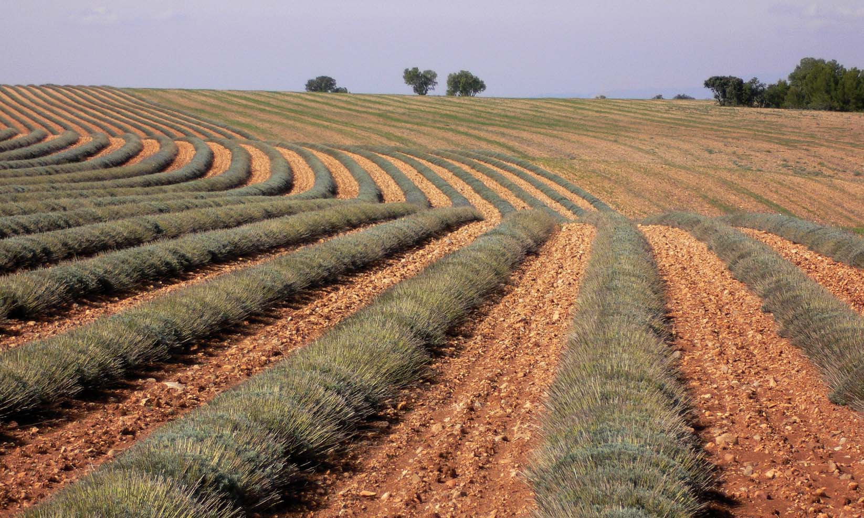
Questions?

