Slide 1
Biofuels: effects on land use change and GHG emissions
(Elke Stehfest, G Woltjer, AG Prins, B Eickhout, M Banse, A Tabeau, H van Meijl)
Outlook on REDD
www.eururalis.eu

Slide 2
Biofuels: Context
Ambitous biofuel policies in the EU, and other OECD countries
Strong increase in production and use of biofuels
EU and other countriesRequied GHG savings, and sustainability criteria

Slide 3
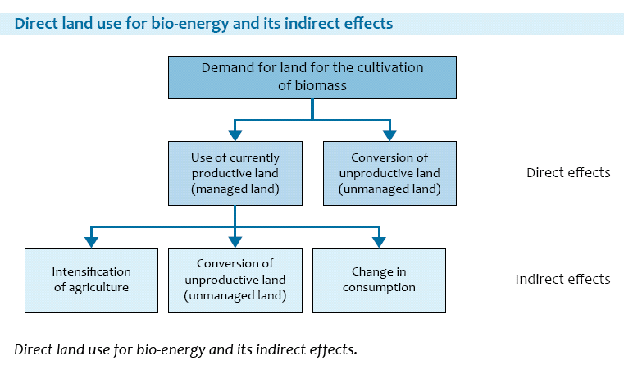
Indirect land use change
2008
Strong increase in food prices, some blame biofuels
concerns about so-called indirect effects, resulting in a strong reducting in GHG savings or net emissions
EC needs to present a method on how to deal with indirect land use change

Slide 4
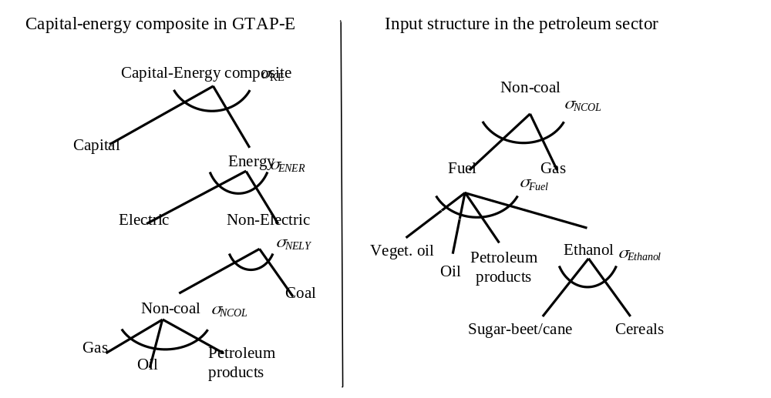
LEITAP-IMAGE work on biofuels
Quantify the land use and GHG implications of biofuel mandates
Implementation of biofuels in LEITAP
By-products taken into account
Biofuels in the fuel sector, not other uses
Figure 1: Nesting structure in energy modeling of the extended LEITAP model
Notes:
Replace

Slide 5
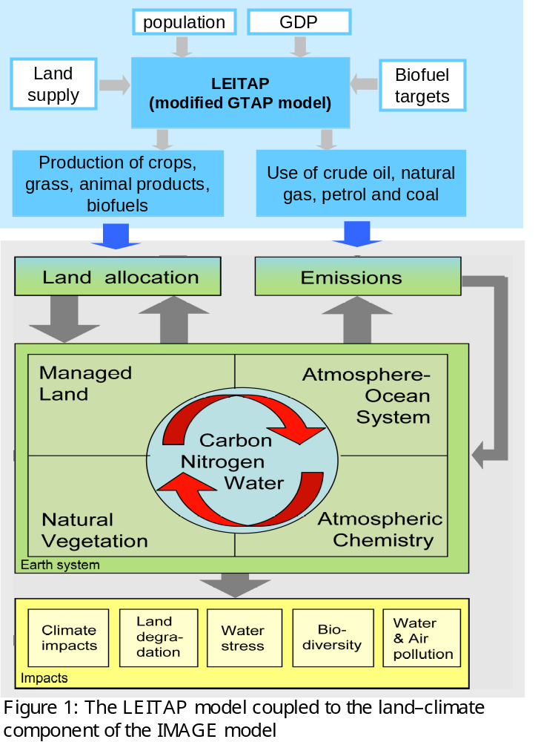
LEITAP-IMAGE linkage for Biofuel directive
Reference scenario (‘business as usual’)
EU Biofuel Directive (5.75% in 2010, 10% in 2020) “BioEU”
OECD Biofuels(EU, Canada, US, Japan, SouthAfrica …) “BioOECD”
Sustainability criteria (forests, protected areas)

Slide 6
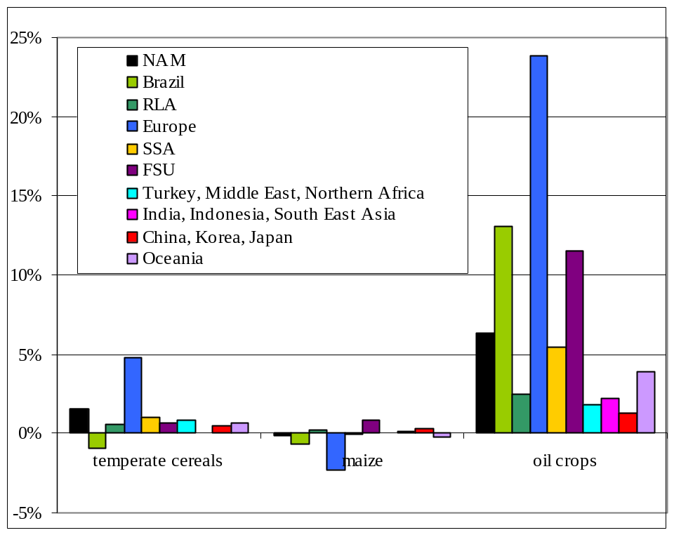
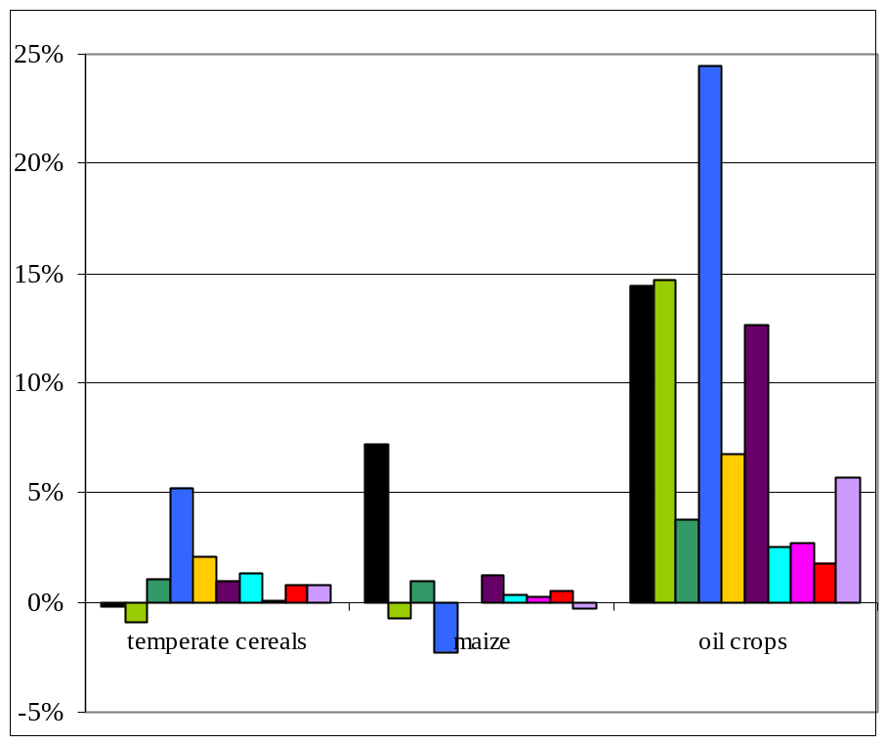
Change in crop production
Figure 3. Change in crop production [%] in 2020 for BioEU (left panel) and BioOECD (right panel), compared to the Reference.

Slide 7
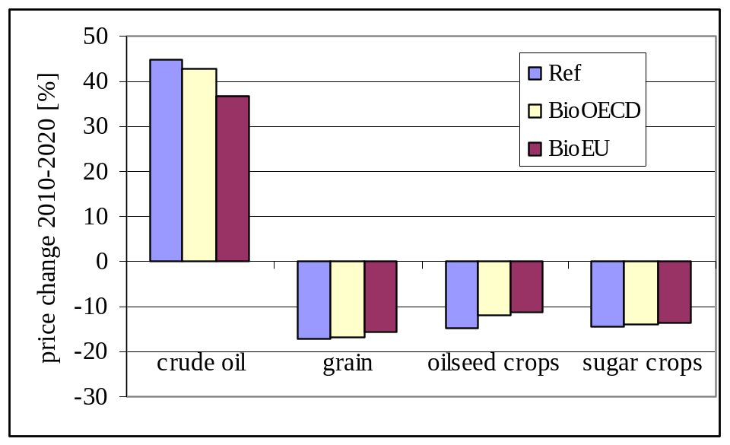
Change in commodity prices
Ref
Bio EU
Bio OECD
Figure 5. Change in commodity prices [%] between 2010 and 2020 under the Reference and the Biofuel scenarios.
As a consequence, also a small change in consumption

Slide 8
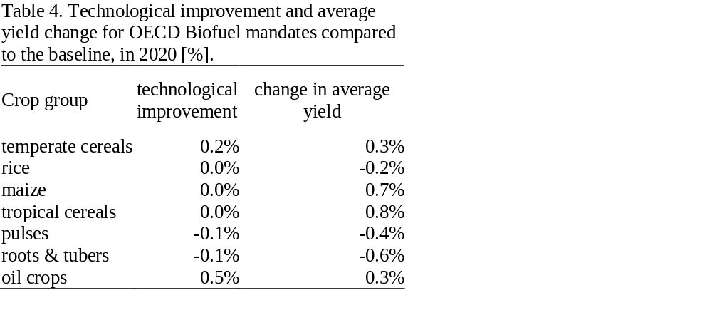
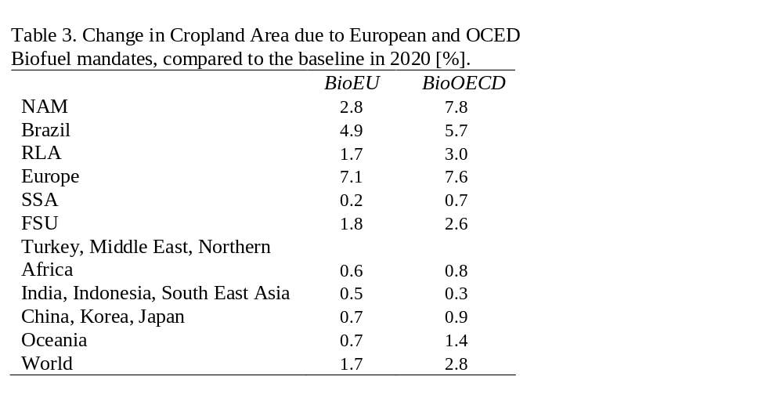
Change in land use due to biofuel directive
Expansion of agriculture
Small intensification effect

Slide 9
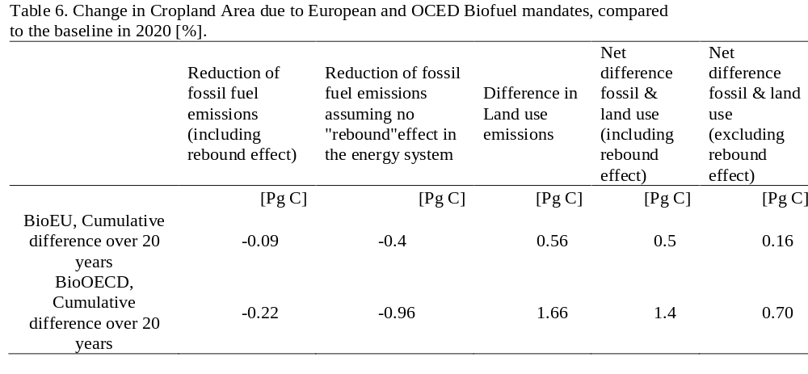
Effect on GHG emissions, and total CO2 balance
Carbon Payback time
28
34

Slide 10
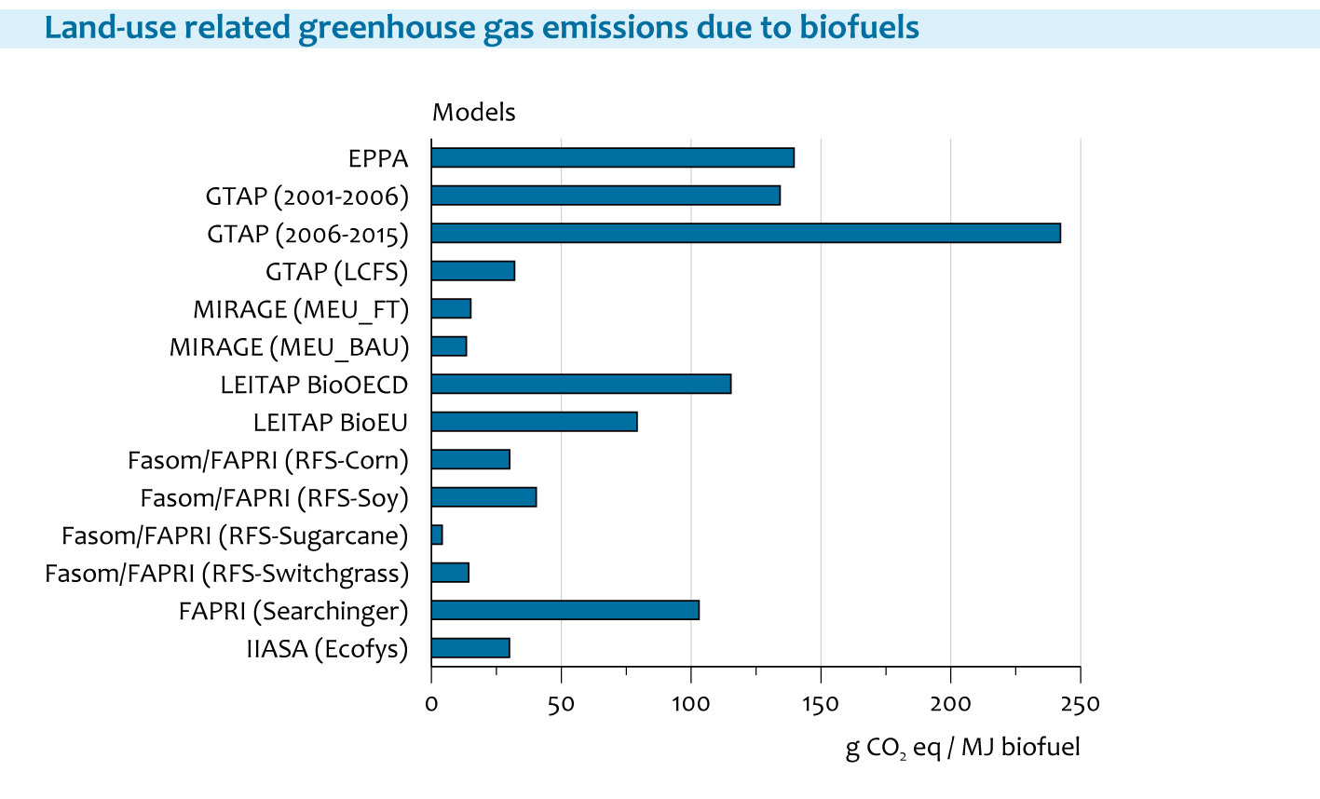
Comparison with other models
84 fossil fuel equivalent
LEITAP-
IMAGE
On the long run, most biofuels will have a net GHG saving.
BUT: next 20 years crucial for bend in emissions
Proper accounting for time would lead to a longer climate payback time (O’Hare et al 2009)
Source: PBL report “Are models suitable for determining iLUC factors”, Prins, Stehfest, Overmars, Ros, 2010

Slide 11
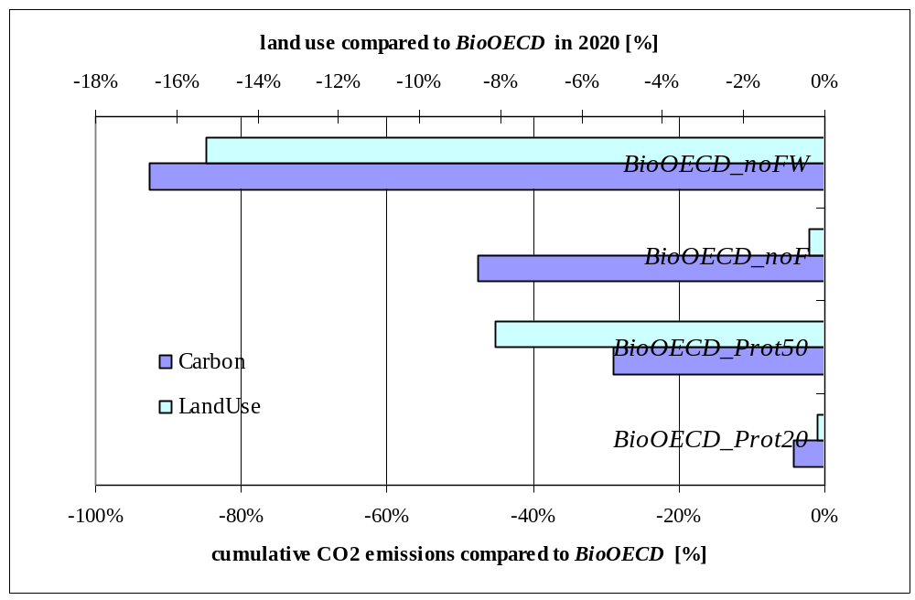
Sustainability criteria: Protecting Carbon and biodiversity
Protecting …
all Forest and Woodland
all Forests
50% of all Ecoregions
20% of all Ecoregions
Figure 10. Effect of sustainability criteria on cumulative Carbon emissions and Land use, compared to BioOECD. For scenario acronyms see table 1.

Slide 12
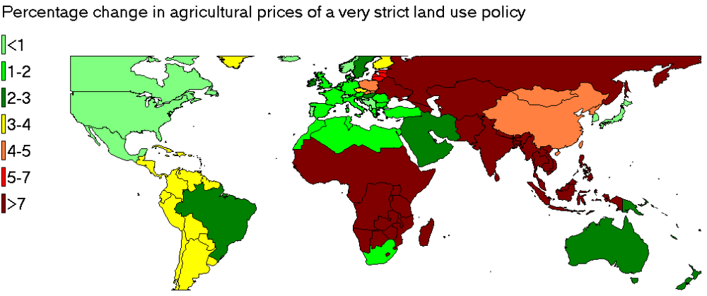
Impacts on prices (preliminary)
Protection of forest systems

Slide 13
Biofuels: Conclusions
Large uncertainty in model results
Most of the additional biofuel crops are produced in EU, Brazil and North America (preservation of current structures)
Up to 2030 land use emissions exceeds reduction in fossil fuel emissions
Simulatanous protection of large areas can reduce the effect of land use change, but, in the most extreme cases, may have implications for food security

Slide 14
REDD = reducing emissions from deforestation and degradation
Will be important ingredient of a new climate treaty
Economic instruments for REDD, small and large scale trials under way (e.g. Amazon Fund)
Central Question: How much deforestation can be avoided at which carbon price?
Model instruments IMAGE LEITAP:
Include REDD as one of the climate policy options
Include REDD as one of the competing claims on land
Study side-effects (displacement, leakage of agricultural production, food-price effects)
REDD will change land supply and land price

Slide 15
Land Supply Curve (LSC)
price
Suitable - unsuitable
Land demand function
P1
Current situation at L1, P1,
Land supply curve
Meijl et al. 2006
L1
Land Area in use

Slide 16
Land Supply Curve (LSC)
price
Suitable - unsuitable
New land suply curve
Additional price element for carbon
IMAGE provides additional price/ha under certain Carbon prices.
Land supply curve
Land Area in use

Slide 17
Marginal abatement cost curve
Carbon price [$/tC]
LEITAP-IMAGE results from runs with different carbon price levels
Emission reduction [MtC]

Slide 18
Further activities
First REDD results by the end of the year
Degradation not included yet, PBL-ISRIC cooperation
REDD is an example for ecosystem services …Explore payments or other incentives for other (biodiversity, hydrological service)
Include other competing claims: Forestry

Slide 19
Thank you

Slide 21
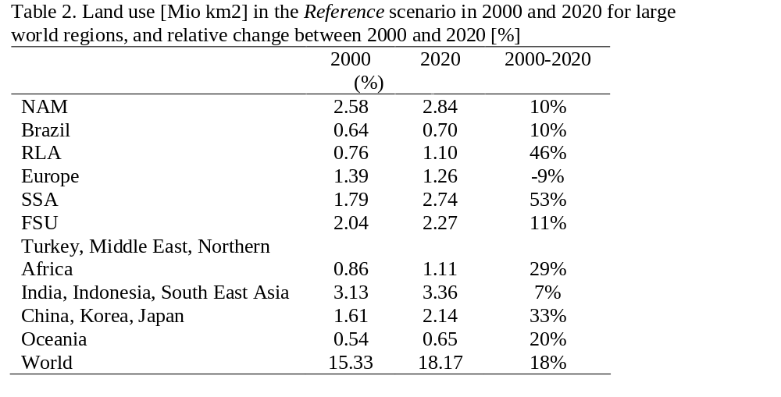
Reference land use

Slide 22
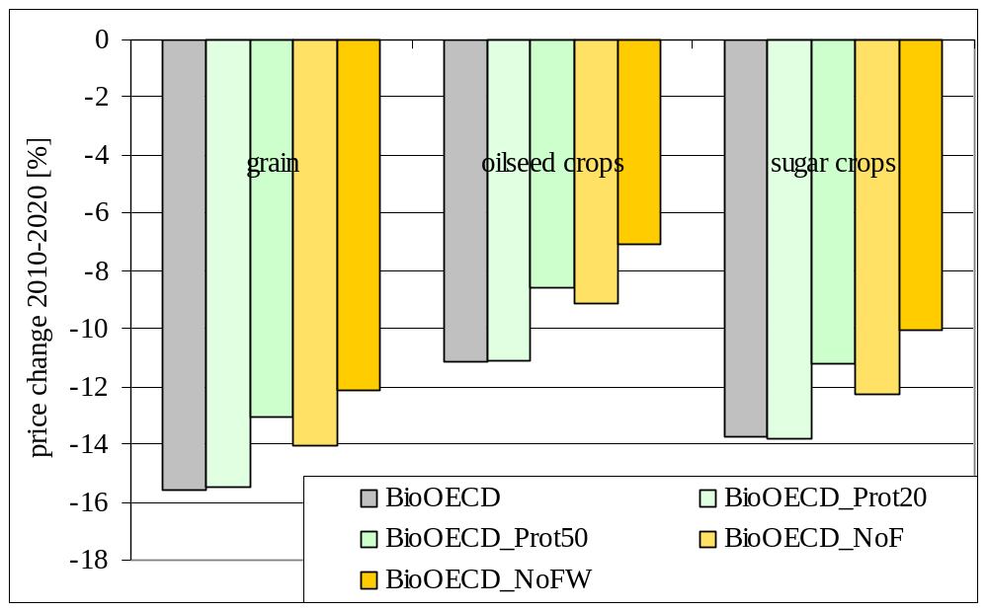
Effect of protected areas on commodity prices
Figure 9.Change in commodity prices [%] between 2010 and 2020 under the BioOECD scenario, and the sustainability options with protection of biodiversity and forests and woodlands. For scenario acronyms see table 1.

Slide 23
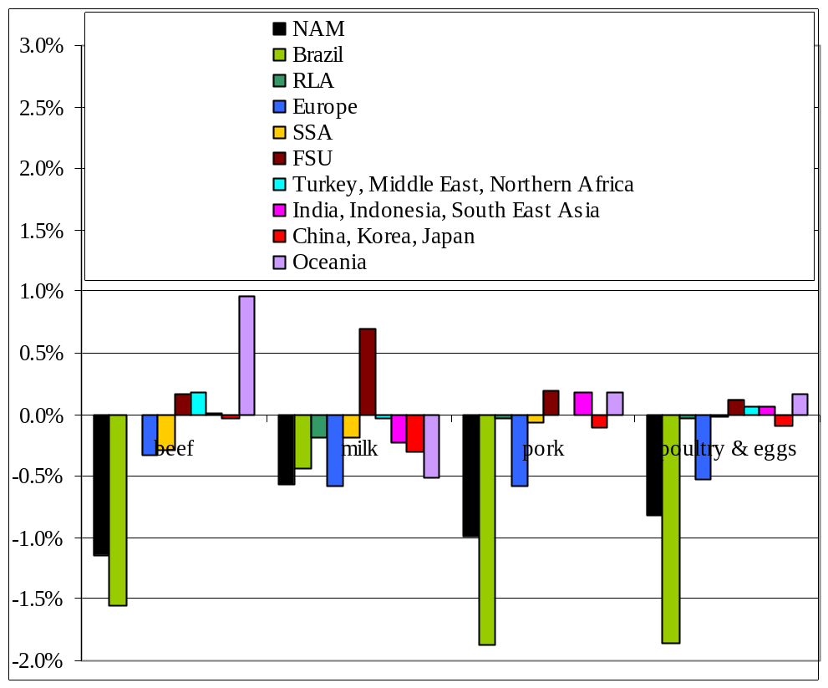
Effects on consumption
Figure 4. Change in production of animal products [%] in 2020 for the BioOECD scenario, compared to the Reference. Changes in BioEU are even smaller and therefore not shown.

Slide 24
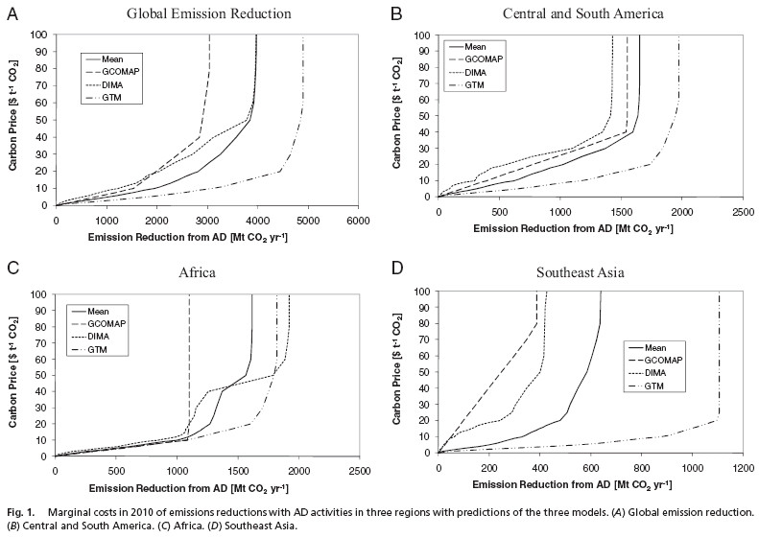
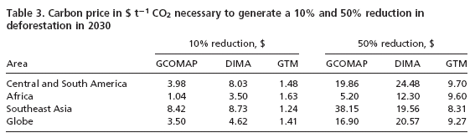
A: Publications: Kindermann et al., PNAS

