Slide 1
WP3: Indicator for biodiversity in agricultural areas
The Hague, 1 November 2010
Koen Overmars, Nynke Schulp, Rob Alkemade, Peter Verburg, Nancy Omtzigt

Slide 2
Content
Global biodiversity context
European biodiversity in agricultural areas
How do these connect?
Land for food, land for biodiversity, or for both?

Slide 3
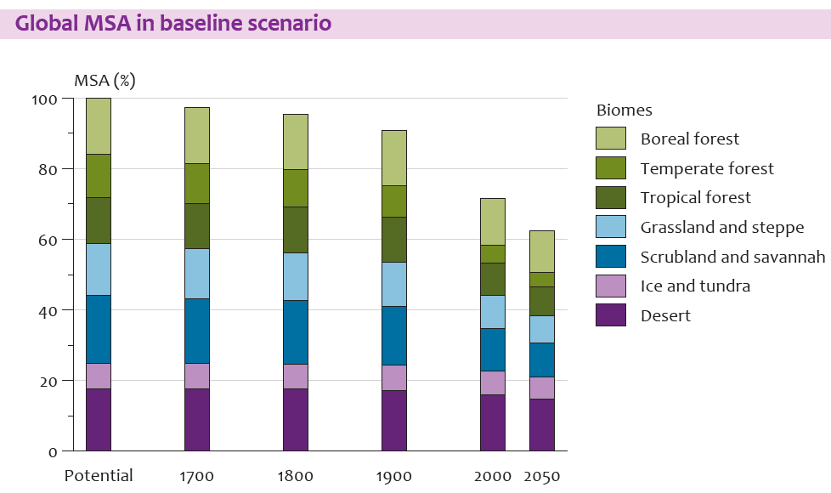
Biodiversity loss until 2050 in the baseline
Notes:
De drukfactoren vereenvoudigen:
Akkerbouw – Veeteelt – Biobrandstoffen – Bosbouw - Effecten van infrastructuur – Klimaatverandering - Stikstof-depositie. Ook weer op volgorde van grootte?
Boodschap waar is wat te halen:
Landgebruik (paars) – vooral tot 2030!
Infrastructuur / verstoring / versnippering (groen) stijgt verder– maar kunnen we niet / weten niet hoe te verminderen
Klimaat: neemt steeds sneller toe: traag reagerend systeem

Slide 4
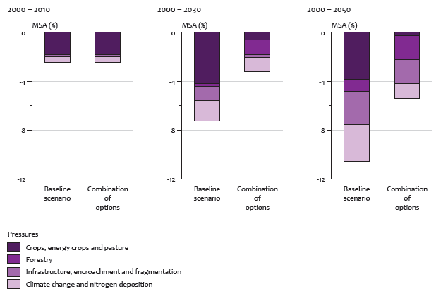
Results of combined options
Protected areas
Agricultural productivity
Reduced losses
Diet change
Notes:
The combined options are:
Protected areas
Increase agricultural productivityReduce losses
Change in diet
Tov van baseline is vooral het minder grote areaal voor crops een belangrijke factor voor de beperking van biodiversiteitsverlies

Slide 5
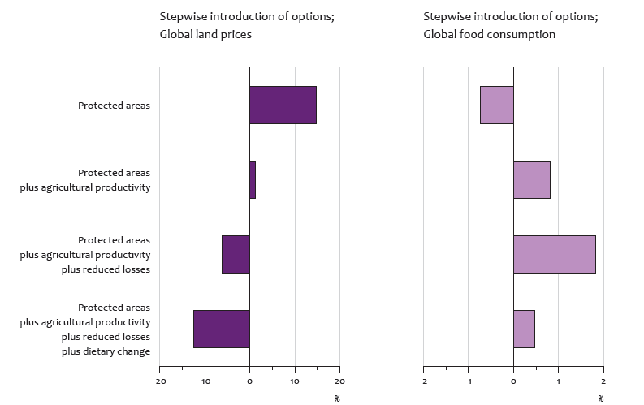
Change in food prices and consumption, compared to the baseline, 2030
Here additional TEEB slides, in English
Baseline
WP3 Agrobiodiversity
Koen Overmars – 5 oktober 2010
Notes:
De verschillende maatregelen hebben verschillede uitwerking op bv landprijcen en consumptie.
Dooreen goede mix te kiezen kunnen negatieve bij effecten naast biodiversiteitswinst worden vermeden en evt. Positieve effecten worden benadrukt.

Slide 6
Europa: Theoretical background
Conversion from natural to agricultural land use affects biodiversity
However: EU agricultural land contributes also significantly to biodiversity
  Conversions from one agricultural system to another affects biodiversity

Slide 7
Policy background
CAP has been (was) a driver in intensification and abandonment
Current and feature measures in CAP aim (besides many more) at biodiversity in agricultural areas
Need to have a relevant indicator for biodiversity related to agriculture
Current indicators mainly targetted at natural areas
Notes:
CAP has been (was) a driver in intensification and abandonment
Reforms are changing this driver: decoupling, AES, etc.
Extensification, payments for environmental services

Slide 8
Objective
Biodiversity indicator for the agricultural areas
  Based on actual species presence of species in agricultural areas
  Database on species presence and their pressure factors

Slide 9
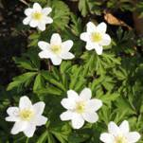
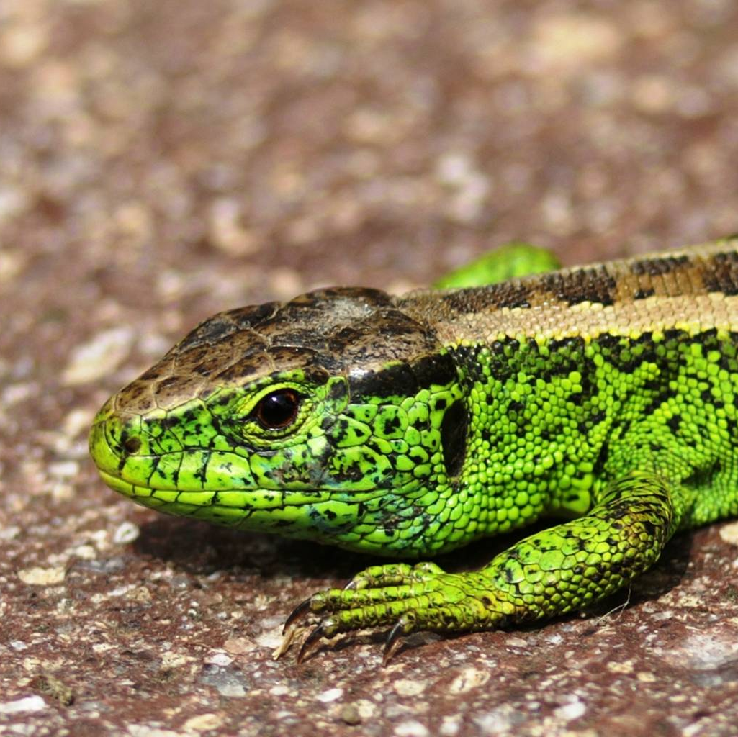
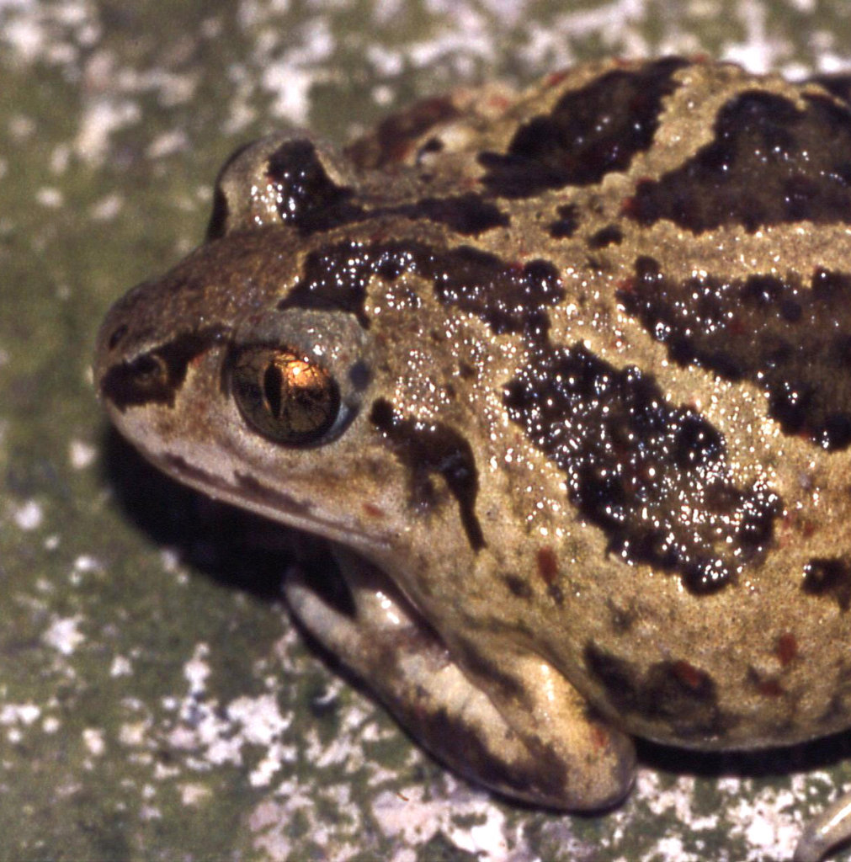
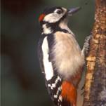
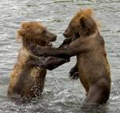
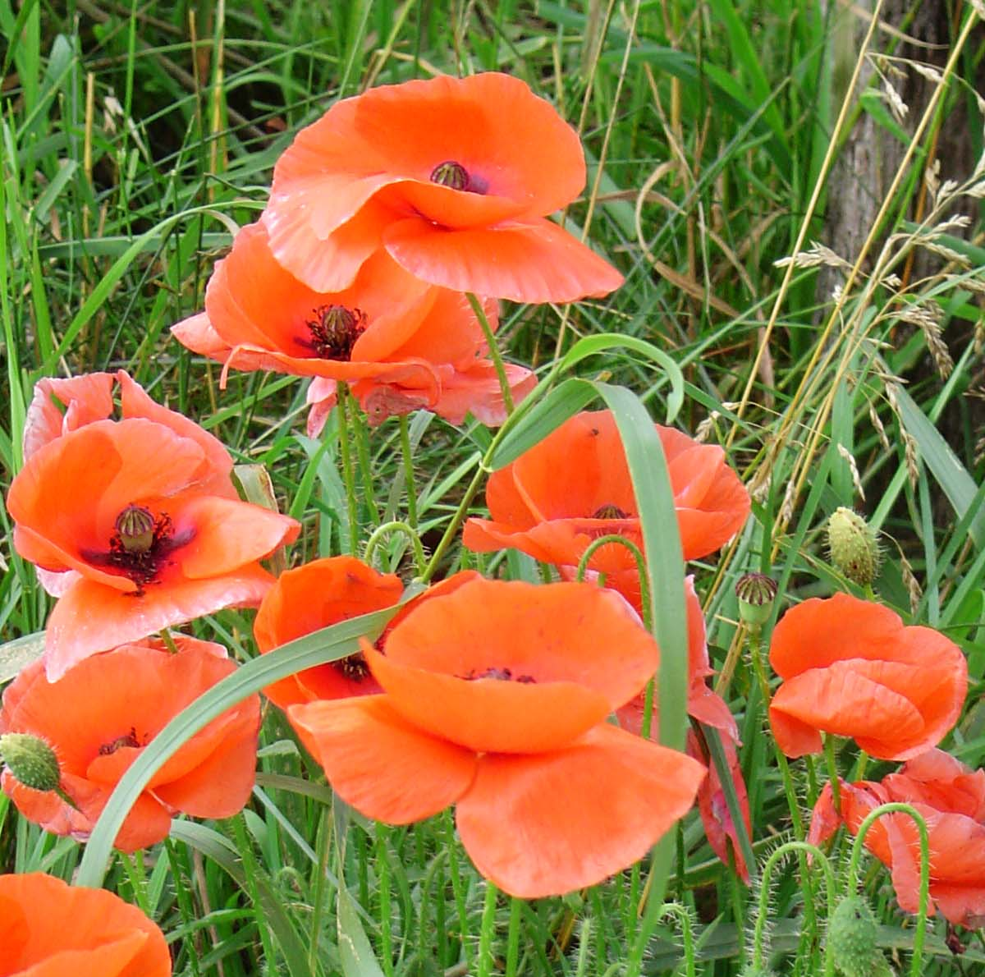
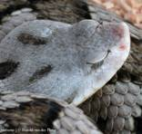
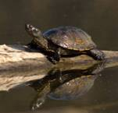
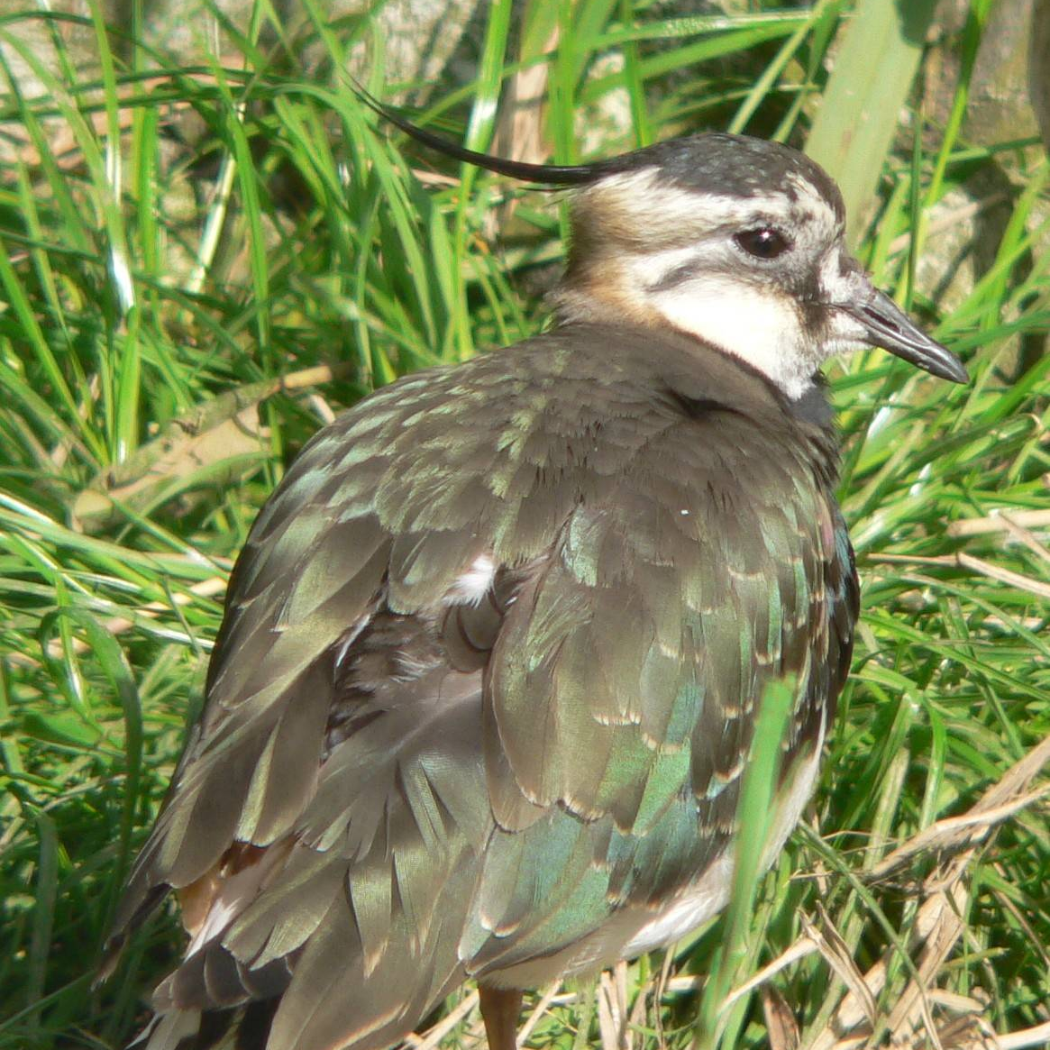
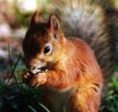
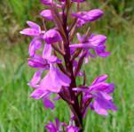
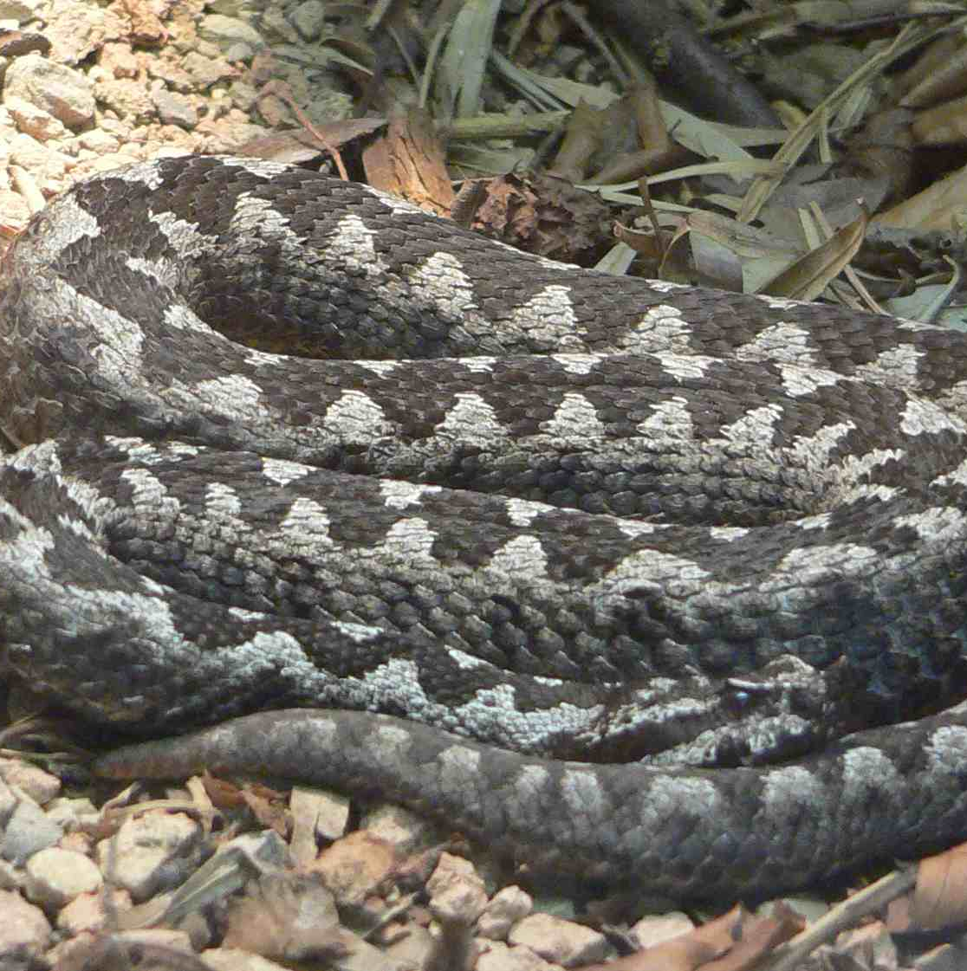
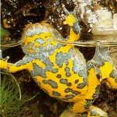
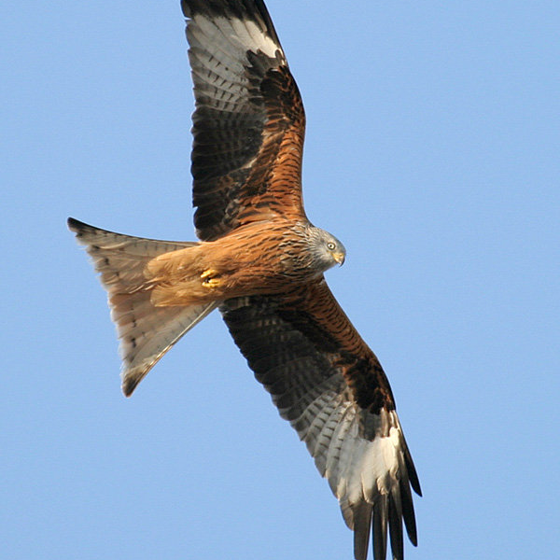
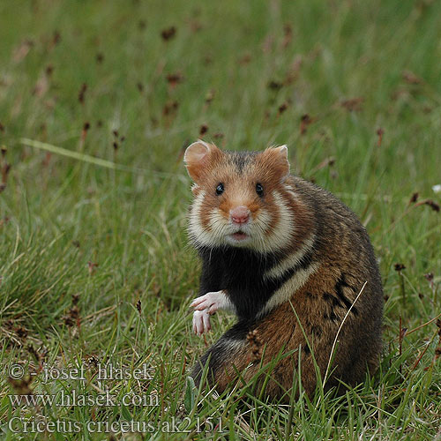
Bioscore components - Species
Notes:
So first we ripped some components out of Bioscore. I’ll explain this in somewhat more detail.
Firstly, of the 1100 Bioscore species……

Slide 10
Bioscore components – Species in agricultural areas
Notes:
Many are not relevant because they do only occur in natural land use like forests or swamps.
Only the species that have a preference for agricultural land are kept. We ended up with some 35 birds, 15 mammals, 15 reptiles, 15 amphibians and 80 plants.

Slide 11
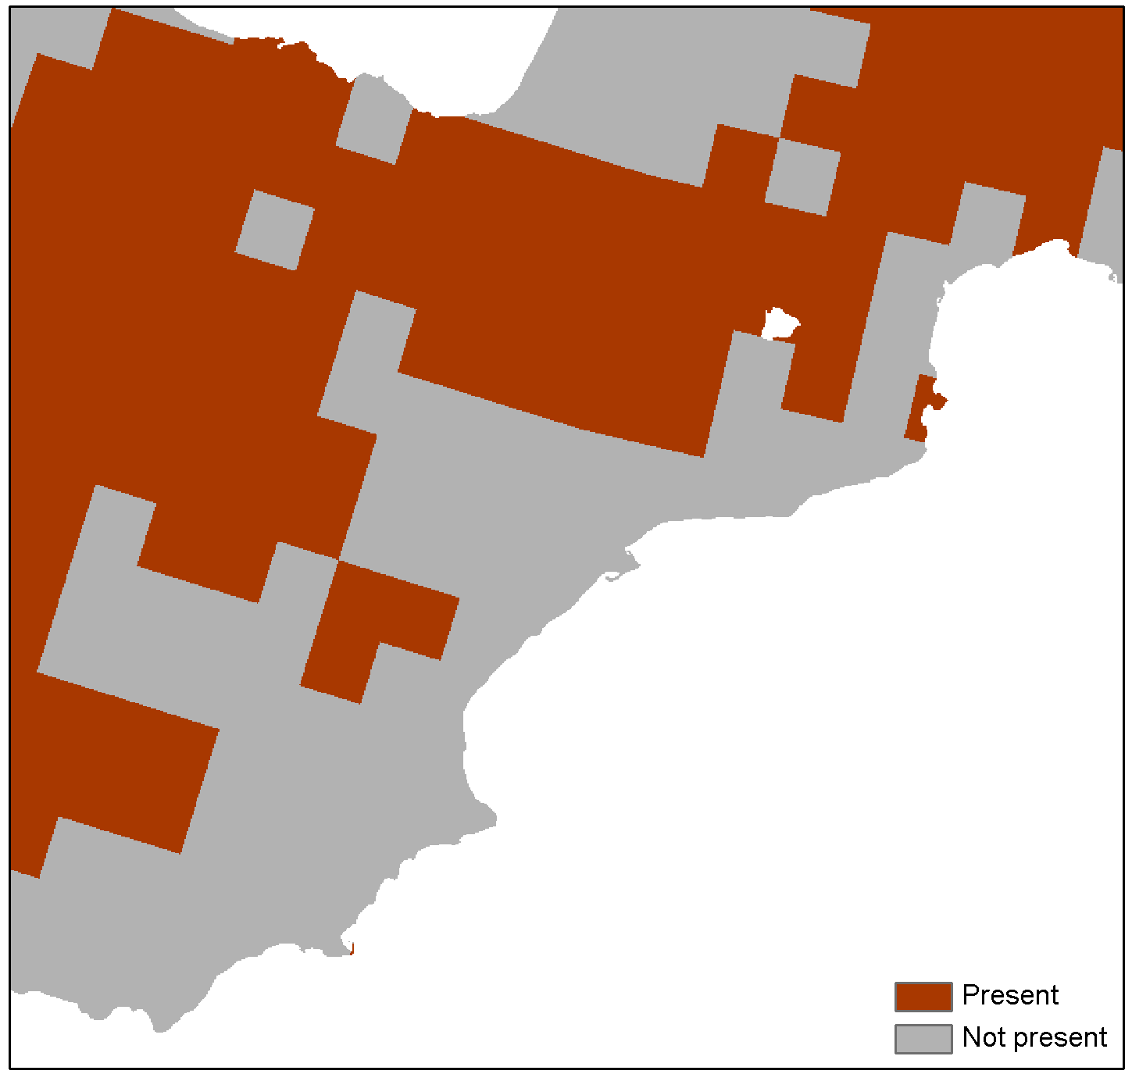
Methodology
Species maps (75 animals, 75 plants)

Slide 12
Bioscore components – Pressures related to agriculture
Dead wood | Pollution | Nitrogen
Land use | Felling age | Competition
Hunting | Flooding | Climate change
Water quality | Fragmentation | Trampling
Competition | Light | Predation
Disturbance | Harvesting | Powerlines
Temperature | Toxic pollutants | ….and 50 more
Notes:
so the pressures that are relevant in agricultural land.

Slide 13
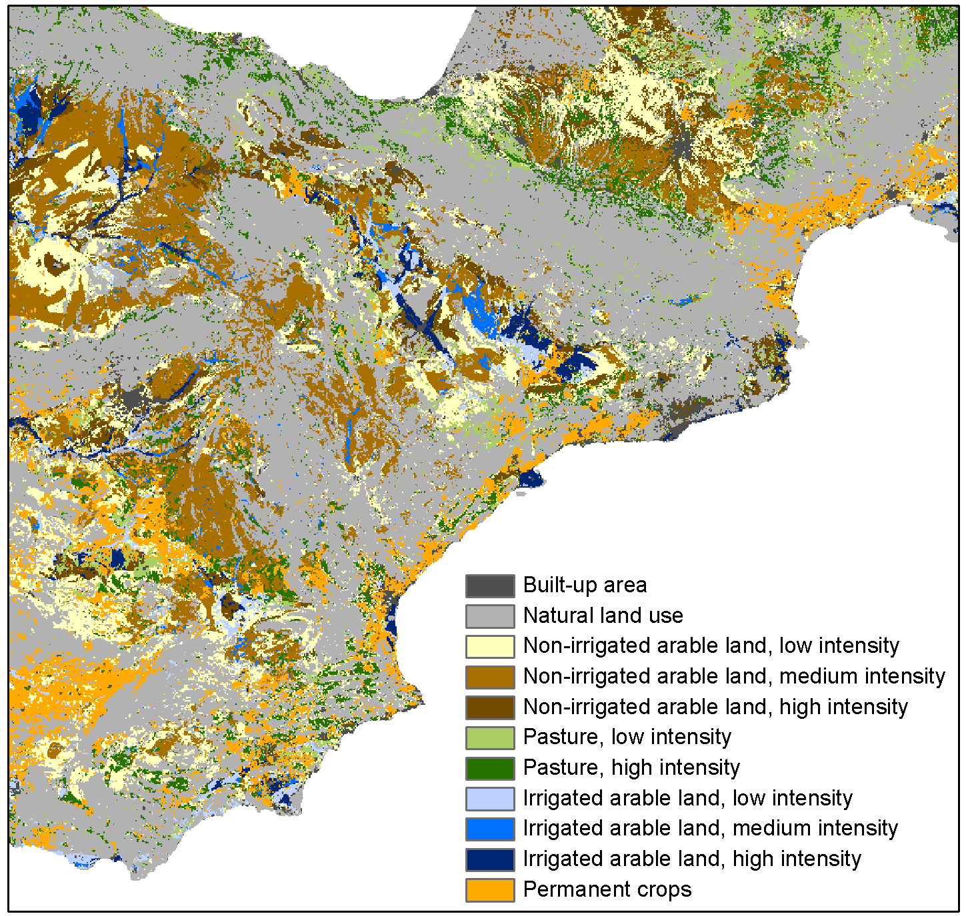
Methodology
Pressures: e.g. Land use, including intensity

Slide 14
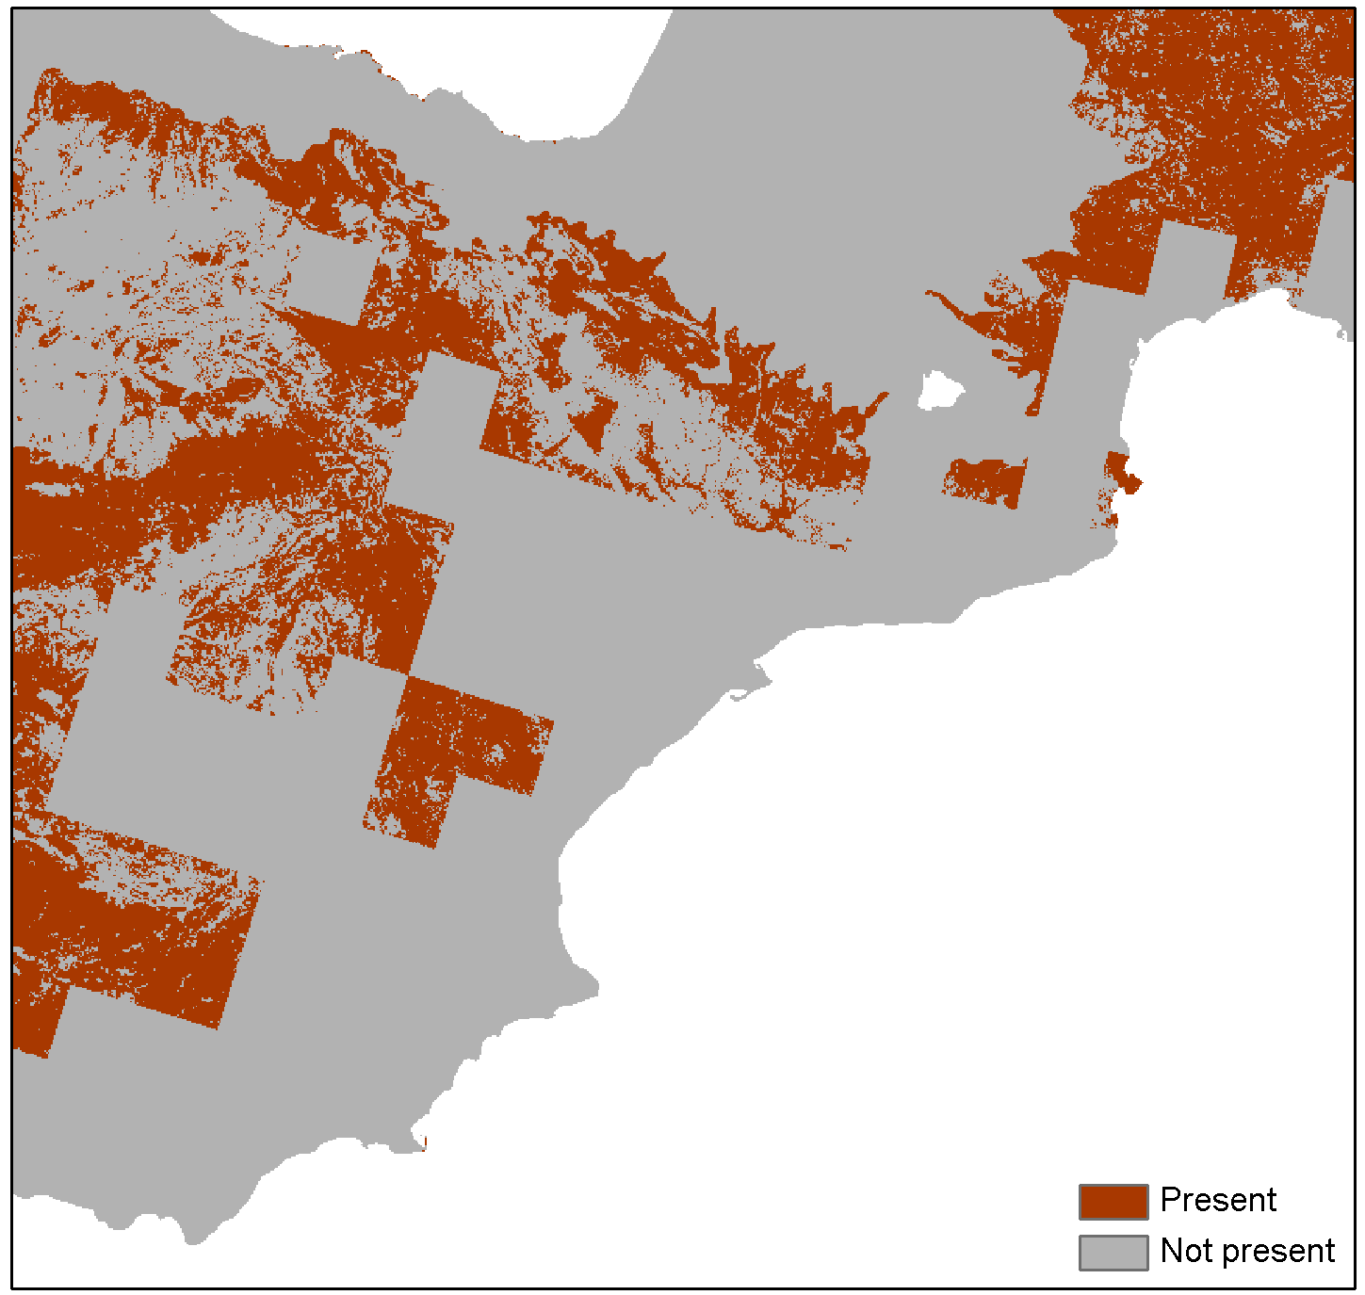
Methodology
Pressures and species presence combined

Slide 15
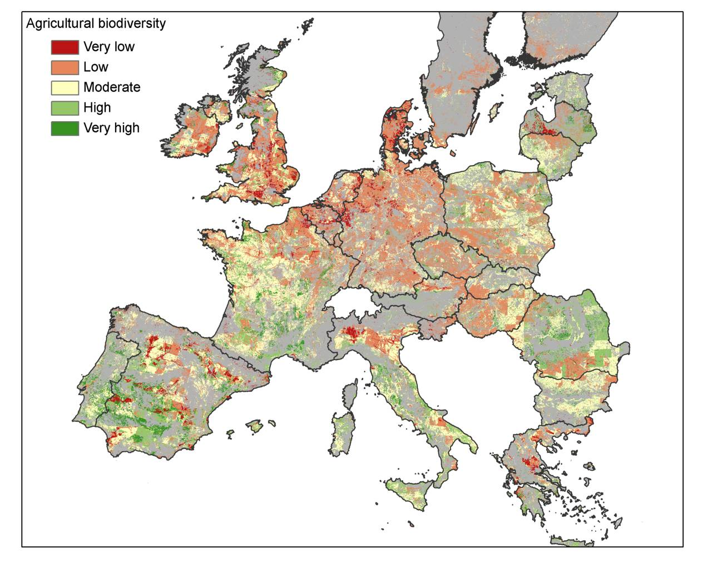

Slide 16
Applications
Scenario analysis for assist policy making, evaluations, etc.
Biodiversity in agricultural areas
Trade-off with natural areas
Global perspective: Trade-offs with biodiversity in other parts of the world
Eururalis approach: integrated economic-biophysical at EU and global level
Notes:
Wat je wilt in Europa is je eigen biodiversiteitsdoelen halen zonder het landgebruik te exporteren naar buiten de EU.

