Slide 1
Eururalis:
Models and data
Amsterdam, April 26 2006
Bas Eickhout

Slide 2
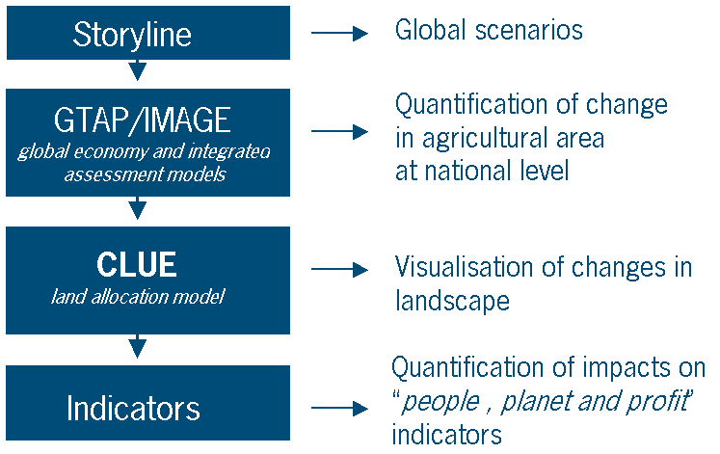
Methodology of Eururalis-1

Slide 3
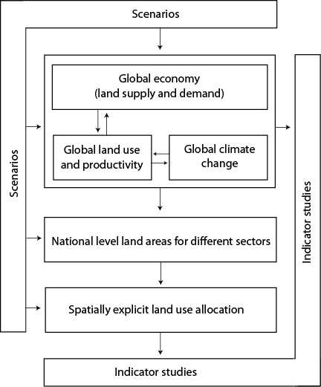
In detail:

Slide 4
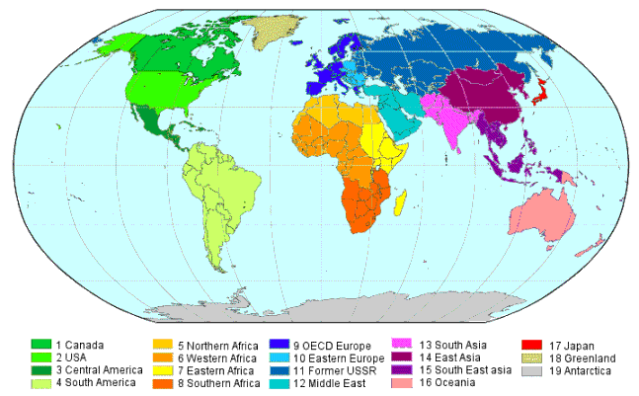
Europe in a global context

Slide 5
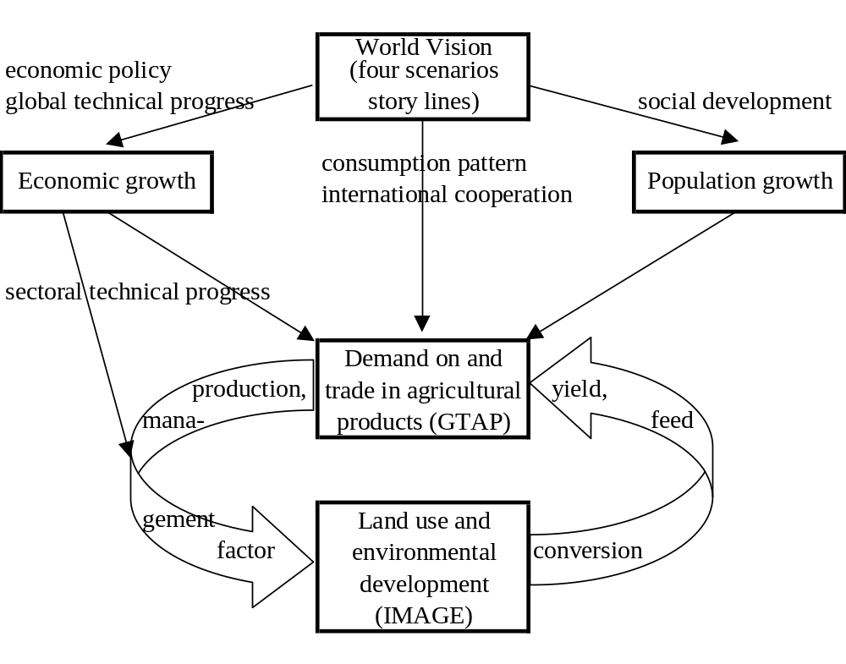
The linkage of GTAP and IMAGE
Source: Eickhout et al., 2004

Slide 6
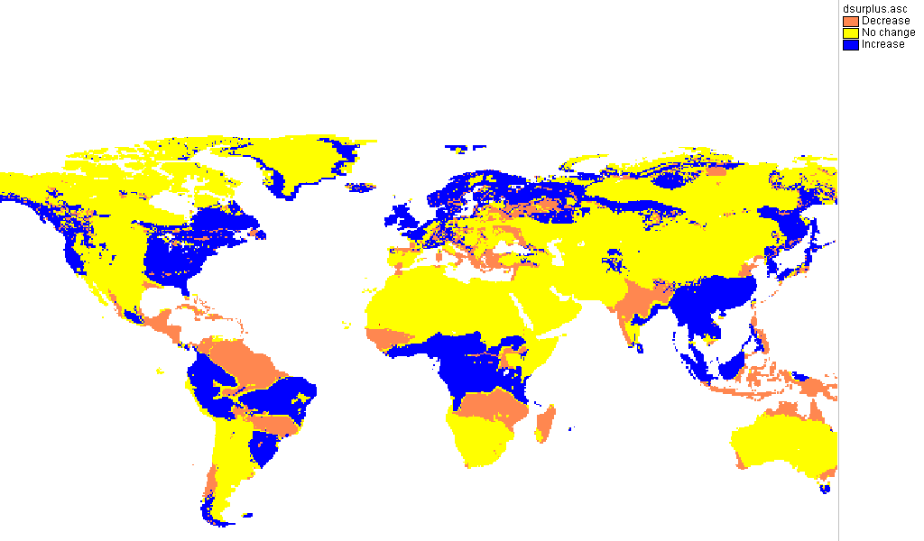
Linking environmental conditions to economic modelling

Slide 7
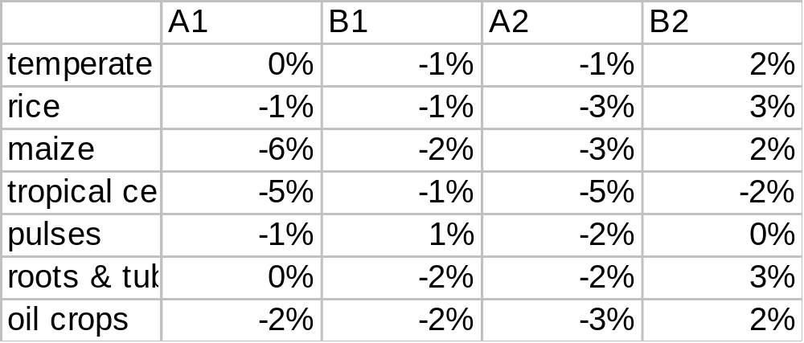
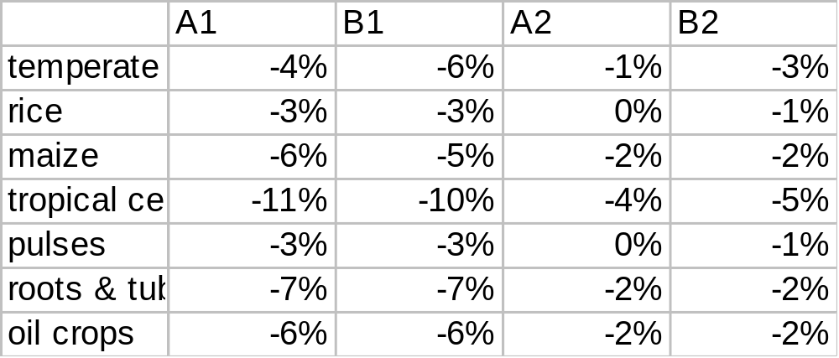
Corrections in achieved crop productivity because of climate change and land allocation
OECD Europe
South America

Slide 8
Improvements in Eururalis-2
Implement land supply curves in GTAP on basis of IMAGE crop productivities
  Main assumption: low productive areas are more expensive to bring in cultivation
Implement biofuel demand from IMAGE energy model in GTAP model
  Extension of LEI-GTAP model with GTAP-E

Slide 9
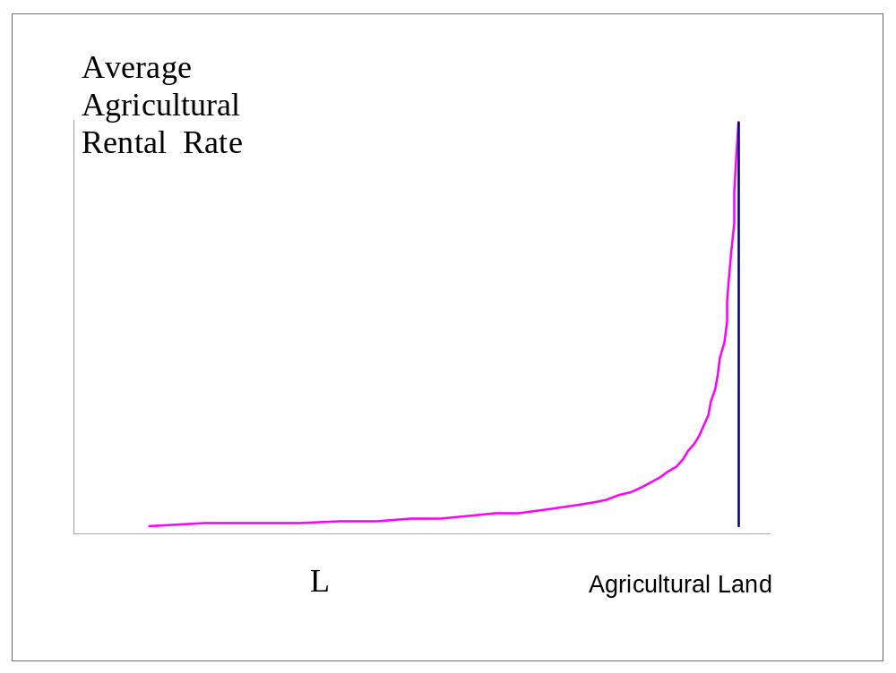
Land supply curve
Source: Van Meijl et al., 2006

Slide 10
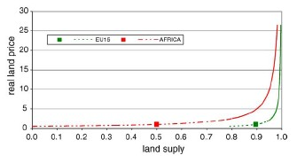
Based on IMAGE per region
Source: Van Meijl et al., 2006

Slide 11
Methodology of Eururalis-1

Slide 12
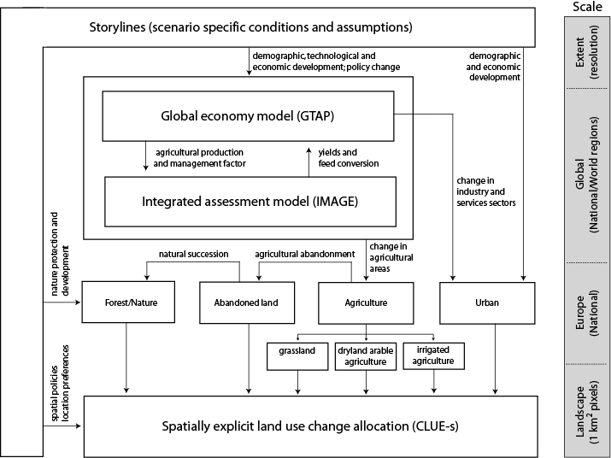

Slide 13
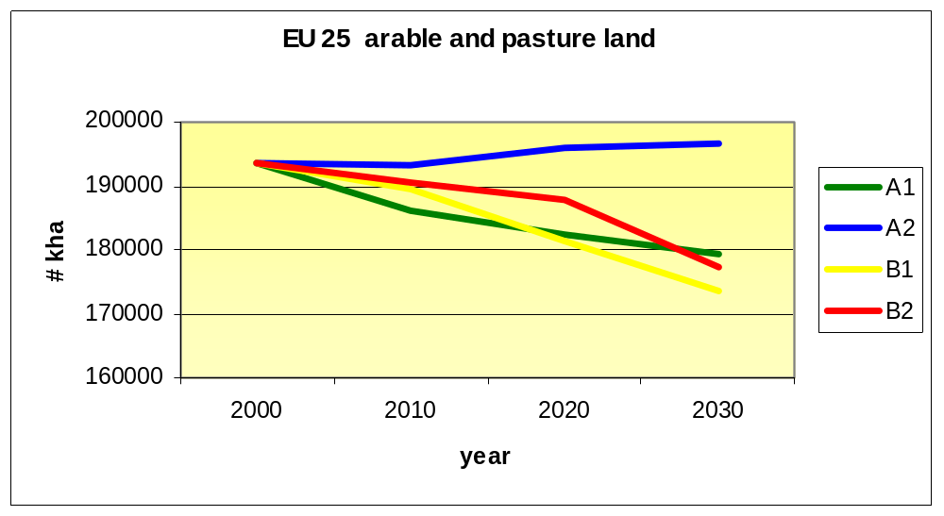
After GTAP-IMAGE model iteration: change in land per country available

Slide 14
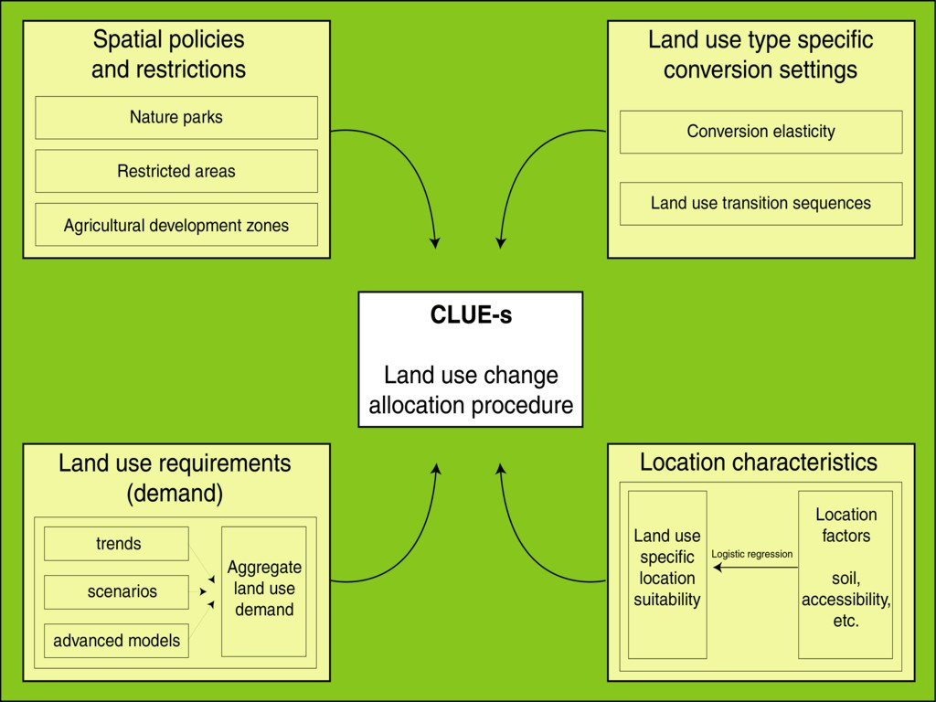

Slide 15
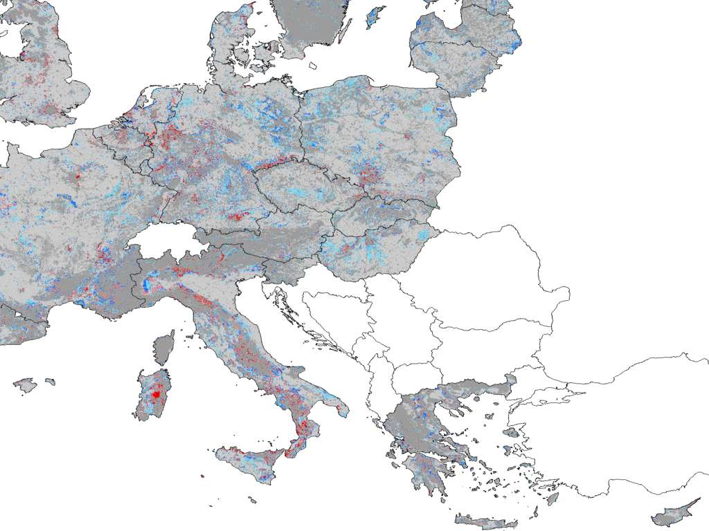
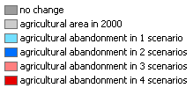

Slide 16
Improvements of CLUE in Eururalis-2
Fallow land based on GTAP-IMAGE output
Treatment of abandoned land
Distinguish intensity of grazing systems
Including land allocation of biofuels

Slide 17
Eururalis models in scientific field
Each individual model published in many scientific papers
Eururalis modelling chain published in Special Issue of Agriculture, Ecosystems & Environment
Development of GTAP-IMAGE link presented at GTAP conference (starting 2004) and will be part of forthcoming GTAP book on “Land”.
Linked models part of many new European projects (Scenar-2020, MATISSE, Nitro-Europe) and OECD’s Environmental Outlook

Slide 18
Thank you for your attention

