Slide 1

EURURALIS
Discussing the future of European rural areas
Amsterdam April 26 2006
Willem Rienks
Alterra Wageningen UR

Slide 2
Goals of Eururalis
possible developments of EU rural areas
Impact of policy options on PPP
European focus - global context
Spatially explicit – 2030
strategic discussion

Slide 3
Conclusions Eururalis 1
Agriculture remains strong in all scenarios
land to spare in most scenarios (max 10%):
biofuels; biodiversity?
Insight in the trade off’s – eg higher farm income versus lower biodiversity or lower self sufficiency
There are not only threats but also chances…
There is something to choose for….
Outcomes sometimes differ from what you expected….

Slide 4
Eururalis 1.0
Developed in 2004
Presented at policy meetings
Presented to scientific community
Presented at stakeholder meetings
Used in teaching/training
Scientific articles & special issue
Success - Dutch parliament: follow up

Slide 5
Whats next: Eururalis 2.0
Preserve strong points
  Strategic discussion tool for future rural Europe
  Improve consciousness of Europe’s diversity and the effects of large scale, long term, global driving forces
  Common Language
  Spatial explicit
Extensions
  Policy options – interactive altering of policy
  Transparancy – why is what happening?
  Information on regional level
  Trade off information – balance winners and losers

Slide 6
Organizational 2006
December 2006 - new version Eururalis 2.0
October 2006 - Calculations/modelling finished
3x in 2006 - PAG meetings:
  Defining policy options & iscussions on impacts
  Making better policy
2x in 2006 - SAG: feedback + scientific imbedding
3x – Eururalis newsletter
Summer 2006 - Startup Eururalis 3.0

Slide 7
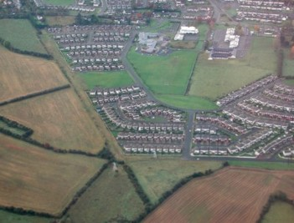
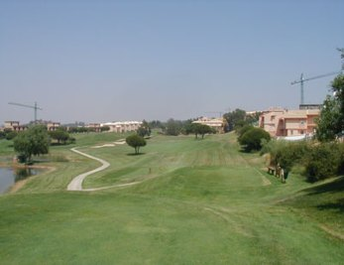
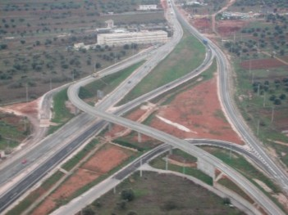
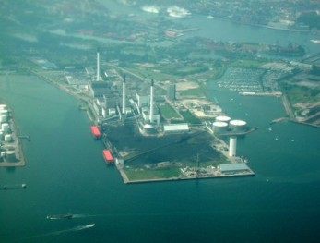
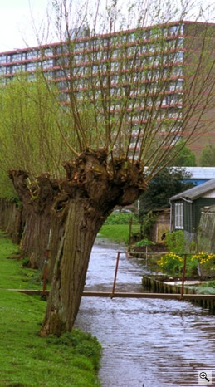
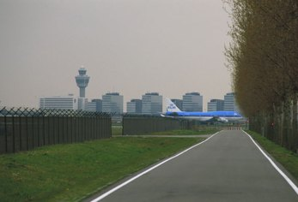
Urbanization
Residential
Industrial
Infrastructure
Recreation

Slide 8
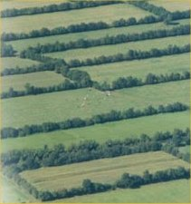
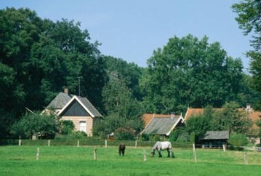
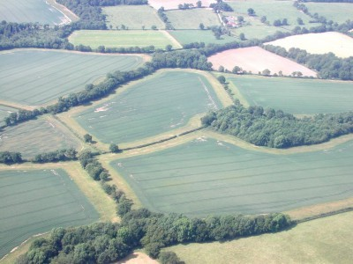
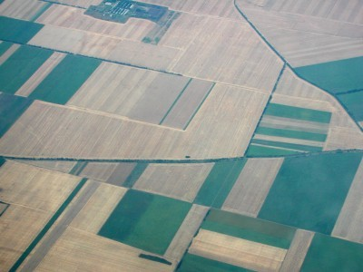
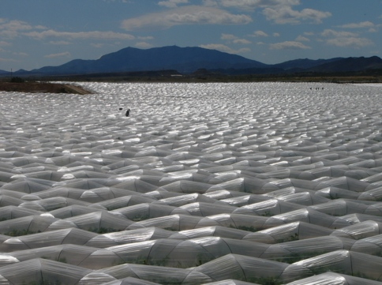
Intensification of agriculture
Management and scale

Slide 9
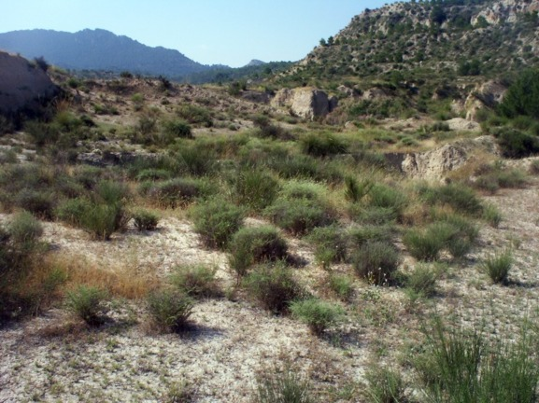
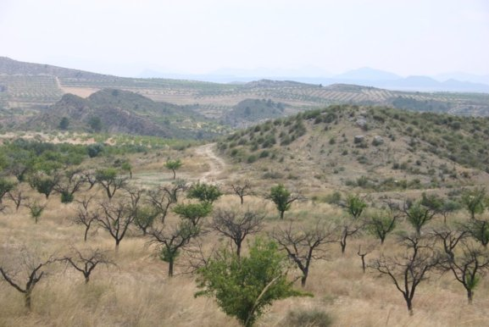
Land abandonment
Regrowth of natural vegetation
Degradation
Extensive land uses (hobby farming)

Slide 10
Driving forces of rural areas
Demography
Economic growth
Technology
Climate
Policy – eg CAP, biofuels

Slide 11
Eururalis 2.0 proces
Choose one of the four scenarios
Adjust policy options (new)
  2006: CAP, biofuels, LFA
  Later: WFD, nature, RDP
Calculations are being made (GTAP, Image, Clue + meta models)
Explore impact indicators PPP
  Graphs, text, maps
  Overview of trade offs
  Compare scenario’s and policy options (new)
  Why does what happen? (new)

Slide 12
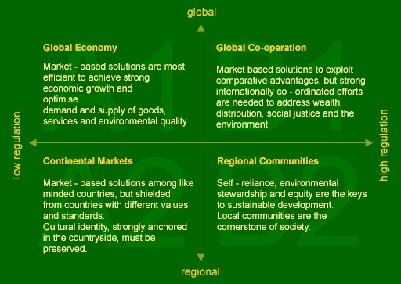
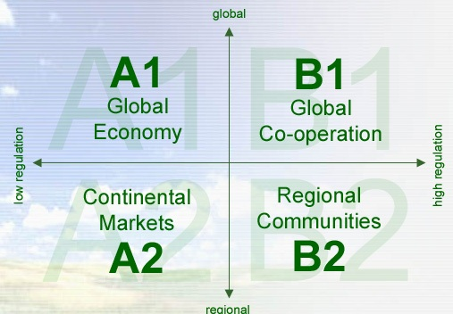

Slide 13
Adjust strategic policy
Policy packages – defined by policy makers
CAP 1 –market support in CAP
  100% - 50% - 0% of current budget
CAP 2 –income support – distortion of the market
  150% - 100% - 50% - 0%
Budget implications result from the combination

Slide 14
Adjust policy
Policy packages
Biofuels – ambition on biofuels
  High – medium – low
LFA – area designated for extra payment
  No LFA – current LFA – new LFA

Slide 15
Policy options
Combined table Options for CAP1 and CAP2
 | CAP2 – market support | 100% constant price support |  | 50% decreasing price support |  |  | 0% liberalisation
CAP2 – income support
150% increasing support |  | B2 |  | A2 | B2
100% stable support |  | A2 | B2 | A2 | B1 | B2 | B1
50% decreasing support |  | A2 | B2 | B1 |  |  | A1 | B1
0% no support |  | A2 |  |  |  |  | A1

Slide 16
EURURALIS 2.0 prototype
1 Intro 2 past 3 scenario 4 drivers 5 general policy 6 rural policy 7 landuse change 8 indicators 9 integration 10 conclusions
Scenario A1 scenario A2 scenario B1 scenario B2 ……….
Choose scenario
Adjust policy
Effect indicators
Agro employment
Rural employment
Self-sufficiency
CO2 storage
N-use per ha
Air pollution
Water quality
Biodiversity
Landscape
Farm Income
Farm size
Expenses
Means indicators
Available land
Inputs
Water
Landuse change
100%
50%
0%
CAP1
info
150%
100%
50%
0%
CAP2
info
30% biofuels
Medium ambition
20% biofuels
No ambition
0% biofuels
Energy
info
current LFA
Services payments
New LFA
No LFA
LFA
info

Slide 17
EURURALIS 2.0 prototype
1 Intro 2 past 3 scenario 4 drivers 5 general policy 6 rural policy 7 landuse change 8 indicators 9 integration 10 conclusions
Scenario A1 scenario A2 scenario B1 scenario B2 ……….
Choose scenario
Adjust policy
Effect indicators
Agro employment
Rural employment
Self-sufficiency
CO2 storage
N-use per ha
Air pollution
Water quality
Biodiversity
Landscape
Farm Income
Farm size
Expenses
Means indicators
Available land
Inputs
Water
Landuse change
100%
50%
0%
CAP1
info
150%
100%
50%
0%
CAP2
info
30% biofuels
Medium ambition
20% biofuels
No ambition
0% biofuels
Energy
info
current LFA
Services payments
New LFA
No LFA
LFA
info

Slide 18
Impact indicators
People
  Share of agricultural employment
  Share of unemployment
  Share of industries and services employment
  Self sufficiency
Planet
  Biodiversity
  Nitrogen emissions
  Livestock intensities
  Erosion
  Carbon sequestration
  Landscape pressure
  Landuse dynamics
Profit
  Agricultural income
  Gross added value in food production

Slide 19
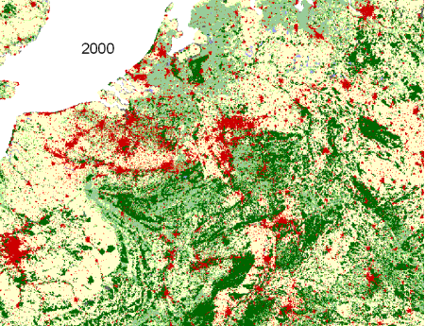

A1: Global Economy
B2: Regional Communities
Land use dynamics differ by scenario:
Quantity of change
Spatial pattern of change

Slide 20
Each indicator
Graph over time
Hotspotmap of Europe
Explanatory text
Compare scenario’s & policy options
Causal tracing:
  overview of main forces responsible for the outcome
Overview of indicators
  Overview of trade off’s

Slide 21
Whats next: Eururalis 3.0
Preserve strong points
Extensions 3.0
  New Policy options:
    water framework directive?
    Nature policy?
    Rural development policy?
  Instead of downscaling real models
  Connecting EU scientists

Slide 23
Indicators
List of impact indicators
Wishes of policy makers
Continuation of Eururalis 1.0 indicators
Extended impact assessment rural development
Irena indicators list
Pragmatic – scientifically possible to elaborate

Slide 24
Impact indicators
People
  Share of agricultural employment
  Share of unemployment
  Share of industries and services employment
  Self sufficiency
Planet
  Biodiversity
  Nitrogen emissions
  Livestock intensities
  Erosion
  Carbon sequestration
  Landscape pressure
  Landuse dynamics
Profit
  EU budget
  Farm income
  Gross added value in food production

Slide 25
Each indicator
Graph over time
Hotspotmap of Europe
Explaining text
Compare scenario’s & policy options
Causal tracing:
  overview of main forces responsible for the outcome
Overview of indicators
  Overview of trade off’s

Slide 26
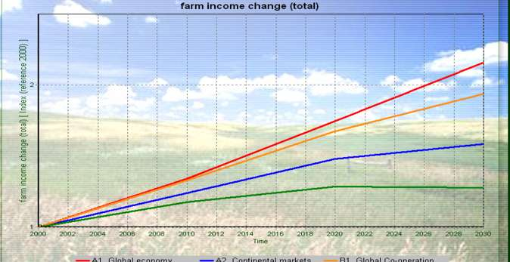
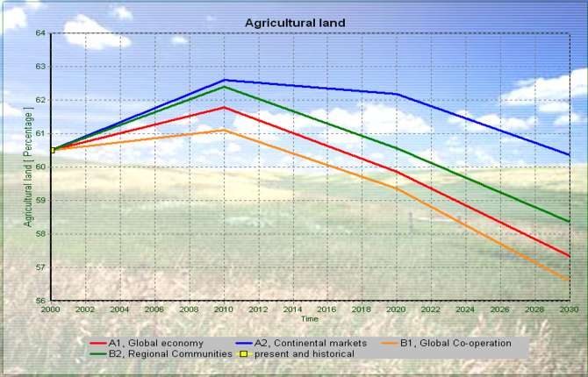
Example Poland
A1 – highest farm income
A1 - decline agri area
But A1 means also:
High food self sufficiency
Lowest biodiversity
Average carbon storage
Highest GDP growth
What about water quality?

Slide 27
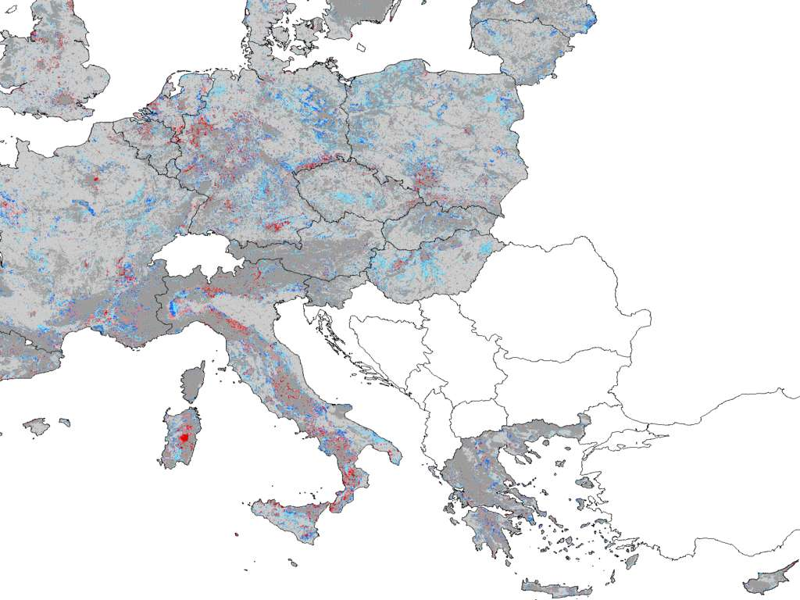
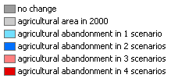

Slide 28
Trade off’s between indicators
Scenario
GDP
…
Carbon sequestration
…
Bio diversity agro
Policy
Farm income
Bio diversity nature

Slide 29
Socio-economic indicators
Now: country level
Downscaling to nuts 2 level
How?
  Socio & biophysical criteria
Future: regional economic models?
Preferably more than just agriculture….

Slide 30
Planet indicators
Land use & land use change
Carbon sequestration
Erosion
Biodiversity in nature
Finetuning the current approach

Slide 31
Planet indicators
Livestock intensities
  Downscaling livestock information per country;
  5 animal types
  Different downscaling per scenario
    Current situation
    Environment
    Spatial spread versus concentration
    Land based versus barn systems
  Different spatial pattern per scenario
Nitrogen output
  Link with previous indicator
  In close cooperation with nitro Europe project
  Nitrogen loss and NH3 emissions

Slide 32
Planet indicators
Landscape pressure
  Danger of loss of landscape quality
  Inputs: Landuse Management factor (upscale/intensification)
Biodiversity connected to agriculture
  Inputs: Landuse / climate / environmental pressure
  & intensity of farming
  - now only per nuts area
  More precise by using HNV farmland? Data?

