Slide 1

EURURALIS
Discussing the future of European rural areas
Mainz 17 March 2006
Willem Rienks
Alterra Wageningen UR

Slide 2
Goals of Eururalis
possible developments of EU rural areas
Impact of policy options on PPP
European focus - global context
Spatially explicit – 2030
strategic discussion

Slide 3
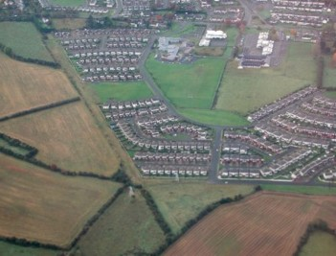
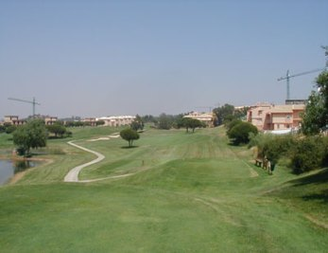
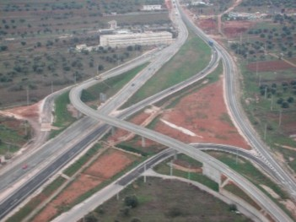
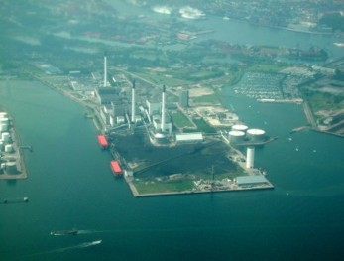
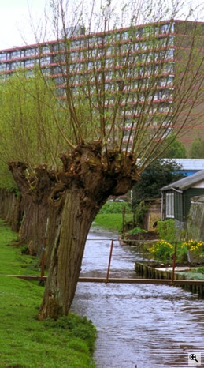
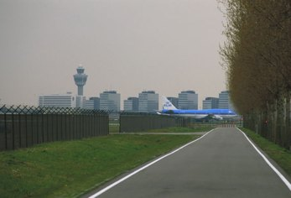
Urbanization
Residential
Industrial
Infrastructure
Recreation

Slide 4
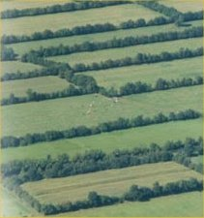
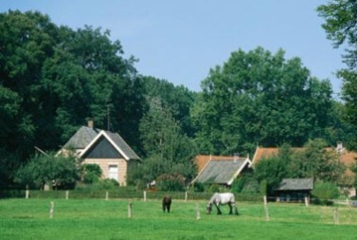
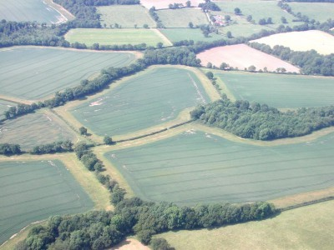
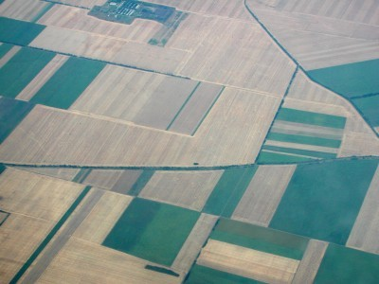
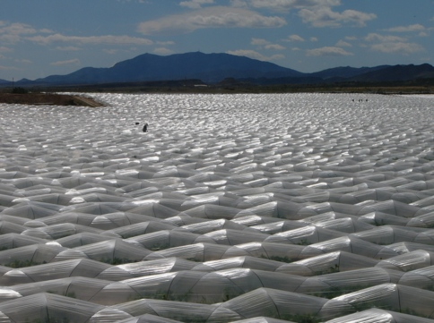
Intensification of agriculture
Management and scale

Slide 5
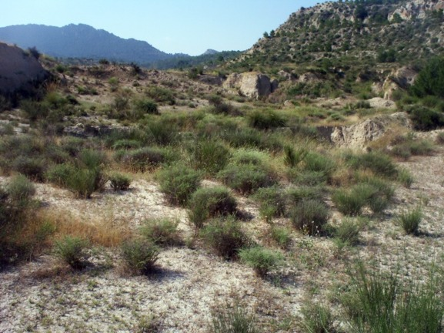
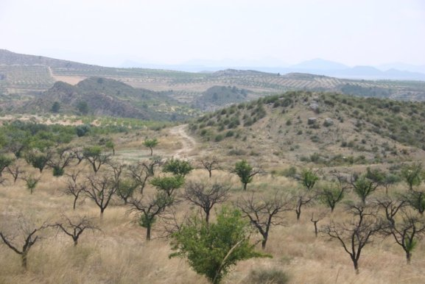
Land abandonment
Regrowth of natural vegetation
Degradation
Extensive land uses (hobby farming)

Slide 6
Why a scenario approach ?
Address the complexity and uncertainty of future developments from now to 2030, like:
  demography, economic growth, oil prices
  the future of the CAP & WTO;
Look 30 years back: EU-10, divided Europe, no quota, no nature conservation policy, no Euro etc
No agreement on policies after 2013
  CAP after 2013?
  Rural & regional policies after 2013 ?
  Size of EU 27? 28? 35?
Scenarios do not lead necessarily lead to a “desired” situation

Slide 7
Explorative scenarios
Based on continuous development from present to future
Built on driving forces, like:
Major uncertainties
  Globalisation versus regionalisation
  High versus low governmental regulation
Macro-economic development
Demography

Slide 8
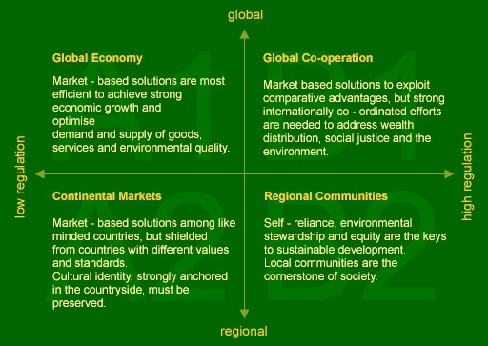
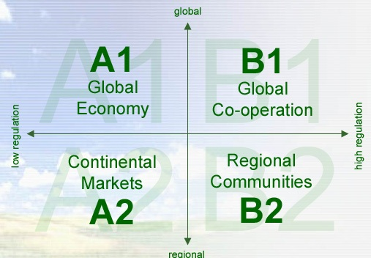

Slide 9
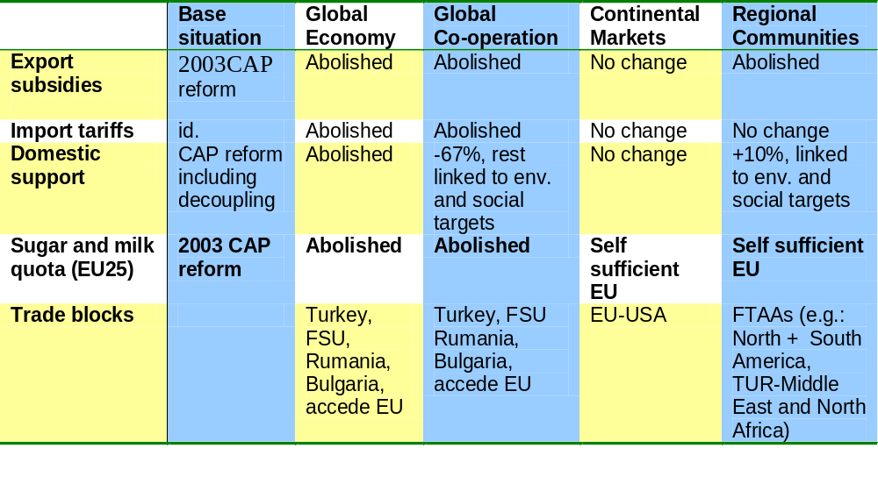
Policy assumptions

Slide 10
Agriculture A1 – global economy
Free trade; no subsidies – world market oriented
High economic growth
Strong upscale agriculture; high tech & innovative
Few but large farms
Modernisation of the landscape
Strong urbanisation
Increase of land prices
Division between land use and land ownership
New investors (estates)

Slide 11
Agricult. A2 – transatlantic market continental markets
Free trade only in transatlantic market; still subsidies
Specialisation & bulk production
Peri urban areas with service farming
Uniform landscape
Increase of land prices
Division between land use and land ownership
New investors (estates)

Slide 12
Agricult. B1 – strong Europe global cooperation
Market based but with government interference
Cross complience offer new possibilities – pluriform agriculture
Active landscape policy
Division of rural and urban land markets
Stable land prices in rural areas
Active government

Slide 13
Agricult. B2 – regional communities
Aimed at self sufficiency
Diversification of agriculture
Division of rural and urban land markets
Decreasing land prices in rural areas
Active government; but budget problems
Marginalizing landscapes

Slide 14
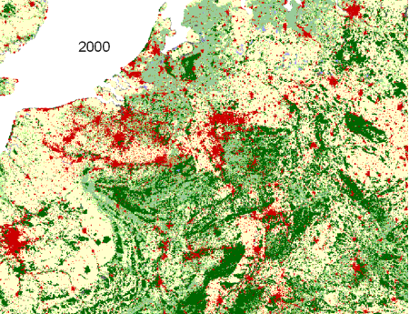

A1: Global Economy
B2: Regional Communities
Land use dynamics differ by scenario:
Quantity of change
Spatial pattern of change

Slide 15
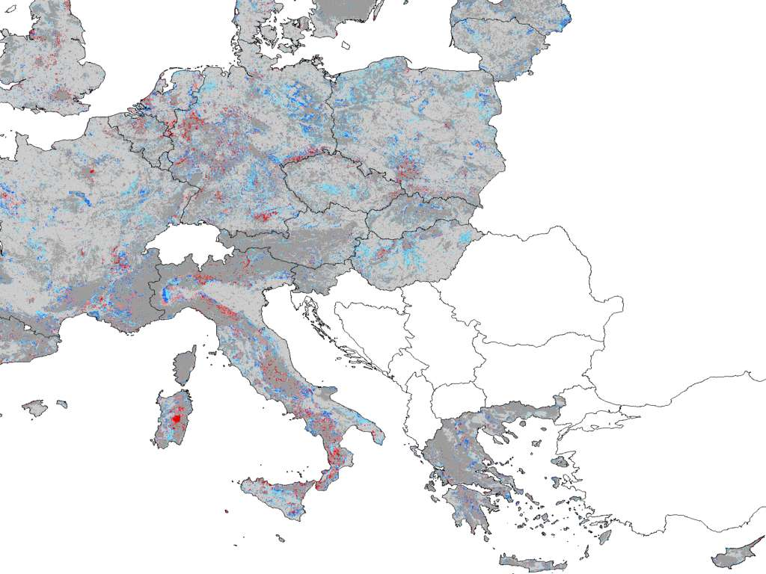
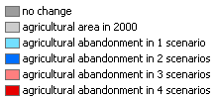

Slide 16
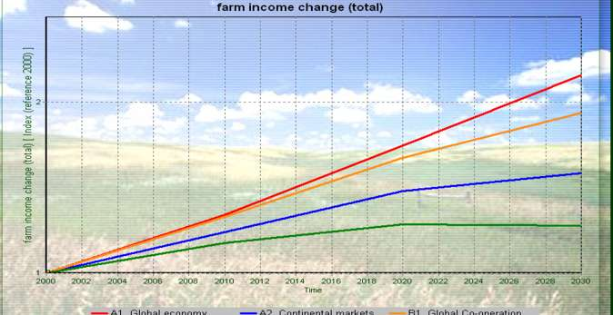
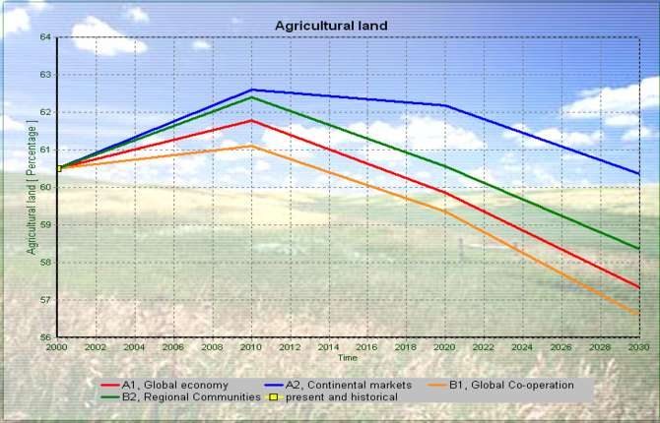
Example Poland
A1 – highest farm income
A1 - decline agri area
But A1 means also:
High food self sufficiency
Lowest biodiversity
Average carbon storage
Highest GDP growth

Slide 17
Conclusions
Rural population is ageing and shrinking in all scenarios
Agriculture remains strong in all scenarios
land to spare in most scenarios (max 10%):
biofuels; biodiversity?
Influence of trade liberalization on European land use is not be exaggerated
Insight in the trade off’s – eg higher farm income versus lower biodiversity or lower self sufficiency
There are not only threats but also chances…
There is something to choose for….

