Slide 1

EURURALIS 1.0 -> 2.0
Cracow 30 november 2005
Willem Rienks
Alterra Wageningen UR

Slide 2
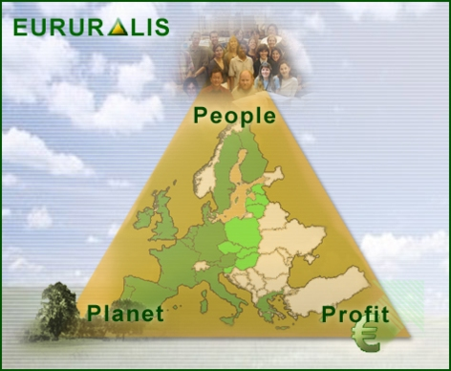
Contents
EURURALIS 1.0 results
EURURALIS 2.0 dummy
What’s in it for you

Slide 3
Goals of Eururalis
possible developments of EU rural areas
Impact of policy options on PPP
European focus - global context
Spatially explicit – 2030
strategic discussion

Slide 4
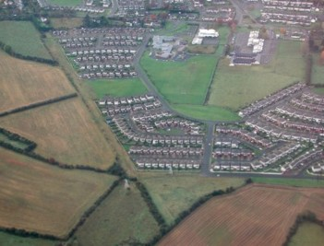
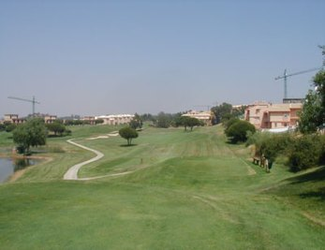
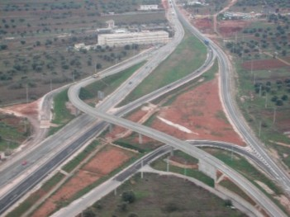
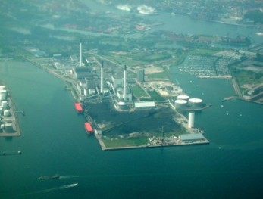
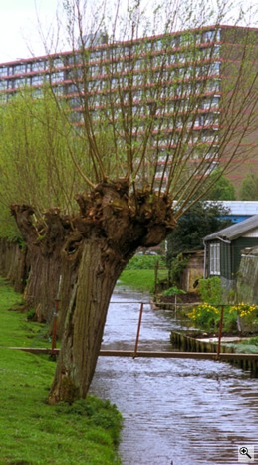
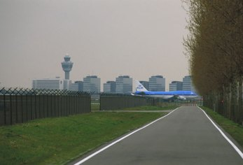
Urbanization
Residential
Industrial
Infrastructure
Recreation

Slide 5
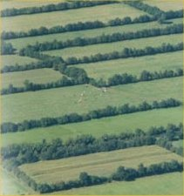
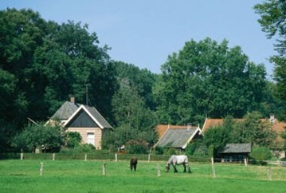
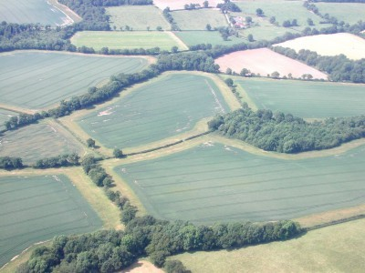
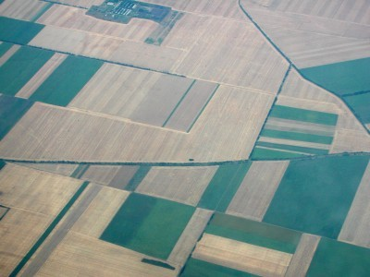
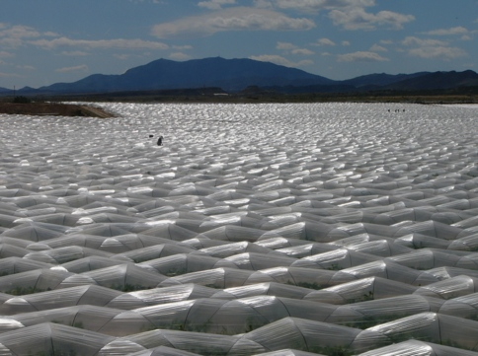
Intensification of agriculture
Management and scale

Slide 6
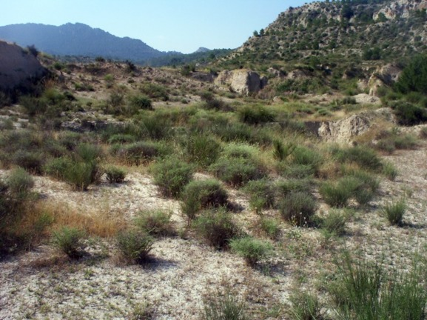
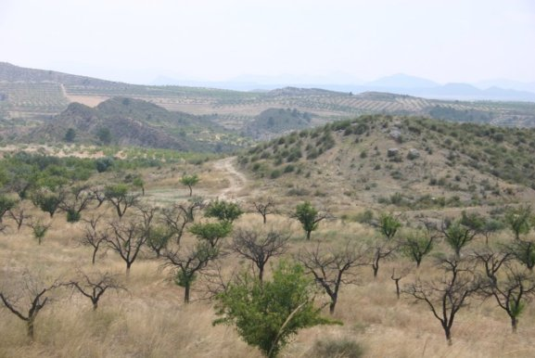
Land abandonment
Regrowth of natural vegetation
Degradation
Extensive land uses (hobby farming)

Slide 7
Why a scenario approach ?
Address the complexity and uncertainty of future developments from now to 2030, like:
  demography, economic growth, oil prices
  the future of the CAP & WTO;
Look 30 years back: EU-10, divided Europe, no quota, no nature conservation policy, no Euro etc
No agreement on policies after 2013
  CAP after 2013?
  Rural & regional policies after 2013 ?
  Size of EU 27? 28? 35?
Scenarios do not lead necessarily lead to a “desired” situation

Slide 8
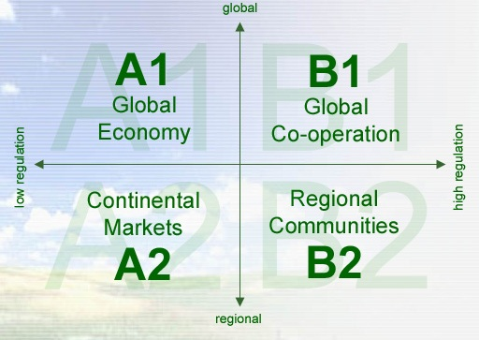

Slide 9
Overview driving forces
Climate
Population
Income
Trade
Production / yield
CAP policy

Slide 10
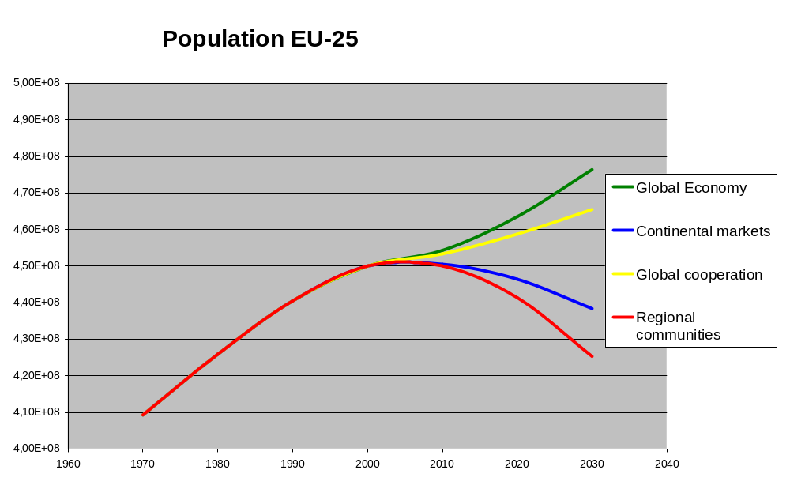
Drivers

Slide 11
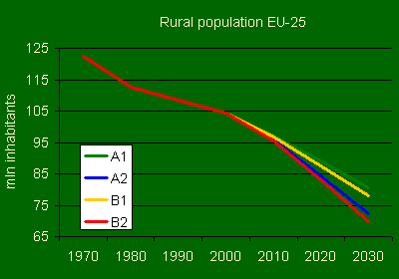
Drivers

Slide 12
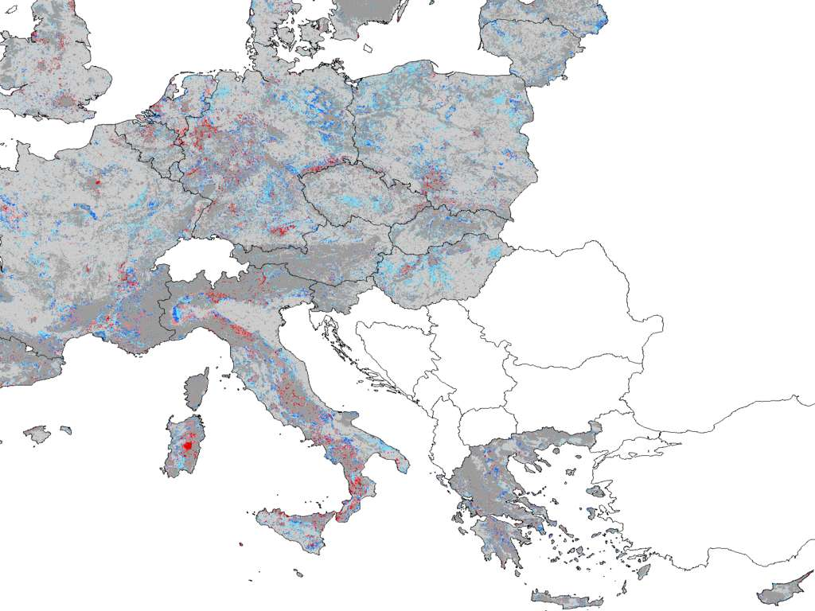
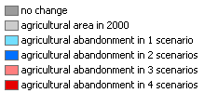

Slide 13
Conclusions
Rural population is ageing and shrinking
Agriculture remains strong in all scenarios
land to spare in most scenarios :
biofuels; biodiversity?
Rural transitions require support
Climate change asks for adaptive strategies

Slide 14
Whats next: Eururalis 2.0
Preserve strong points
  Strategic discussion tool for future rural Europe
  Common Language
Extensions
  Policy options – interactive altering of policy
  Transparancy – why is what happening
  Information on regional level

Slide 15
Glimpse of Eururalis 2.0

Slide 16
EURURALIS 2.0 prototype
1 Intro 2 past 3 scenario 4 drivers 5 general policy 6 rural policy 7 landuse change 8 indicators 9 integration 10 conclusions
Scenario A1 scenario A2 scenario B1 scenario B2 ……….
Choose scenario
Adjust policy
Effect indicators
Agro employment
Rural employment
Self-sufficiency
CO2 storage
N-use per ha
Air pollution
Water quality
Biodiversity
Landscape
Farm Income
Farm size
Expenses
Means indicators
Available land
Inputs
Water
Landuse change
governance philosophy
A1: Global Economy
value: competetiveness
market regulation
B1: Global Co-operation
value: global solidarity
government rules/regulations
narrative
narrative
A2: Continental Market
value: security
legal liability
B2: Regional communities
value: local responsibility
behavioural change
narrative
narrative

Slide 17
EURURALIS 2.0 prototype
1 Intro 2 past 3 scenario 4 drivers 5 general policy 6 rural policy 7 landuse change 8 indicators 9 integration 10 conclusions
Scenario A1 scenario A2 scenario B1 scenario B2 ……….
Choose scenario
Adjust policy
Effect indicators
Agro employment
Rural employment
Self-sufficiency
CO2 storage
N-use per ha
Air pollution
Water quality
Biodiversity
Landscape
Farm Income
Farm size
Expenses
Means indicators
Available land
Inputs
Water
Landuse change
50 bill. Euro 1st pillar
Continuation quota
Continuation tariff
25 bill. Euro 1st pillar
No quota
Lower tariff walls
0 bill. Euro
No quota
No tariff wall
CAP
info
80% GEP
50% GEP
20% GEP
WFD
info
30% biofuels
10 % reduction CO2
20% biofuels
5 % reduction CO2
10% biofuels
0 % reduction CO2
Energy
info
50% LFA
Services payments
25% LFA
0% LFA
RDP
info

Slide 18
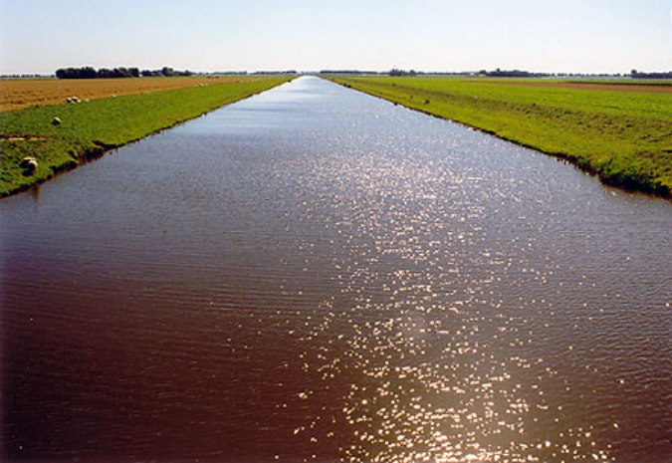
EURURALIS 2.0 prototype
1 Intro 2 past 3 scenario 4 drivers 5 general policy 6 rural policy 7 landuse change 8 indicators 9 integration 10 conclusions
Scenario A1 scenario A2 scenario B1 scenario B2 ……….
Choose scenario
Adjust policy
Effect indicators
Agro employment
Rural employment
Self-sufficiency
CO2 storage
N-use per ha
Air pollution
Water quality
Biodiversity
Landscape
Farm Income
Farm size
Expenses
Means indicators
Available land
Inputs
Water
Landuse change
Information
Water Framework directive
Clean Water for Europe
80% GEP
50% GEP
20% GEP
WFD
GEP = Good Ecological Potential
Designated Areas
100 kg N/ha or less
Normal farming areas
170 kg N/ha or less
back

Slide 19
EURURALIS 2.0 prototype
1 Intro 2 past 3 scenario 4 drivers 5 general policy 6 rural policy 7 landuse change 8 indicators 9 integration 10 conclusions
Scenario A1 scenario A2 scenario B1 scenario B2 ……….
Choose scenario
Adjust policy
Effect indicators
Agro employment
Rural employment
Self-sufficiency
CO2 storage
N-use per ha
Air pollution
Water quality
Biodiversity
Landscape
Farm Income
Farm size
Expenses
Means indicators
Available land
Inputs
Water
Landuse change
50 bill. Euro 1st pillar
Continuation quota
Continuation tariff
25 bill. Euro 1st pillar
No quota
Lower tariff walls
0 bill. Euro
No quota
No tariff wall
CAP
info
80% GEP
50% GEP
20% GEP
WFD
info
30% biofuels
10 % reduction CO2
20% biofuels
5 % reduction CO2
10% biofuels
0 % reduction CO2
Energy
info
50% LFA
Services payments
25% LFA
0% LFA
Okay
RDP
info

Slide 20
EURURALIS 2.0 prototype
1 Intro 2 past 3 scenario 4 drivers 5 general policy 6 rural policy 7 landuse change 8 indicators 9 integration 10 conclusions
Scenario A1 scenario A2 scenario B1 scenario B2 ……….
Choose scenario
Adjust policy
Impact indicators
PEOPLE
Agro employment
Rural employment
Self-sufficiency
PLANET
CO2 storage
N-use per ha
Water quality
Biodiversity
Landscape
PROFIT
Farm Income
Farm size
Expenses
Means indicators
Available land
Inputs
Water
Landuse change
Agro employment
Biodiversity
0 Target: 5% 30
0 Target: 100 120
Rural employment
Landscape div.
0 Target: 7% 40
0 Target: 100 120
Self sufficiency
Farm income
0 Target: 100% 200
0 Target: 30.000 euro 100.000 euro
CO2 storage
Farm size
0 Target: 30
0 Target: 40 ha 1000 ha
Nitrogen use
EU expenses
0 Target: 170 kg / ha 300
0 50 bill euro 100 bill. euro
Current level
A1 level
A1* + policy
level
Adjust
target
Water quality
0 Target: 50 mg N/l 100

Slide 21
EURURALIS 2.0 prototype
1 Intro 2 past 3 scenario 4 drivers 5 general policy 6 rural policy 7 landuse change 8 indicators 9 integration 10 conclusions
Scenario A1 scenario A2 scenario B1 scenario B2 ……….
Choose scenario
Adjust policy
Effect indicators
Agro employment
Rural employment
Self-sufficiency
CO2 storage
N-use per ha
Water quality
Biodiversity
Landscape
Farm Income
Farm size
Expenses
Means indicators
Available land
Inputs
Water
Landuse change
Nitrogen use
0 Target: 170 kg / ha 300
210
170
A1
Target
A1 + policy
Maps
Compare other scenarios
2000 2010 2020 2030

Slide 22
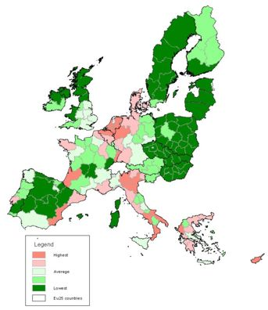
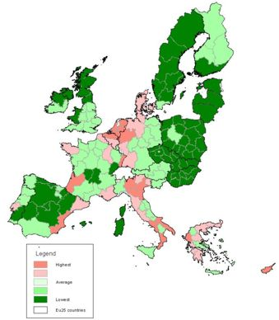
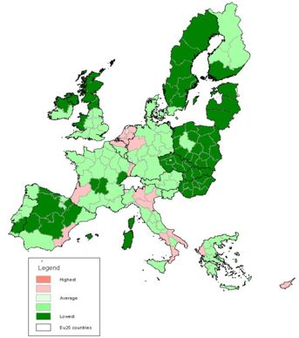
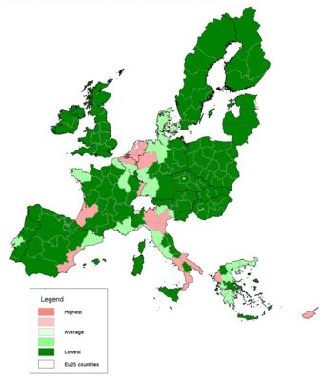
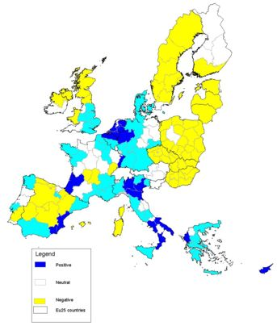
EURURALIS 2.0 prototype
1 Intro 2 past 3 scenario 4 drivers 5 general policy 6 rural policy 7 landuse change 8 indicators 9 integration 10 conclusions
Scenario A1 scenario A2 scenario B1 scenario B2 ……….
Choose scenario
Adjust policy
Effect indicators
Agro employment
Rural employment
Self-sufficiency
CO2 storage
N-use per ha
Water quality
Biodiversity
Landscape
Farm Income
Farm size
Expenses
Means indicators
Available land
Inputs
Water
Landuse change
N use per ha
Policy effect
2030
2020
2000
2010
Λ 2000-2030
STATE
Effect of policy options on Nitrogen use per ha. In the green areas the target is reached; in the red areas the target is not reached.
COMPARISON
The blue areas there is a positive policy effect. In the yellow and white areas there is no policy effect.
back

Slide 23
EURURALIS 2.0 prototype
1 Intro 2 past 3 scenario 4 drivers 5 general policy 6 rural policy 7 landuse change 8 indicators 9 integration 10 conclusions
Scenario A1 scenario A2 scenario B1 scenario B2 ……….
Choose scenario
Need for rural policy
Opportunities axis 1
Livestock farming
High value crops
Opportunities axis 2
Improve water quality
Opportunities axis 3
Tourism
Diversification
Regional SWOT
Choose region
Highlights SWOT
Rural policies:
Regional strengths and weaknesses

Slide 24
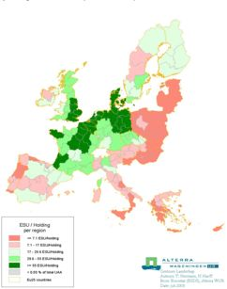
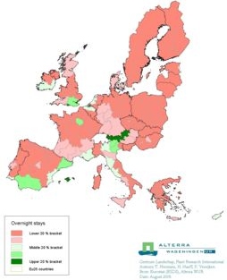
EURURALIS 2.0 prototype
1 Intro 2 past 3 scenario 4 drivers 5 general policy 6 rural policy 7 landuse change 8 indicators 9 integration 10 conclusions
Scenario A1 scenario A2 scenario B1 scenario B2 ……….
Choose scenario
Need for rural policy
Opportunities axis 1
Livestock farming
High value crops
Opportunities axis 2
Improve water quality
Opportunities axis 3
Tourism
Diversification
Regional SWOT
Choose region
Highlights SWOT
Axis 3
diversification
Map with animation
Over time
Bv Tourist beds/km2
Axis 1 – competitiveness
GVA / holding 2000
Axis 2 – environment
N per ha in 2030
Axis 3 – diversification
Overnight stays 2000
Potential axis 1
Potential axis 2
Potential axis 3
This sheet gives an indication of the
need for rural development policy in
The EU over time.

Slide 25
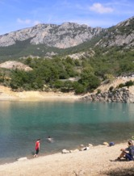
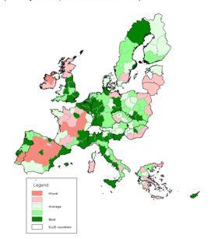
EURURALIS 2.0 prototype
1 Intro 2 past 3 scenario 4 drivers 5 general policy 6 rural policy 7 landuse change 8 indicators 9 integration 10 conclusions
Scenario A1 scenario A2 scenario B1 scenario B2 ……….
Choose scenario
Need for rural policy
Opportunities axis 1
Livestock farming
High value crops
Opportunities axis 2
Improve water quality
Opportunities axis 3
Tourism
Diversification
Regional SWOT
Choose region
Highlights SWOT
Actual tourism 2000
Potential tourism 2030
Tourism
The maps show a huge unused potential for tourism In 2030. Especially in regions with a nice landscape and nature close to urban areas the potential is there. Investments in infrastructure, accommodation, marketing, landscape and nature quality could make this potential come true.
On the other hand there are regions where the actual tourism will decline due to for instance climate change (less snow in winter) or deterioration of the
landscape.

Slide 26
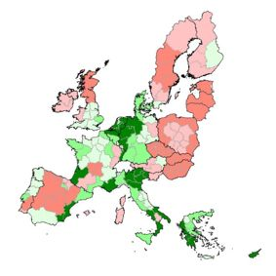
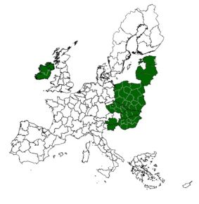
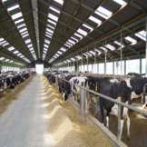
EURURALIS 2.0 prototype
1 Intro 2 past 3 scenario 4 drivers 5 general policy 6 rural policy 7 landuse change 8 indicators 9 integration 10 conclusions
Scenario A1 scenario A2 scenario B1 scenario B2 ……….
Choose scenario
Need for rural policy
Opportunities axis 1
Livestock farming
High value crops
Opportunities axis 2
Improve water quality
Opportunities axis 3
Tourism
Diversification
Regional SWOT
Choose region
Highlights SWOT
Current Livestock density
New livestock regions?
Increase livestock
The worldwide demand for livestock will increase rapidly the next decades. This gives new opportunities to regions with low livestock density. Especially in combination with arable farming this could lead to competitive production for the world market. Of course the environmental laws must be taken into account.
The regions with potential for increase in livestock should invest in infrastructure, training of farmers, farm loans, etc.

Slide 27
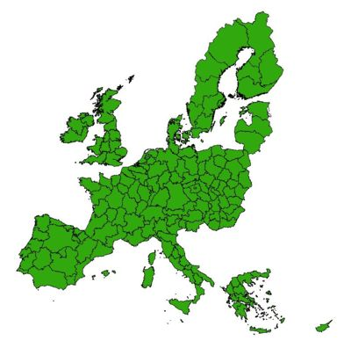
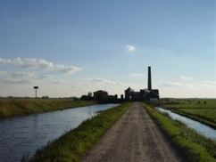
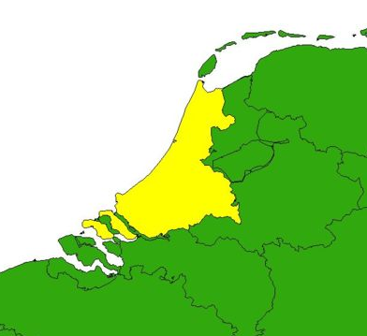
EURURALIS 2.0 prototype
1 Intro 2 past 3 scenario 4 drivers 5 general policy 6 rural policy 7 landuse change 8 indicators 9 integration 10 conclusions
Scenario A1 scenario A2 scenario B1 scenario B2 ……….
Choose scenario
Need for rural policy
Opportunities axis 1
Livestock farming
High value crops
Opportunities axis 2
Improve water quality
Opportunities axis 3
Tourism
Diversification
Regional SWOT
Choose region
Highlights SWOT
Choose a region by clicking with your mouse on the map.
Nederland West
6.4 mln inhabitants
Area 0.8 mln ha
Peri urban region

Slide 28
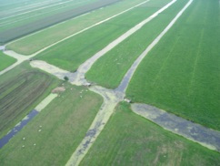
EURURALIS 2.0 prototype
1 Intro 2 past 3 scenario 4 drivers 5 general policy 6 rural policy 7 landuse change 8 indicators 9 integration 10 conclusions
Scenario A1 scenario A2 scenario B1 scenario B2 ……….
Choose scenario
Need for rural policy
Opportunities axis 1
Livestock farming
High value crops
Opportunities axis 2
Improve water quality
Opportunities axis 3
Tourism
Diversification
Regional SWOT
Choose region
Highlights SWOT
Nederland West
6.4 mln inhabitants
Area 0.8 mln ha
Peri urban region
Opportunities
Tourism & recreation
High value crop farming
Threats
Landscape & nature deterioration
Water quality
Urbanisation
Climate change

Slide 29
What is in it for you:
Common language for strategic discussion
Adjust policy options interactively
Insight in autonomous developments
Insight in effectiveness of options
Insight in interactions / trade-offs
Find regions with the same problems

Slide 30
join the discussion: learning by doing!

