Slide 1
EURURALIS I: THE IMPACT OF DIFFERENT POLICY ENVIRONMENTS ON LAND USE IN EUROPE
H. van Meijl, T. van Rheenen, A. Tabeau, B. Eickhout*
Agricultural Economics Research Institute, Wageningen-UR, LEI
* Netherlands Environmental Assessment Agency (MNP-RIVM)

Slide 2
Contents
Part of EURURALIS
Methodology
Results
Conclusions

Slide 3
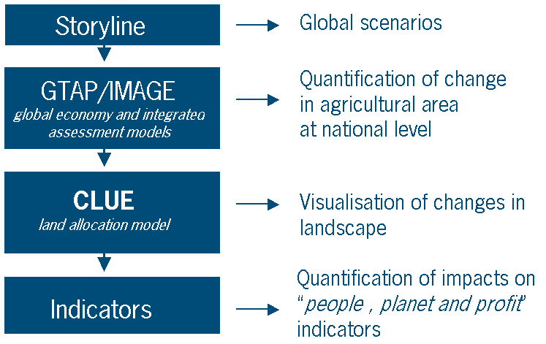
EURURALIS: Future of EU-25 rural area (2030)

Slide 4
Methodology
Economic model with global and economy wide coverage (GTAP)
  Database (baseyear 2001):
    88 regions (including individual EU25)
    57 sectors (14 primary agriculture and 7 food processing)
    input-output data covering intersectoral linkages
    bilateral trade data, transport data, protection data
  Strength:
    global trade (Doha-WTO) and agricultural policies
    structural change (long run)
    factor markets (e.g. labour and land)
  Weakness:
    land-use is a new focus and standard model is not developed to deal with it

Slide 5
Elaborate standard model
  Land allocation structure (PEM from OECD)
  Land supply curve
  Linkage with IMAGE (biophysical model) to improve treatment of yields and feed conversion rates based on feed diet

Slide 6
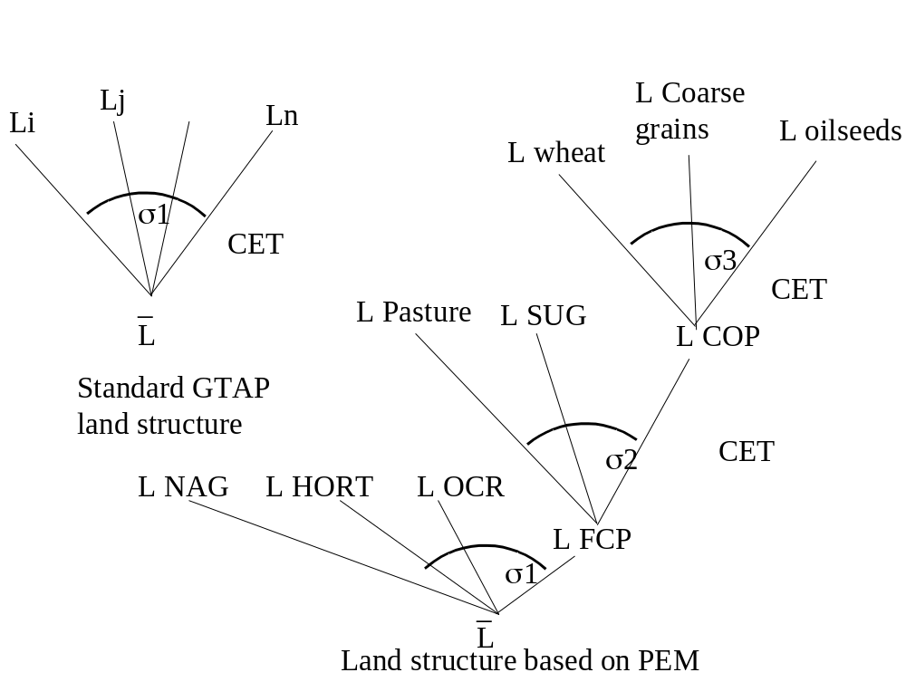
Land allocation based on PEM from OECD

Slide 7
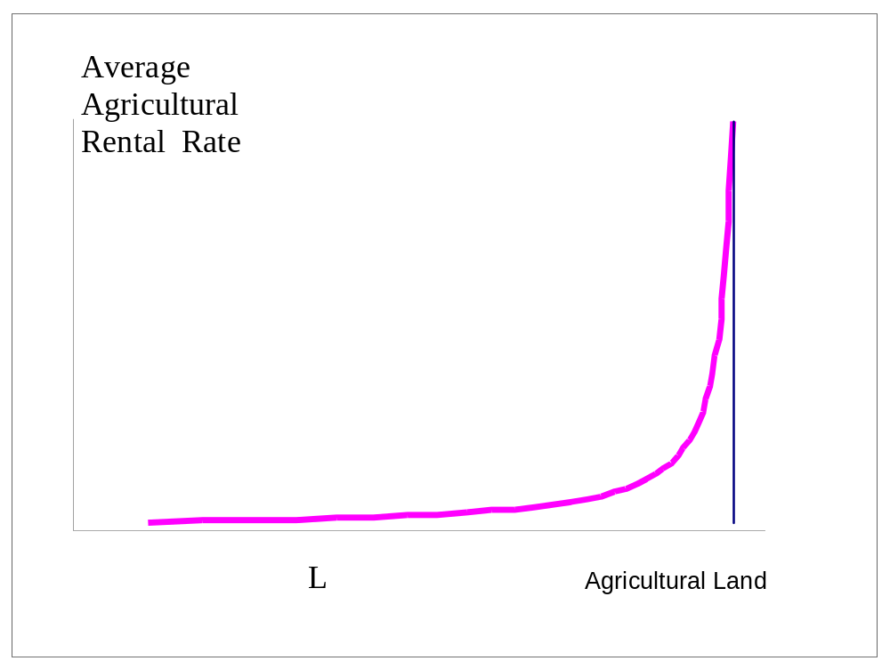
Land supply curve

Slide 8
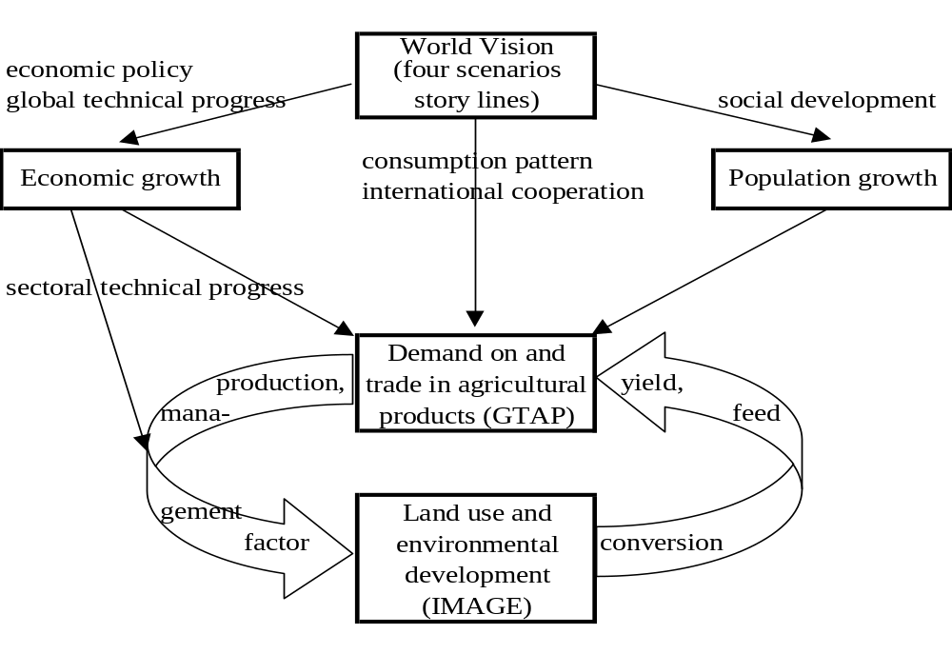
LINKAGE with IMAGE (session 2.5 Eikhout)

Slide 9
Yield
Yield dependent on:
  Trend factor (exogenous)
    FAO (2030 study)
    iteration obtained from IMAGE
      climate change impact
      Land use change
  Management factor: degree of land intensification (endogenous)
    substitution effect: dependent on price of land versus price of other inputs

Slide 10
Aim
Future of EU-25 rural area
Key uncertainties
- Degree of liberalisation (Doha succeeds)
- Economic paradigm or balanced people-planet profit paradigm
Special feature: quantify impact of agricultural policies and macro developments on economic variables: special attention land use

Slide 11
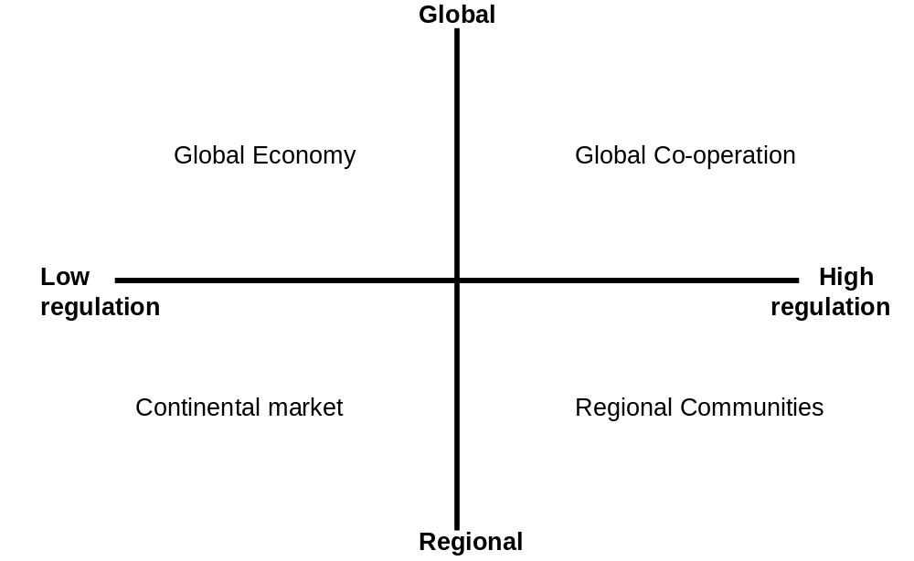
4 EURURALIS scenarios (Westhoek)
Explicit treatment: agricultural domestic support, import tariffs, export subsidies, production quotas and consumer preferences

Slide 12
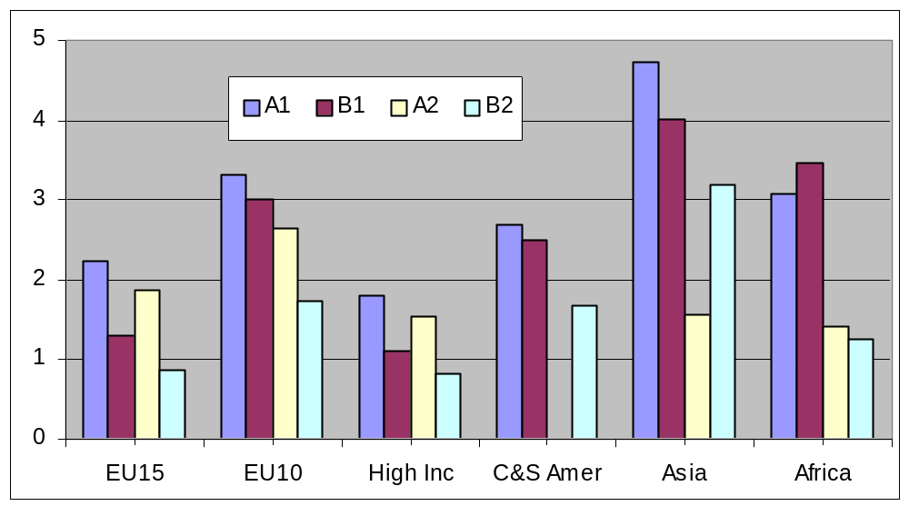
Development GDP per capita 2000-2030

Slide 13
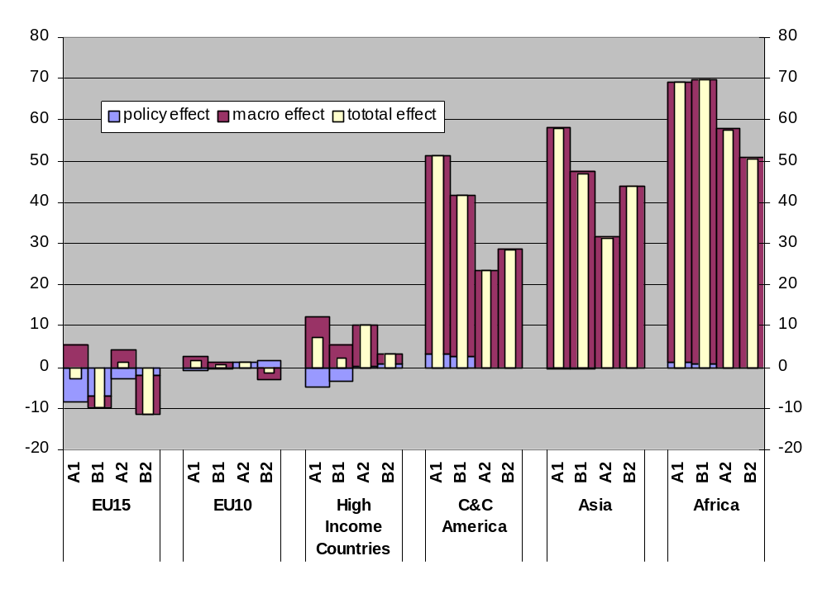
Land use
Neg impact lib limited for EU
extensification
CAP reforms: market to income support

Slide 14
Conclusions
agricultural land use changes in EU 15 are relatively small in all scenarios
negative impact of policy is limited due to extensificaton and shift in the past from market to income support and mitigated by the macro-economic factors such as GDP - population growth
Crops: decline area and intensification, decoupling leads to intensification, reduction border support to extensification
Livestock: increase area by production (A1 and A2), extensification (B1 and B2) reduction\decoupling leads to extensification

Slide 15
To be done
Data: improve land data and include quantitative land data (acres)
Empirical validation of land supply curves (land asymtote)
Include non-ag land in supply curves and land allocation mechanism
Improve feed-pasture relation

Slide 16
© Wageningen UR

Slide 17
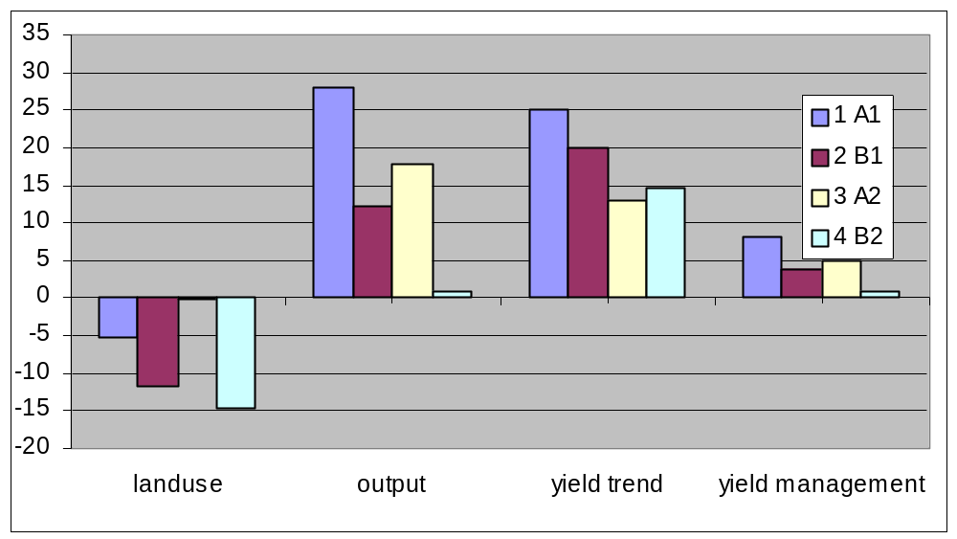
LAND use in EU15: crop area

Slide 18
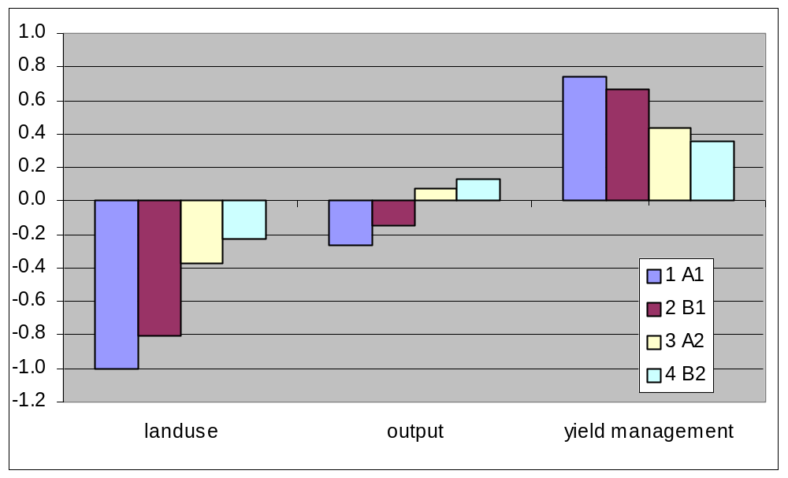
Contribution of domestic policies
Decoupling leads to intensification and reduction area

Slide 19
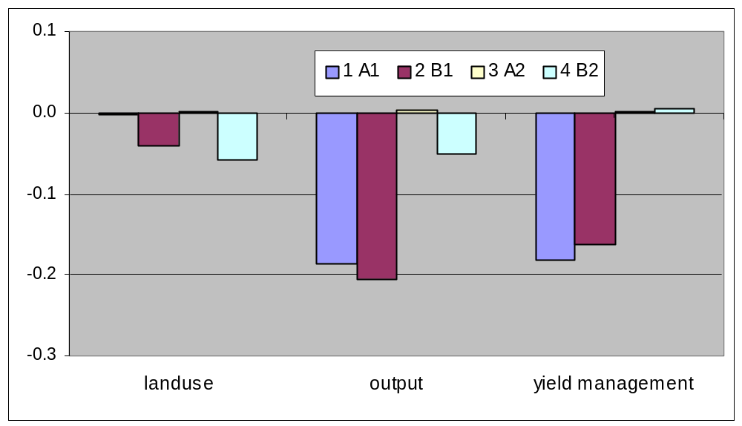
Impact of changes in border policies
Reduction border support leads to intensification instead of abandonment of land

Slide 20
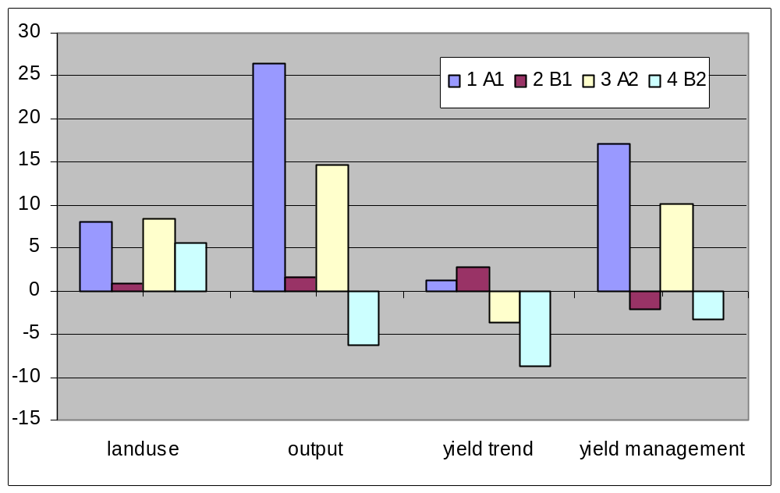
Driving forces of livestock landuse in EU15, 2001-2030 growth

Slide 21
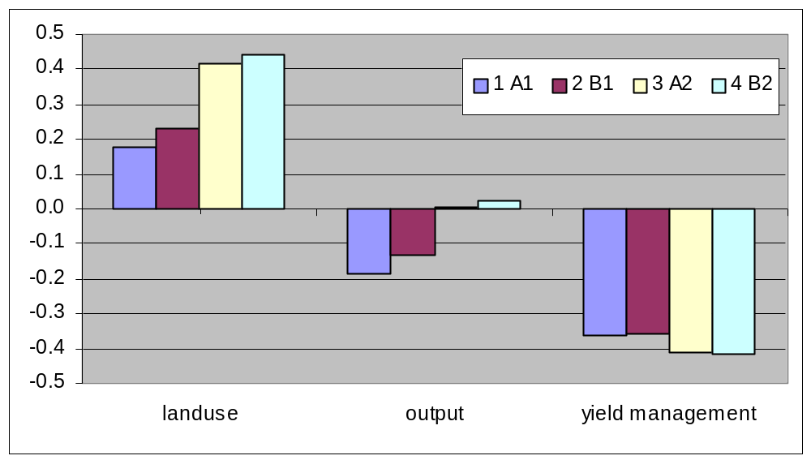
Contribution domestic support (e.g. decoupling)
Livestock: decoupling leads to extensification and increase area

