Slide 1
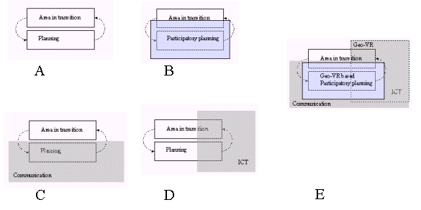
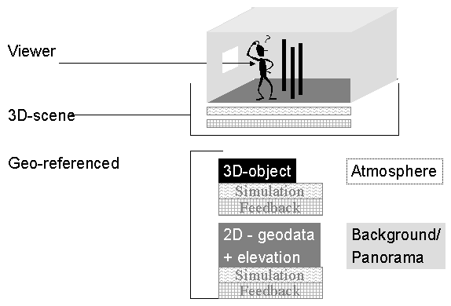

Geo-virtual reality in participatory planning
by Dienst Landelijke Gebieden, Vrije Universiteit Amsterdam and Wageningen Universiteit
Planning by Participation via Geo-VR
A: Spatial Planning: B: Participatory Spatial Planning as an extension of single-actor spatial planning
C: Communication as a base for participatory planning; D: Information Communication Technology (ICT) to describe
the spatial planning subject and to support communication protocols within the participatory planning procedure;
E Geo-Virtual Reality to support participatory planning
Meet in Geo-VR
DOWNLOAD PAPER VIA http://cgi.girs.wageningen-ur.nl/cgi/news/
Contact: dr.ir. Ron van Lammeren
Centre for Geo-Information
Correspondence: Postbus 339, 6700 AH Wageningen, The Netherlands
e-mail: ron.vanlammeren@wur.nl
Web : http://www.geo-informatie.nl

