Slide 1
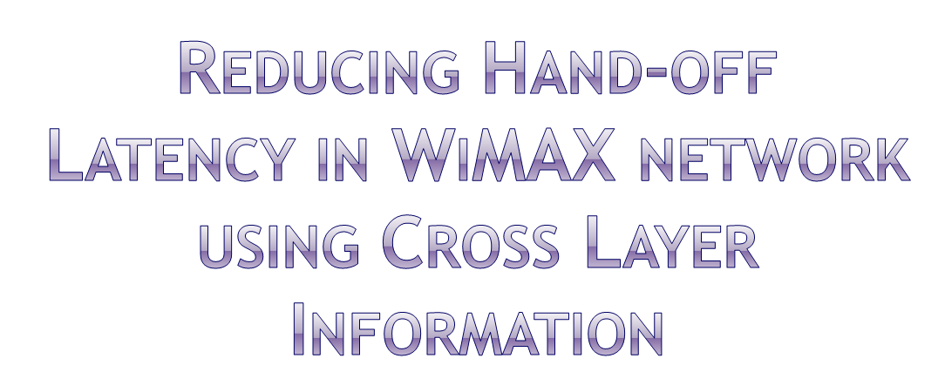
By
Suman Bhunia
School of Mobile Computing & Communication
Jadavpur University
Kolkata-32, India

Slide 2

The IEEE 802.16 (WiMAX) network consists of the access services network (ASN) and connectivity services network (CSN).
The core elements in the ASN are the base station (BS) and ASN gateway (ASN-GW).
In hierarchical architecture, multiple BSs are connected to CSN through ASN-GW facilitating resource management and mobility support in highly efficient manner
WiMAX flat architecture consolidates the functionalities of the ASN-GW and the BS are merged together in a single node which can act as an independent router and these integrated elements are directly connected to the IP core network.
22 June 2010
Suman Bhunia Jadavpur University

Slide 3

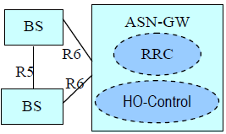
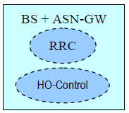
WiMAX Hierarchical network architecture
WiMAX flat network architecture
22 June 2010
Suman Bhunia Jadavpur University

Slide 4

The flat model of WiMAX offers low network latency as number of nodes between SS and IP core network is reduced to one and provides high scalability as there is no centralized bottleneck. It avoids costly and complex inter-node interfaces.
Most significant challenge for flat architecture is hand off latency. Hierarchical network gives fast hand-off through only layer 2 hand-off but flat architecture requires network layer mobility which causes significant delay and thereby affecting real time application.
22 June 2010
Suman Bhunia Jadavpur University

Slide 5

SS
Old BS
Target BS
HA
Data Connection
HO-REQ
RES_REQ
HO_RSP
RES_RSP
L2
Hand-off
HO-CMP
Agent Solicit
L3
Hand-off
Agent Adv
Reg_Req
Reg_Req
Reg_Rep
Reg_Rep
Data Connection
22 June 2010
Suman Bhunia Jadavpur University

Slide 6

In this paper we take the advantages of OPNET Wireless modeler suites (OPNET 15.0.A) particularly the WiMAX platform for our performance study.
We have constructed 3 different scenario to compare the performance. The common attributes are listed below.
Attributes | Values
Base Station Model | wimax_bs_router
Subscriber Station Model | wimax_ss_wkstn
Link model | PPP_DS3
IP Backhaul model | Router_slip64_dc
OFDM PHY Profile | Wireless OFDMA 20 MHz
Application traffic demand | 96Kbps (100 packets/s)
Scheduling type | ertPS
22 June 2010
Suman Bhunia Jadavpur University

Slide 7

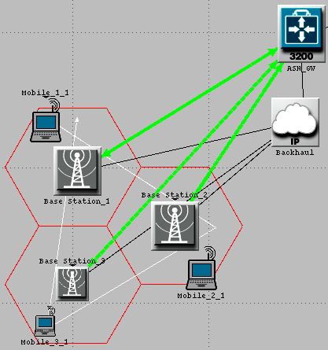
Mobile_1_1 is moving along the trajectory denoted by white line.
3 GRE tunnels (denoted by green lines) are configured among the BSs and the ASN-GW
22 June 2010
Suman Bhunia Jadavpur University

Slide 8

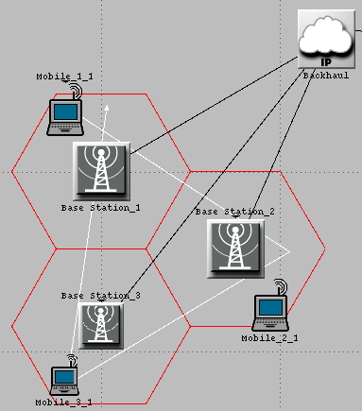
Mobile_1_1 is moving along the trajectory denoted by white line.
Base Station_1 is HA
Base Station_2 & Base Station_3 are configured as FA.
Minimum MIP Agent Advertisement Interval = 5 sec.
22 June 2010
Suman Bhunia Jadavpur University

Slide 9

All network configurations are same as the conventional flat architecture.
WiMAX-MAC and MIP process modules of the wimax_ss_wkstn node model are modified.
We have modified these process :
  wimax_ss_control
  ip_dispatch
  mobile_ip_mgr
  mobile_ip_mn
22 June 2010
Suman Bhunia Jadavpur University

Slide 10

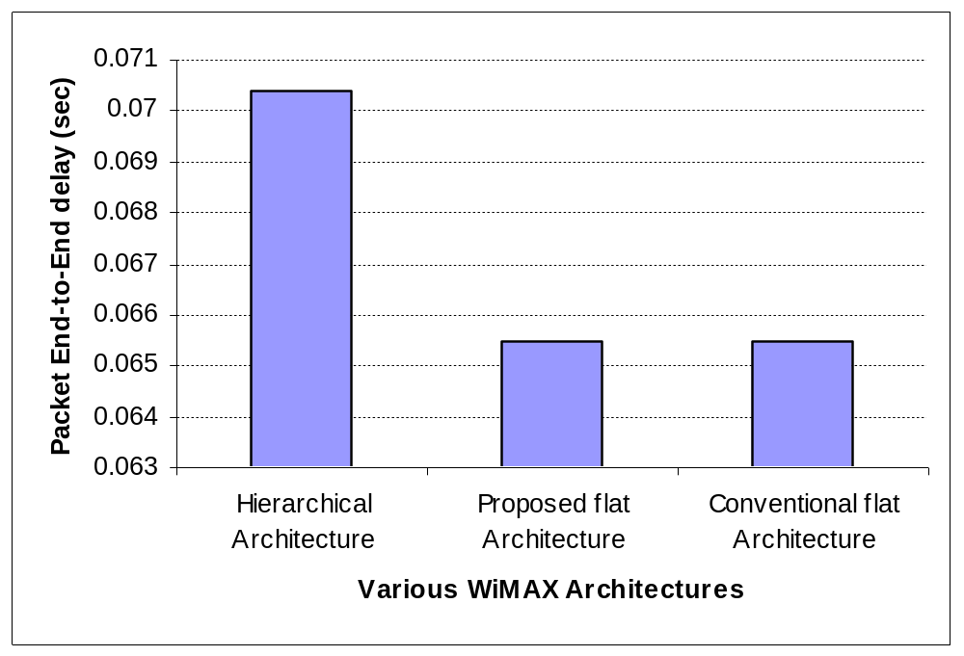
Average packet End-to-End delay comparison
22 June 2010
Suman Bhunia Jadavpur University

Slide 11

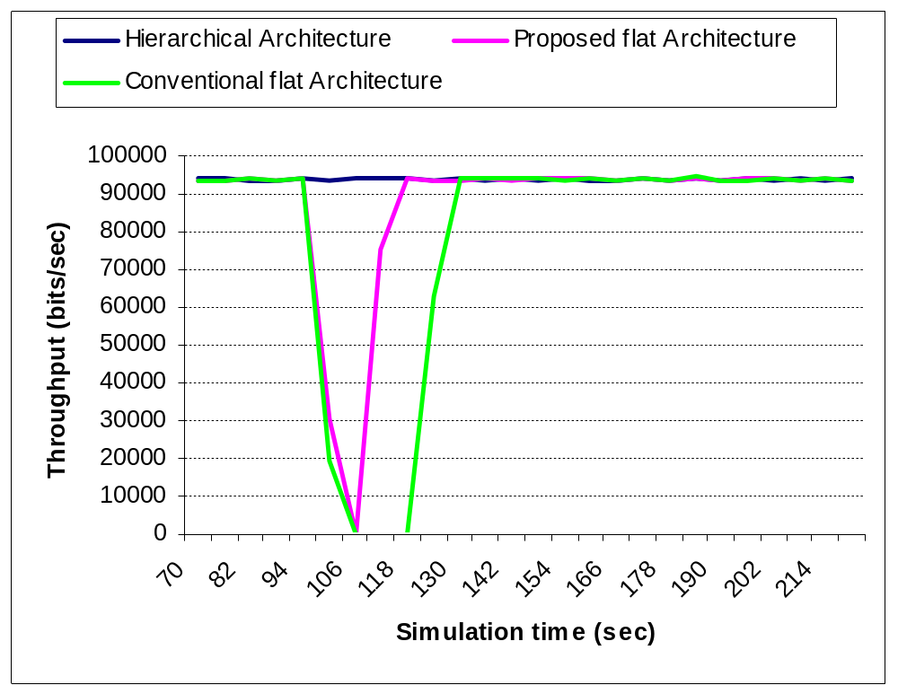
Throughput comparison with respect to simulation time
22 June 2010
Suman Bhunia Jadavpur University

Slide 12
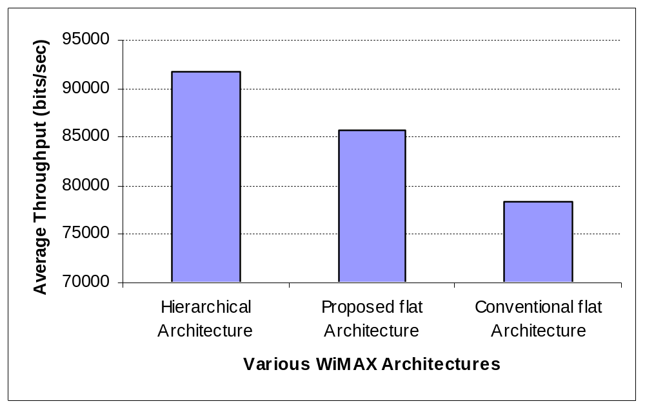
Average throughput omparison
22 June 2010
Suman Bhunia Jadavpur University

Slide 13

Benefits and challenges of flat architecture network model have been discussed.
Flat architecture though advantageous, cost more handoff latency which is very crucial for QoS aware data communication.
The simulation model based on OPNET modeler confirms that our proposed scheme exploits the benefits of hierarchical network with reduced handoff delay maintaining the less signal overhead and end-to-end delay features of flat network without any network overhead.
22 June 2010
Suman Bhunia Jadavpur University

Slide 14

Proper design can be made to minimize hand-off latency by guessing the next target BS and sending the control signal accordingly to the currently attached BS.
Hand-off management can be scaled using hierarchical mobile-IP.
In designing the backhaul network, advantages of MPLS can be incorporated by proper design of MIP-MPLS integrated network.
22 June 2010
Suman Bhunia Jadavpur University

Slide 15
IEEE 802.16e, “Air Interface for Fixed and Mobile Broadband Wireless Access Systems,” 2005.
Kamran Etemad, “Overview of Mobile WiMAX technology and Evolution” , IEEE Communication Magazine, October 2008.
Subir Das, Archan Misra, Prathima Agrawal and Sajal K. Das, “TeleMIP: Telecommunication Enhanced Mobile IP Architecture for Fast Intradomain Mobility.”, IEEE Personal Communication Magazine, August 2000.
Rose Qingyang Hu, David Paranchych, Mo-Han Fong, and Geng Wu, “On the Evolution of Handoff Management and Network Architecture in WiMAX”, IEEE Xplore.
OPNET Modeler,Release 15.0 Product Documentation, Chapter WiMAX (802.16e)
Semin Sim and Seung-Jae Han, “Seamless IP Mobility Support for Flat Architecture Mobile WiMAX Networks”, IEEE Communication Magazine, June 2009.
C. Perkins, “IP Mobility Support for IPv4”, IETF RFC 3344.
Bo Li, Yang Qin, Chor Ping Low and Choon Lim Gwee, Republic Polytechnic “A Survey on Mobile WiMAX”, IEEE Communication Magazine, December 2007.
22 June 2010
Suman Bhunia Jadavpur University

Slide 16


Contact Details:
Suman Bhunia
School of Mobile Computing & Communication
Jadavpur University
Kolkata-700032
sumanbhunia@gmail.com
sumanbhunia@ieee.org
22 June 2010
Suman Bhunia Jadavpur University

Slide 17
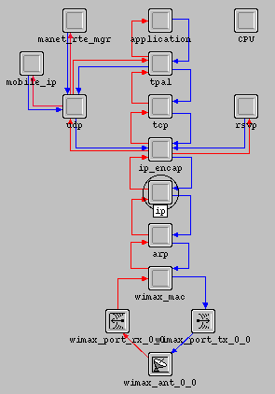
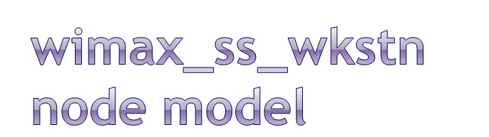
wimax_mac module is aware of layer 2 hand-off.
In this module an interrupt has been configured.
This will cause an interrupt to trigger the ip module to initiate the agent solicitation message.
22 June 2010
Suman Bhunia Jadavpur University

Slide 18

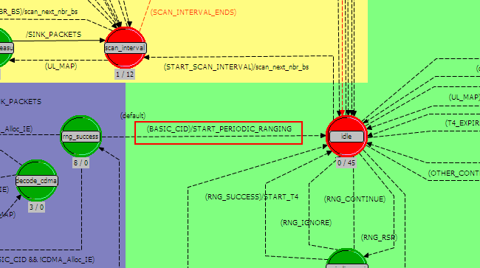
22 June 2010
Suman Bhunia Jadavpur University

Slide 19

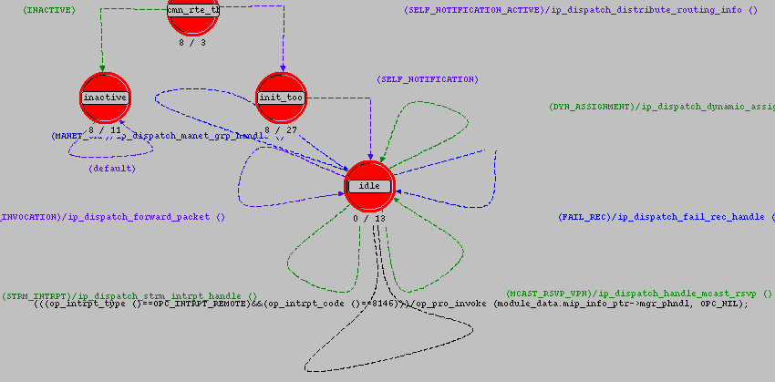
New Transaction for Agent solicitation
22 June 2010
Suman Bhunia Jadavpur University

Slide 20

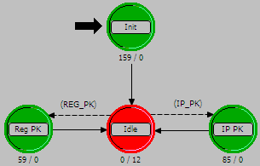
22 June 2010
Suman Bhunia Jadavpur University

Slide 21
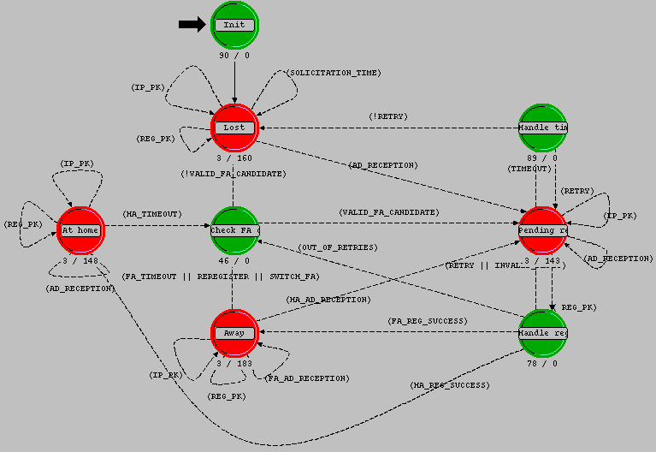
Schedule the code here
22 June 2010
Suman Bhunia Jadavpur University

