Slide 1
Study of OPNET and performance evaluation of WiMAX network under various path loss and terrain conditions in OPNET
Anindita Kundu
Suman Bhunia
School of Mobile Computing and Communication
Jadavpur University, Kolkata -32

Slide 2
overview
Introduction
Path Loss and Path loss models
OPNET
Network Setup
Results
Conclusion

Slide 3
Introduction
WiMAX network is chosen for simulation as it promises to deliver high speed broadband internet connectivity for mobile users with high coverage area.
VoIP is expected to be the communication medium of the next generation and FTP is one of the most popular data transfer application.
OPNET is expected to provide us with comprehensive development environment and provide real life environment.
Our target is to verify the performance of the path loss models over a WiMAX network using a real time simulator, OPNET.

Slide 4
What is Path Loss?
Path loss is the reduction in power density or attenuation of an electro magnetic wave as it propagates through space.
Path loss may be due to many effects like free space path loss, refraction, diffraction, reflection and absorption.
Path loss is also influenced by terrain contours, environment (urban or rural), propagation medium (dry or moist air), distance between transmitter and receiver, and height and location of antennas.

Slide 5
Path Loss Models
Free Space – no or very little obstruction
Suburban Fixed
  Terrain Type A – hilly terrain with moderate to high tree density.
  Terrain Type B – mostly flat terrain with moderate to heavy tree density or a hilly terrain with light tree density.
  Terrain Type C – flat terrain with light tree density.
Outdoor to Indoor and Pedestrian – small cells, low transmission power, low BS height, pedestrians on street or inside buildings.
Vehicular – larger cells, high transmission power, vehicular mobility.

Slide 6

WHY OPNET?
GUI for topology design which allows for realistic simulation of networks and has performance data collection and display module.
It has been used extensively and there is wide confidence in the validity of results it provides.
OPNET provides effective implementation of WiMAX technology modules.

Slide 7
Simulation Methodology
Start
Understanding your goals and aspects for the Simulation
Specifying the System Model
Understanding the System
Defining input and output
NO
NO
Results Statistically useful
YES
Results sufficiently detailed
YES
System Results accurate
Choosing inputs and running simulation
YES
NO
End

Slide 8
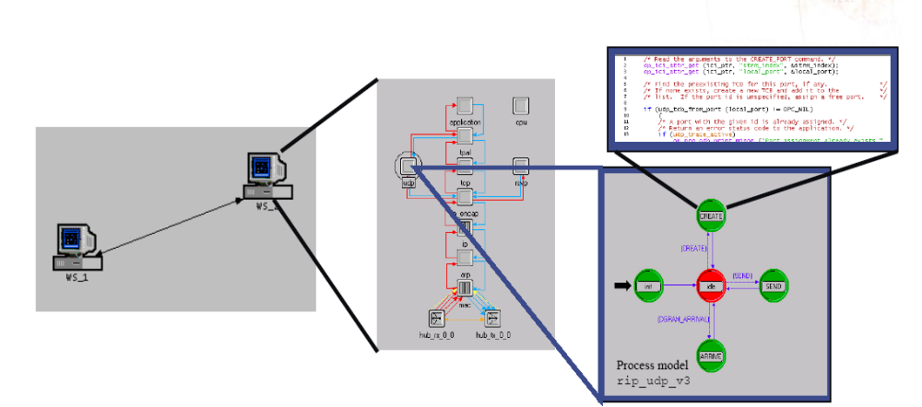
The 3-tiered OPNET Hierarchy
Three domains: Network, node, and process
Node model specifies object in network domain
Process model specifies object in node domain

Slide 9
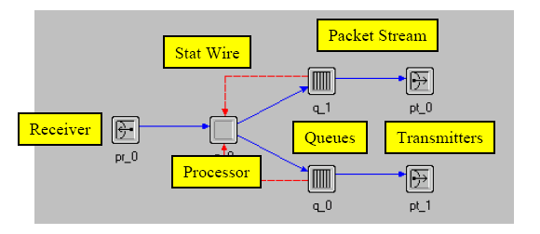
Node Domain
Basic building blocks (modules) include processors, queues, and transceivers
  Processors are fully programmable via their process model
  Queues also buffer and manage data packets
  Transceivers are node interfaces
Interfaces between modules
  Packet streams
  Statistic wires

Slide 10
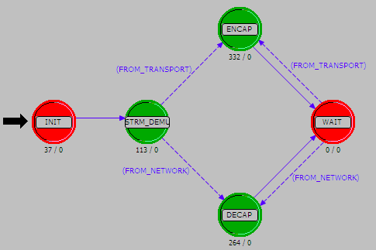
Process Domain
Process model components
  State transition diagrams
  Blocks of C code
  Kernel Procedures
  State variables
  Temporary variables
A process is an instance of a process model
Processes can dynamically create child processes
Processes can respond to interrupts

Slide 11
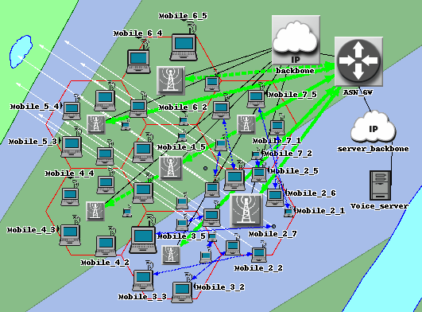
Network Setup

Slide 12
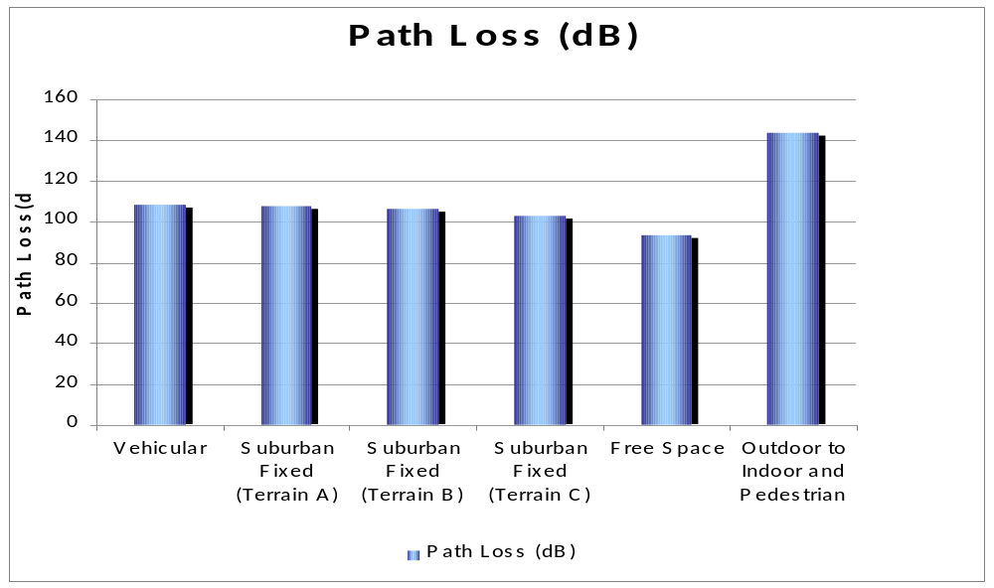
Results

Slide 13
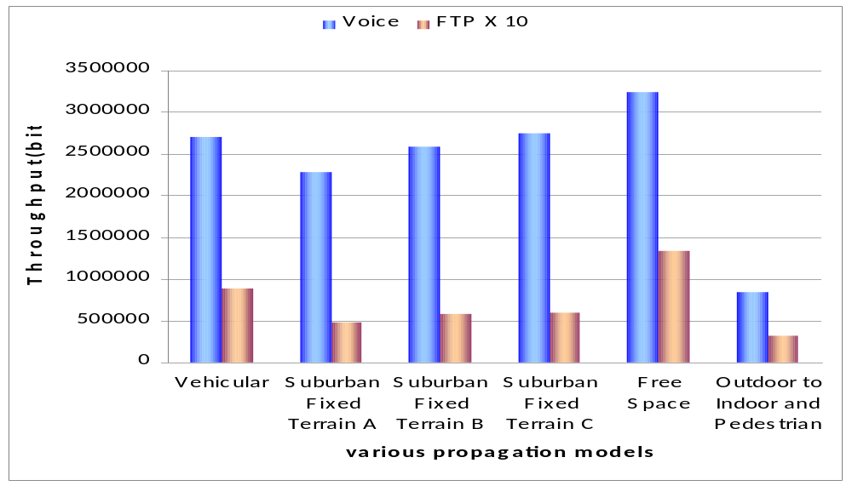
Results

Slide 14
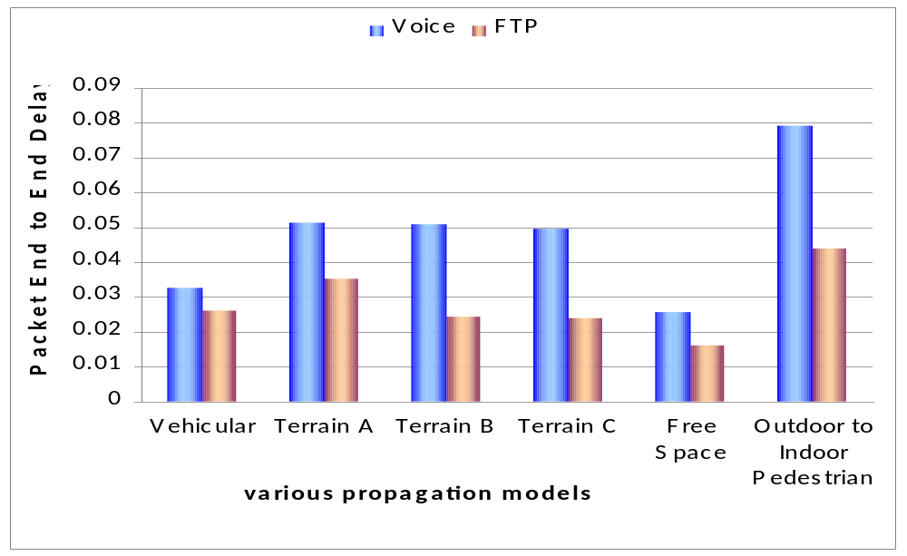
Results

Slide 15
Conclusion
OPNET Modeler provides us with a real life simulation environment
Path loss value varies with the amount of reflection in the communicating path.
The reduction in Line-Of-Sight due to the terrain model of any area
  decreases network throughput due to increase in attenuation and diffraction losses
  increases packet end to end delay by causing nodes to re-initiate network registration more frequently under fluctuating cell coverage.

Slide 16
acknowledgement
We deeply acknowledge the support from
DST, Govt. of India
for this work in the form of
FIST 2007 Project on
“Broadband Wireless Communications”
in the
Department of ETCE, Jadavpur University.

Slide 17
References
Aphiraksatyakul,D., Boon-Chong Seet, Chiew-Tong Lau, “Evaluation of Terrain Effects on Mobile WiMax in a Vehicular Environment”,ITS Telecommunications 2008, pp.379-383, October 2008.
Jeich Mar, Chin-Chung Ko, Chung-Haw Li and Shao-En Chen, “CELL PLANNING AND CHANNEL THROUGHPUT OF MOBILE WiMAX AT 2.5 GHz”, vol. 32, No. 5, Journal of the Chinese Institute of Engineers, 2009, pp.585–597.
N.Nagarajan' , Rajeev, B. Kaarthick, “Performnance analysis of Video Conferencing and Multimedia application Services over WiMAX”, IEEE International Advance Computing Conference (IACC 2009), Patiala, India, 6-7 March 2009
G. Chu, D.Wang, S. Mei, “A QoS Architecture for the MAC protocol of IEEE 802.16 BWA System,” IEEE 2002 ICC, Circuits and Systems, vol. 1, July 2002, pp. 435 -439.
V.Erceg et al., “An Empirically Based Path Loss Model for Wireless Channels in Suburban Environments”, IEEE JSAC, vol. 17, July 1999, pp. 1205-1222.
OPNET Documentation. http://www.opnet.com
Xinjie Chang. Network simulations with OPNET. In Winter Simulation Conference, pages 307-314, 1999.
Iti Saha Misra, “Wireless Communications and Networks 3G and beyond”, Tata McGraw Hill Education Private Limited, 2009, New Delhi.
ITU-R, M.1225 “GUIDELINES FOR EVALUATION OF RADIO TRANSMISION TECHNOLOGIES FOR IMT-2000”

Slide 18
Thank You

Slide 19
Service classes of WiMAX
WiMAX supports five types of service classes.
Service Class | Characteristic Feature
UGS( Unsolicited Grant Service) | fixed-size data packets at a constant bit rate (CBR). Supports real time applications like VoIP or but it wastes bandwidth during the off periods
rtPS (real time Polling Service) | variable bit rate real-time service like VoIP
nrtPS (non real time Polling Service) | Delay-tolerant, variable-size data grants at minimum guaranteed rate. Contention based polling FTP
ertPS (extended real time Polling Service) | variable rate real-time services such as VoIP and video streaming. Advantageous over UGS and rtPS for VoIP applications because it carries lower overhead than UGS and rtPS
BE (Best Effort) | Do not require a minimum service-level guarantee. Never polled but they can only receive resources through contention Web Browsing

Slide 20
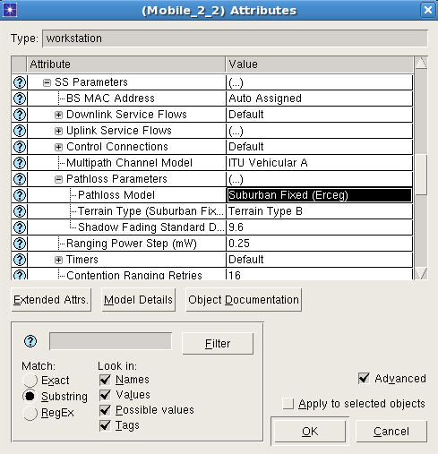
Network Setup
The path loss models are selected from the drop down menu

