Slide 1
Cracking the Code: A CTF Exhibition
By CTF 2.0

Slide 2
Table of Contents
01
Introduction
02
Project Logistics
03
Solution
04
Reflection
Capture the Flag (CTF) competitions and their importance.
Project stakeholders, objectives, organization, and challenges.
Technical deep dive into project requirements and infrastructure.
Reflect on our capstone experiences

Slide 3
01
Introduction
What are CTF Competitions?
Why are the important (pedagogically)?

Slide 4

What are CTF’s
CTF (Capture the Flag) is a cybersecurity competition where participants solve challenges to find hidden “flags” (specific pieces of data).
Notes:
Let’s dive into the core of our project: Capture the Flag competitions, or CTFs. These are dynamic cybersecurity events designed to test and hone problem-solving skills in a fun, competitive environment.
At their heart, CTFs challenge participants to solve puzzles and uncover hidden 'flags'—specific pieces of data that prove you’ve cracked the challenge.

Slide 5
Main variations of CTF’s
Jeopardy-Style
Attack-Defend
Challenges are divided into categories
Reverse engineering, web exploitation, cryptography, etc.
Challenges are presented in a dashboard format
Participants solve each challenge independently
Participants earn points by finding the ‘flag’
ex: muctf{flag_was_here}
Each team provided a virtual environment
Given a vulnerable system
Team must defend their system while attempting to breach opposing team’s defenses
Points are awarded for capturing the opposing team's flag.
Points are also awarded for good defense
Notes:
There are three main types of CTFs. First, we have Jeopardy-style CTFs. These consist of standalone puzzles in categories like cryptography, reverse engineering, and digital forensics. You solve as many as you can, earning points along the way.
Second, there’s the Attack-Defense format. Here, teams secure their own systems while simultaneously trying to exploit vulnerabilities in their opponents' systems. It’s like a high-tech game of capture the flag meets chess, requiring both offensive and defensive strategies.
And finally, some CTFs combine both styles for a mixed experience.

Slide 6
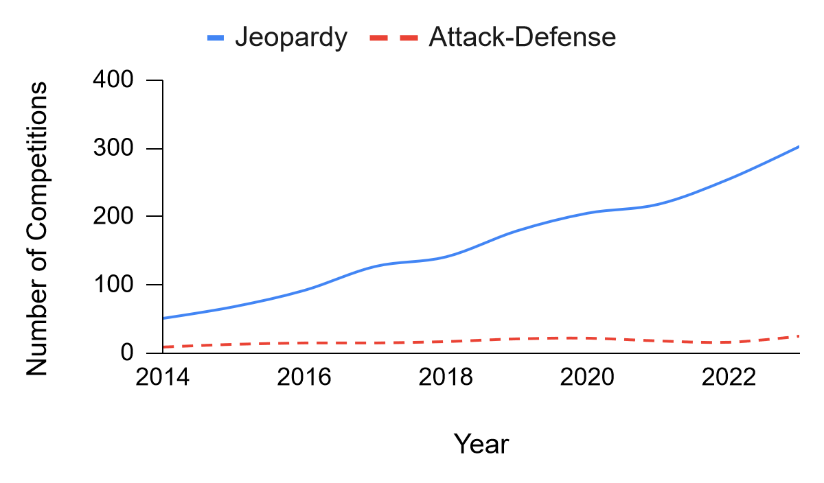
Popularity of Competitions
Source: https://ctftime.org
Notes:
Data is from CTF Time, this graphs shows that Jeopardy is the most used competition, attack-defend is used for more final rounds of competitions

Slide 7

The importance of CTF’s
Purpose:
Develops problem-solving and critical thinking.
Provides hands-on experience with cybersecurity tools and techniques.
Encourages collaboration and innovation.
Why They Matter:
Real-world simulation of cybersecurity challenges.
Bridges theoretical knowledge with practical application.
Notes:
But CTFs are more than just competitions. They simulate real-world cybersecurity challenges, making them an invaluable tool for developing both technical expertise and teamwork. Participants work under pressure, use real tools, and face scenarios they might encounter in professional settings.
CTFs matter because they bridge the gap between theory and practice. They teach participants how to identify vulnerabilities and secure systems, skills that are crucial in today’s digital landscape.
By focusing on CTFs for our project, we’re equipping high schoolers with foundational cybersecurity knowledge while keeping the experience interactive, engaging, and—most importantly—fun!"

Slide 8

— David A. Kolb
“Knowledge is continuously derived from and tested out in the experiences of the
learner.”
Notes:
From a quote from David A. Kolb, an American educational theorist and psychologist, says “Knowledge is continuously derived from and tested out in the experiences of the learner” This quote connects to the experiential learning is hands on experience, allowing for a better understanding of the material.

Slide 9
02
Project Logistics
Notes:
Next we will go over the projects structure

Slide 10
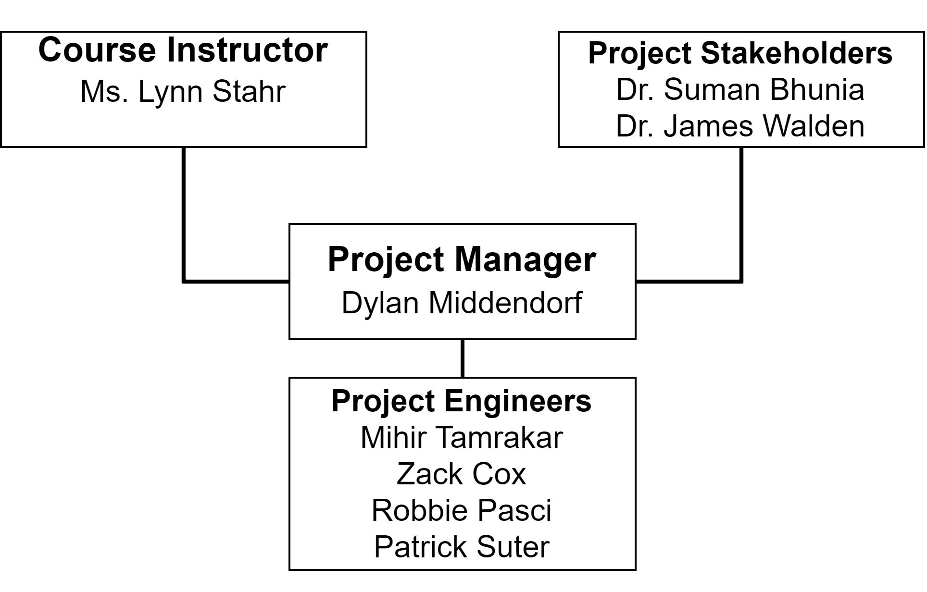
Team Organization
Notes:
Two stakes holders: Dr. Suman Bhunia & Dr. James Walden. Ms. Lynn Stahr acted as a sort of project head, giving us inputs and feedback on our progress on the project. Dylan acted as our project manager, while the rest of the team acted as the engineers, or developers, for the project development.

Slide 11
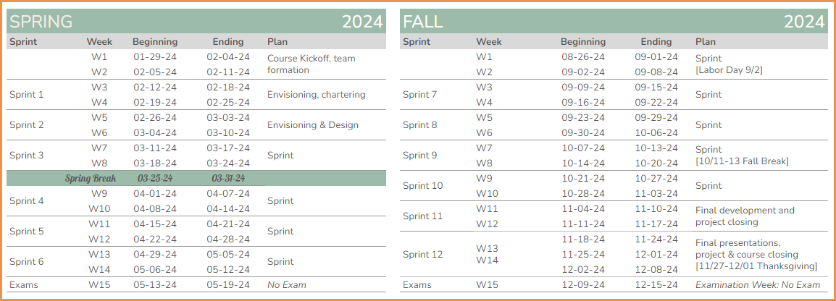
Software Development Methodology
Notes:
For our project, we adopted an Agile approach to ensure flexibility and continuous improvement throughout the development process. Agile allowed us to iterate quickly, respond to challenges effectively, and maintain a clear focus on delivering value to our users."
"Our Agile process was structured into 12 sprints, each lasting two weeks. This framework provided us with manageable time blocks to plan, develop, and test challenges."
"At the beginning of each sprint, we held sprint planning meetings to define objectives and prioritize tasks. By the end of each sprint, we conducted reviews to evaluate progress and identify areas for improvement."
"We utilized GitLab as our central collaboration platform, aligning closely with Agile principles of transparency and teamwork. Issue cards represented user stories or tasks, and we worked on them in short cycles to ensure steady progress."

Slide 12

GitLab
Selected as the DevOps platform to store the repository of challenges
Managed and organized all challenges through issue cards
Created a new branch off the master repository for each challenge
Stores the challenges files and information
User challenge story
Challenge files
Solution file
Name of hidden flag
Once finished, the merge request is made for the branch
Other member reviews the merge request
Makes comments on what needs revised
If looks good, the merge request is approved
Contains information about the framework & working agreement
Notes:
We utilized GitLab as our DevOps platform to manage the repository of challenges and organize our workflow."
"Each challenge was handled as an independent issue card, with all relevant files and solutions stored in the repository. To maintain organization and reduce errors, team members created new branches off the master repository for each challenge."
"Once the branch was complete, a merge request was submitted, reviewed, and approved by another team member. This review process ensured quality and allowed for constructive feedback."
"Overall, GitLab provided a centralized framework for collaboration and served as the backbone for our software development process."

Slide 13
03
Challenges and Solution

Slide 14
Requirements
25 distinct challenges to test proficiency
Robust and secure digital platform
Tailored for high school / intra-collegiate level
Comprehensive documentation available
Notes:
"For our project to meet its objectives, we set clear requirements that addressed the needs of the users and the scope of the competition."
"First, we developed 25 distinct challenges to test participants' proficiency across various cybersecurity domains such as cryptography, reverse engineering, and web exploitation."
"Next, we ensured that the platform was robust and secure, providing a reliable environment for participants while protecting sensitive data like challenge files and flags."
"The challenges and platform were tailored specifically for high school and intra-collegiate competitions, making them approachable yet impactful."
"Lastly, comprehensive documentation was provided to ensure participants and administrators could easily navigate the platform and understand the challenges."

Slide 15
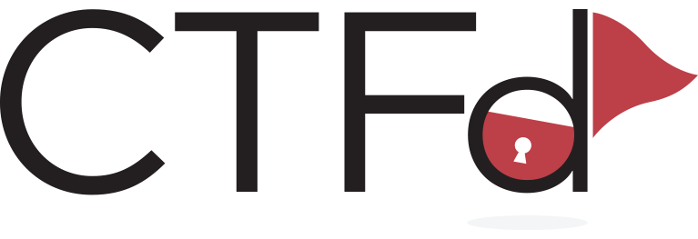
Platform Architecture
Challenges:
All were uploaded to group GitLab
Some challenges were built with languages such as: Python, HTML, SQL, Javascript, etc
CTFd Framework:
Open-source platform designed to host our CTF challenges
Provides users with scoring and challenge tracking
Simplifies challenge creation and deployment

Slide 16
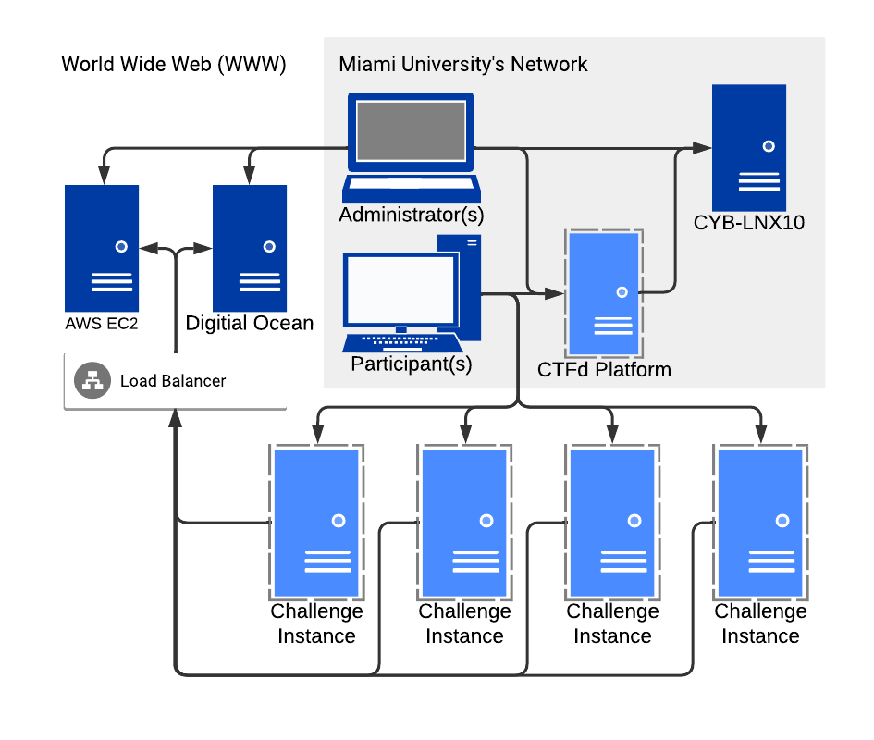
Project Infrastructure (Overview)

Slide 17
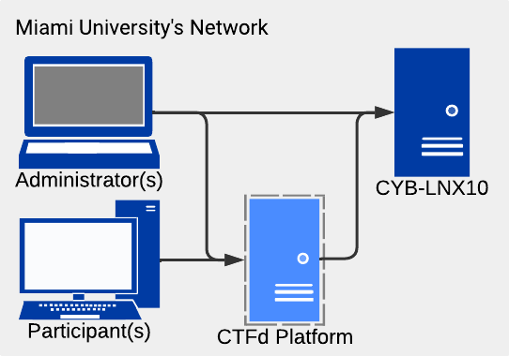
Project Infrastructure (Overview)

Slide 18
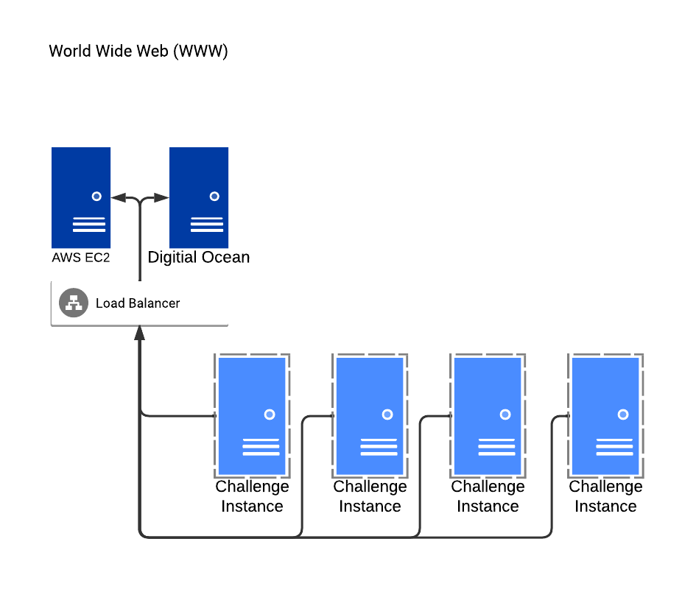
Project Infrastructure (Overview)

Slide 19

(Live) Demo
CTF2.0 CTFd Instance
Crypto – Prime Suspect

Slide 20
04
Reflection
Notes:
Reflecting on our journey through this project, it’s amazing to see how much we’ve grown—not just as developers, but as individuals.

Slide 21
What did we learn?
Areas to Improve
Technical Skills
Soft Skills
Cybersecurity fundamentals
gitlab
Communication and teamwork
Time Management
Adaptability
Acclimatizing to CTFs before diving in
Scheduling
Notes:
"Let’s start with what we learned.
On the technical side, this project gave us hands-on experience with cybersecurity fundamentals. From creating CTF challenges to understanding vulnerabilities, we delved into concepts that will serve us in the real world. We also became more proficient with tools like GitLab, which streamlined our version control and collaboration.
But beyond the code, the real growth came in soft skills. Communication and teamwork were at the heart of everything we did. From brainstorming ideas to troubleshooting roadblocks, we learned to work together efficiently and respectfully. Time management was another big takeaway. Balancing project deadlines with our other responsibilities wasn’t always easy, but it taught us to prioritize and plan effectively. And of course, adaptability—when things didn’t go as planned, we found ways to pivot and keep moving forward.
That said, we know there’s always room for improvement. One realization was the importance of acclimatizing to CTFs ourselves before diving in. Taking time to truly understand the nuances of CTF design might have saved us a few headaches. Lastly, scheduling—ensuring everyone’s availability and aligning tasks proved to be a learning curve we had to navigate.
All in all, this project has been a rewarding experience. The lessons we’ve learned—both technical and personal—will stick with us, and we’re grateful for the journey it’s taken us on."

Slide 22
Thanks
Do you have any questions?
middendm@miamioh.edu
tamrakm@miamioh.edu
coxzn@miamioh.edu
pacsir@miamioh.edu
suterpm@miamioh.edu

