Slide 1

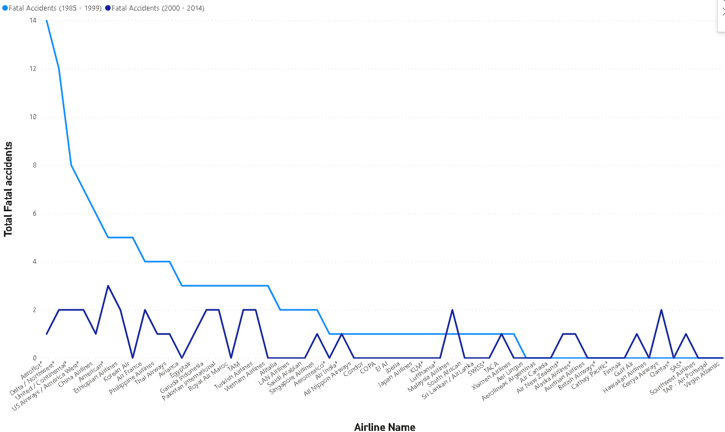
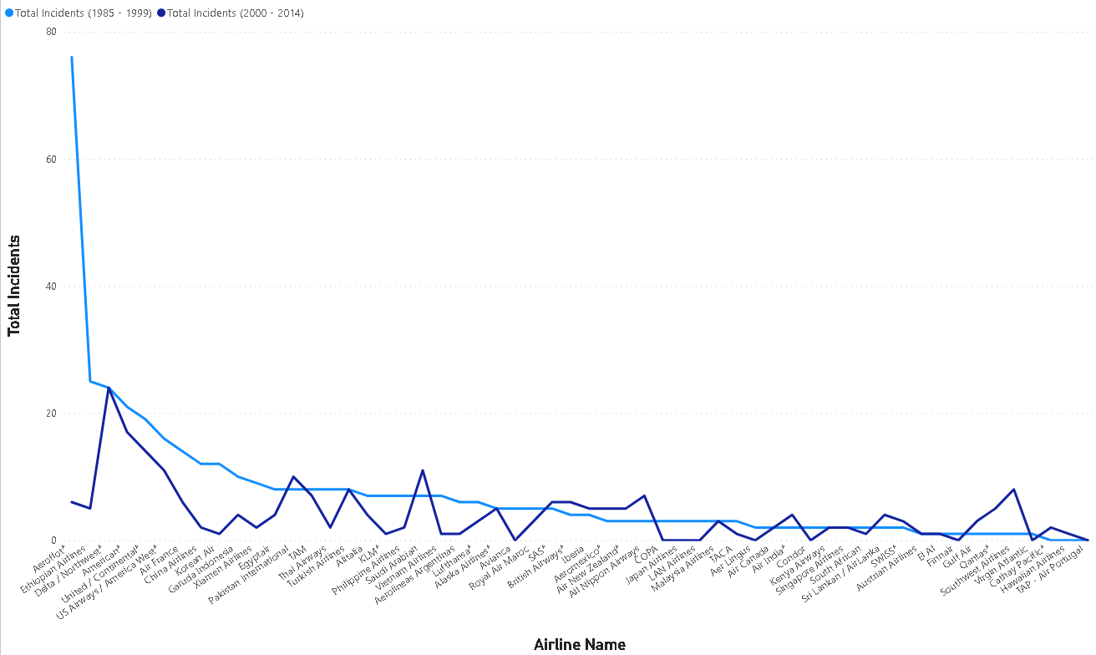
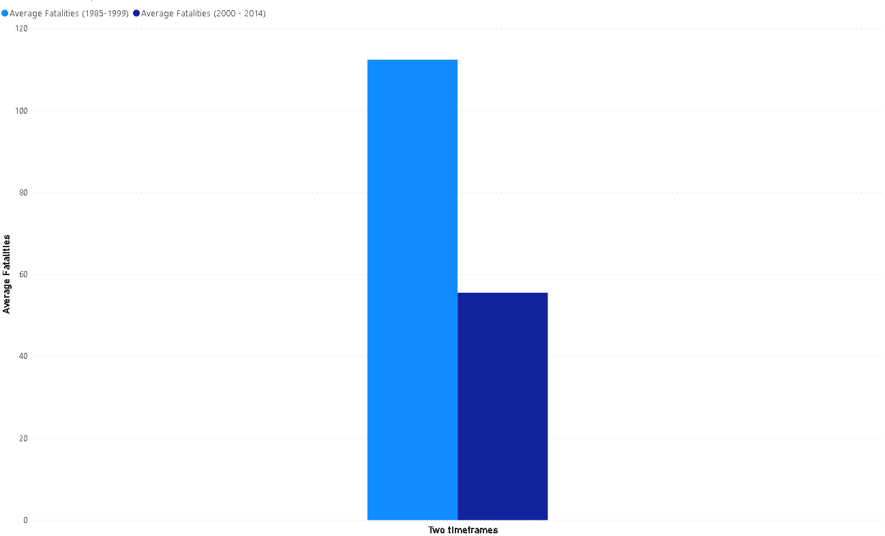
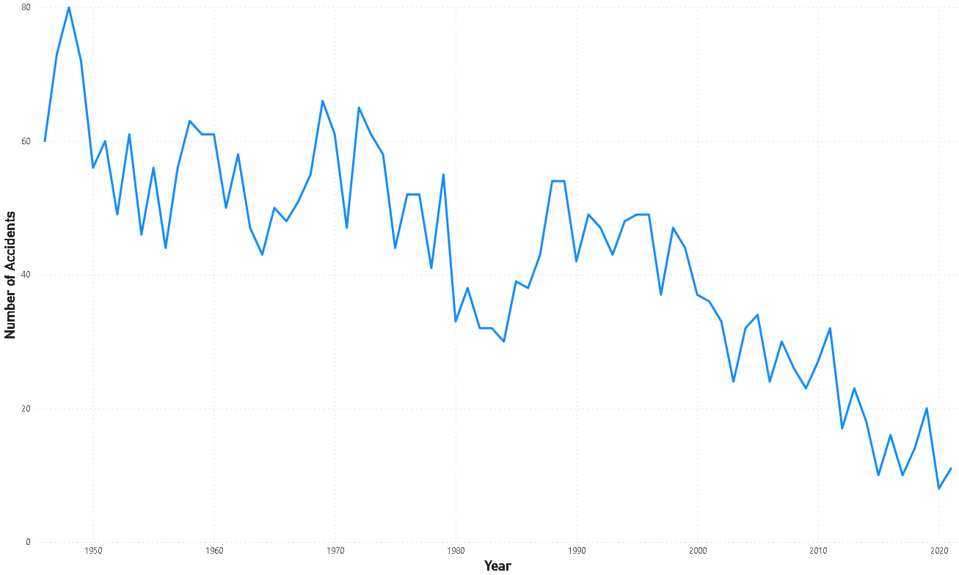
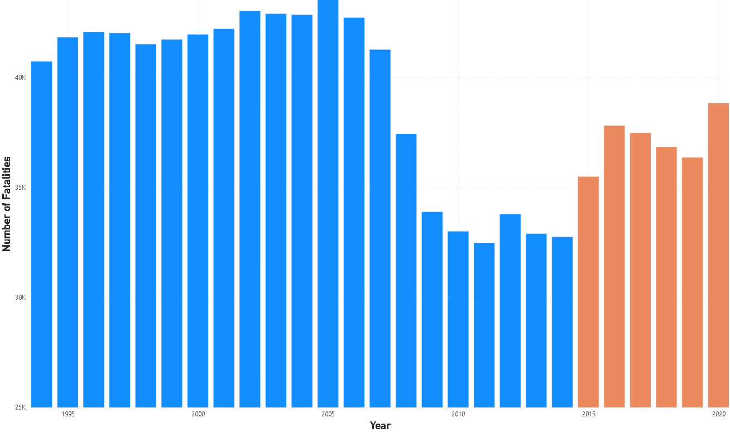
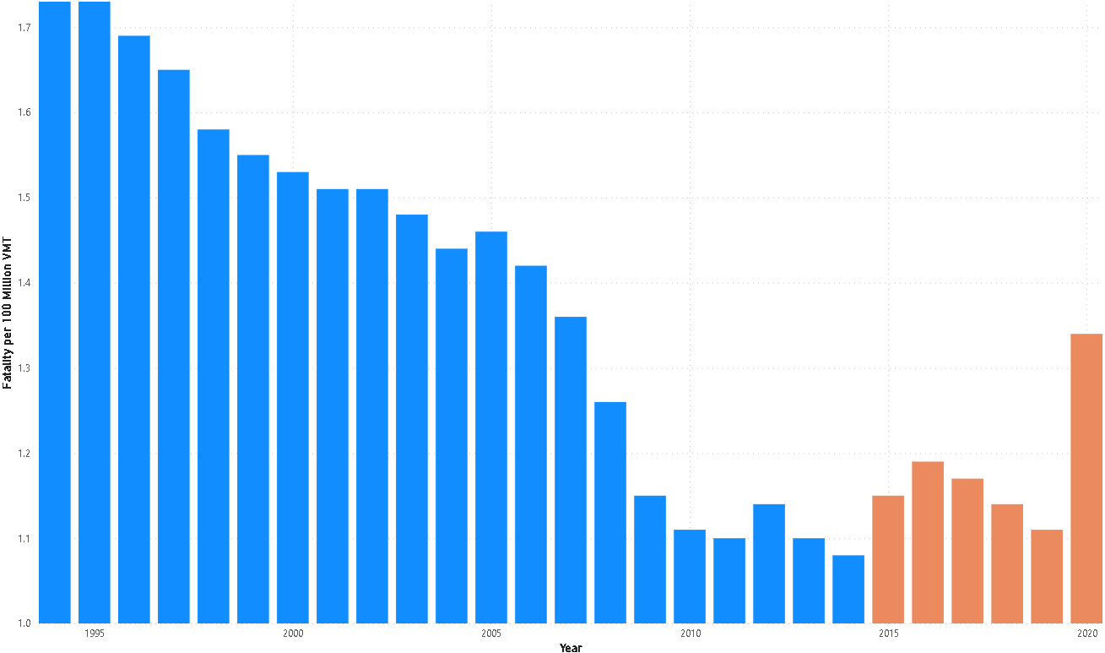
Is air travel no longer safe? Let’s explore with data!
Total fatal accidents and incidents (2000-2014) < (1985-1999) for majority of airlines
Average fatalities / airline (2000-2014) < ½ than in (1985-1999). Consistent decreasing trend in airline accidents through 2020
Airline safety improving while road fatalities showing increasing trend starting 2015
Source of Data:
data/airline-safety at master · fivethirtyeight/data · GitHub
Accidents and fatalities per year - Google Sheets
FARS Encyclopedia: Trends - General (dot.gov)

